Slide 1

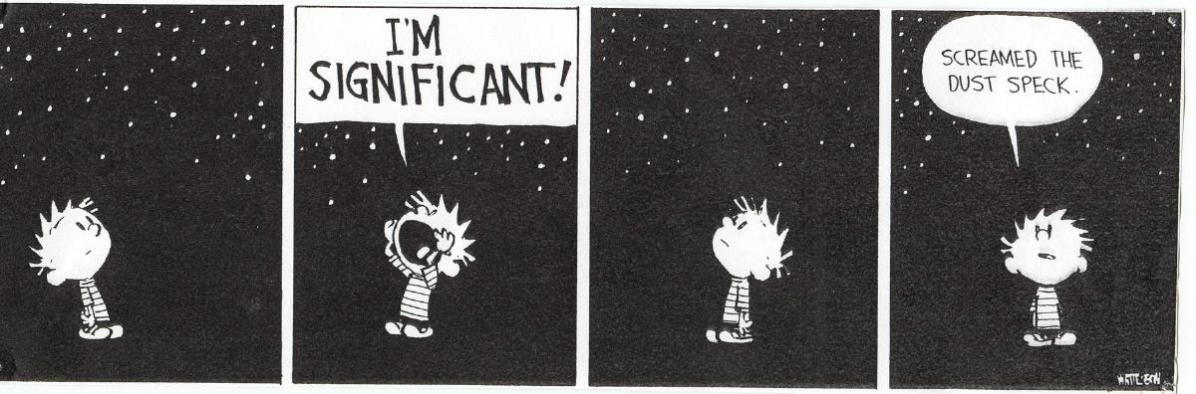
Science Questions
What is the Universe made of?
Where are the planets?
Is there life?
don’t forget your map …

Slide 2
100
dwarfs
6 wd
1 A
2 F
5 G
11 K
75 M
Henry & Jao
Annual Reviews 2024

Slide 3












Nearby Star Teams
Team K
Team M
Leonardo
Paredes
Hodari-Sadiki
Hubbard-James
Serge
Dieterich
Jen
Winters
Eliot
Vrijmoet
Sebastian
Carrazco
Tim
Johns
Andrew
Couperus
Aman
Kar
Madison
LeBlanc
Todd
Henry
Wei-Chun
Jao

Slide 4



More Specific Science Questions
Where / What are the companions?
stars
brown dwarfs
planets
formation processes
Where would life live?
composition
flares
rotation
spot cycles

Slide 5
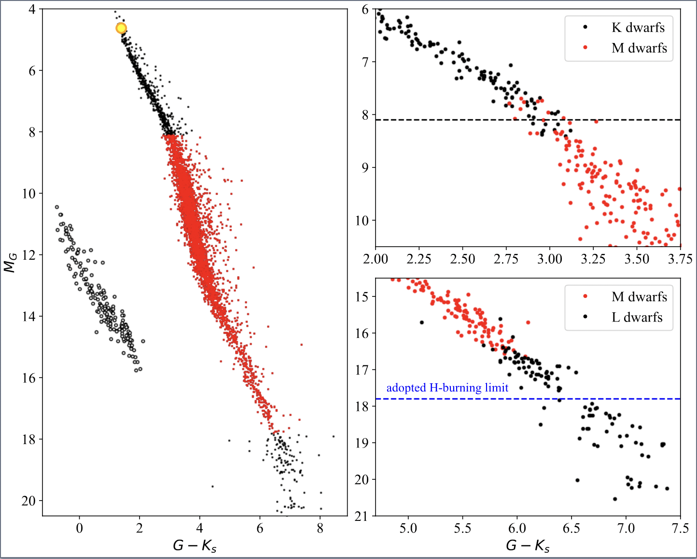
What is “K”? What is “M”?
M_{G} = 5.5
M_{G} = 8.1
M_{G} = 17.8
Henry & Jao
Annual Reviews 2024
Notes:
Why L, not T/color? …

Slide 6
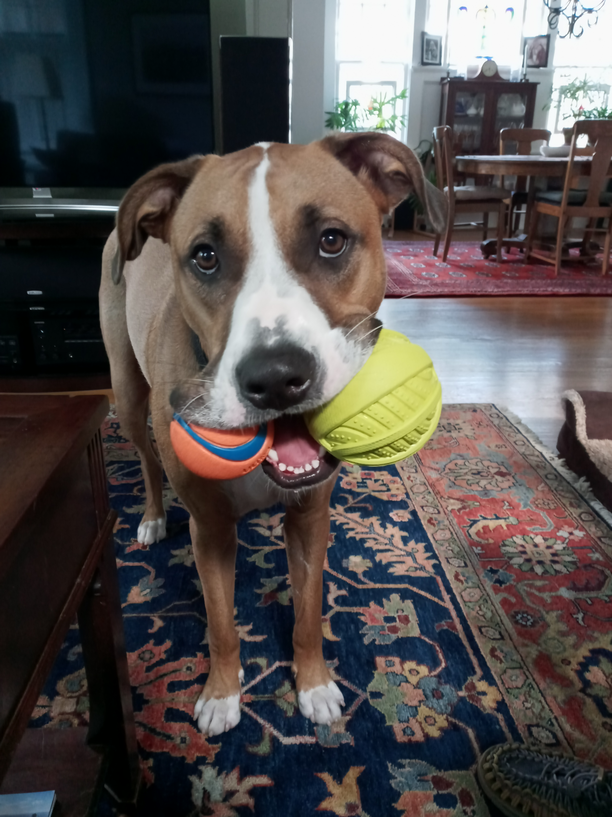
RKSTAR and RMSTAR

Slide 7
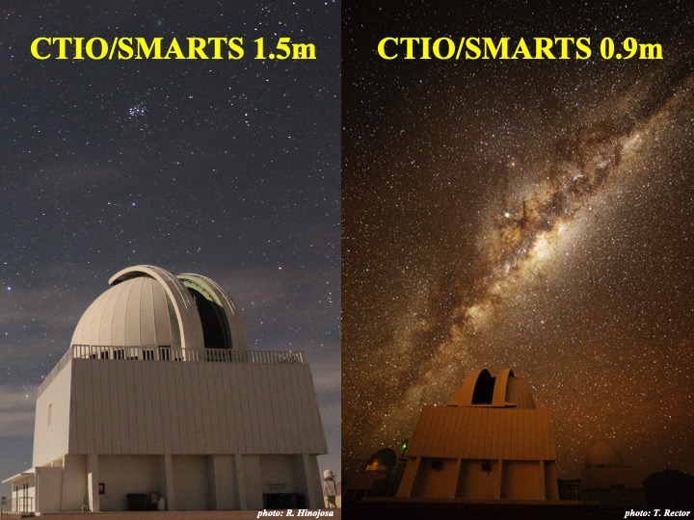
radial
velocity
program
2017+
imaging
program
1999+

Slide 8
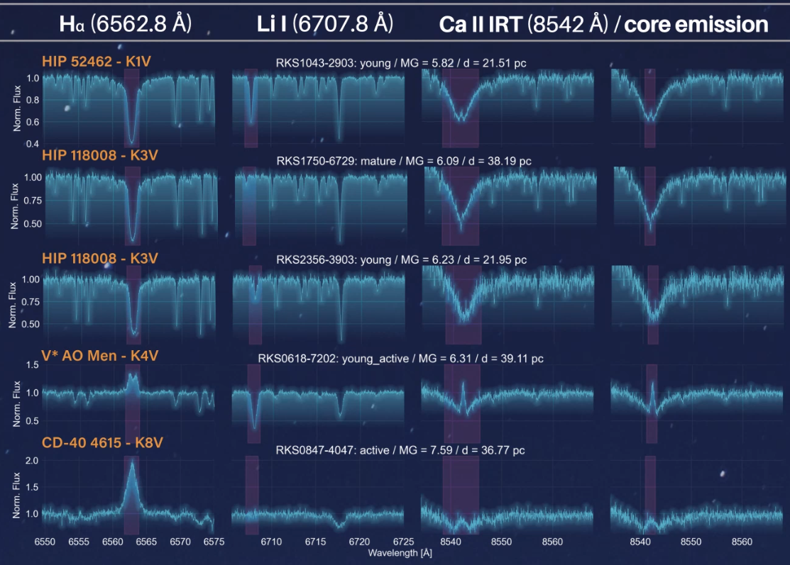
RKSTAR Characterization
10% young / active … 90% mature / calm
Notes:
> 11,000 spectra

Slide 9
RKSTAR Speckle Survey
most stellar companions within 5 AU

Slide 10
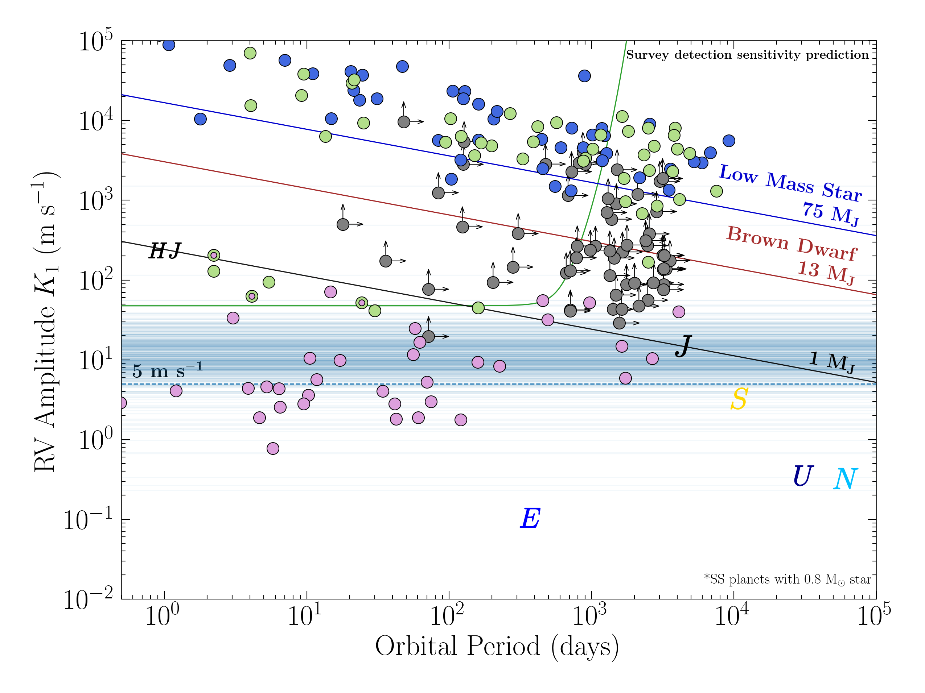
RKSTAR RV Survey
so many discoveries already

Slide 11
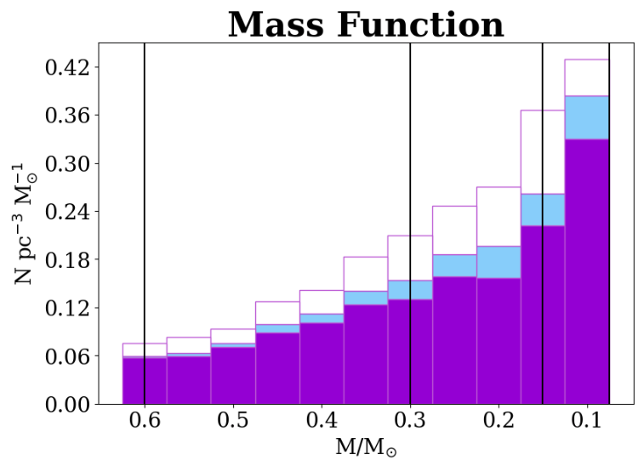
RMSTAR Characterization
Mass Function smooth and rising to end of stars

Slide 12
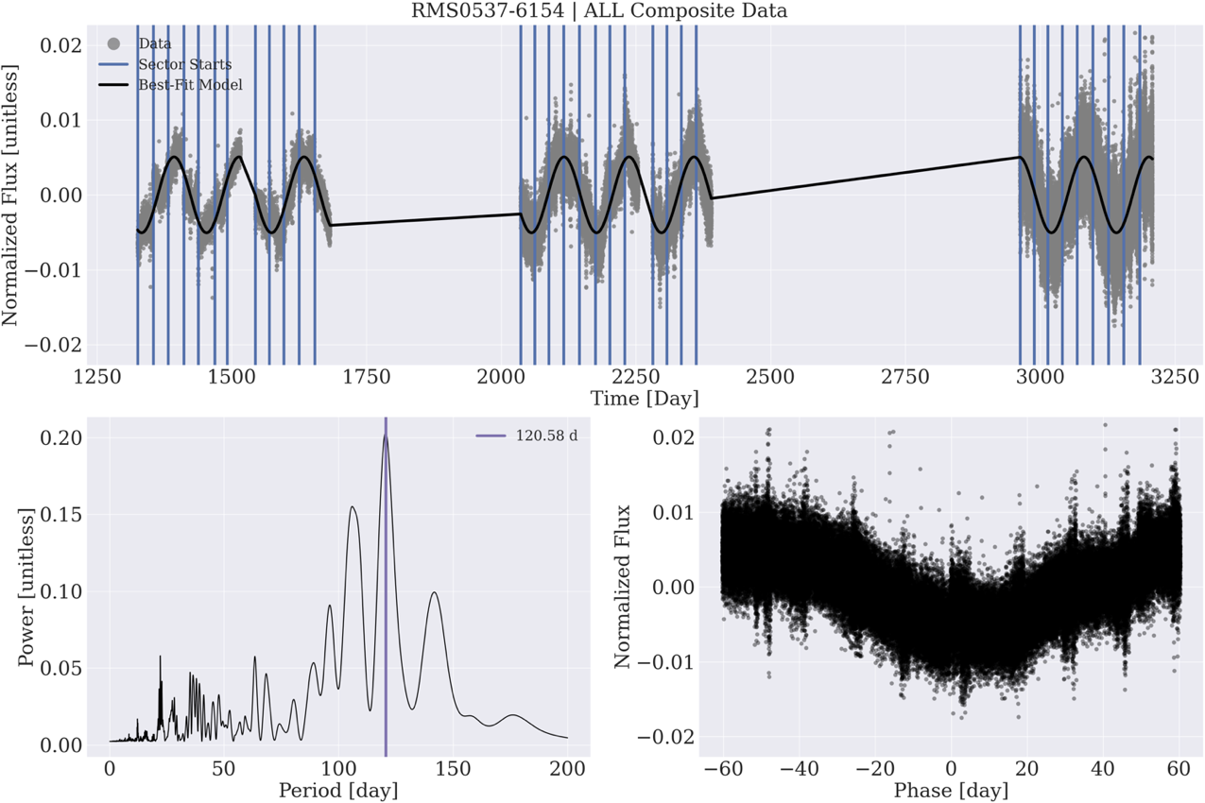
RMSTAR Characterization
rotation periods from 3 hours to 120 days

Slide 13
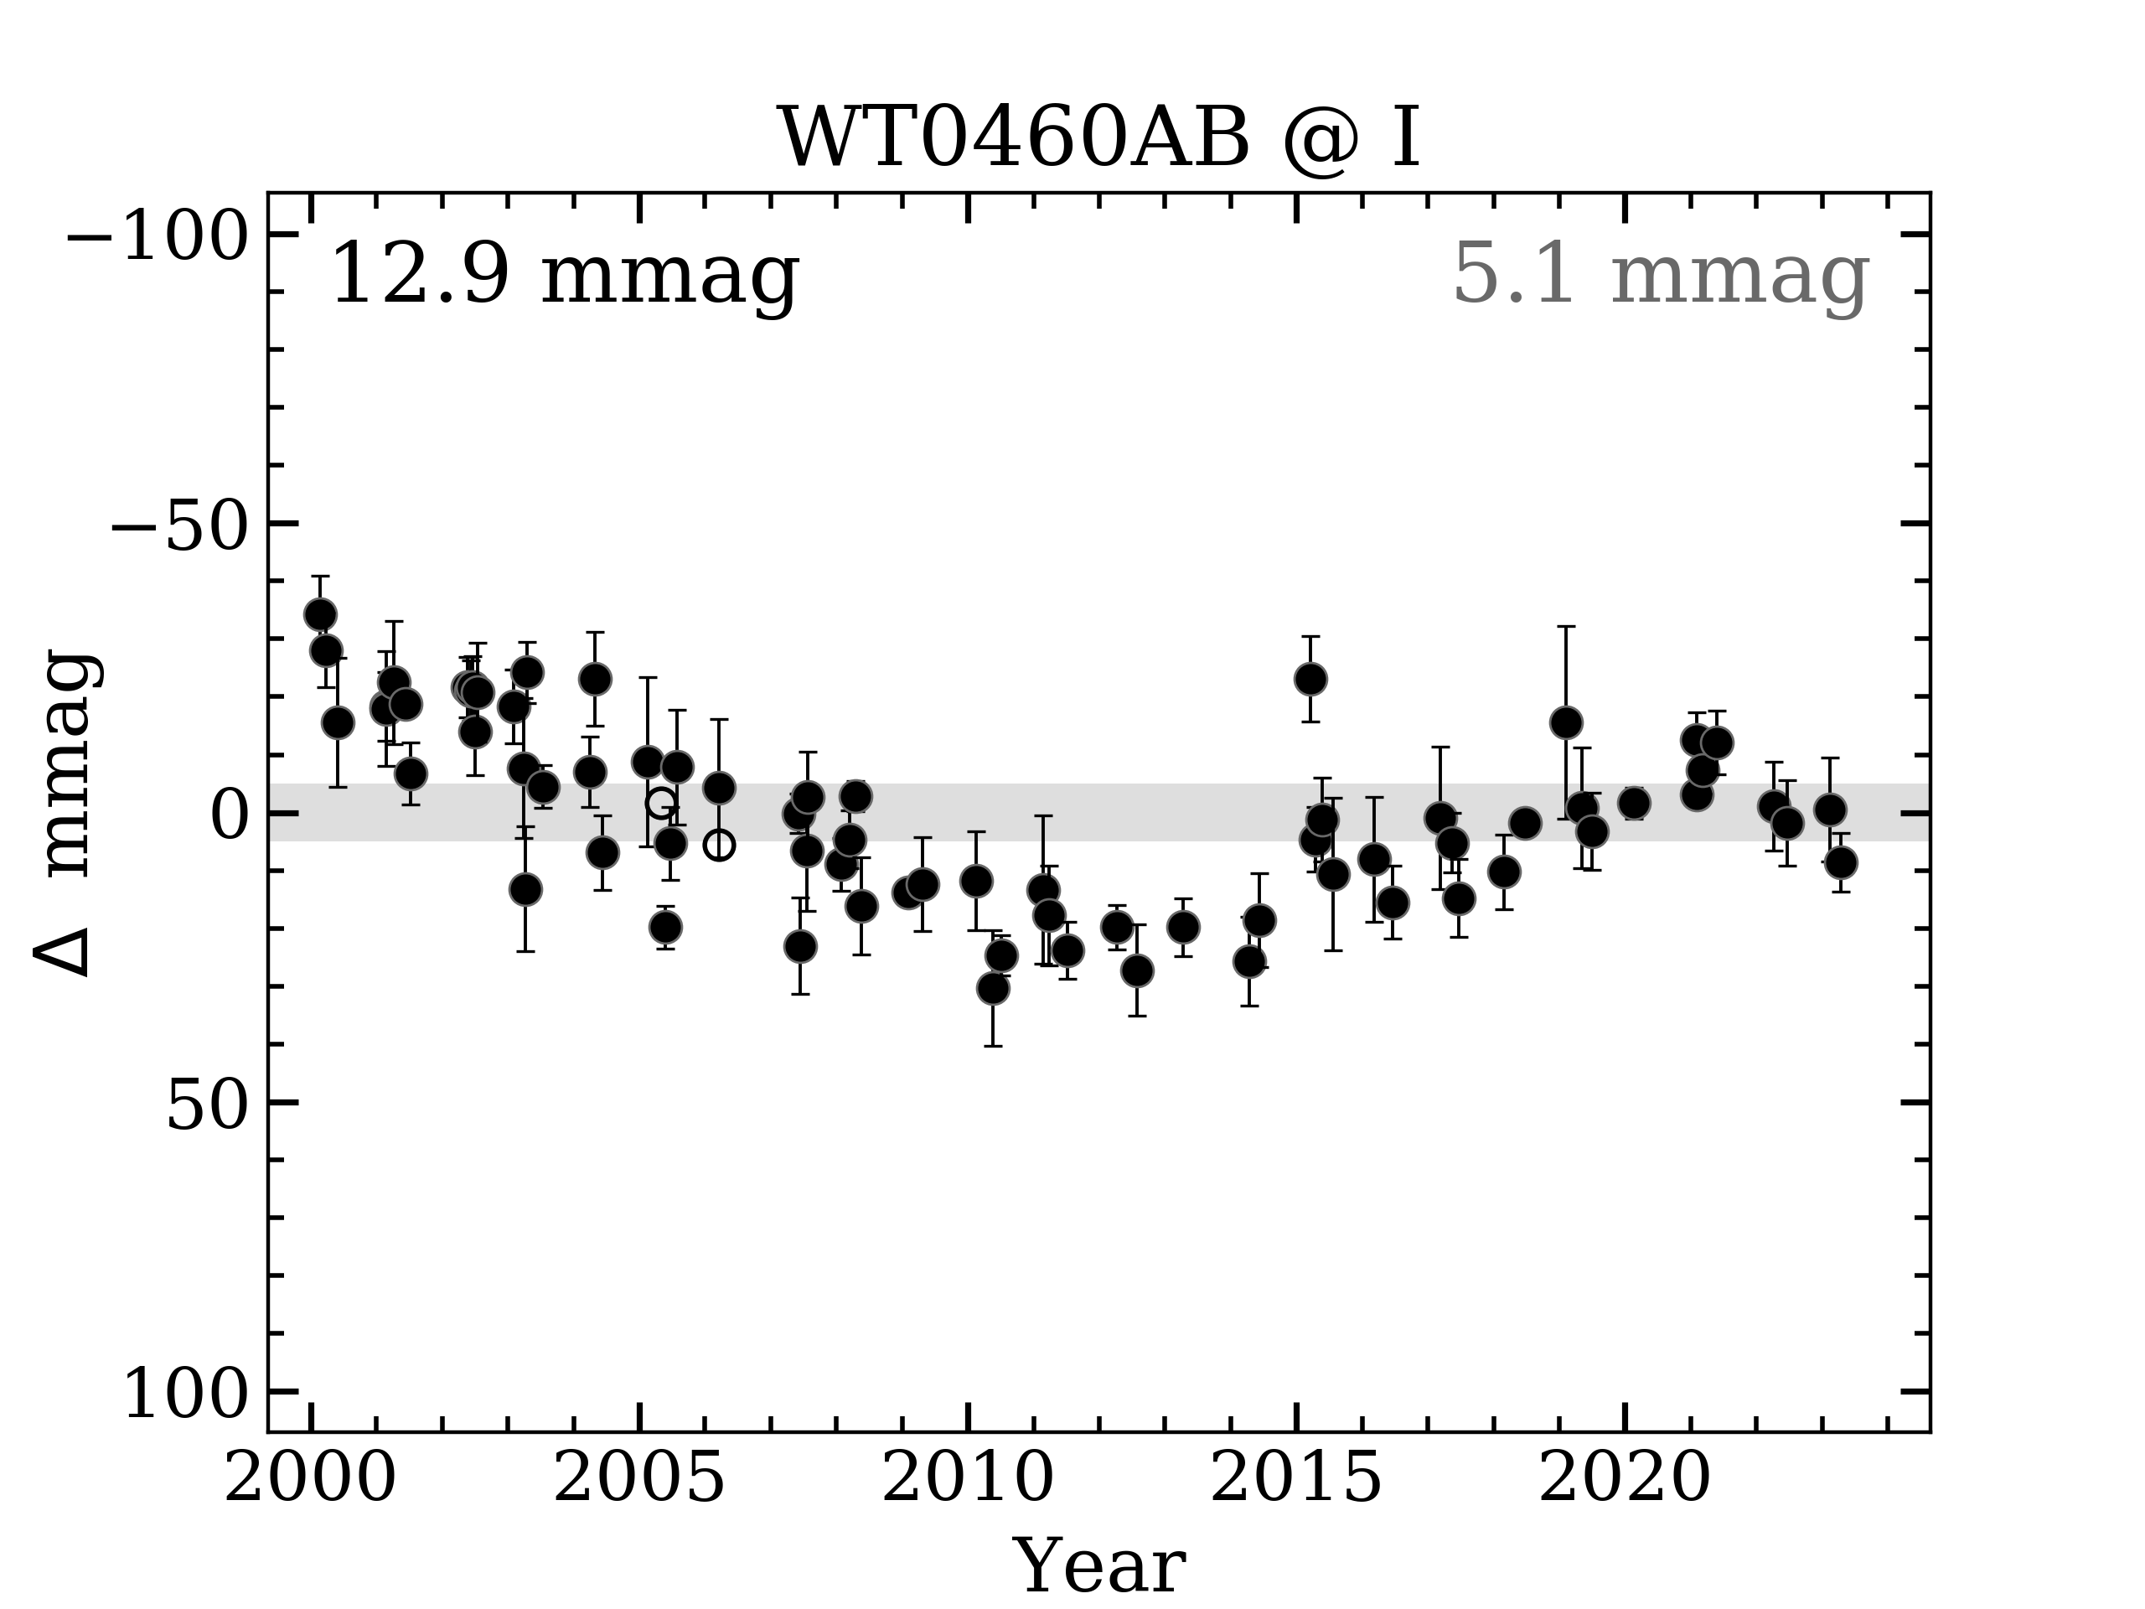
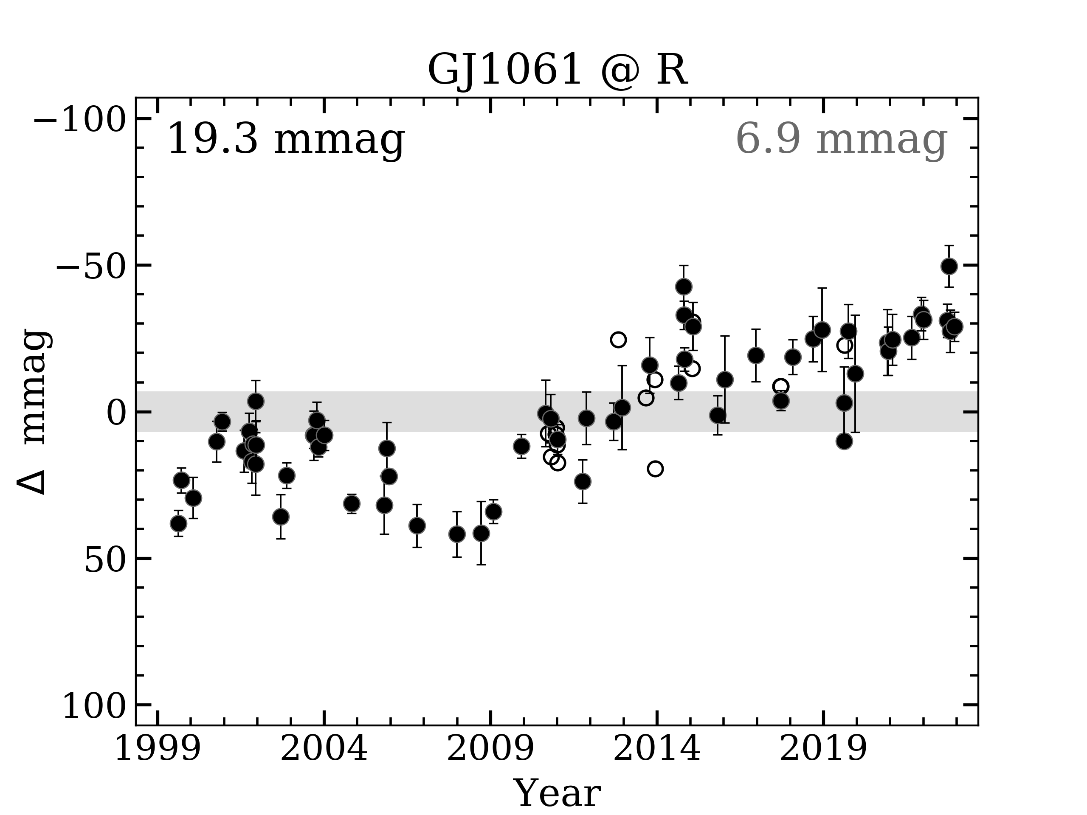
RMSTAR Characterization
starspot cycles from 3 to 30 years

Slide 14
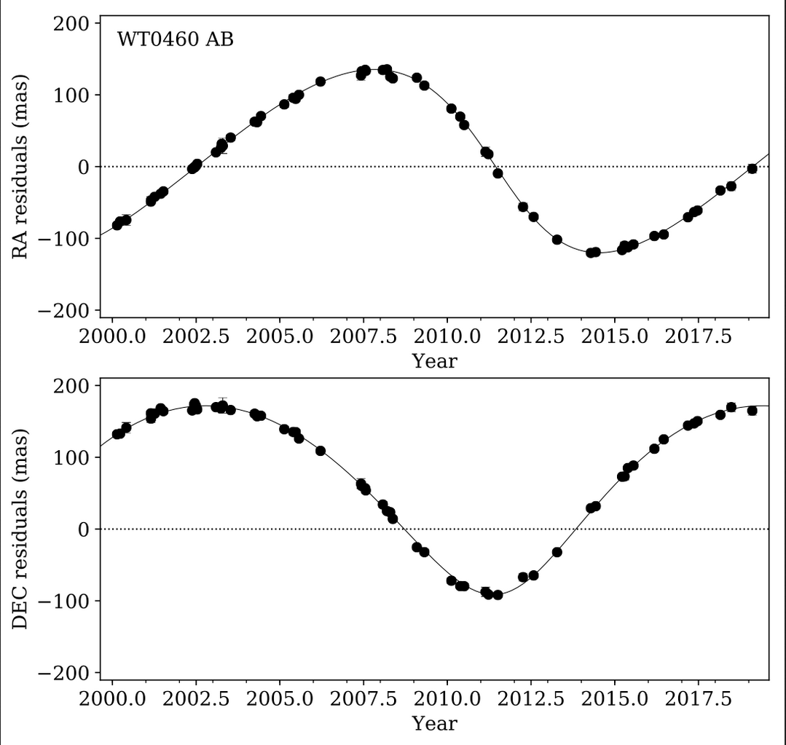
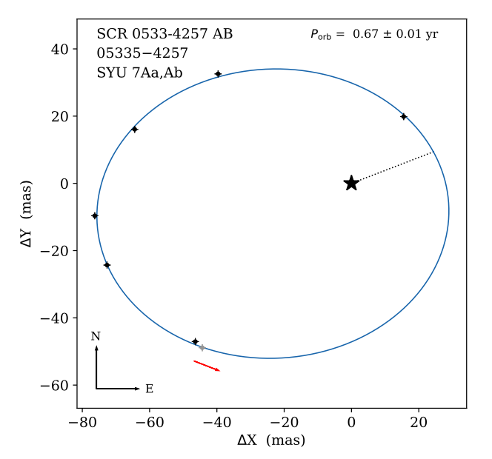
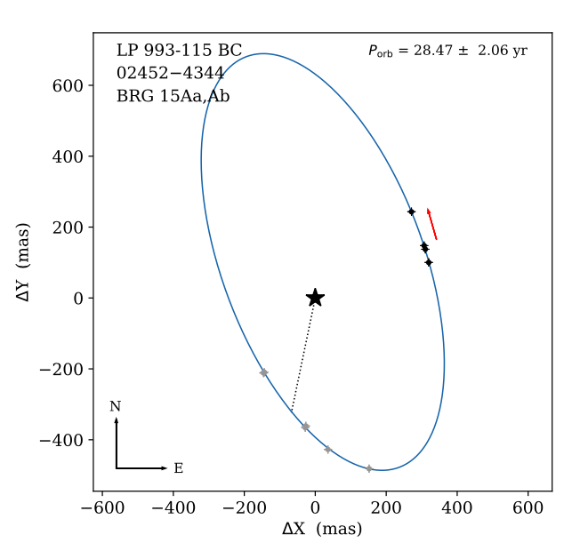
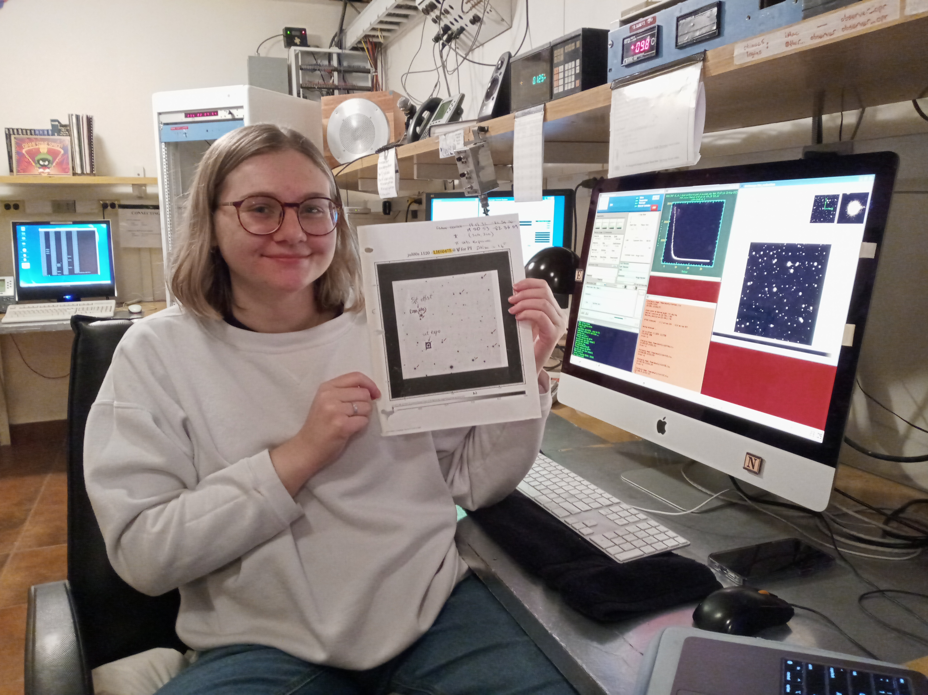
RMSTAR Speckle + RV Surveys
orbital periods from days to 30 years

Slide 15
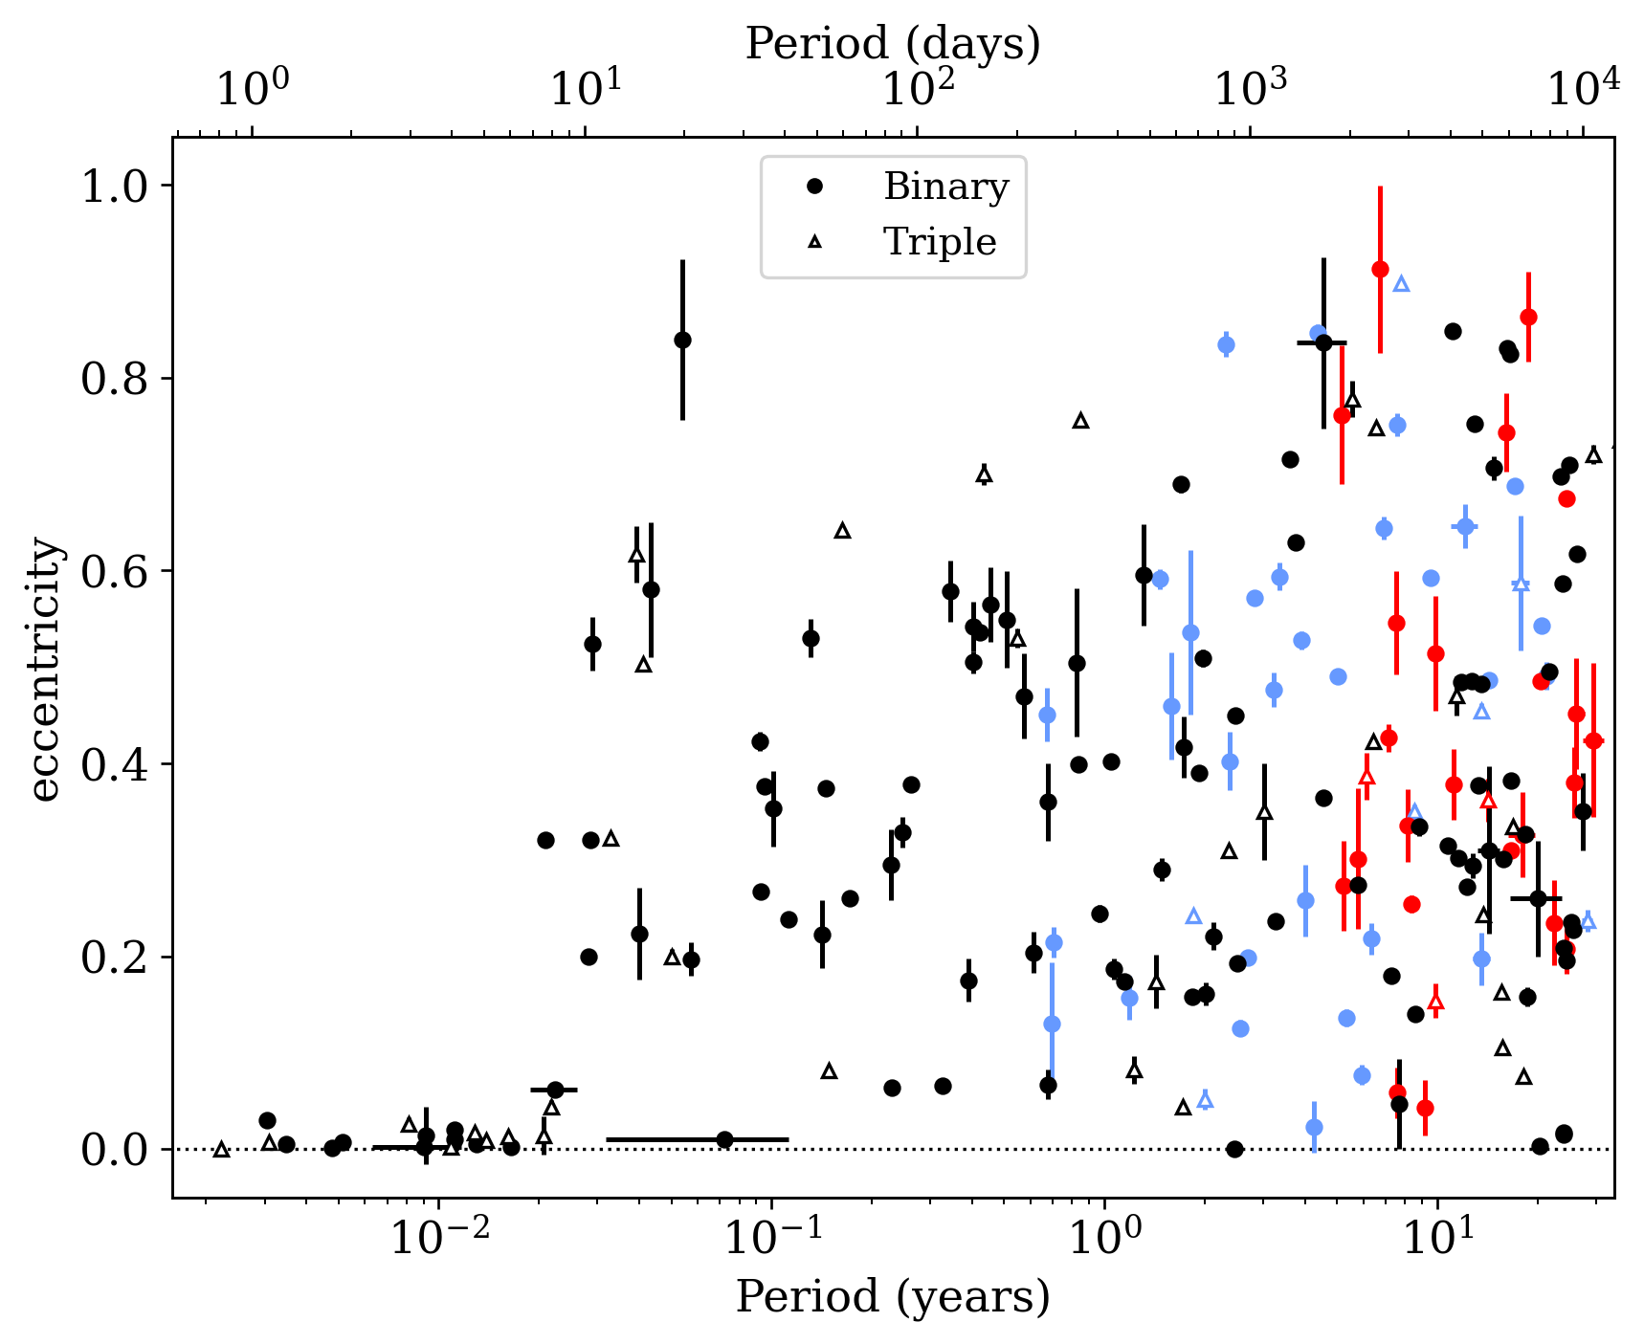
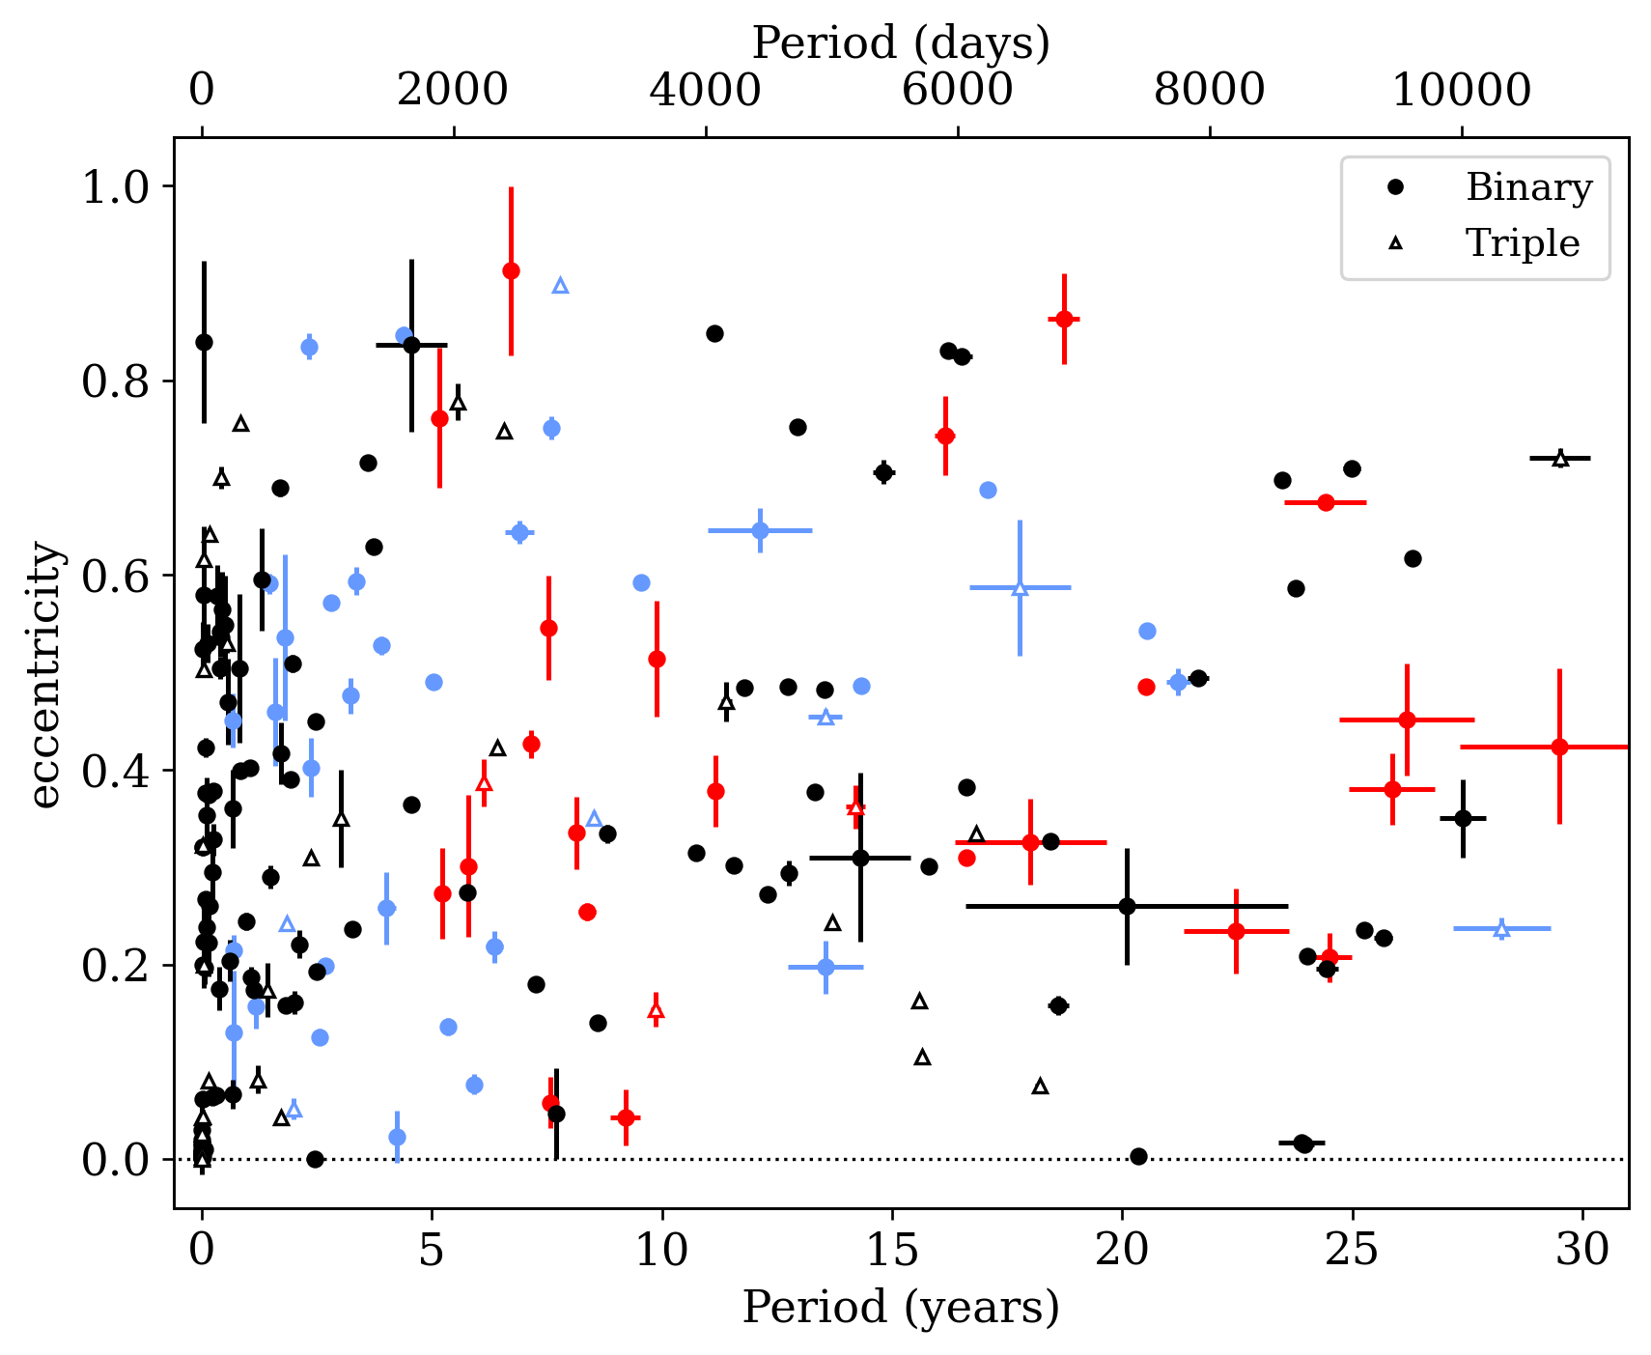
RMSTAR Speckle + RV Surveys
RECONS SOAR Literature
all circular orbits at less than 1 week
~ no circular orbits beyond 10 years

Slide 16
RKSTAR + RMSTAR Planets
What %
have planets?
3% K
have
planets
3% M
have
planets
AFG
K
M
so few planets KNOWN
so many more to find …

Slide 17
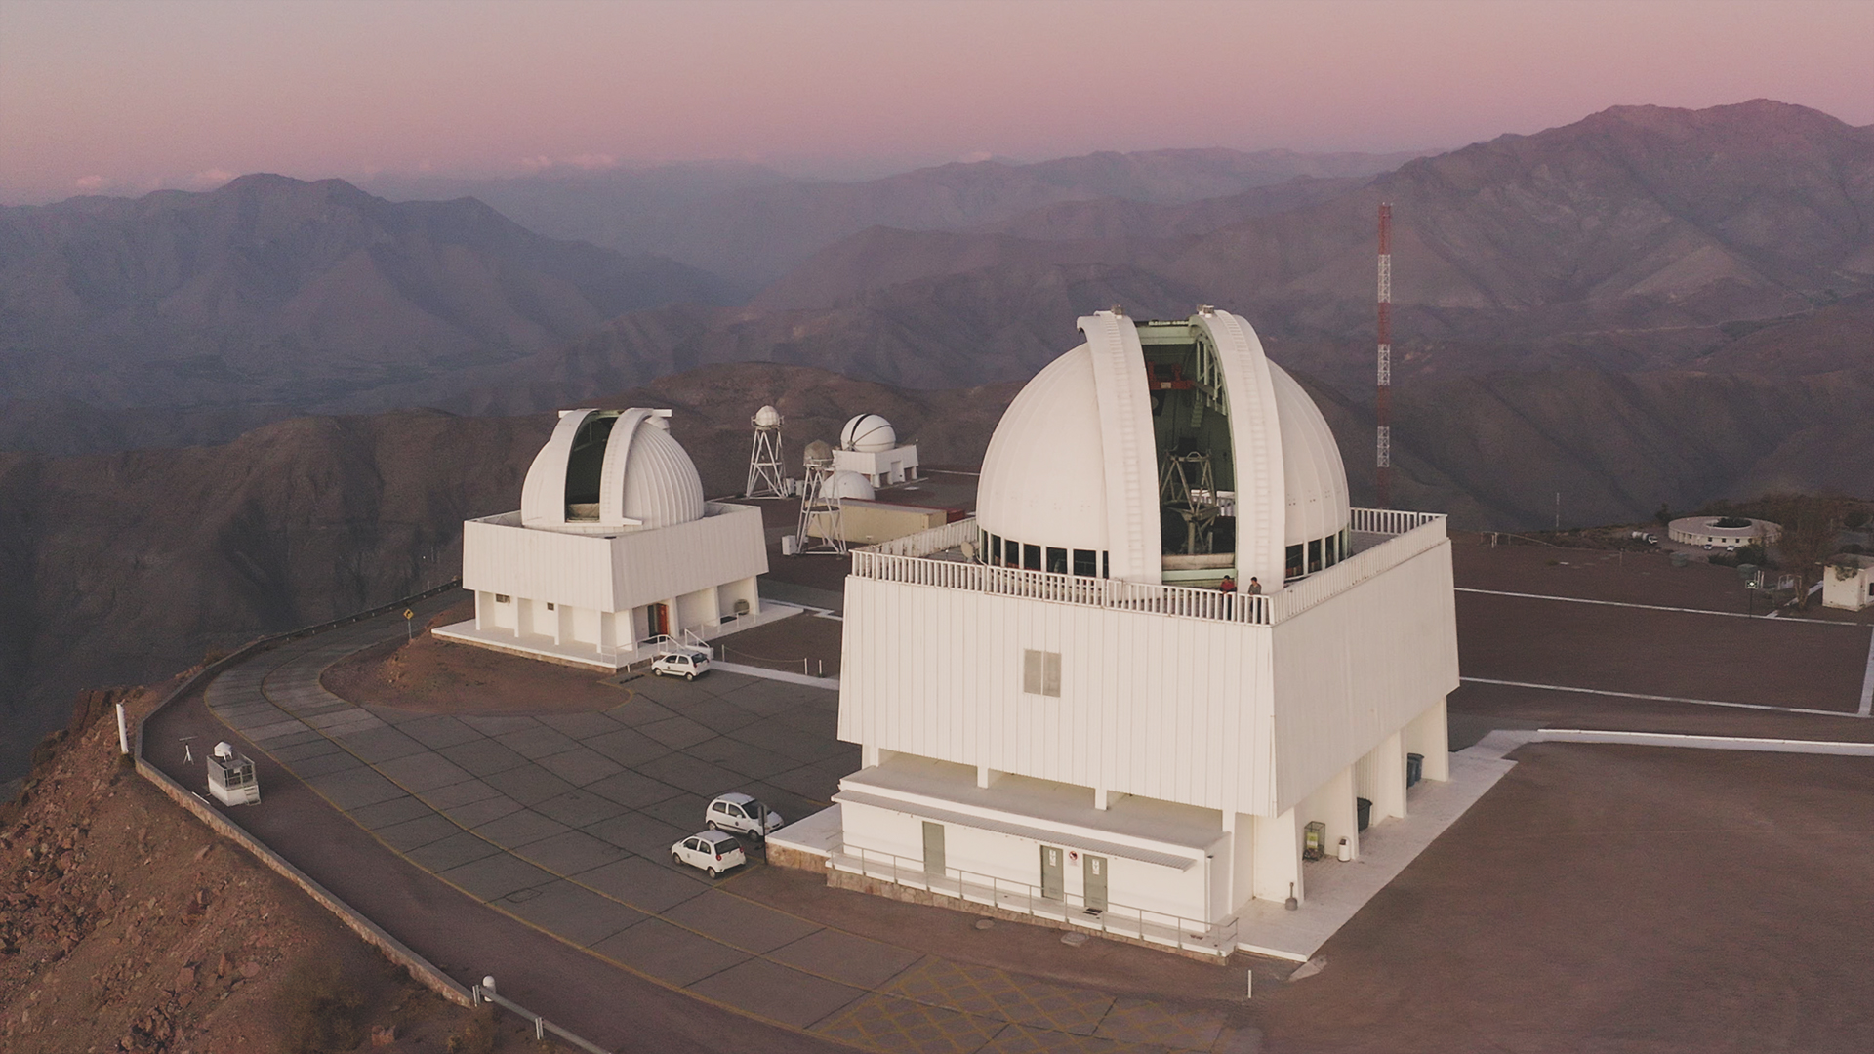

Slide 18
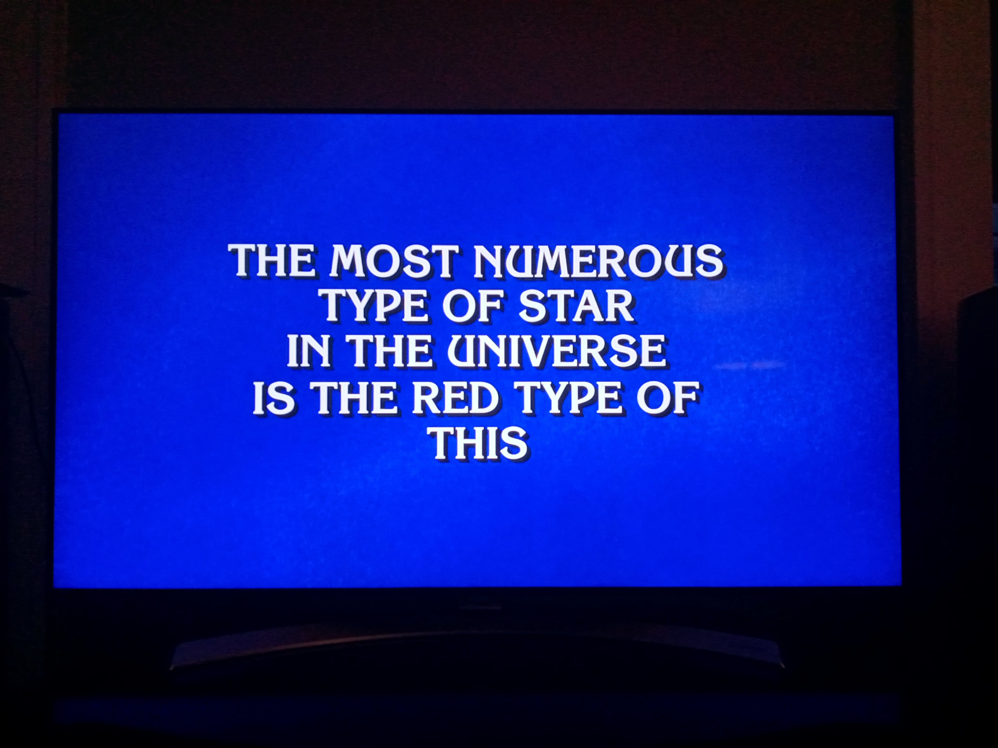

Key Answer
Jeopardy
01 AUG 2023

Slide 20
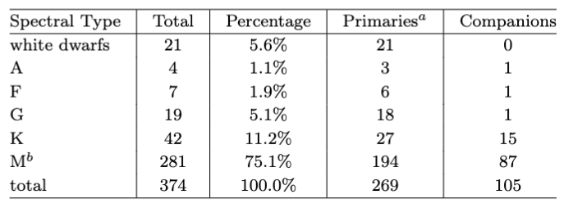
10 Parsec Census
Henry & Jao
Annual Reviews 2024

Slide 21
