Slide 1
Announcements

Slide 2
Galaxy Classification
Tiffany Pewett
pewett@chara.gsu.edu

Slide 3
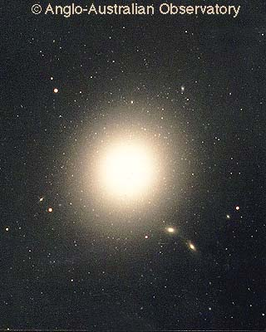
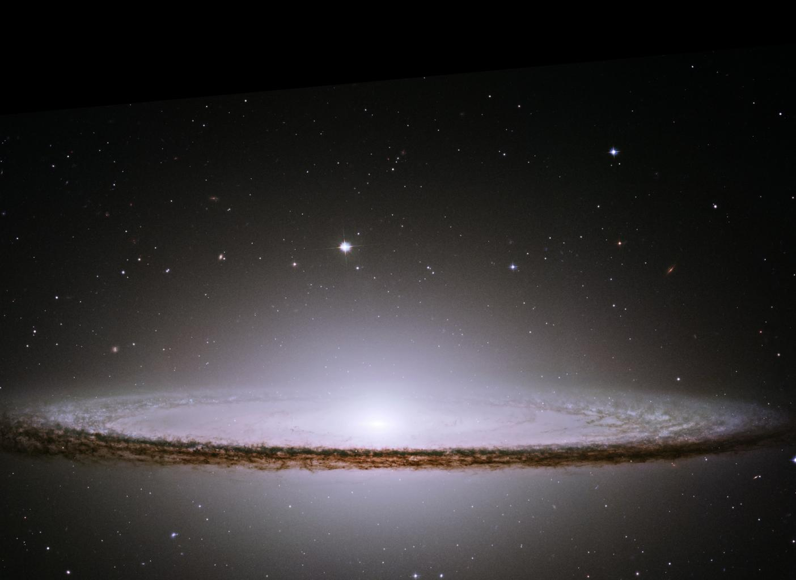
Galaxy Structure
Ellipticals
  Core, Envelope, Halo
Spiral
  Bulge, Disk, Halo

Slide 4
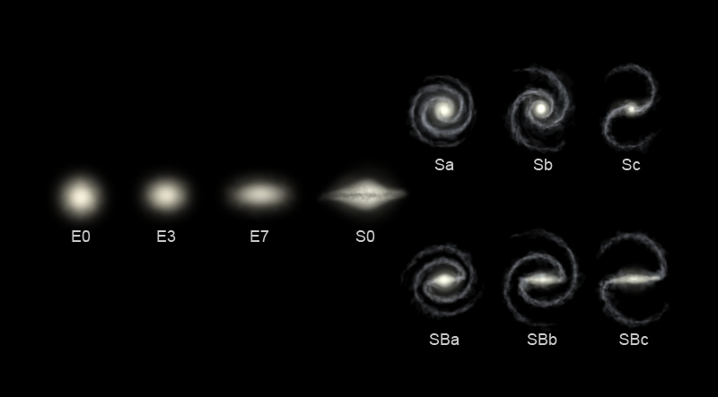
Tuning Fork
Notes:
Bulge size decreases, arms become more loosely wound. Ellipticals become more eccentric…

Slide 5
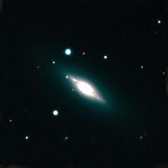
Lenticular (S0)

Slide 6
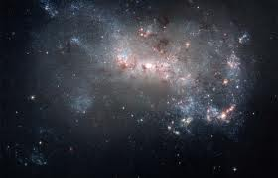
Irregular

Slide 7
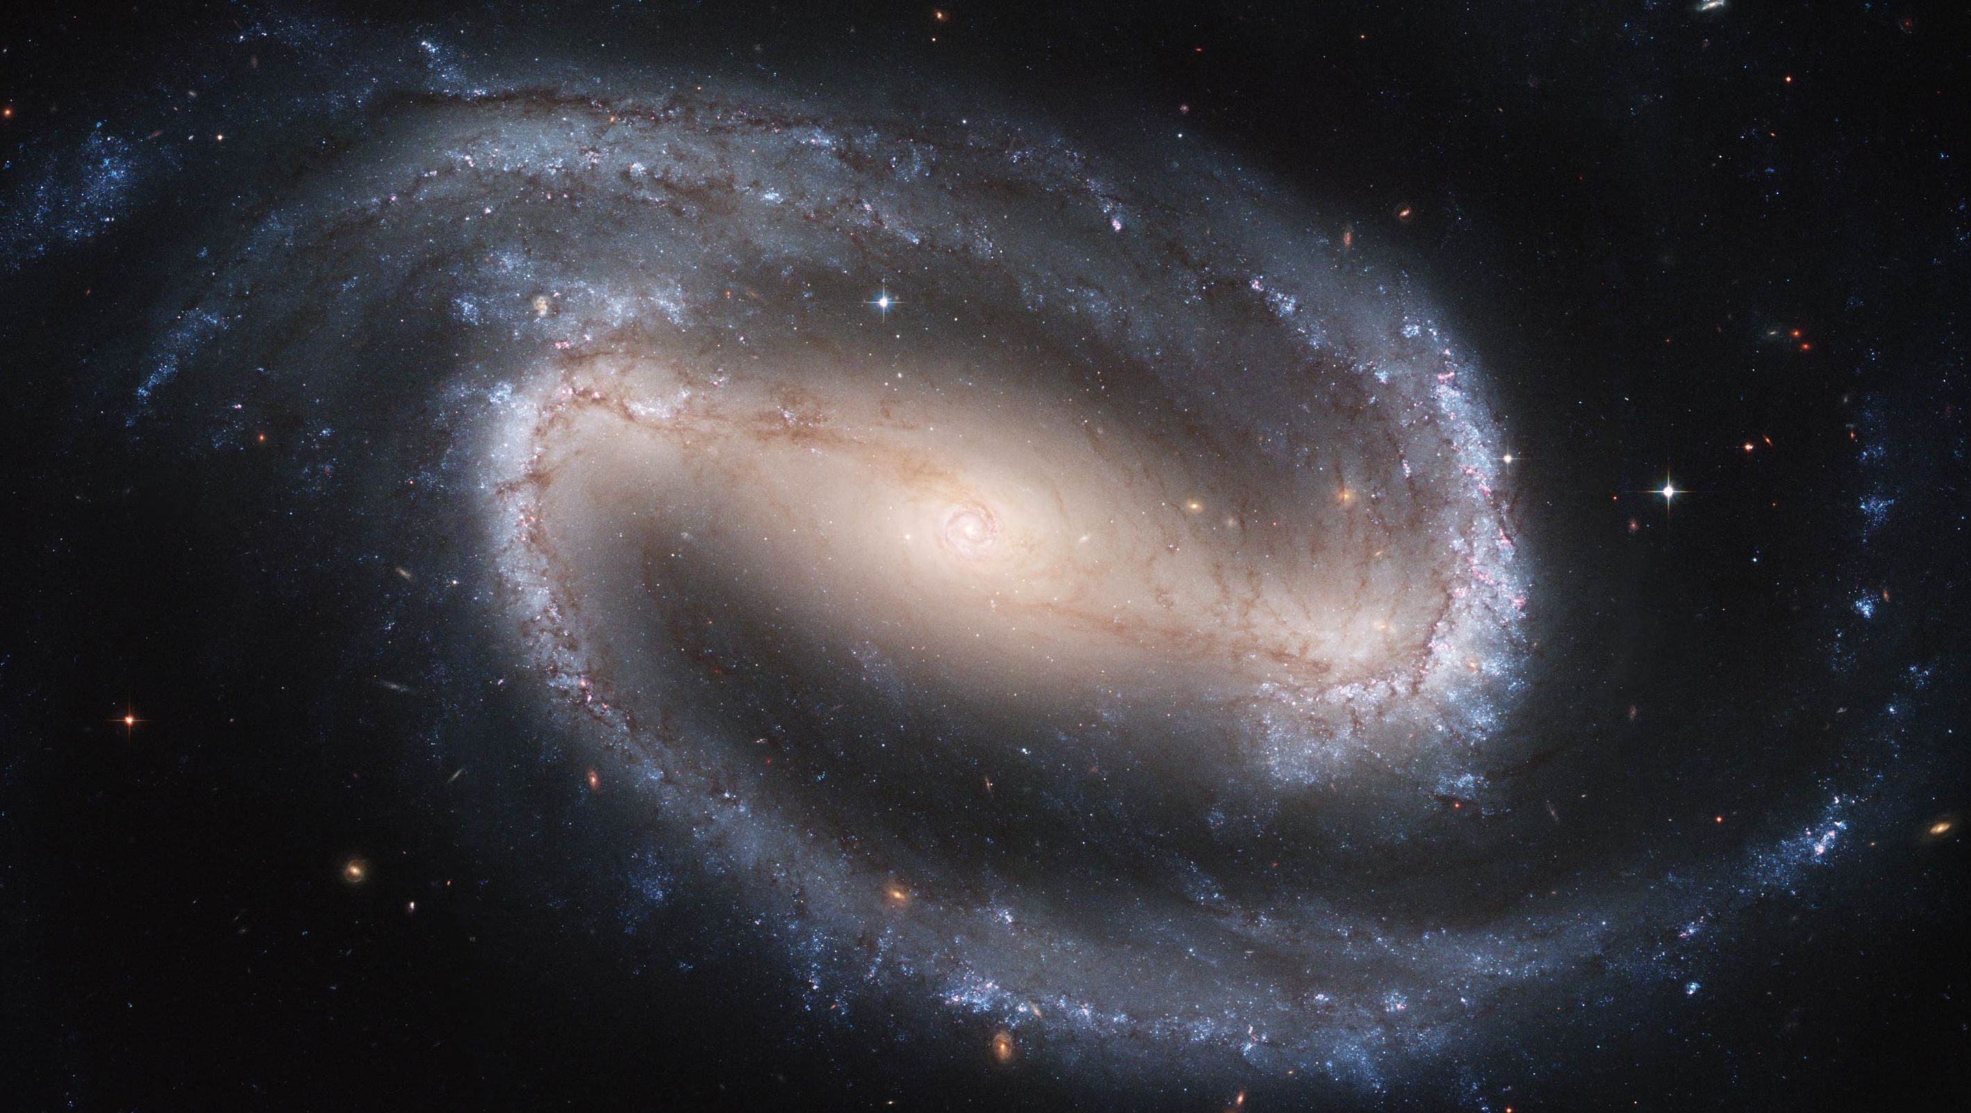
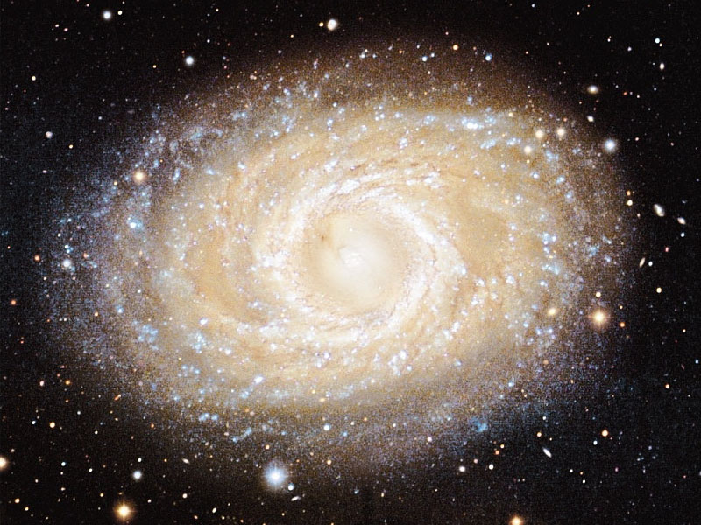
Bars

Slide 8
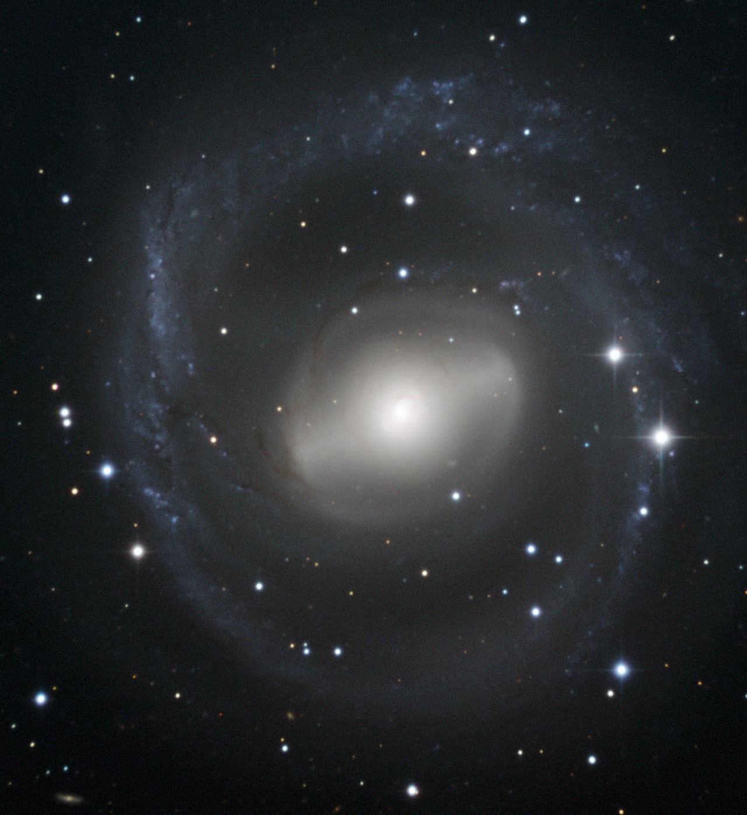
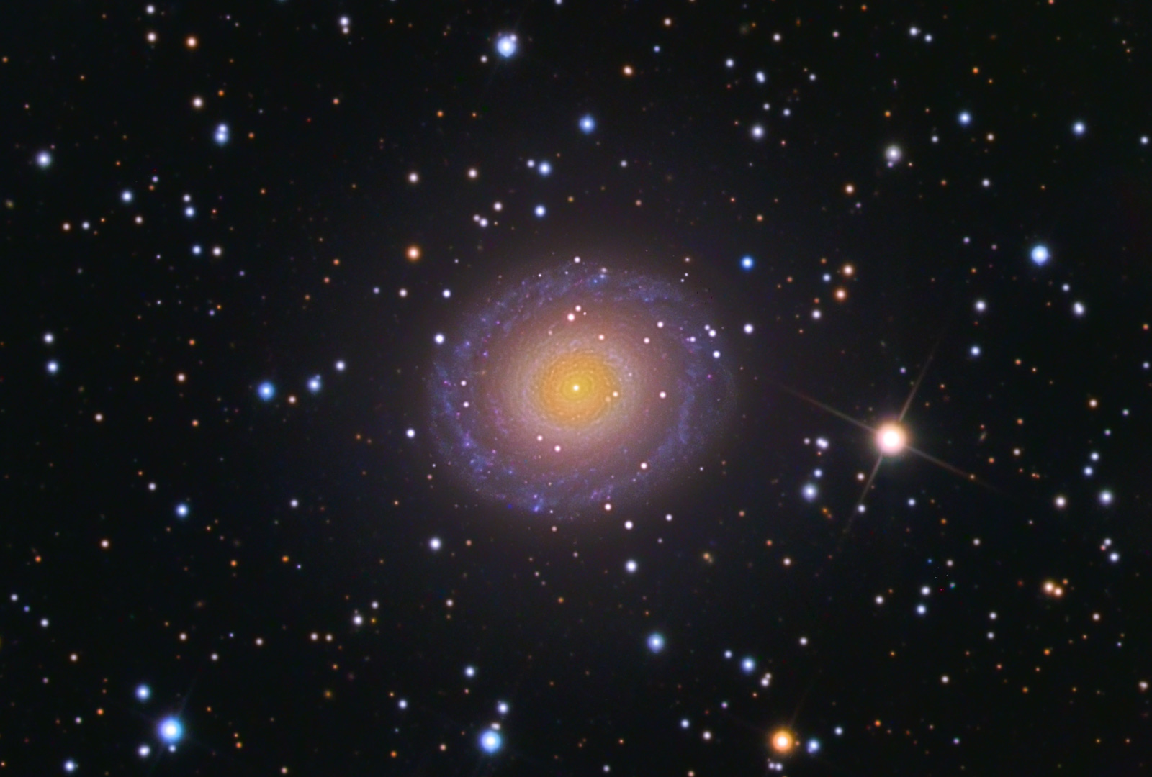
Rings

Slide 9
Procedure
Galaxy Classification Program
Use knowledge from this lecture and Hubble’s Tuning Fork to classify all 25 galaxies.
Answer questions on back!

