Slide 1
Lab Intro & Lab 1: Celestial Sphere & Planispheres
Tiffany Pewett
pewett@astro.gsu.edu
25 Park Place, 625E

Slide 2
General Lab Info
If you don’t already have the book you need to get one and make sure you bring it to each lab.
Please do all labs in pencils, scratched out pen is hard to grade.
Put your name and preferred email address on the first lab.
Do your own work!

Slide 3
Lab Points
11 labs total, lowest lab is dropped, each worth 10 points = 100 points
Observatory project: 10 points
Lab 24 (“Moon Project”): 20 points
Total points= 130
This means each lab is worth ~7.5% of your lab grade so it is in your best interest to attend every lab.

Slide 4
Observatory Project
Lab 28 in your book, make sure you take this lab with you.
Visit any observatory, get a signature from the astronomer on duty, ask questions to fill in your report.
Reports must be written in FULL sentences for full 10 points.

Slide 5
Lab 24: Observing the Phases of the Moon
Take pictures of the Moon at each of the 7 main phases (not including New Moon).
At least 1 must in the daytime.
Build the gradient and use it to measure Moon altitude in each picture.
Fill out remaining info and answer the questions at the end.
Due on the last day of lab.

Slide 6
Extra Credit
There is enough extra credit offered to make up one full lab.
4 points to attend an HLCO Open House.
3 points to visit a 2nd (different) observatory.
2 points for building your gradient and bringing it to lab early.
1 point for bringing in an early Moon picture.

Slide 7
Lab Information
All the information you might need about the lab can be found at my lab website.
If you need help with something that is not there you are more than welcome to email me or stop by my office during office hours.

Slide 8
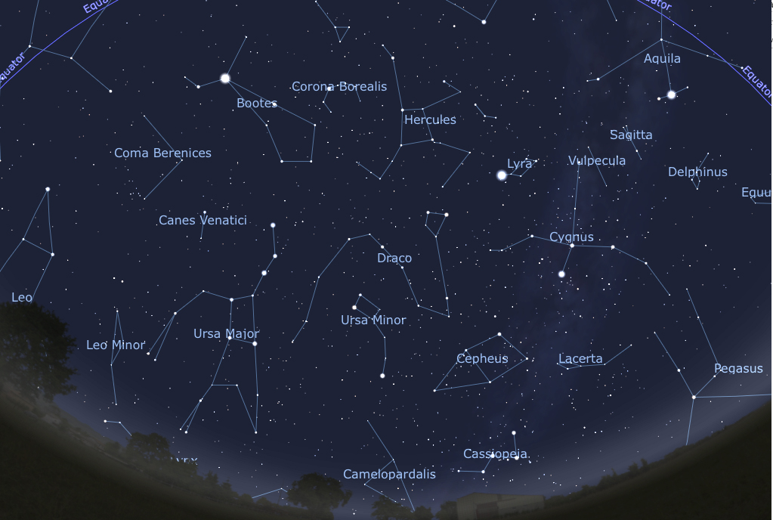
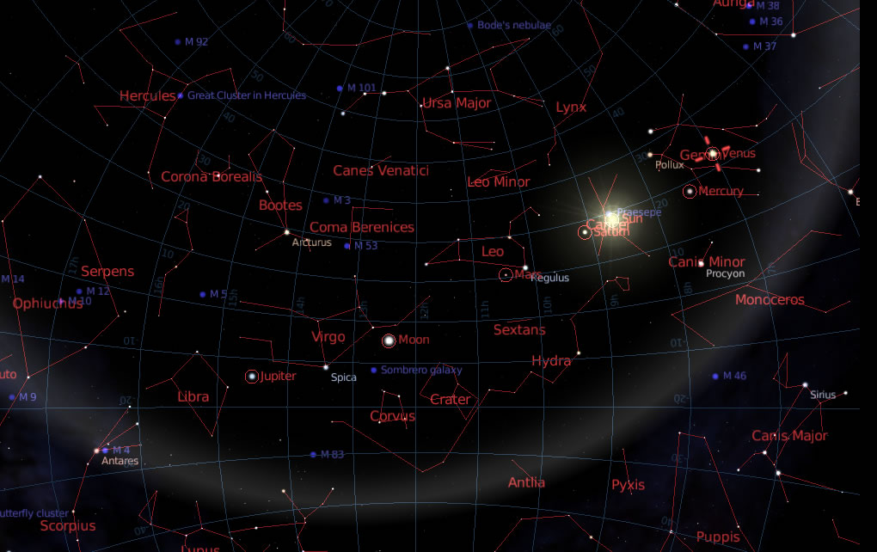
Today’s Lab (Lab 1)
Are constellations important in Astronomy?
How do Astronomers use them?
Notes:
Constellations are mainly used to locate objects or stars that we want to study. Constellation borders and planet locations.

Slide 9
Celestial Coordinates
Right Ascension (RA)
  East-West coordinates on the sky.
  Measured in units of time (Hours:Minutes:Sec.)
Declination (Dec)
  North (+), South (-) coordinates on the sky.
  Measured in units of angle (Degrees:Arcminutes:Arcseconds or °:’:”)
Origin is at RA=00h:00m:00s, Dec=00°:00’:00”

Slide 10
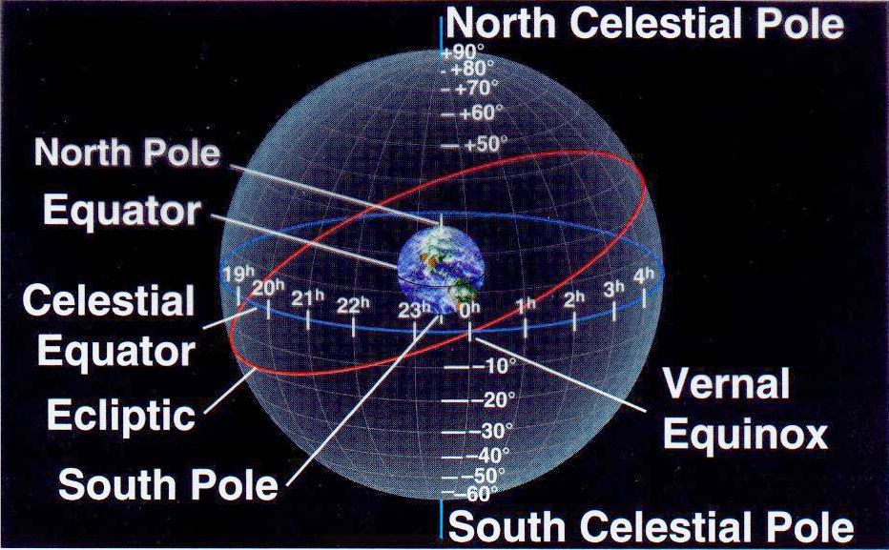
Celestial Sphere
Projection of the Earth’s coordinates onto sky.
Origin at the Vernal Equinox.
Earth’s Equator= Celestial Equator
Ecliptic= Location of planets, Moon, & Sun.
Notes:
Discuss Equinoxes, tilt of the Earth, and seasons here.

Slide 11
Current Planet Positions
Mercury: RA= 21H:46M, Dec= -14°:18’
Venus: RA= 18H:58M, Dec= -15°:46’
Mars: RA= 13H:23M, Dec= -06°:06’
Jupiter: RA= 06H:56M, Dec= 23°:00’
Saturn: RA= 15H:22M, Dec= -16°:10’

Slide 12
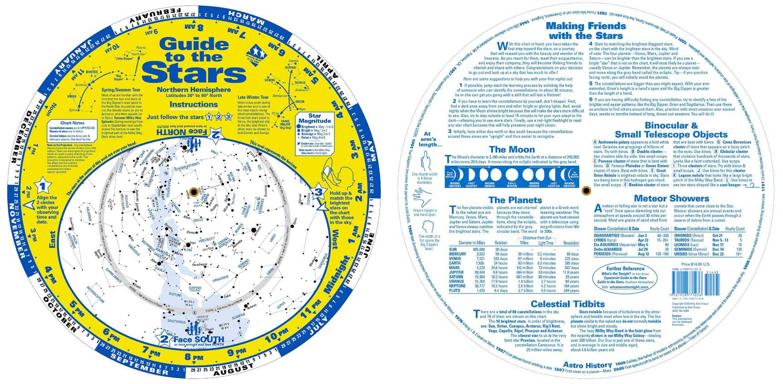
Planispheres
Tool used to locate constellations and other objects in the current night sky.
Set time and date by rotating.
Circumpolar constellations never set.
Notes:
Explain circumpolar constellations further. Assume sunset= 6pm and sunrise= 6am

