Slide 1
Upcoming Events
Project Medley Sign-Up Next Week. Pick a project before then!

Slide 2
Lab 10: Spectroscopy and Atomic Structure
Tiffany Pewett
pewett@chara.gsu.edu

Slide 3
How Do We Study Stars?
Photometry: taking pictures of the object to determine its brightness (magnitude) and color.
Spectroscopy: Spreading the light out into a rainbow (spectrum) and studying the features to determine what the object is made of.

Slide 4
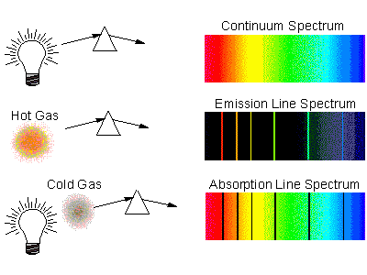
Spectral Features

Slide 5
Spectral Features and Kirchoff’s Laws
Continuous Spectra: No features, created by a “hot, glowing solid”. No gasses involved to create features (ex: light bulb).
Emission Lines: Bright, colored lines created by a hot, glowing gas (ex: Supernova).
Absorption Lines: Dark Lines created by a cooler gas in front of a hot star (ex: photosphere).

Slide 6
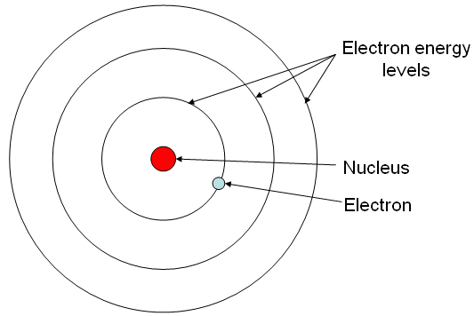
Hydrogen Atom
Notes:
Protons and neutrons inside nucleus, only 2 electrons per orbital. Orbitals act like floors. Electrons can only be on one floor at a time, but they are most stable on the lowest “floors”. Very specific distances between each orbital.

Slide 7
What Causes Emission Lines?
The hot gas is full of excited electrons. These electrons, in order to be stable, fall back down to lower orbitals releasing a photon (light) of a very specific wavelength (color).
Every atom produces a very specific set of spectral lines that act as fingerprints to identify that element.
Notes:
Every element has a different orbital radius resulting in different wavelengths.

Slide 8
What Causes Absorption Lines?
There is a hot source behind a cooler gas. The electrons in the gas are excited to higher orbitals by the hot source.
  A photon has to be absorbed for this to happen, causing a dark line at that specific wavelength (color).

Slide 9
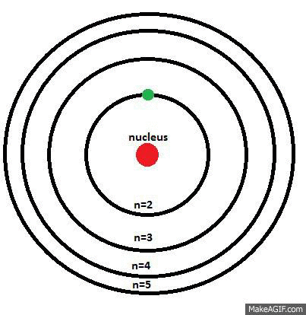

Hydrogen Atom & Balmer Lines
Notes:
Balmer lines are created by transitions to and from the n=2 orbital, these can be observed in visible light. The further an electron has to fall or rise the higher the energy produced/absorbed → lower wavelength.

Slide 10
Spectral Tubes
Gas inside becomes heated, exciting the electrons of the element, they then de-excite and produce emission lines.
Tubes are very sensitive!
  Must be ON for at least 30 seconds, then OFF for as long as they were on for (ex. 45 seconds ON =45 seconds OFF).
  Do not touch the tubes, the oils on your hands will contaminate the gasses.

Slide 11
Part 1
Answer the first 3 questions using the regular light bulb at Station 1.
Use Station 2 (hydrogen) to fill out Table 1 and make sure that you draw what you see to use as a reference.
The remaining 8 stations you need to draw, then use the key to identify the element inside the tube.
Notes:
These can be done in any order.

Slide 12
Part 2
Read the Procedure carefully!
Use a drawing compass to create a scale model of a hydrogen atom using your work from Table 1 where 1 Angstrom=1 cm.
Label your model with the orbital numbers, the transitions that occurred and the colors they produced.

