Slide 1
Summer Lab Stuff & The Rotation of the Sun
Tiffany Pewett pewett@chara.gsu.edu
Office: Kell 515

Slide 2
General Lab Stuff
If you don’t already have the book you need to get one and make sure you bring it to each lab.
Please do all labs in pencils, scratched out pen is hard to grade.
Put your name and preferred email address on the first lab.
Do your own work!

Slide 3
Lab Points
11 labs total, lowest lab is dropped, each worth 10 points = 100 points
Observatory project: 10 points
Project Medley: 20 points
Total points= 130
This means each lab is worth ~7.5% of your lab grade so it is in your best interest to attend every lab.

Slide 4
Observatory Project
Lab 28 in your book, make sure you take this lab with you.
Visit any observatory, get a signature from the astronomer on duty, ask questions to fill in your report.
Reports must be written in FULL sentences for full 10 points.

Slide 5
Project Medley
List of topics can be found at: https://sites.google. com/site/tiffanydpewett/summer-20121020-lab
Topics will be chosen in two weeks.
Be creative with your project! As long as the questions are answered and the topic is understood your project is good!
Outline is worth 5/20 points

Slide 6
Extra Credit
There is enough extra credit offered to make up one full lab.
4 points to attend an HLCO Open House.
3 points to visit a 2nd (different) observatory.
3 points to present your project at the end of the semester.

Slide 7
Lab Information
All the information you might need about the lab can be found at my lab website
If you need help with something that is not there you are more than welcome to email me or stop by my office during my posted office hours.

Slide 8
HLCO Open House
This Saturday, September 14 at 8pm.
Parking is limited so carpool if you can.
Get directions from the website, it’s the middle of nowhere so GPS can be unreliable.
This is weather dependent, if it’s mostly cloudy or raining then it is cancelled.

Slide 9
Today’s Lab (Lab 11)
How long does it take the Sun to rotate?
Notes:
The Sun is close enough that we are able to watch it rotate. We can use sunspots as markers to find how long it takes to complete one full rotation.

Slide 10
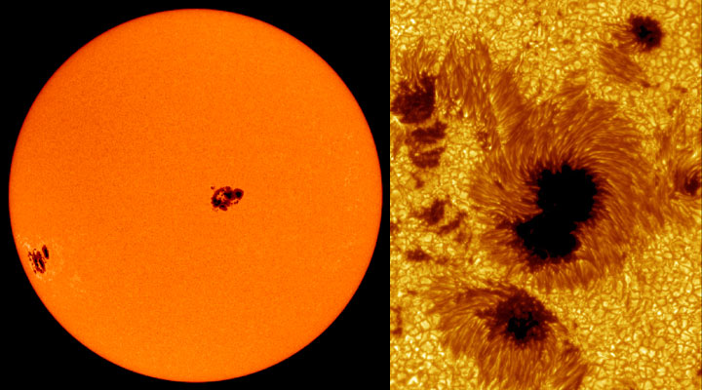
Sunspots
“Cold” spots on the Sun created by the magnetic field of the Sun.

Slide 11
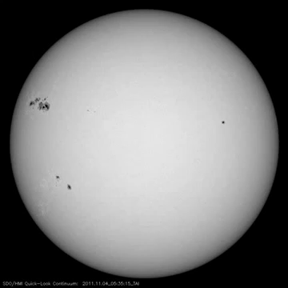
Stationary Spots
Notes:
Sunspots move with the Sun, they don’t drift on the surface.

Slide 12
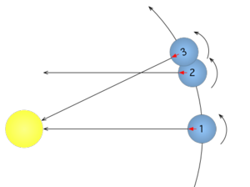
Rotation Periods
Synodic
Sidereal
Observed rotation period from a moving Earth.
Actual rotation period (as viewed from a stationary Earth).
Notes:
Will find both. Answer is given for Synodic rotation.

Slide 14
Trace Paper
Trace a circle the size of the Sun on the images, using a drawing compass, label North and South.
Choose 3 different sunspots at 3 different vertical locations on the Sun.
Trace these sunspots as they move across the Sun making sure to label the date under each point.

Slide 15
3 Half Circles
Draw a half circle for each spot.
To do this: measure the length of the path of a spot from one edge of the Sun to the other.
  Draw a line the same length as the path then use a drawing compass to draw a proper half circle around it
Copy the locations of your spot from the trace paper.
Notes:
Easiest to copy the spots if they fold the trace paper at the line and transfer them that way.

Slide 16
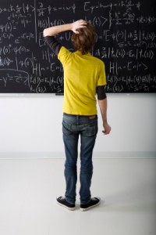
Finding Your Answers
Simply use the formulas provided in the lab and check your answer!

