Slide 1
Announcements
Project Medley Outlines due in 2 weeks!
  Start thinking about how you want to do your project!
If you did not sign up for a project yet, do so now!
On-campus observing October 9, 7:30pm.
  Meet in this room no later than 7:30!

Slide 2
Lab 12: Eclipsing & Spectroscopic Binaries
Tiffany Pewett
pewett@chara.gsu.edu

Slide 3
Eclipsing binaries
Many binaries cannot be visually separated.
These stars sometimes line up from our point of view so they eclipse each other as they orbit.
Produces a “light curve” showing the system becoming fainter as they eclipse.

Slide 4
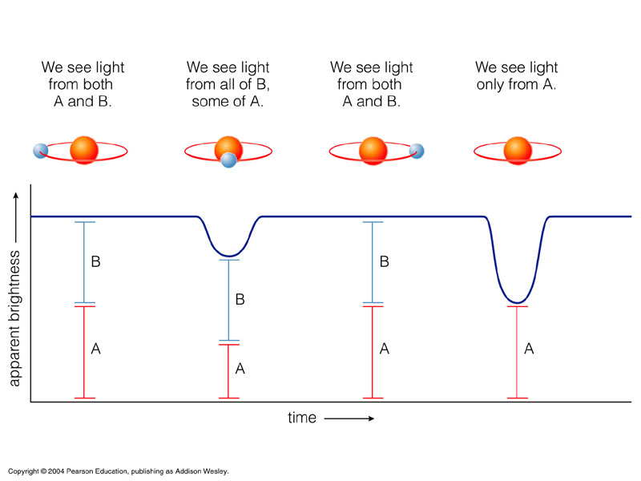
Lightcurve
Notes:
Small Sun-like star orbiting red giant star. Becomes fainter as the stars block each others’ light.

Slide 5
Which eclipse is which?
Does the smaller, hotter star being in front or behind cause the larger dip?

Slide 6
Notes:
Losing all of light from smaller star as opposed to part of light from larger.

Slide 7
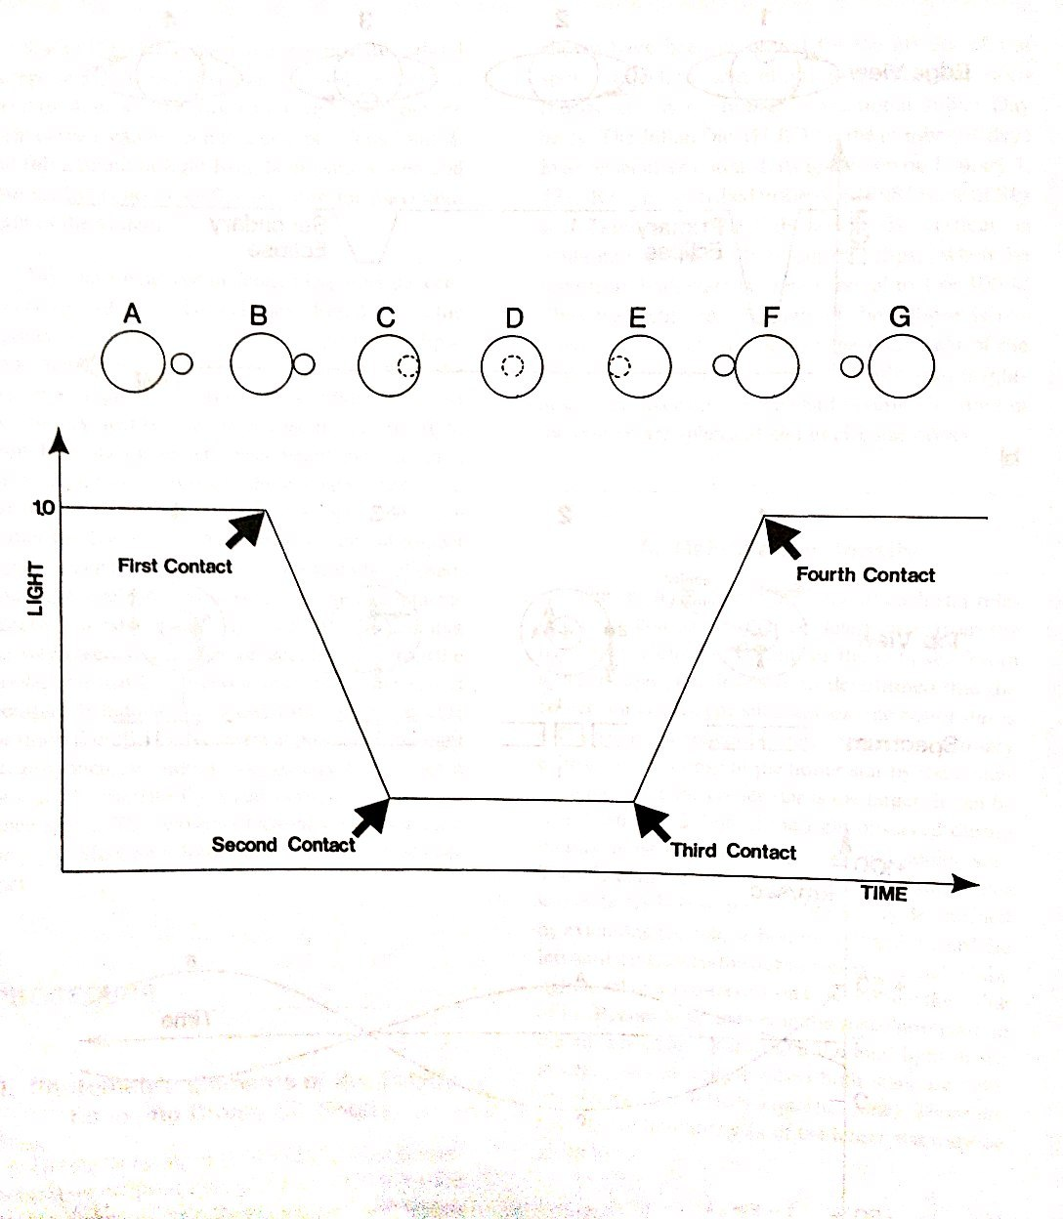
Contact Points
Notes:
Which points are used to find radius of large star? Small star?

Slide 8
Part 1
Read the procedure carefully!
Find individual luminosity fractions.
Find t1, t2, and t3 (note these are times in days).
Fill in the rest using the equations provided in the lab procedure.

Slide 9
Spectroscopic Binaries
Can see 2 spectra in one moving back and forth as the stars orbit each other.
Can use this motion to find their velocities, which will give their separation, radii, and masses!!

Slide 10
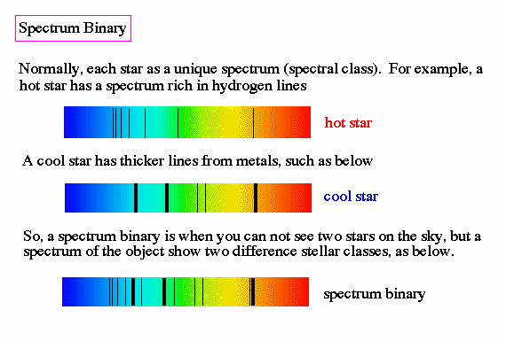
Their Spectrum

Slide 11
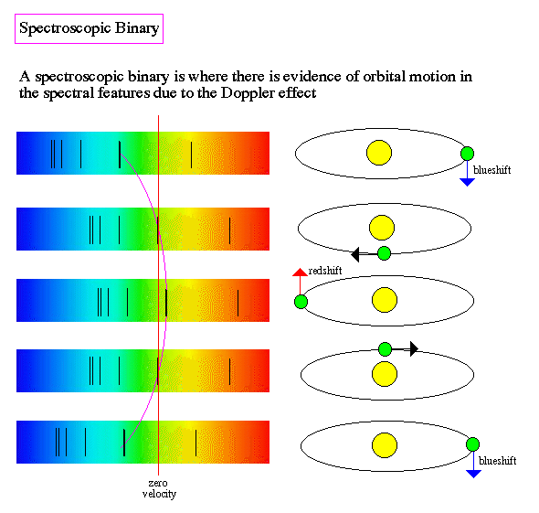
Their Spectral Motion
Notes:
The doppler shift of each set of lines provides the velocity of each star towards and away from us.

Slide 12
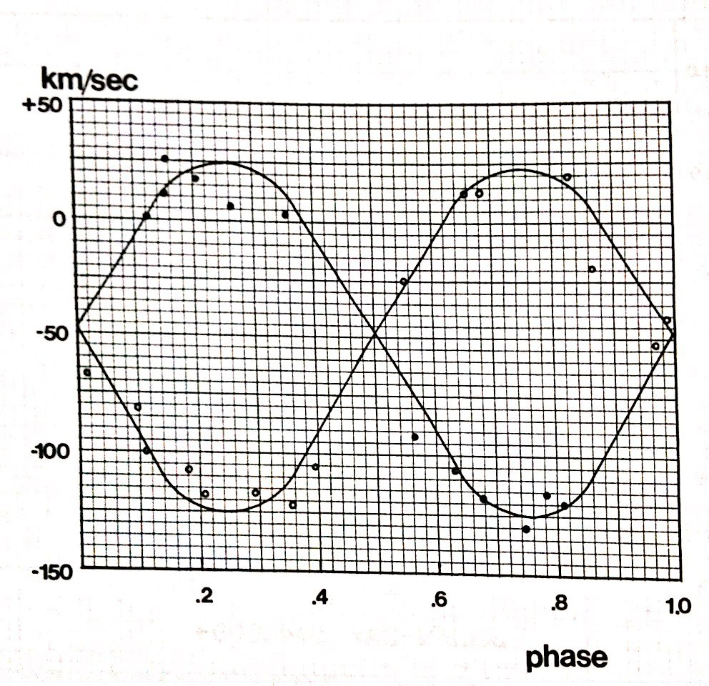
Radial Velocity Curve
Notes:
Plot the velocities of the 2 different sets of lines over time.

Slide 13
Part 2
Find γ, α’s, and β’s from your chart.
Use the equations from the lab procedures. Make sure you are careful with your calculators and you put parenthesis where they are needed.
Hint: the masses should be almost equal.

Slide 14
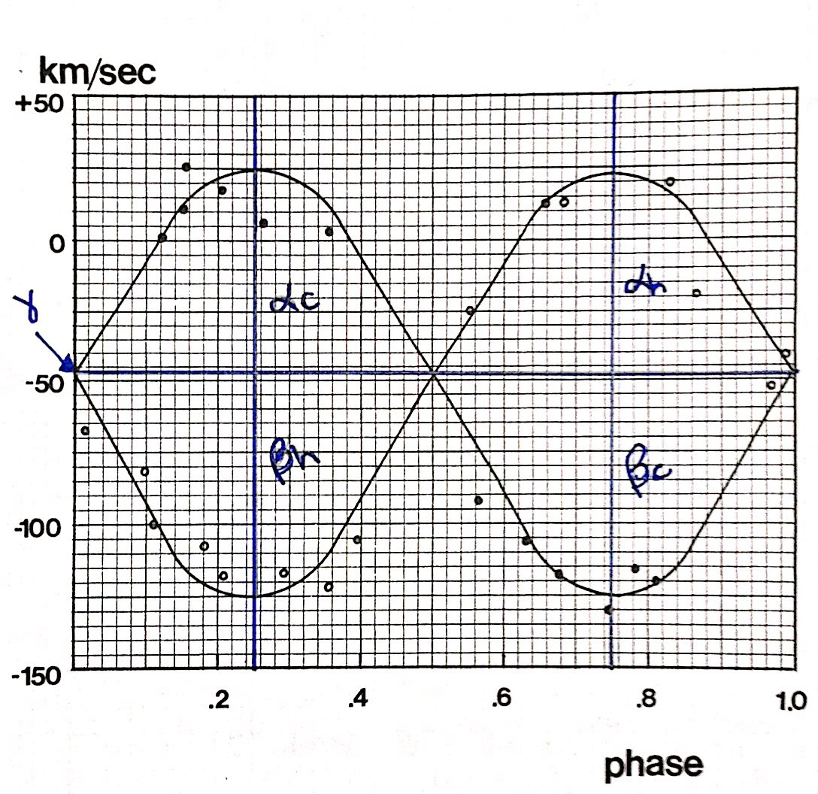
Finding γ, α’s, and β’s
γ = proper motion of the star system.
α_{c} = peak velocity of cooler star away from us.
β_{c} = peak velocity of cooler star towards us.
A
B
C
D
Notes:
Beta’s will be negative, must use them as positive in all equations!!

Slide 15
Finding Individual Masses
M_{c}/M_{h}=Mass Ratio
M_{c}+M_{h}=Total Mass
Use these together with some algebra to find ->
M_{h}=Total Mass÷(Mass Ratio+1)
M_{c} is whatever is left of the total mass.
  TM-M_{h}=M_{c}
Check your answers!

