Slide 1
Announcements
Turn in Outlines now.
On-campus observing re-scheduled to (likely) July 15, 9pm.
No labs meet on Thursday!

Slide 2
Lab 13: Ages & Distances of star clusters
Tiffany Pewett
pewett@chara.gsu.edu

Slide 3
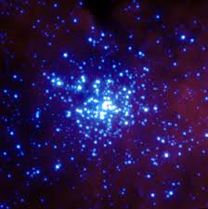
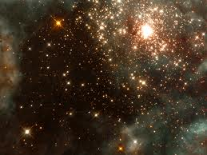
Star Clusters
Can use main sequence fitting to find distance and age.
Notes:
Large groups of stars that formed together. Useful for finding distances and ages since they formed at the same time.

Slide 4
Main Sequence Fitting
Plot color magnitudes for many stars in the cluster to form a main sequence.
Match this to known M-S absolute magnitudes.
Find Distance!

Slide 5
Lining Up the Main Sequence
Line it up with the bottom of the star cluster.
There are many binary stars in clusters which show a higher luminosity.
  This pushes them higher up on the plot and will negatively affect your answers.

Slide 6
Distance Modulus
Apparent magnitude (m) value at absolute magnitude (M)=0.
Part of distance modulus equation:
  D=10×10^{(m-M)/5}
Use this m value to find distance on the plot.

Slide 7
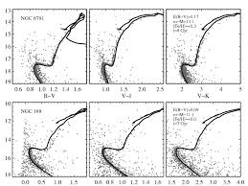
Finding Ages
We know all stars formed at same time.
Can find age by finding what types of stars are left and which are starting to die.
This is called a “turn-off”

Slide 8
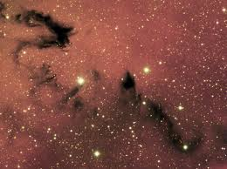
Color Index
Accounts for light lost to dust in space.
Light appears redder when absorbed by dust.
Can affect our distance measurements!

