Slide 1
Announcements
Projects due in 2 ½ weeks!!
On-campus observing rescheduled for July 16th, this may move to the 15th or 17th depending on weather!
Powerpoints: 20 info slides. Papers: 4.5 info pages.

Slide 2
Lab 14: The Period-Luminosity Relation
Tiffany Pewett
pewett@chara.gsu.edu

Slide 3
Cepheid Variables
Yellow Supergiant stars.
Are pulsating.
  This causes them to become brighter and fainter over time.
  They have extremely regular (& predictable) periods!

Slide 4
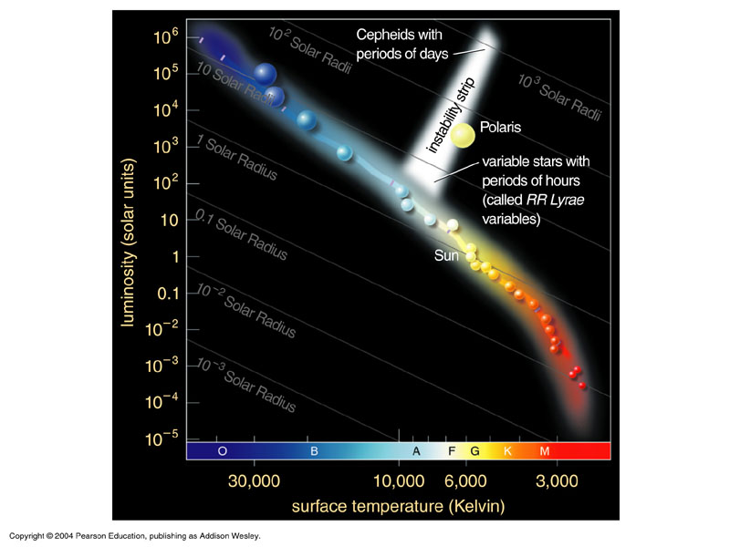
Cepheid Properties

Slide 5
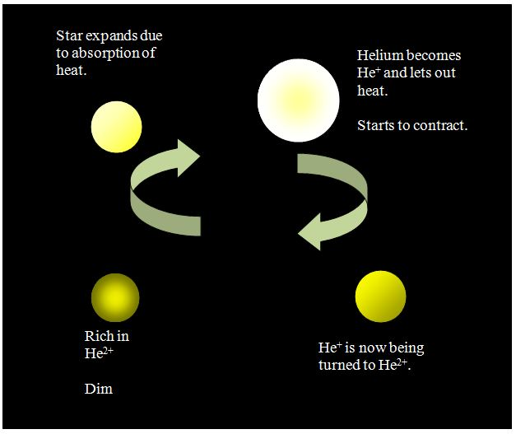
Cepheid Pulsations

Slide 6
Types
There are 2 types of Cepheid Variables.
  We will only be working with classical Cepheids
The two types show 2 different, strong relationships between their pulsation periods and their luminosity!

Slide 7
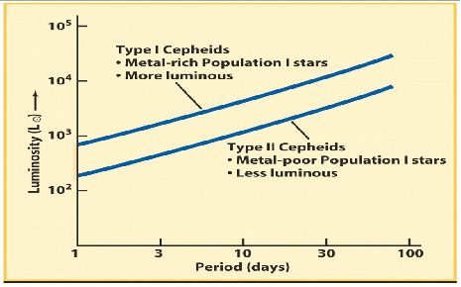
Types

Slide 8
Using Cepheids
They are extremely useful for finding accurate distances to far off galaxies!
Since they are very bright they are easy to spot.
Period ➔Luminosity ➔Distance!

Slide 9
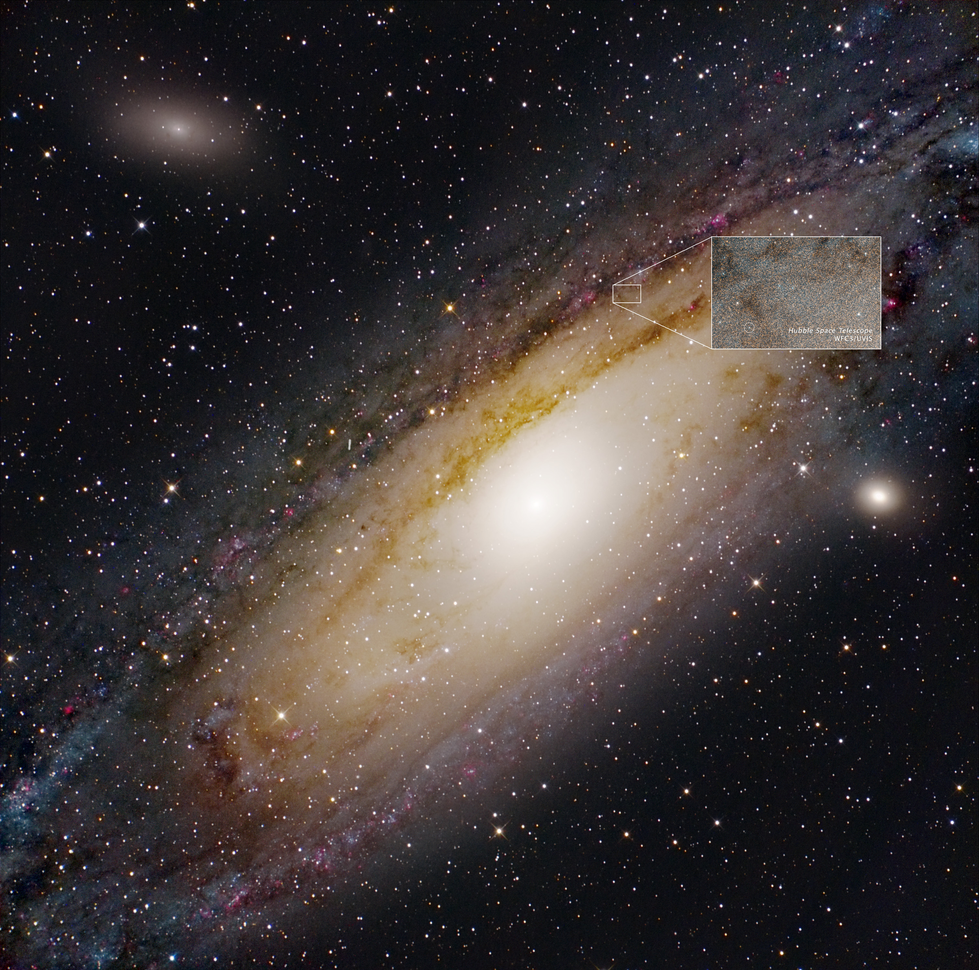
Using Cepheids

Slide 10
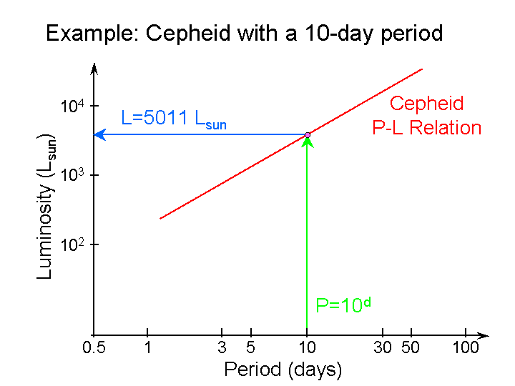
Using Cepheids

Slide 11
Procedure
First, make sure you carefully read and follow the lab procedure!
Fill in the blank column on Table I first!
  Use the equation: M= m+5-(5×log(2600pc))
On Figure 1 plot all points from Table I & II, you are plotting logP & M.
  This is your P-L relation!
  Use a ruler to help you plot, if needed.

Slide 12
Procedure
Draw a straight line (using a ruler) through your cluster of points on Figure 1.
  Note: This line will NOT go through your origin!
On Figure 2 plot all 25 points from Table III.
  When done, draw a “best-fit” curve through your points, your peaks need to be the same height!

Slide 13
Final Answers
Follow the procedure closely and fill in all answers!
m= 15.556 (you will have gotten this by averaging all mag values from Table III).
P is the time passed between your two peaks.
Find M using your plot on Figure 1.
Find D using the provided graph on Figure 3.

