Slide 1
Announcements

Slide 2
Lab 15: Hubble’s Law
Tiffany Pewett
pewett@chara.gsu.edu

Slide 3
Distance Ladder

Slide 4
Edwin Hubble
Notes:
Studied galaxies and redshifts. Discovered universe is much larger than Milky Way. Discovered “Hubble’s Law”. Led the way to combining the fields of astronomy and physics – Nobel Prize. Hubble Telescope.

Slide 5
Redshift
Notes:
The faster something is moving away from us, the stronger the redshift.

Slide 6
Hubble’s Law
Notes:
More distant galaxies have higher redshifts, i.e. are moving away from us at higher velocities.

Slide 7
Hubble’s Constant
Notes:
New data has constrained this value to a certainty of 0.8!

Slide 8
Goal of Lab
Find distances and recessional velocities of galaxies.
Determine Hubble’s Constant.
Determine Age and Radius of the Universe!
Current known values?

Slide 9
Finding Velocities
You first need to find your scale for the spectral images.
Then measure the distance to the Calcium K & H lines to nearest ½ mm.
Fill in the Table I using the appropriate equations.
Note: Round your final velocities to nearest 1000!

Slide 10
Scale & Velocities
5015.7 Å
3888.7 Å
Notes:
Measure line in mm, to nearest ½ mm!! Measure distance to each absorption line from first line.

Slide 11
Velocities

Slide 12
Finding Distances
Determine scale for galaxy images.
Measure longest and shortest sides of galaxies and average them.
Measure to edge of each galaxy.
Fill in Table II using appropriate equations.

Slide 13
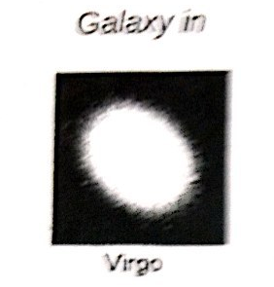
Scale & Distance

Slide 14
Plotting
Carefully Plot all five of your data points.
Final Velocity vs. Distance.
Use a ruler to draw a “best-fit” line starting at the origin (0,0) through your points.

Slide 15
Hubble’s Constant
Hubble’s constant is the slope of the line you just drew.
Slope= Rise ÷ Run
Origin is 0,0 so you only need one point.
Find a spot on your line that is on a grid cross-section. Find the y and x values here, you have your rise and your run!
Notes:
Complete the rest of the lab using provided equations, and common sense!

