Slide 1
Lab 2: Phases of the Moon
Tiffany Pewett
pewett@astro.gsu.edu

Slide 2
Introduction
The Moon orbits the Earth once every 29.5 days.
Phases are caused by this orbit as different parts of the illuminated Moon face the Earth.
Always see the same side because the Moon rotates at the same rate that it orbits the Earth.

Slide 3
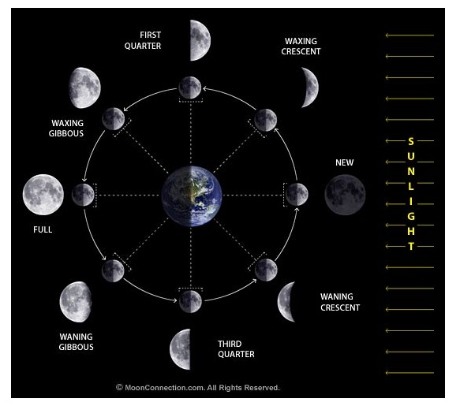
Phases
Half of the Moon is always in sunlight.
We can only see the part that is facing us.
In this view Earth rotates counter-clockwise.

Slide 4
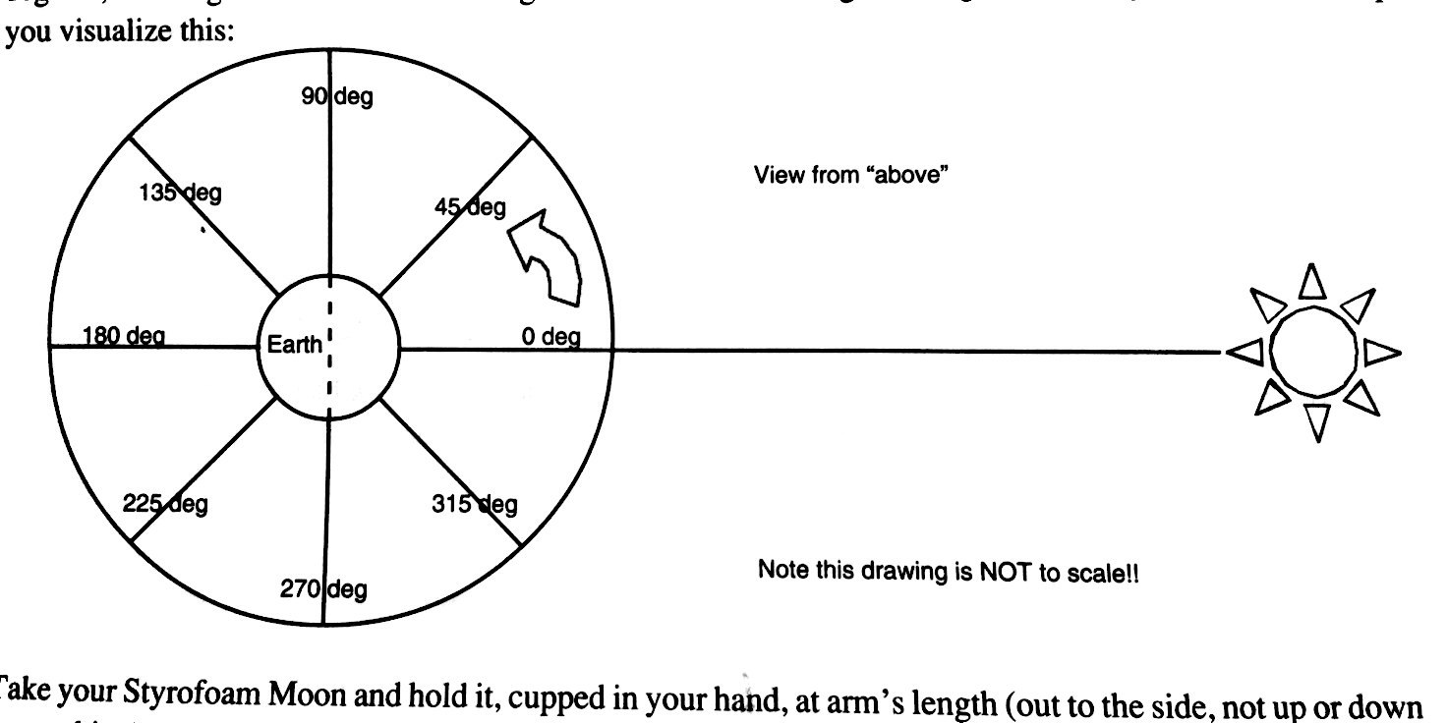
Procedure
After 1st 3 questions, use ball and lamp to draw different phases at different angles.
7: Draw phases on diagram and table.
Nothing should look like a “pie chart”!

Slide 5
Times
About what time is it when the Sun is directly overhead?
Time at sunrise?
Time at sunset?
Label these and all in between for later.

Slide 6
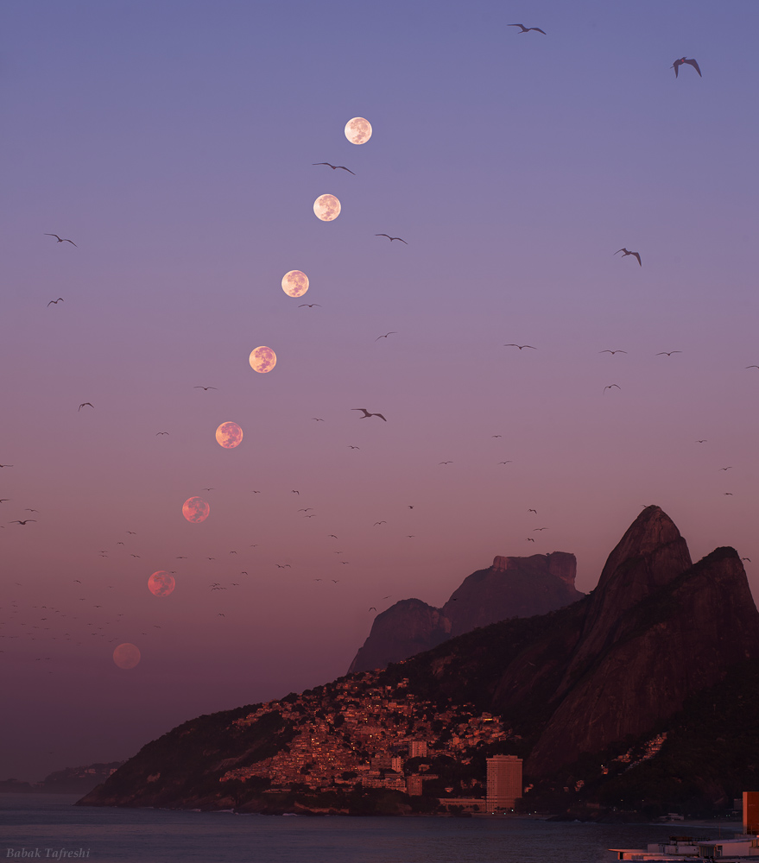
Moonrise and Moonset
Moonrise occurs right when the Earth begins to turn towards the Moon.
Moonset, when the Earth starts turning away from it.

Slide 7
Determining Times
Easiest way is to make a “T”.
Example using the Sun.
  Sunrise?
  Overhead?
  Sunset?
Do the same for the Moon at different positions.
6pm
noon
6am

Slide 8
Remaining Questions
You’ll need to use everything you’ve learned so far for question 13.
14: Look at the rising and setting times for the Moon phases.
15: Current Moon phase is Waning Crescent (almost New).
Staple and turn in lab when finished.

