Slide 1
Announcements
Project Medley Outlines due Tuesday!
  1 page typed and double-spaced
  What do you plan to do for your project?
On-Campus Observing Moved (likely July 15, depending on weather forecasts).

Slide 2
Photometry of the Pleiades
Tiffany Pewett
pewett@chara.gsu.edu

Slide 3
The Pleiades
Well known star cluster near Taurus the Bull.
Nearby, easy to study.

Slide 4


Slide 5
Goal of the Lab
Use computer program (CLEA) to gather photometric data of several stars in the Pleiades star cluster.
Use this data with Main Sequence Fitting to find the distance to the cluster.
Notes:
Photometry is the study of astronomy through the magnitudes of stars in different colors by taking pictures of them.

Slide 6
Magnitudes
Absolute Magnitude (M)- brightness of an object if it were only 10 parsecs away.
Apparent Magnitude (m)- brightness of an object as viewed from Earth.
Higher magnitude number = fainter object.
1 unit in magnitude = 2.5× brighter or fainter.

Slide 7
H-R Diagram
Luminosity
Temperature

Slide 8
H-R Diagram
Luminosity
Temperature

Slide 9
H-R Diagram
RG
Luminosity
WD
Temperature

Slide 10
CLEA Program
Do not exit out of the program, it takes a while to set it back up.
You MUST measure sky brightness (first table) before you can do anything else.
Wall computers gather data for stars 1-8, front computers do 9-15. Share these with people behind you once you have finished.

Slide 11
Exposure Times & Integrations
Exposure time- how long the shutter remains open.
  Want it open long enough to gather enough light from the star.
Integrations- number of images taken which are then combined.
  This reduces error by eliminating any light that doesn’t belong.

Slide 12
Gathering Star Data
Use only 2 filters B (blue) and V (visible).
Center the star in the circular aperture.
Take 4 integrations for each star.
Determine exposure time based on size of star.
Notes:
Integrations give better data by adding images together in order to cancel out noise.

Slide 13
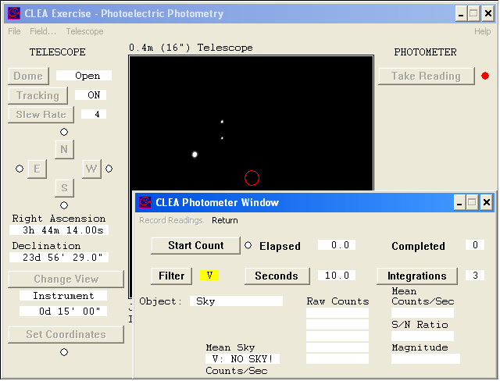
Gathering Data

Slide 14
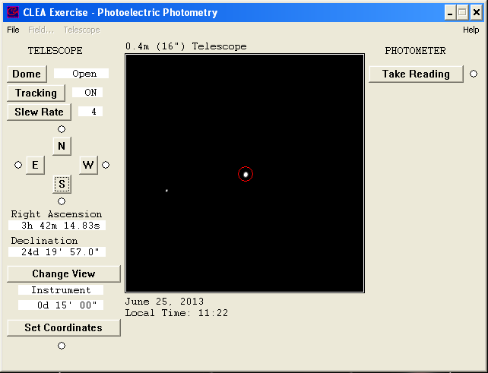



Determining Exposure Time

Slide 15
Plot your points while you wait.

Slide 16
Answer Questions
Make sure you fully answer ALL questions on the front page of your lab!

Slide 17
Finding Distance
M=absolute magnitude (mag. From 10 pc away)
M=apparent magnitude (mag. Seen from Earth)
Use M=0 on transparency to find m
D(in pc)=10 × 10^{(m-M)/5}
  Remember you used M=0
  1 parsec=3.26 lightyears

