Slide 1
Announcements

Slide 2
Radio Astronomy of Pulsars
Tiffany Pewett
pewett@chara.gsu.edu

Slide 3
Pulsars
Remnants from supernova explosions (neutron stars).
Rapidly rotating.
Strong magnetic fields.
Beams of radio energy emitted at the magnetic poles.

Slide 4
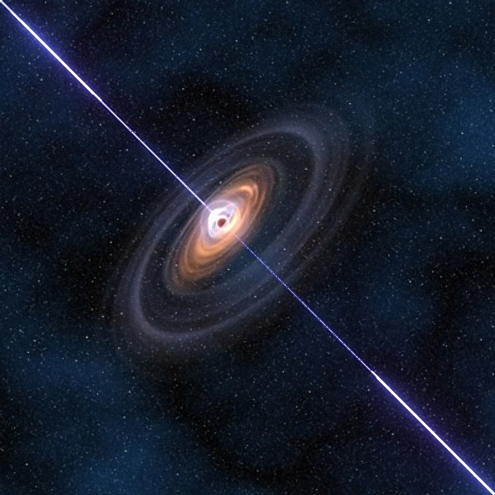
Pulsars

Slide 5
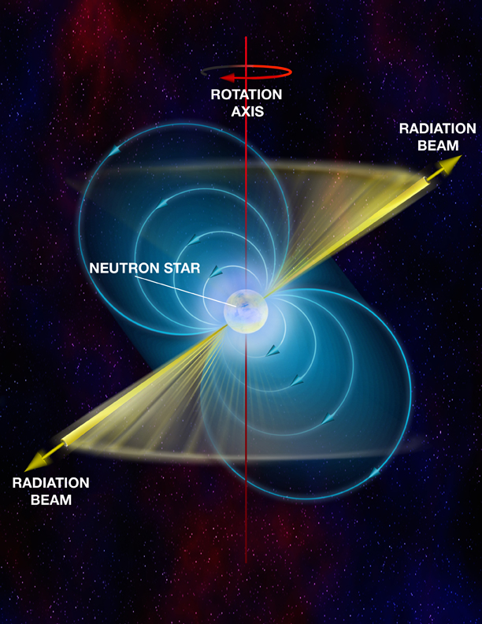
Pulsar Structure

Slide 6
Pulsar Detection
Initially thought to be a signal from another planet.
Observed using radio telescopes on Earth.
Detected radio “pulses”

Slide 7
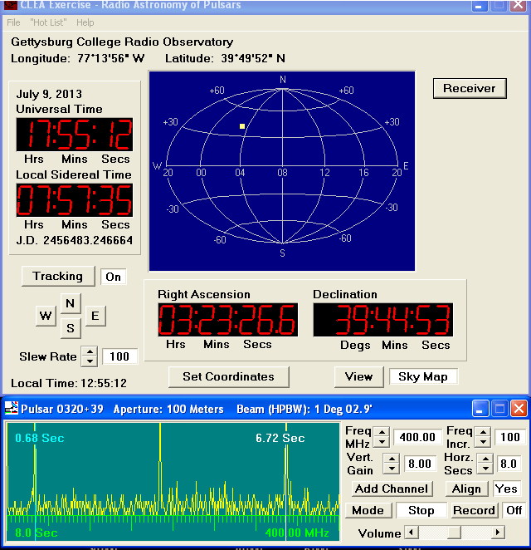
Radio Pulses
Notes:
# of periods is 1 less than # of pulses! Left-click for first time, right-click for second.

Slide 8
Finding Distances
Pulsars provide distance using “pulsar timing”
Pulses arrive at different times when observed in different frequencies.
  This delay provides the distance.

Slide 9
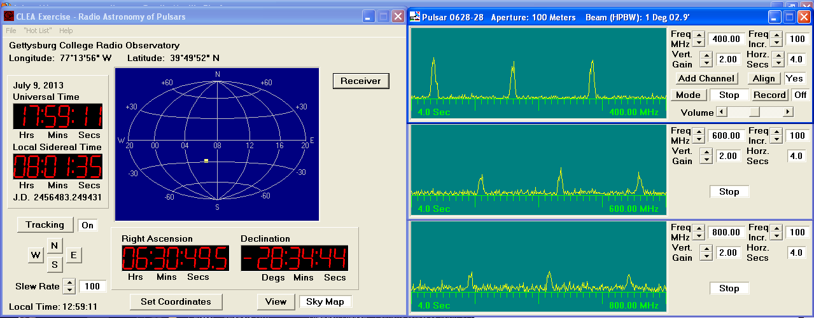
Finding Distances
Notes:
Make sure you watch this run for a minute to see which pulses match!

Slide 10
Procedure
Carefully read the CLEA manual.
Fully answer ALL questions and show your work.
Don’t forget to use units, typically seconds (sec)
For last part, use same frequencies (much easier).
Do NOT record your data!
Notes:
1400 Hz will be difficult to see. Do the best you can and interpolate the number of pulses by eye!

Slide 11
Distance Equations
T₁=T_{f1}, so if f₁=600, then T₁=T₆₀₀
Same goes for T₂(=T_{f2})
D=(T₂-T₁)÷(124.5×((1/f₂)²-(1/f₁)²))
Show ALL work and fully answer all questions!

