Slide 1
Upcoming Events
Sign-up for semester Project topics (Now).
On-Campus Observing

Slide 2
Stellar Spectral Classification
Tiffany Pewett
pewett@chara.gsu.edu

Slide 3
Different Spectral Types
O,B,A,F,G,K,M
Larger, hotter ⬅➔ smaller, cooler
Subtypes:0-9
0 is hottest of type, 9 is coolest
Ex: B7 & K4
Notes:
Initially classified by the strength of Hydrogen lines, hence the strange order.

Slide 5
Stellar Spectra
Use a spectrograph to spread starlight into a rainbow.
Absorption lines show what the star is made of!
Blackbody Curve can show us the temperature(=spectral type)

Slide 6
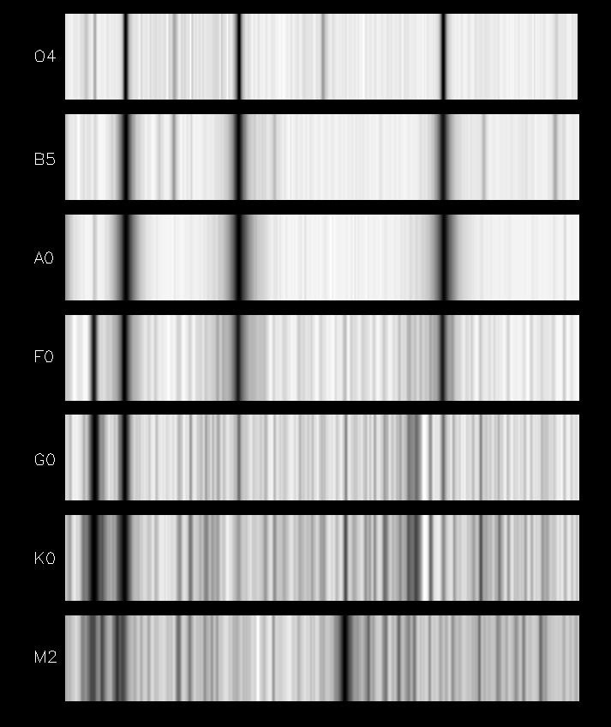
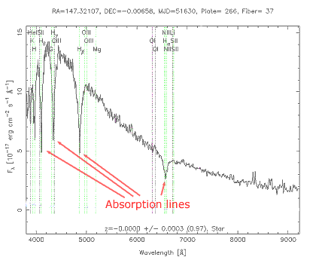
Absorption Lines
Notes:
We will work with plots of brightness (intensity) vs wavelength.

Slide 7
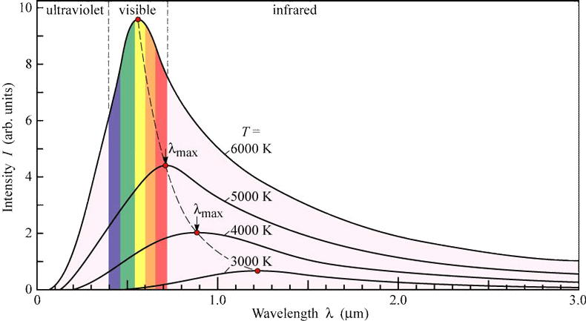
Blackbody Curves
Notes:
Wein’s Law

Slide 8
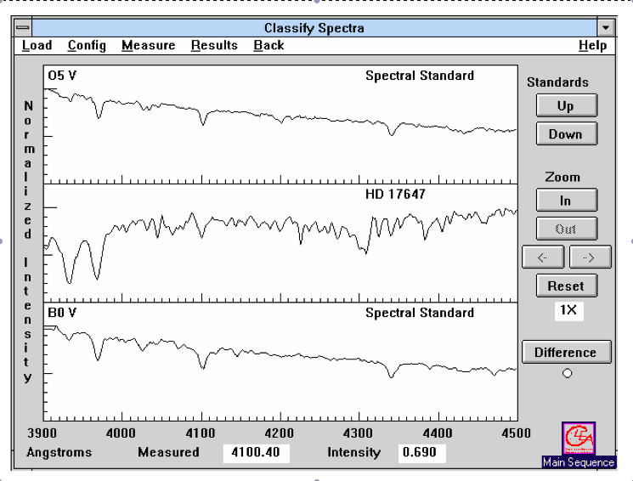
Starting the Lab
Notes:
Need to answer the first page of questions before you can start classifying spectra. Click anywhere on the line and you will find Wavelength (Measured) and Intensity.

Slide 9
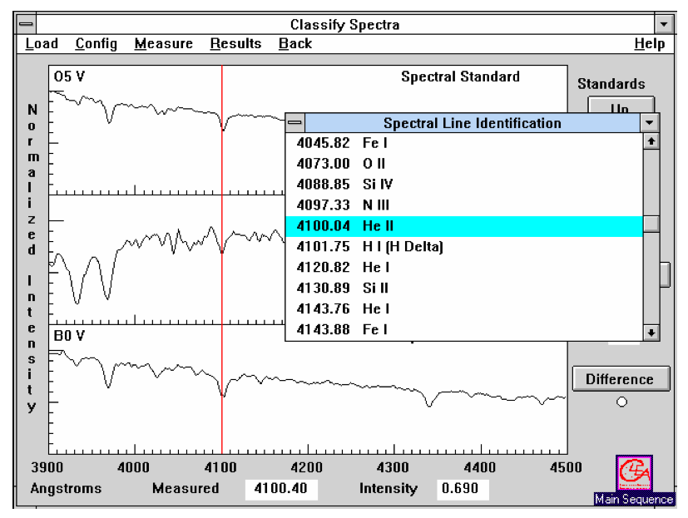
Identifying Lines
Notes:
Once line identification is open, double-click a line to identify the element.

Slide 10
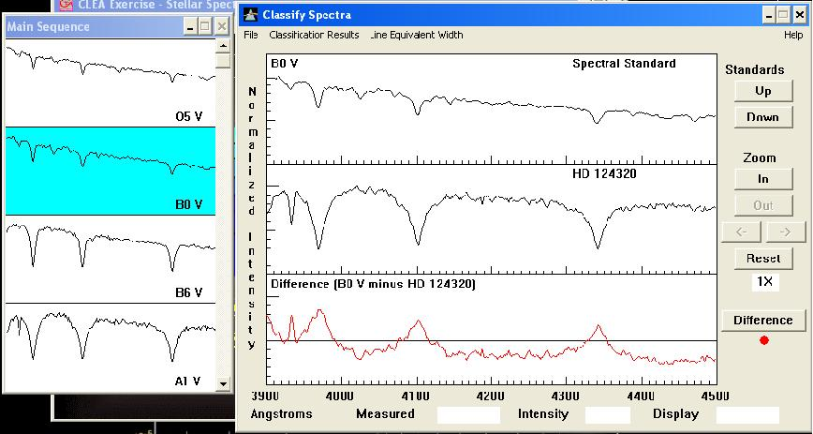
Finding Spectral Type
Notes:
Use Difference! The flatter this red line is the closer you are to having the correct spectral type. Guess between 2 types if it never becomes flat enough.

Slide 11
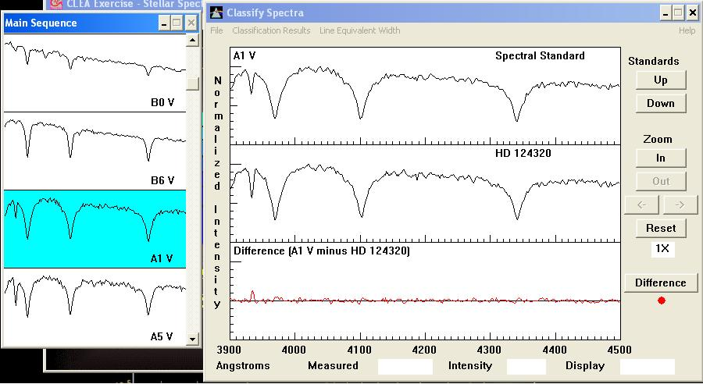
Using “Difference”
Notes:
Good match!

Slide 12
To Complete the Lab
Answer all questions on front page fully.
Classify ALL spectra on back as accurately as you can.
Provide “reasons” for the at least three of the spectra that you classify (not all), using specific spectral lines.
  Ex: He I, Halpha, & CaII lines match between A0 and A5.
Notes:
Notice for specific questions that are confusing.

