Slide 1
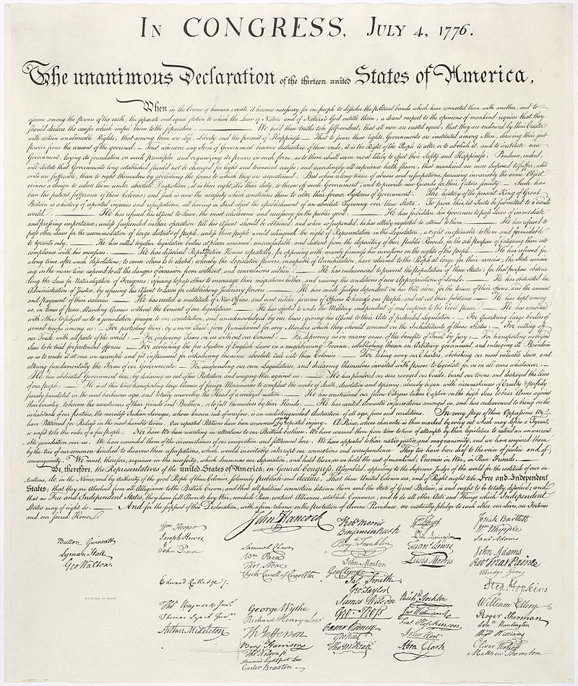
Writing Proposals
X
$
with appreciation of assistance from Hans Krimm for NSF details

Slide 2
Writing Proposals
CONTEXT

Slide 3
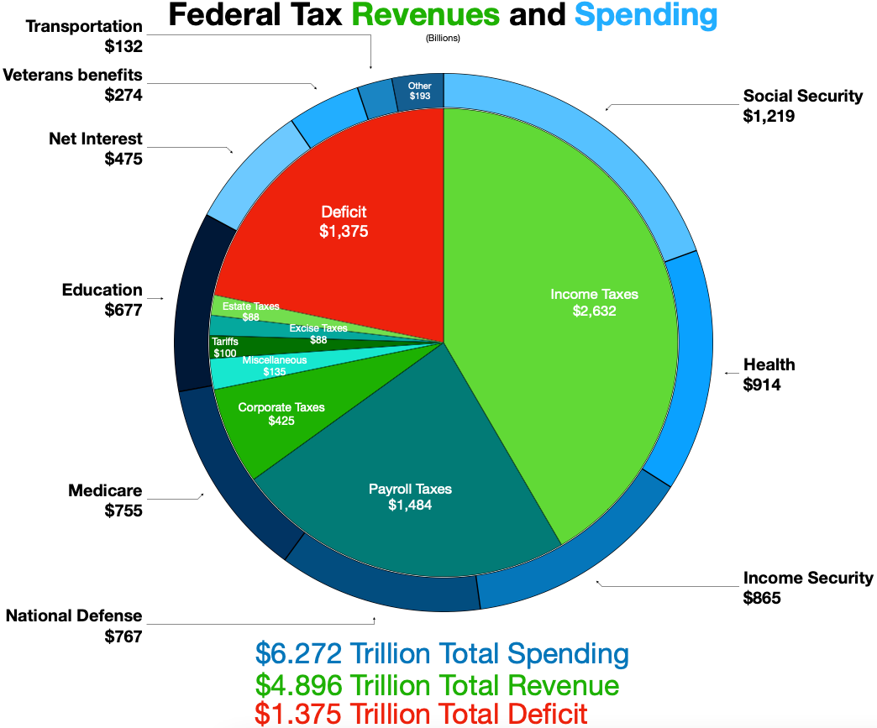
US Federal Budget (FY2022)
in 2022:
World GDP
$ 95 trillion
US GDP
$ 25 trillion
US budget
$ 6 trillion
Notes:
China was 18T .. Japan/Germany 4T … India/UK/France 3T

Slide 4
US Federal Budget (FY2022)
in 2022:
Medicare+ 27%
Social Sec. 19%
Defense+ 17%
Welfare 14%
Education 11%
Interest 8%
Transportation 2%
Other 3%
Notes:
China was 18T .. Japan/Germany 4T … India/UK/France 3T

Slide 5
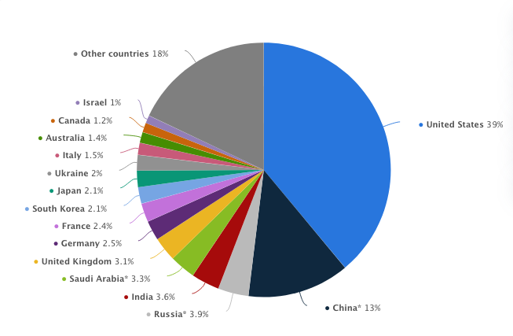
Military Spending (2022)
Notes:
US spends about 1/3 of all defense spending in the world

Slide 6
US Federal Budget (FY2022)
in 2022:
Other 3.08%
NIH $45B 0.72%
NASA $24B 0.38%
NSF $ 9B 0.14%
Notes:
China was 18T .. Japan/Germany 4T … India/UK/France 3T

Slide 7
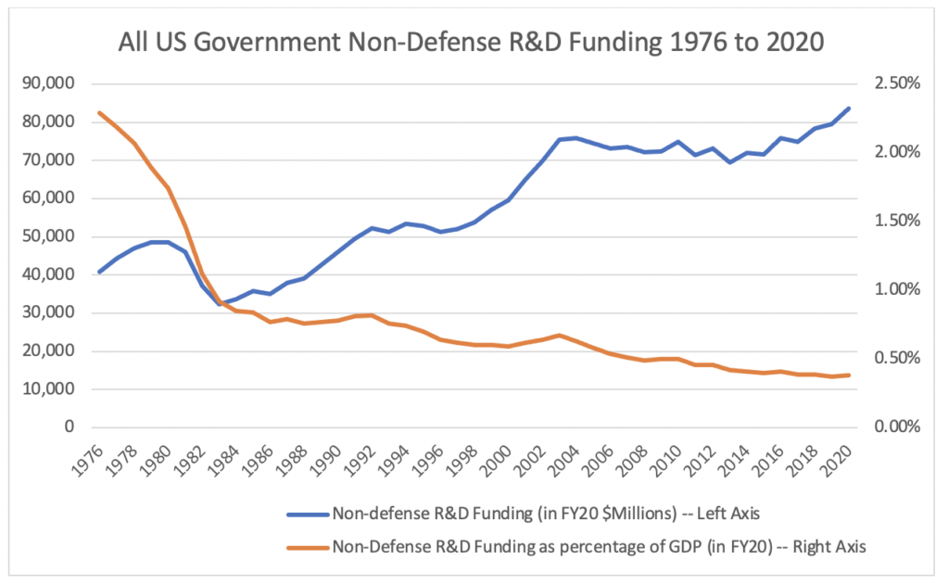
US Science Budget
Notes:
stays flat for 2021-2024

Slide 8
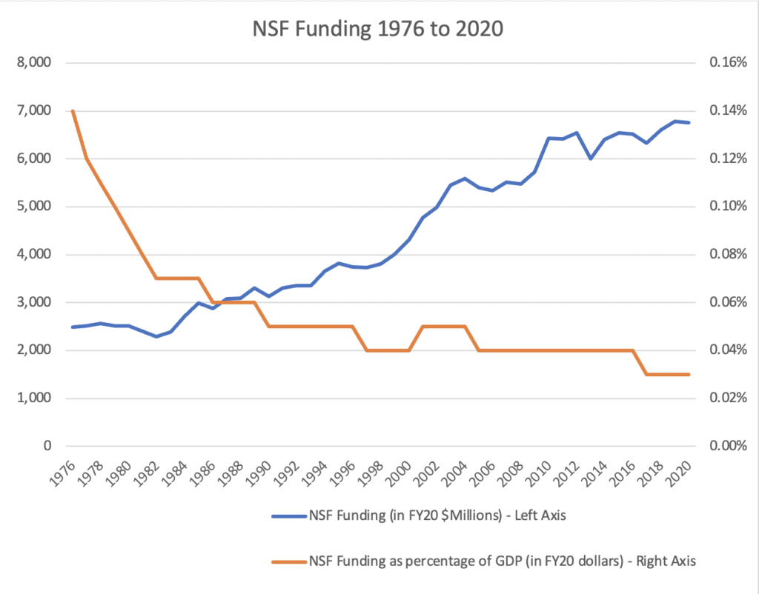
NSF Budget
Notes:
NIH FY2019 budget $39.1B via HHS

Slide 9
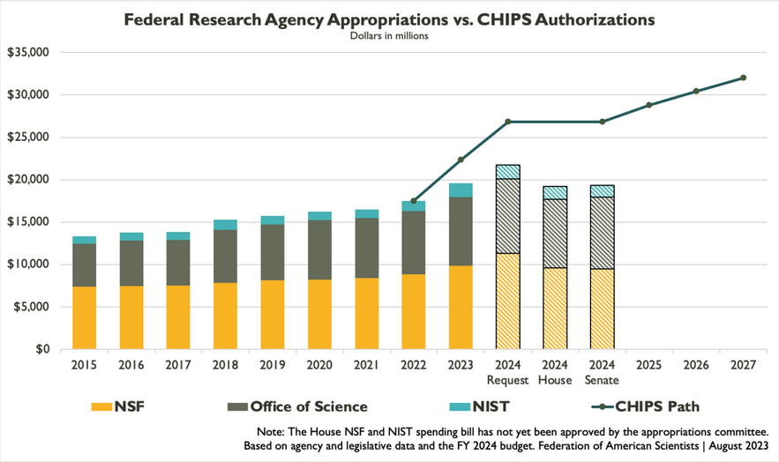
NSF Budget
NSF basically flat … but CHIPS
Notes:
NIH FY2019 budget $39.1B via HHS

Slide 10


National Science Foundation
US: National Science Foundation (NSF)
UK: Science and Technology Facilities Council (STFC)
Chile: National Commission for Scientific and Technological Research (CONICYT)
Vision: A nation that creates and exploits new concepts in science and engineering and provides global leadership in research and education.
Mission: To promote the progress of science; to advance the national health, prosperity, and welfare; to secure the national defense; and for other purposes.
driven by science and scientists
driven by missions it is told to do
Notes:
NSF is driven by science and scientists … NASA is driven by missions it is told to do

Slide 11
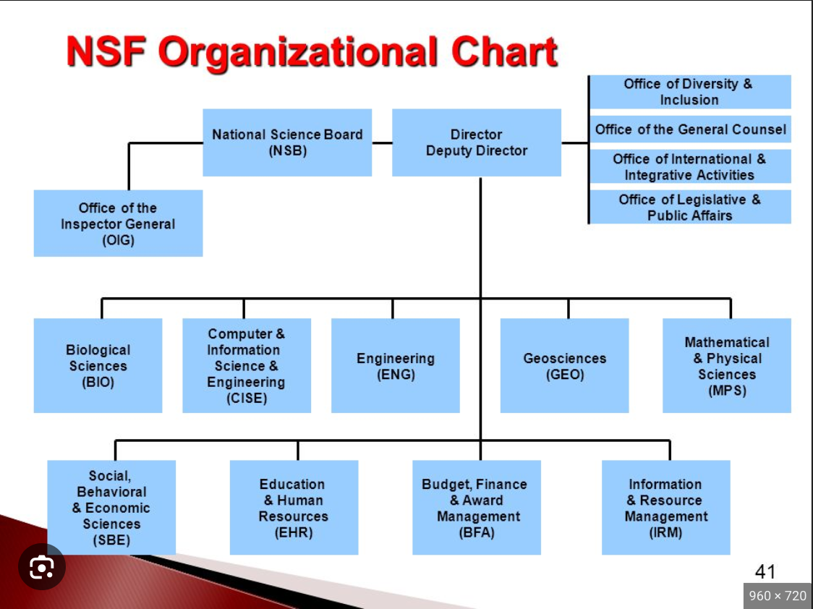
National Science Foundation
“MPS”
AST
CHE
DMR (Materials)
DMS (Math)
OSI (Strategic)
PHY

Slide 12
NSF 8.84B = 8840M (FY2022)
MPS 1613M
AST 290M
AAG 50M
50M out of 6.272T = 0.0008 % = 1 part in 125000
AAG: observational, theoretical or laboratory, addressing astronomical research in planetary, solar, stellar, exoplanets, galactic, extragalactic, or cosmology topics
Proposals that are solely or predominantly for the acquisition, analysis, or interpretation of space-based data from NASA-supported missions will be returned without review.

Slide 13
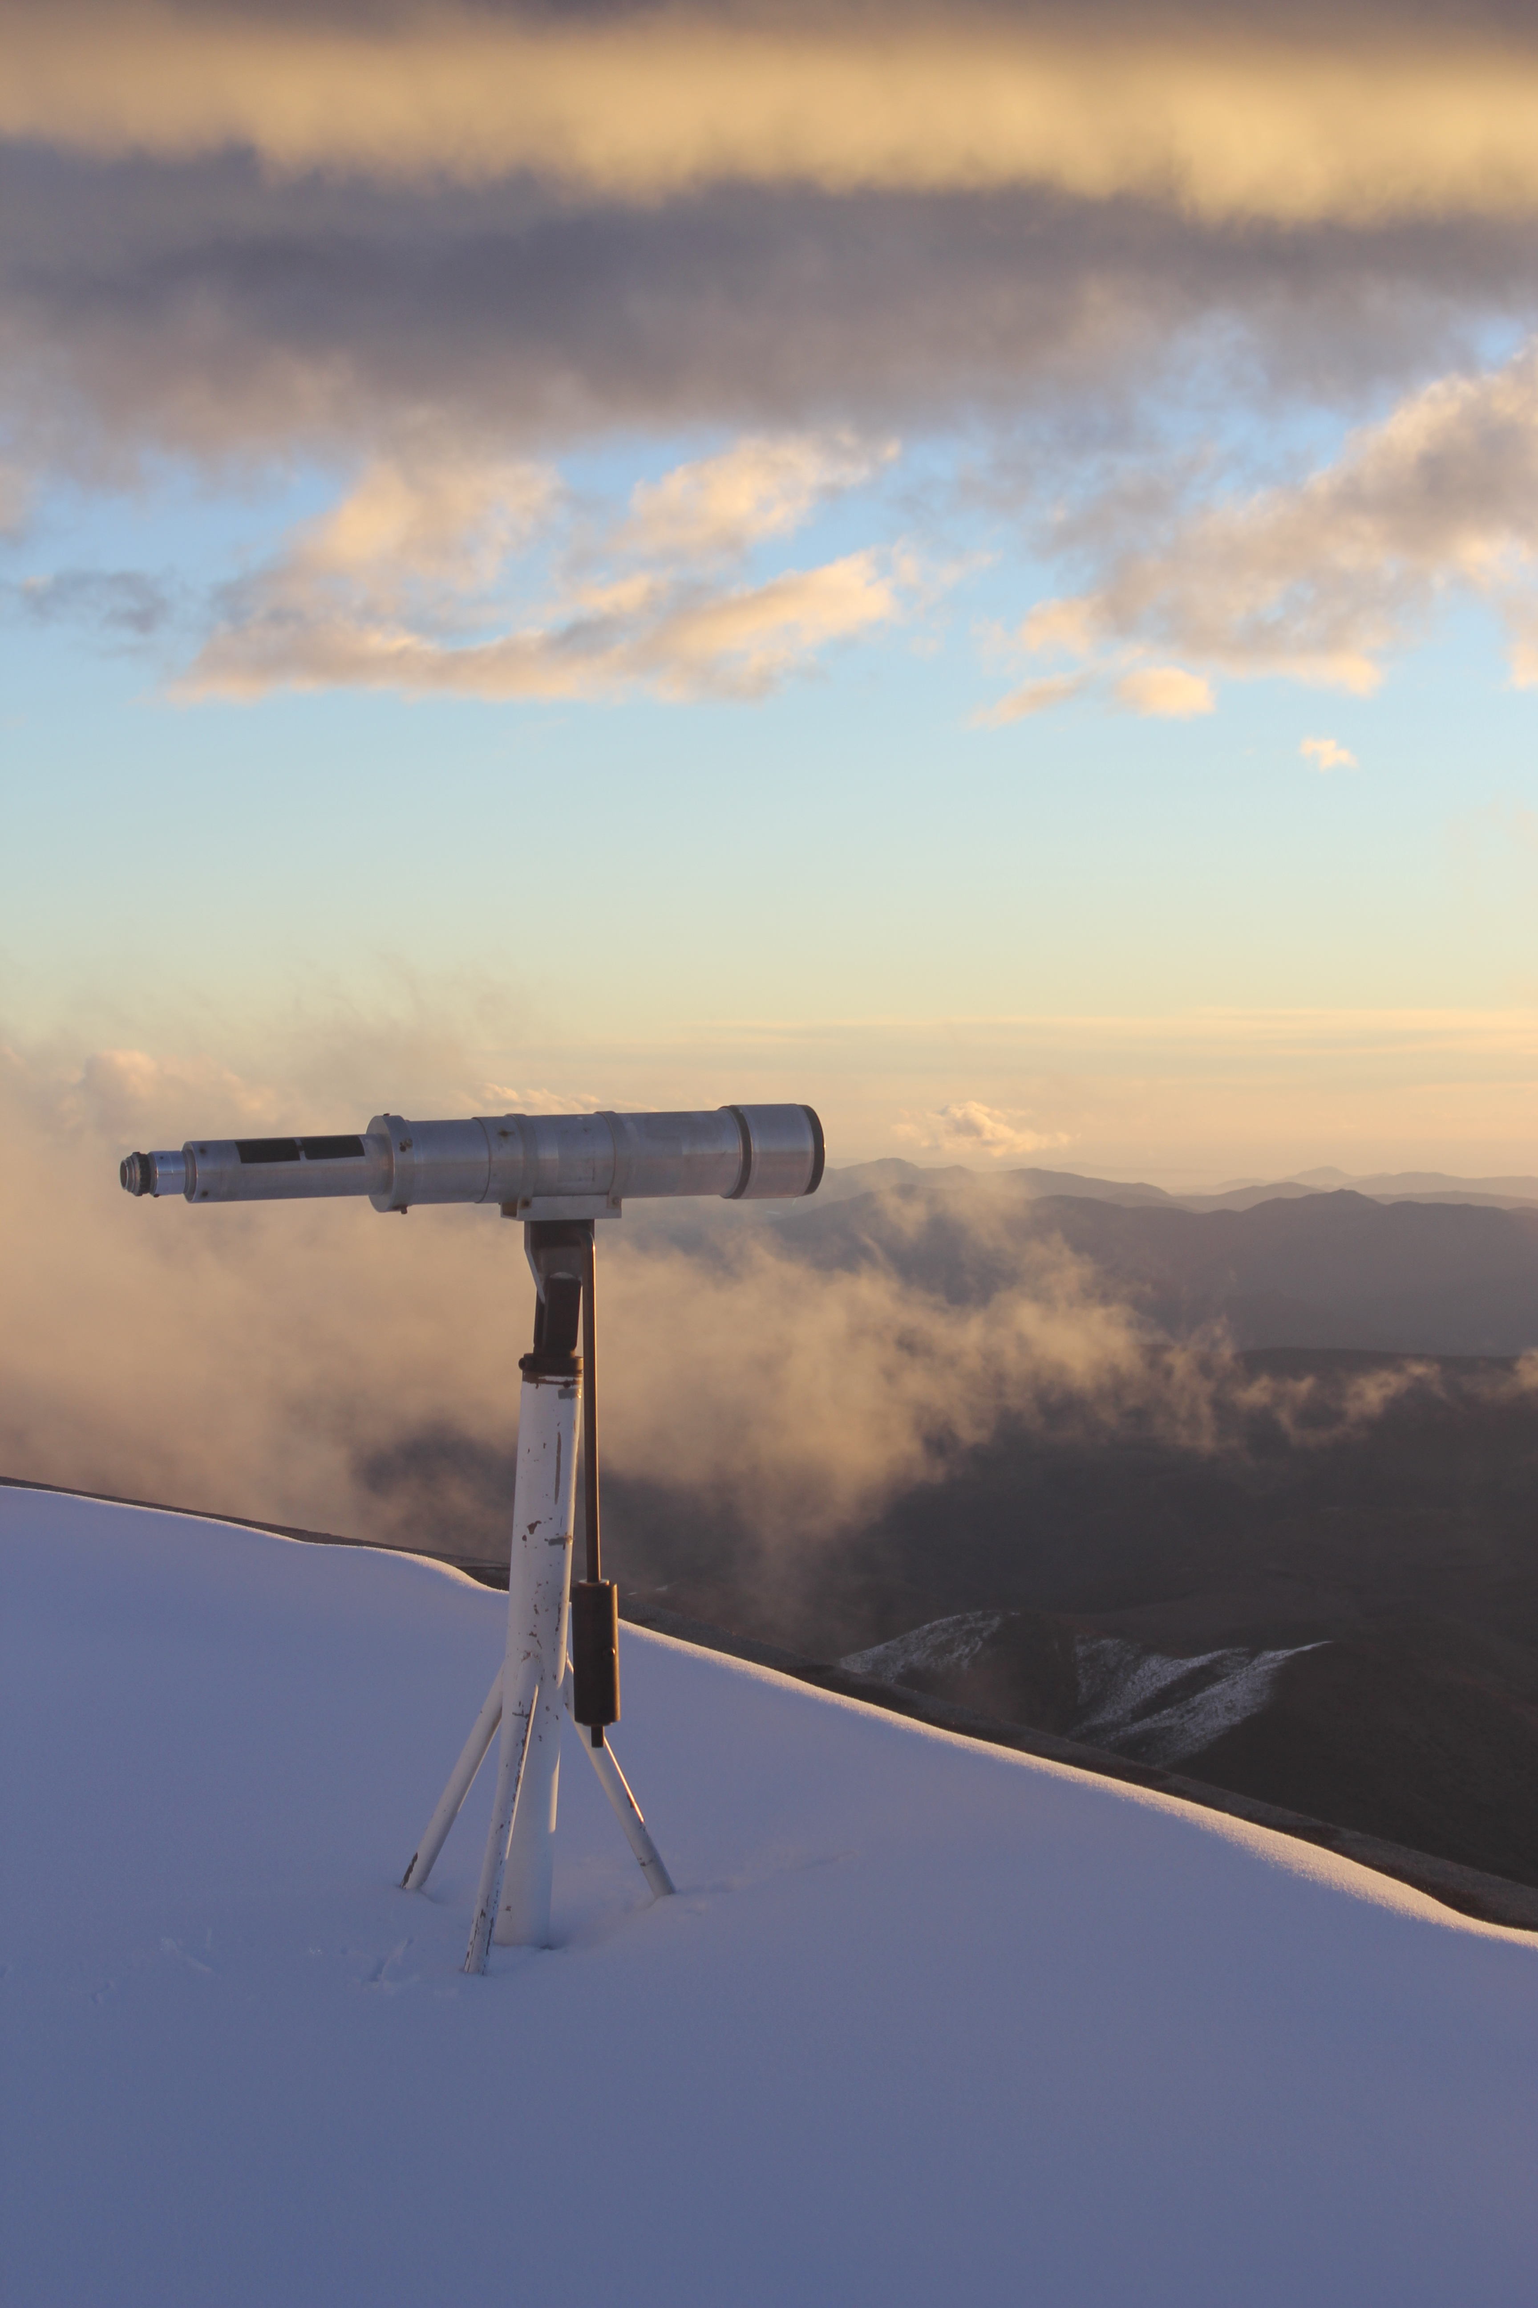
How Do I Propose?
Two sets of rules to follow
1. PAPPG = Proposal & Award Policies & Procedures Guide
2. Solicitation
Goal of Program
Eligibility
Deadlines
Pre/Full Proposal

Slide 14
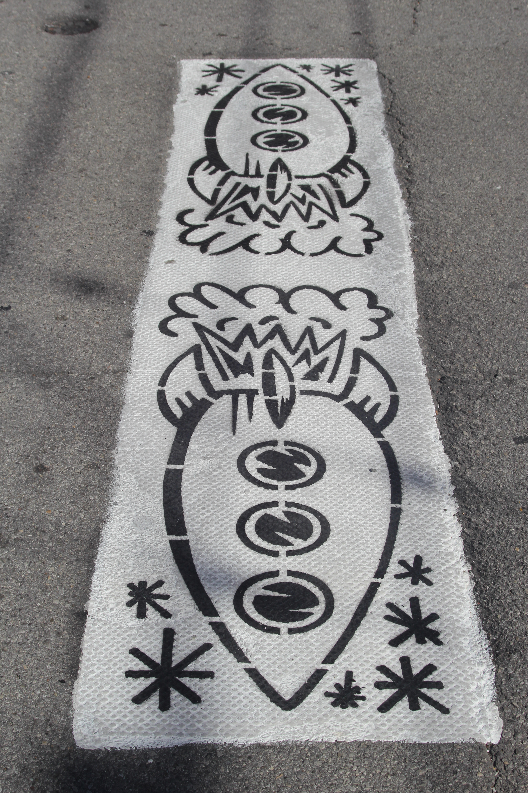
Where Do I Propose?
1. investigate Program websites
2. search the Award Database at nsf.gov
using relevant keywords
3. talk to colleagues
4. read the relevant Solicitation …
does your science fit there?
you will all use AAG
5. contact the relevant Program Director
email one or two paragraph outline
phone call to discuss project
*** not a scientific evaluation, only
appropriateness assessment ***
Notes:
! in #5 was emphasis in Hans Krimm’s slides

Slide 15
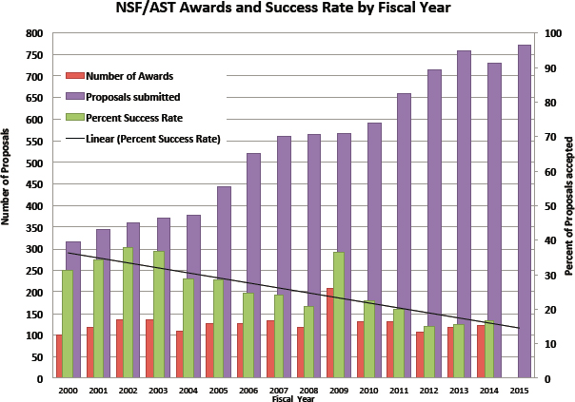
AAG Proposals 2000-2015
960
2023

Slide 16
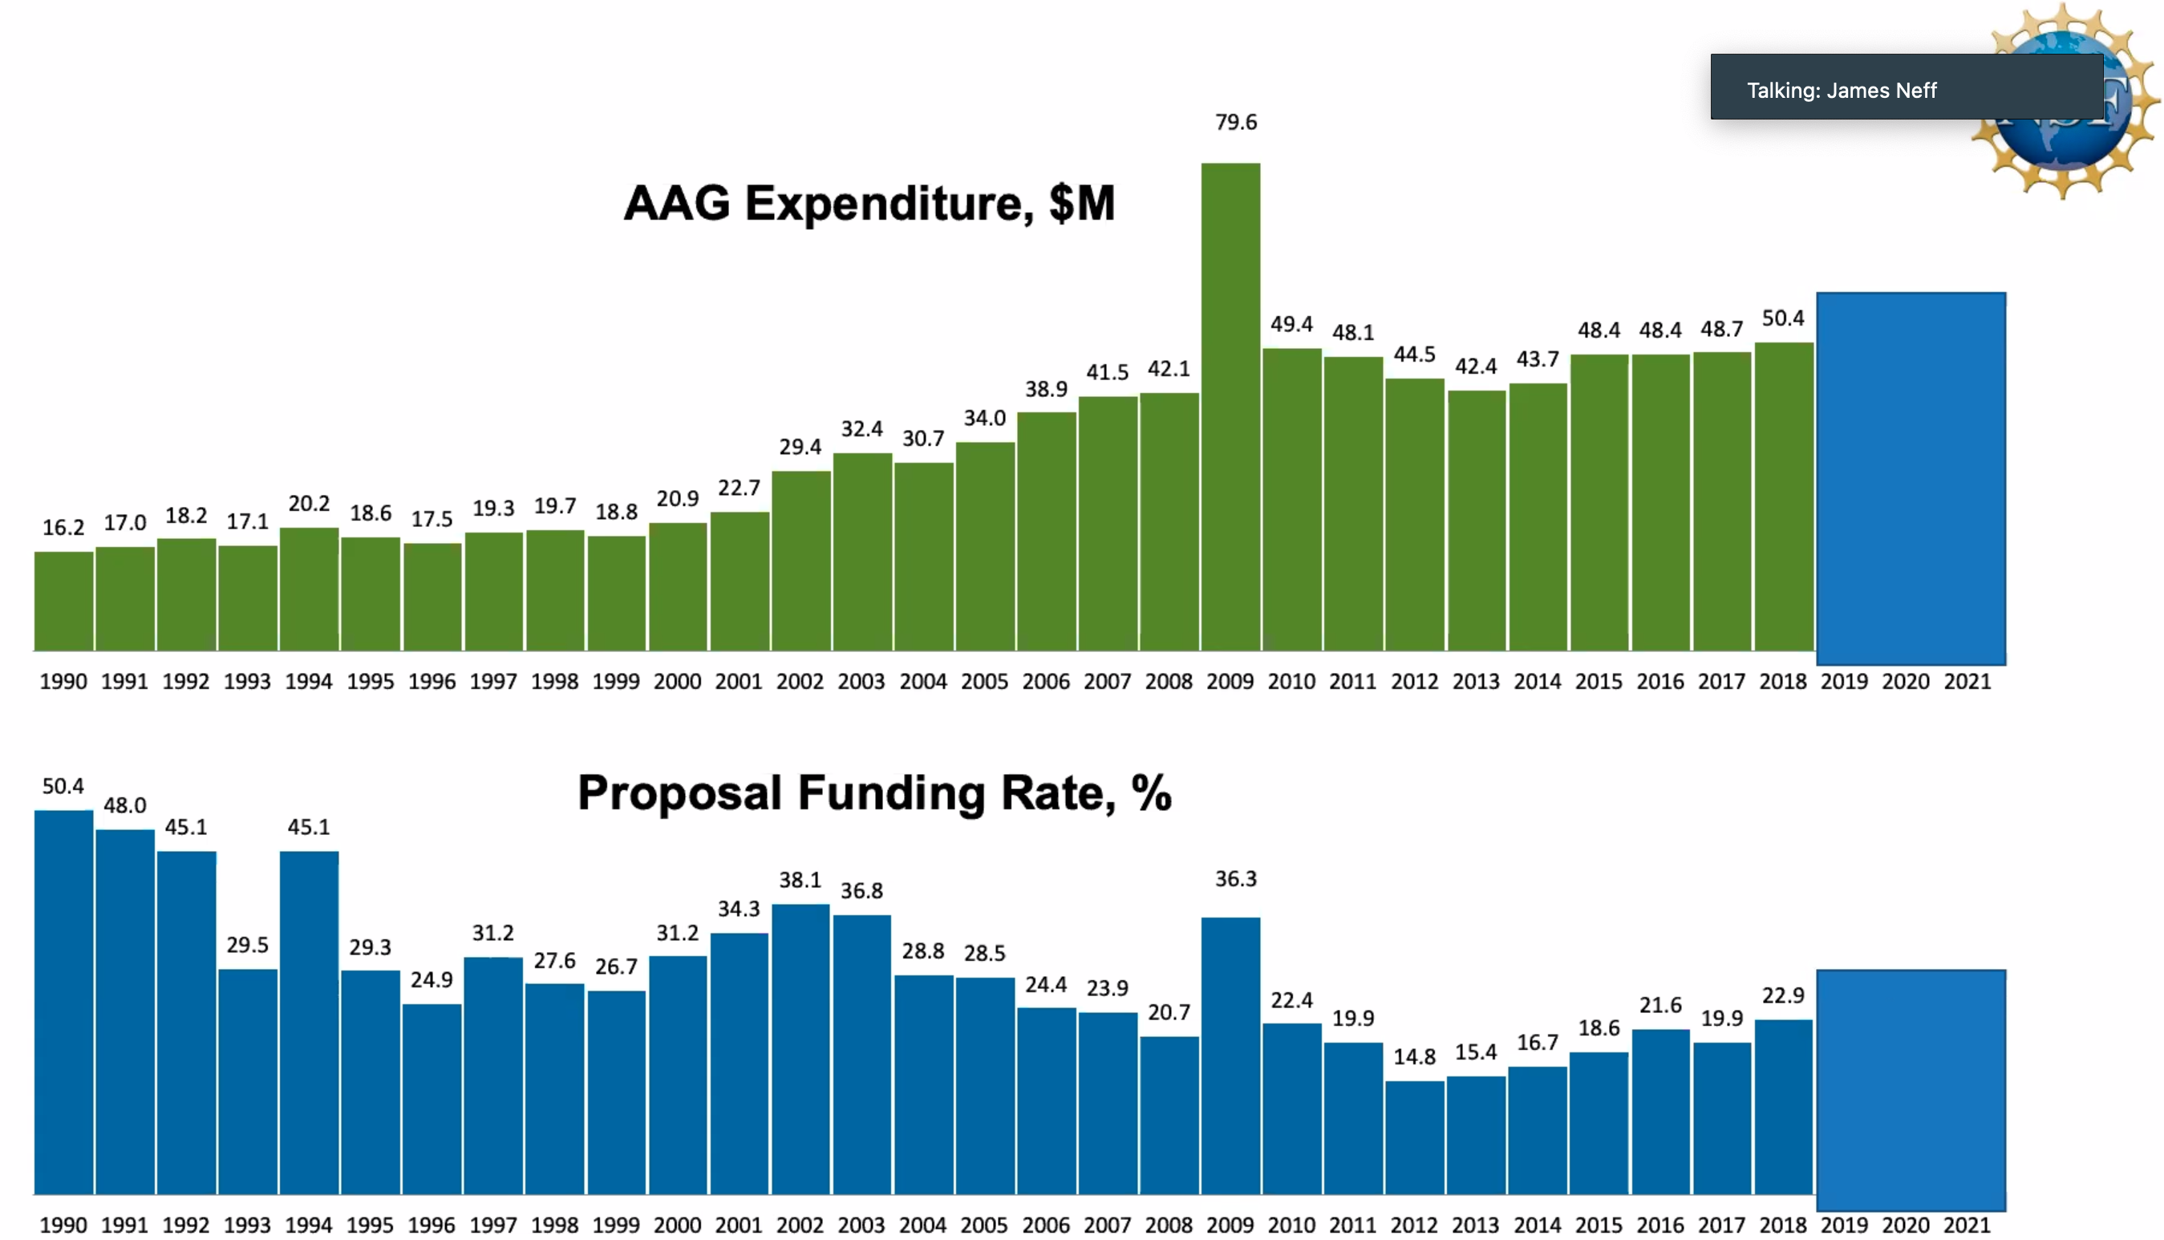
AAG Proposals 1990-2021
2023: 19.7%
R
R
R
R
R
8
6
R
R
R
R
?
2024

Slide 17

Proposal Pieces
GOAL: Fund yourself as a $75K/year postdoc for 3 years.
1. Project Summary
2. Project Description
3. References
4. Biographical Sketch (SciENcv)
5. Budget and Justification
6. Facilities
7. Postdoc Mentoring Plan
8. Data Management Plan
9. Current and Pending Support
10. Collaborators and Affiliations
NOPE
8 pages text + 2 pages Tab/Fig
0.5 page
2 pages (including spreadsheet)
2 pages (NSF form)
0.5 page
0.5 page mentoring (under)grad(s)
0.5 page
NOPE
NOPE
Total Challenge ~ 16 pages

Slide 18
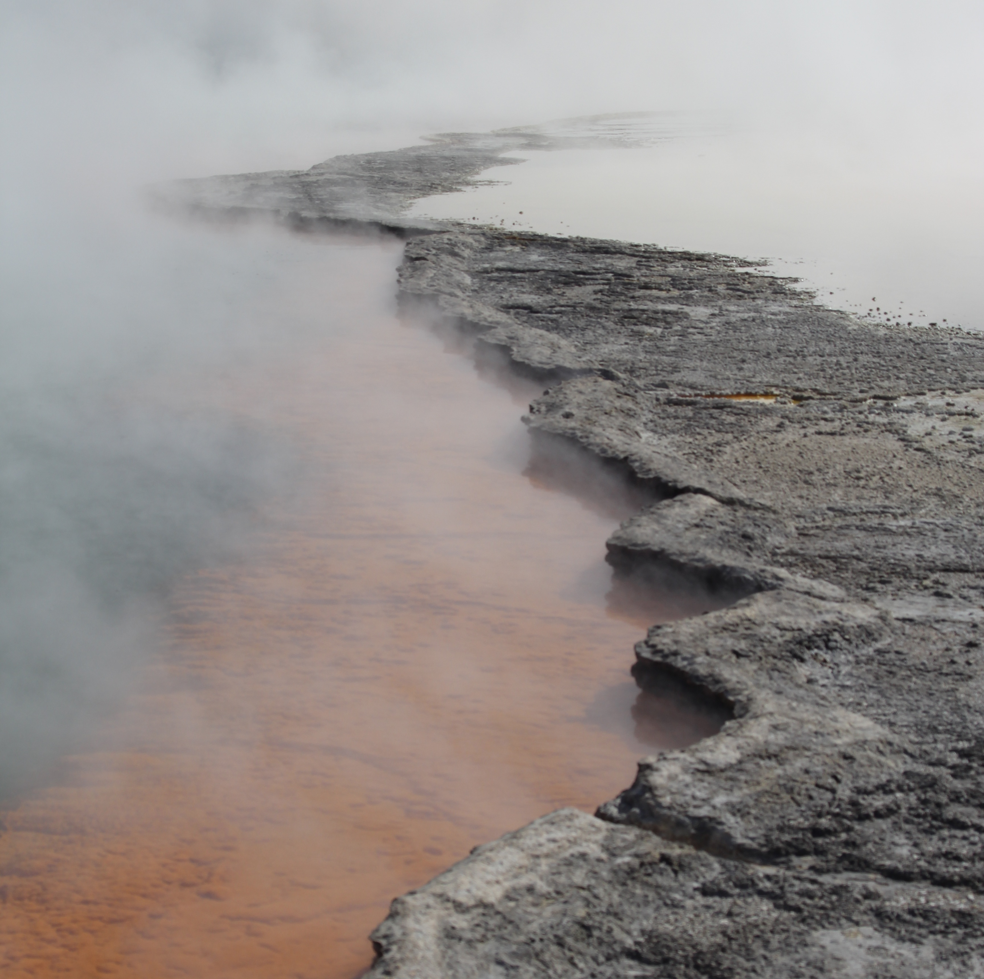
Proposal Rules
1. Must use Gaia DR3 data.
2. Must use a ground-based facility.

Slide 19
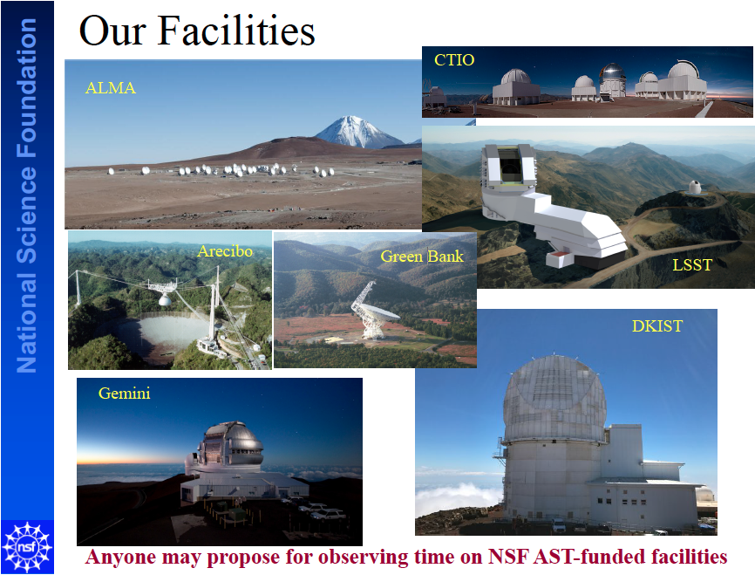
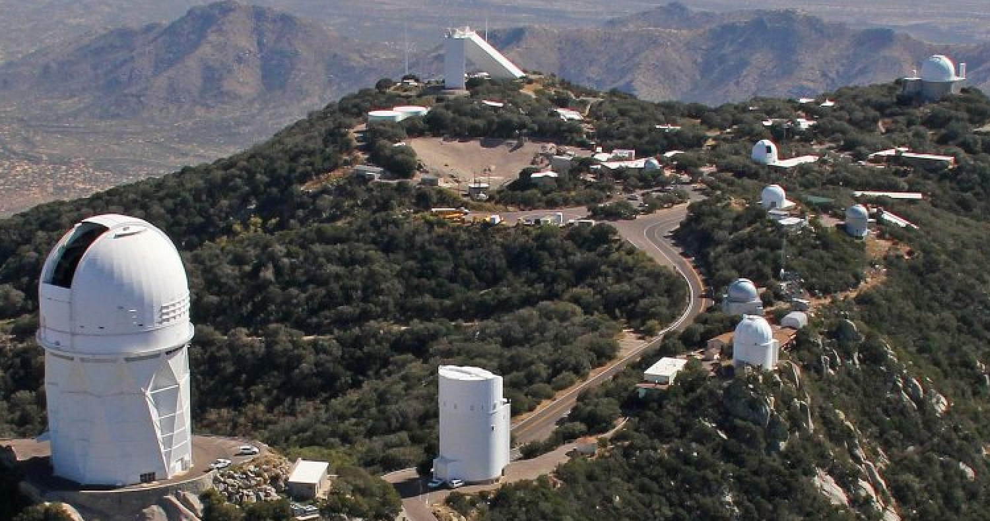
+ SOAR
KPNO

Slide 20
Proposal Rules
1. Must use Gaia DR3 data.
2. Must use a ground-based facility.
3. Can be related to current research,
but not identical.
4. One 3-year project.
5. Must submit all 7 bits.

Slide 21



Why My Proposal?
1. Why this project?
2. Why you and not someone else?
Intellectual Merit … uniqueness of research
available facilities (SMARTS, CHARA, APO)
Broader Impact
educational opportunities
3. What are your strengths?
4. Express yourself clearly --- YOU must convince reviewer.
5. Have a colleague read your proposal and leave your ego behind …

Slide 22
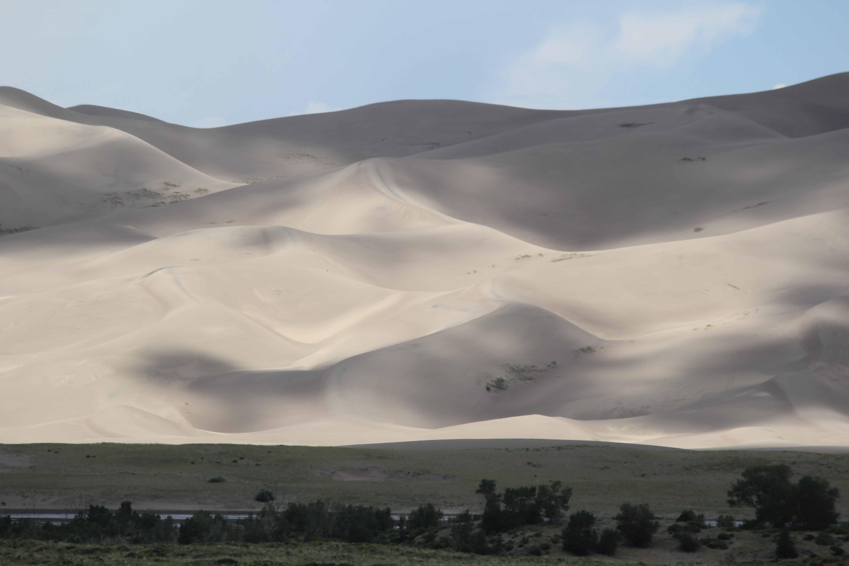
Key Proposal Bits
Intellectual Merit the potential to advance knowledge
Broader Impacts the potential to benefit society and contribute to the achievement of specific, desired societal outcomes
Education: improved STEM education at any level
Outreach: increase public scientific literacy Broadening Participation: diverse STEM workforce
Partnerships: academia/industry/others

Slide 23
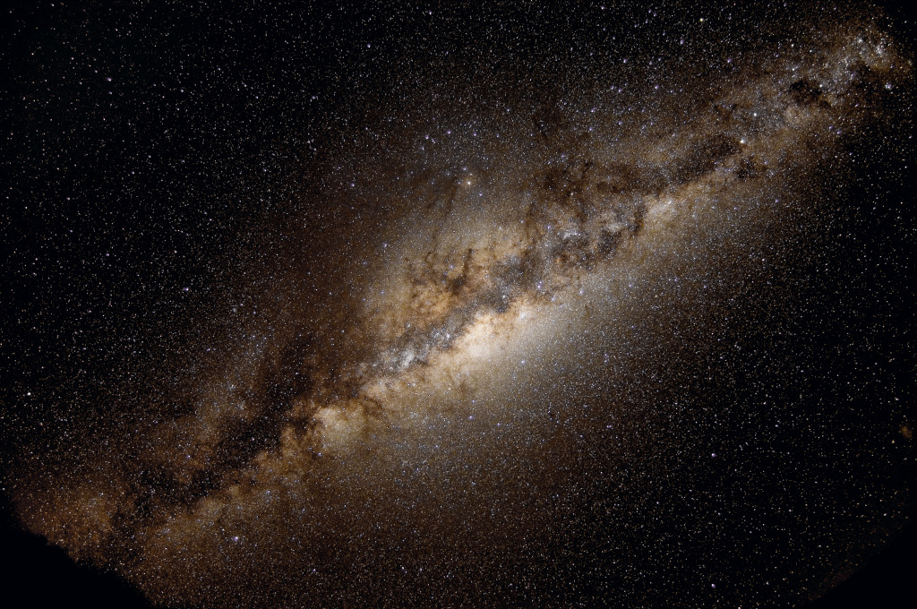
How Will YOU Explore the Milky Way?
Notes:
Figure from 1922 paper (?)

Slide 24
Notes:
Figure from 1922 paper (?)

Slide 25
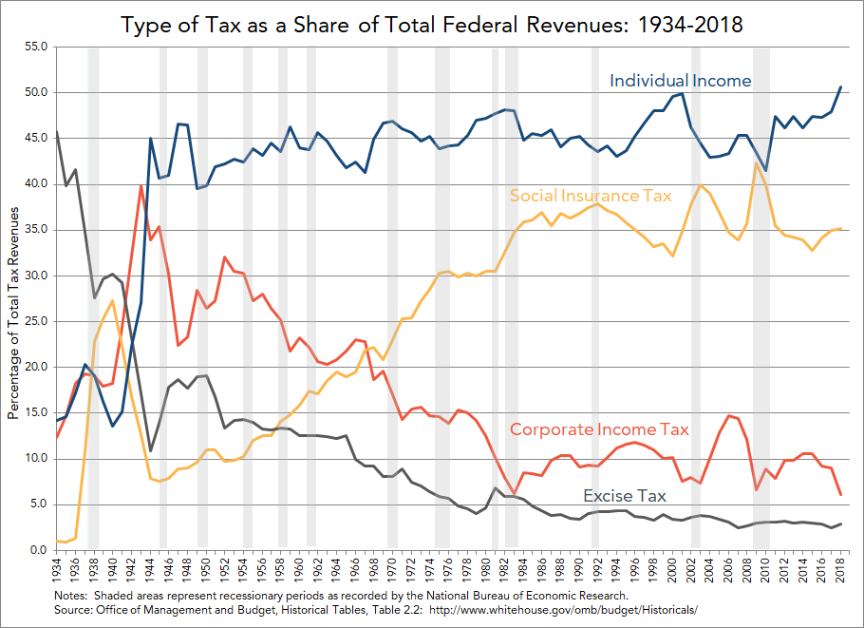
US Income
Notes:
Excise taxes are charged on goods/services/activities … fuel, airline tickets, tobacco

Slide 26
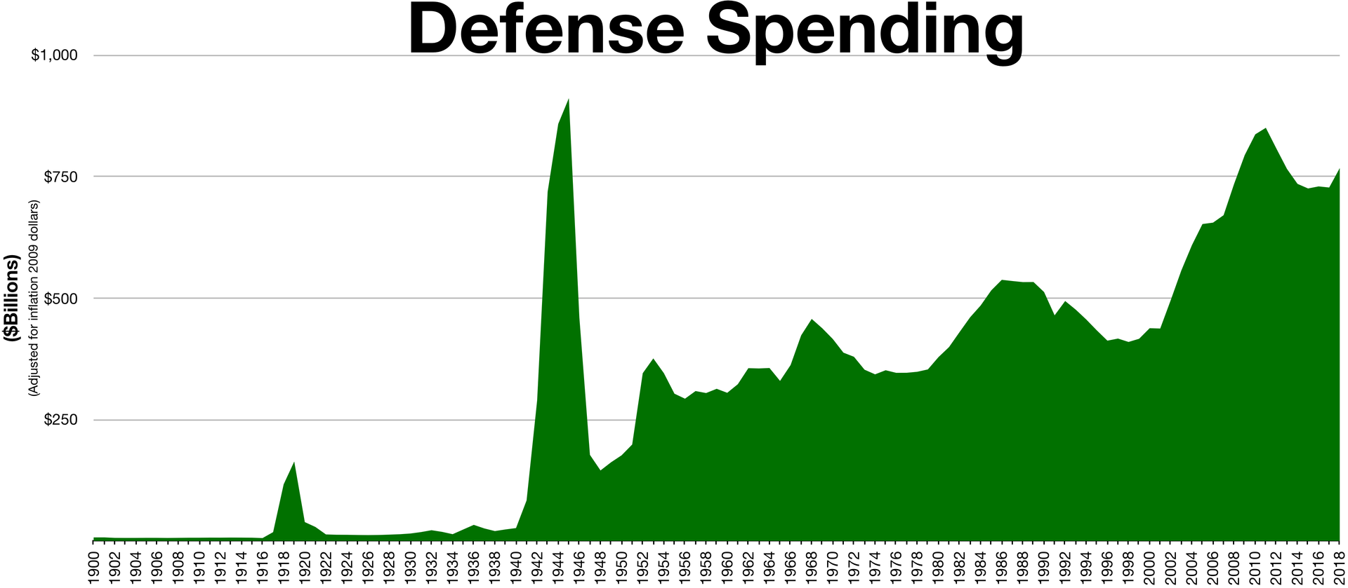
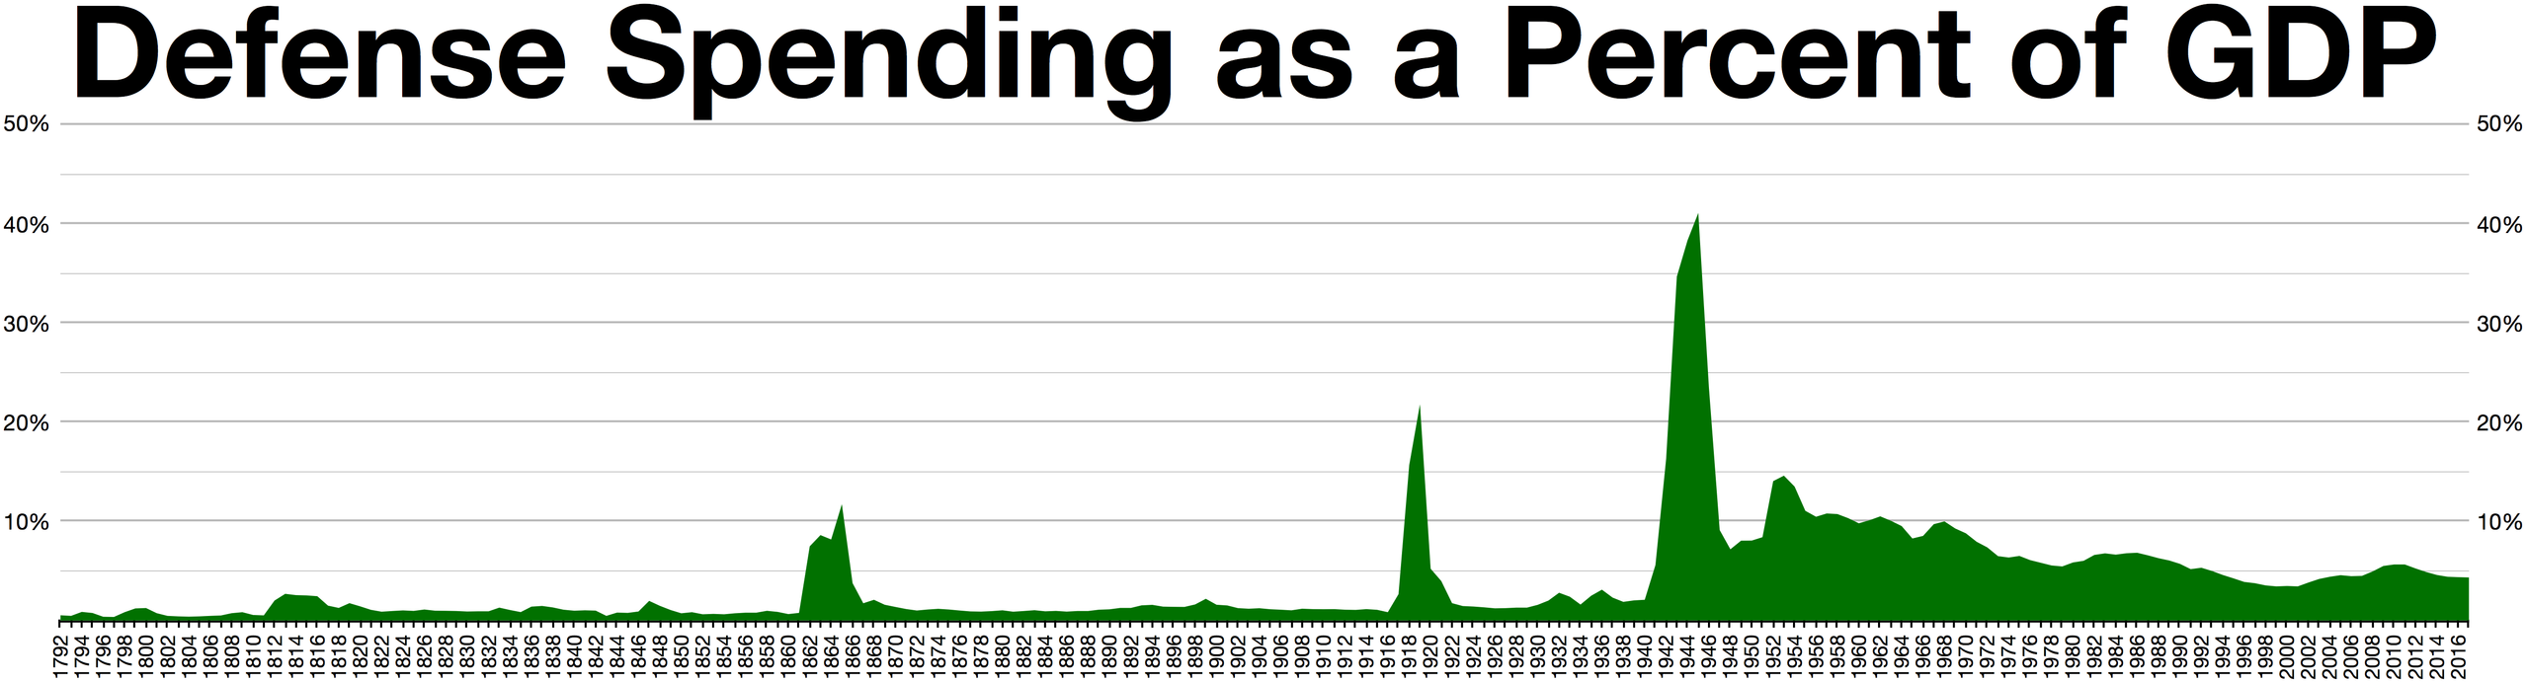

Slide 27
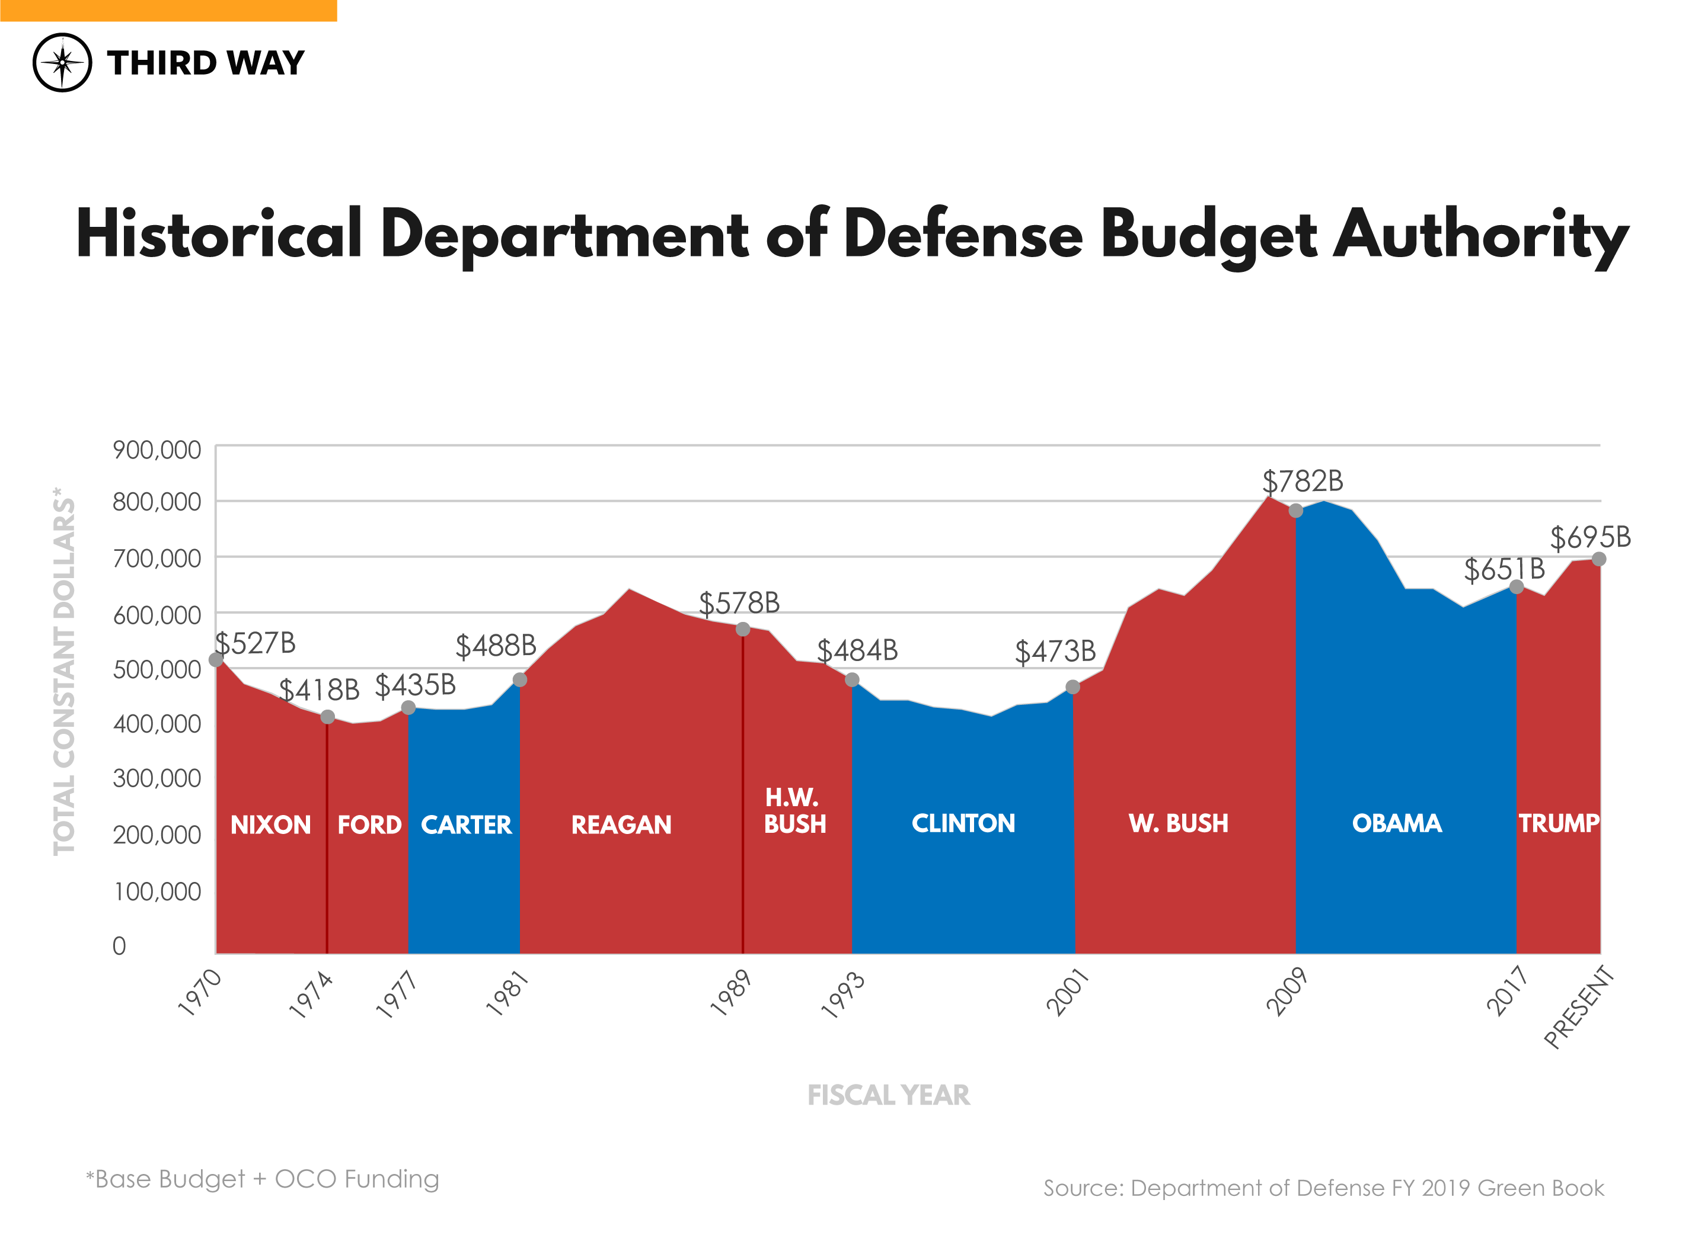

Slide 28
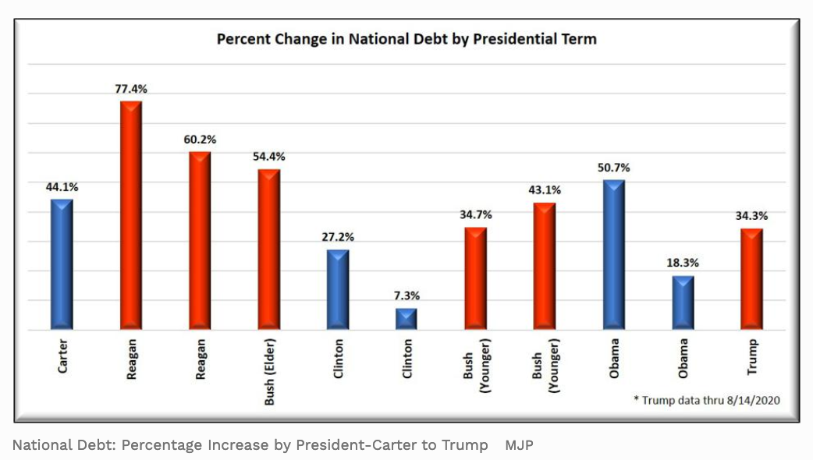
Presidential Debt Increases

Slide 29
