Slide 1

Proposal Brainstorming
https://www.merriam-webster.com/words-at-play/definition-of-brainstorming

Slide 2
Galactic Explorers 1
1. In what year did Gaia science observations start?
2. How many main instruments are on board Gaia?
3. Will about 1%, 10%, 25%, or 50% of stars in the Milky Way will be observed by Gaia?
4. What type of planetary systems will Gaia reveal the most of: single Jovian, single terrestrial, or multi-planet?
5. How many months of observations are included in Gaia DR3 --- 14, 22, 34, or 66?
6. Which are there more of in Gaia DR3, Solar System objects or binary stars?
7. Other than ~0 parallaxes, give one reason why quasars are useful for assigning the parallax zero point.
8. Is the Gaia DR3 magnitude limit G ~ 15, 17, 19, or 21?
9. Where are the GAPS catalog sources found in the sky?
10. For extended sources, does Gaia detect mostly elliptical, spiral, or irregular galaxies?
BONUS …
Notes:
X. How many months of observations were included in Gaia DR2? … 22 months
X. What types of objects are used to tie the Gaia grid to ICRS? … quasars
X. Are the positions and parallaxes known to better or worse than 1 milliarcsecond at G = 17? … better: 0.04 mas for G < 14, 0.1 mas at G = 17, 0.7 mas at G = 20

Slide 3
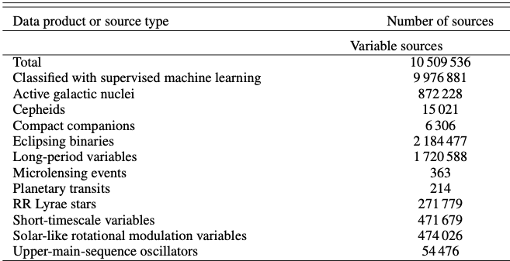
BONUS #1
Name two types of variables released in Gaia DR3.

Slide 4
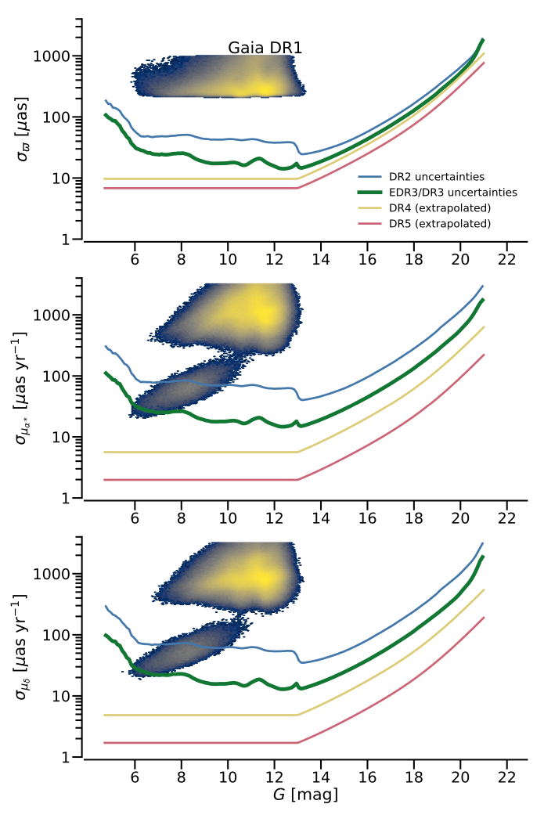
BONUS #2
Why are these blobs in these plots for stars in Gaia DR1?

Slide 5

Galactic Explorers 1

Slide 6
Galactic Explorers 1
1. In what year did Gaia science observations start?
2014
2. How many main instruments are on board Gaia?
3 = astrometer, BP-RP prism photometers, RVS (Radial Velocity Spectrometer)
3. Will about 1%, 10%, 25%, or 50% of stars in the Milky Way will be observed by Gaia?
1% (not really even that many)
4. What type of planetary systems will Gaia reveal the most of: single Jovian, single terrestrial, or multi-planet?
single Jovian systems
5. How many months of observations are included in Gaia DR3 --- 14, 22, 34, or 66?
34
6. Which are there more of in Gaia DR3, Solar System objects or binary stars?
150,000 Solar System objects … 800,000 binary stars
7. Other than ~0 parallaxes, give one reason why quasars are useful for assigning the parallax zero point.
large number (1.6 million “QSO-like sources” in DR3), all-sky, point-like, zero proper motions
8. Is the Gaia DR3 magnitude limit G ~ 15, 17, 19, or 21?
G = 21
9. Where are the GAPS catalog sources found in the sky?
Gaia Andromeda Photometric Survey
10. For extended sources, does Gaia detect mostly elliptical, spiral, or irregular galaxies?
elliptical
BONUS …

Slide 7
BONUS #1
Name two types of variables released in Gaia DR3.

Slide 8
BONUS #1
Name two types of variables released in Gaia DR3.

Slide 9
BONUS #2
Why are these blobs in these plots for stars in Gaia DR1?
proper motions using 24-year baseline of Hipparcos + Gaia data

Slide 10



Your Future: Proposal Strategy
http://www.astro.gsu.edu/~thenry/GALACTIC/
Tuesday 30 JAN Reading #1
Prusti+ 2016 --- first 2 sections, 3 pages
Vallenari+ 2023 --- 12 pages
Thursday 01 FEB Choose 2 Topics
3 sentences each --- send single page .pdf
sentence #1 = SCIENCE QUESTION
sentences #2 and #3 = how will you do it?
Thursday 08 FEB Biographical Sketch on SciENv

Slide 11
Topics
naked eye stars
O/B dwarf population(s)
blue/red supergiants
red giants
red clump/horizontal branch stars
hot subdwarfs
cool subdwarfs
white dwarfs
brown dwarfs
binaries
Cepheid variables (phot time series)
RR Lyrae variables (phot time series)
RV Tauri variables (yellow supergiants)
long period variables (Mira)
cataclysmic variables
recurrent/dwarf novae
SN remnants
planetary nebulae
moving groups
young clusters (Orion, other Messier)
old clusters (M67)
globular clusters
map a Galactic arm
MW thin/thick disk via kinematics
MW tidal streams
LMC/SMC/And/Tri populations
LMC/SMC/And/Tri proper motions
Andromeda visitors
LBVs … only ~20
asteroids/comets … Solar System
exoplanets … not Galactic

Slide 12
Observing Techniques
ASTROMETRY
positions
proper motions
parallaxes
orbits
PHOTOMETRY
gamma-ray
x-ray
ultraviolet
optical
infrared
radio
SPECTROSCOPY
low/medium/high resolution
wavelength range
CADENCE

Slide 13
Galactic Research Tools
Gaia DR3 list of objects … sample
colors … HR diagrams
distances, transverse velocities
membership confirmation for clusters, small galaxies
mean RVs
variable light curves
unresolved binaries … NSS = Non-Single Star Catalogue

Slide 14
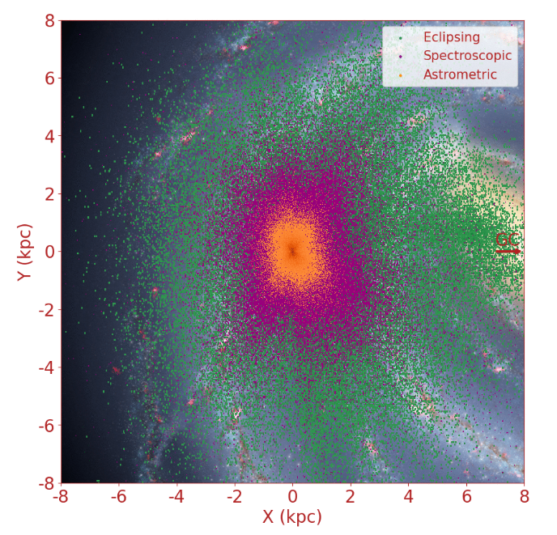
Galactic Research Tools
Notes:
As the angular motion on the sky of the binaries decreases with distance, astrometric binaries are detected at small distances only. At the other extreme, eclipsing binaries can be detected at very large distances by even a small drop of brightness of faint stars. In between, the spectroscopic binaries could in principle be seen independently of distance, but since spectra are obtained for bright stars only, the stars are generally at a limited distance only.

Slide 15
Galactic Research Tools
Gaia DR3 list of objects … sample
colors … HR diagrams
distances, transverse velocities
membership confirmation for clusters, small galaxies
mean RVs
variable light curves
unresolved binaries … NSS = Non-Single Star Catalogue
TESS all-sky, 200000 stars, V~16, 30/2/+ min cadences, 27 days
ZTF north of DEC ⎯31, 2” FWHM, gri~20, since 2018, 4B lightcurves
ASAS south of DEC +28, 15 million stars, V~14, since 1997
0.9m/ARCSAT confirmation at any cadence
CHIRON confirmation spectral types V~16, accurate RVs V~12, metallicities
TRES same for northern hemisphere
APO … CHARA
Notes:
TESS 200,000 stars searched for exoplanets … many more in full frame images

Slide 16
NSF Proposal Ideas
Isaac A. HB stars
Sebastian C. G. FGK stellar cycles
Naba D. Tidal streams / variables in nearby galaxy/GC
Griffin G. Tri spitballs
Jessica H. Old clusters
Tim J. And spitballs / K/wd binaries/faraway eclipsors
Colin K. M dwarf rotation in old clusters
Matthew L. Bright OB stars … where were you?
Madison L. SMC/LMC vs MW pops
Saba …
Kayvon S. Disintegration of clusters
Yasmeen S. ?
Melodie S. LMC? And?
Jacob T. Metallicities of globulars of MW vs And

Slide 17
Why My Proposal?
1. Why this project?
2. Why you and not someone else?
Intellectual Merit … uniqueness of research
available facilities (SMARTS, CHARA, APO)
Broader Impact
educational opportunities
3. What are your strengths?
4. Express yourself clearly --- YOU must convince reviewer.
5. Have a colleague read your proposal and leave your ego behind …

Slide 18
Gaia
NSF Bio Sketch
https://www.ncbi.nlm.nih.gov/sciencv/

Slide 19
Gaia
NSF Bio Sketch

Slide 20
Funding Level Matters (some)
RECONS 2005 $523K Awarded
RECONS 2008 $683K Declined
RECONS 2009 $582K Awarded
RECONS 2012 $557K Declined
RECONS 2013 $572K Declined
RECONS 2014 $492K Awarded
RECONS 2017 $496K Awarded
RECONS 2020 $487K Declined
RECONS 2021 $493K Awarded
Collaborative:
RKSTAR 2014 $232K Declined
RKSTAR 2015 $243K Awarded
RKSTAR 2018 $311K Declined
RKSTAR 2019 $363K Awarded
Notes:
also REDDOT = RECONS+ 2011 $232K Awarded

Slide 21
Comments: 2012 RECONS
Many on the panel appreciated the PI’s long-term success in identifying the low mass content of our stellar neighborhood, and the very strong publication record of this group over the years. However, the panel felt that the motivation presented in this present proposal is a bit of a miss, with only a brief mention of the (previous) improvement in our knowledge of the slope of the IMF. There was concern that perhaps further improvement at this point would only be incremental.
Although there were along list of “goals” the overall scientific motivation could have been more strongly developed; in the end, that was the main reason the proposal was not ranked higher.

Slide 22
Comments: 2013 RECONS
The panel agreed that this proposal is competitive and highly relevant to contemporary directions in astrophysics. Concerns were expressed though about the competitiveness of the proposed effort in the era of Panstars, Gaia and others. It was noted, however, that the PI is fully aware of these efforts, and places the RECONS survey in context.
The intellectual merit was considered to be very high, along with the broader impacts. Having a census of the closest stars is important. The panel felt that the relevance of this effort will be eclipsed in about 3 years with the public release of Gaia and Panstars data. No major weakness was spotted.

Slide 23
Comments: 2020 RECONS
The data quality is excellent, and the majority of low mass targets that are observed with this survey are not accessible to other astrometric surveys (i.e. Gaia).
The proposal lacked a strong grounding in theory, which could have been used to justify the total time baseline of observations necessary to achieve
the overall scientific goals. For example, the proposal would have been improved had it included information about the theoretical predictions regarding
the duration of magnetic field cycles on low mass stars and/or the scientific implications of characterizing the long versus short term activity cycles.
The proposal failed to recognize that twin stars should not necessarily produce similar observable magnetic field quantities because magnetic dynamos
are stochastic.
The layout of the proposal that distributed the broader impact efforts throughout the text was refreshing and nice to read.
The broader impact efforts have the potential to increase the diversity in our field in particular, and science in general, due to the diverse population of GSU, but the proposal failed to explain the PI's explicit role in this process.

Slide 24
Comments: 2014 RKSTAR
The panel expressed concern about whether the proposers will be able to confirm the necessary Gemini observing time with their camera in the longer term, especially in connection with Gemini South.
The research is straightforward, but the team's observational capabilities indicate that it will be of great value. The panel's only concern is whether the necessary amount of large-telescope time will be forthcoming.

Slide 25
Comments: 2018 RKSTAR
After discussing initial disparate scores, the committee had significant concerns about the sample size and techniques employed for this study. The value of 2000 K dwarfs along an equatorial band was not clear to the committee, as compared to a similarly volume-limited, volume-complete sample of nearby FGK stars. The number of stars was not a compelling component of the proposal, since it was not clear what would be learned with 2,000 stars rather than 1,000 or 500.
There was little detail discussed beyond binary fraction, such as mass ratios and the presence of hierarchal systems.
There was little quantitative discussion of observing space properties, such as contrast ratios and expected mass-separation sensitivity.
The technique used for wide binaries (blinking) is no longer sufficient, given the sensitivity of Gaia proper motions. Within four years, Gaia will deliver the binary properties of many of these stars, limiting the overall impact of the sample.
It was also not clear how the exoplanet community would adopt this sample, as most planet searches are focused on bright stars, or low-mass M dwarfs to find small, rocky planets.

Slide 26
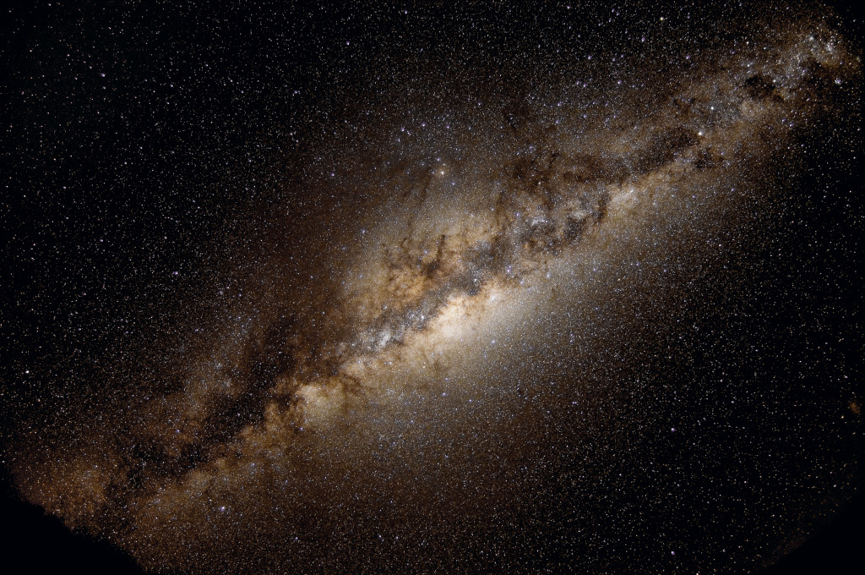
How will YOU explore the Milky Way?

