Slide 1
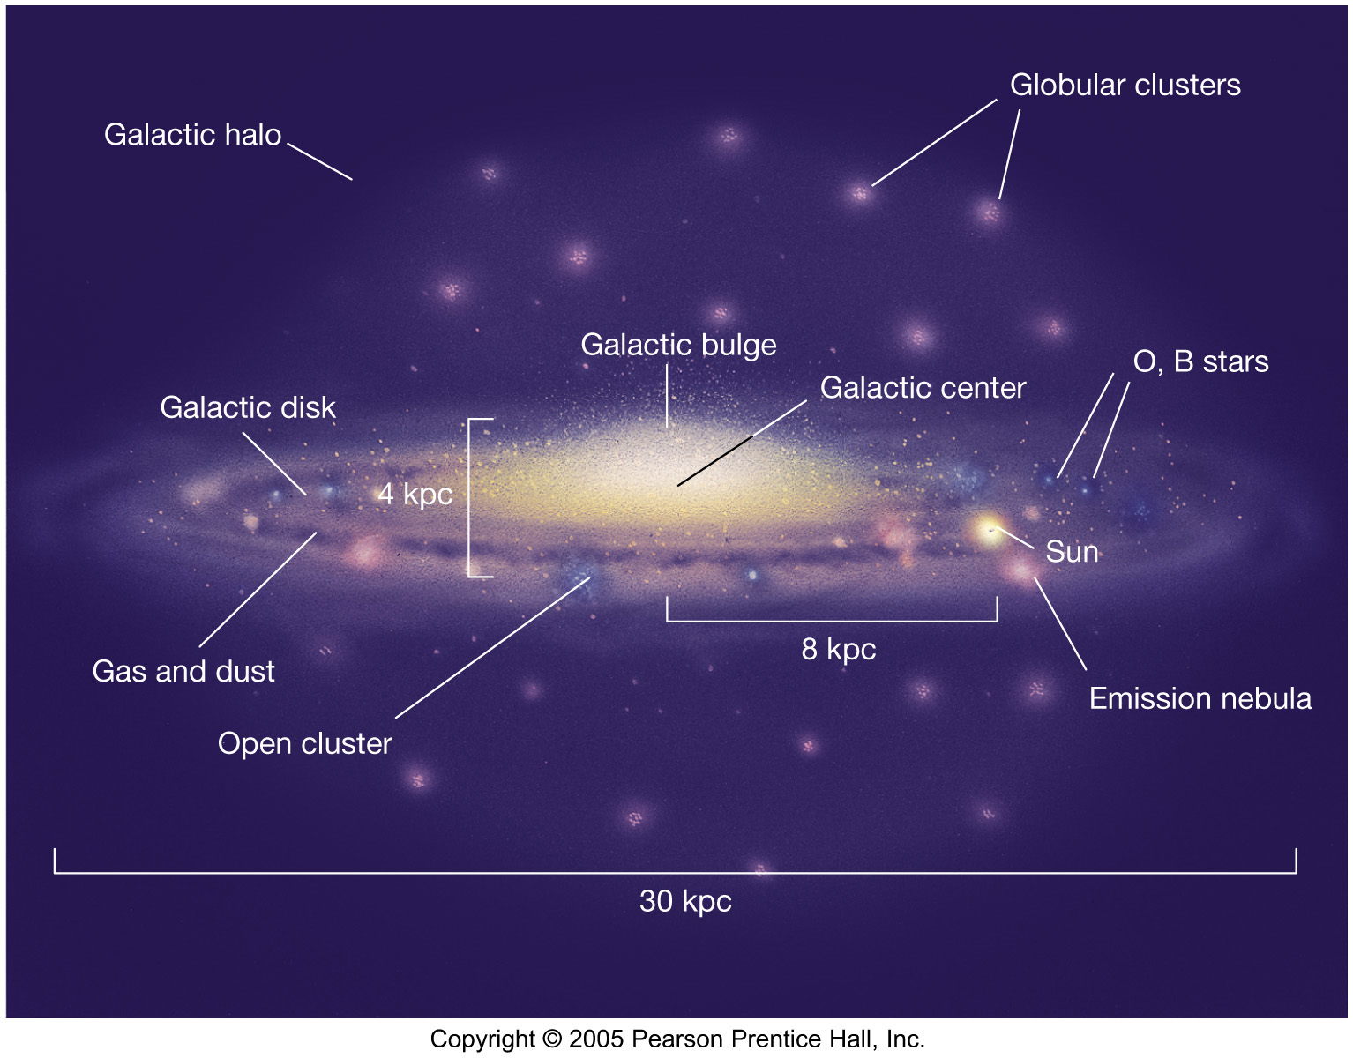
Milky Way Overview

Slide 2
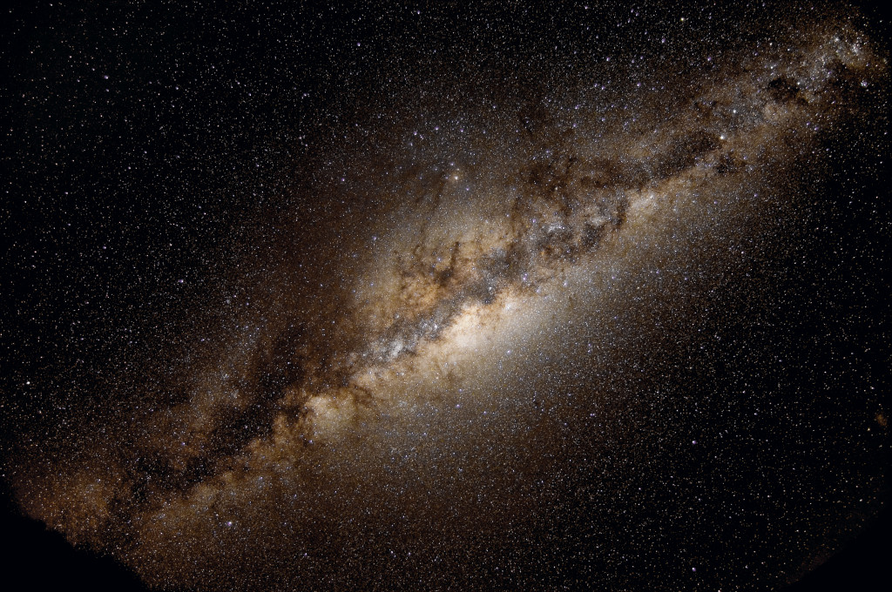
How will YOU explore the Milky Way?

Slide 3
NSF Proposal Ideas
Isaac A. HB stars (tie) binary star evolution
Sebastian C. G. K dwarf binaries … eclipsing?
Naba D. LMC globulars / Cepheid companions
Griffin G. MW undiscovered globulars
Jessica H. globulars’ multiple populations
Tim J. K + wd binaries
Colin K. MW bar metallicities
Matthew L. MW runaway stars
Madison L. brown dwarf companions in Gaia
Saba …
Kayvon S. disintegration of globular clusters + dwarf galaxies
Yasmeen S. mass segregation in clusters (?)
Melodie S. SMC substructure
Jacob T. Sun in a stellar stream?

Slide 4
Milky Way Overview

Slide 5
Milky Way Galaxy
Members stars 10¹¹ to 10¹²
entire HR Diagram
not stars black holes, neutron stars, white dwarfs
brown dwarfs
rocks solar systems, planets, asteroids, TNOs, comets
gas/dust nebulae, ISM, GMCs
life

Slide 6
Milky Way Territories
DISK
30 x 0.3 kpc
100:1
arms
young
blue/white
2% metals
open clusters
gas/dust/* formation
merry-go round
last
BULGE
4 x 6 kpc
football
bar
mixed
yellow
massive BH
gas/dust ring
tilted ellipses
HALO
~ 100 kpc
~ spherical
edge?
old
red
0.02% metals
globular clusters
no gas/dust/planets
giant electron-like
first
size
details
stars
contents
motion
origin
Notes:
Sun is 98% H and He
As of 2019, lowest metallicity stars were SMSS 0313-6708 with Fe/H = -7.3 (Fe not detected) and SMSS 1605-1443 = -6.2 (Fe detected)

Slide 7
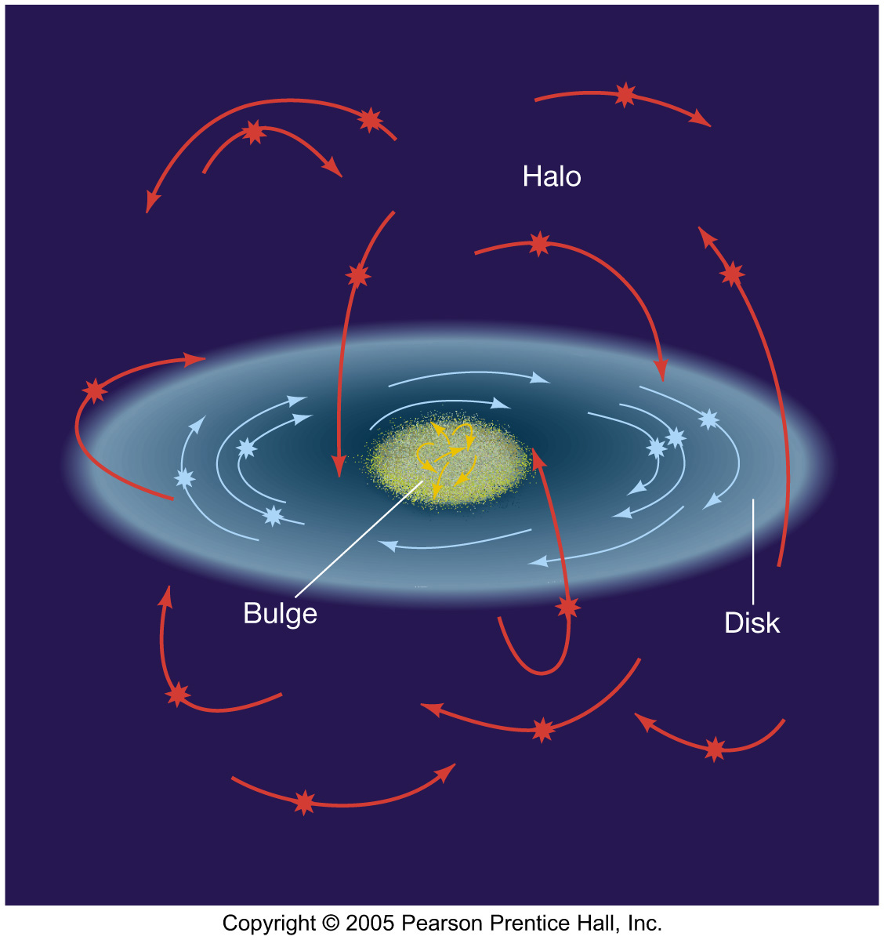
Star Motions

Slide 8
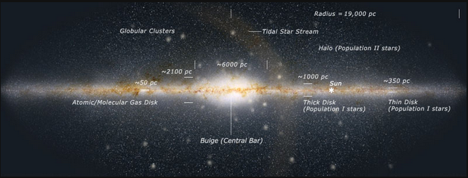
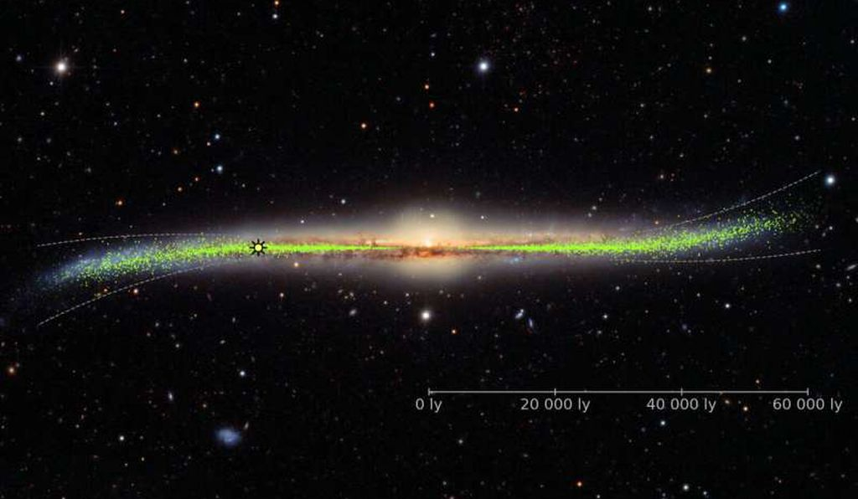
Milky Way Warp (?)

Slide 9
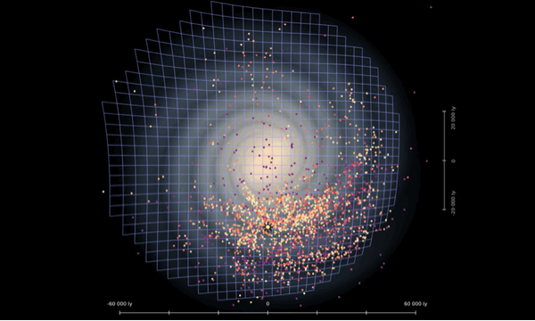
Milky Way Warp (?)
200,000+ images of 2341 Cepheids
(Skowron et al. 2019, Science, 365, 478 / OGLE / Astronomical Observatory, University of Warsaw)

Slide 10
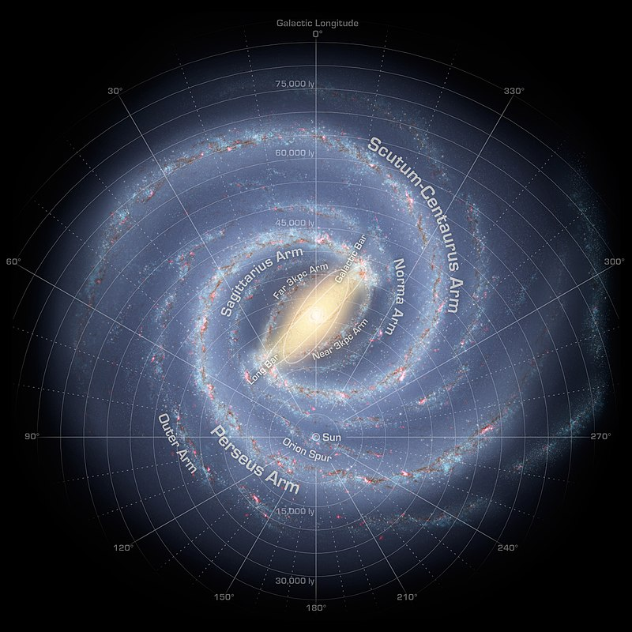
Milky Way Map
2 ARMS (2008):
Spitzer solar-type *s
N = 110 million
1. Perseus
2. Scutum-Centaurus
… or …
4 ARMS (2013):
massive young *s
N = 1600
1. Sagittarius
Orion Spur
2. Perseus
3. Norma/Outer
4. Scutum-Centaurus
Notes:
before Spitzer in 2008, thought there were 4 arms

Slide 11
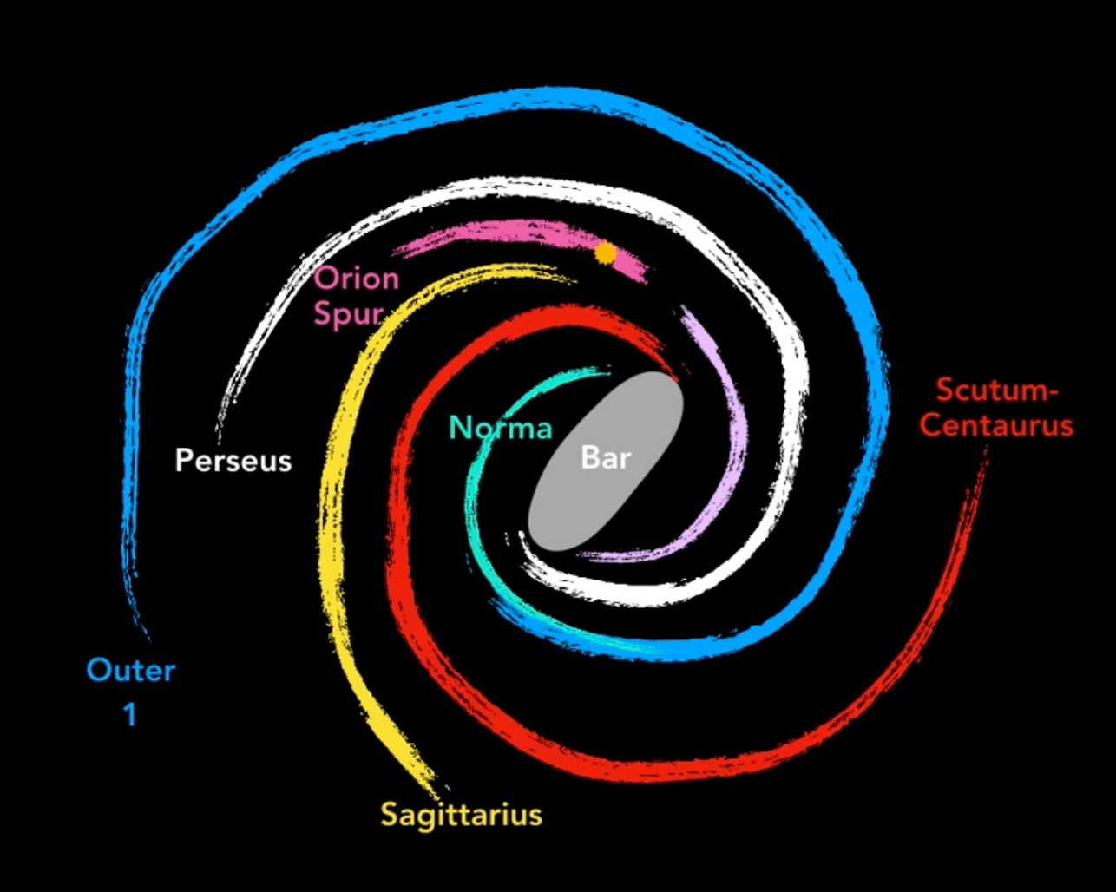
Milky Way Map
Alyssa Goodman’s take
https://www.youtube.com/watch?v=oSYWTsNCoyI

Slide 12
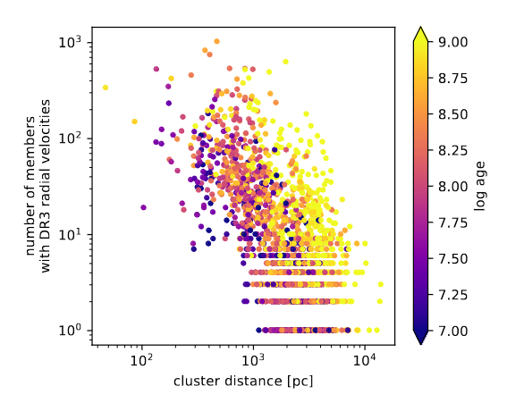
Relatively Local Situation (GDR3)
possible via GDR3
RVs … 6D XYZ+velocities
parameters OB/RGB/etc.
OB stars … 580,000
open clusters … 988
… structure to 5 kpc
Cepheids … 2800
… structure to 10 kpc
?
Pleiades
Hyades
Gaia Collab/Drimmel+ (2023)
Notes:
Fig. 1. Number of cluster members with available line-of-sight velocities in Gaia DR3 as a function of cluster distance and age.
Classical Cepheids are young Pop I and 4-20 Msun

Slide 13
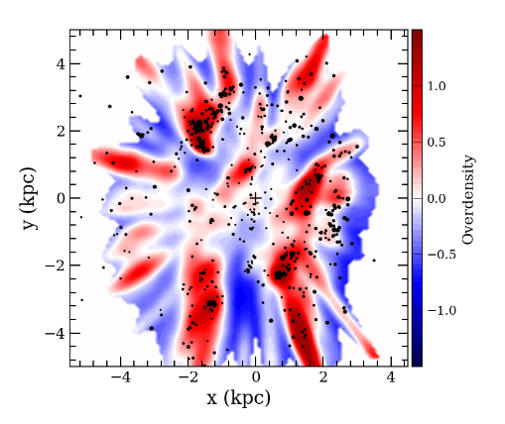
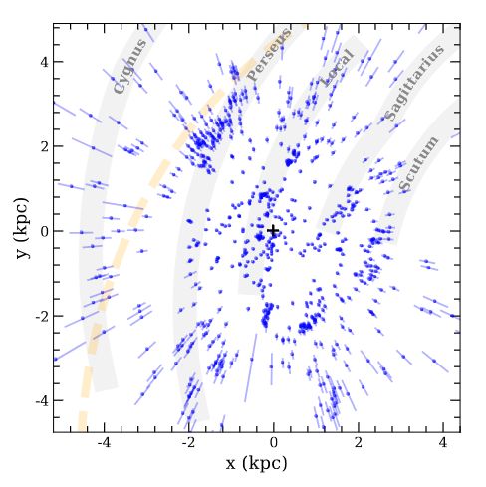
Relatively Local Situation (GDR3)
OB stars … red/blue
open clusters … dots
… structure to 5 kpc
Do you see any arms?
grey bars: Reid+ (2019)
dotted: Levine+ (2006)
Gaia Collab/Drimmel+ (2023)
Notes:
Fig. 13. Overdensity map of the OB stars overplotted with the positions of the open clusters younger than 63 Myr and with n0 > 5, plotted with filled circles whose size is proportional to √n0. The cross indicates the position of the Sun.
Fig. 14. Heliocentric coordinates of the clusters younger than 63 Myr. Thick grey lines are the spiral arm model of Reid et al. (2019), and the dashed line is the trace of the Perseus arm modelled by Levine et al. (2006). The bars represent the 1σ uncertainty on the distance. They take statistical and systematic parallax errors into account.

Slide 14
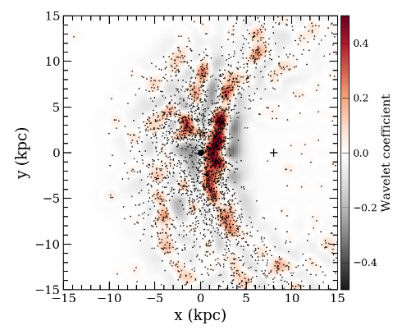
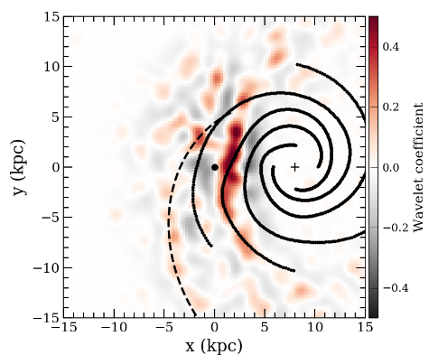
Relatively Local Situation (GDR3)
Cepheids < 200 Myr
dots: individual stars
… structure to 10 kpc
Do you see any arms?
lines: Taylor/Cordes (1993)
dotted: Levine+ (2006)
Gaia Collab/Drimmel+ (2023)
Notes:
Fig. 15. Wavelet transformation of the Cepheids with age <200 Myr. Black dots in the left panel show the positions of the single sources, and the right panel shows on a larger scale an overlay of the model from Taylor & Cordes (1993, solid lines) and the model from Levine et al. (2006, dashed line).

Slide 15
Milky Way Neighborhood
 | X (kpc) | Y (kpc) | Z (kpc) | Distance (kpc) | References / Notes
Milky Way |  |  |  | 0
LMC
SMC
Andromeda
M32 (smaller)
M110 (larger)

Slide 17
Milky Way Neighborhood (2022)
 | X (kpc) | Y (kpc) | Z (kpc) | Distance (kpc) | References / Notes
Milky Way | 32 | 32 | 0.3 | 0 | Reid+ (2014), Rix+Bovy (2013)
LMC | 4.5 | 6.1 | 2.5 | 50 | Balbinot+ (2015), Huxor, Grebel (2015)
SMC | 5 | 4 |  | 62 | Gonidakis+ (2009), Graczyk (2020)
Andromeda | 84 | 84 | 14 | 752 | DeVaucouleurs (1991), Riess+ (2012)
M32 (smaller) |  |  |  | 734 | Fiorentino+ (2012)
M110 (larger) | 4.5 | 2.5 |  | 848 | Tammann+ (2008)

Slide 18
Milky Way Neighborhood (2020)
 | X (kpc) | Y (kpc) | Z (kpc) | Distance (kpc) | References / Notes
Milky Way | 40 | 40 | 0.6 | 0 | Cepheids (Skowron+ 2019, Science) dist: eclipsing binary (1!) (Ribas+ 2005)
LMC | 5 | 2.5 | 4 | 50 | dist: pulsars + H/pi/SN rem/globular (Taylor+ 1993)
SMC | 2.8-5.6 | 1.6-3.3 | 2.2-3.4 (4.9) | 44 | optical images in blue (de Vaucouleurs 1991) OIR imaging SDSS/Spitzer (Cook+ 2014) dist: Cepheids (Inno+ 2013)
Andromeda | 61-480 |  | 0.3 | 765 | Kafle+ (2018)
M32 (smaller) | 1.2 | 1.2 | (1.2) | (same) | foot de Ilija
M110 (larger) | 3.7 | 5.5 | (3.7) | (same) | foot de Ilija

