Slide 1
Stellar Populations I
100
dwarfs
6 wd
1 A
2 F
5 G
11 K
75 M
Henry & Jao (2024)
Notes:
FINAL VERSION USED

Slide 2



Assignments
http://www.astro.gsu.edu/~thenry/GALACTIC/
Thursday 08 FEB Biographical Sketch
basically done
Tuesday 13 FEB Reading #2
Babusiaux+ 2018 --- 18 pages (not Appendix)
Thursday 15 FEB Proposal Level 0 --- Key References
choose 5 papers for Introduction
direct relation to your topic

Slide 3
Stellar Populations I
100
dwarfs
6 wd
1 A
2 F
5 G
11 K
75 M
Henry & Jao (2024)
Notes:
FINAL VERSION USED

Slide 4
Dwarfs
B
A
O
F
G
M
K
Notes:
used Willie Torres’ table from 2009 paper to generate sizes

Slide 5
Dwarfs
B
A
O
F
G
M
K

Slide 6
Dwarfs
A F G K M
1% 2% 5% 11% 75%
+ 6%
white dwarfs

Slide 7
Stellar Populations I
1 million stars
super
giant
I
bright
giant
II
(reg)
giant
III
sub
giant
IV
(reg)
dwarf
V
sub
dwarf
VI
O
B
A
F
G
K
M
< 1
300
10,000
18,000
50,000
110,000
750,000
300
1,000
5,000
10?
10?
8,000
20,000
W (Wolf Rayet) < 1
S+C (AGB )stars < 1
white dwarfs 55,000
neutron stars unknown
black holes unknown
Notes:
O stars --- maybe 20,000 in entire MW
B stars --- 4 within 100 light years = 30.7 pc

Slide 8
Stellar Types within 25 Parsecs
supergiants I
bright giants II
giants III
subgiants IV
dwarfs V
pre-main seq …
subdwarfs VI
white dwarfs VII
SUBTOTAL
unclassified
TOTAL
Database Expected Fraction
0 0 0%
1 1 ~ 0%
24 ~ 30 ~ 1%
83 ~ 100 ~ 3%
2693 ~3500 ~ 90%
12 ~ 30 ~ 1%
16 ~ 30 ~ 1%
190 ~ 200 ~ 5%
3019 …… ……
874 …… + dwarfs
3893 3893 100%
RECONS pre-GDR2
Notes:
using RECX25 search by Wei-Chun on 2020.0211
179 WDs in Subasavage+ 2017

Slide 9
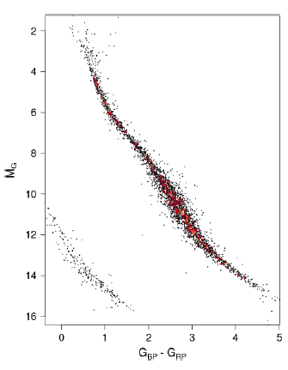
Gaia’s Solar Neighborhood
critical bit: NOT COMPLETE
unresolved multiples
young stars
Riedel thesis
old stars (cool subdwarfs)
Jao thesis
non-stars (white dwarfs)
Subasavage thesis
end of main sequence
Dieterich thesis
M dwarf flavors
Clements thesis
Couperus thesis
Kar thesis
M dwarf multiples
Winters thesis
Vrijmoet thesis
LeBlanc thesis
K dwarfs
Paredes thesis
James thesis
Carrazco thesis
Johns thesis
25 pc
K0
M0
M3
M6
Babusiaux+ (2018)

Slide 10
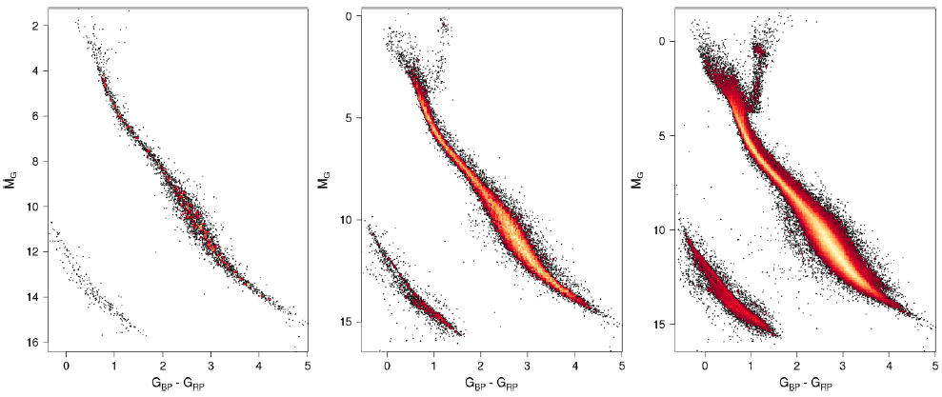
Gaia’s Solar Neighborhood
25 pc 50 pc 100 pc
What “extra” populations are evident past 25 parsecs? (high end first)
red giants, red clump stars
Babusiaux+ (2018)
Notes:
because (a) faint stars missed beyond 25 pc, and (b) close multiples get merged and are not affected so much by astrometric perturbations

Slide 11
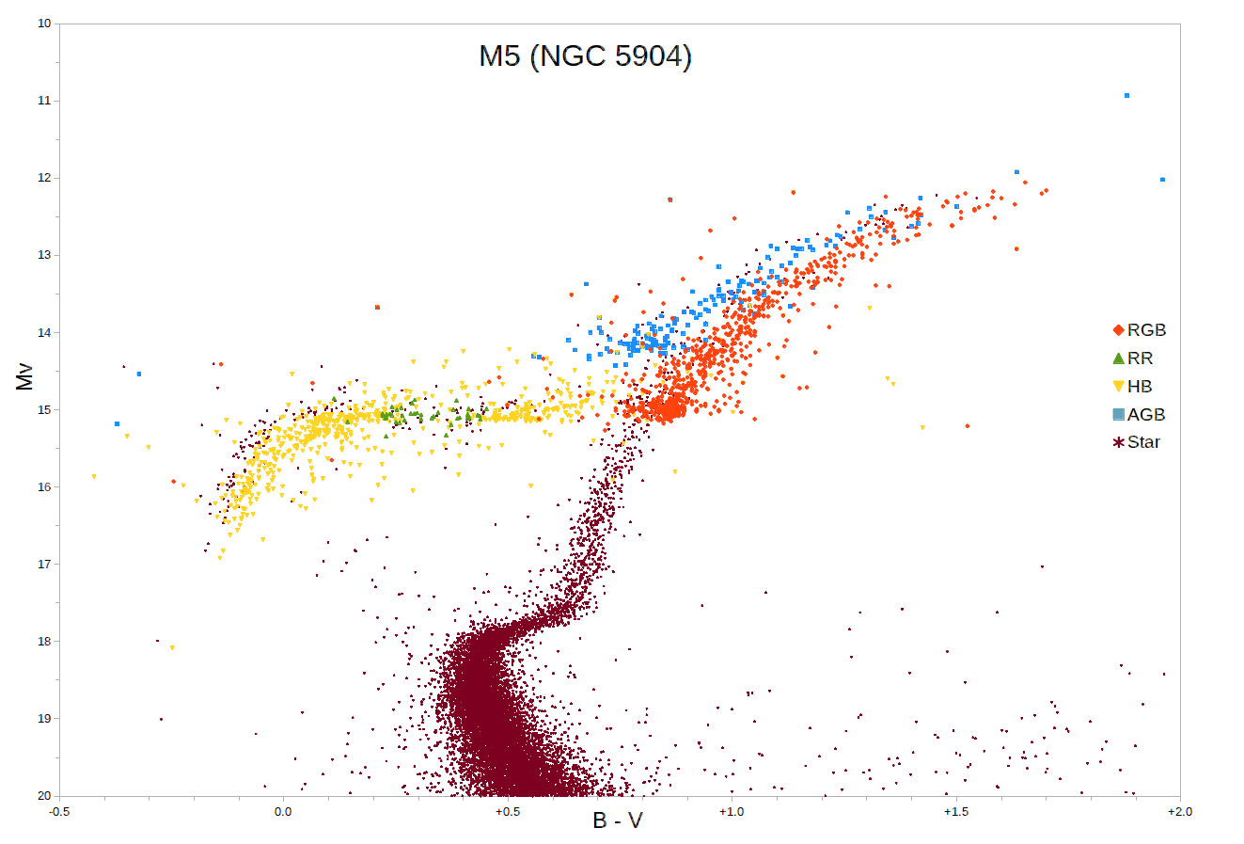
Red Clump Stars
Notes:
M5 is a globular cluster
note WRONG vertical axis … should be V (?)
red clump stars are core He burning at reddest edge of HB

Slide 12
Gaia’s Solar Neighborhood
25 pc 50 pc 100 pc
What “extra” populations are evident past 25 parsecs?
red giants, red clump stars, binary M dwarfs, binary WDs, cool subdwarfs
How many more stars expected within 100 pc compared to 25 pc?
Why aren’t there 64X as many stars?
Babusiaux+ (2018)
Notes:
because (a) faint stars missed beyond 25 pc, and (b) close multiples get merged and are not affected so much by astrometric perturbations

Slide 13
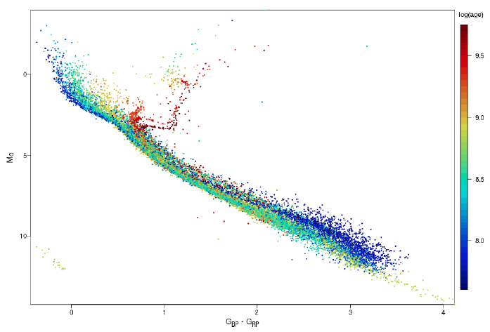
32 Open Clusters in Gaia
1
old clusters have RG branches
young clusters have
M dwarfs settling
onto main sequences
3
2
young clusters have
no white dwarfs yet
4
K0
M0
M3
Hyades
M5
GC/Babusiaux+ (2018)
Notes:
Red clump stellar properties vary depending on their metallicities, but typically have early K spectral types and T~5000 K. There is a considerable spread in the properties of red clump stars even within a single population of similar stars such as an open cluster, due to variations in temperatures and luminosities of horizontal branch stars when they form and as they evolve. Although red clump stars are generally hotter than red-giant-branch stars, the two regions overlap and the status of individual stars can only be assigned with a detailed chemical abundance study.

Slide 14
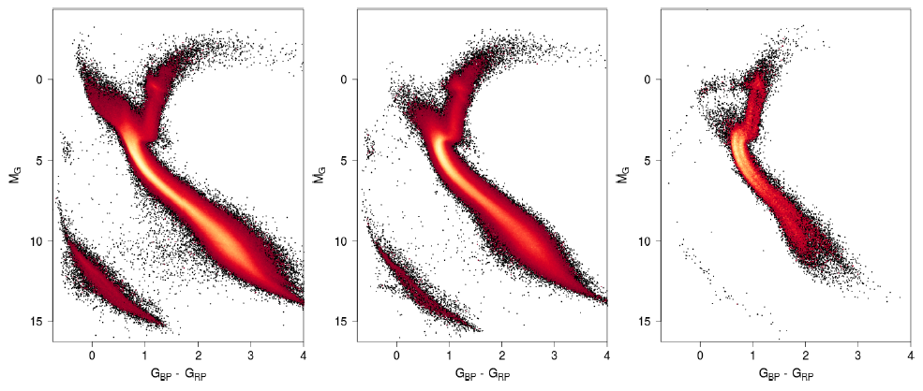
Gaia’s Solar Neighborhood
thin
disk
thick
disk
halo
How can you tell which population (thin disk, thick disk, halo) is being plotted?
thin disk: young, hot stars
thick disk: more localized turnoff
halo: lack of upper main sequence, extended HB, fewer fainter stars
NOTE! 2 main sequences in halo …
Babusiaux+ (2018)

Slide 15
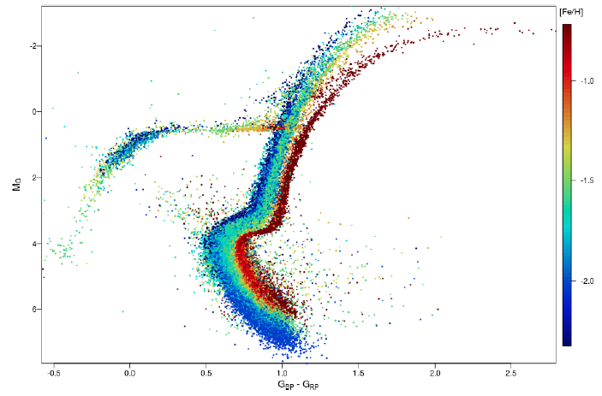
14 Globular Clusters in Gaia
metal-poor clusters have
blue horizontal branches
metal-rich clusters
have redder RG branches
1
2
1
3
blue
stragglers
formed later
not cluster members
collision/merger
mass transfer
formed later
not cluster members
collision/merger
mass transfer
Babusiaux+ (2018)

Slide 16
Limits?
B
A
O
F
G
M
K
Notes:
used Willie Torres’ table from 2009 paper to generate sizes

Slide 17
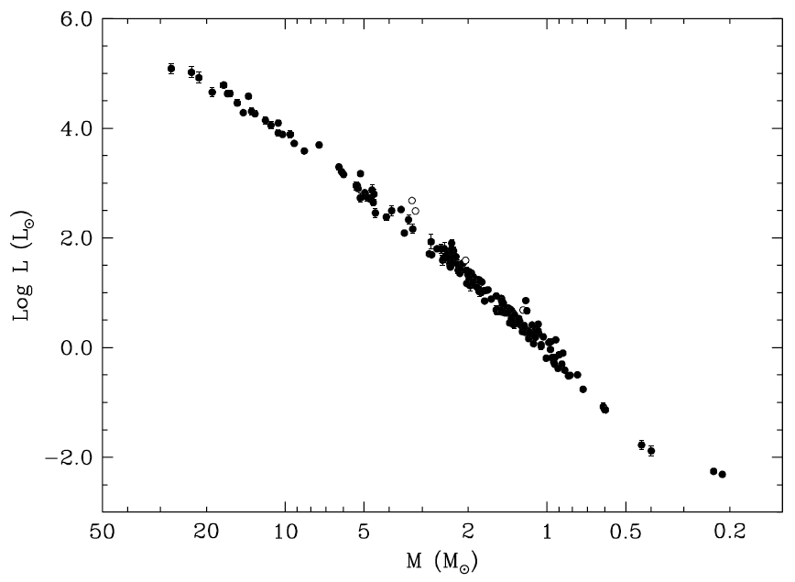
Mass-Luminosity Relation
27.27 ± 0.55 M
masses and radii
±3%
0.214 ± 0.008 M
Torres+ (2010)

Slide 18
Stellar Limits Large and Small
Largest MS Star
10⁷ L
53000 K
O2-3V
WN5h
Wolf-Rayet
N+H emission
315 M
???
Luminosity
Temperature
(Spectral Type)
Mass
Radius
What is the radius of the largest main sequence star?

Slide 19
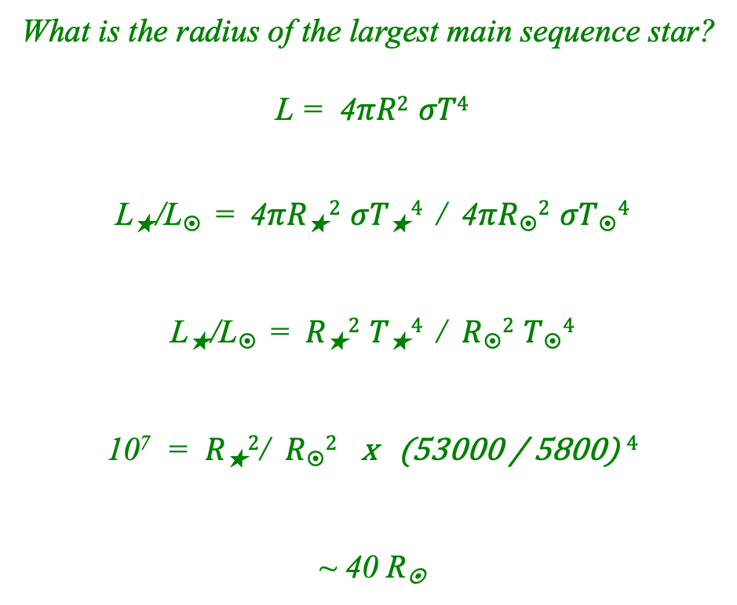
Stellar Limits Large and Small
Largest MS Star
10⁷ L
53000 K
O2-3V
WN5h
Wolf-Rayet
N+H emission
315 M
???

Slide 20
Stellar Limits Large and Small
Largest MS Star
10⁷ L
53000 K
O2-3V
WN5h
Wolf-Rayet
N+H emission
315 M
40 R
Luminosity
Temperature
(Spectral Type)
Mass
Radius

Slide 21
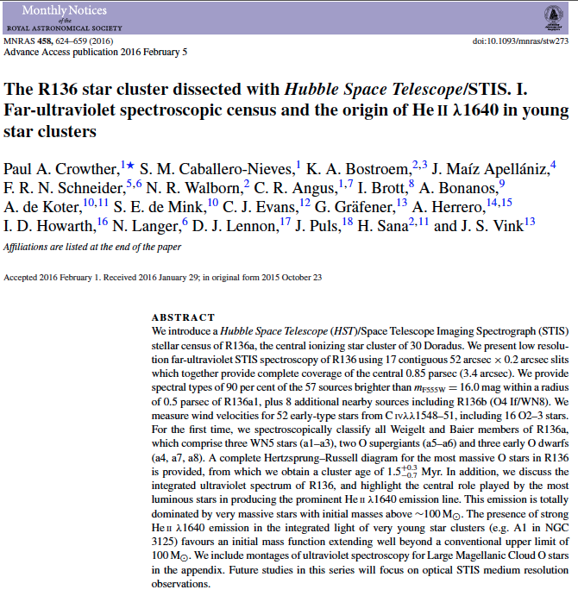
Largest Stars
LMC
…
30 Doradus = Tarantula Nebula
…
NGC 2070 cluster
...
R136 stellar group
(Radcliffe Obs. Magellanic Clouds catalog)
~ 10000 stars
~ 1.5 Myr old
not highly reddened … UV
Crowther+ (2016)

Slide 22
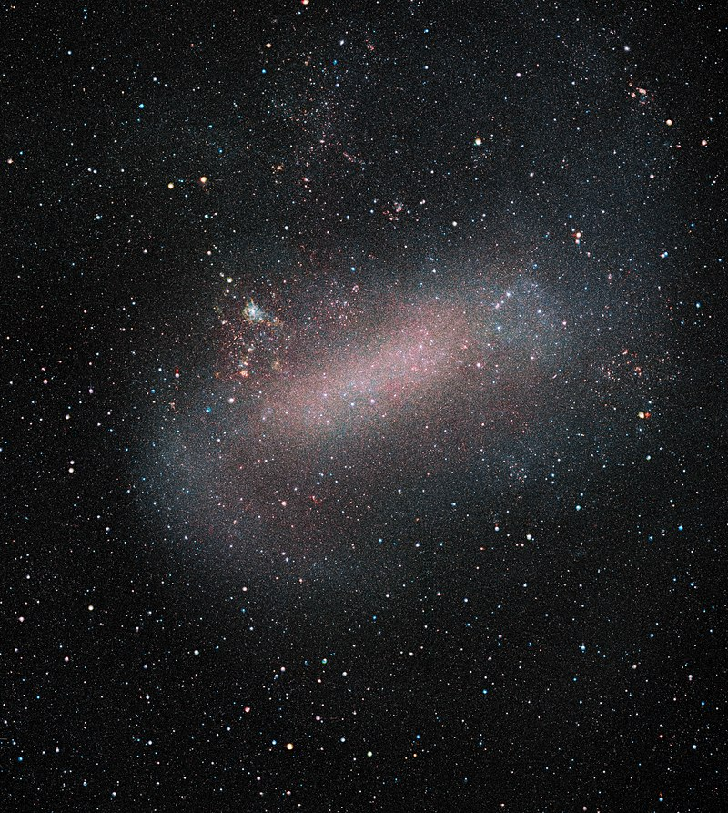
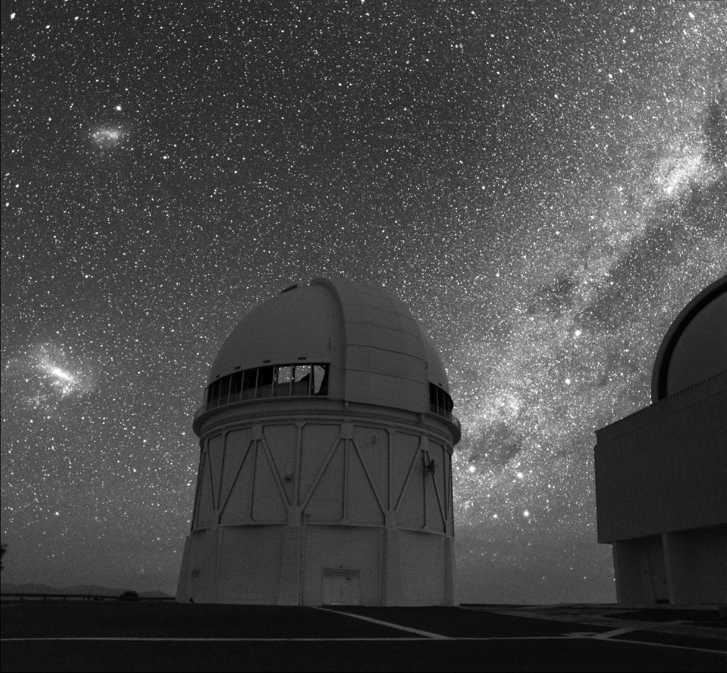
The Largest Star
photo: Roger Smith

Slide 23
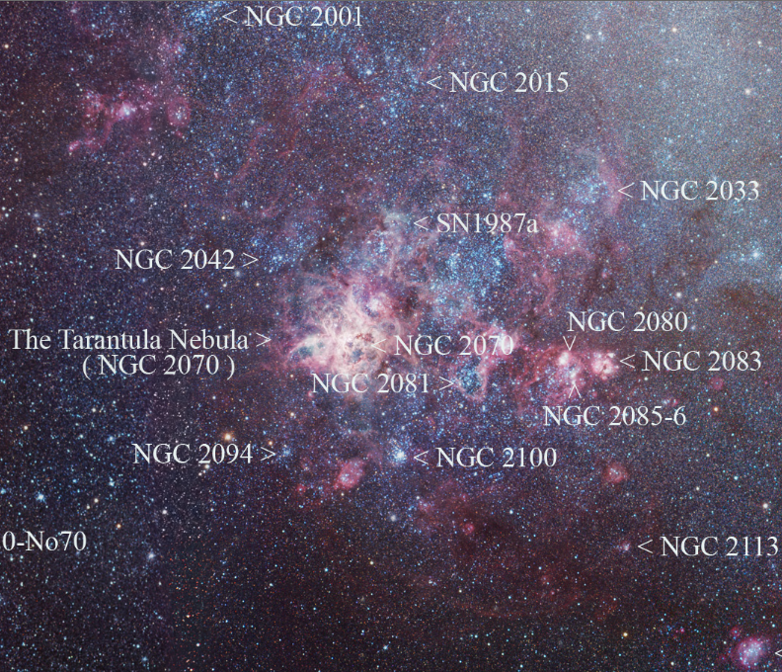
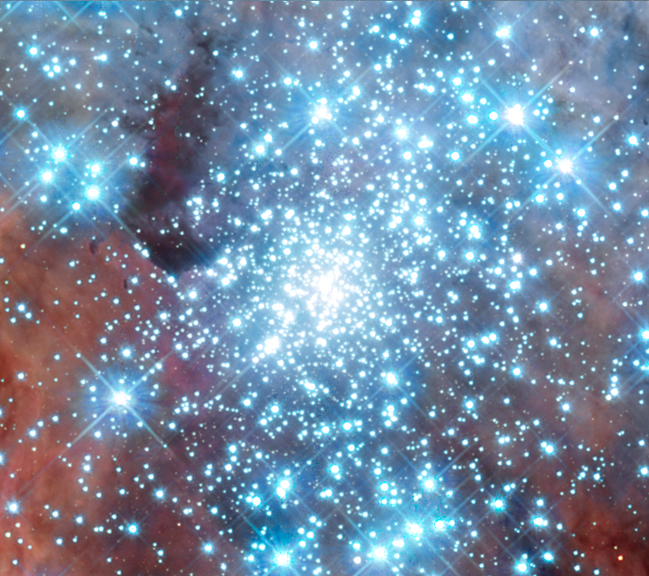
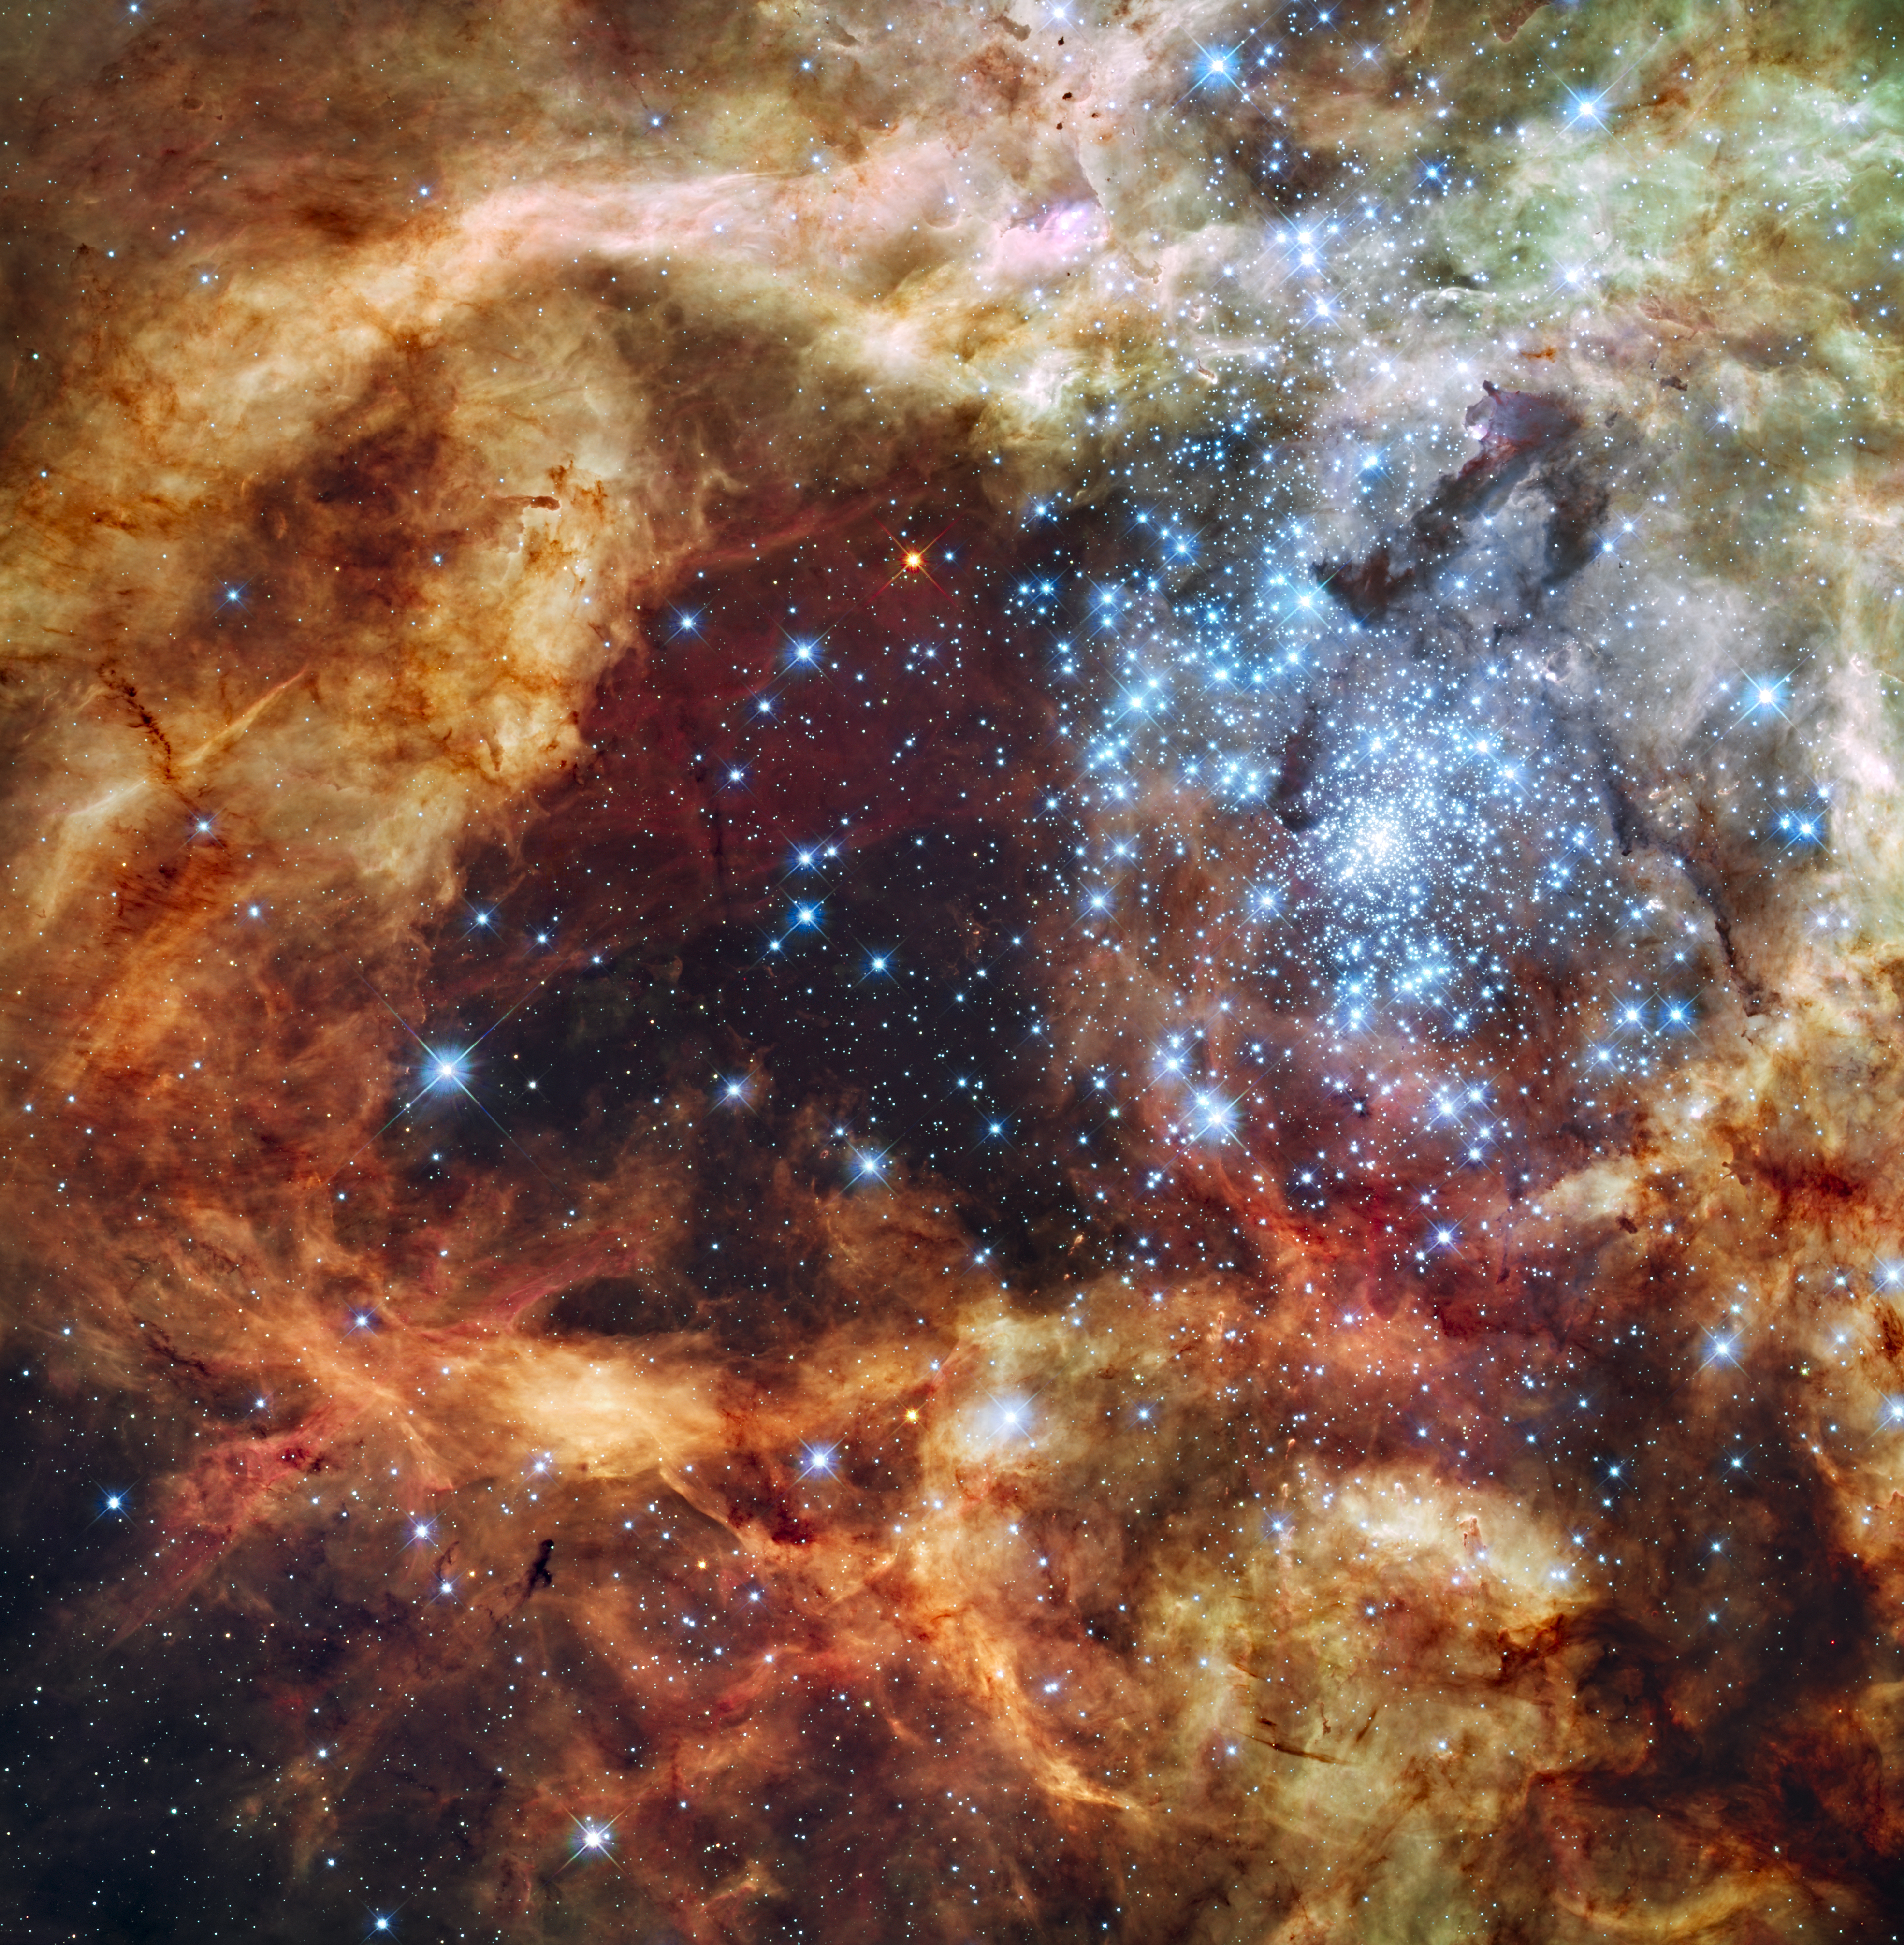
The Largest Star

Slide 24
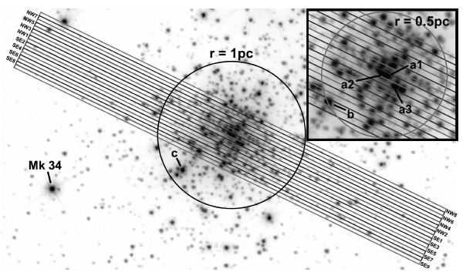
Largest Stars: Observations
HST-STIS spectroscopy of central parsec (0.2” slits)

Slide 25
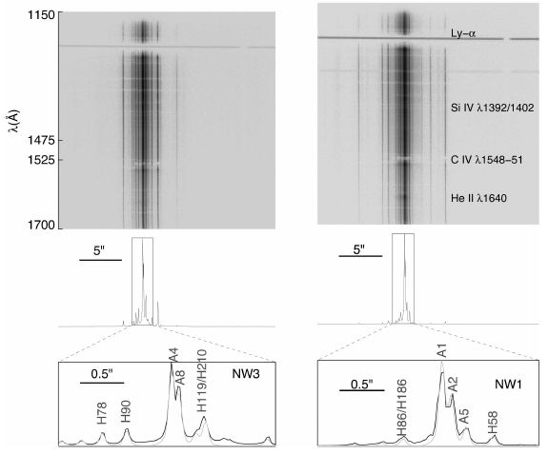
Largest Stars: Observations

Slide 26
Largest Stars: BONNSAI
BONN Stellar Astrophysics Interface (Schneider+ 2014 A&A, 570, 66)
Bayesian statistical method comparing observations to models
can use
magnitudes … luminosities
colors/SEDs/spectra … temperatures
compositions
radii/surface gravities
rotational velocities
Initial Mass Function (IMF)
test components in eclipsing binaries: masses 4-28 M
input = masses, radii, rotational velocities
output = initial masses, initial rotations, ages
probability distributions of initial masses and ages
works to a few % … but systematics evident
NO TRULY MASSIVE CALIBRATION STARS

Slide 27
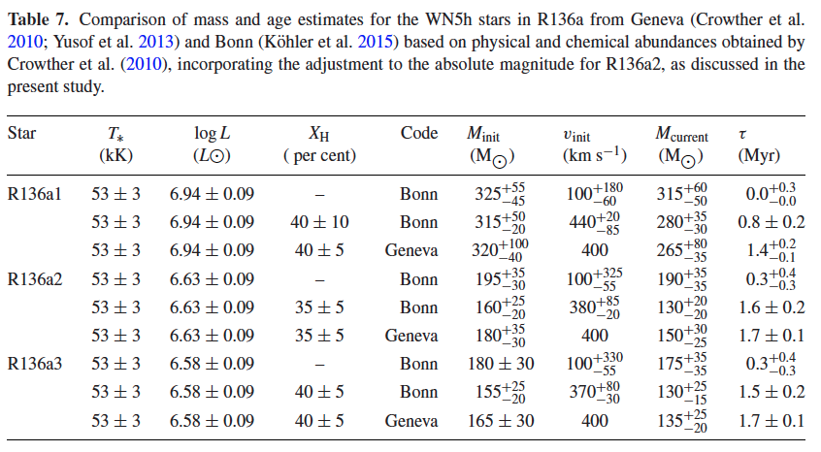
Largest Stars: Stats
6 stars with masses > 100 M 3 WN stars (below)
1 Of/WN … 1 O2If … 1 O2-3V

Slide 28
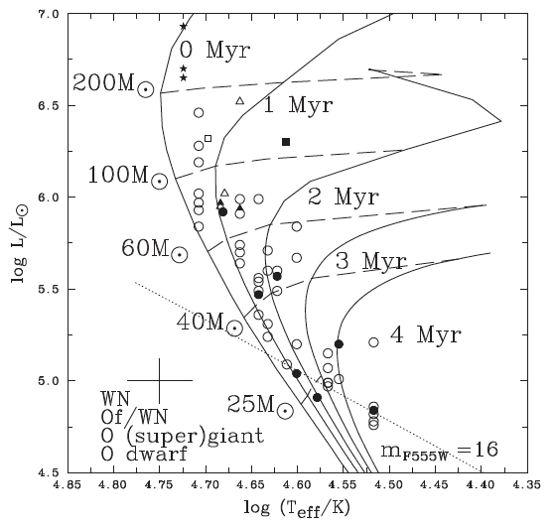
Largest Stars: HR Diagram
★
○
Notes:
starred points are Wolf-Rayet (WR) stars … WN = spectra dominated by nitrogen … WC = spectra dominated by carbon/oxygen
filled points are optical spectral types … open points are UV spectral types … both yield temperatures

Slide 29
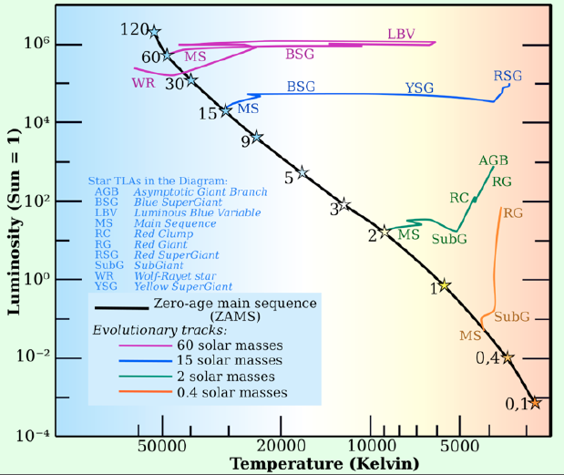
Stellar Evolutionary Tracks
MS
core H➔He
RGB
shell H➔He
HB/RC
core He➔C
AGB
shell H➔He
shell He➔C

Slide 30
Mass-Luminosity Relation
Schnurr+ (2008)
NGC 3603 A1
eclipsing
116±31 and 89±16
Why are there few points here for massive stars?
masses and radii
±3%
Why are there few points here for low mass stars?
Torres+ (2010)

Slide 31
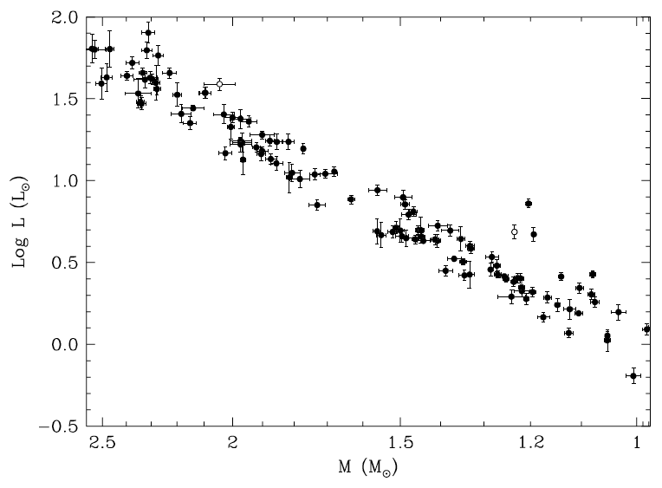
Accurate Luminosities
Why don’t all the stars
fall along a line?
Torres+ (2010)

Slide 32
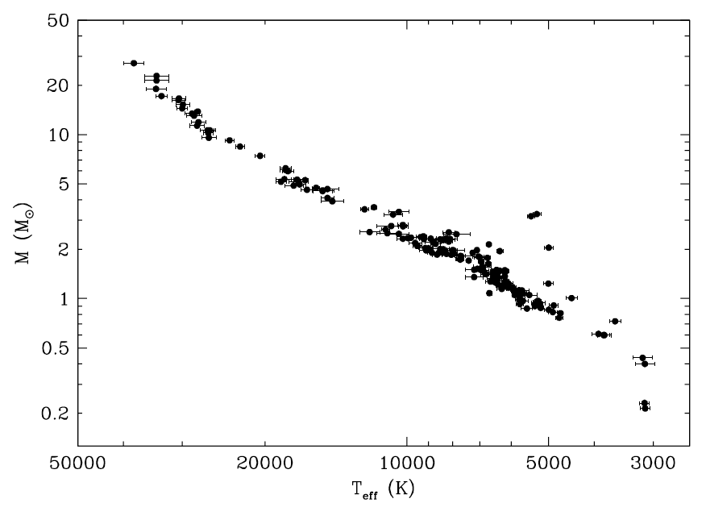
Accurate Temperatures
Torres+ (2010)

Slide 33
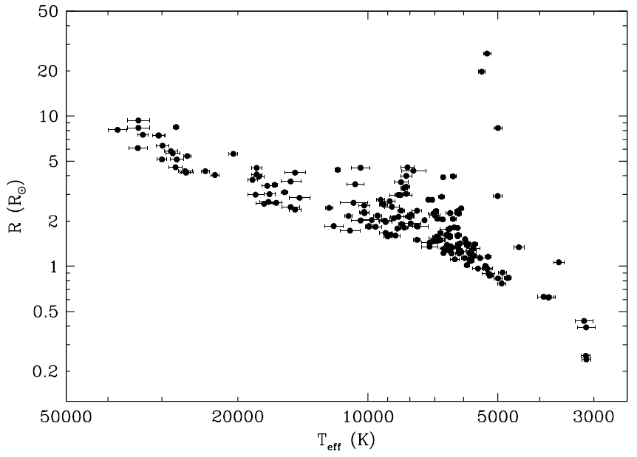
Accurate Radii
Torres+ (2010)

Slide 34
Mass-Luminosity Relation
27.27 ± 0.55 M
masses and radii
±3%
0.214 ± 0.008 M
Torres+ (2010)

