Slide 1
Stellar Populations II
100
dwarfs
6 wd
1 A
2 F
5 G
11 K
75 M
Henry & Jao (2024)
Notes:
FINAL VERSION USED

Slide 2
Galactic Explorers 2
1. Positions on the HR diagram are set primarily by mass, composition, and age, all discussed via HR diagrams in the paper. Name ONE other characteristic of stars that may shift their positions.
2. Several categories of objects NOT on the main sequence are discussed. Other than white dwarfs, name TWO.
3. At worst, what is the uncertainty on parallax adopted by the authors for acceptable stars for the HR diagrams?
0.1%, 1%, 5%, 10%
4. To what distance within the local bubble is extinction stated to be “almost negligible” (Lallement+ 2003)?
10 pc, 60 pc, 100 pc, 300 pc
5. What are the red stars ~1 magnitude below the main sequence called?
6. About how many brown dwarfs are there in Gaia DR2 with parallaxes better than 10% (and shown in plots)?
50, 500, 5000, 50000
7. What is the explanation given for the two white dwarf sequences?
8. What is the explanation given for the two main sequences in the halo star sample?
9. (see Figure)
10. (see Figure)
BONUS …

Slide 3
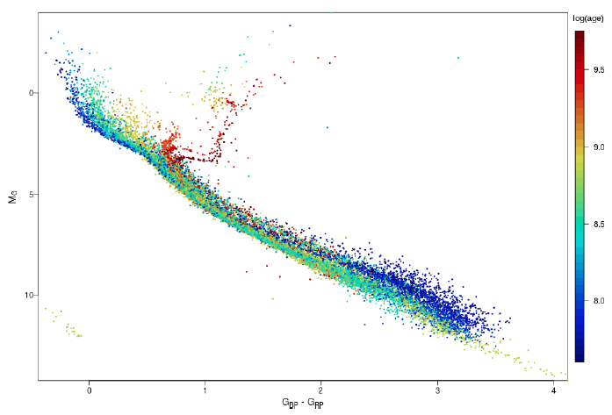
#9.
Why don’t these parts of the
main sequences overlap?

Slide 4
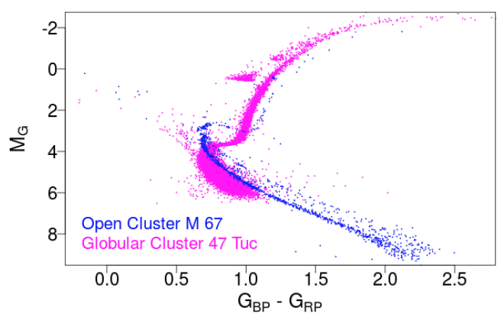
#10.
What is this group of stars?

Slide 5
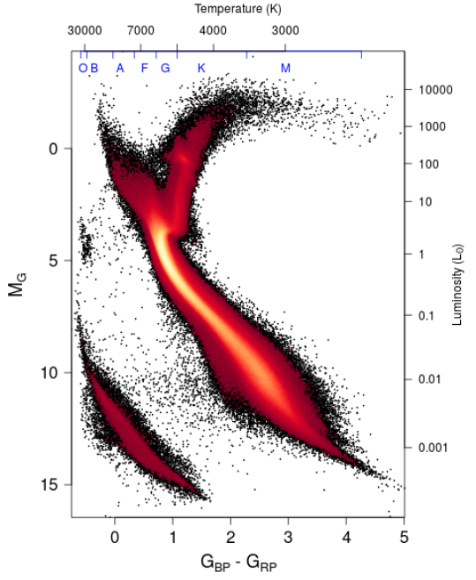
BONUS #1 and #2
B1: What are these stars called?
B2: What ARE they?
Notes:
Red clump stellar properties vary depending on their metallicities, but typically have early K spectral types and T~5000 K. There is a considerable spread in the properties of red clump stars even within a single population of similar stars such as an open cluster, due to variations in temperatures and luminosities of horizontal branch stars when they form and as they evolve. Although red clump stars are generally hotter than red-giant-branch stars, the two regions overlap and the status of individual stars can only be assigned with a detailed chemical abundance study.

Slide 6

Galactic Explorers 2

Slide 7
Galactic Explorers 2
1. Positions on the HR diagram are set primarily by mass, composition, and age, all discussed via HR diagrams in the paper. Name ONE other characteristic of stars that may shift their positions.
youth, magnetic field, rotation, winds/mass loss, convection/overshooting, unresolved multiplicity
2. Several categories of objects NOT on the main sequence are discussed. Other than white dwarfs, name TWO.
hot subdwarfs, post-AGB stars, planetary nebulae stars, cool subdwarfs, brown dwarfs
3. At worst, what is the uncertainty on parallax adopted by the authors for acceptable stars for the HR diagrams?
0.1%, 1%, 5%, 10%
4. To what distance within the local bubble is extinction stated to be “almost negligible” (Lallement+ 2003)?
10 pc, 60 pc, 100 pc, 300 pc
5. What are the red stars ~1 magnitude below the main sequence called?
cool subdwarfs
6. About how many brown dwarfs are there in Gaia DR2 with parallaxes better than 10% (and shown in plots)?
50, 500, 5000, 50000
7. What is the explanation given for the two white dwarf sequences?
hydrogen vs. helium white dwarfs
8. What is the explanation given for the two main sequences in the halo star sample?
different metallicities of -0.5 and -1.3
9. (see Figure)
10. (see Figure)
BONUS …

Slide 8
#9.
Why don’t these parts of the
main sequences overlap?
red dwarfs not yet on main
sequence in younger clusters

Slide 9
#10.
What is this group of stars?
sequence of multiples

Slide 10
BONUS #1 and #2
B1: What are these stars called?
“red clump” stars
B2: What ARE they?
red giants on horizontal branch
Notes:
Red clump stellar properties vary depending on their metallicities, but typically have early K spectral types and T~5000 K. There is a considerable spread in the properties of red clump stars even within a single population of similar stars such as an open cluster, due to variations in temperatures and luminosities of horizontal branch stars when they form and as they evolve. Although red clump stars are generally hotter than red-giant-branch stars, the two regions overlap and the status of individual stars can only be assigned with a detailed chemical abundance study.

Slide 11
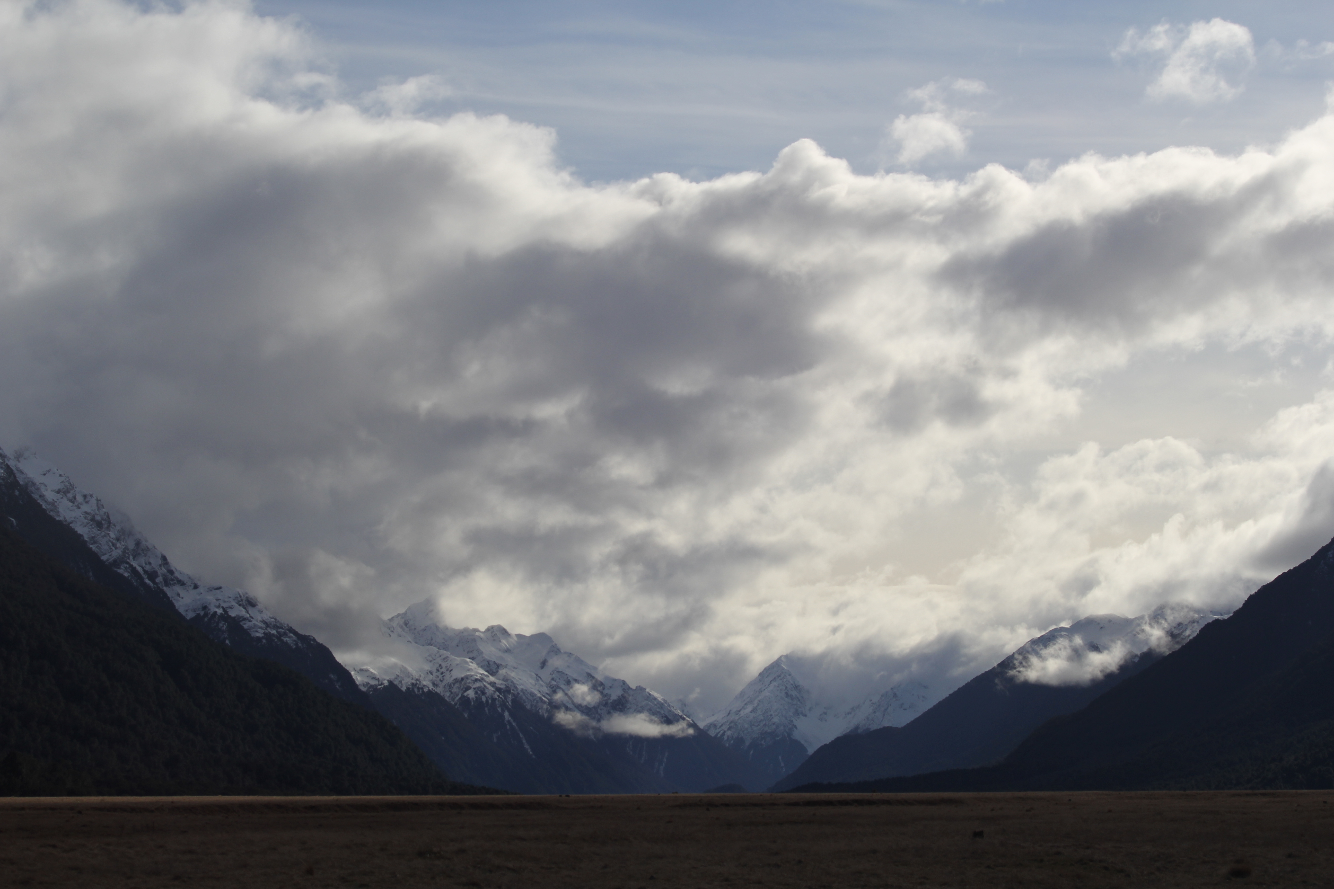


Assignments
http://www.astro.gsu.edu/~thenry/GALACTIC/
Thursday 15 FEB Proposal Level 0 --- Key References
choose 5 papers for Introduction
direct relation to your topic
Thursday 22 FEB Proposal Level 1 --- OUTLINE
Page 1: Title/Name/Intellectual Merit/Broader Impacts
IM (Abstract) and BI have a few sentences each
Page 2: Introduction has a few sentences (3+ refs)
Sections, Tables, Figures listed

Slide 12
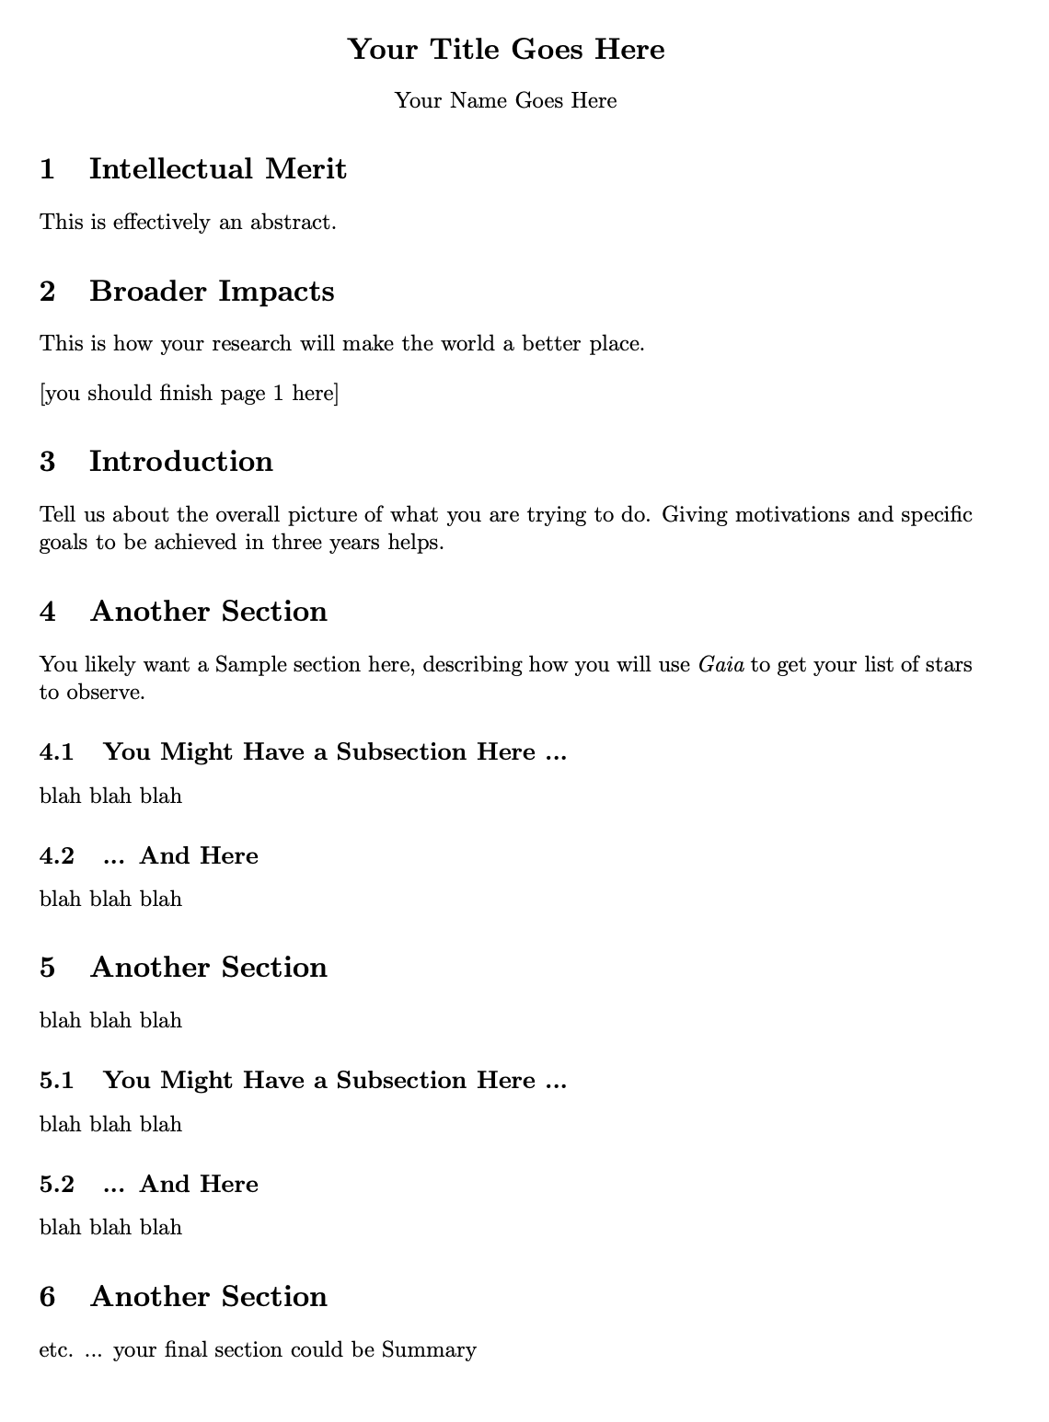
Assignments

Slide 13
Proposal Pieces
GOAL: Fund yourself as a $75K/year postdoc for 3 years
1. Project Description + Refs 8 pages text + 2 pages Tab/Fig
+ References 0.5 page
2. Biographical Sketch 2 pages (SciENcv)
3. Budget and Justification 2 pages (including spreadsheet)
4. Facilities 0.5 page
5. Student Mentoring Plan 0.5 page
6. Data Management Plan 0.5 page
Total Challenge ~ 16 pages

Slide 14
Stellar Populations II
100
dwarfs
6 wd
1 A
2 F
5 G
11 K
75 M
Henry & Jao (2024)
Notes:
FINAL VERSION USED

Slide 15
Stellar Limits Large and Small
Largest MS Star
10⁷ L
53000 K
O2-3V
WN5h
Wolf-Rayet
N+H emission
315 M
40 R
Luminosity
Temperature
(Spectral Type)
Mass
Radius

Slide 16
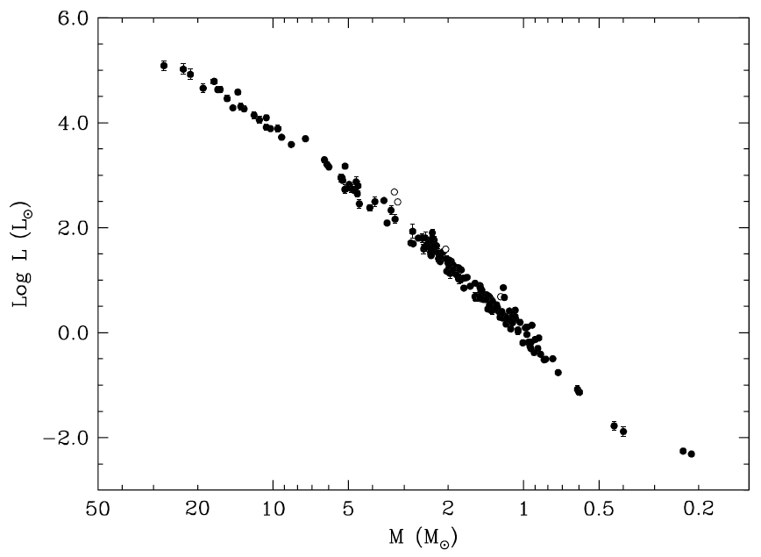
Mass-Luminosity Relation
27.27 ± 0.55 M
masses and radii
±3%
rarely eclipse
… we need
something else
0.214 ± 0.008 M
Torres+ (2010)

Slide 17
High Resolution Techniques
“High Resolution” here means anything < 1”
Technique Mag Limit Res Limit Telescope/Instrument
Gaia G ~ 21 0.5” in space
RoboAO / Lucky Imaging J ~ 11 0.1” various ~4m
Infrared AO (4m) K ~ 9 0.07” CFHT/KIR
Infrared AO (8m) K ~ 10 0.07” VLT/NaCo or Gemini-N/NIRI
Infrared AO (10m) K ~ 10 0.05” Keck/NIRC2
Fine Guidance Sensors V ~ 15 0.05” HST-FGS
Optical Speckle (4m) R ~ 15 0.02” WIYN, APO, LDT, SOAR
Optical Speckle (8m) R ~ 16 0.01” Gemini-N/S
LB Interferometry K ~ 8? 0.001” CHARA

Slide 18
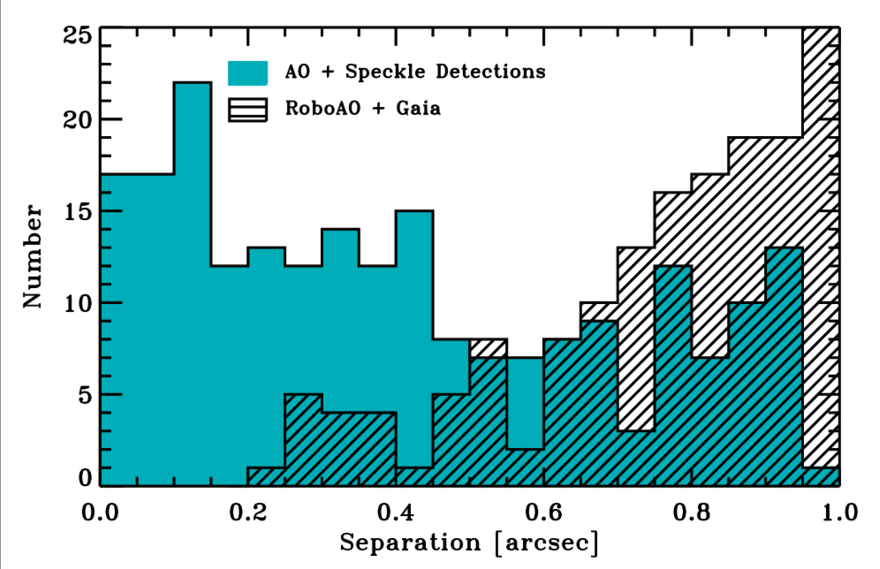
High Resolution Sensitivities
Ciardi (2018)

Slide 19
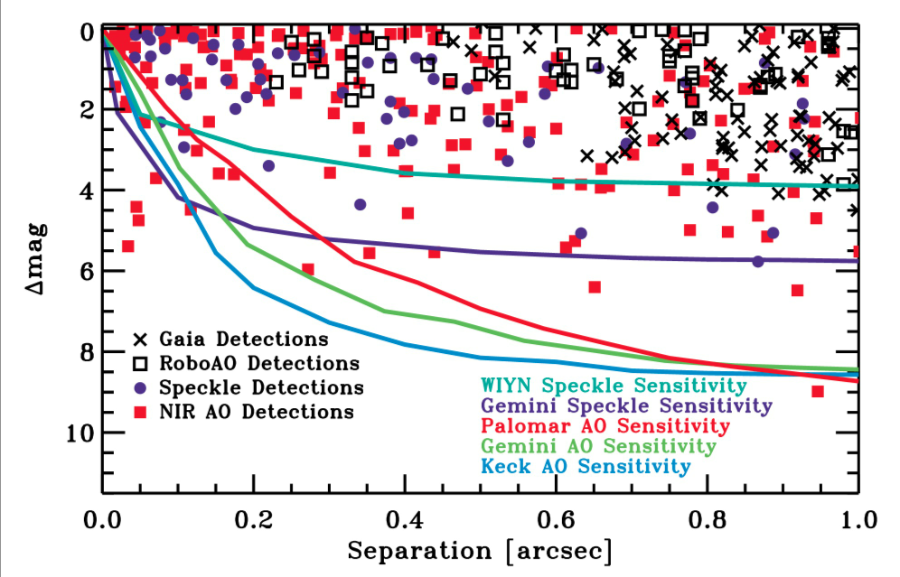
High Resolution Sensitivities
Ciardi (2018)

Slide 20
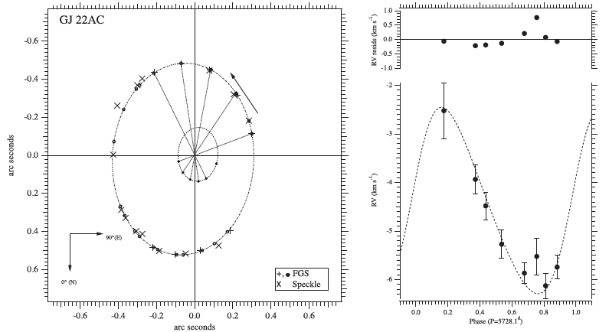
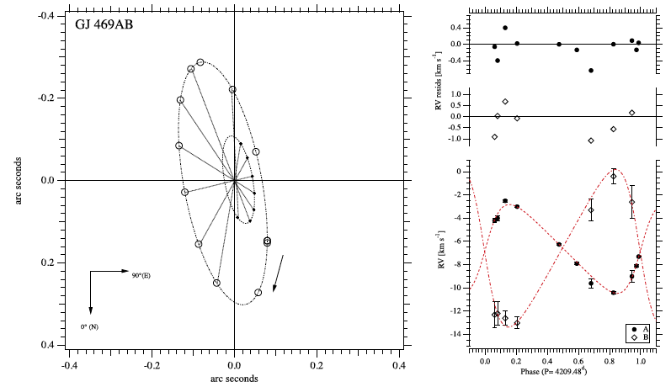
Mass-Luminosity Relation
Benedict+ (2016)

Slide 21
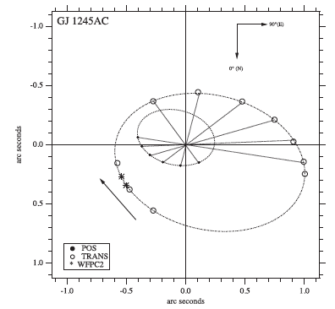
Mass-Luminosity Relation
A: 0.111 ± 0.001 M
B: 0.076 ± 0.001 M
not eclipsing
Benedict+ (2016)

Slide 22
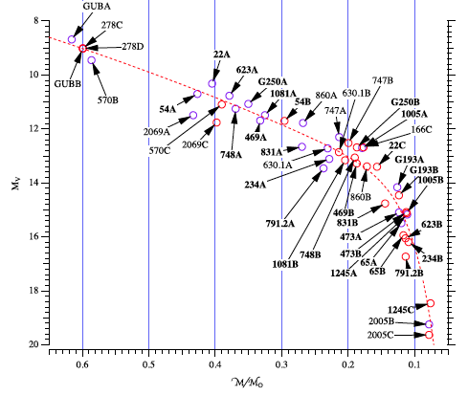
Mass-Luminosity Relation
Benedict+ (2016)

Slide 23
Mass-Luminosity Relation
Torres+ (2010) and Benedict+ (2016)

Slide 24
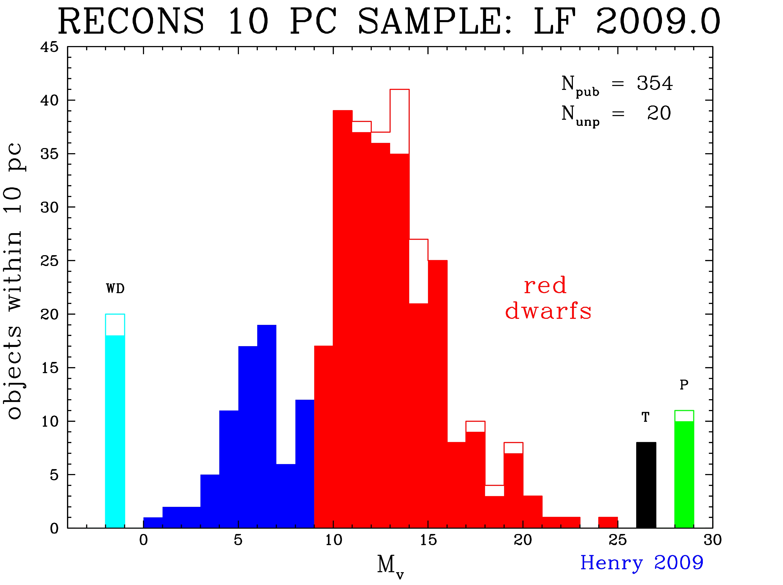
Luminosity Function (LF)

Slide 25
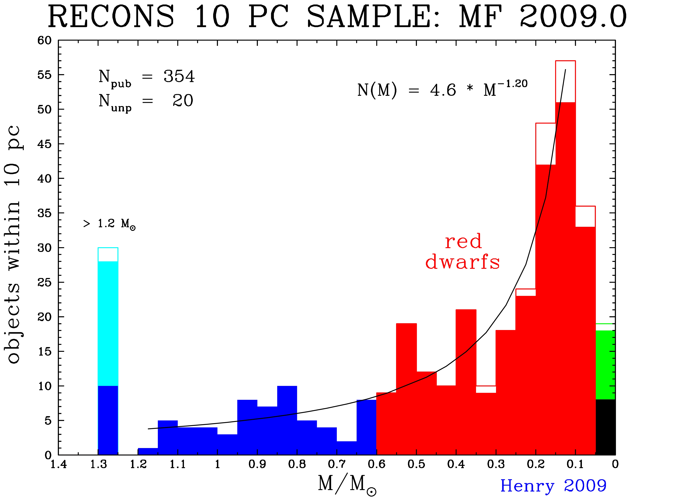
Mass Function (MF)

Slide 26
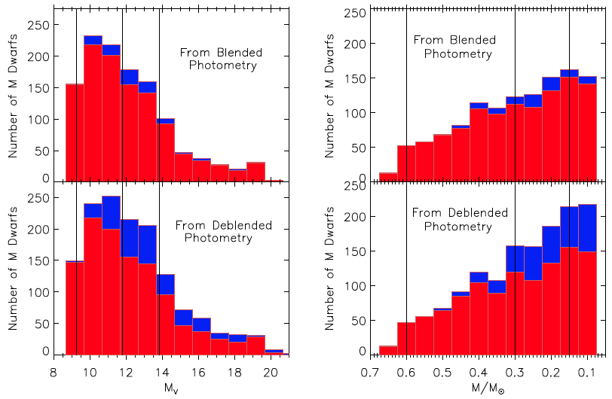
Red Dwarfs: Companions Matter
LF MF
primaries … secondaries
Winters+ (2019)
Notes:
lines are factors of 2 in mass

Slide 27
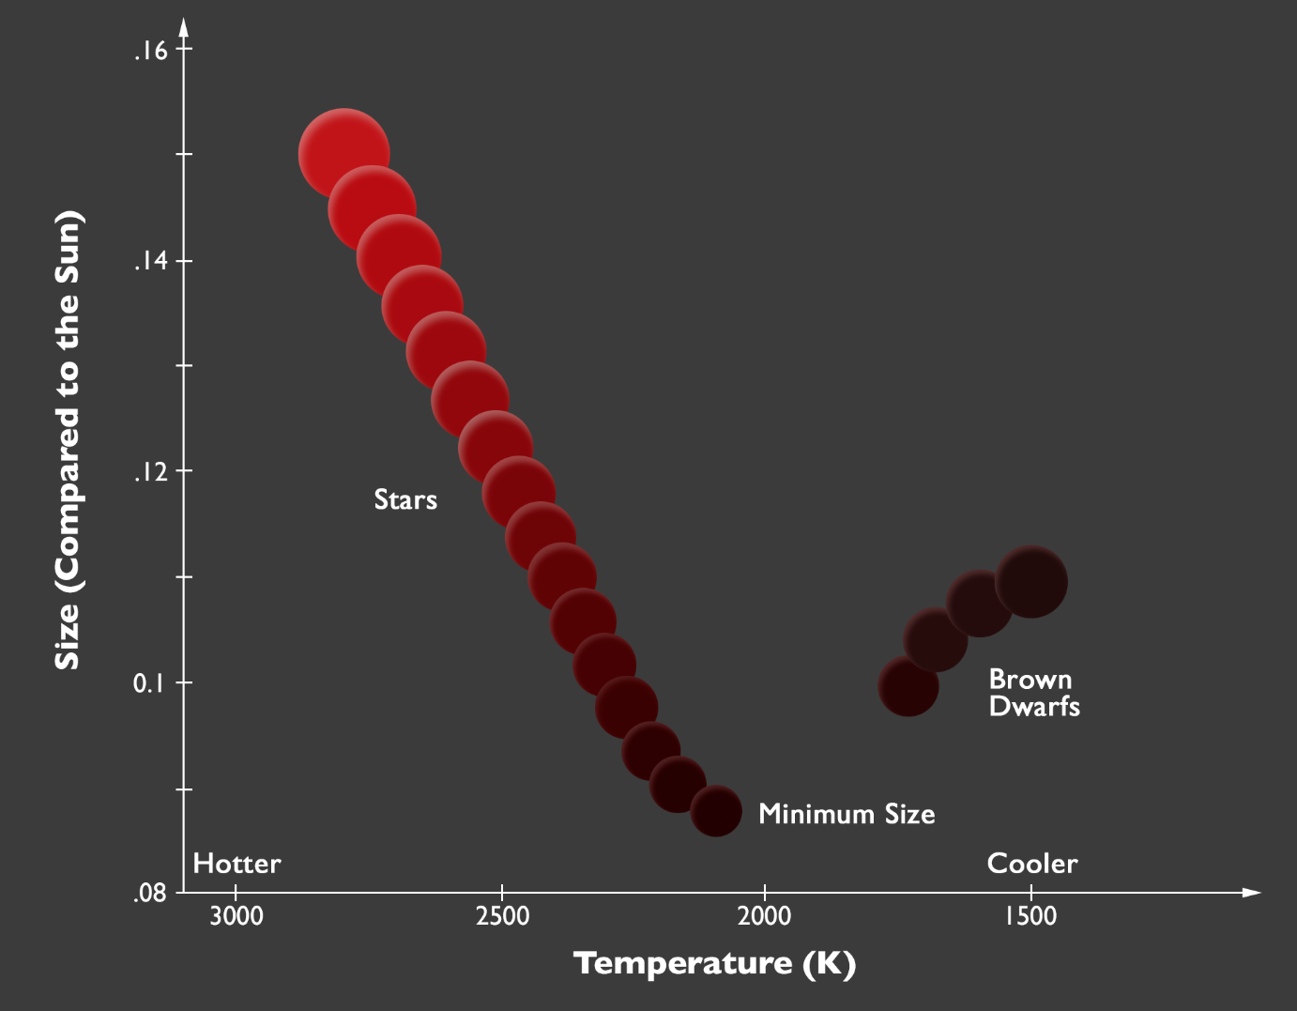
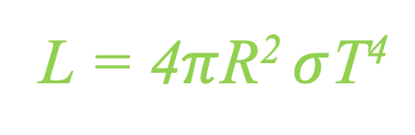
Smallest Stars
thermo equil e⁻ degeneracy
hydrogen
burning
limit
… or Luminosity
Dieterich/NOAO
Notes:
Stefan-Boltzmann Law

Slide 28
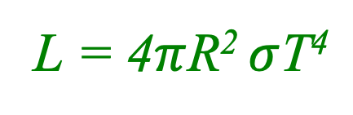
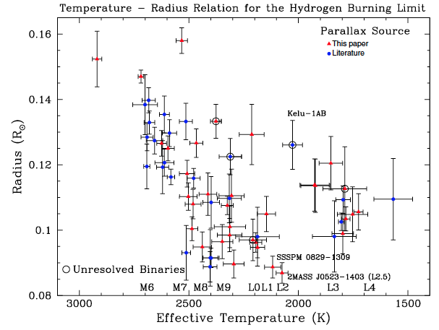
Smallest Stars
thermo equil e⁻ degeneracy
T ~ 2000 K
Dieterich+ (2014)

Slide 29
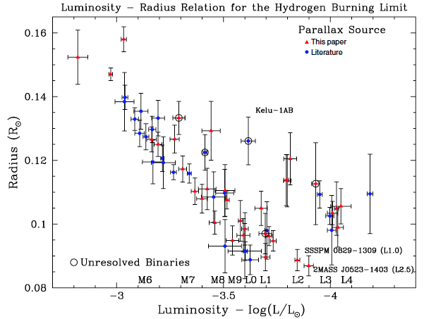
Smallest Stars
thermo equil e⁻ degeneracy
L ~ 10⁻⁴ L
Dieterich+ (2014)

Slide 30
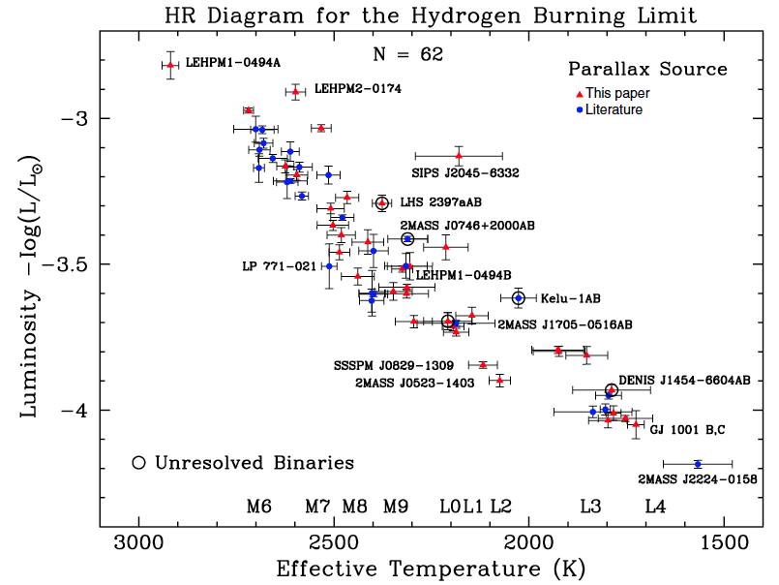
Smallest Stars
Dieterich+ (2014)

Slide 31
Stellar Limits Large and Small
Largest MS Star
10⁷ L
53000 K
O2-3V
WN5h
Wolf-Rayet
N+H emission
315 M
40 R
Smallest MS Star
10⁻⁴ L
2000 K
M9.5V
L2.5V
0.075 M
0.085 R
Luminosity
Temperature
(Spectral Type)
Mass
Radius

Slide 32
Dwarfs
WN
L
O
M
X
X
27 ± 0.6 M
or
116 ± 31 M
or
315 ± 60 M
0.075 M
What about other characteristics?

Slide 33

Stellar Populations
5 Characteristics
mass
age
composition
magnetism
rotation/convection
…
temperature
luminosity class
evolutionary state
…
(multiplicity)

