Slide 1
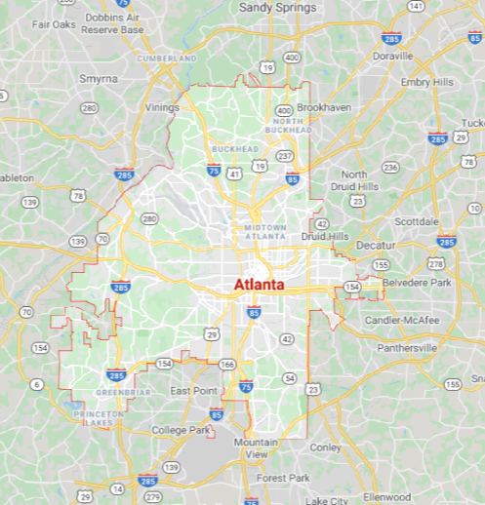
Neighborhoods

Slide 2
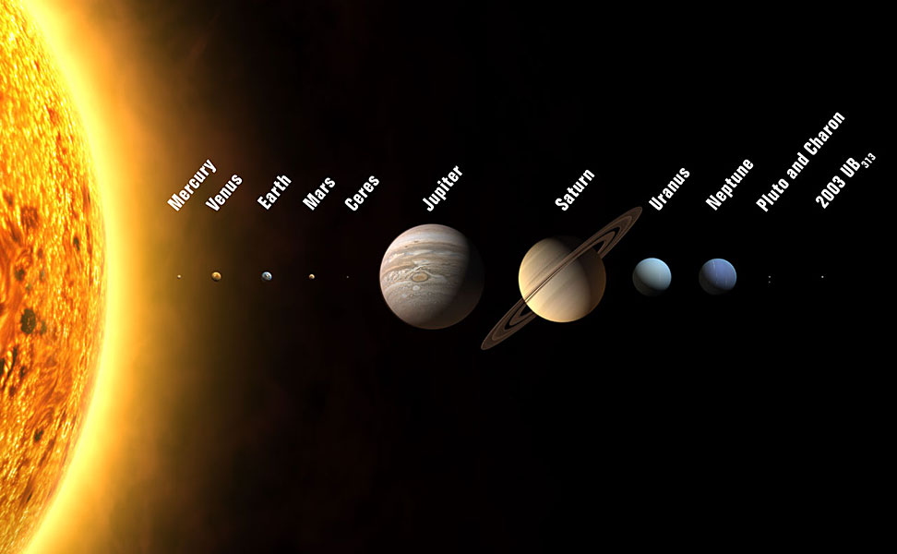
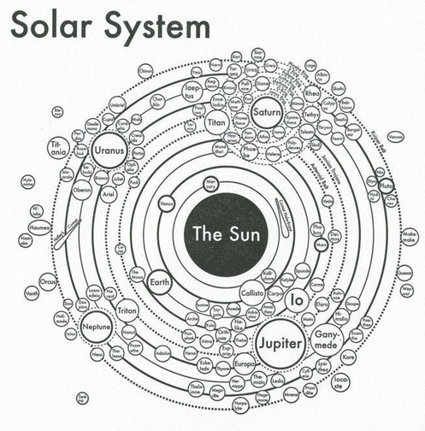
Neighborhoods
Notes:
2003 UB313 = Eris

Slide 3
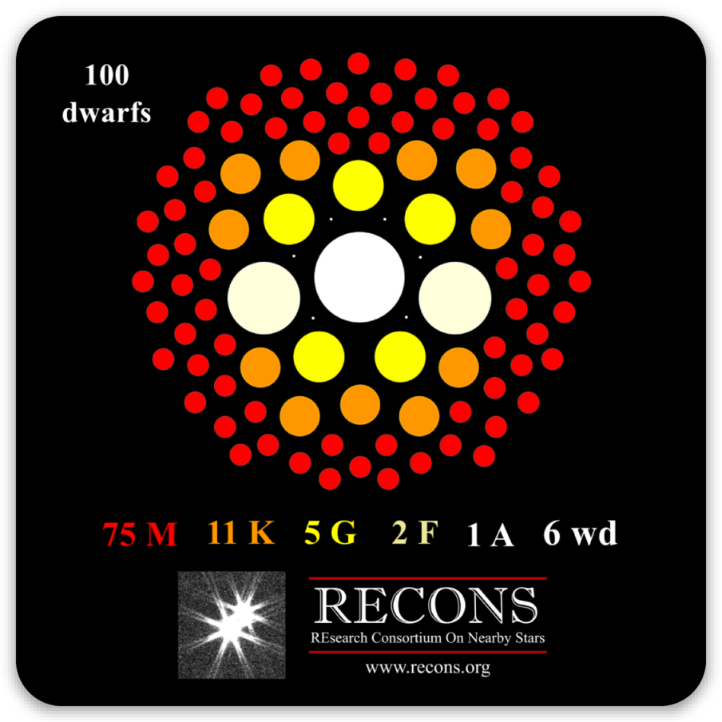
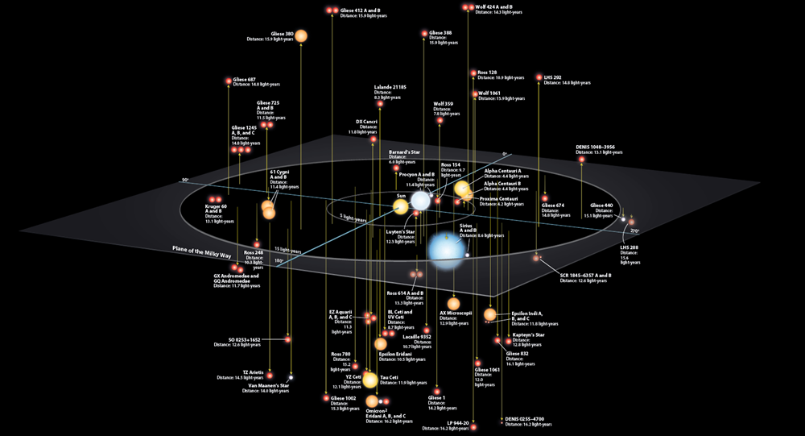
Neighborhoods

Slide 4
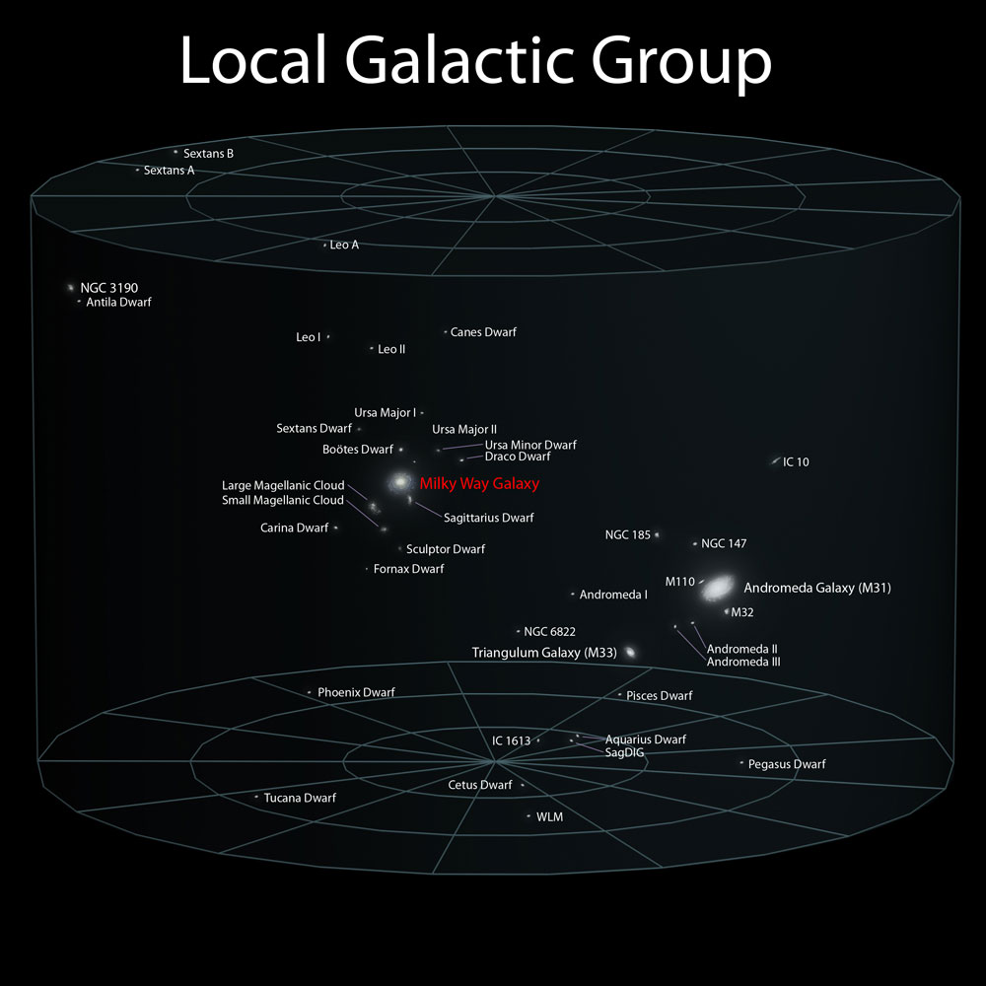
Milky Way Neighborhood

Slide 5
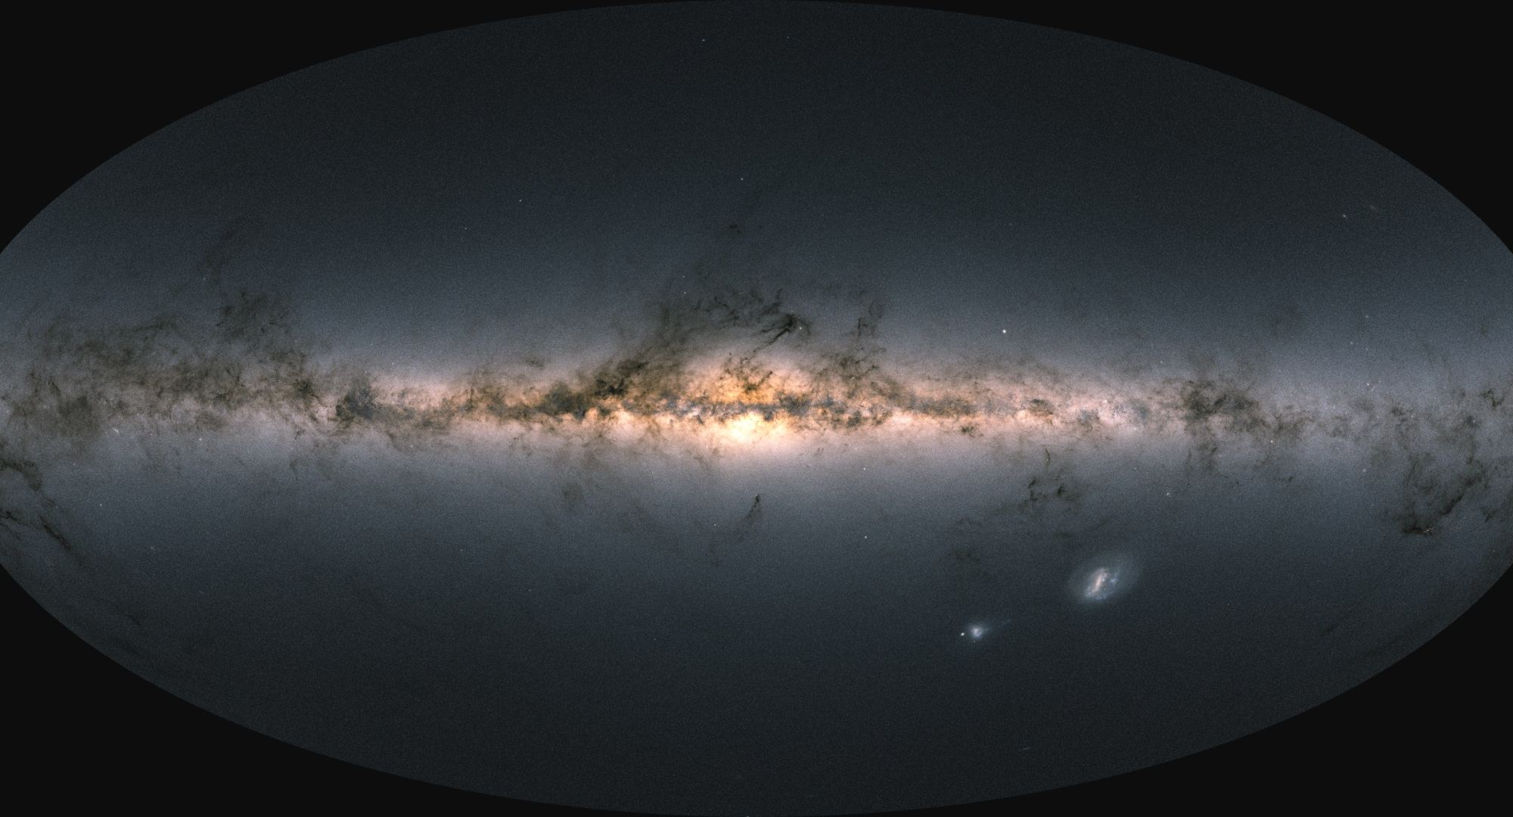
Team Milky Way
Milky Way
Large
Magellanic
Cloud
Small
Magellanic
Cloud

Slide 6
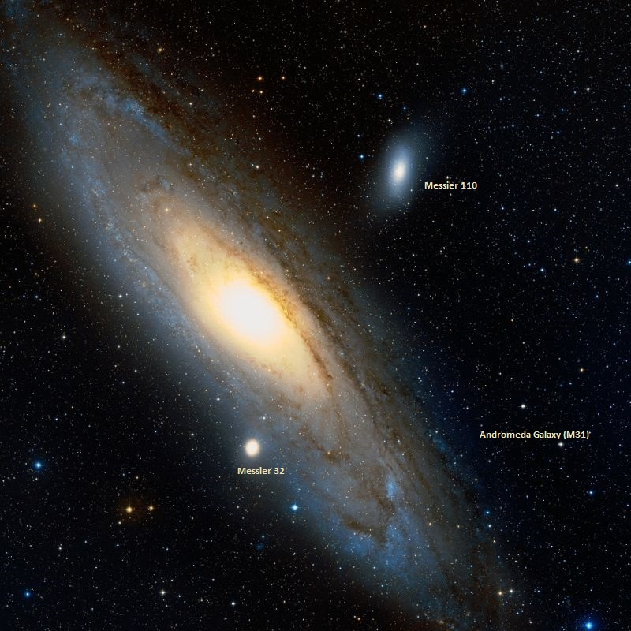
Team Andromeda

Slide 7
Milky Way Neighborhood

Slide 8
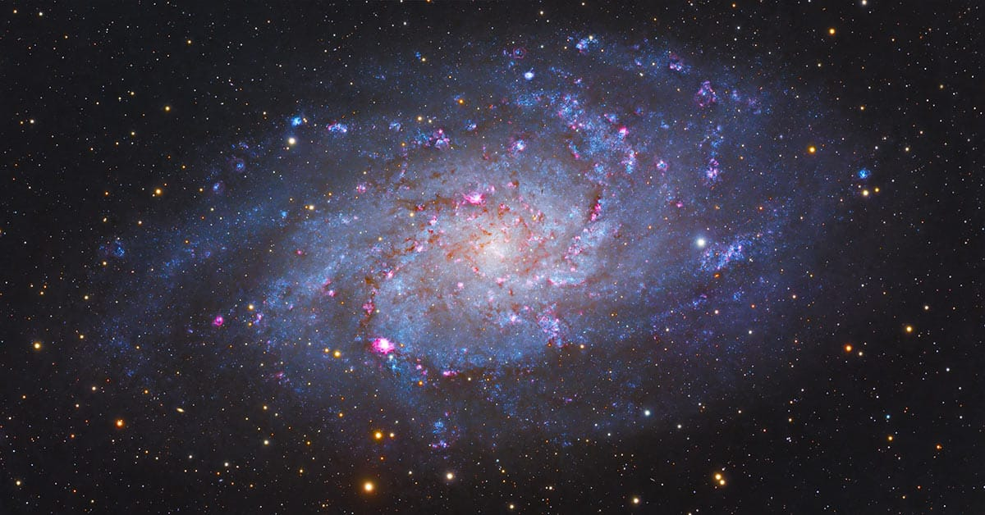
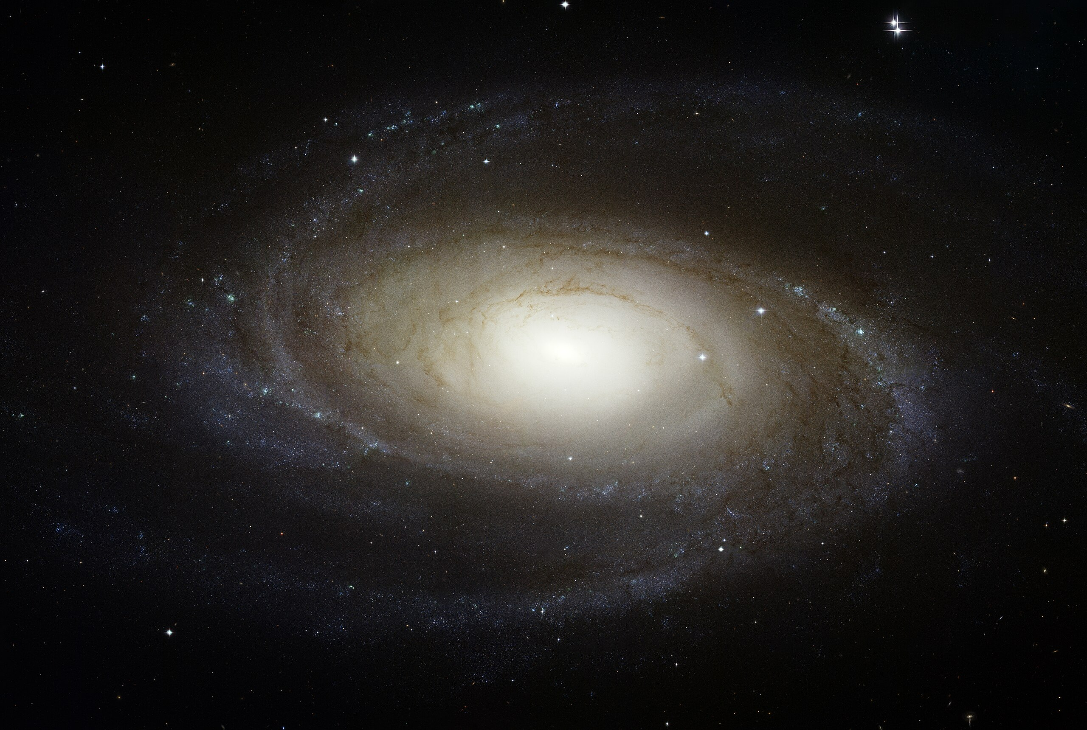
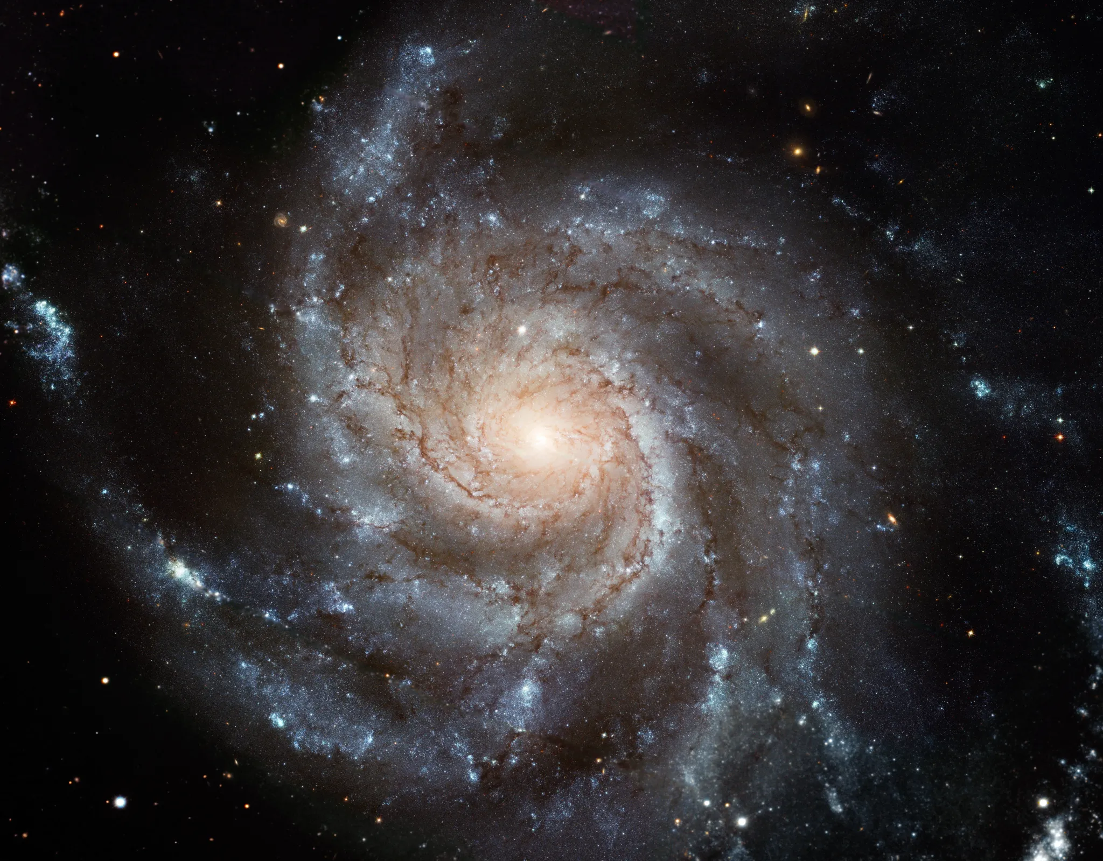
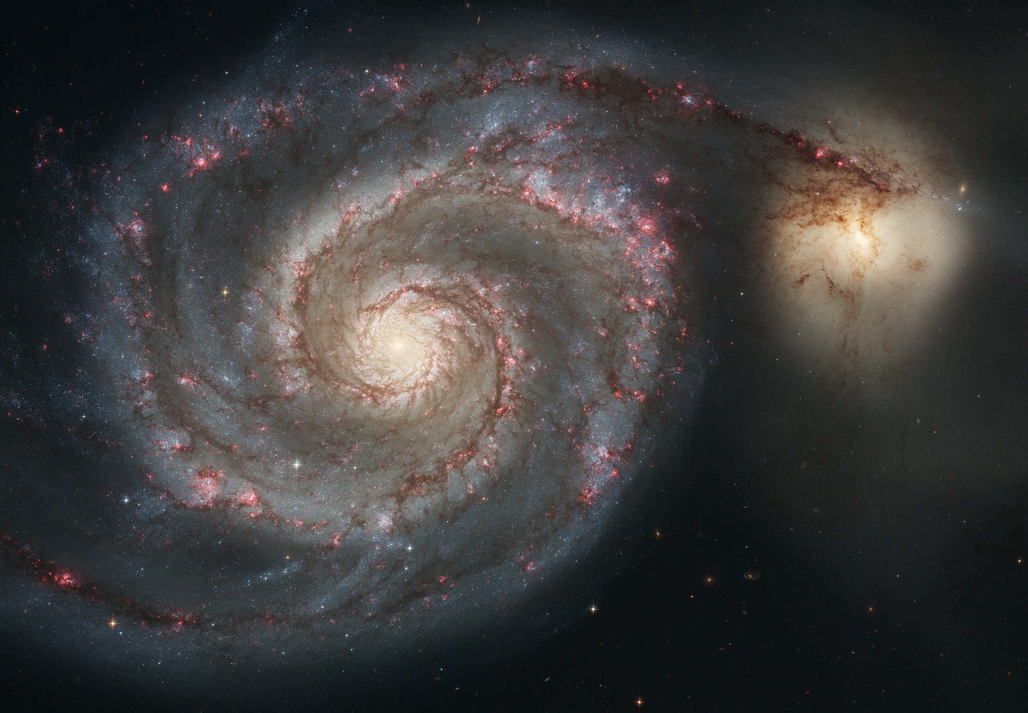
Milky Way Neighborhood
Team Triangulum (M33)
Team Bode’s (M81)
Team Pinwheel (M101)
Team Whirlpool (M51)

Slide 9
Milky Way Neighborhood (2024)
 | RA | DEC | Size (kpc) | Dist (kpc) | Bits / # Globulars / References
Milky Way | --- | --- | 40 | 0 | warp, bar, 2-4 arms, LMC, SMC, Sgr dSph, ~150 globulars
Andromeda M31 | 00:43 | +41:16 | 50 | 730 | warp, bar, 2? arm / ring, M32, M110, ~460 globulars
Triangulum M33 | 01:33 | +30:39 | 19 | 912 | AGN, flocculent, 54 globulars
Bode’s M81 | 09:55 | +69:03 | 27 | 3675 | AGN low-luminosity, thick disk only?, N globulars
Pinwheel M101 | 14:03 | +54:20 | 59 | 6500 | Nearly face-on, circular, > 10^12 stars, 150 globulars
Whirlpool M51 | 13:30 | +47:13 | 38 | 7800 | M52 companion, bridge starburst

Slide 10
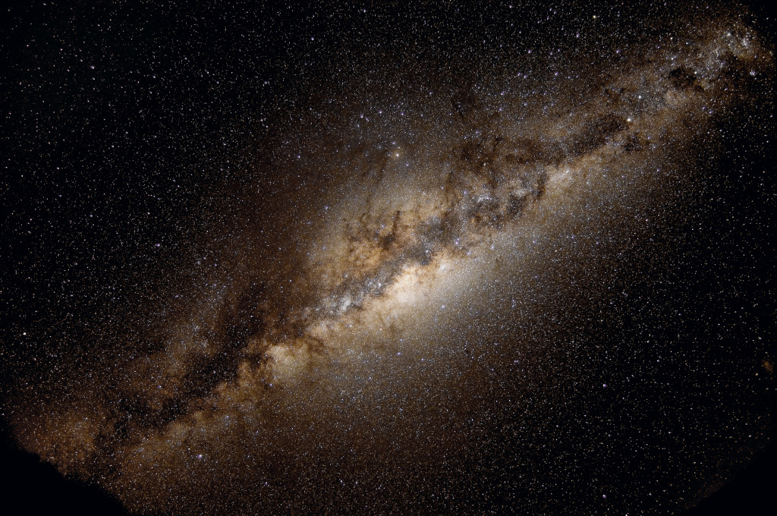
Milky Way Today
What defines the edge of a galaxy?
How do you know the depth of galaxies?
What is the best way to get a distance in the MW Neighborhood?
Why is H_{o} a bad idea here?

Slide 11
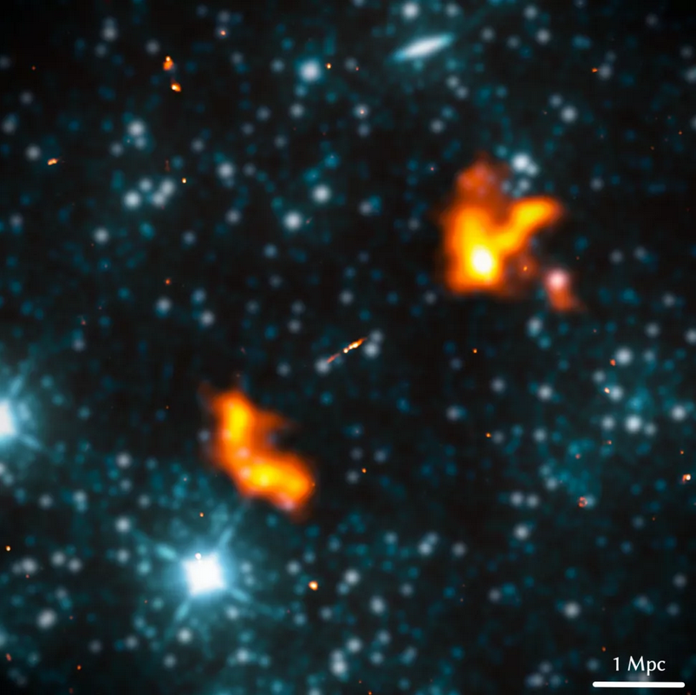
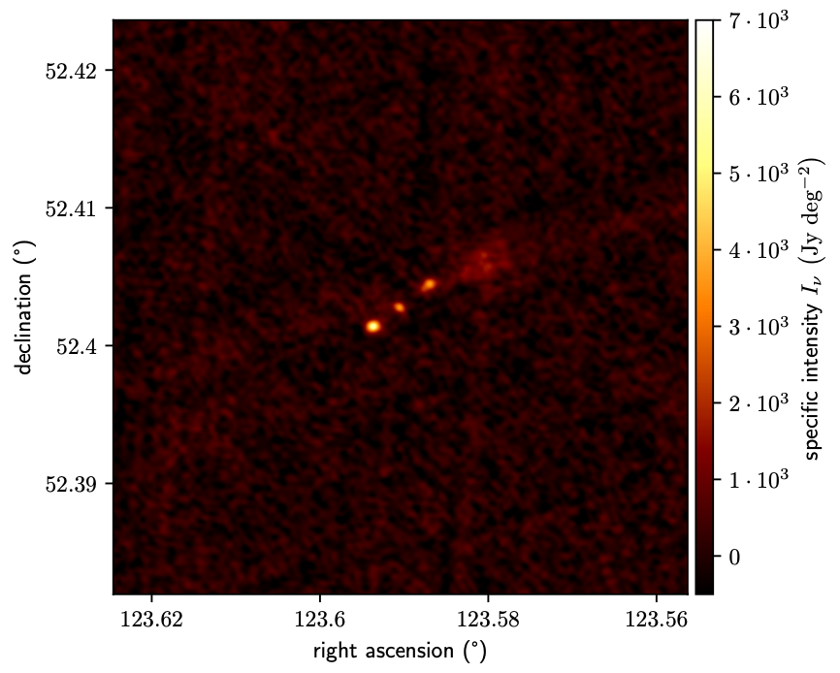
Largest Galaxy Ever
“Alcyoneus”
Alcyoneus was the son of Ouranos, the Greek primordial god
of the sky. He was also one of the greatest of the Gigantes
(Giants), and a challenger to Heracles during the Gigantomachy
— the battle between the Giants and the Olympian gods for
supremacy over the Cosmos.
giant radio galaxy
host at z = 0.25
elliptical … 2.4 x 10¹¹ M_{sun}
SMBH … 4 x 10⁸ M_{sun}
projected length 4.99 Mpc
M. Oei+ (2022)
joint radio (orange) infrared WISE (blue) image
Notes:
host galaxy appears to be ”normal” for giant radio galaxies (which are hardly normal galaxies)
Al – key – o -- nus

