Slide 1
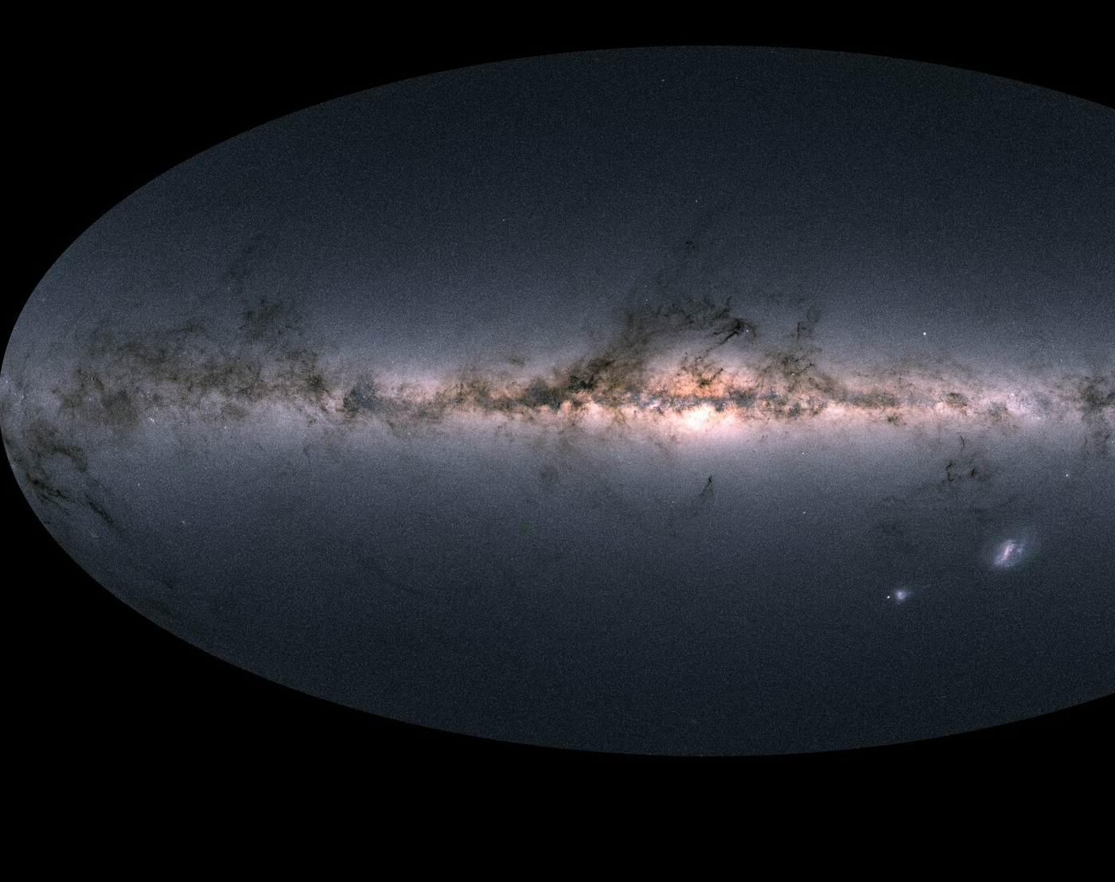
Galactic Structure
Disk Structure and Formation
Guest Lecture
Ilija Medan

Slide 2
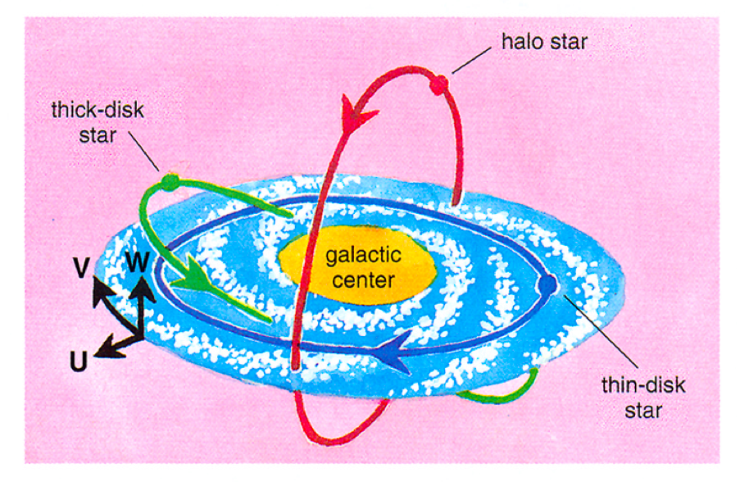
How Did the Galaxy Form?
Evidence of Milky Way formation from both kinematics and chemistry
Kinematics:
Halo star: no rotational velocity
Disk stars: high rotational velocity
Image Credit: Cristina Chiappini
Notes:
Halo stars tend to have almost no rotational velocity (low angular momentum!). Disk is very high angular momentum

Slide 3
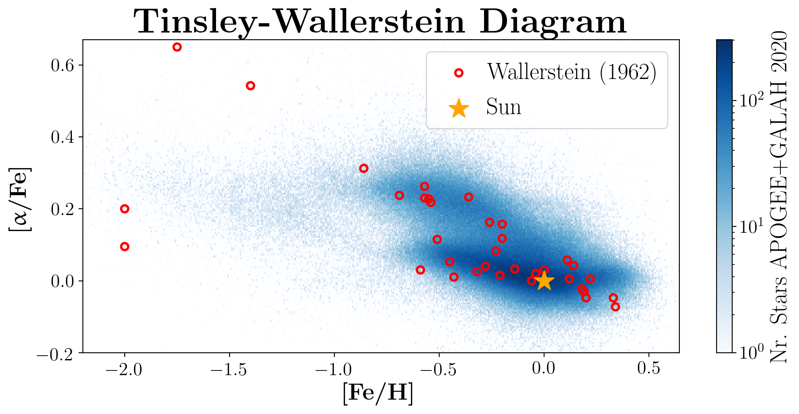
How Did the Galaxy Form?
Evidence of Milky Way formation from both kinematics and chemistry
Kinematics:
Halo star: no rotational velocity
Disk stars: high rotational velocity
Chemistry
Alpha abundance relative to iron different for disk
Indication of periods of star formation
Halo + Thick Disk
Thin Disk
Notes:
Halo stars tend to have almost no rotational velocity (low angular momentum!). Disk is very high angular momentum

Slide 4
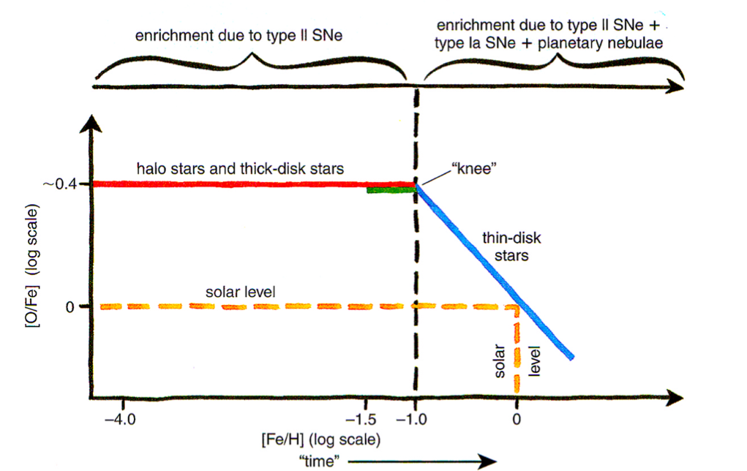
How Did the Galaxy Form?
Evidence of Milky Way formation from both kinematics and chemistry
Kinematics:
Halo star: no rotational velocity
Disk stars: high rotational velocity
Chemistry
Alpha abundance relative to iron different for disk
Indication of periods of star formation
Image Credit: Cristina Chiappini
Notes:
Halo stars tend to have almost no rotational velocity (low angular momentum!). Disk is very high angular momentum
Takes ~I billion years for Type Ia to start. Disk formed after that initial period. Also some amount of star formation happening while knee part going on

Slide 5
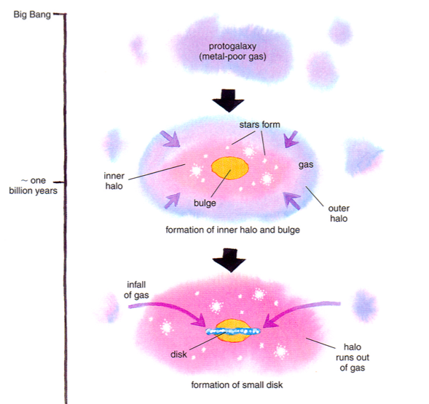
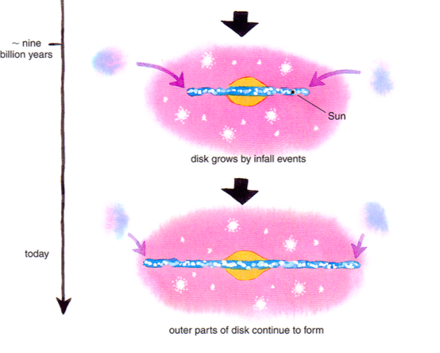
Disk Formation: Two-Infall Model
Image Credit: Cristina Chiappini
Notes:
First infall is what forms the halo and the bulge. This is low angular momentum gas so that’s why its not unform
Disk is formed from infall of high angular momentum gas. Probably from another merger or satellite passing by. As infall happens, get star formation. HALO FIRST DISK LAST!

Slide 6
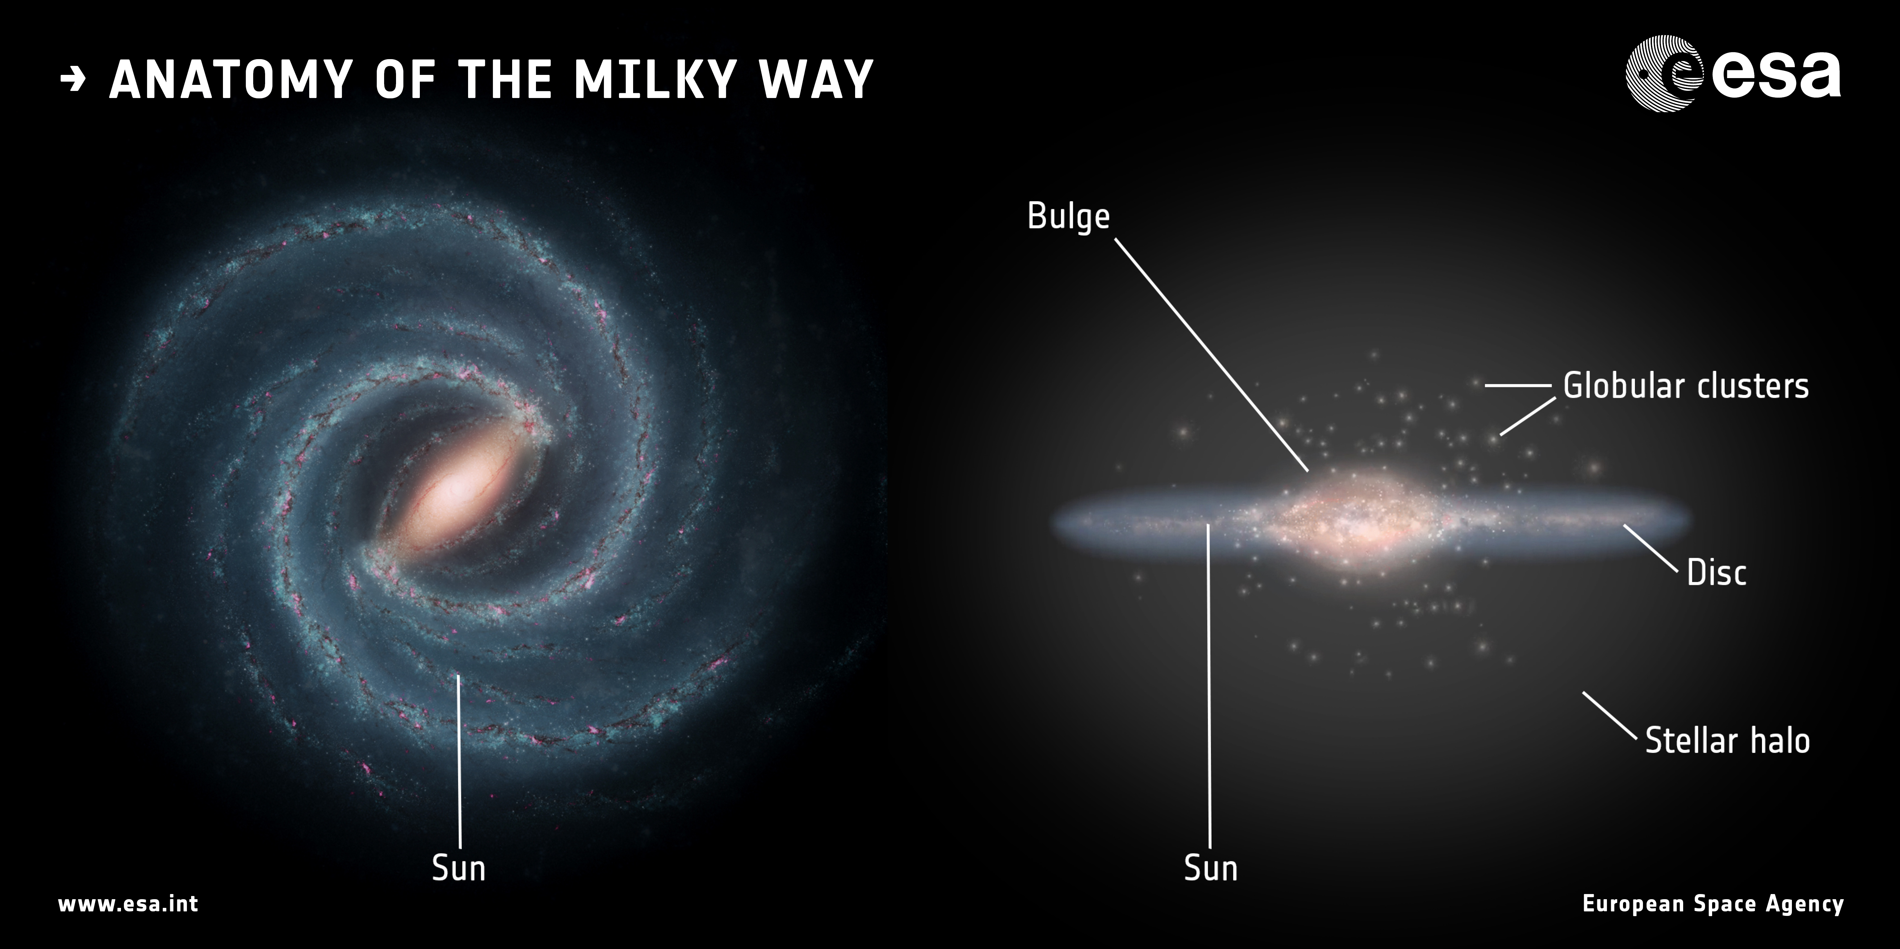
Where’s the Mass?
We now have a good visual picture of the disk
Also have good idea how it formed
How is the mass distributed? How do we trace this?

Slide 7
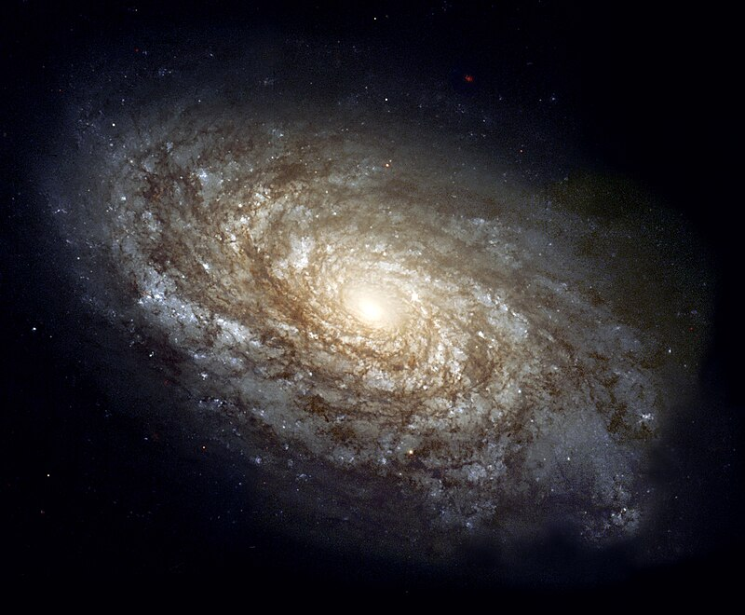
Galactic Rotation Curves
Can use rotational velocity to inform about mass of galaxy:
Most visible light in galaxies in the disk! So, would imply:

Slide 8
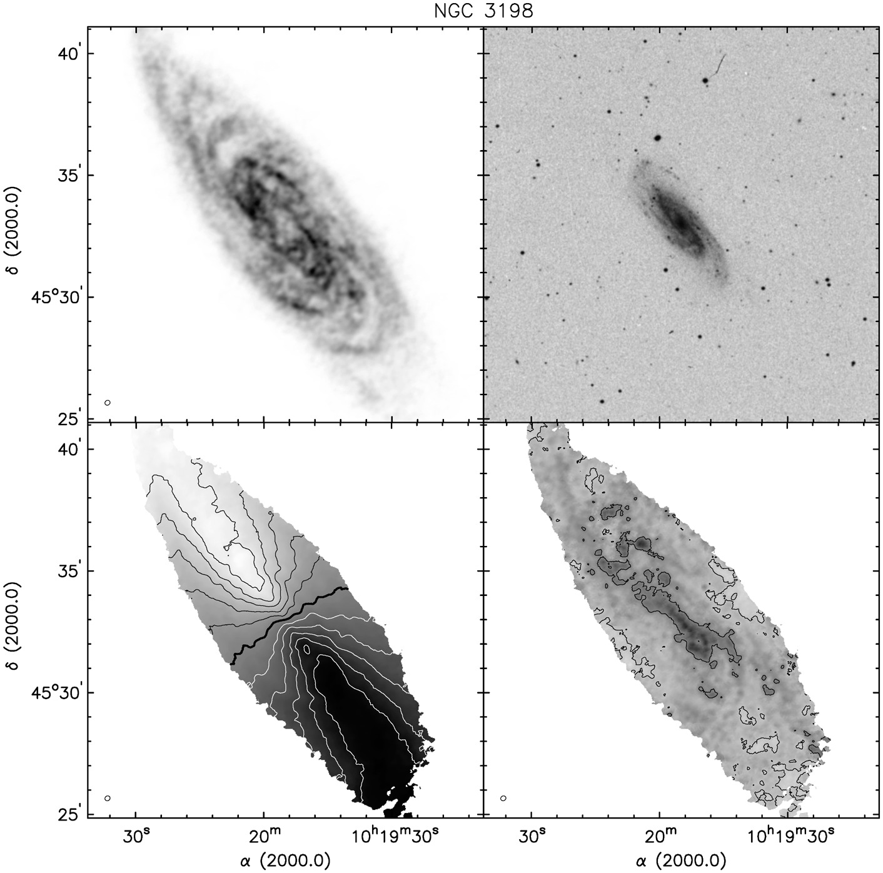
Rotation Curves External Galaxies
HI
Optical
LOS Velocity
Velocity Dispersion
Image Credit: Walter et al. 2008
Image Credit: Begeman 1989
Notes:
MGC 3198
Mu = surface brightness profile. Assume mass to light ratio to get density profile

Slide 9
Rotation Curves External Galaxies
HI
Optical
LOS Velocity
Velocity Dispersion
What’s Missing???
Image Credit: Walter et al. 2008
Image Credit: Begeman 1989
Notes:
Mu = surface brightness profile. Assume mass to light ratio to get density profile
Know inclination? Then can get rotation curve

Slide 10
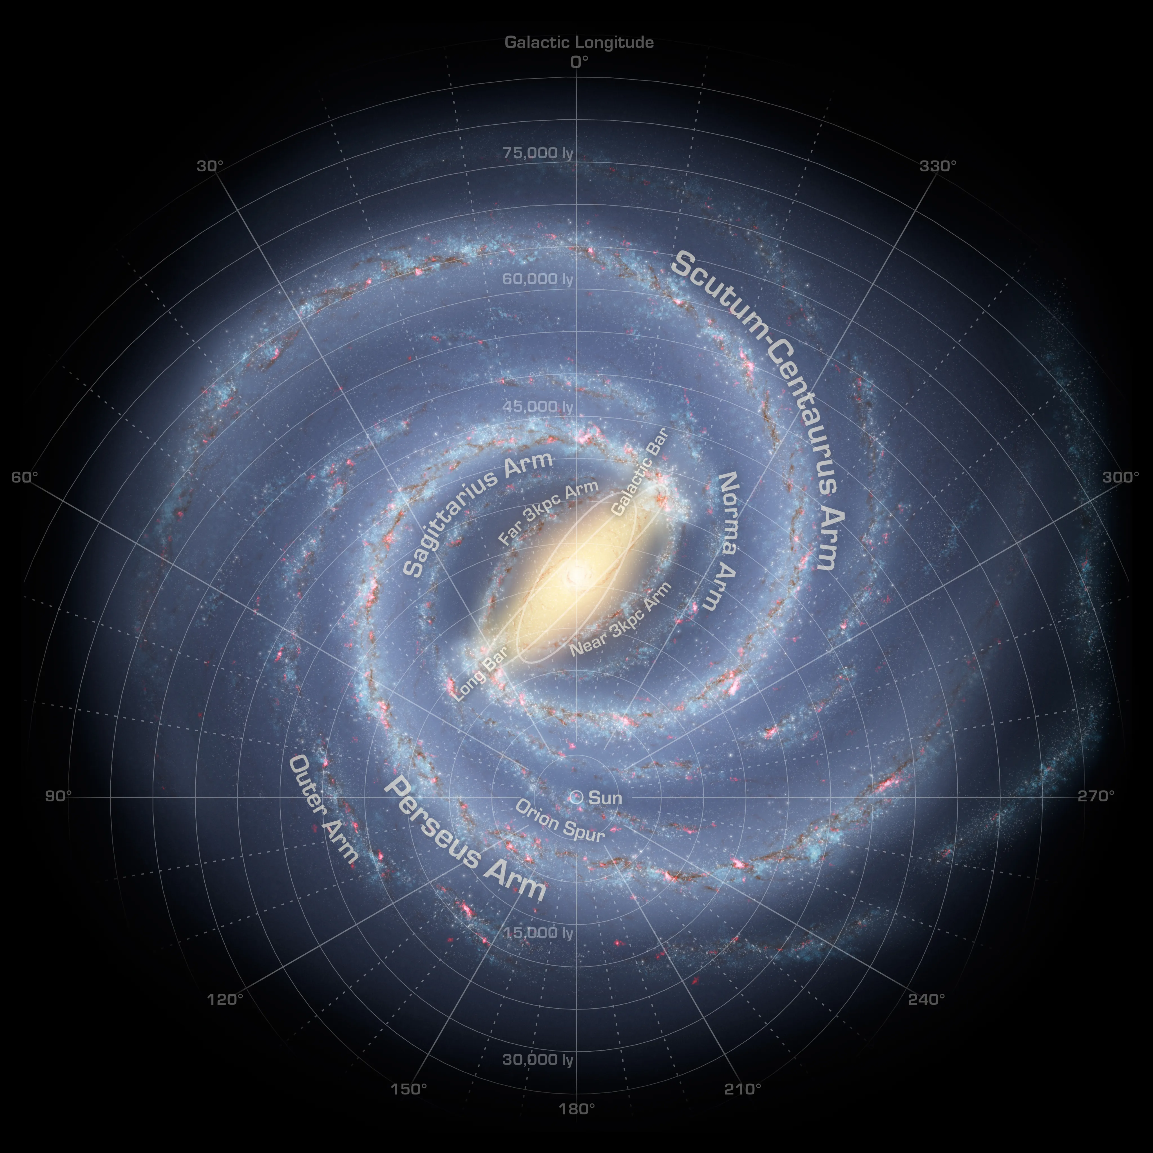
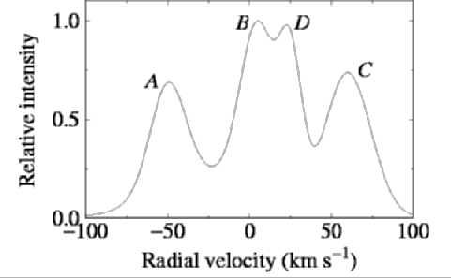
Milky Way Rotation Curve – Tangent Method
How do you measure rotation when you are inside the rotating disk?
Use HI clouds!
Don’t know distance to clouds? Assume v decreases with R
Have relationship between circular velocity and R!
Only works for R < R_{Sun}…
Assumes maximal velocity at tangent…
A
B
R_{min}
C
R_{Sun}
l
d
D

Slide 11
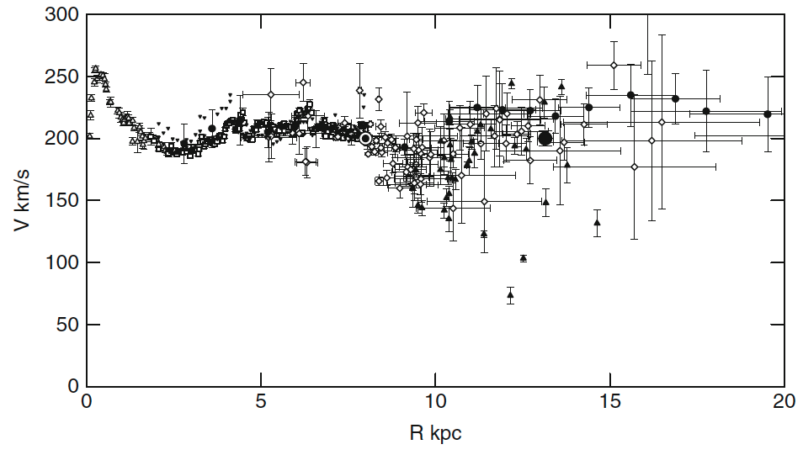
Milky Way Rotation Curve
Less tracers at large R (use HII regions, VERA parallax)
Dips?
NEED MORE THAN A DISK!
Also, no dropoff at large R
Image Credit: Sofue et al. 2009
Notes:
Vera parallax is from mission monitoring radio emitting stars

Slide 12
Milky Way Rotation Curve
Bulge
Disk
(Dark) Halo
NEED MORE THAN A DISK!
Image Credit: Sofue et al. 2009

Slide 13
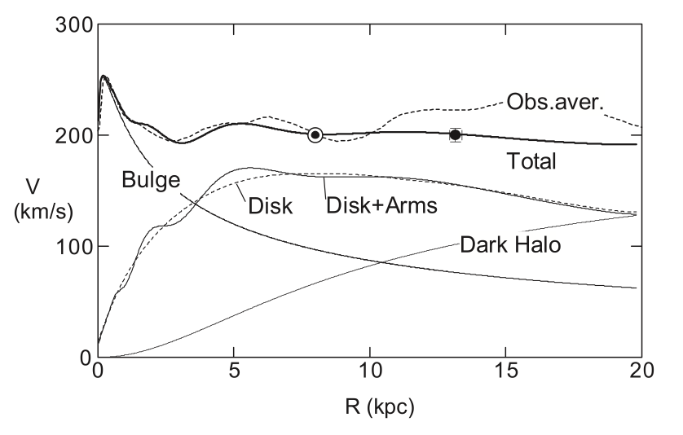
Milky Way Components
Velocity profile of three components
Adding spiral arms adds “wiggles” to the curve
Explain dips in rotation curve?
Some recent studies don’t see such pronounced dips
Image Credit: Sofue et al. 2009

Slide 14
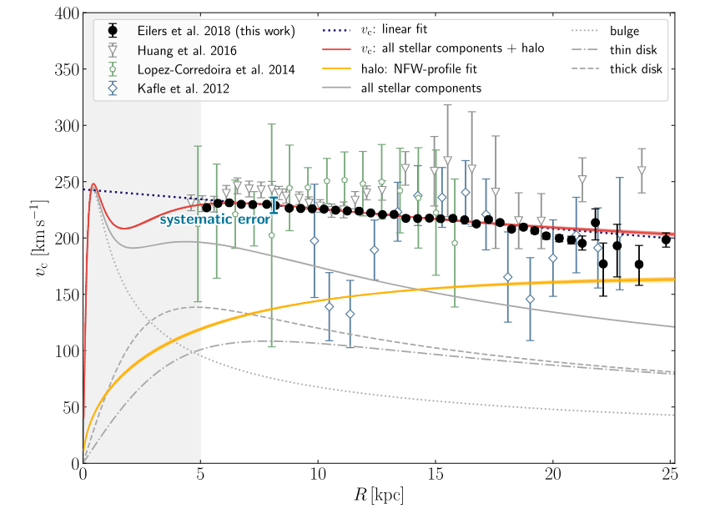
Milky Way Components
Velocity profile of three components
Adding spiral arms adds “wiggles” to the curve
Explain dips in rotation curve?
Some recent studies don’t see such pronounced dips
Image Credit: Eilers et al. 2019

Slide 15
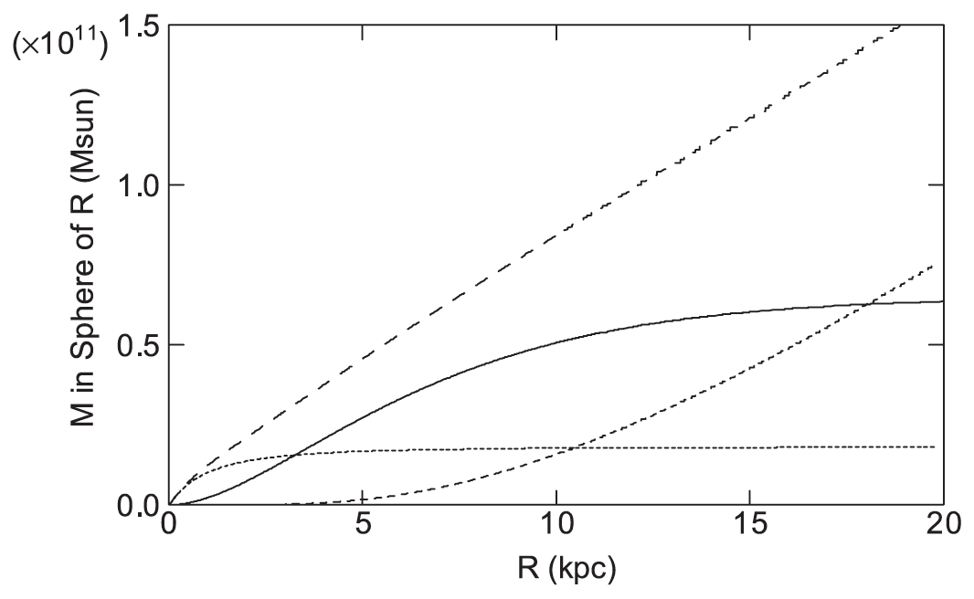
Milky Way Mass Profile
Fitting rotation curve with 3 components gives total mass profile
~10¹¹ M_{sun} for R < 12 kpc
Median stellar mass:
0.3 M_{sun}
~300 billion stars
Total
Disk
(Dark) Halo
Bulge
Image Credit: Sofue et al. 2009

Slide 16
Next Week
In class exercises!
https://github.com/imedan/gs_guest_lecture

