Slide 1




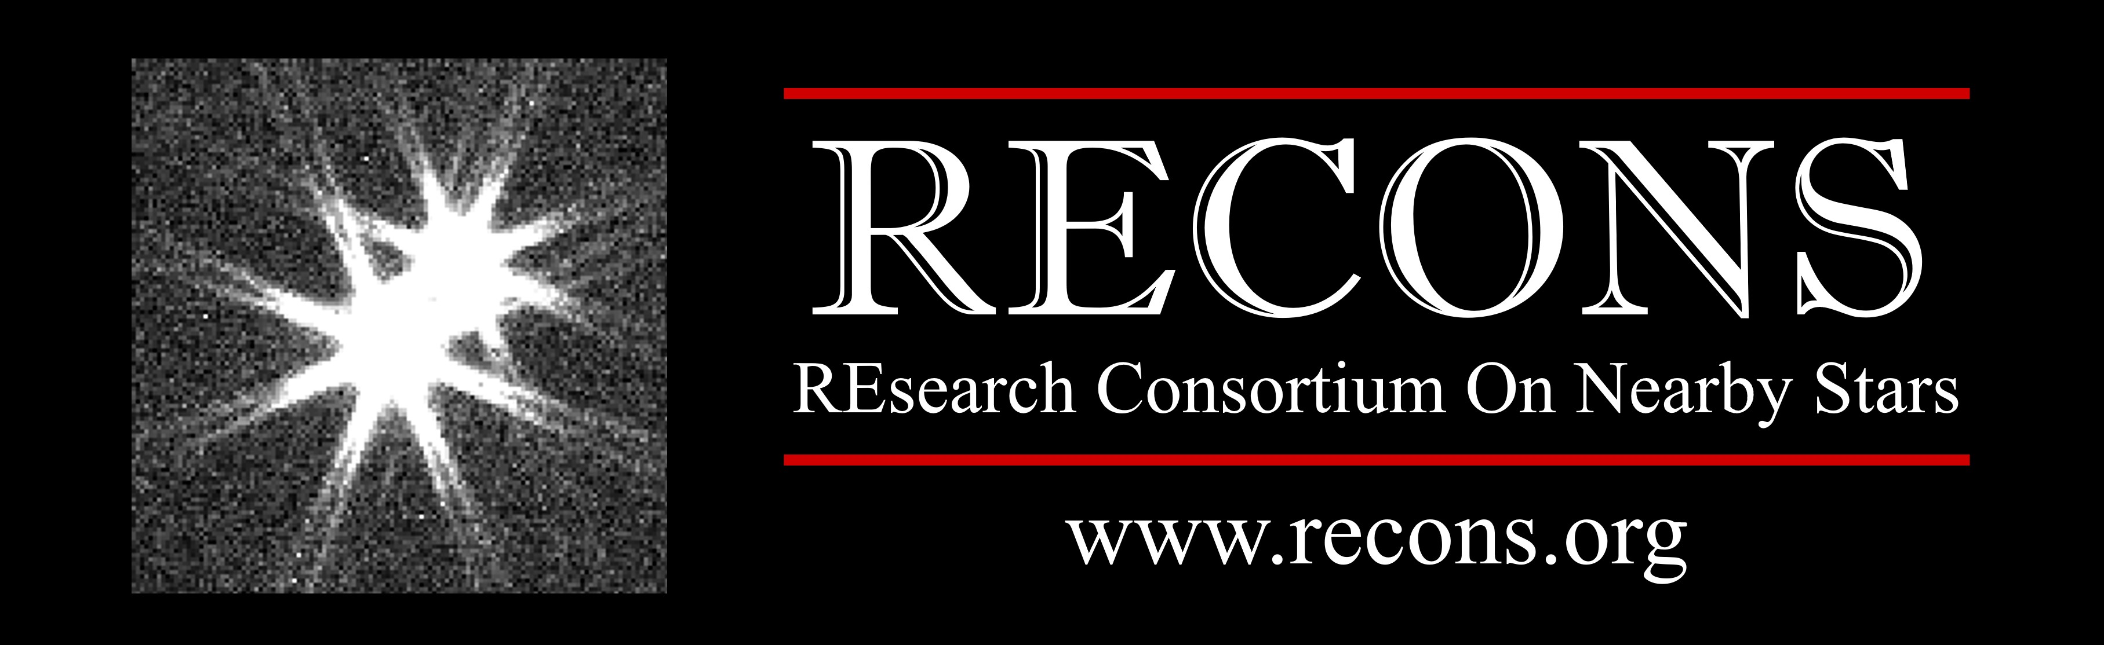





Young K Dwarfs and Space Motions in the Solar Neighborhood: The Nearby Young K dwarfs Paradox, and How I’m losing my mind
SEBASTIÁN CARRAZCO-GAXIOLA ^{1,2}
Astronomy PhD Candidate | CHIRON/SMARTS 1.5-m Telescope Fellow
ASTR8200 / Guess Lecture
2026.0303
Notes:
00:00-00:30
Young K Dwarfs and Space Motions in the Solar Neighborhood
Since you are actually an astronomer (or presenting in that field), using this specific image is a fantastic "full circle" moment. It’s not plagiarism; in fact, it’s a standard way to bridge pop culture and science history.
The Backstory (Use this to your advantage)
The image on Unknown Pleasures is a "stacked plot" of 80 pulses from the first pulsar ever discovered: PSR B1919+21 (then called CP 1919).
The Scientist: While Jocelyn Bell Burnell discovered the pulsar in 1967, the specific visualization used on the album was actually created by Harold D. Craft, Jr. for his 1970 PhD thesis at Cornell/Arecibo.
The Designer: Peter Saville (the album artist) simply found it in the Cambridge Encyclopedia of Astronomy and inverted the colors.
How to Acknowledge it on a Slide
Since you are giving a science talk, you can credit the "scientific" source and "aesthetic" source simultaneously. Here are two ways to do it:
Option 1: The "Classy Science" Credit (Lower corner of the image)
Data visualization of PSR B1919+21 by Harold D. Craft, Jr. (1970); stylized after Peter Saville’s cover for Joy Division's Unknown Pleasures.
Option 2: The "Short & Punchy" Credit (Good for a title slide)
Visual: Pulsar B1919+21 (Credit: H. Craft / Joy Division)

Slide 2
CHIRON / NOIRLab Resources
CHIRON FAQ:
https://astro.gsu.edu/~thenry/SMARTS/CHIRON_FAQ.pdf
NOIRLab Obs Archive:
https://astroarchive.noirlab.edu/portal/search/
NASA Funding Recources
https://science.nasa.gov/researchers/sara/grant-solicitations/

Slide 3

Galactic Kinematics and Young Associations
Current status

Slide 4
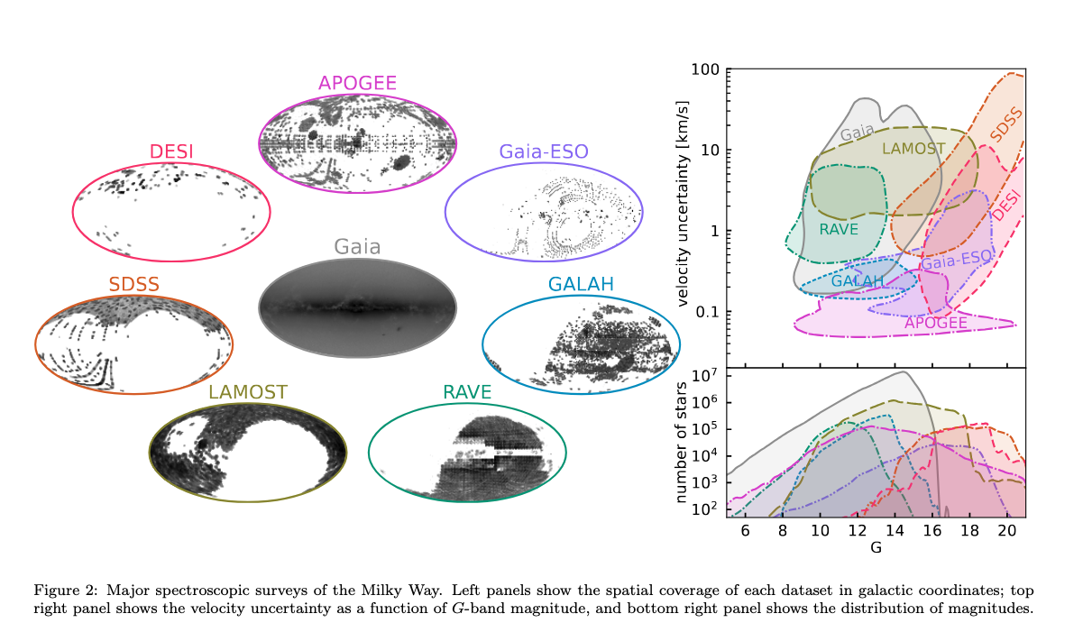
Industrial Scale Spectroscopy and Kinematics
Hunt & Vasiliev, 2025

Slide 5
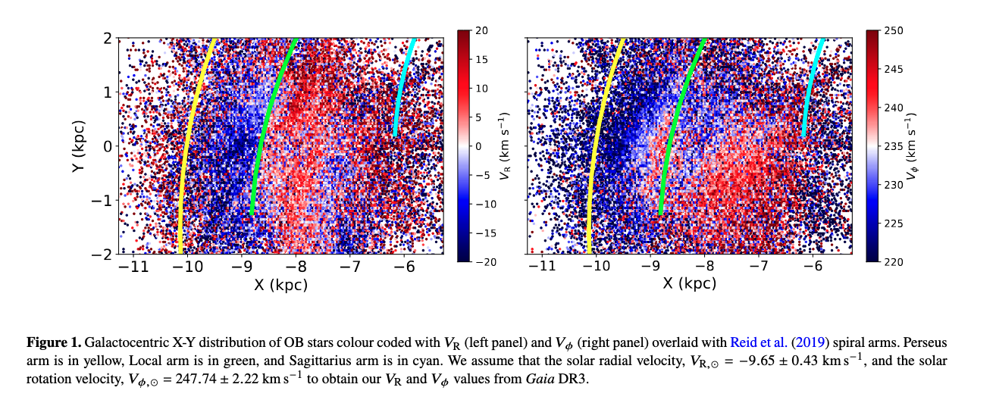
Using Young Stars: OB stars
Almannaei+24

Slide 6
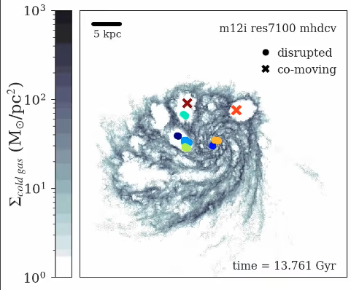
MHD Simulations, Mergers, and Star Formation
https://aas247-aas.ipostersessions.com/?s=8E-5C-70-81-14-E5-54-51-EC-55-35-20-09-2B-A5-07
Bertolloto-Stefanelli+2026

Slide 7
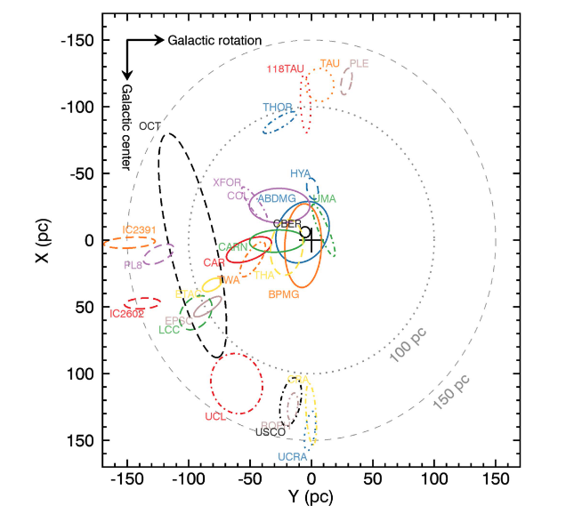
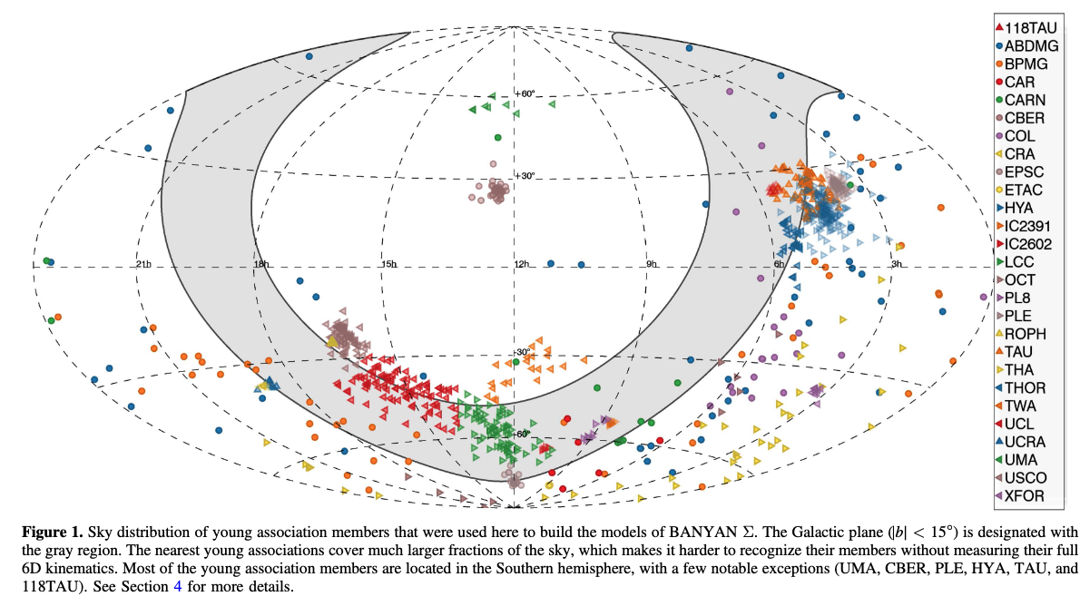
Young Moving Associations // BANYAN Σ

Slide 8
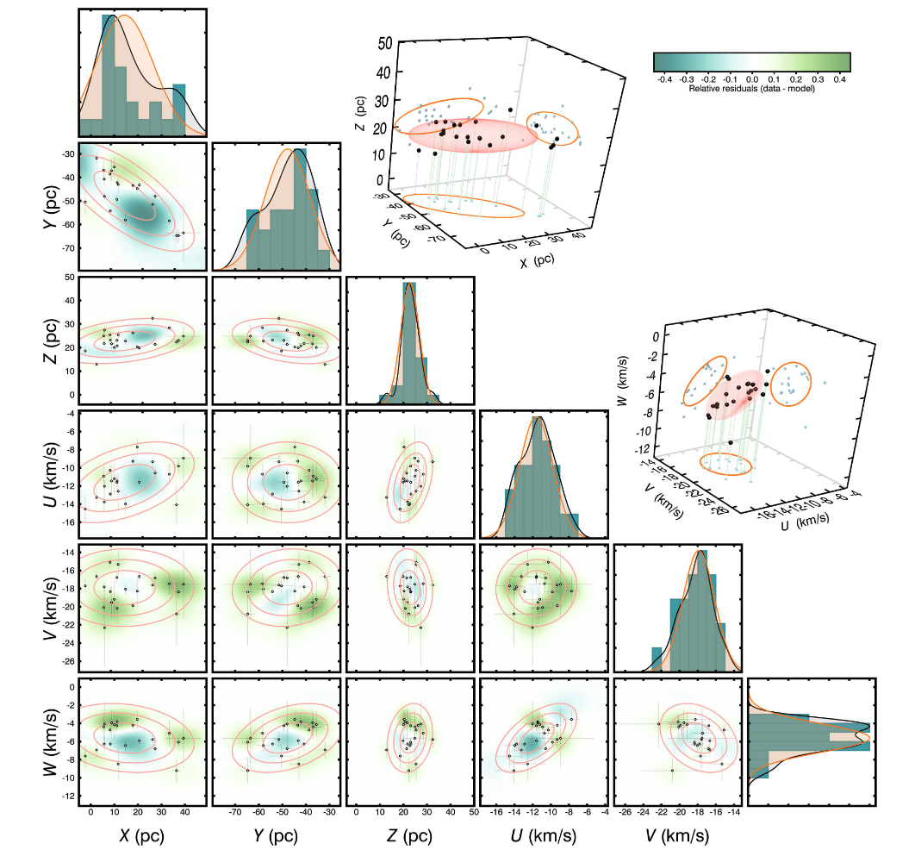
BANYAN Σ
in work
Multivariate Gaussian model of TW Hydrae association

Slide 9
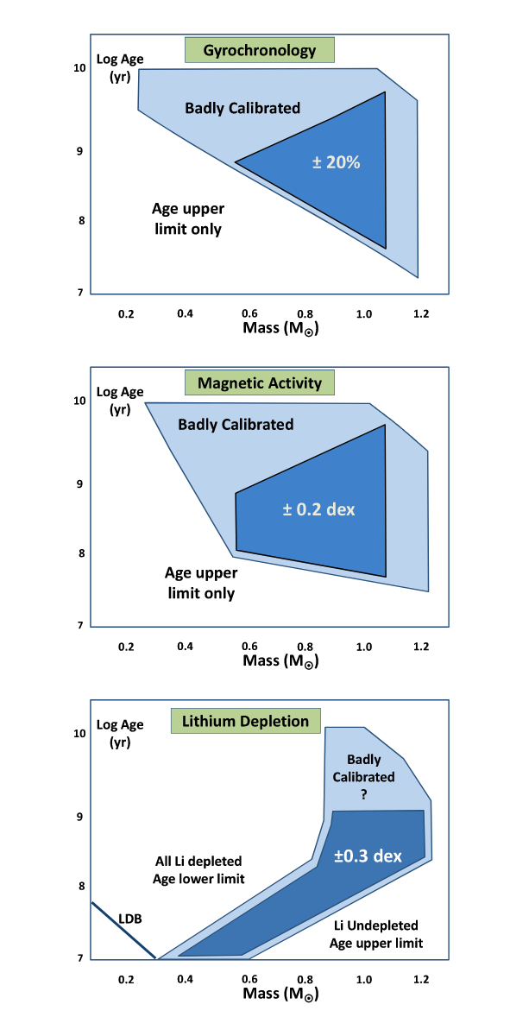
Ages // The age Matrix
From: Jeffries+2014

Slide 10
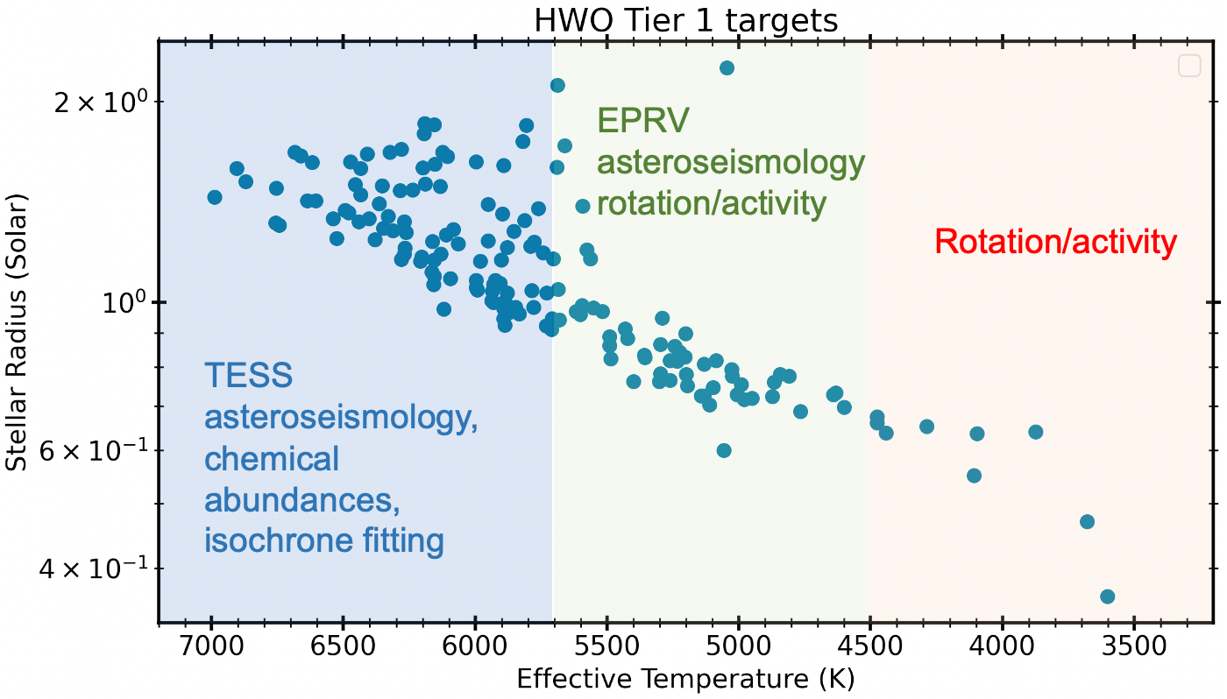
Ages // The age Matrix
From: “Precursor and Preparatory Science Needs for the HWO Target Star Systems”
Mamajek in prep.

Slide 11
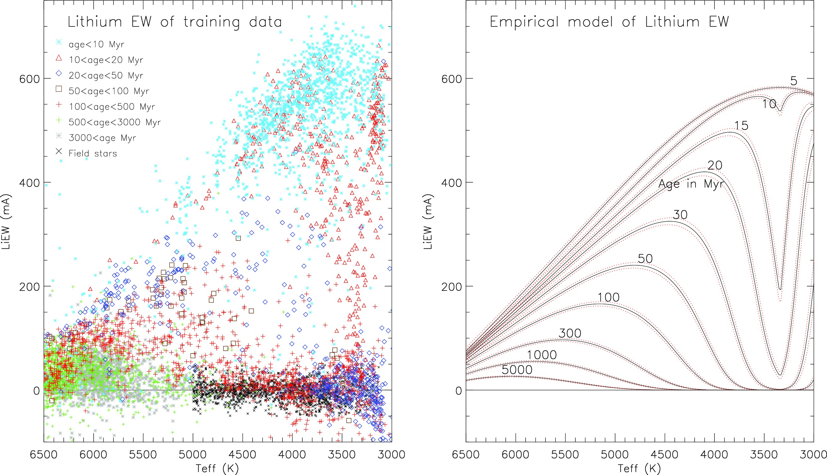
Ages by
Li I Depletion
K dwarfs
Perfect!
Lithium in photosphere from formation
Is depleted as star ages
Depletes Li I faster
Clumpy
EAGLES*, Jeffries+2023
6200 stars in 52 open clusters, observed in the Gaia-ESO spectroscopic survey.
ages from 2–6000 Myr
−0.3 < [Fe/H] < 0.2,
Jeffries+2023

Slide 12
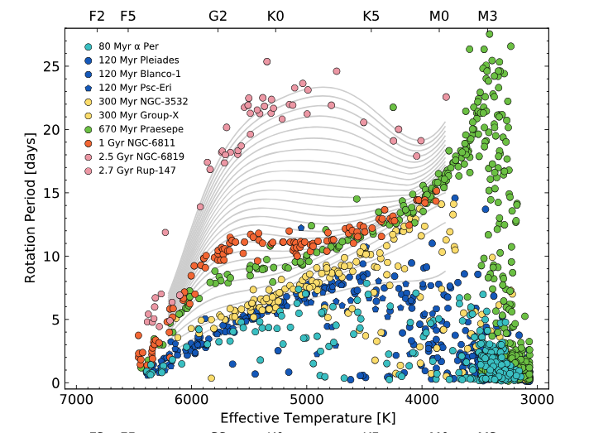
Gyrochronology, Up to 3 Gyr
K dwarfs
Clumpy
Perfect!
To derive ages of field stars using the
spin down clocking relation, using young coeval of stars
Bouma+2023,+2024

Slide 13
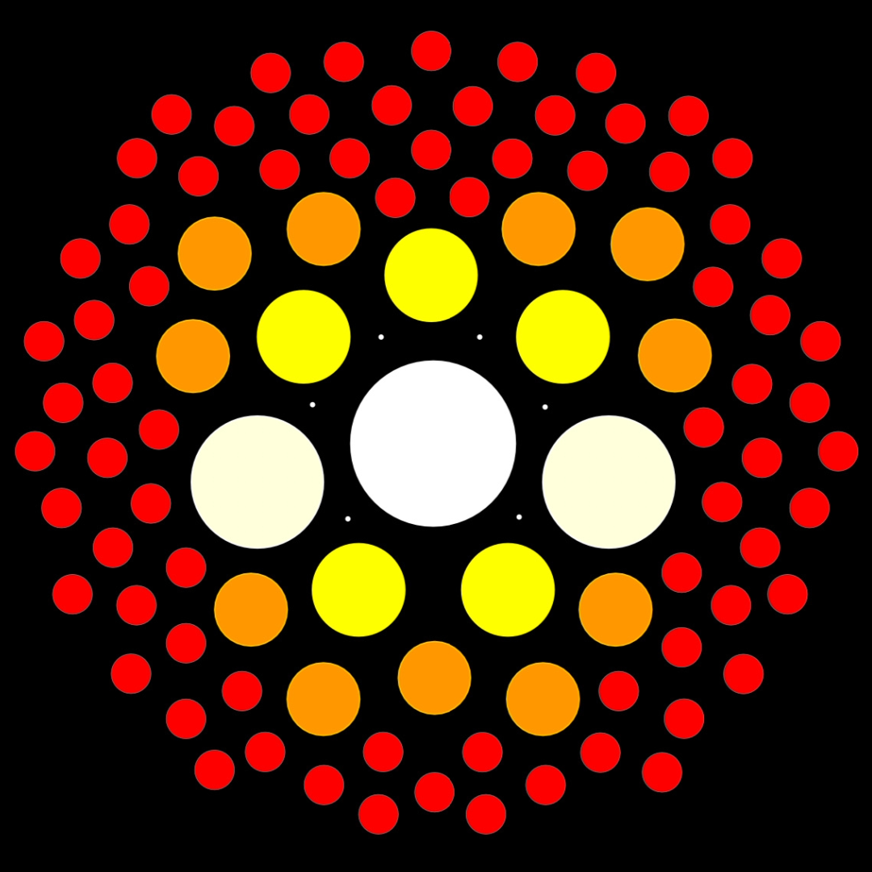
How K dwarfs contribute??
Current status

Slide 14
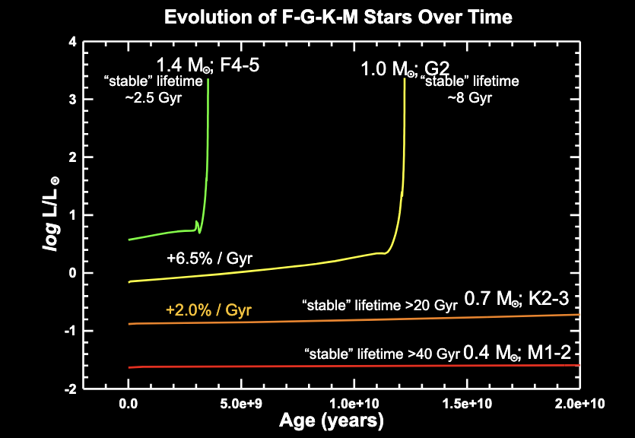
Why K dwarfs?
Second most abundant type of stars, 11% in solar neighborhood
Long lifetimes
15-45 Gyr (Guinan+2016)
Perfect trackers for abundances and star formation history (Kotoneva+2002)
Guinan+2016
Notes:
01:30-2:30

Slide 15
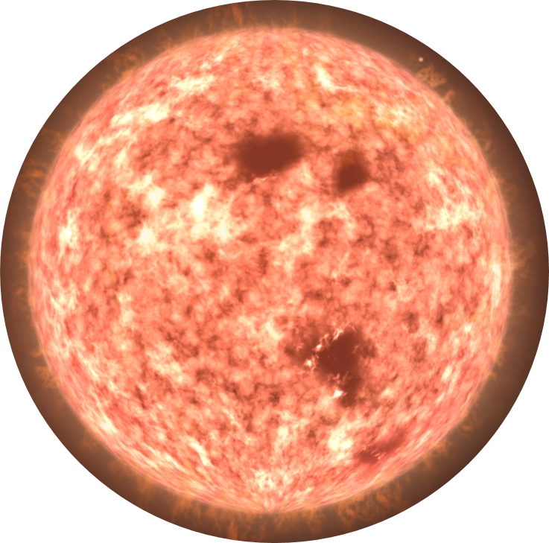

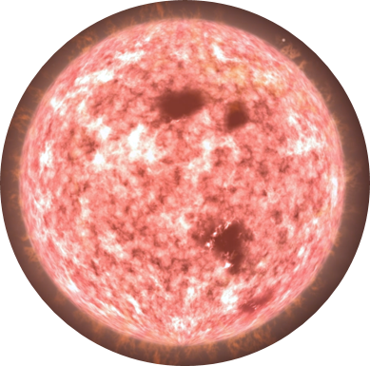
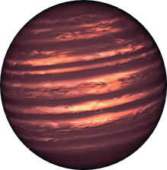
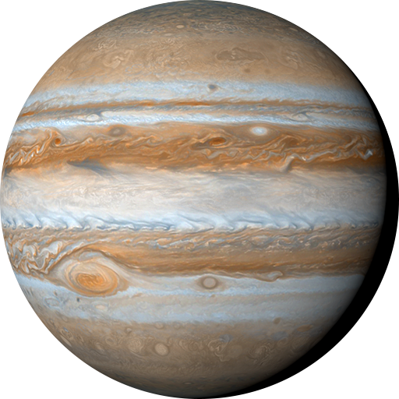
RKSTAR Project
RECONS K STAR
RKSTAR
Characterization
Primary stars
study 2198 K dwarf systems within 40 parsecs
4 science surveys (more at Hubbard-James+2026)
companions at 3 separations
characterization … TODAY
High-Resolution Imaging
Speckle
Wide Companions
Spectroscopy
Radial Velocity
Characterization
Lower mass companions, down to Jupiter mass
S. Carrazco-Gaxiola, K-dwarf Spectroscopic Census, AAS 247 Talk 231.06
Notes:
03:00-03:30

Slide 16
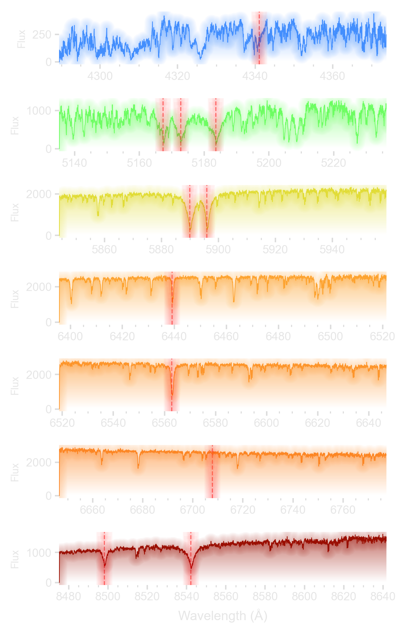
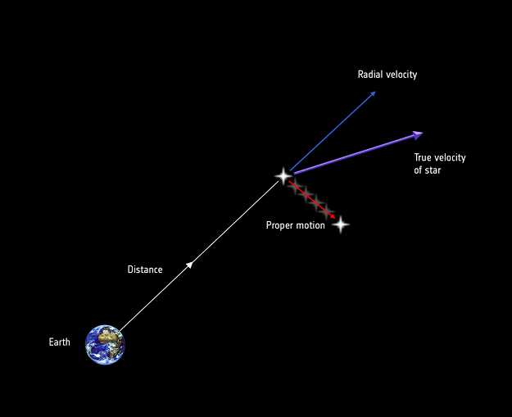

RKSTAR
Characterization
High-Resolution Spectroscopy
Spectroscopy
these spectra give us:
Temperature,
Luminosity,
Composition,
Activity/Magnetism,
Space Velocities
Ages
Space Astrometry
Credit: ESA/ATG medialab
S. Carrazco-Gaxiola, K-dwarf Spectroscopic Census, AAS 247 Talk 231.06

Slide 17
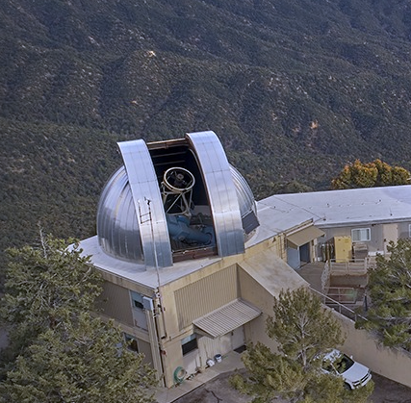
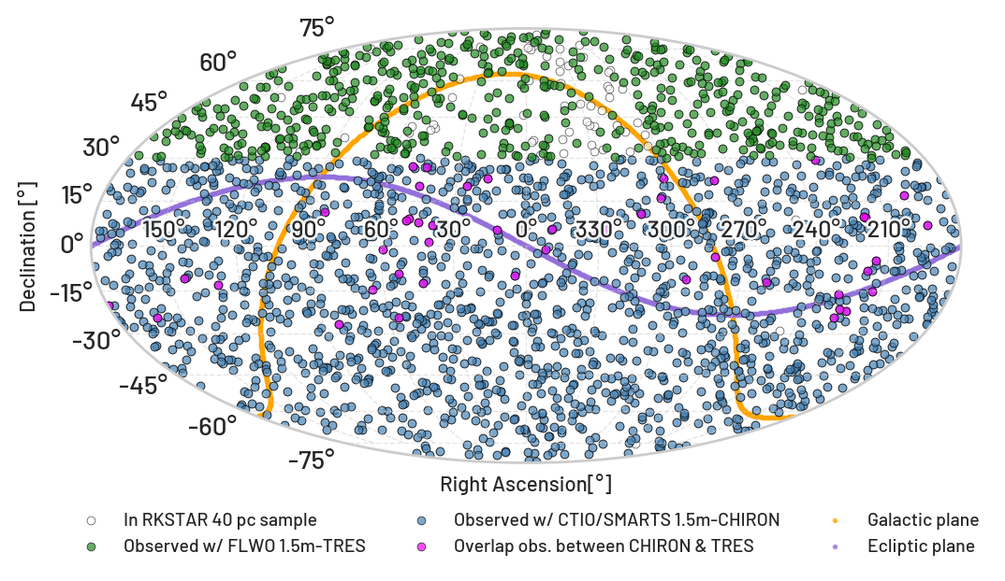
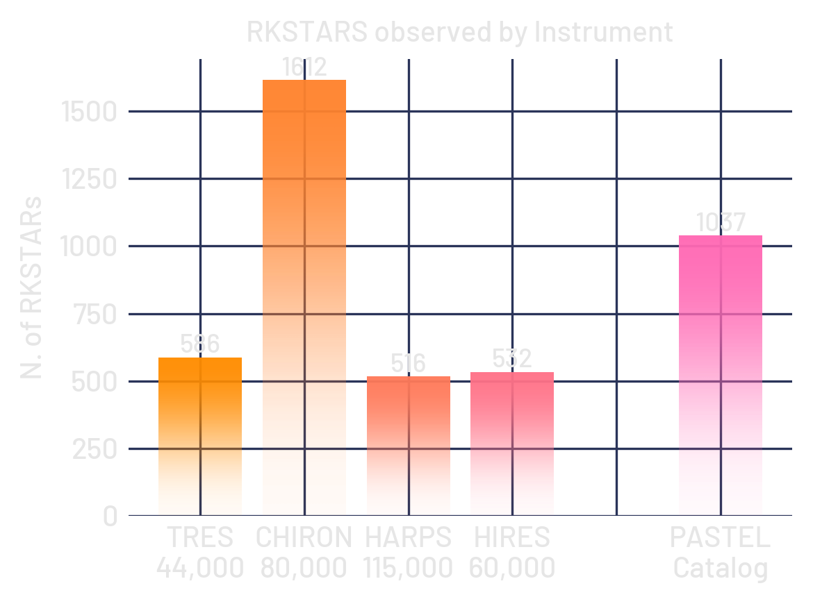
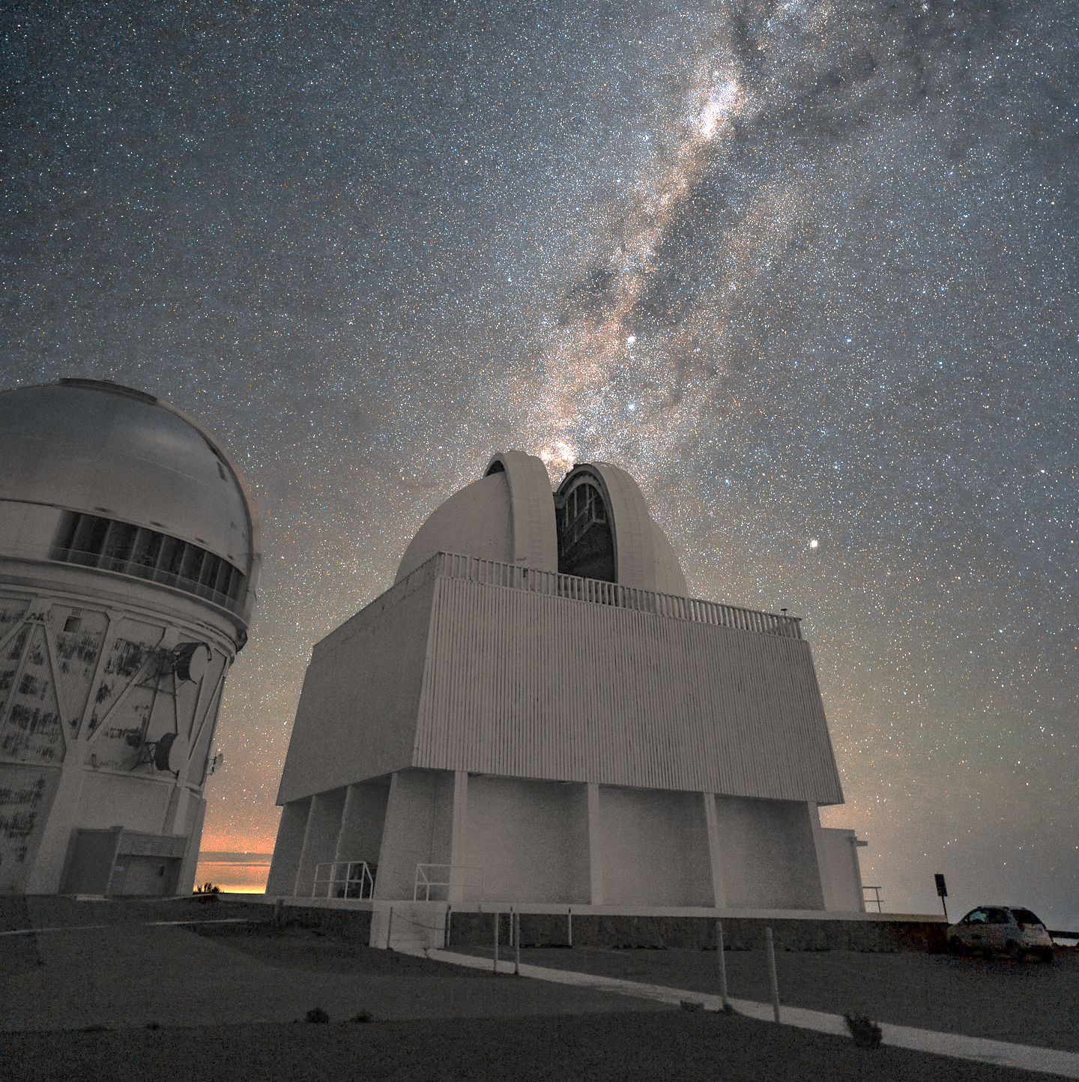
Volume-Limited Sample, completed
Statistics!!
The RKSTAR Project has performed the largest high-resolution spectroscopy reconnaissance of K dwarfs ever.
The RKSTAR Project has performed the largest high-resolution spectroscopy reconnaissance of K dwarfs ever.
FLWO 1.5m
CTIO 1.5m
2198 K dwarf primary systems within 40 pc, from the RKSTAR Catalog
- Check out iPoster 211.02 by Tim Johns
Resolution -

Slide 18

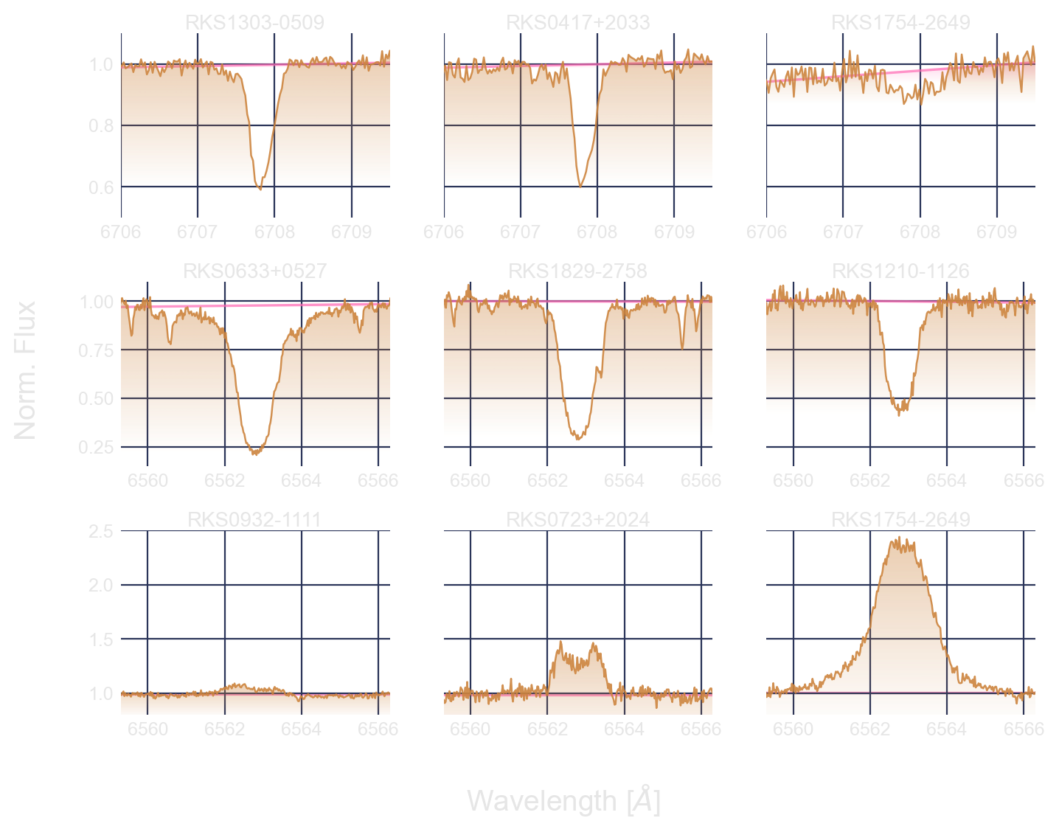
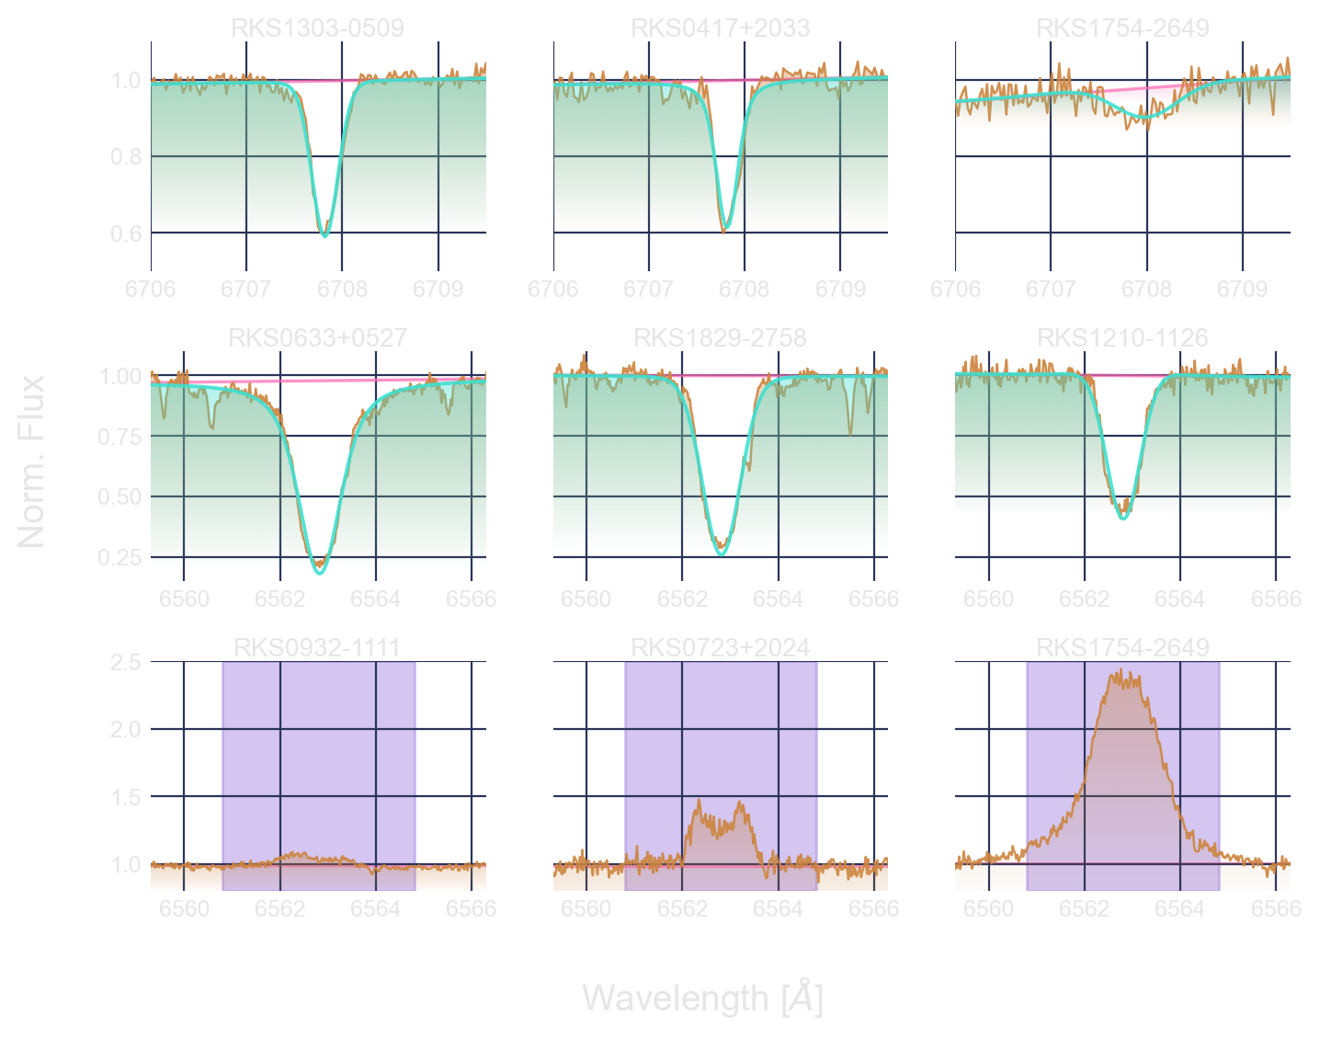
Equivalent Widths (EW)
Hα (6562.8 Å)
Hubbard-James in prep
Voigt profile fitting
Window integration
Visual inspection
S/N
Continuum
SB2
Fast Rotators
18
Notes:
06:00-06:30
1.- Li I _{D} (6707.8 Å)
EWs by Voigt profile fitting accounting for local continuum
2.- H_{α} (6562.8 Å)
Voigt profile fitting for absorption features
Integration in a spectral window otherwise

Slide 19
Equivalent Widths (EW)
Li I (6707.8 Å)
Hubbard-James in prep
Voigt profile fitting
Window integration
Visual inspection
S/N
Continuum
SB2
Fast Rotators
19
Notes:
06:00-06:30
1.- Li I _{D} (6707.8 Å)
EWs by Voigt profile fitting accounting for local continuum
2.- H_{α} (6562.8 Å)
Voigt profile fitting for absorption features
Integration in a spectral window otherwise

Slide 20
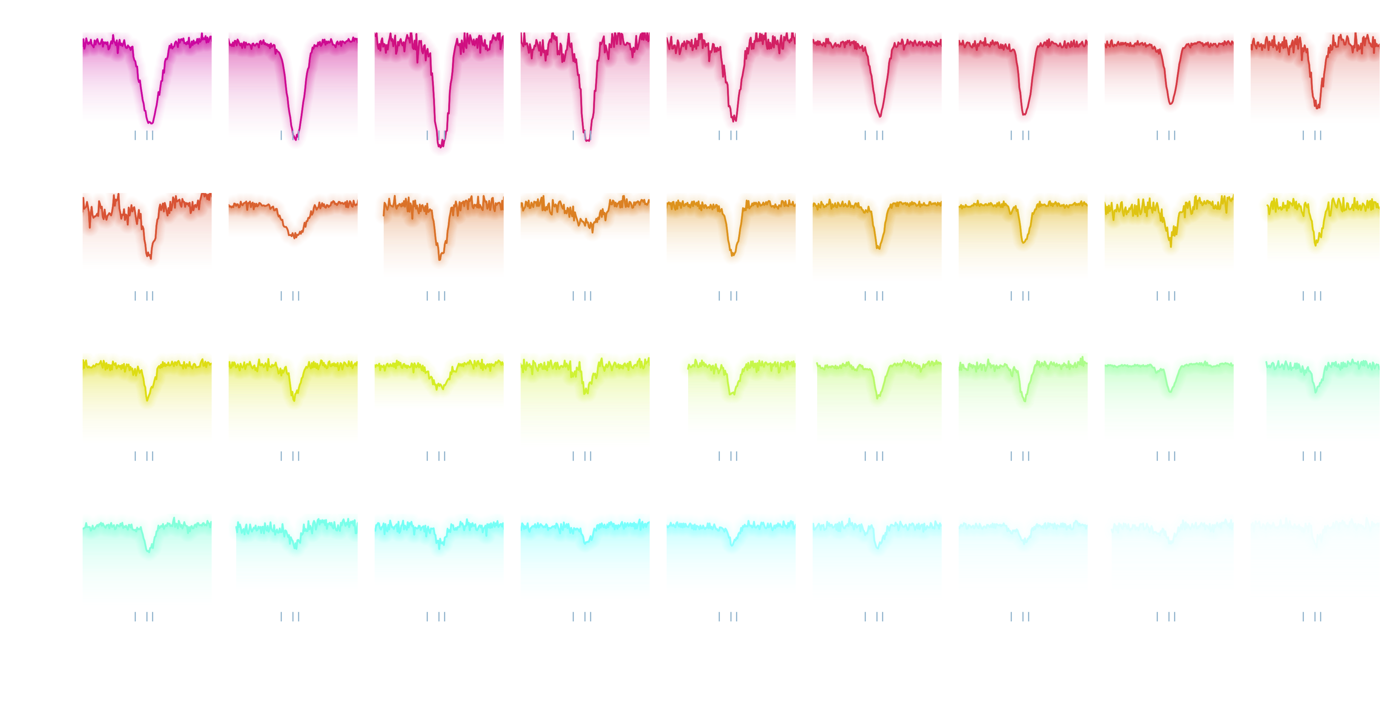
Li I

Slide 21
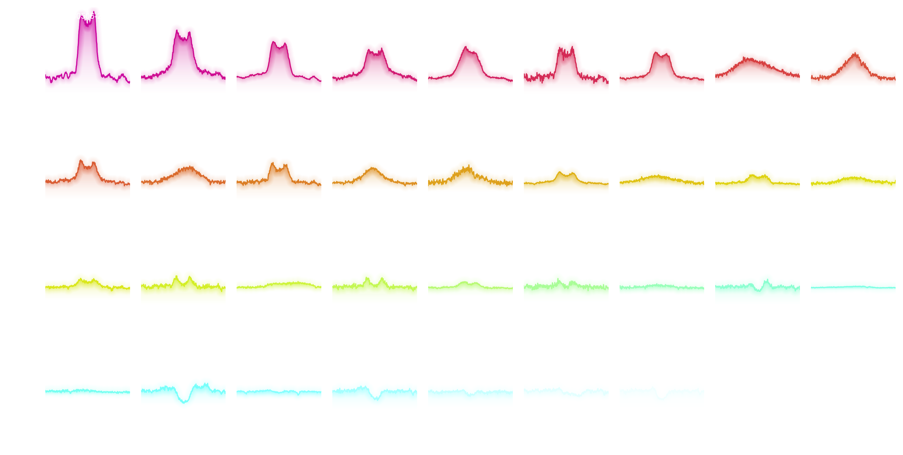
Hα

Slide 22
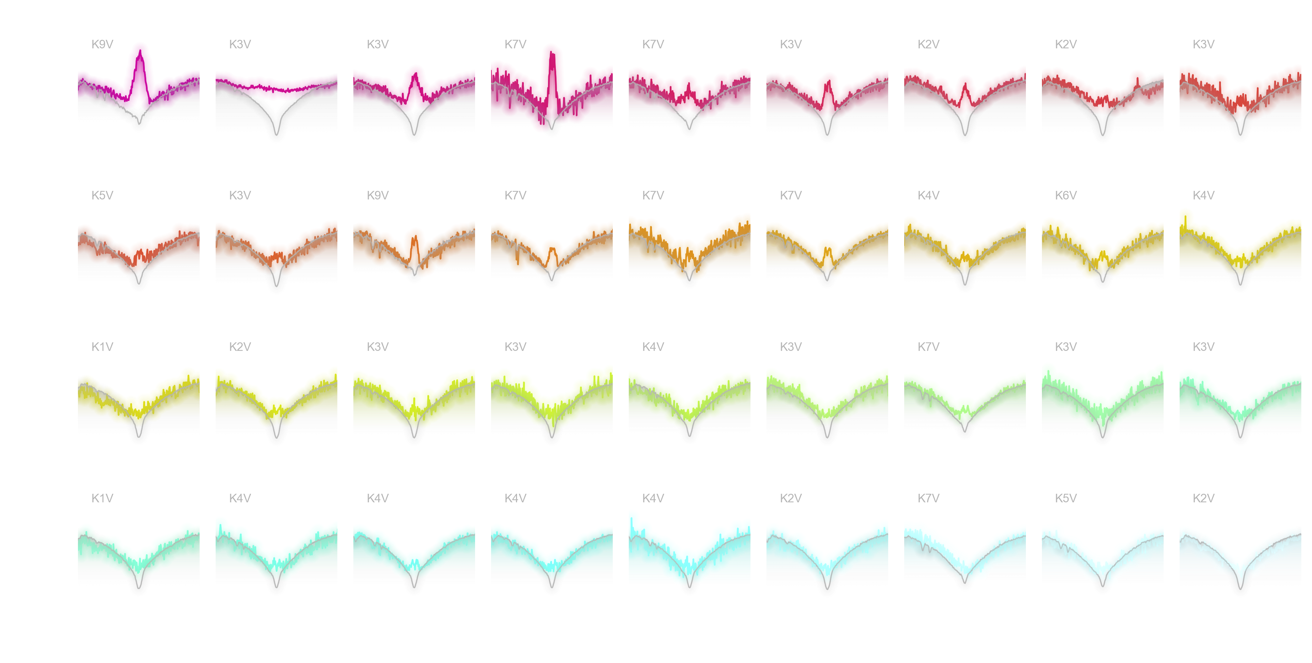
Ca II IRT_{8542Å}

Slide 23
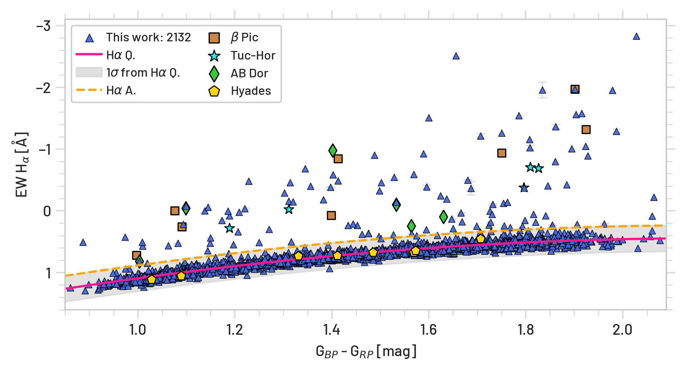
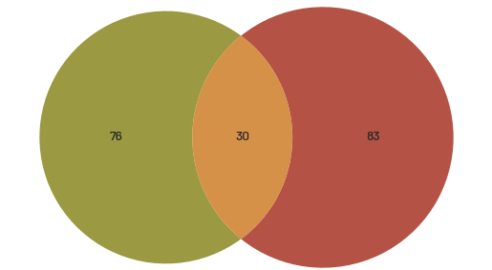
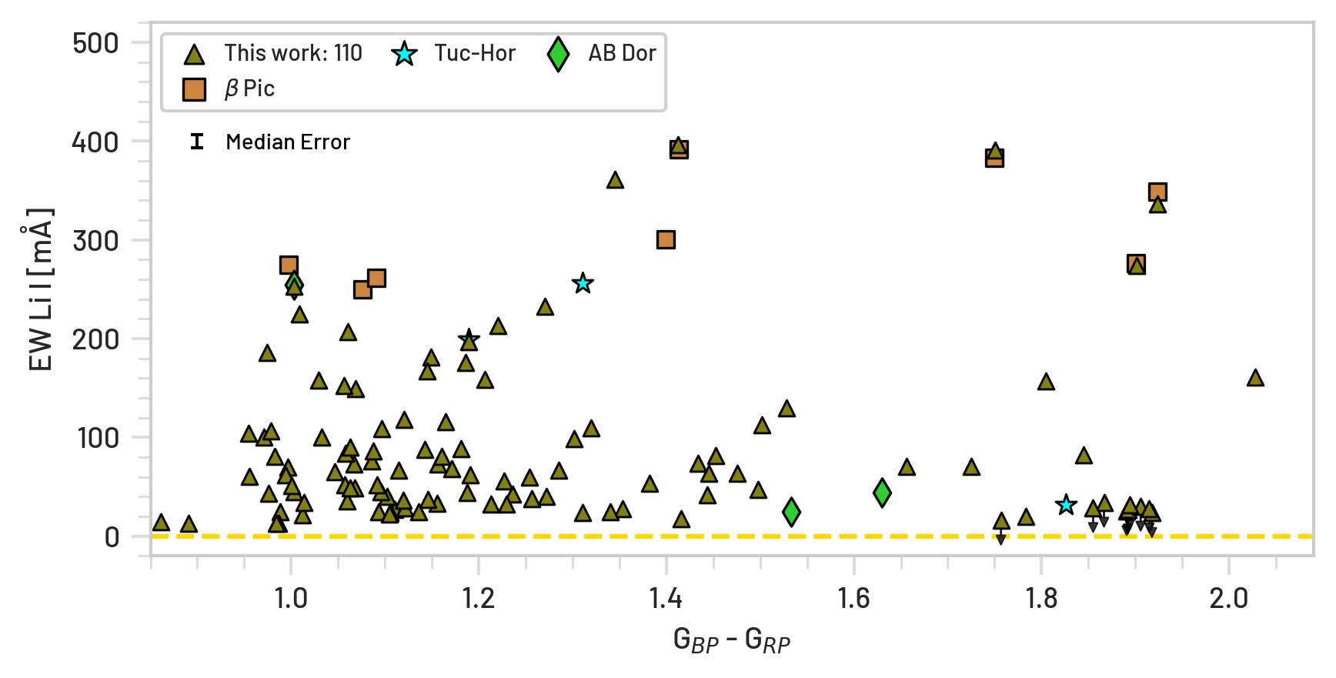
Spectral Analysis
Spectral Indicators for Age and Activity
83
Hα active
(6562.8 Å)
76 with
Li I_{D}
(6707.8 Å)
30
with both
9 Fast Rotators
198 TOTAL
Notes:
Great for stellar and planet formation and evolution studies

Slide 24
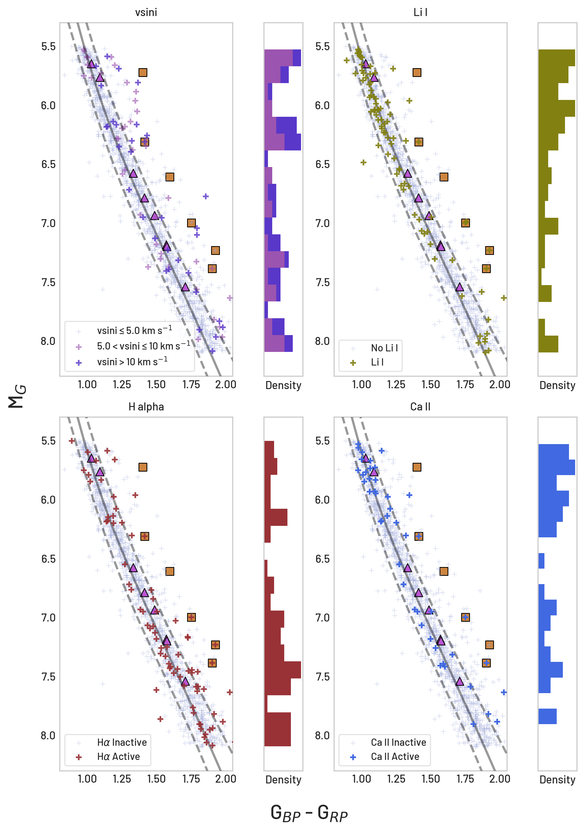
Spectral Analysis
Spectral Indicators for Age and Activity
83
Hα active
(6562.8 Å)
76 with
Li I_{D}
(6707.8 Å)
30
with both
9 Fast Rotators
198 TOTAL
Notes:
Great for stellar and planet formation and evolution studies

Slide 25
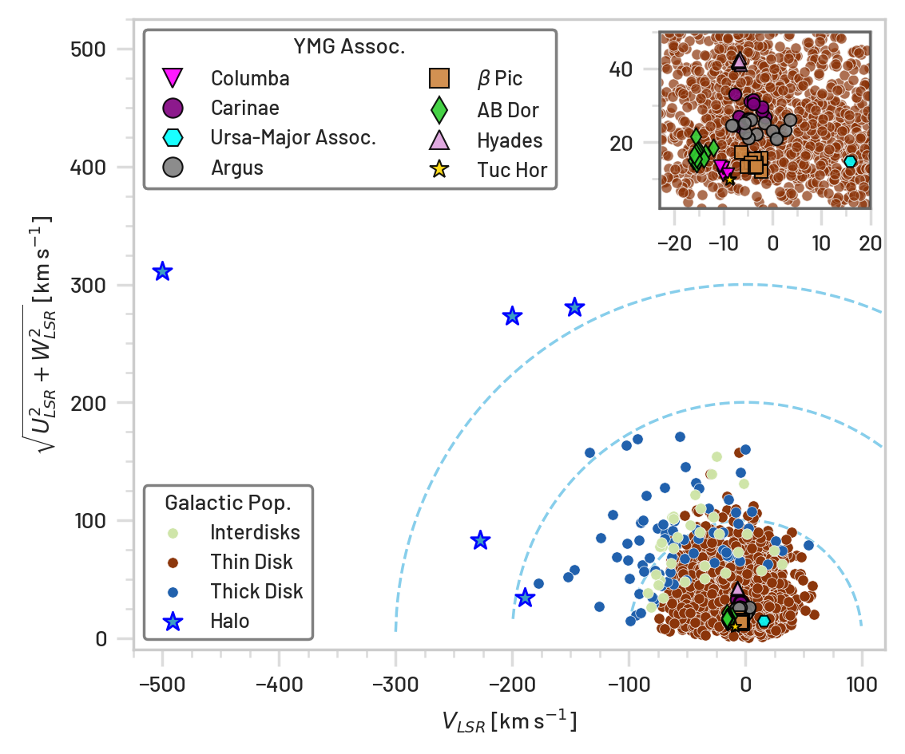
Kinematic Analysis
RKSTAR 40pc Toomre Diagram
Galactic Populations
Using Reddy+2006:
Thin disk stars: 94%
Thick disk stars: 4%
Ambiguous stars: 1.5%
Halo stars: < 0.5% (5 stars)
CHIRON+TRES RVs
179 without Gaia Radial Velocities
… 218 TOTAL Young/Active
Notes:
2:00 – 3:00
thin 94.56% thick 3.66% intermediate 1.55% halo 0.23%

Slide 26
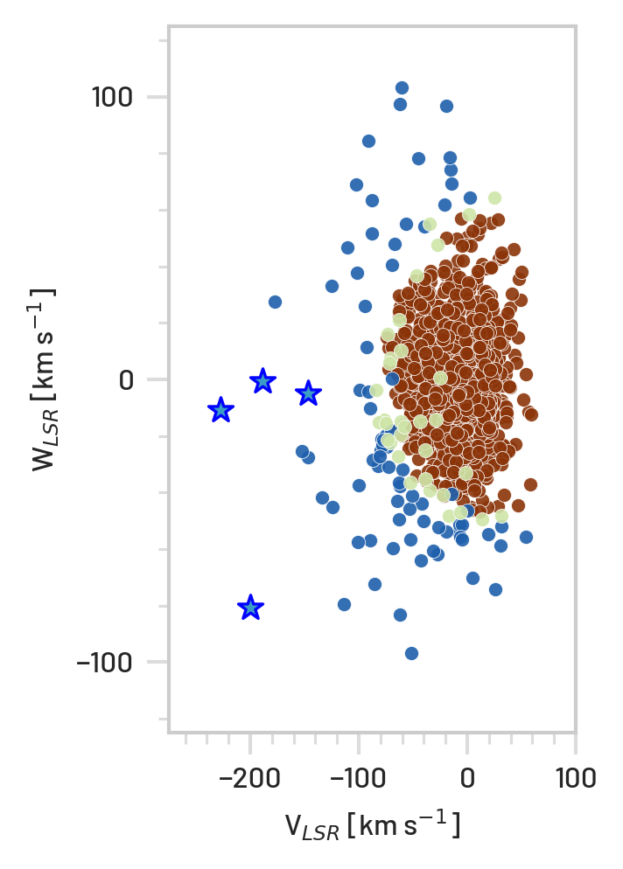
Kinematic Analysis
RKSTAR 40pc Toomre Diagram
RKS0753+3036
Notes:
2:00 – 3:00
thin 94.56% thick 3.66% intermediate 1.55% halo 0.23%

Slide 27
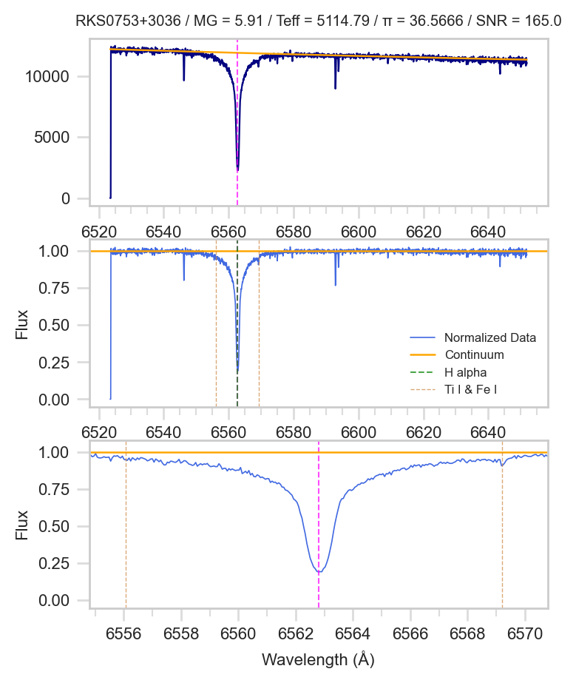
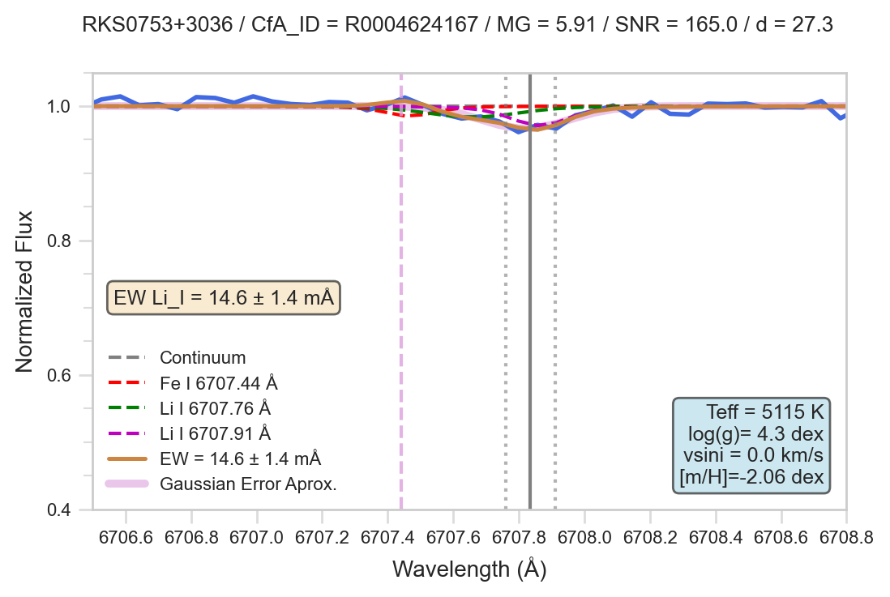
RKS0753+3036
Cosmological Lithium Problem
Stellar Depletion
vs. New Physics

Slide 28
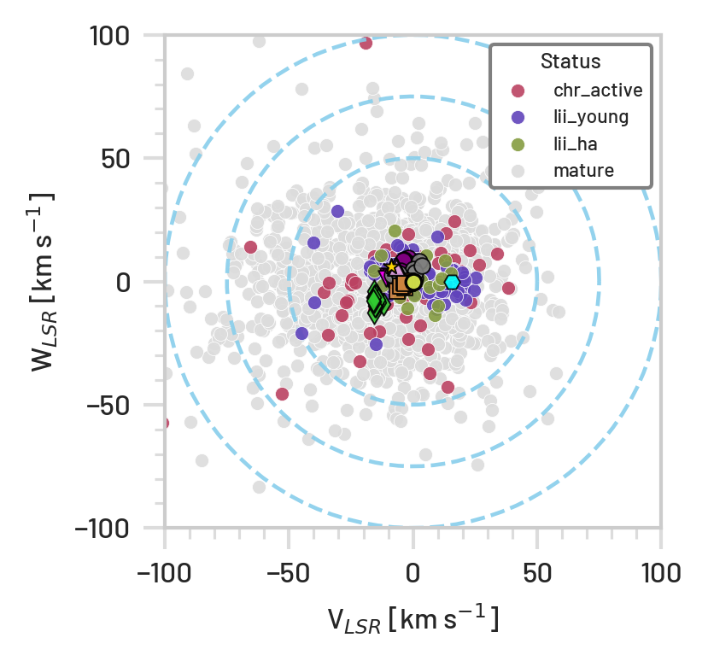
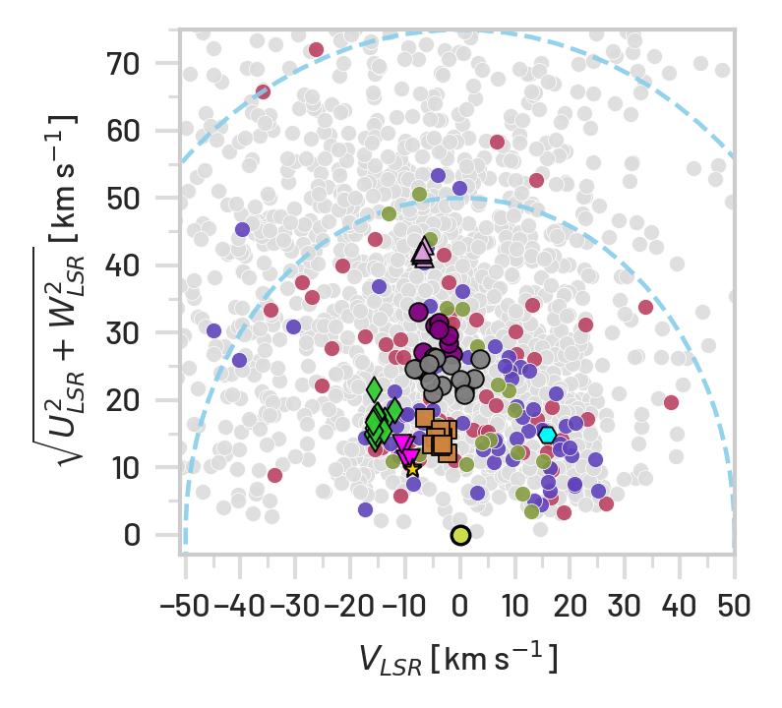
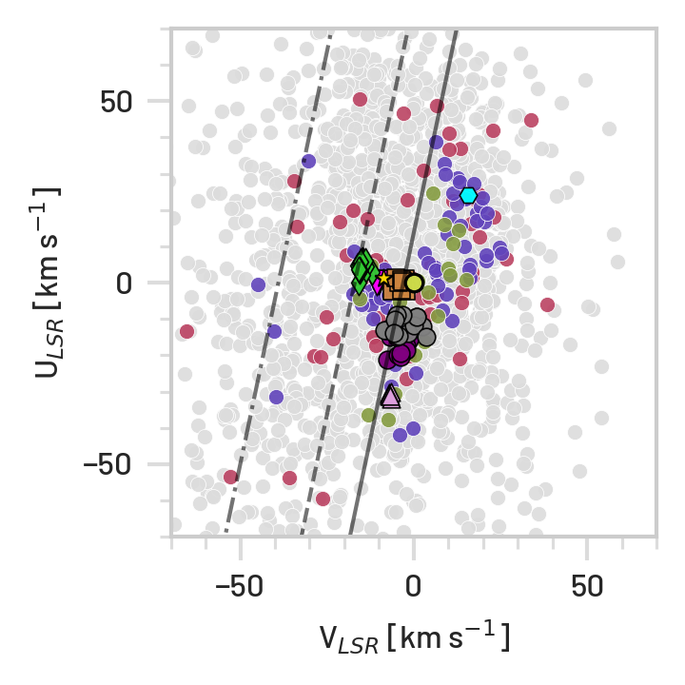
Kinematic Analysis
Members of Young Moving Groups
Using BANYAN Σ, Gagné+2018:
63 members of Young Moving Associations (YMA)
… 20 without Li I or Ha active
… 218 TOTAL Young/Active
Hercules branch
Sirius branch
Pleiades stream
Notes:
2:00 – 3:00
thin 94.56% thick 3.66% intermediate 1.55% halo 0.23%

Slide 29
Nearby Young K dwarfs Paradox
Hercules branch
This Volume-Limited Completed study finds:
218 (~10%) of K- dwarfs are Young/Active
75
123
155 were found as field stars
40-60% not found in MOCA db
(Gagné in prep.)
80 are traveling counter to the direction of Galactic rotation and mostly migrating radially inward
Li I depletion suggest they are a different populations
Velocity toward the Galactic Center
Pleiades stream
Sirius branch
Velocity to Galaxy’s rotation
29

Slide 30
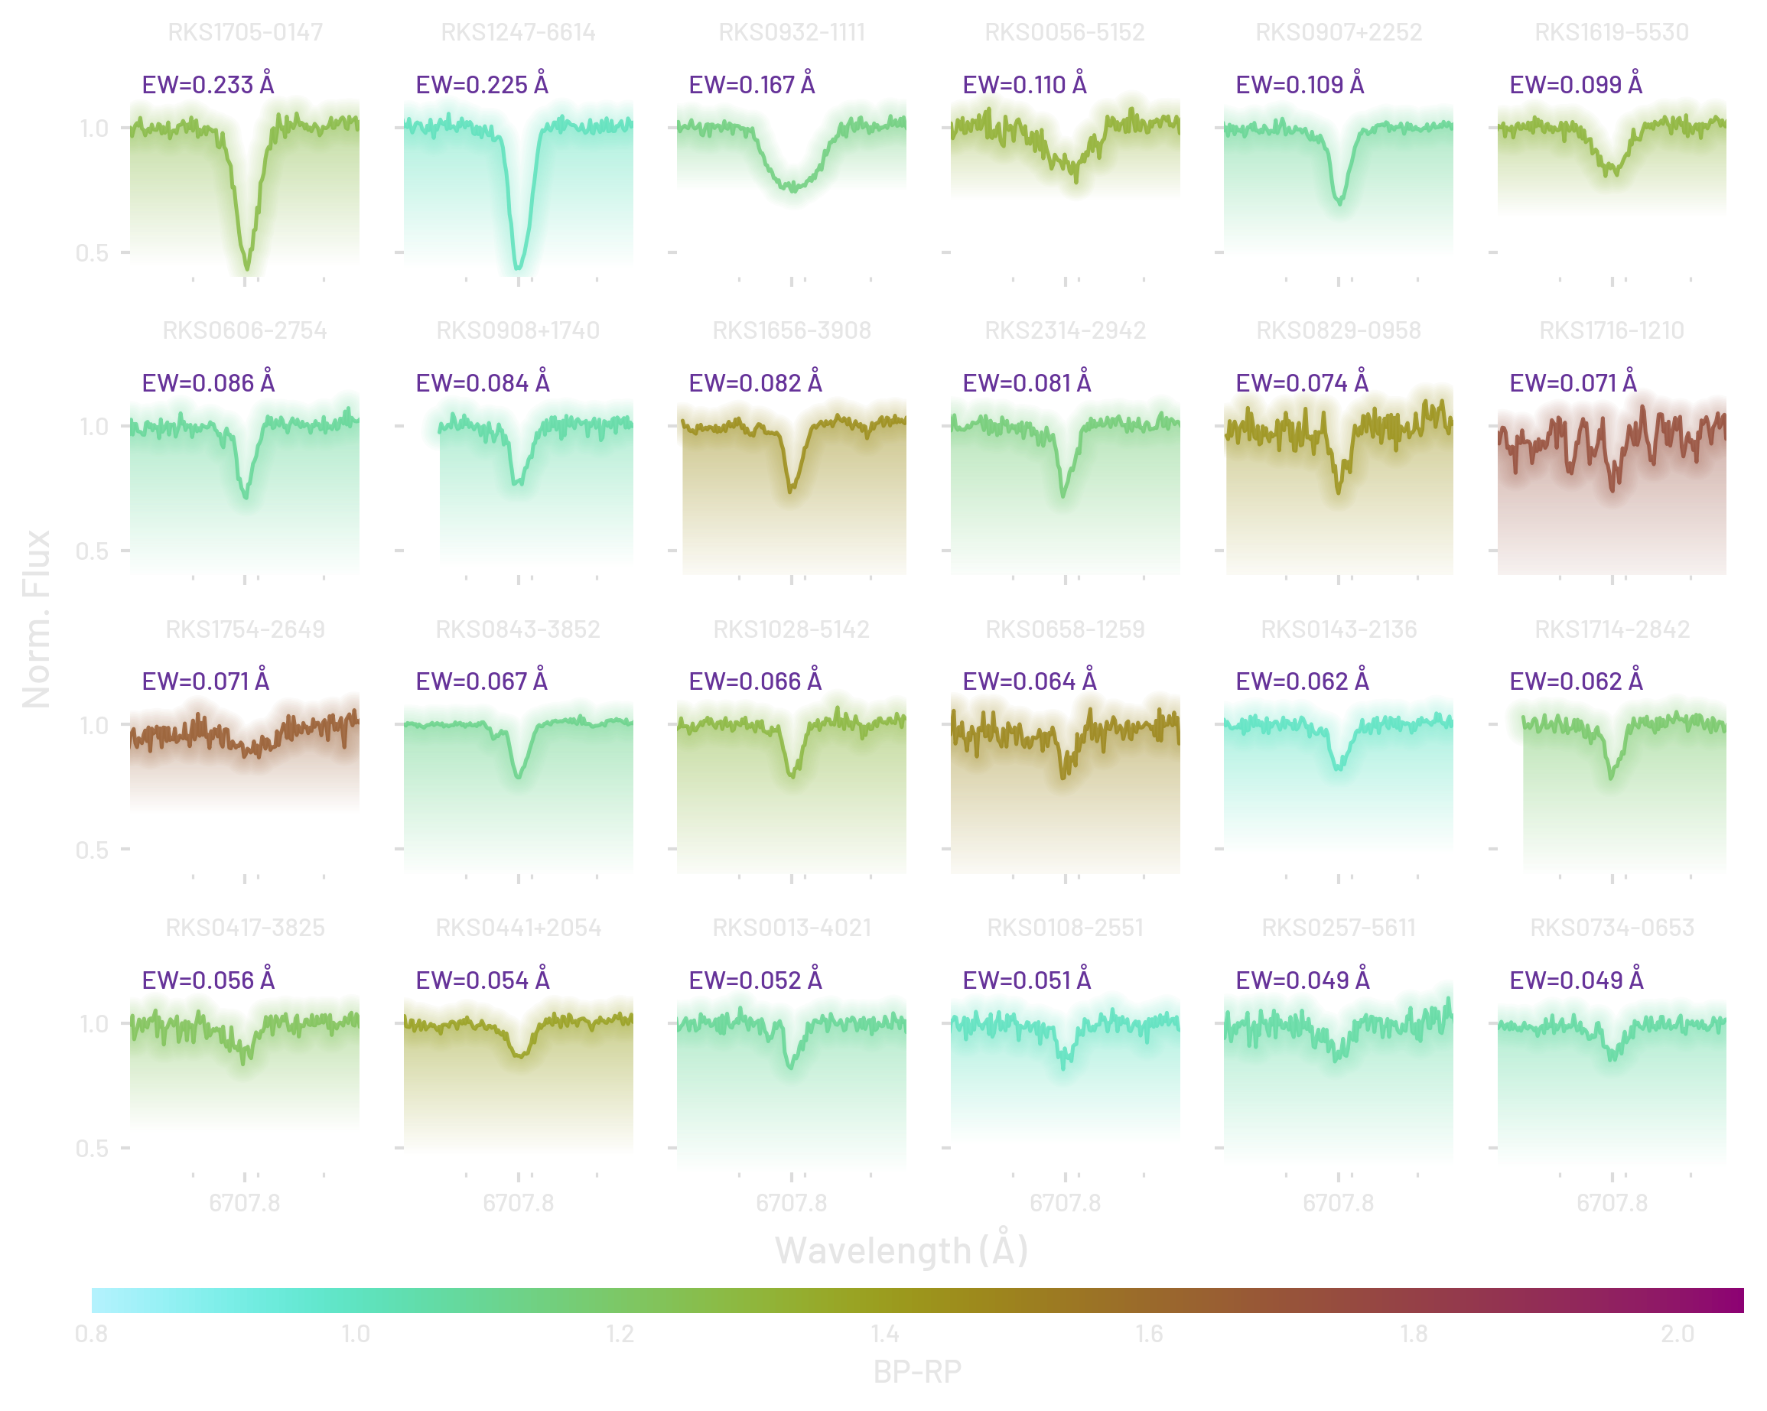
Showcase of spectra of Li I line of counter-galactic rotating stars

Slide 31
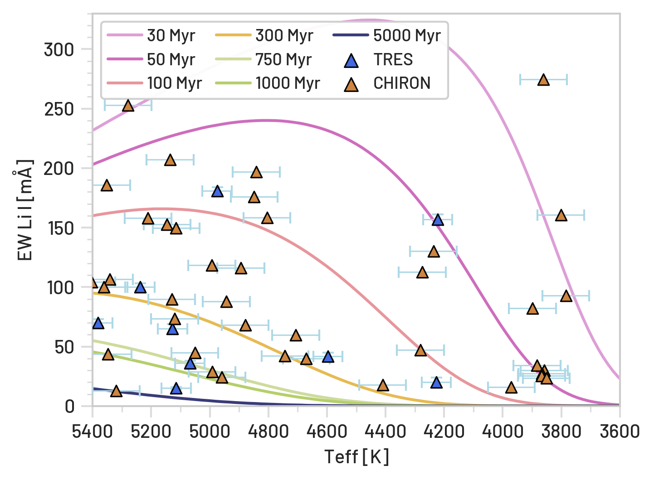
Nearby Young K dwarfs Paradox
Relative Ages through EAGLES Li I Isochrones
Notes:
U Velocity (toward/away from the Galactic center)
Positive U → The star is moving toward the Galactic center.
Negative U → The star is moving away from the Galactic center.
V Velocity (with or against Galactic rotation)
Positive V → The star is moving in the same direction as the Galaxy’s rotation (prograde).
Negative V → The star is moving opposite Galactic rotation (retrograde).
This is the key indicator for identifying counter-rotating stars.

Slide 32
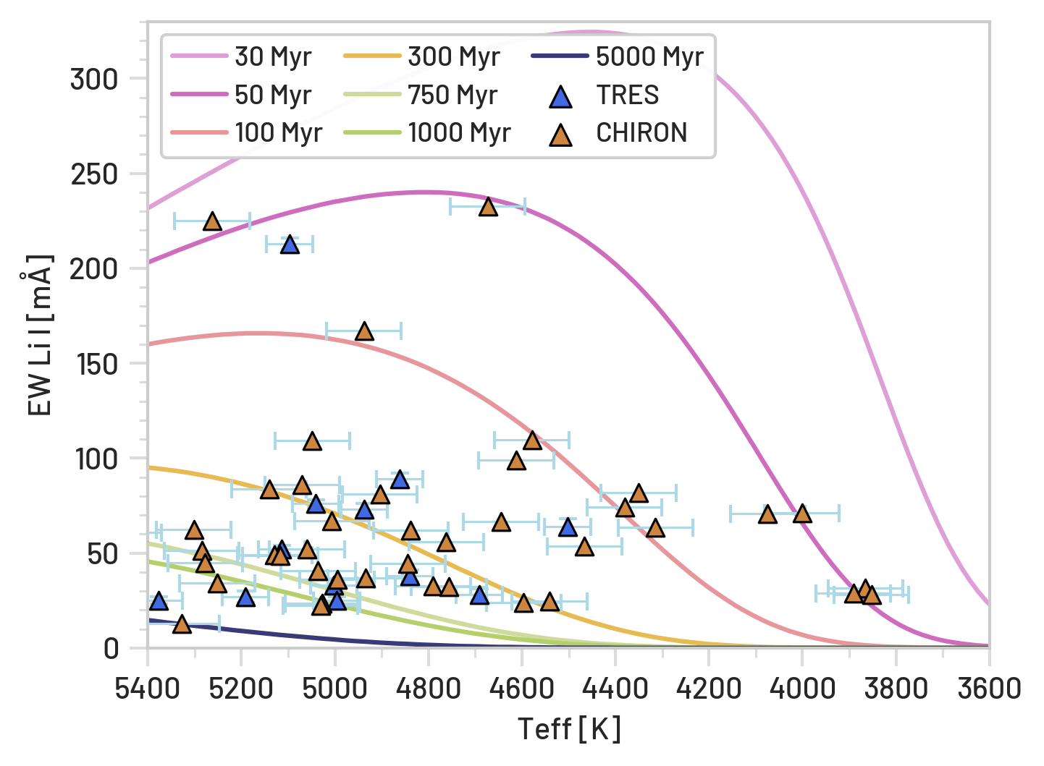
Nearby Young K dwarfs Paradox
500 Myr
Relative Ages through EAGLES Li I Isochrones
Notes:
U Velocity (toward/away from the Galactic center)
Positive U → The star is moving toward the Galactic center.
Negative U → The star is moving away from the Galactic center.
V Velocity (with or against Galactic rotation)
Positive V → The star is moving in the same direction as the Galaxy’s rotation (prograde).
Negative V → The star is moving opposite Galactic rotation (retrograde).
This is the key indicator for identifying counter-rotating stars.

Slide 33
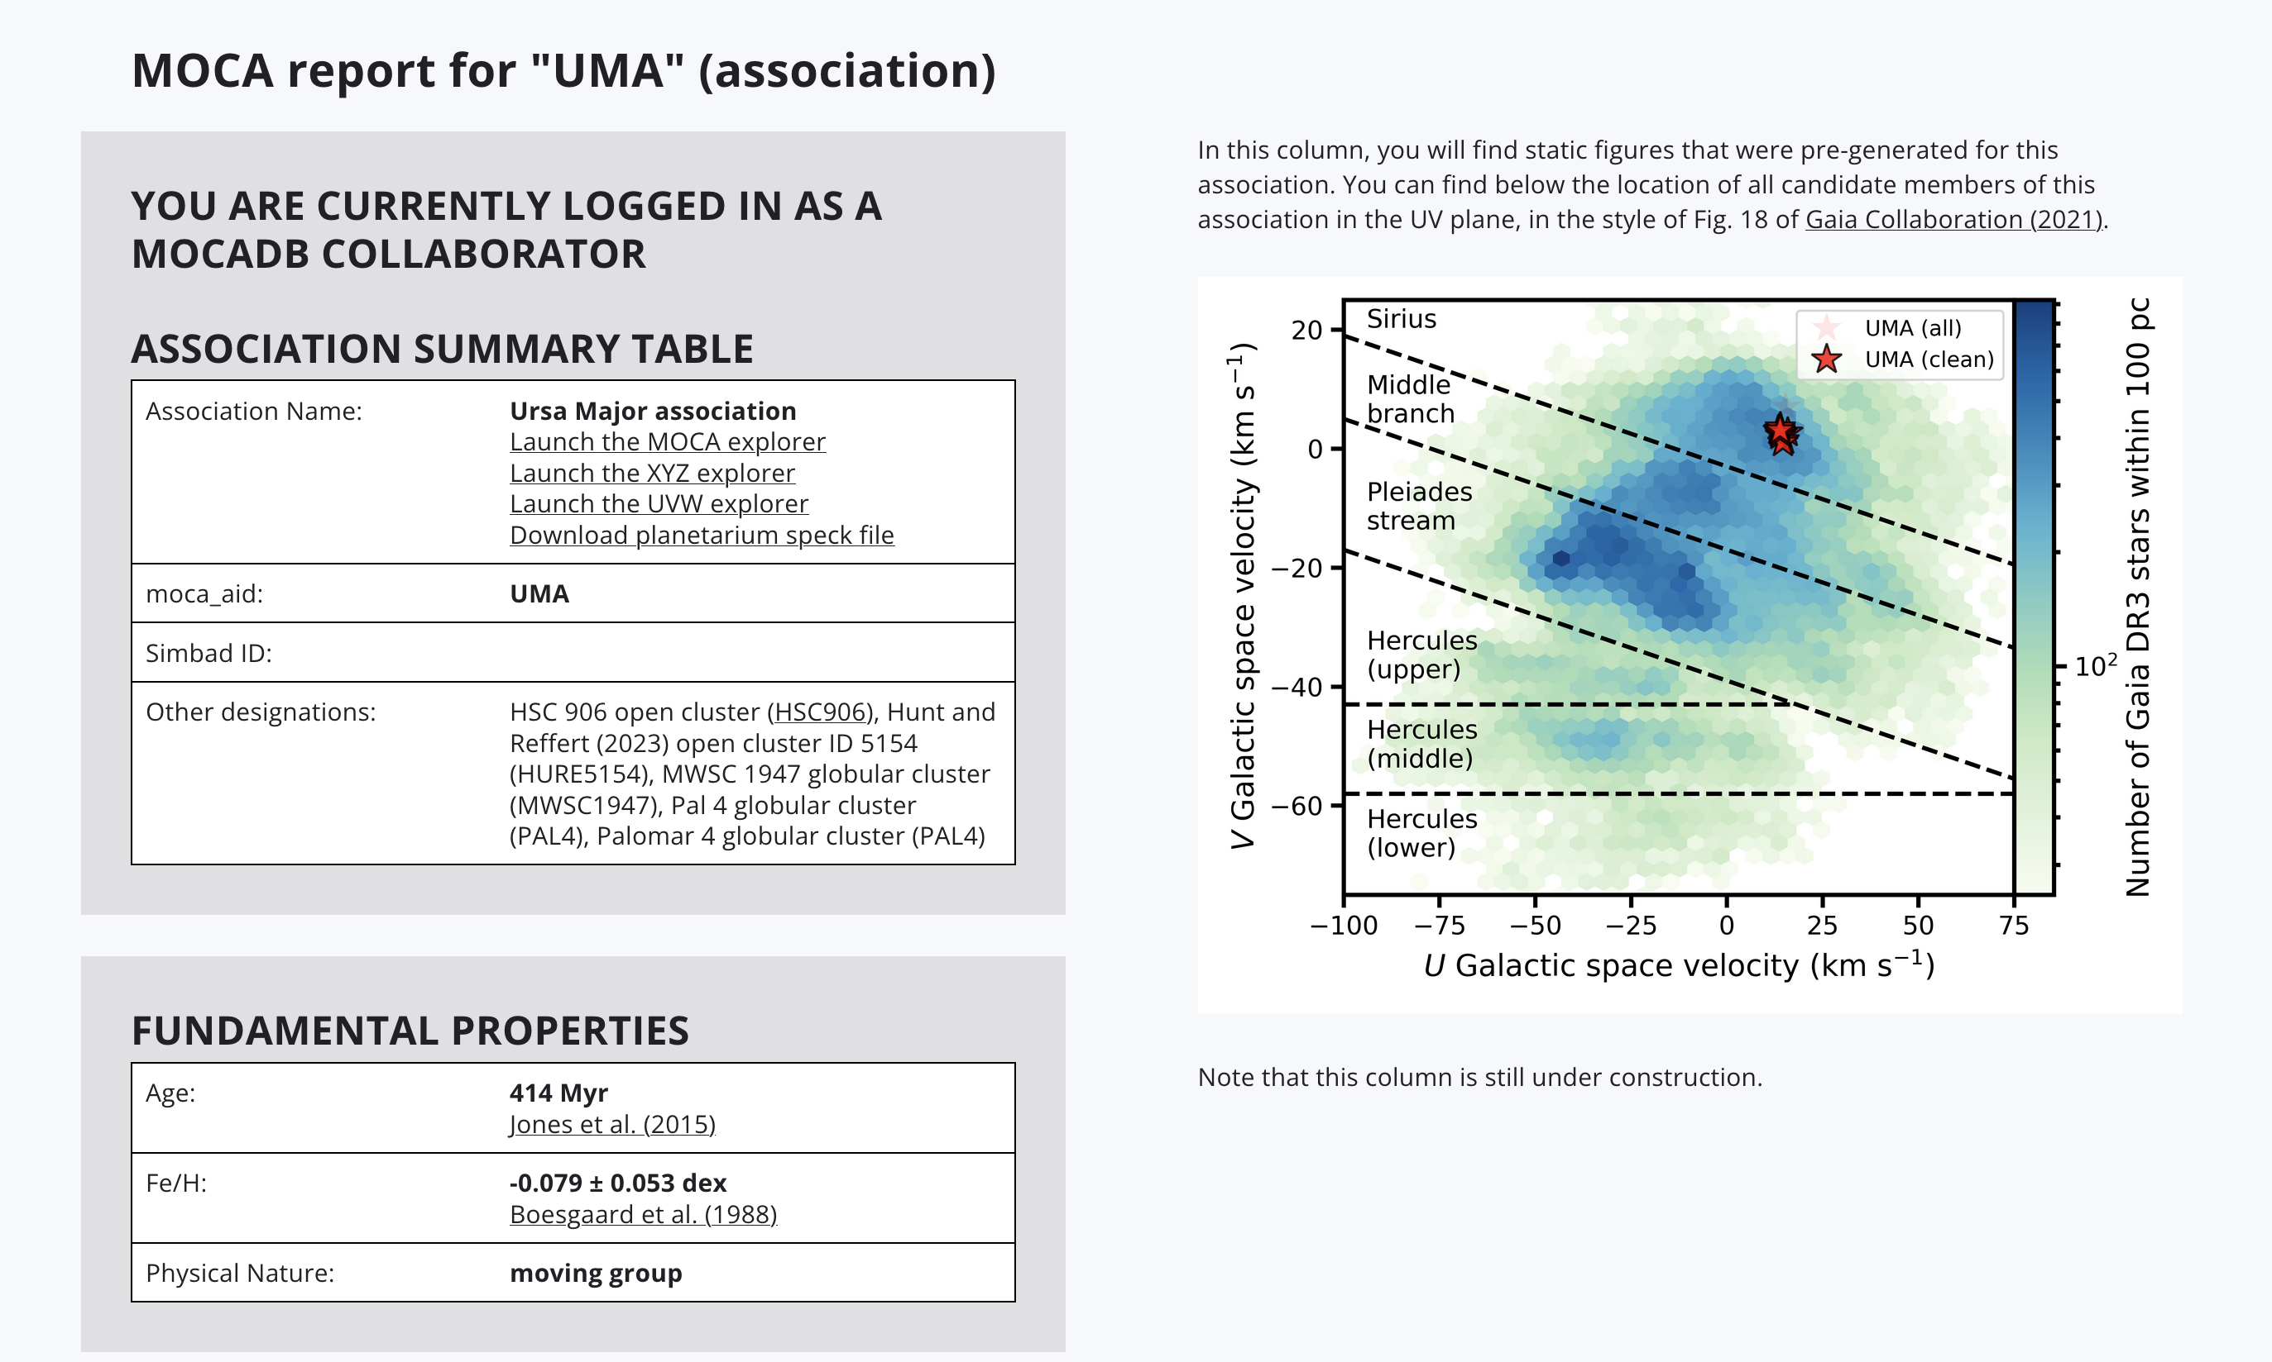

Slide 34
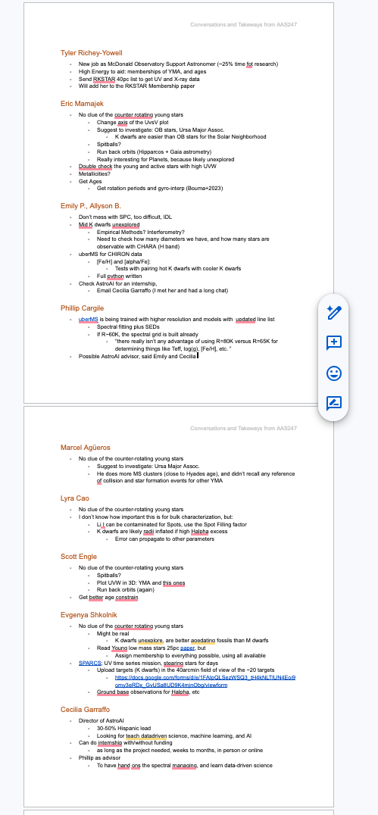
Explanations?
I asked ~10 experts at AAS 247, no clue

Slide 35
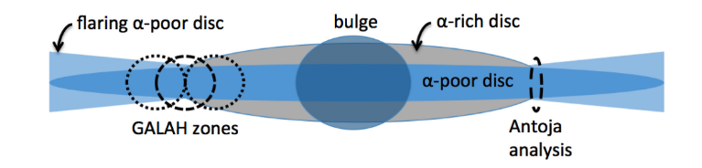
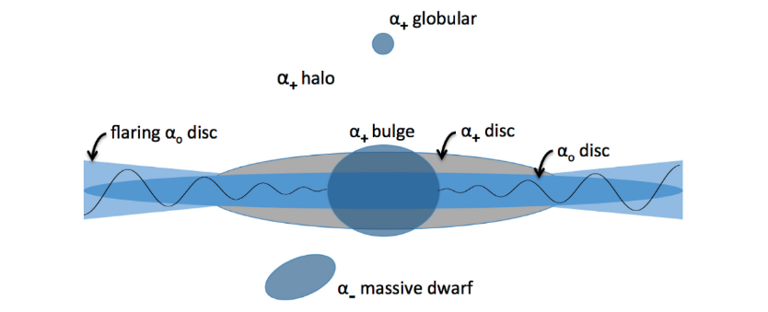
Bland-Hawthorn et al. 2019,
using the GALAH survey and Gaia DR2: Chemodynamic correlations
RESULT: A ∼3 × 10¹⁰ M⊙ Sagittarius‑like perturber crossing the Galactic disc about 0.5 Gyr ago excited the Vₙ phase spiral

Slide 36
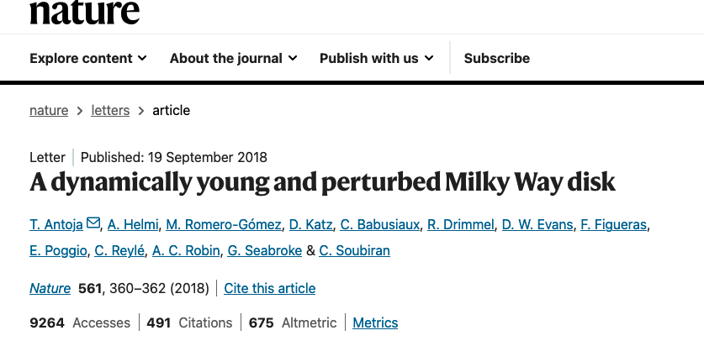
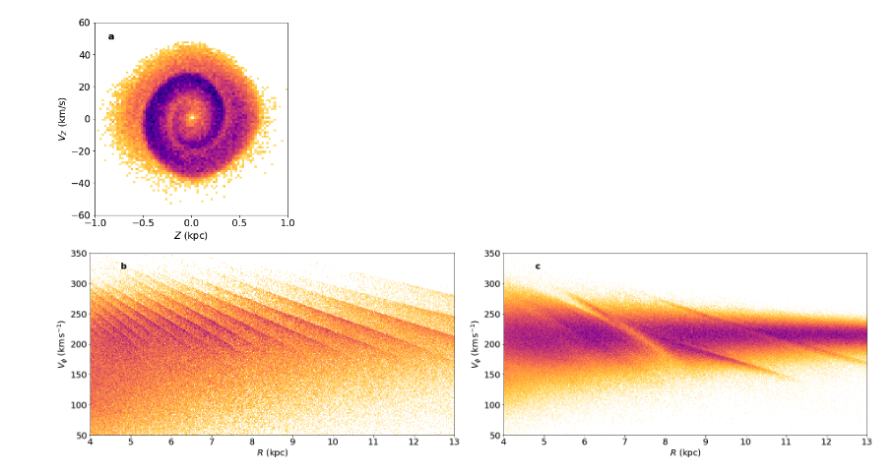
From Gaia DR2 to recreate substructures using particle simulations
RESULT:
Substructures show that the disk is phase‑mixing from a disturbed state and is strongly influenced by the bar and/or spiral arms, indicating a perturbation 300–900 Myr ago consistent with the last passage of the Sagittarius dwarf galaxy
LINK: https://users.flatironinstitute.org/~jhunt/research-Mergers.html

Slide 37
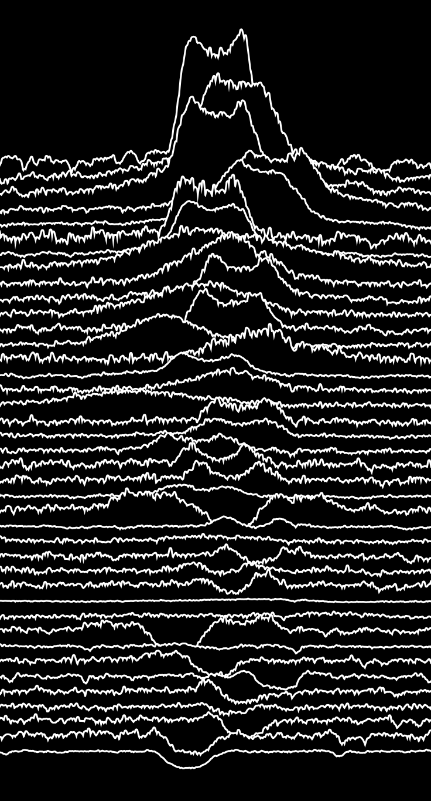
The SPICY RKSTARs: Spectroscopic Photometric Interferometric Catalog of Young RKSTARs
Hα profiles of Young Nerby K dwarf. Stylized after Joy Division’s album cover of Unknown Pleasures, with data from PSR B1919+21 by Harold D. Craft, Jr. (1970).
Credit: Sebastian Carrazco (GSU, RECONS)

Slide 38
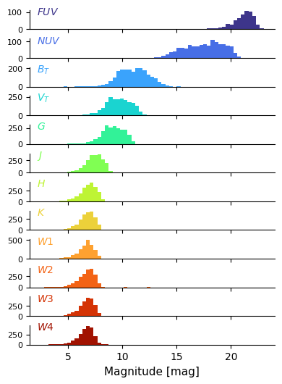



RKS0715-6818
The RKSTARs Photometric and SEDs Catalog, by
Ben Tipton
First Step for Interferometry results with CHARA

Slide 39
Questions?

