Slide 1
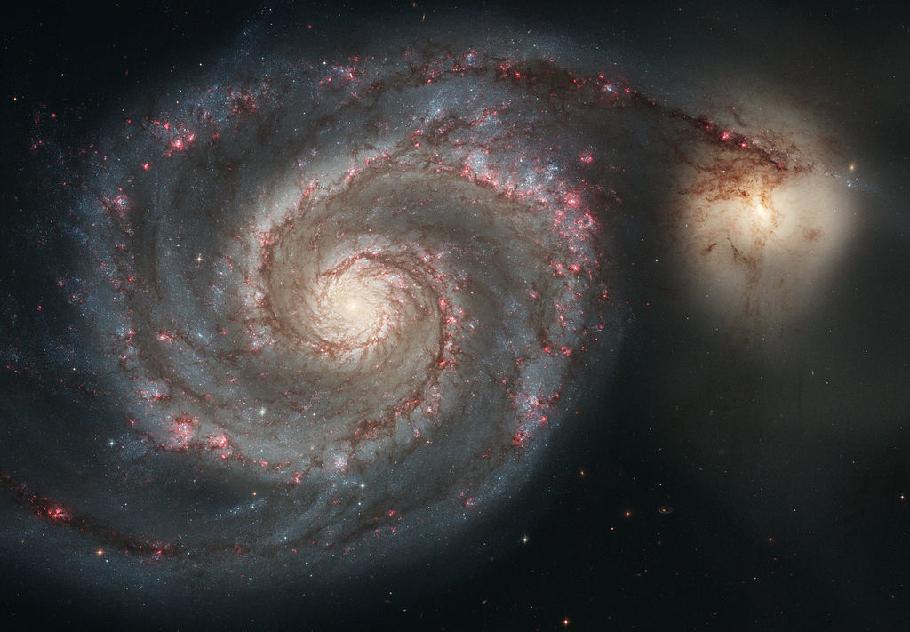
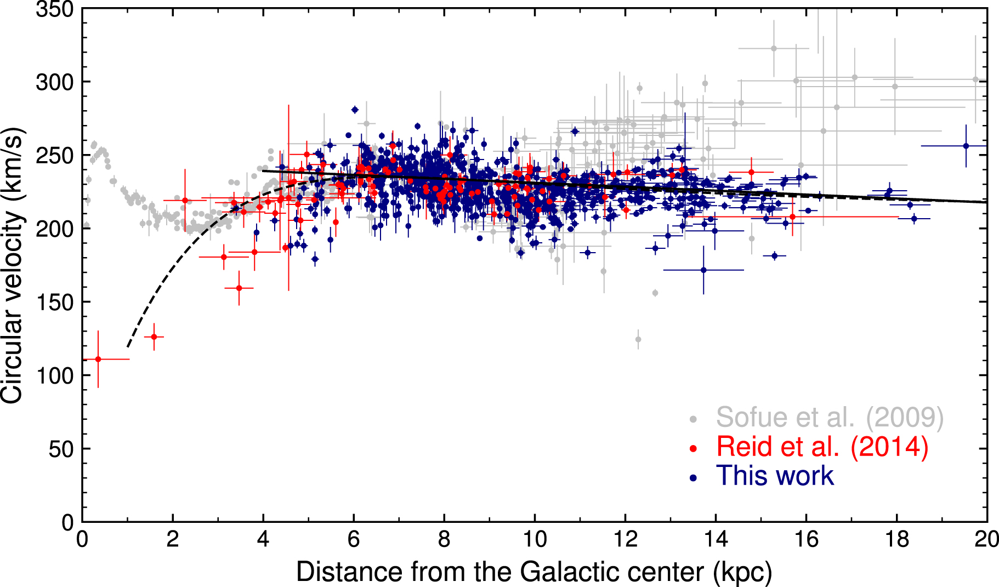
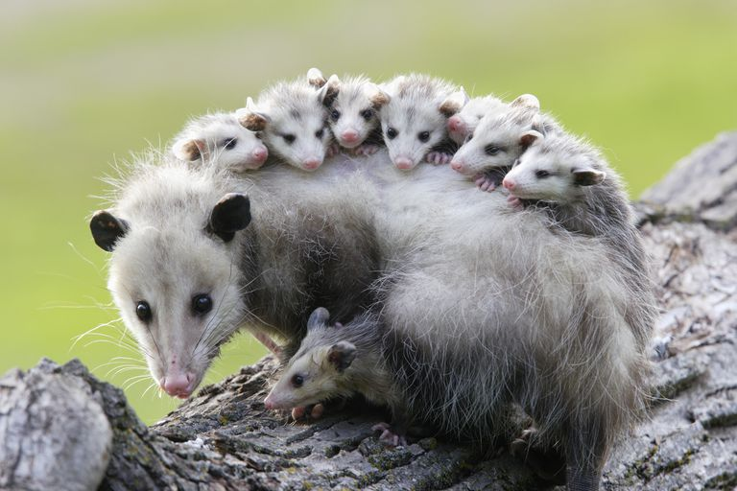
Milky Way Disk Potpourri

Slide 2
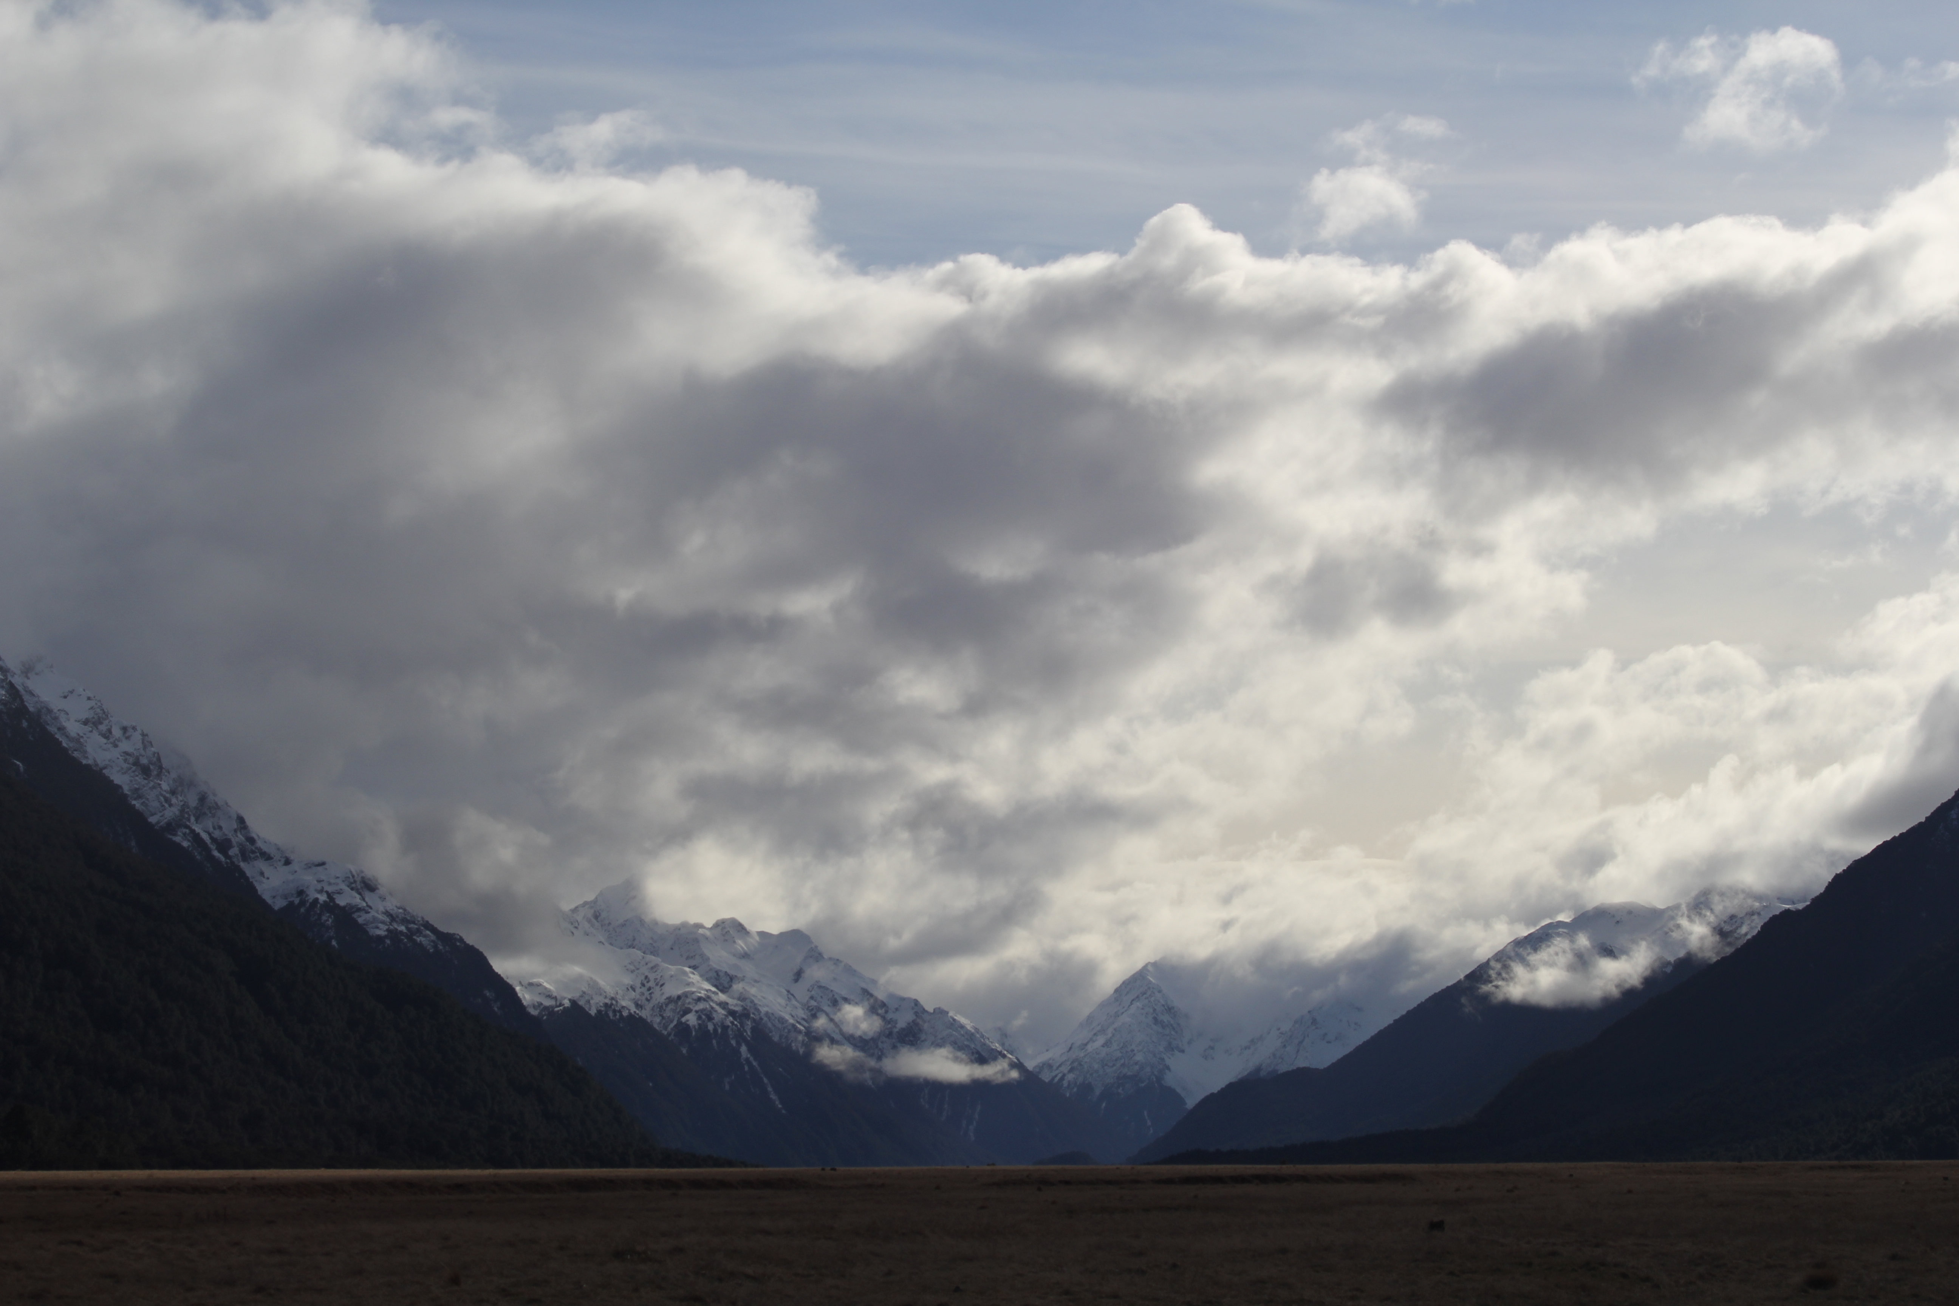
Assignments
http://www.astro.gsu.edu/~thenry/GALACTIC/
Thursday 15 FEB Level 0 … Refs … DONE
Thursday 22 FEB Level 1 … Outline … DONE
Thursday 28 MAR Level 2 … 1st Draft … 5 weeks later
Thursday 18 APR Presentations I
Tuesday 23 APR Presentations II
Thursday 25 APR Level 4 … submit … 4 weeks later
Notes:
r

Slide 3
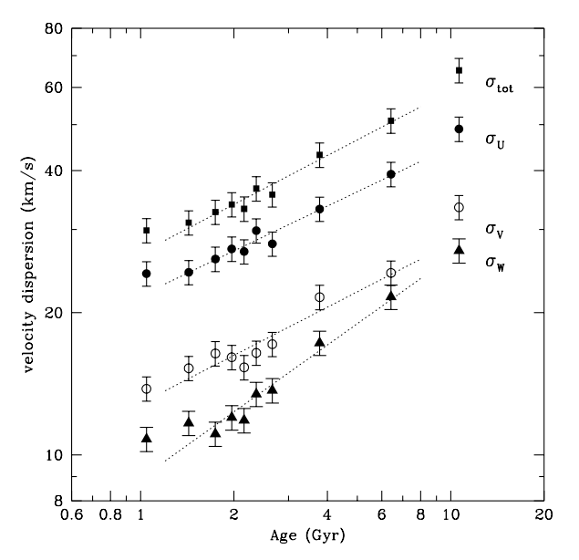
Ages ~ Velocity Dispersion
~ 14000 F/G dwarfs
Hipparcos/Tycho astrometry
~ 63000 RV measurements
ages from isochrone fits
Nordstrom et al. 2004
What is this process called?
ANSWER: thin disk heating by GMCs and spiral arms
Notes:
bubble data not fit --- unrelaxed young structures and thick disk stars

Slide 4
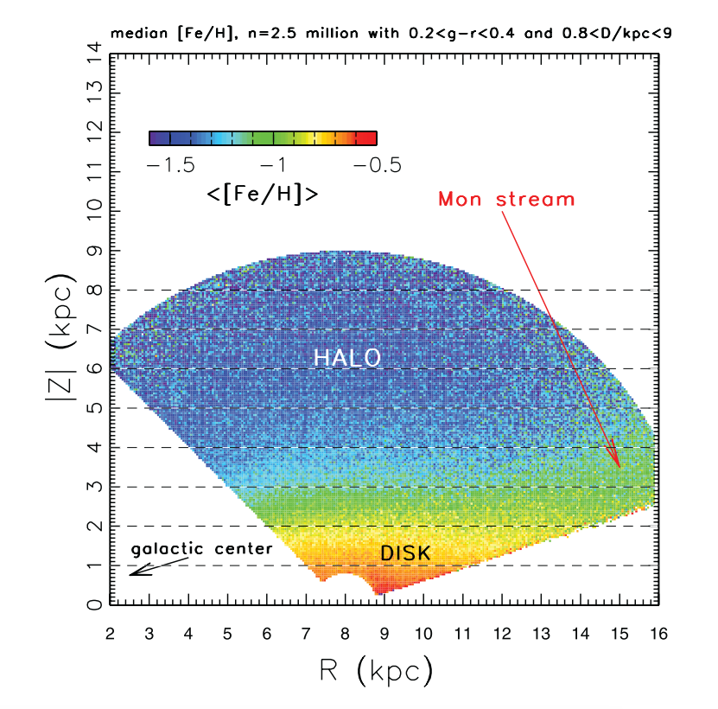
Metallicities and Motions
Ivezic et al. 2008
Medan et al. 2021
How does metallicity change vertically?
How does metallicity change horizontally?
What does this plot show?
What would it look like for OB stars?

Slide 5
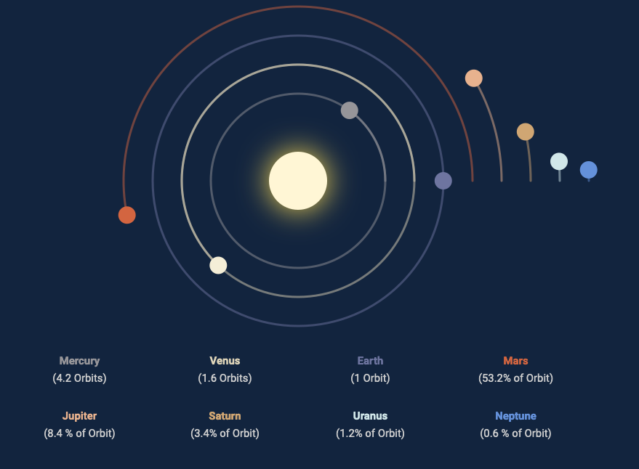
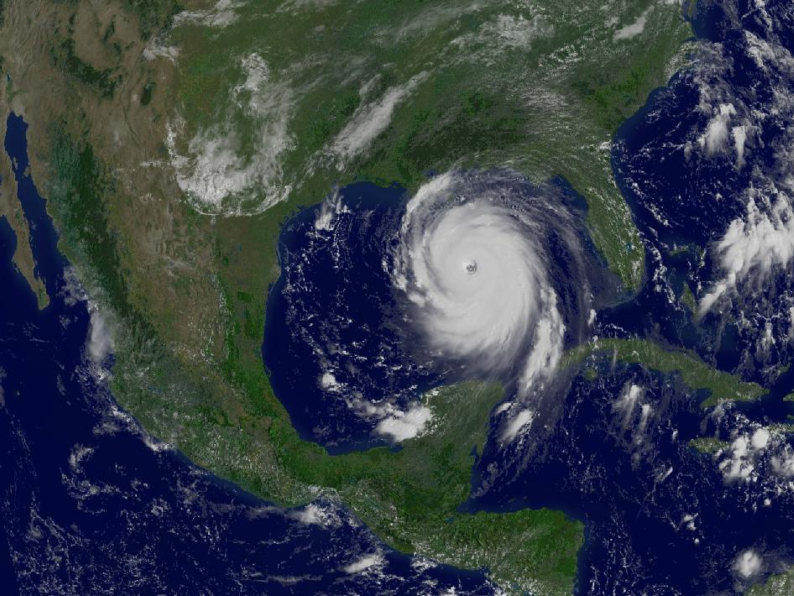
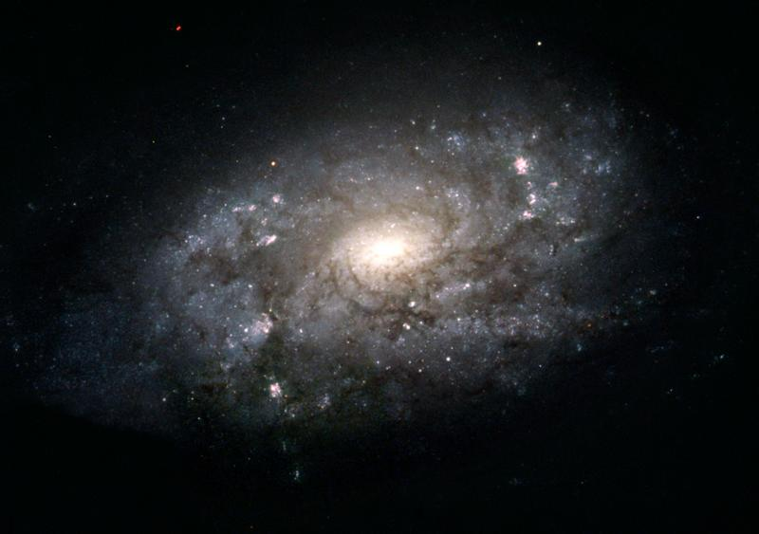
Milky Way Rotation Curve
space-facts.com
Charlotte Leaper
NGC 3949
NASA
NASA (HST)
Notes:
EXERCISE --- students go to the board in groups to map rotation curves before revealing plots
Solar System ---NO, space velocity decreases as you go out
Carousel --- NO, space velocity increases as you go out
Hurricane Katrina --- NO, very fast in center
NGC 3949 --- YES, similar to Milky Way

Slide 6
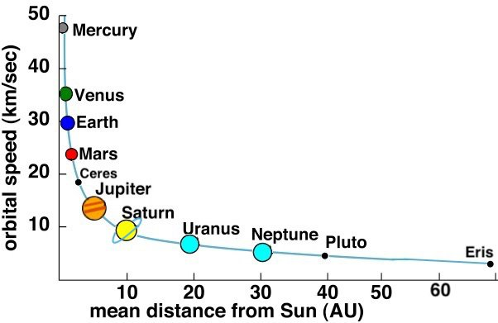
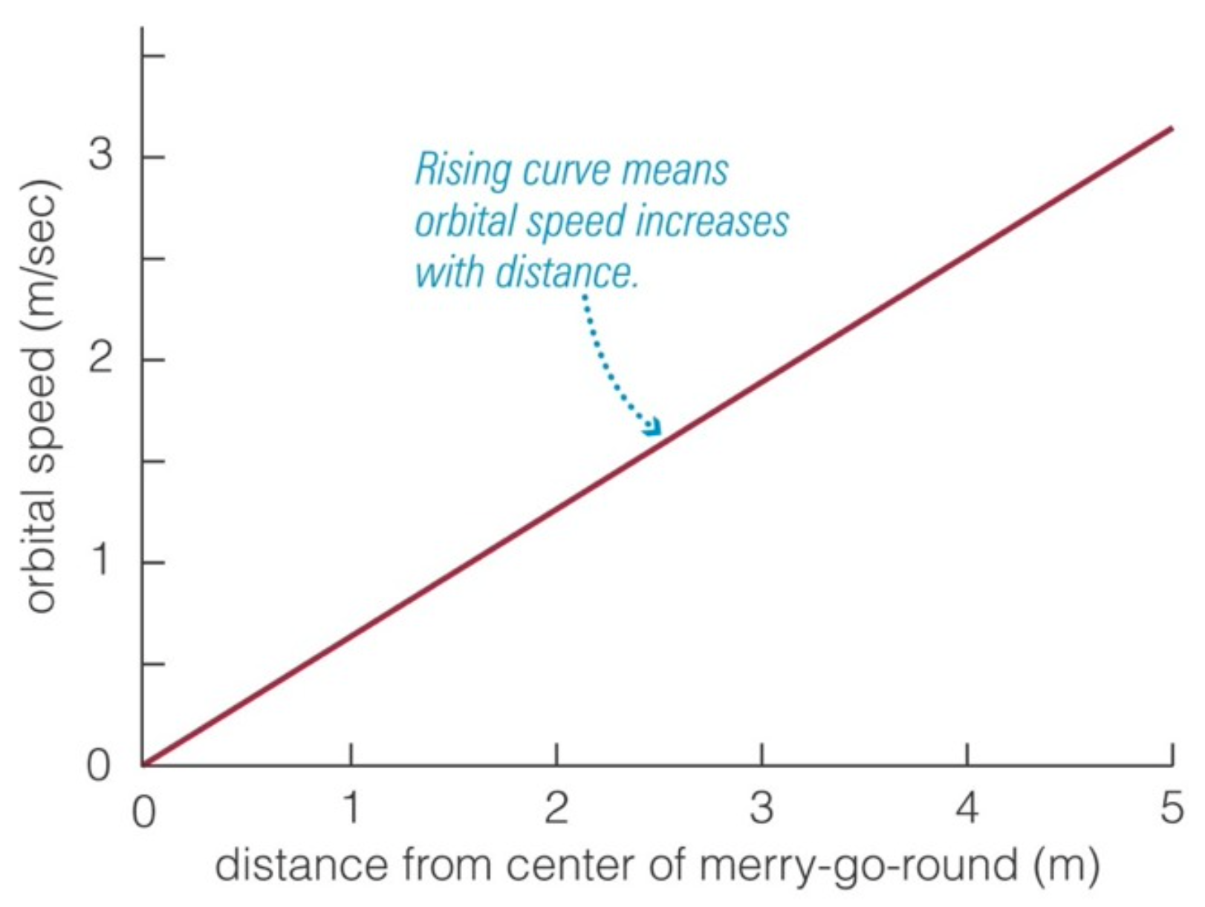
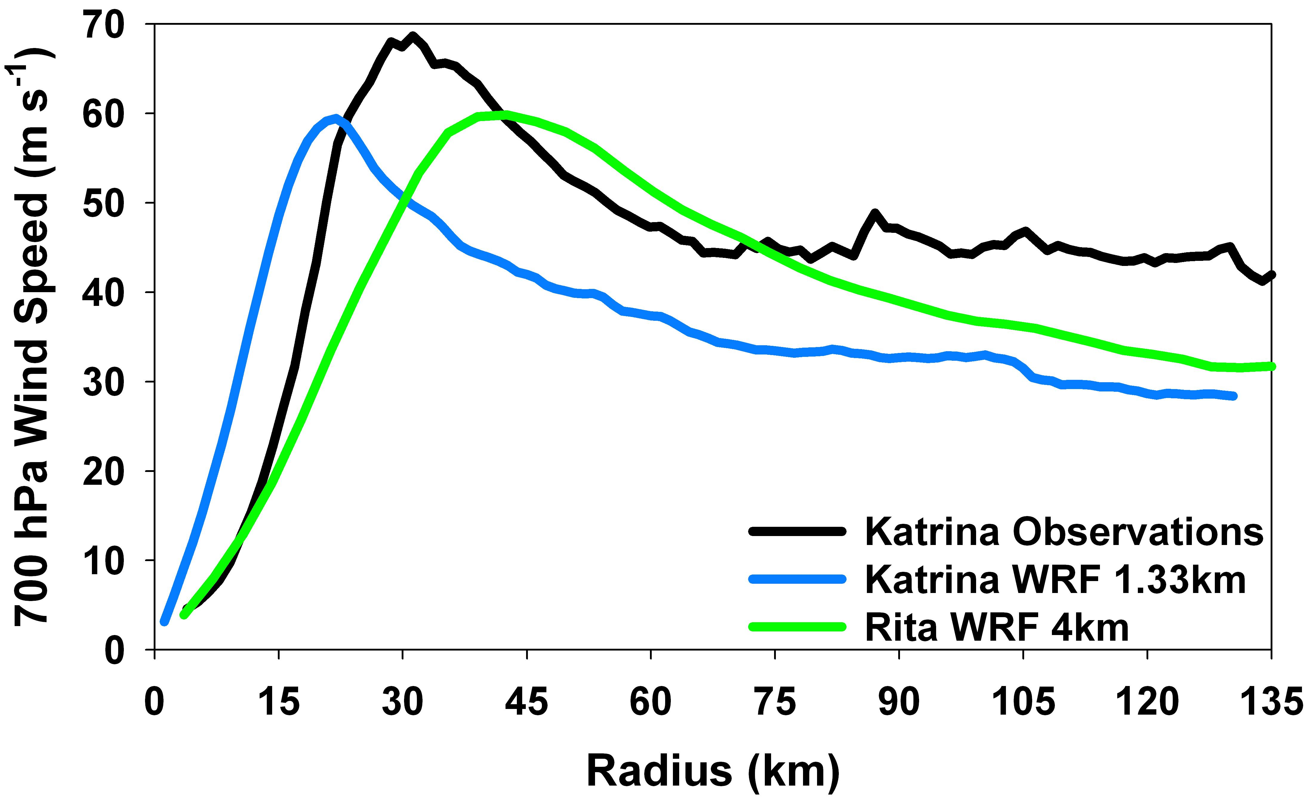
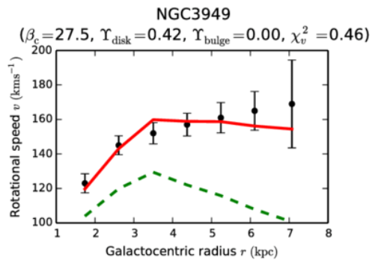
Milky Way Rotation Curve
space-facts.com
Pearson Education
www.atmos.albany.edu
Chan & Hui 2018
Notes:
Solar System ---NO, space velocity decreases as you go out
Carousel --- NO, space velocity increases as you go out
Hurricane Katrina --- NO, very fast in center
NGC 3949 --- YES, flat moving out …NGC3949 similar to Milky Way

Slide 7
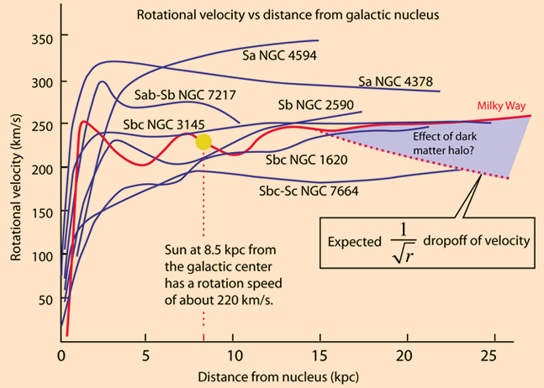
Rotation Curves
Notes:
spirals

Slide 8
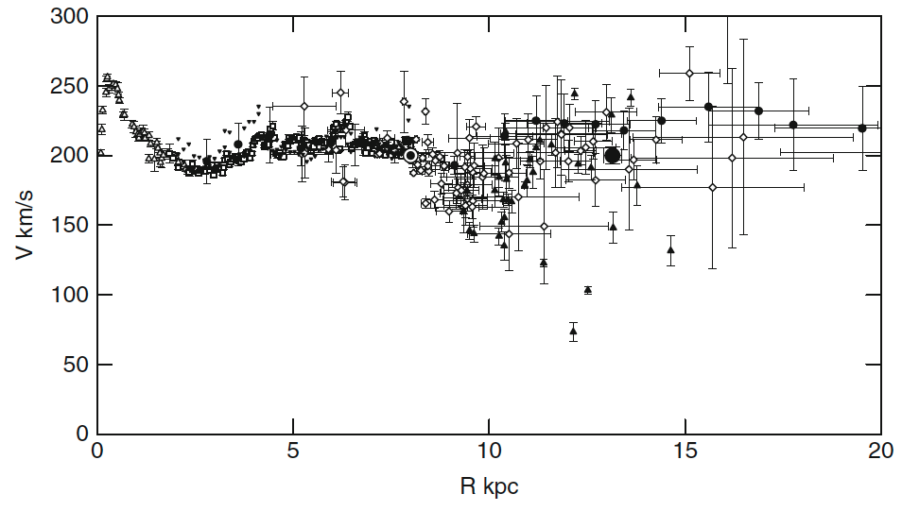
Rotation Curve
HI open/reverse triangles, circles
CO rectangles
CO+HII diamonds
C stars filled triangles
S269 star formation region’s parallax/proper motion = big dot
189 ± 9 microarcsec = 5.3 kpc … same as Sun’s velocity … flat rotation curve
Sofue+ (2009)
Notes:
Fig. 1. Observed circular velocities representing the rotation curve of the Galaxy. Open triangles: HI tangent velocity method (Burton & Gordon 1978); rectangles: CO tangent (Clemens 1989); reverse triangles: HI tangent (Fich et al. 1989); diamonds: CO and HII regions (Fich et al. 1989; Blitz et al. 1982); filled triangles: Demers and Battinelli (2007); circles: HI thickness (Honma and Sofue 1997a, b); big circle at 13.1 kpc: VERA-parallax, proper motion, and velocity (Honma et al. 2007). All data have been converted to (R0, V0) = (8.0, 200.0 km/s).

Slide 9
Rotation Curve
bulge
disk
halo
Sofue+ (2009)
Notes:
Fig. 1. Observed circular velocities representing the rotation curve of the Galaxy. Open triangles: HI tangent velocity method (Burton & Gordon 1978); rectangles: CO tangent (Clemens 1989); reverse triangles: HI tangent (Fich et al. 1989); diamonds: CO and HII regions (Fich et al. 1989; Blitz et al. 1982); filled triangles: Demers and Battinelli (2007); circles: HI thickness (Honma and Sofue 1997a, b); big circle at 13.1 kpc: VERA-parallax, proper motion, and velocity (Honma et al. 2007). All data have been converted to (R0, V0) = (8.0, 200.0 km/s).

Slide 10
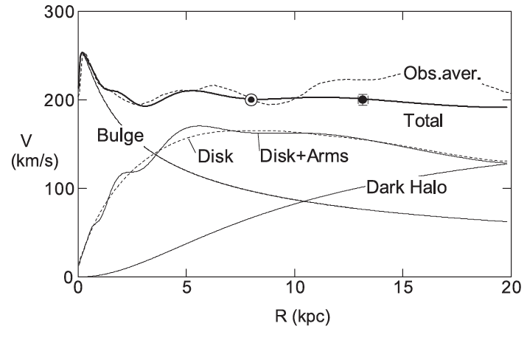
Rotation Curve
Sofue+ (2009)

Slide 11
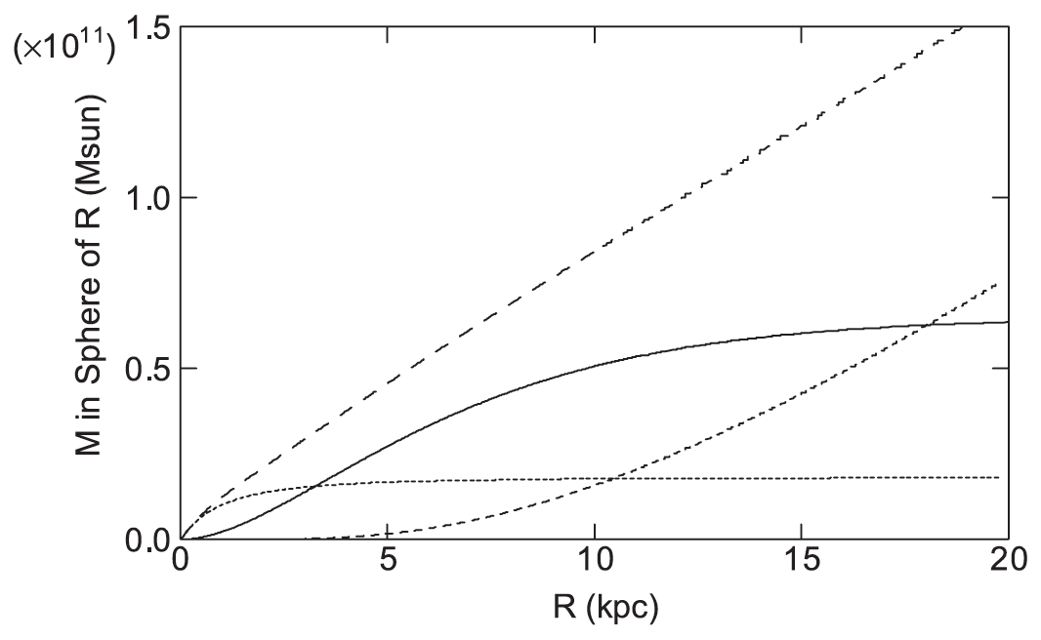
Rotation Curve: total mass
total
disk
halo
bulge
Sofue+ (2009)
Notes:
Total masses of individual components integrated in a sphere of radius R. Dotted line: bulge; thick solid line: disk; dash: halo; and long dashed line: their sum.

Slide 12
Total Mass … Stars
10¹¹ M
median stellar mass ~ 0.3 M
3 X 10¹¹ stars
“300 billion stars”

Slide 13
Rotation Curve
3 kpc dip
9 kpc dip
3 kpc dip
9 kpc dip
sum
bulge disk
halo
773 Cepheids
distances from infrared P-L relations (WISE and Spitzer)
Gaia proper motions and radial velocities
Mroz+ (2019)
Notes:
mid-infrared P-L relations key … you can see the Cepheids far away
Rotation curve of the Milky Way for Cepheids assuming R₀ = 8.09 kpc and Θ₀ = 233.6 km s⁻¹ (model 2). Red data points represent high-mass star-forming regions (Reid et al. 2014). Gray data points are taken from Sofue et al. (2009) and are rescaled to new (R₀, Θ₀) using formula . Solid and dashed lines show the best-fitting models (linear and universal, respectively).

Slide 14
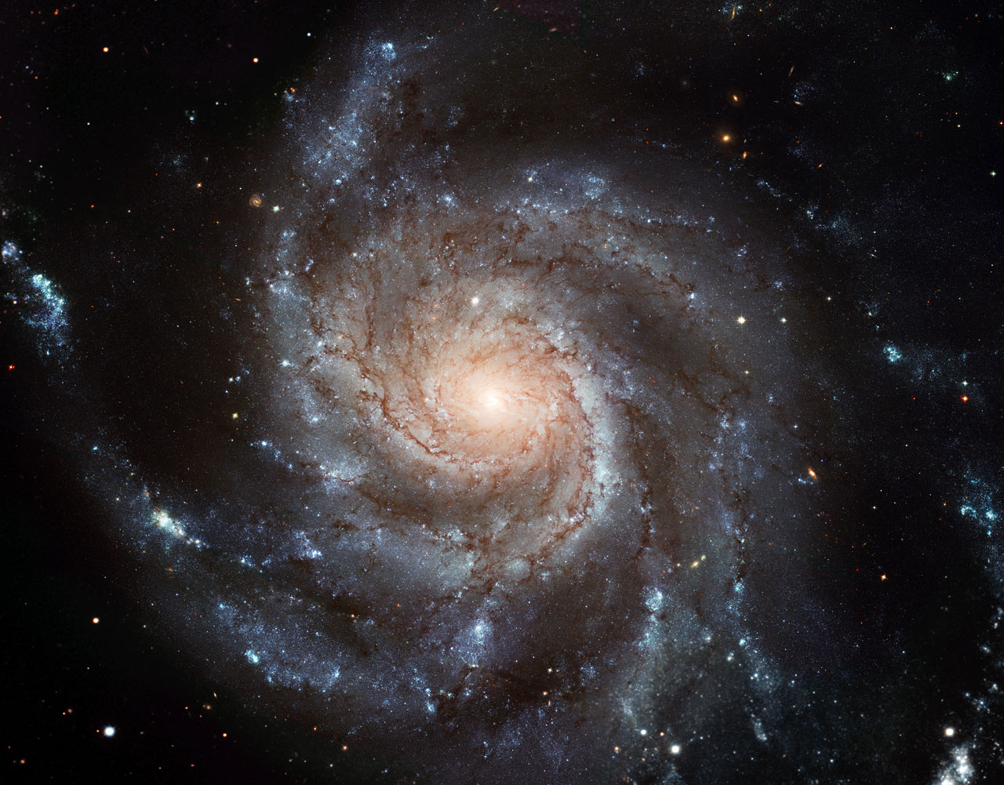
Spiral Arms
M101: Pinwheel Galaxy
How many arms?
Notes:
EXERCISE: trace spiral arms
~ 50 kpc across
2 arms + 2 major spurs = 4 arms?
finished cluster lecture first, so this set would take about 50 min, not 75 min

Slide 15
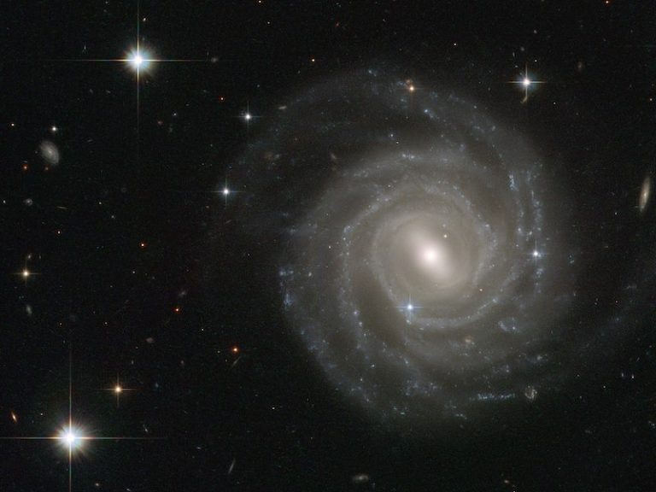
Spiral Arms
UGC 12158
How many arms?
Notes:
EXERCISE: trace spiral arms
2 arms + 2 major spurs = 4 arms?

Slide 16
Spiral Arms
NGC 3949
How many arms?
Notes:
EXERCISE: trace spiral arms
2 arms + 2 minor spurs = 2 arms?

Slide 17
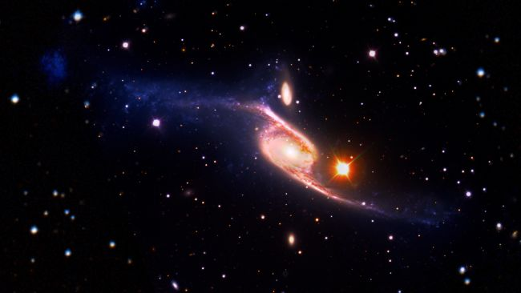
Spiral Arms
Population ~ 2/3 of galaxies are spirals
(locally) ~ 2/3 of spirals have bars
arms attached to bars
Tracers OB stars
H atom 21 cm emission
CO molecule emission in GMCs
masers in star formation regions
Scale Sun is 8 kpc from center of MW
arms seen to 15 kpc
gas seen to 25 kpc
NGC 6872 ~ 5X size of Milky Way

Slide 18
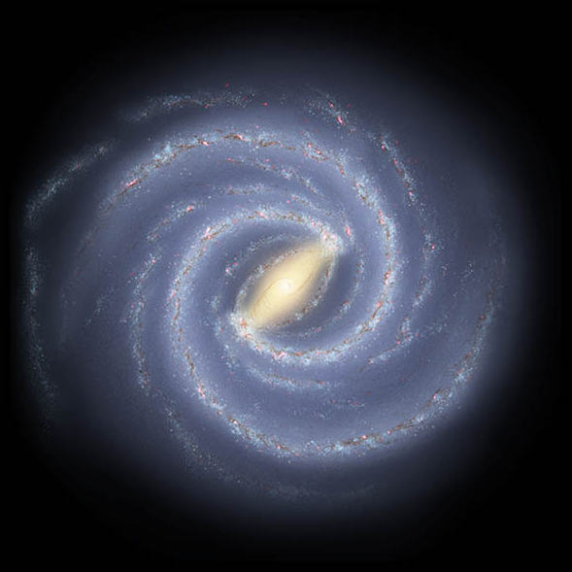
MW Spiral Arms
2 arms or 4 arms?
how tightly wound?
PROBLEM: lack of accurate
distances
WHY?
optical … looking through
dust, crowding
radio … better
model fits to Doppler motion
non-circular motion
quadrant confusion

Slide 19
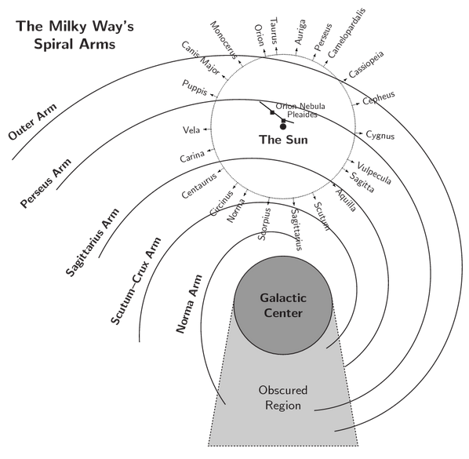
MW Spiral Arms
Milky Way Disk: Spiral Arms I
https://in-the-sky.org/article.php?term=the_milky_way

Slide 20
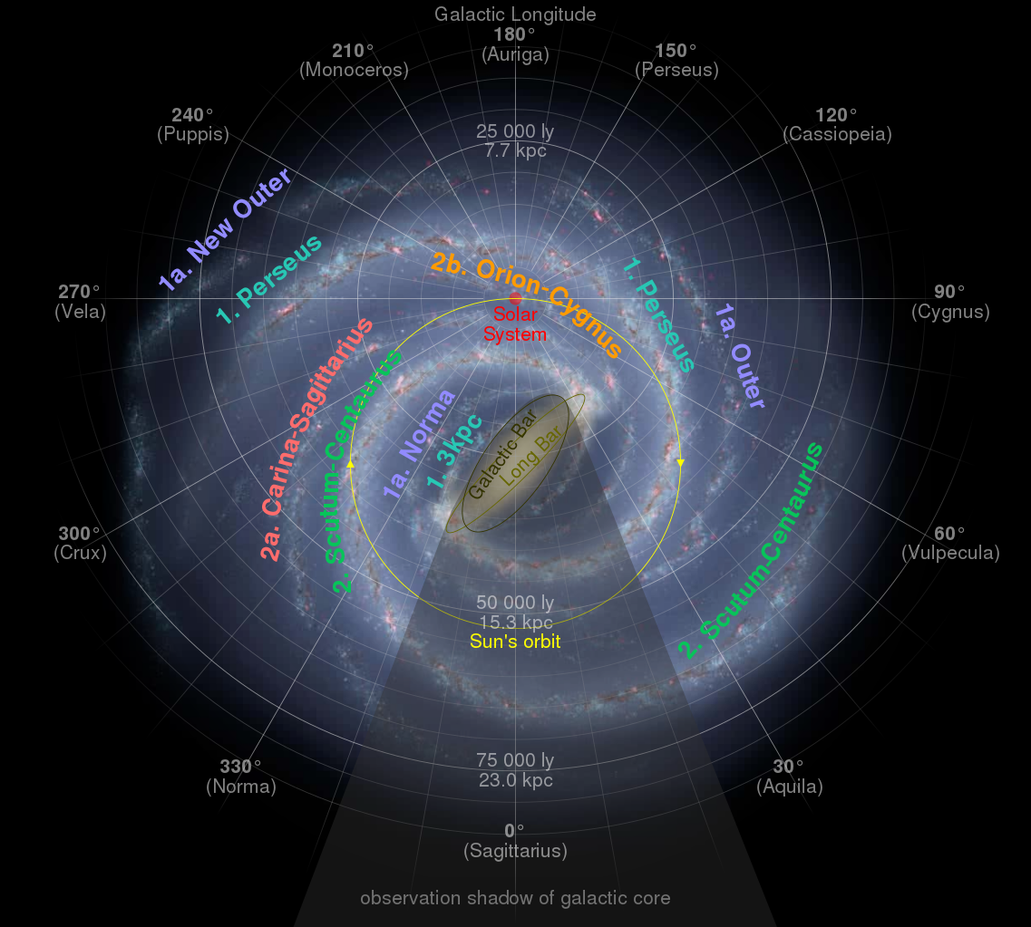
MW Spiral Arms
2 arms or 4 arms?
1. Perseus
1a. Norma(-Outer)
2. Scutum(-Centaurus)
2a. (Carina-)Sagittarius
2b. Orion(-Cygnus)
Notes:
Perseus and Scutum-Centaurus are 2 “major” arms attached to bulge
Norma and Sagittarius are “minor” arms

Slide 21
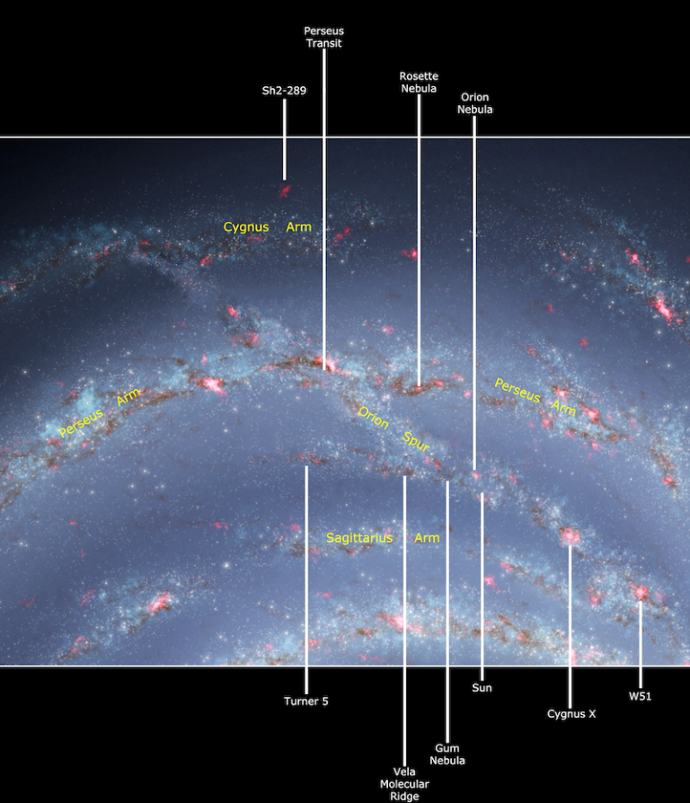
You Are Here
Outer
Orion-Cygnus Arm
a.k.a.
Orion Arm
Local Arm
Orion Bridge
Orion Spur
~1 kpc wide and ~6 kpc long
we ARE MAYBE IN an arm
Orion (minor?)
we ARE BETWEEN arms
Sagittarius (minor) inside
Perseus (major) outside
Scutum
Notes:
Cygnus must be Outer

Slide 22
You Are Here
Outer
Outer
Perseus*
Orion
Sagittarius
Scutum*
UM …
(Norma/Molec.Ring)
*major arms
= OPOSSUM
Scutum
Notes:
alphabetical except for Orion Spur

Slide 23
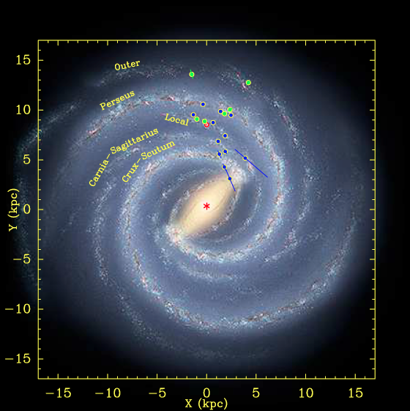
Arms via Masers
Reid+ (2009) … 18 masers
radio VLBA and VLBI
high mass star formation
astrometry of SFR masers
OH, H₂O, SiO, CH₃OH
NOTE clustered distributions
“strong evidence of spiral arms”
Galaxy model
R = 8.4 ± 0.6 kpc
V = 254 ± 16 km/s
pitch angles yield # arms
flat rotation curve
Notes:
MASER = microwave amplification of stimulated emission of radiation
cause = amplification of microwave radiation by stimulated emission, caused by inversion of level populations of interstellar and circumstellar molecules
region < 1000 AU of protostars, caused by individual objects or flows
OH, H2O, NH3, SiO, HCN, CH3OH is methanol

Slide 24
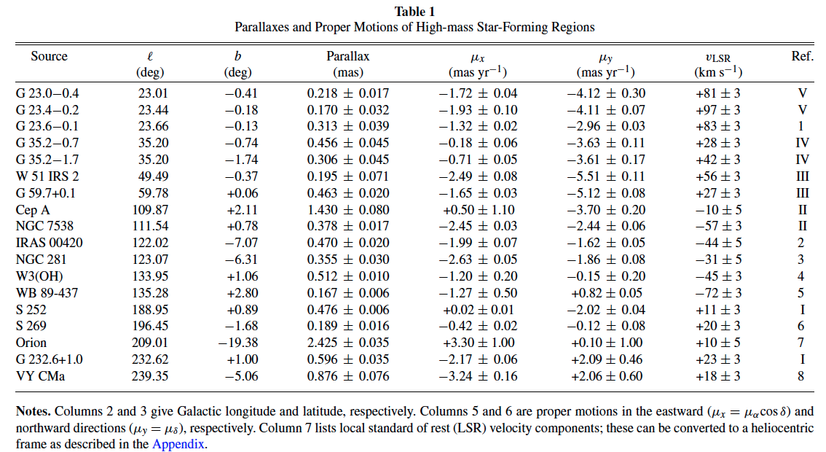
Arms via Masers
Arms via Masers: Parallaxes
parallaxes measured to 10 microarcseconds
= 10% uncertainty at 10 kpc
Reid+ (2009)
Notes:
tiny parallaxes!
S 269 is star formation region key point on rotation curve

Slide 25
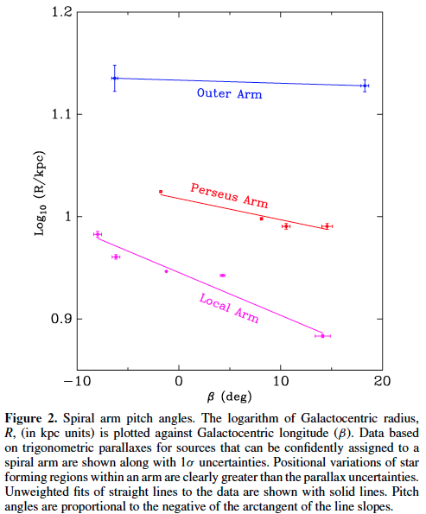
Spiral Arms: Pitch Angles
arms closer to Galactic Center are more tightly wound
Reid+ (2009)

Slide 26
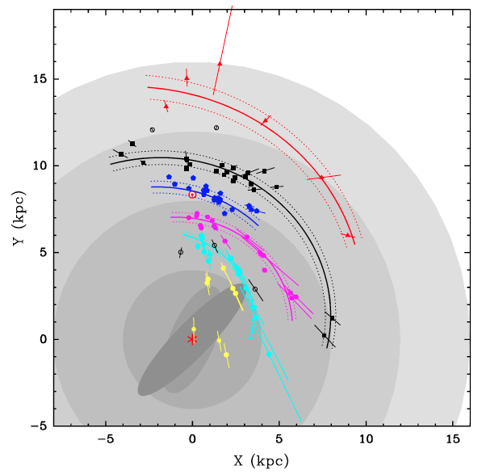
Arms via Masers
Reid+ (2009) … 18 masers
Reid+ (2014) … 103 masers
4 kpc … bar region
8 kpc … solar circle
12 kpc… co-rotation of spiral
pattern and star orbits
Outer Arm
Perseus Arm
Orion Arm
Sagittarius Arm
Scutum Arm
4 kpc 8 kpc 12 kpc 16 kpc
Notes:
long vectors radiate from Sun for distance uncertainties
yellow = inner Galaxy sources … open circles = arm assignment unclear

Slide 27
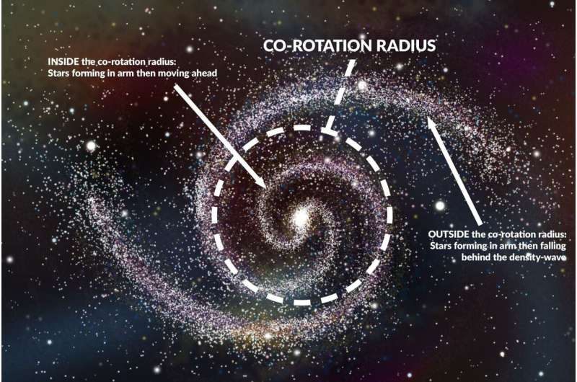
Spiral Arms: Co-Rotation

Slide 28
Arms via Masers
Reid+ (2009) … 18 masers
Reid+ (2014) … 103 masers
4 kpc … bar region
8 kpc … solar circle
12 kpc… co-rotation of spiral
pattern and star orbits
16 kpc … end of star formation
Galaxy model (2009)
R = 8.4 ± 0.6 kpc
V = 254 ± 16 km/s
Galaxy model (2014)
R = 8.34 ± 0.16 kpc
V = 240 ± 8 km/s
Outer Arm
Perseus Arm
Orion Arm
Sagittarius Arm
Scutum Arm
4 kpc 8 kpc 12 kpc 16 kpc
Notes:
long vectors radiate from Sun for distance uncertainties
yellow = inner Galaxy sources … open circles = arm assignment unclear

Slide 29
Arms via Masers
NOTE
TINY
FRACTION
OF
ARMS
MAPPED!
Outer Arm
Perseus Arm
Orion Arm
Sagittarius Arm
Scutum Arm
4 kpc 8 kpc 12 kpc 16 kpc
Notes:
long vectors radiate from Sun for distance uncertainties
yellow = inner Galaxy sources … open circles = arm assignment unclear

Slide 30
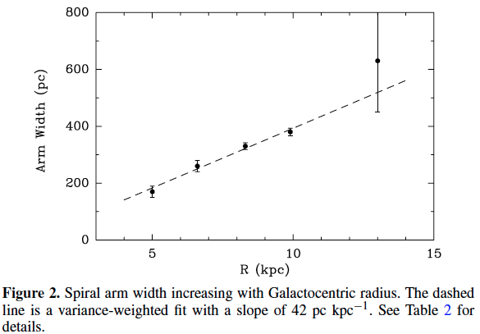
Arm Thickness
arms are wider
further from Galactic Center
Reid+ (2014)

Slide 31
Spiral Arms
Observe optical: young OB stars last ≤ 10 Myr
… star formation rate in arms higher than rest of disk
near-IR: old red giants follow spiral pattern, too … arms broader
… entire stellar disk participates in spiral pattern
if spiral arms have old stars … persistent “density wave”
Density Waves dense region has gravity
… compresses gas … stars form … lights up
Causes rotating bar asymmetry
galaxy collisions
galaxy companions/tides
Results patterns not mass movement
chemical enrichment via stellar evolution
dynamics of gas and stars, e.g., clustering, scattering …

Slide 32
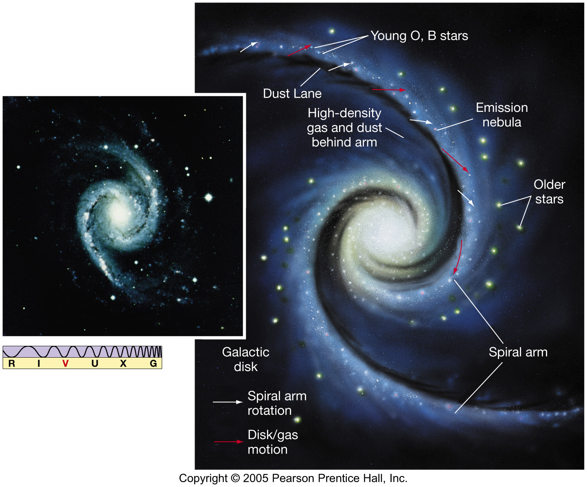
Spiral Arms
arm components:
dust/gas lanes (CO)
young stars (optical, HII)
old stars (near-IR)
Notes:
you don’t see OB stars much past dust lanes because they blow up soon after being made
arms are ~static … gas/dust/stars move through them

Slide 33
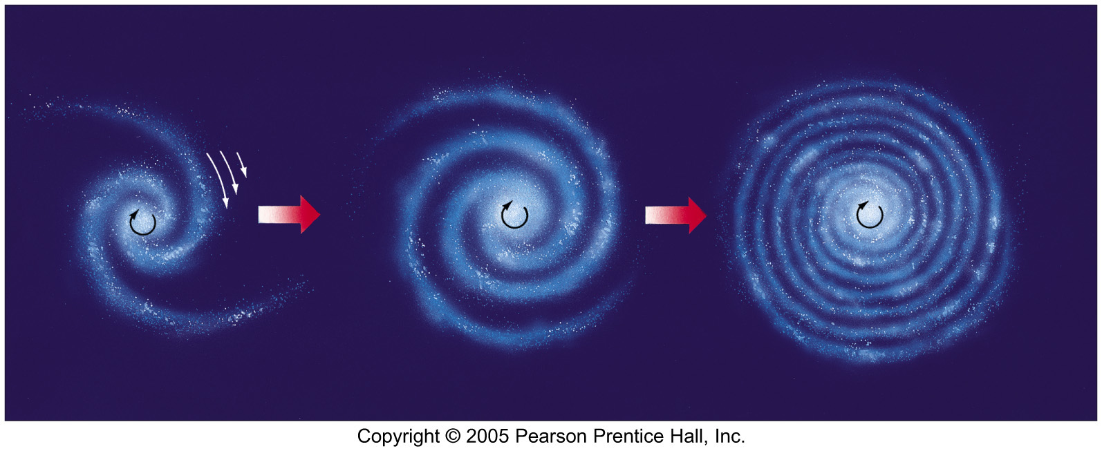
Spiral Arms
Formation? cohesive arms would wind up and disappear …
Spiral Density Lindblad (1920s) arms represent enhanced density regions
Waves rotate more slowly than stars and gas
gas enters a wave, compressed … new stars
Lin & Shu (1964) density waves
periodic compression/rarefaction of surface density
propagate like ocean waves
rotates, NOT stationary, NOT long-lasting
Notes:
Lin-Shu thought the waves were long-lasting (~stationary) and rotated slowly, BUT THEY AREN’T

Slide 34
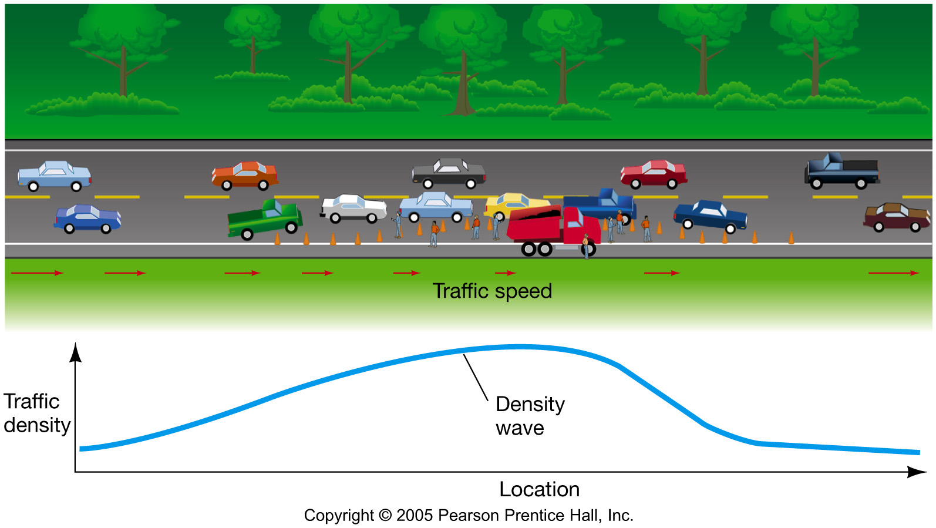
Spiral Traffic

Slide 35
Spiral Arms
M51 Whirlpool Galaxy
Merrifield Description: https://www.youtube.com/watch?v=yiv6a8BVzPE&t=0s
Spiral Arm Creation: https://www.youtube.com/watch?v=lMReQ6hVw5s
Individual Stars: https://www.youtube.com/watch?v=c5Us-jonCLA

