Slide 1
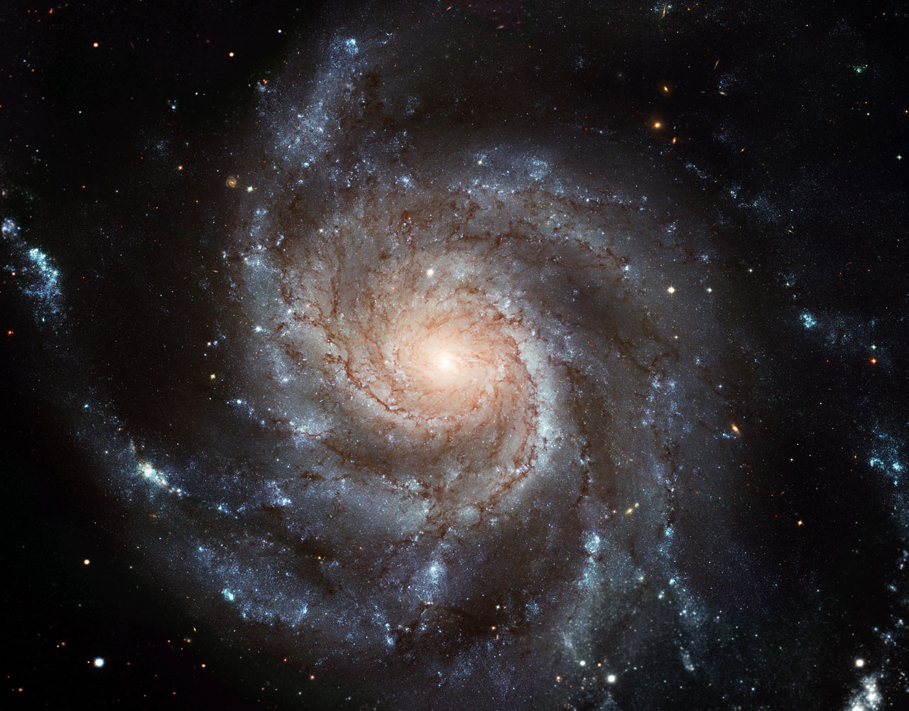
Milky Way Spiral Arms I
M101: Pinwheel Galaxy
Notes:
***** EVEN WITH 8 REVIEW SLIDES, THIS LECTURE WAS ABOUT 10 MIN SHORT *****

Slide 2
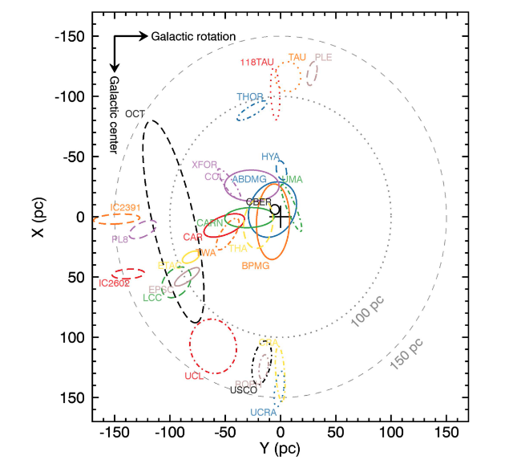
Young Moving Associations // BANYAN Σ
Notes:
CBER = Coma Berenices
THA = Tuc-Hor
CAR = Carina
CARN = Carina-Near
XFOR = chi1 For
THOR = 32 Ori

Slide 3
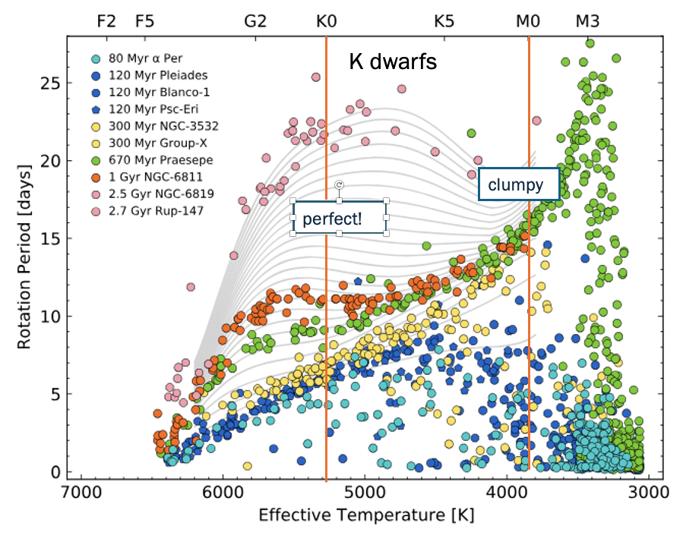
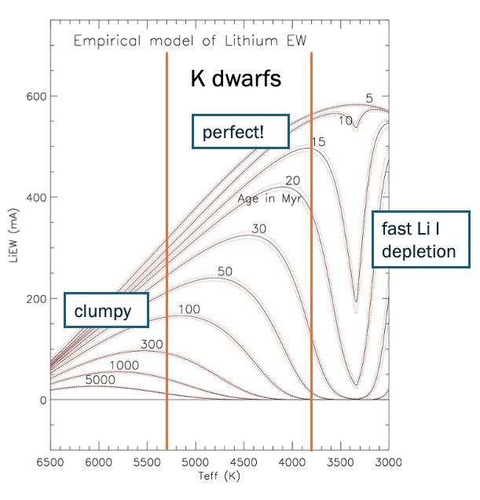
Ages by Gyrochronology
… to 3 Gyr
Ages by Li I Depletion
… to 1 Gyr
Bouma+2023,+2024
Jeffries+2023

Slide 4
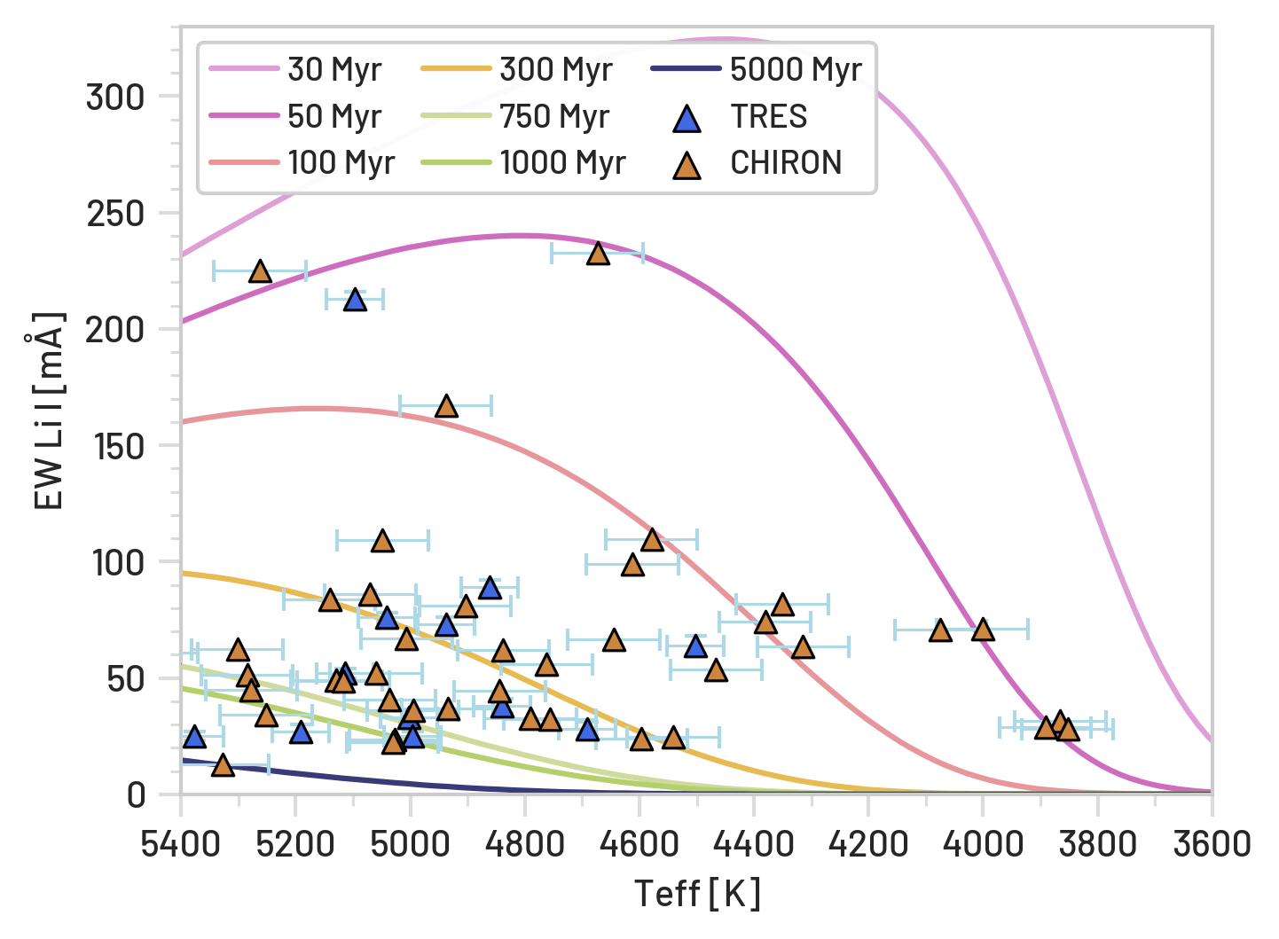
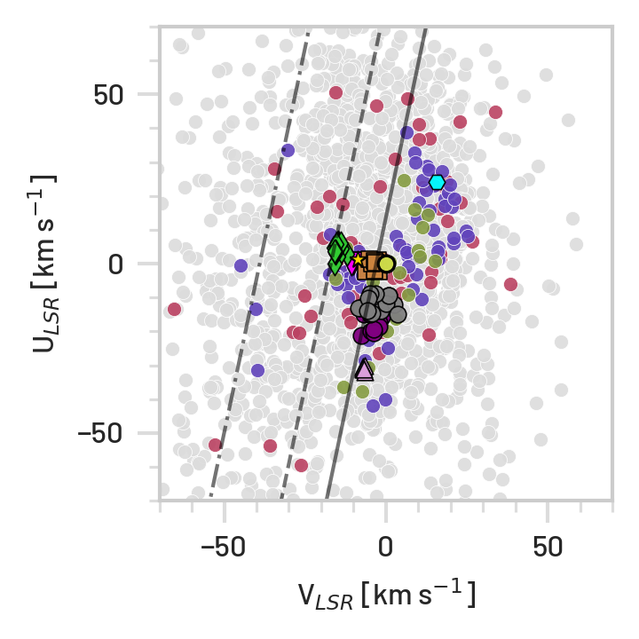
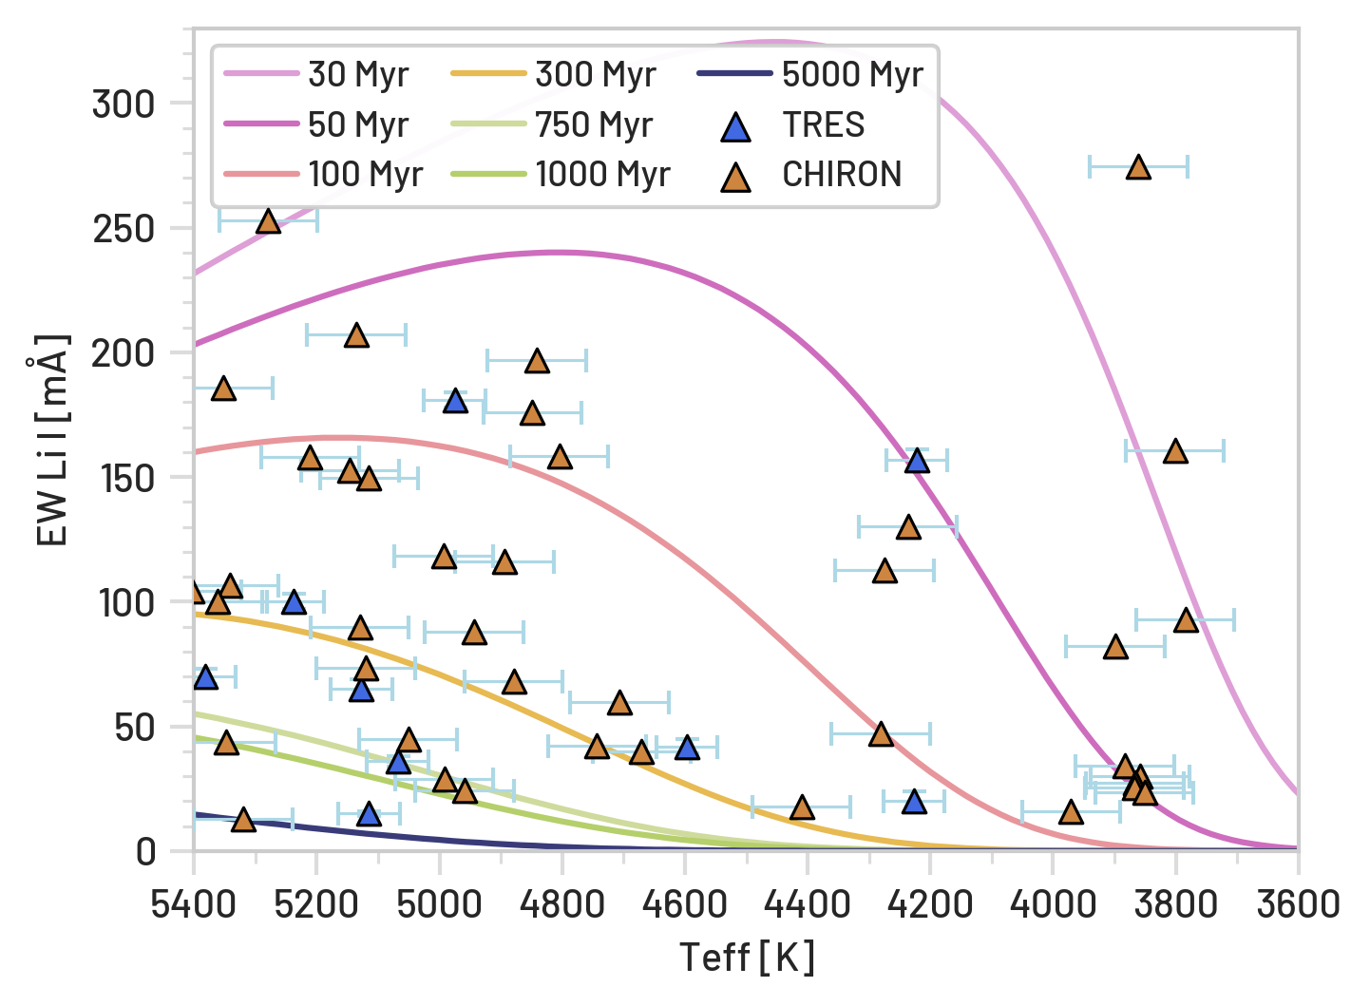
Nearby Young K dwarfs Paradox
500 Myr
Relative Ages through EAGLES Li I Isochrones

Slide 5
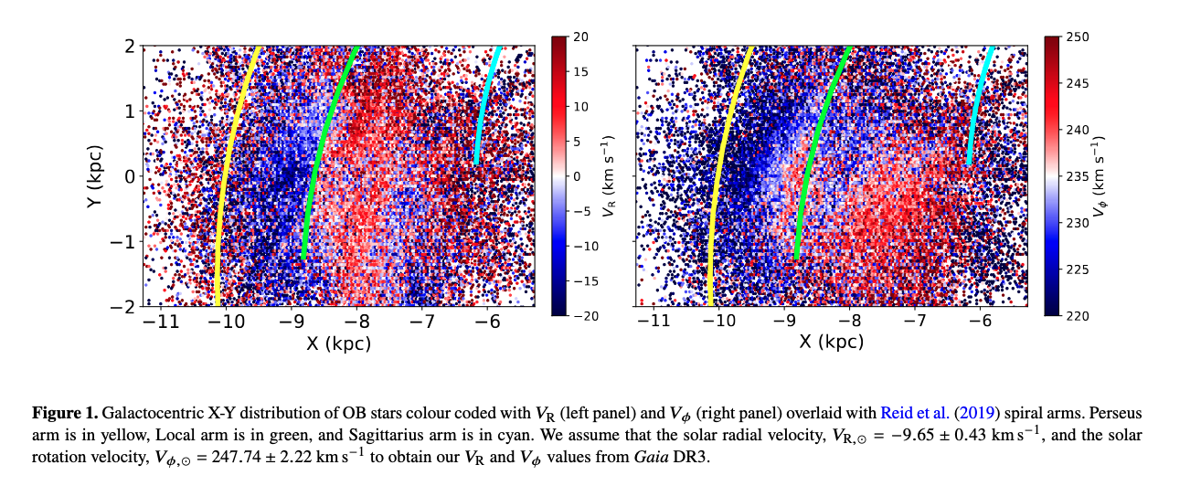
Using Young Stars: OB stars
Almannaei+24

Slide 8
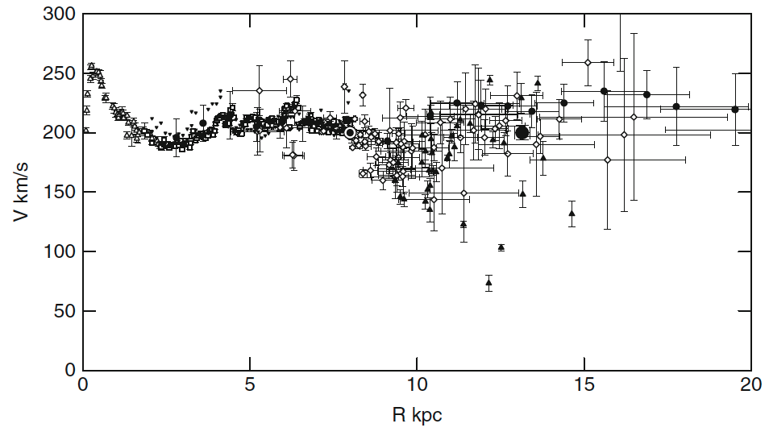
Rotation Curve
inner curve
tangent points
outer curve
distance estimates
Sofue+ (2009)
Notes:
Fig. 1. Observed circular velocities representing the rotation curve of the Galaxy. Open triangles: HI tangent velocity method (Burton & Gordon 1978); rectangles: CO tangent (Clemens 1989); reverse triangles: HI tangent (Fich et al. 1989); diamonds: CO and HII regions (Fich et al. 1989; Blitz et al. 1982); filled triangles: Demers and Battinelli (2007); circles: HI thickness (Honma and Sofue 1997a, b); big circle at 13.1 kpc: VERA-parallax, proper motion, and velocity (Honma et al. 2007). All data have been converted to (R0, V0) = (8.0, 200.0 km/s).

Slide 9
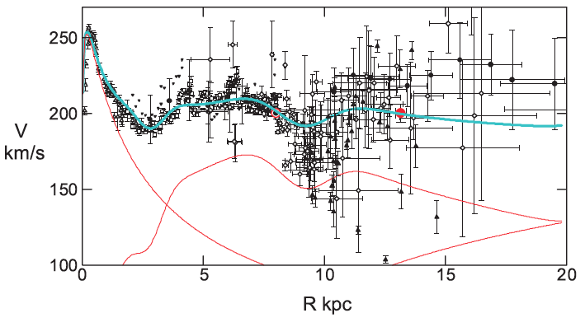
Rotation Curve
sum
bulge disk
halo
Sofue+ (2009)
Notes:
note cutoff at 100 km/s instead of 0 km/s

Slide 10
Milky Way Spiral Arms I
M101: Pinwheel Galaxy
How many arms?
Notes:
EXERCISE: trace spiral arms
~ 50 kpc across
2 arms + 2 major spurs = 4 arms?

Slide 11
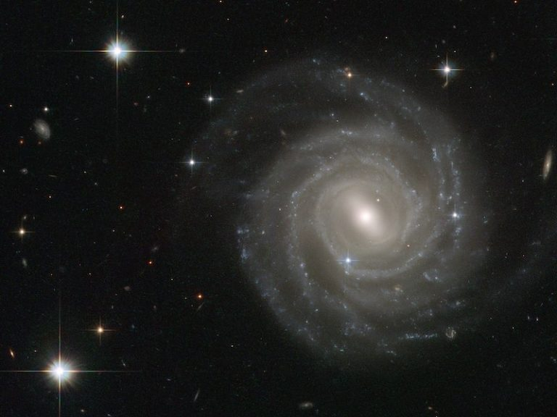
Milky Way Spiral Arms
UGC 12158
How many arms?
Notes:
EXERCISE: trace spiral arms
2 arms + 2 major spurs = 4 arms?

Slide 12
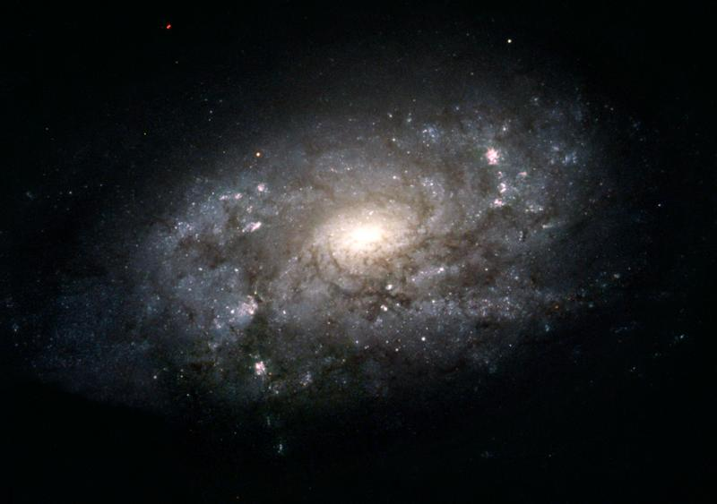
Milky Way Spiral Arms
NGC 3949
How many arms?
Notes:
EXERCISE: trace spiral arms
2 arms + 2 minor spurs = 2 arms?

Slide 13
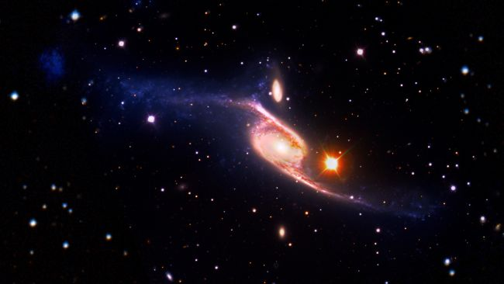
Spiral Arms
Population ~ 2/3 of galaxies are spirals
(locally) ~ 2/3 of spirals have bars
arms attached to bars
Tracers OB stars
H atom 21 cm emission
CO molecule emission in GMCs
masers in star formation regions
Scale Sun is ~8 kpc from center of MW
arms seen to 15 kpc
gas seen to 25 kpc
NGC 6872 ~ 5X size of Milky Way

Slide 14
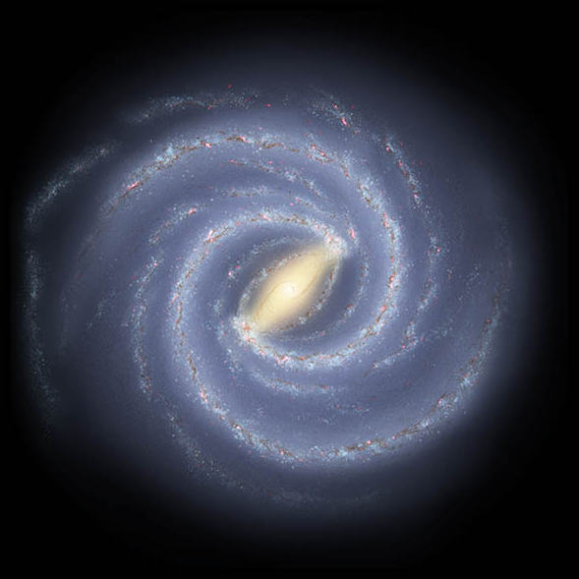
Spiral Arms
2 arms or 4 arms?
How tightly wound?
PROBLEM: lack of accurate
distances
WHY?
optical … looking through
dust, crowding
radio … better
model fits to Doppler motion
non-circular motion
quadrant confusion

Slide 15
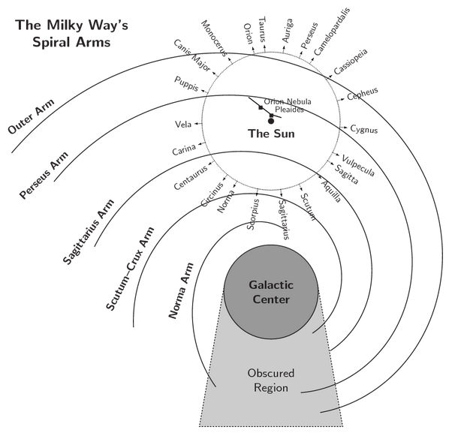
Spiral Arms
Milky Way Disk: Spiral Arms I
https://in-the-sky.org/article.php?term=the_milky_way

Slide 16
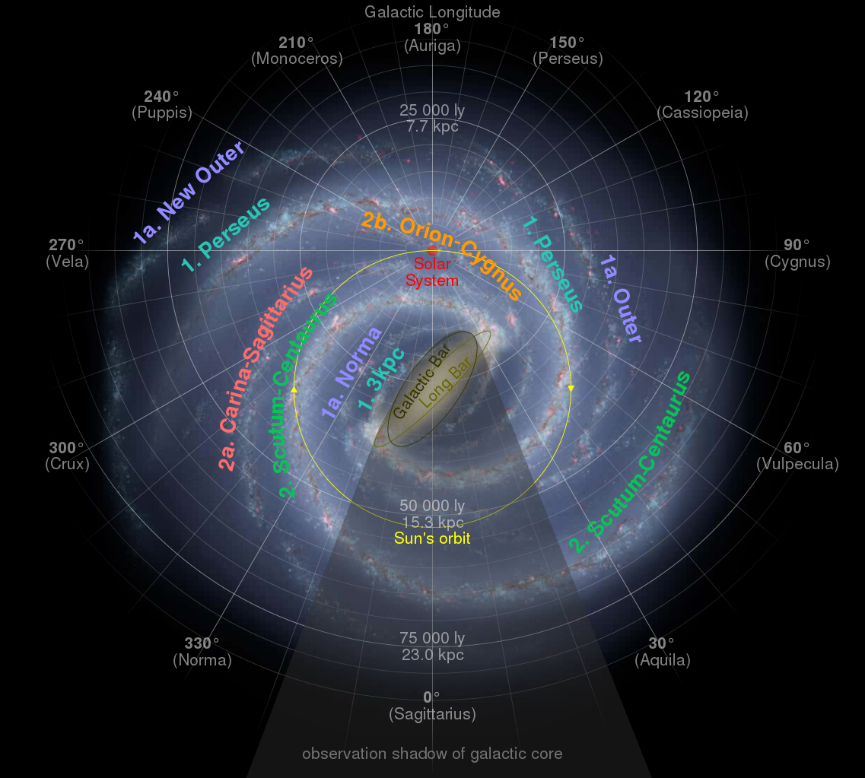
Spiral Arms
2 arms or 4 arms?
1. Perseus
1a. Norma(-Outer)
2. Scutum(-Centaurus)
2a. (Carina-)Sagittarius
2b. Orion(-Cygnus)
Notes:
Perseus and Scutum-Centaurus are 2 “major” arms attached to bulge
Norma and Sagittarius are “minor” arms

Slide 17
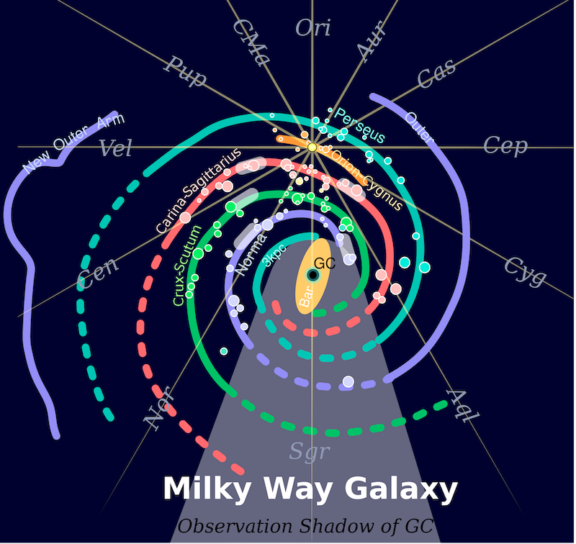
Spiral Arms
2 arms or 4 arms?
1. Perseus
1a. Norma(-Outer)
2. Scutum(-Centaurus)
2a. (Carina-)Sagittarius
2b. Orion(-Cygnus)

Slide 18
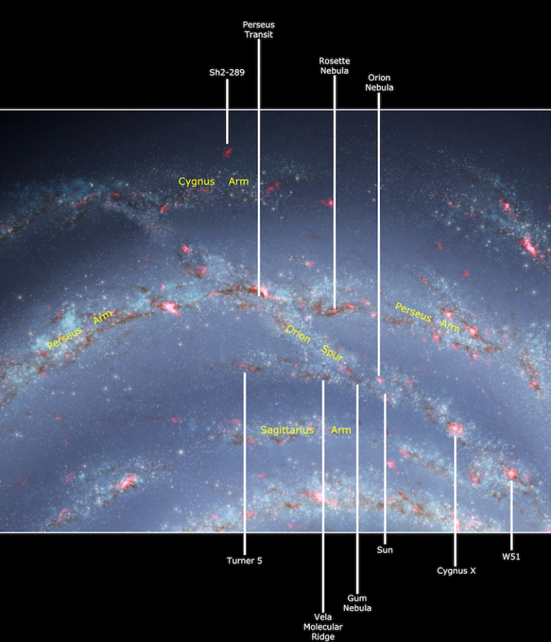
You Are
Here
Outer
Orion-Cygnus Arm
a.k.a.
Orion Arm
Local Arm
Orion Bridge
Orion Spur
~1 kpc wide and ~6 kpc long
we ARE MAYBE IN an arm
Orion (minor?)
we ARE BETWEEN arms
Sagittarius (minor) inside
Perseus (major) outside
Scutum
Notes:
Cygnus must be Outer

Slide 19
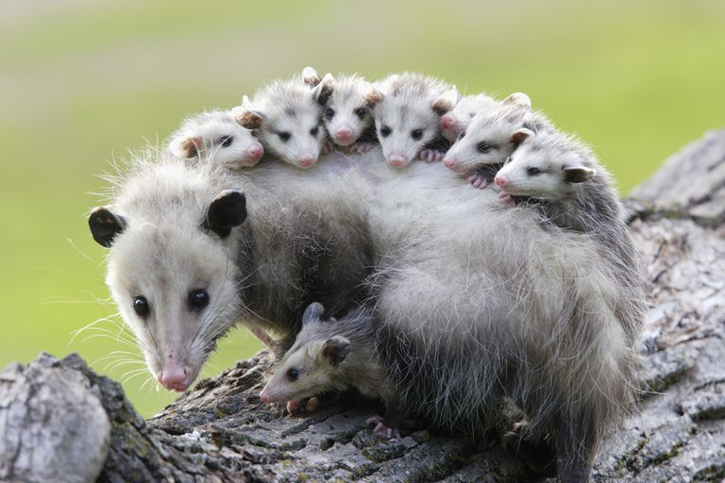
You Are
Here
Outer
Outer
Perseus*
Orion
Sagittarius
Scutum*
UM …
(Norma/Molec.Ring)
*major arms
= OPOSSUM
Scutum
alphabetical except for Orion
Notes:
alphabetical except for Orion Spur

Slide 20
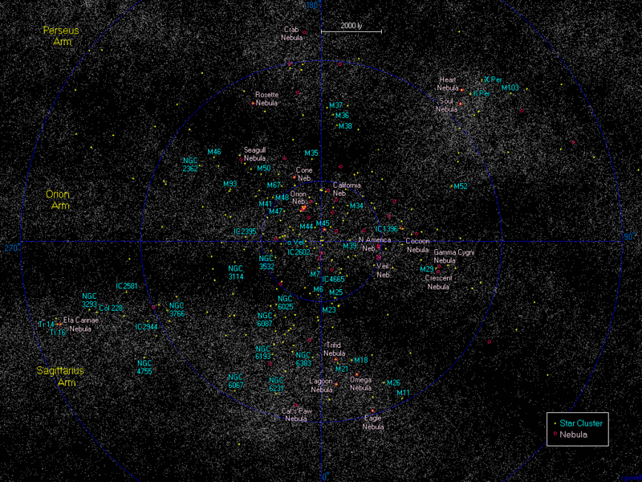
Spiral Arms
Notes:
M45 = Pleiades

Slide 21
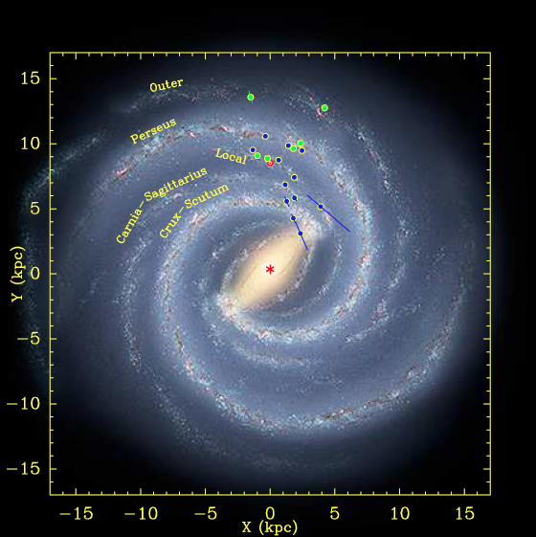
Arms via Masers
Reid+ (2009) … 18 masers
Reid+ (2014) … 103 masers
radio VLBA and VLBI
high mass star formation
astrometry of protostar masers
OH, H₂O, SiO, CH₃OH
NOTE clustered distributions
“strong evidence of spiral arms”
Galaxy model
R = 8.4 ± 0.6 kpc
V = 254 ± 16 km/s
pitch angles yield # arms
flat rotation curve
Notes:
MASER = microwave amplification of stimulated emission of radiation
cause = inversion of level populations of interstellar and circumstellar molecules
region < 1000 AU of protostars, caused by individual objects or flows
OH, H2O, NH3, SiO, HCN, CH3OH is methanol

Slide 22
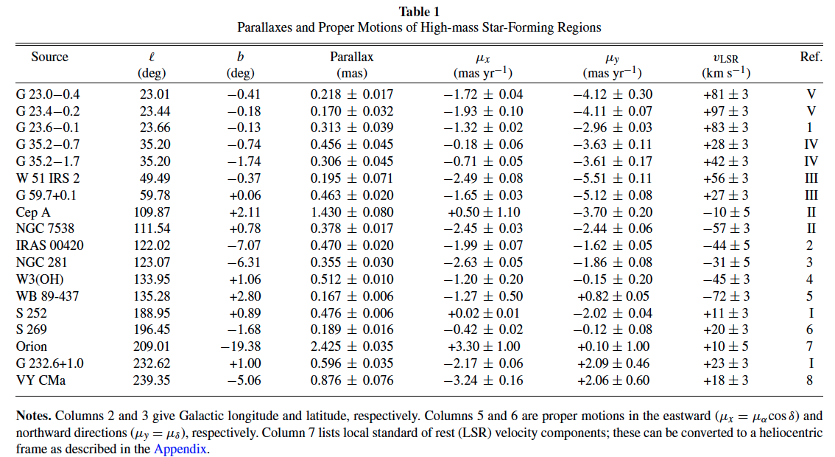
Arms via Masers
Arms via Masers: Parallaxes
parallaxes measured to 10 microarcseconds
= 10% uncertainty at 10 kpc
Reid+ (2009)
Notes:
tiny parallaxes!
S 269 is star formation region key point on rotation curve

Slide 23
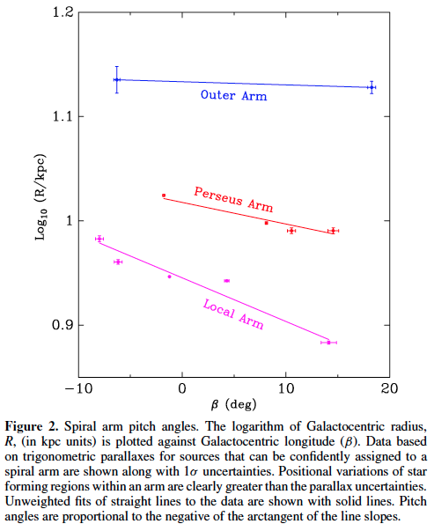
Spiral Arms: Pitch Angles
arms closer to Galactic Center are more tightly wound
Reid+ (2009)

Slide 24
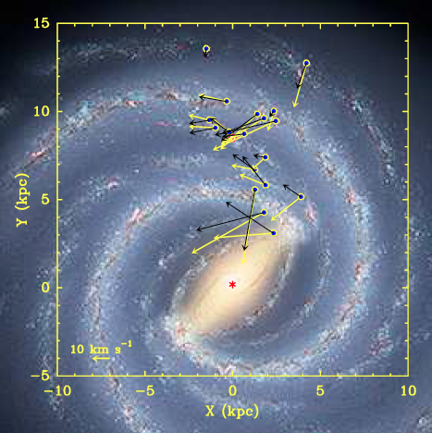
Spiral Arms: Waves
peculiar motions of SFRs
π + μ + RV = 3D motion
galaxy rotates clockwise
(that rotation removed)
yellow: IAU standard values
220 km/s at 8.5 kpc
black: their values
254 km/s at 8.4 kpc
SFRs orbit ~15 km/s slower
than Galaxy rotates
star formation triggered by
gas hitting shock front
Reid+ (2009)

Slide 25
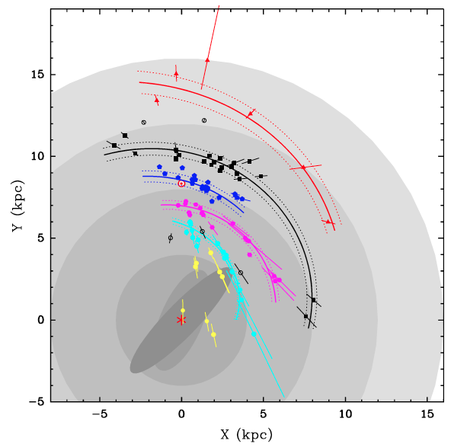
Arms via Masers
Reid+ (2009) … 18 masers
Reid+ (2014) … 103 masers
4 kpc … bar region
8 kpc … solar circle
12 kpc… co-rotation of spiral
pattern and star orbits
Outer Arm
Perseus Arm
Orion Arm
Sagittarius Arm
Scutum Arm
4 kpc 8 kpc 12 kpc 16 kpc
Notes:
long vectors radiate from Sun for distance uncertainties
yellow = inner Galaxy sources … open circles = arm assignment unclear

Slide 26
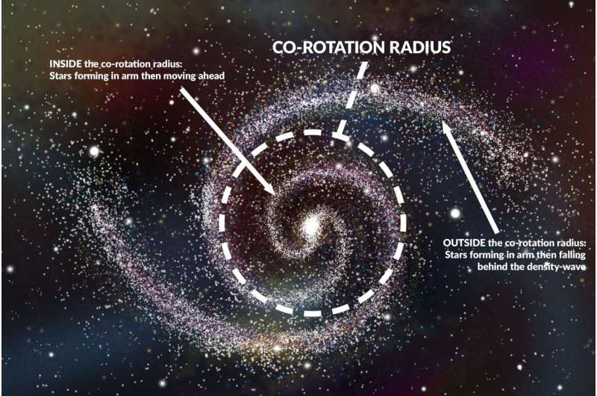
Spiral Arms: Co-Rotation

Slide 27
Arms via Masers
Reid+ (2009) … 18 masers
Reid+ (2014) … 103 masers
4 kpc … bar region
8 kpc … solar circle
12 kpc… corotation of spiral
pattern and star orbits
16 kpc … end of star formation
Galaxy model (2009)
R = 8.4 ± 0.6 kpc
V = 254 ± 16 km/s
Galaxy model (2014)
R = 8.34 ± 0.16 kpc
V = 240 ± 8 km/s
Outer Arm
Perseus Arm
Orion Arm
Sagittarius Arm
Scutum Arm
4 kpc 8 kpc 12 kpc 16 kpc
Notes:
long vectors radiate from Sun for distance uncertainties
yellow = inner Galaxy sources … open circles = arm assignment unclear

Slide 28
Arms via Masers
NOTE
TINY
FRACTION
OF
ARMS
MAPPED!
Outer Arm
Perseus Arm
Orion Arm
Sagittarius Arm
Scutum Arm
4 kpc 8 kpc 12 kpc 16 kpc
Notes:
long vectors radiate from Sun for distance uncertainties
yellow = inner Galaxy sources … open circles = arm assignment unclear

Slide 29
Why Do These Numbers Matter?
Changing the value of V₀ would have widespread impact in astrophysics.
For example, increasing V₀ by 20 km/s with respect to the IAU recommended value of 220 km/s reduces kinematic distances by about 10%, leading to a decrease of 20% in estimated young star luminosities, a corresponding decrease in estimated cloud masses, and a change in young stellar object ages. Estimates of the total mass of the dark matter halo of the Milky Way scale as V_{max}²R_{Vir}. Since the maximum in the rotation curve (V_{max}) and the Virial radius (R_{Vir} ) scale linearly with V₀, the mass of the halo scales as V₀³, leading to a 30% increase in the estimate of the Milky Way’s (dark-matter dominated) mass. This, in turn, affects the expected dark-matter annihilation signal (Finkbeiner et al. 2009), increases the “missing satellite” problem (Wang et al. 2012), and increases the likelihood that the Magellanic Clouds are bound to the Milky Way (Shattow & Loeb 2009).
Reid+ (2014)

Slide 30
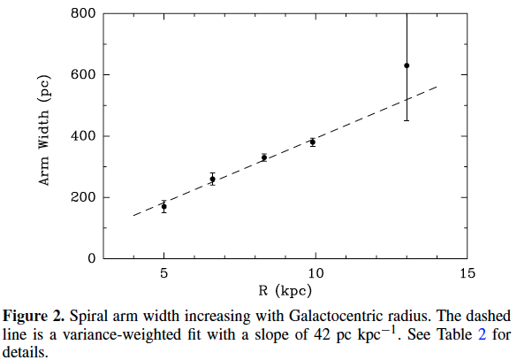
Arm Thickness
arms are wider
further from Galactic Center
Reid+ (2014)

Slide 32
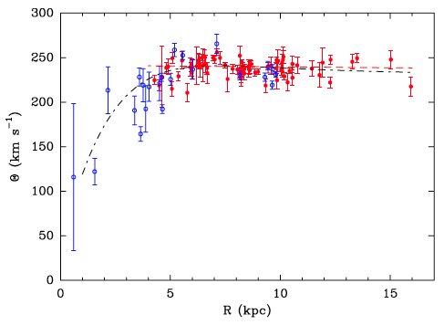
Rotation Curve
red points used for fit (red curve)
blue points not used
black curve universal curve for spirals
… velocity downturn < 5 kpc
Reid+ (2014)
Notes:
looking at Reid 2014 doesn’t reveal why blue points not used

