Slide 1
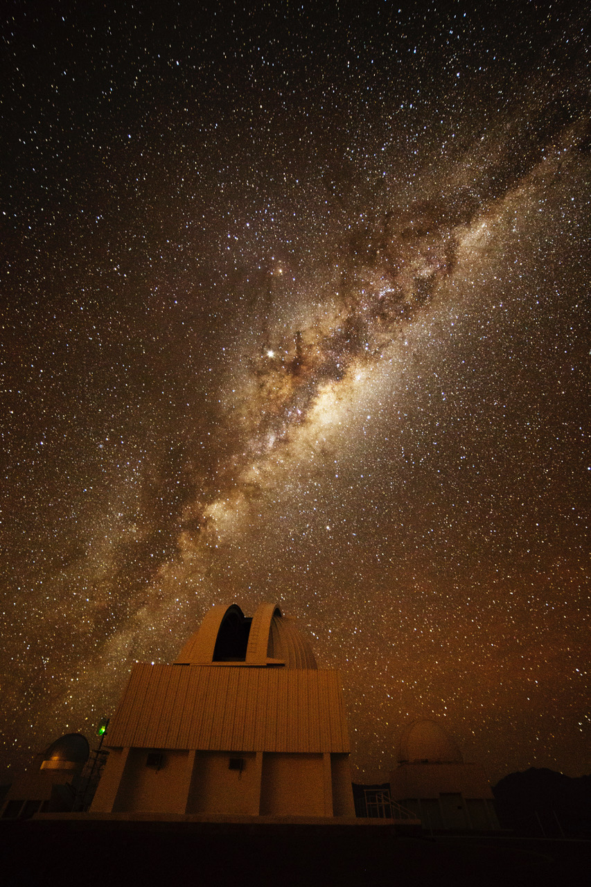
MW Bulge/Bar

Slide 2
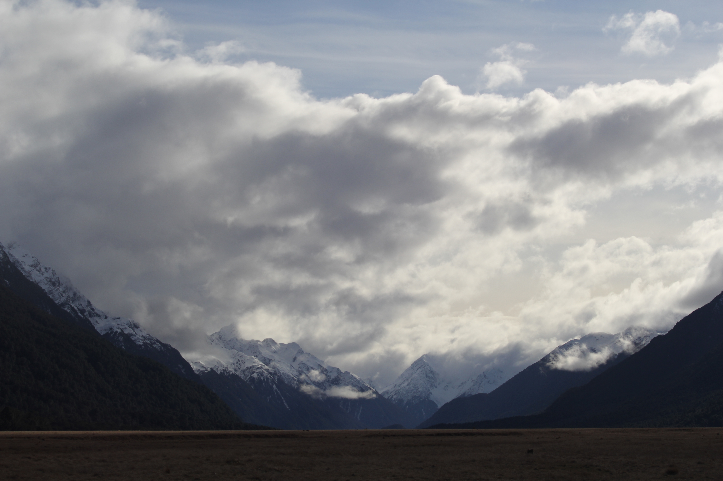
Assignments
http://www.astro.gsu.edu/~thenry/GALACTIC/
Thursday 28 MAR Level 2 … 1st Draft … 5 weeks later
Thursday 18 APR Presentations I
Tuesday 23 APR Presentations II
Thursday 25 APR Level 4 … submit … 4 weeks later
Proposal 8 pages total, not 10 pages total
+ References --- 1 page
+ Bio Sketch --- 2 pages
+ Budget and Narrative --- 2 pages
+ Facilities --- 0.5 page
+ Student Mentoring --- 0.5 page
+ Data Management

Slide 3
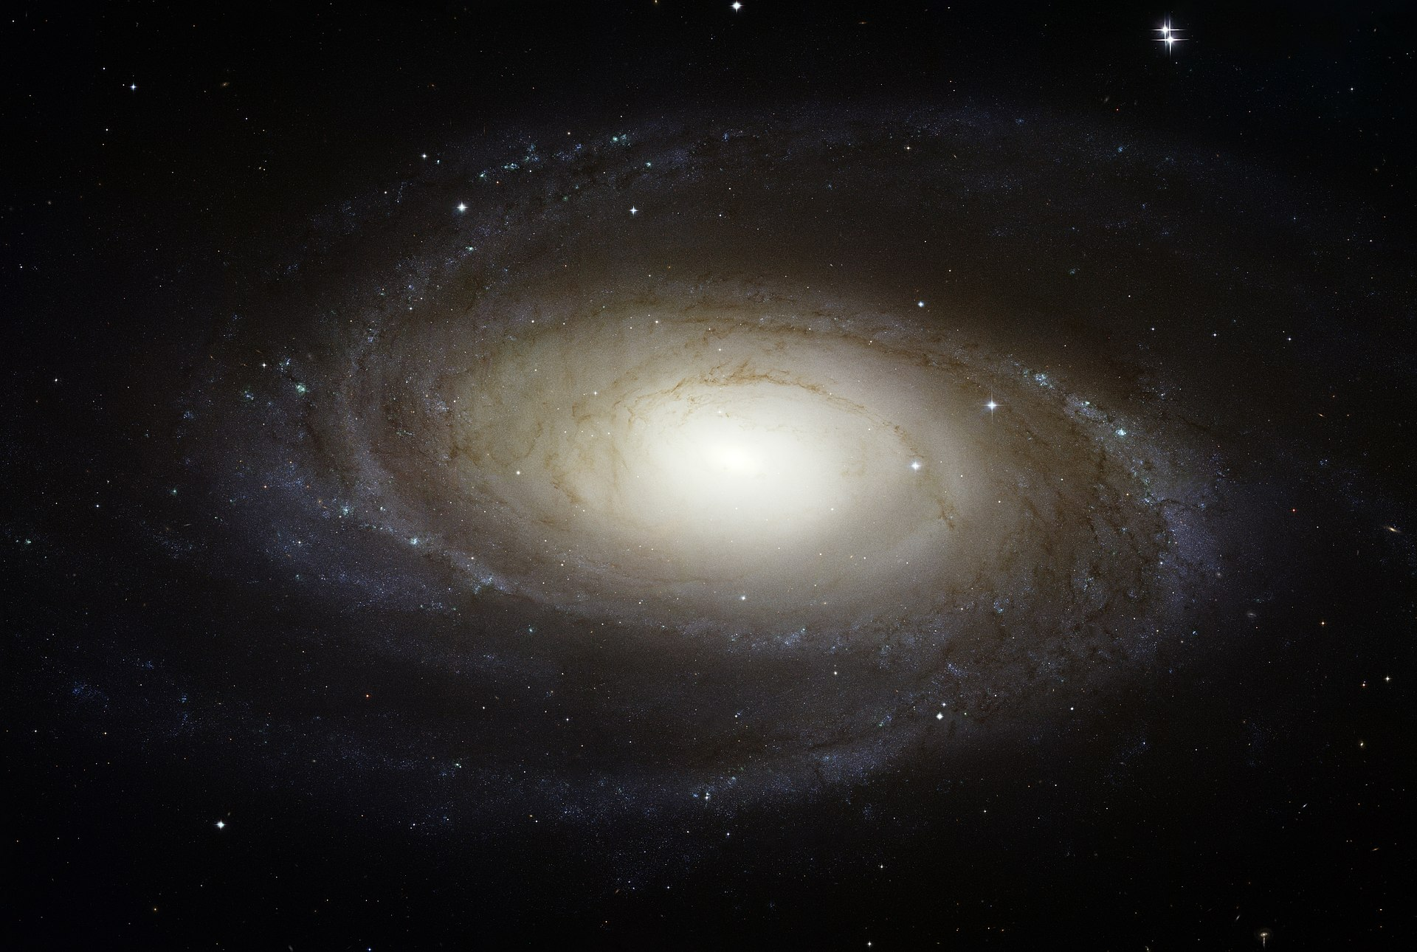
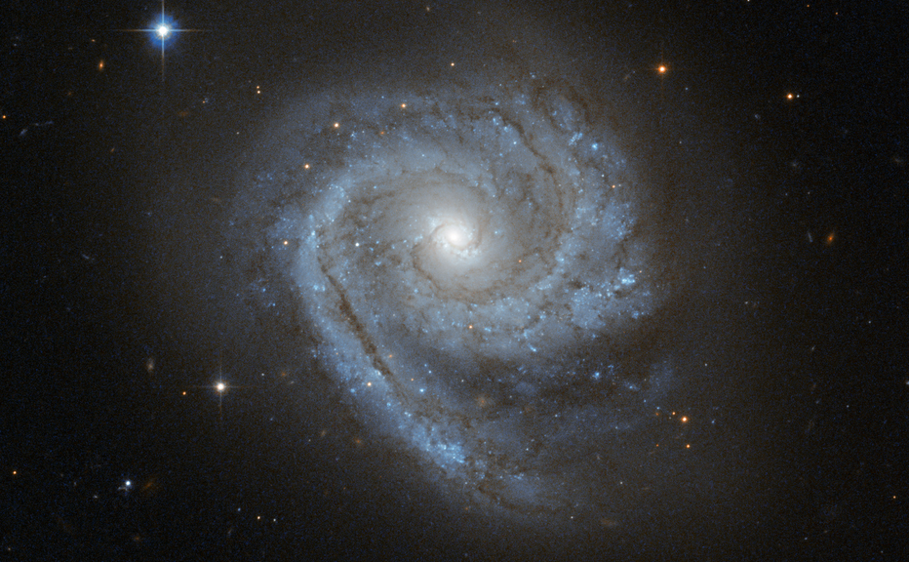
Spiral Bulges
Bulges come in 2 types:
Classical
older stars (Pop II) … reddish
random orbits … spherical
minimal star formation … no gas/dust
formed via collisions … created by major mergers
20% of field galaxies have them … many more in galaxy clusters
Disk-like
some young stars (Pop I) … maybe high in nuclear ring
disk-like orbits … complex structure, tiny spiral
recent gas-rich merger … or …
secular evolution
slow via arms, bar, …
MW is Disk-like, likely secular evolution
… but so many more details …
Notes:
Secular evolution refers to the relatively slow dynamical evolution due to internal processes induced by a galaxy's spiral arms, bars, galactic winds, black holes and dark matter haloes.

Slide 4
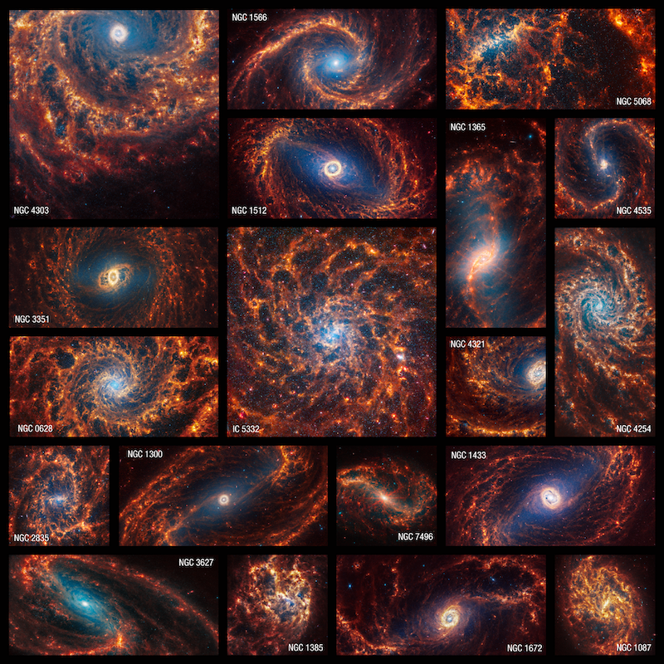
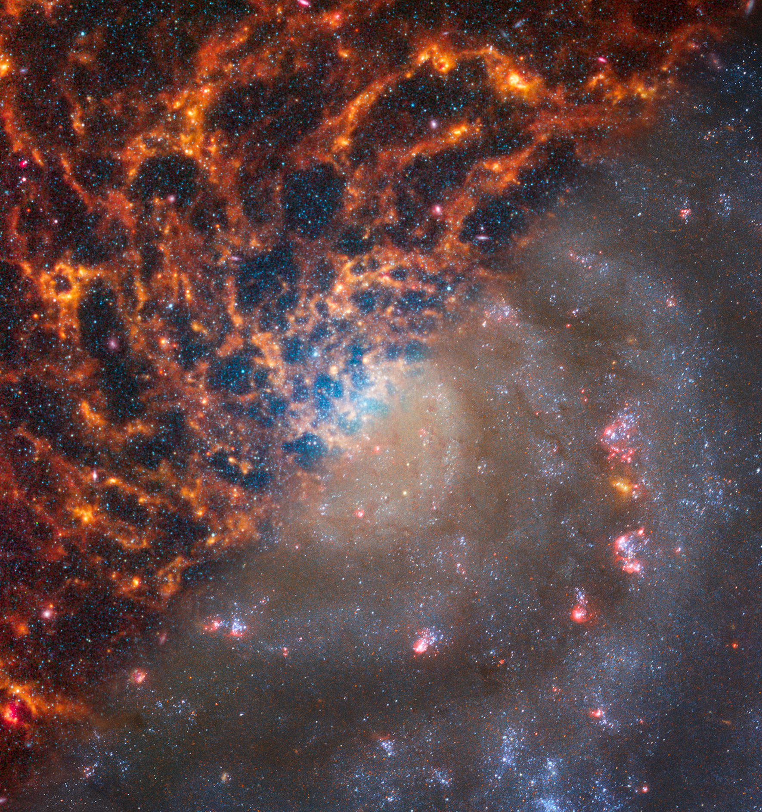
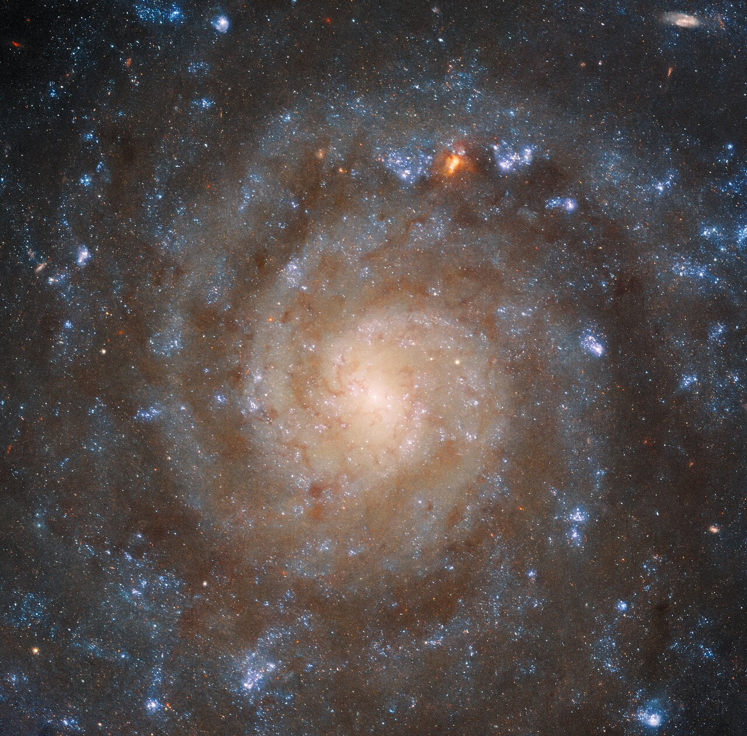
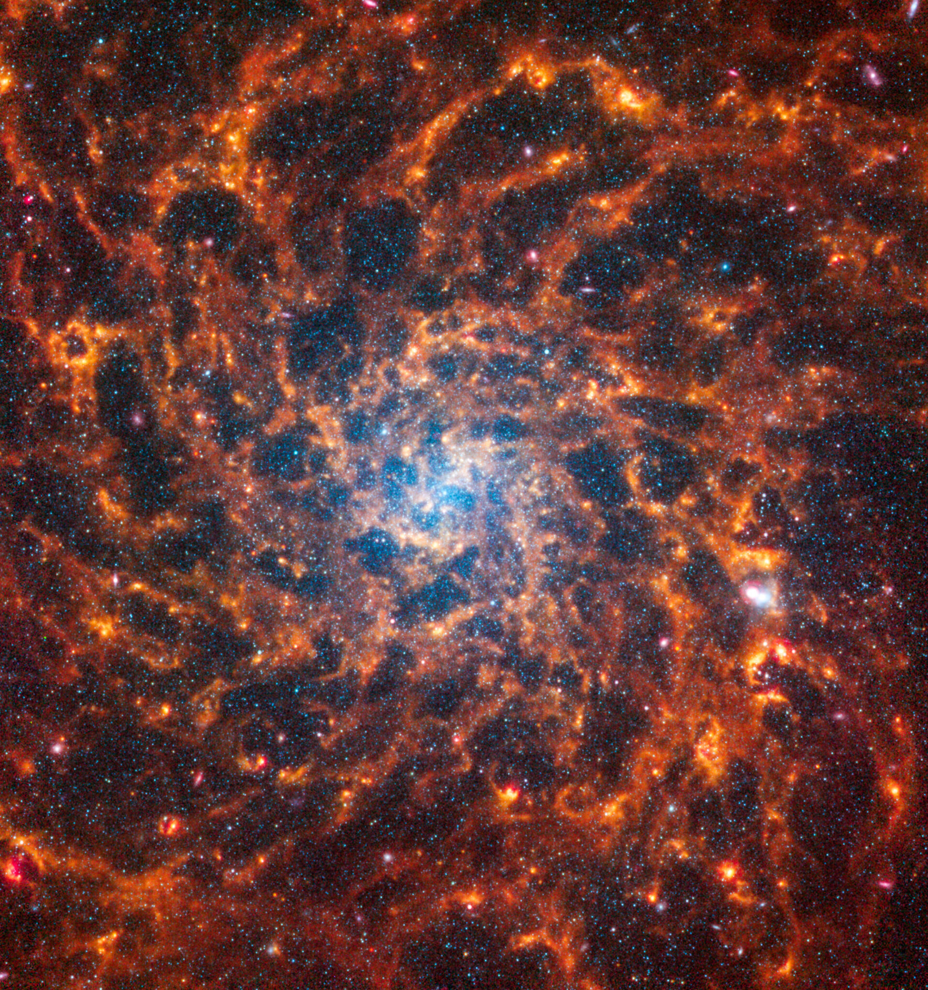
Spirals
Notes:
bottom = JWST images
top = HST + JWST

Slide 5
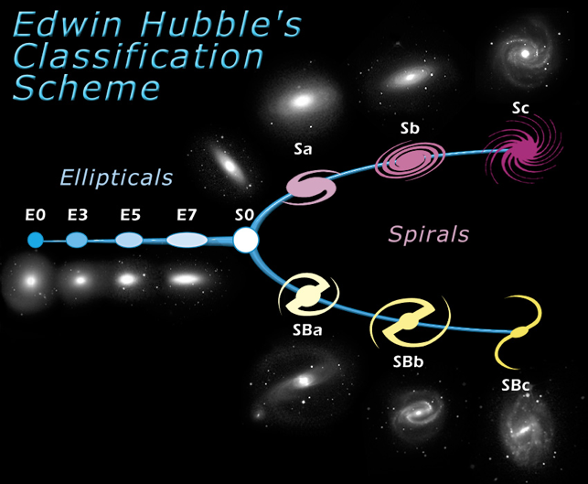
Spirals
Hubble based on
1. spiral arms or not
2. bar or not
3. arm coiling (openness)
NOT based on
1. shape of the spiral pattern
2. strength/contrast of the pattern
3. number of spiral arms

Slide 6
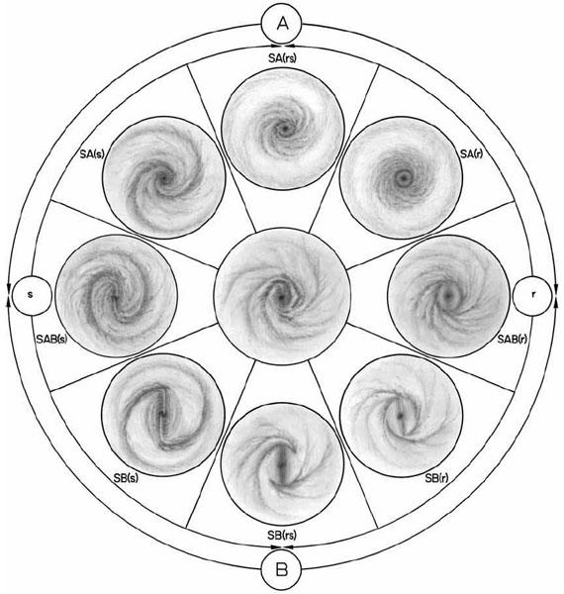
Spirals
de Vaucouleurs adds
1. arm morphology
2. central bar shape and strength
3. ring presence/absence
classification
schemes
are rather
arbitrary
Notes:
A = unbarred … B = barred
s = spiral arms … r = rings

Slide 7
Spiral Brightness Profiles
brightness profiles I (R) of spirals can be reasonably well modeled using the sum of
(a) pure de Vaucouleurs (R^{-1/4}) bulge +
(b) an exponential disk:
I(R) = I_{b} exp{ −7.67 [(R/R_{b})^{1/4}−1] } + I_{d} exp{ −R/R_{d} }
4-parameter fit with:
I_{b} : central brightness of the bulge
R_{b} : radial scale of the bulge
I_{d} : central brightness of the disk
R_{d} : radial scale of the disk

Slide 8
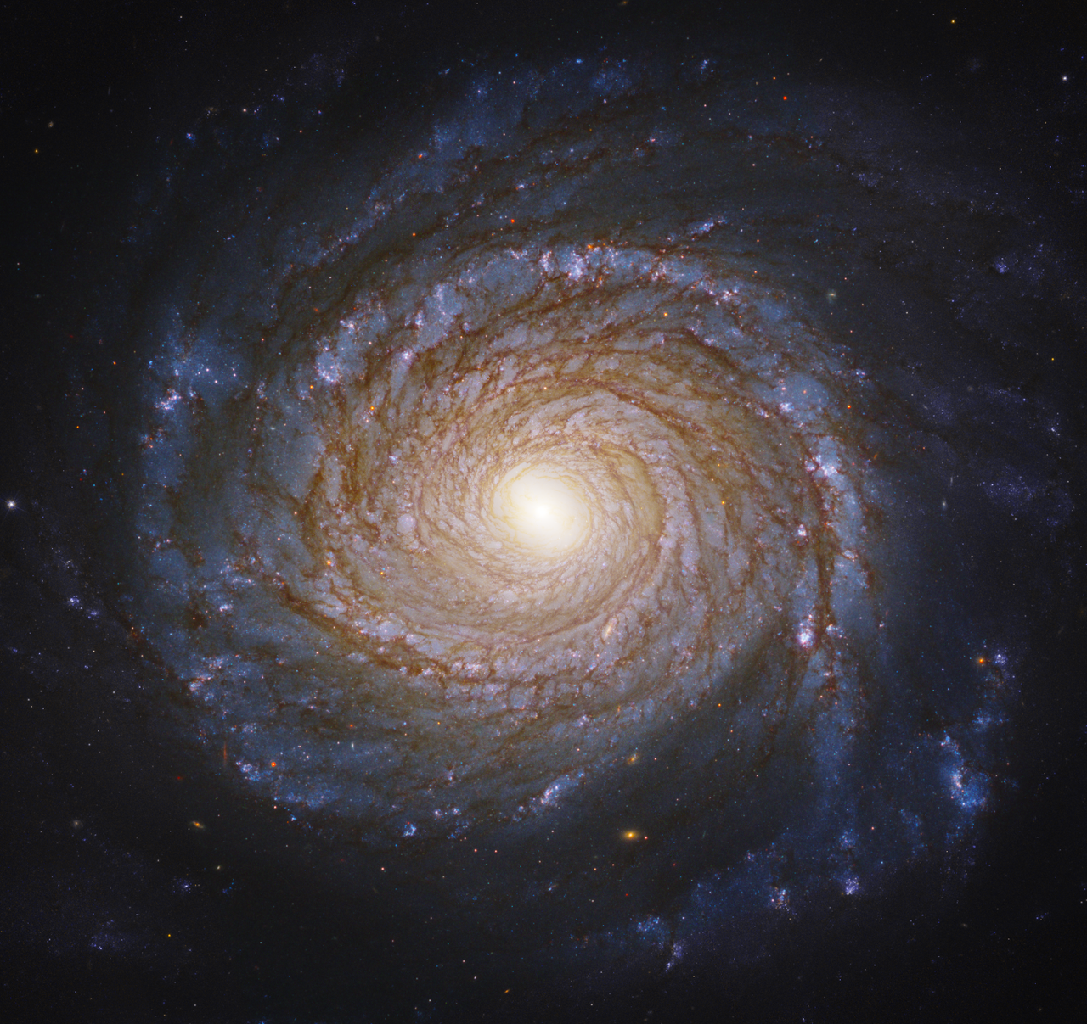
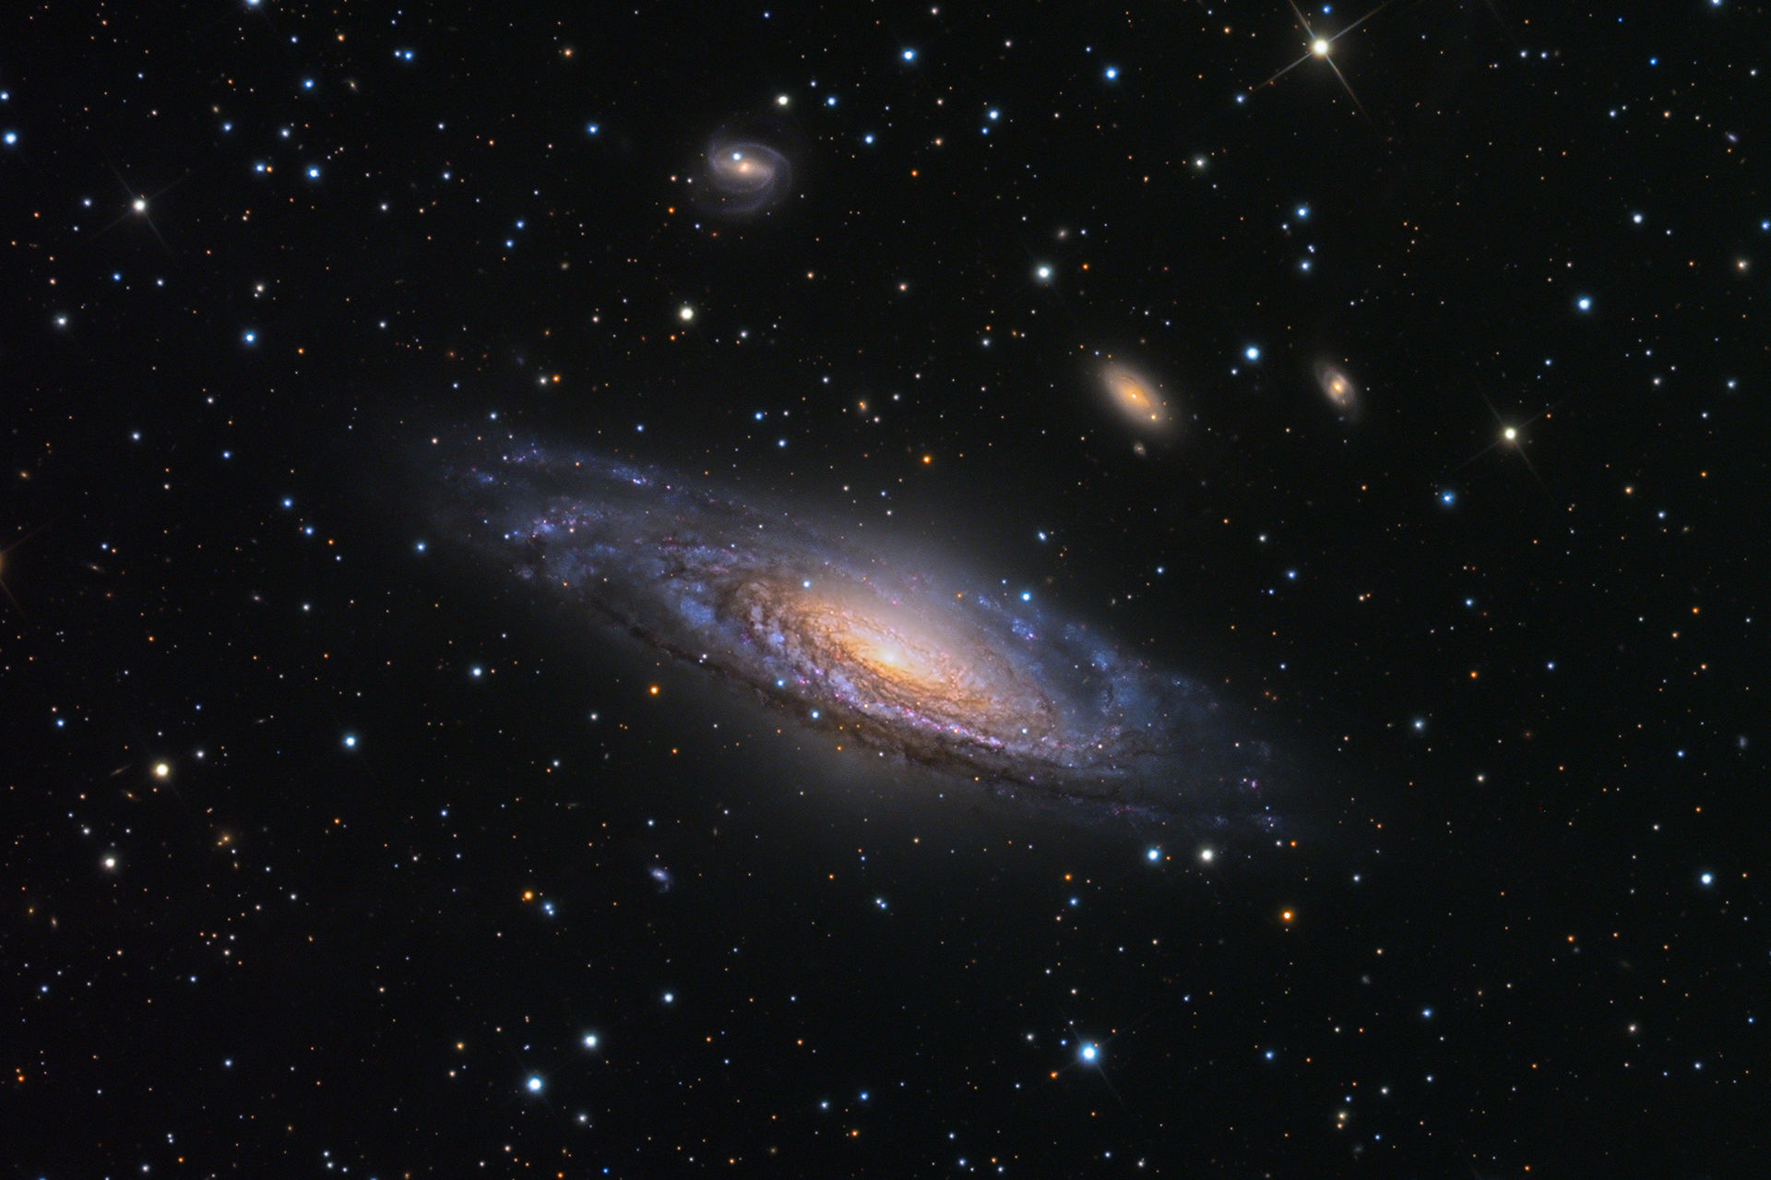
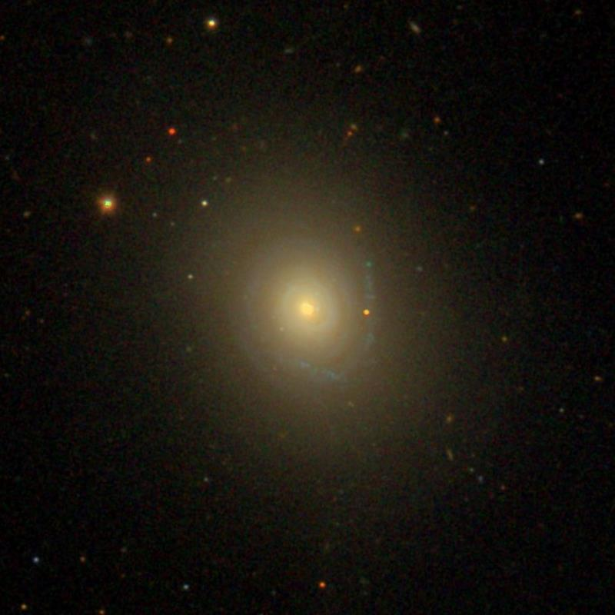
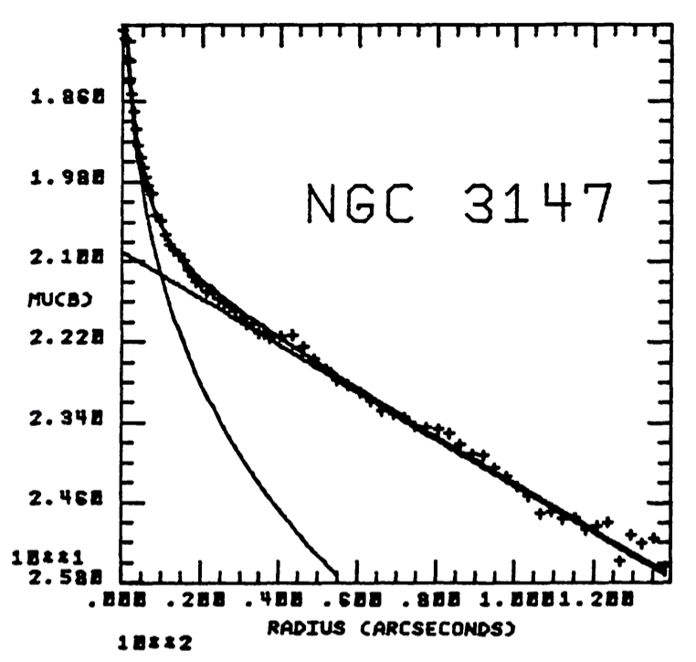
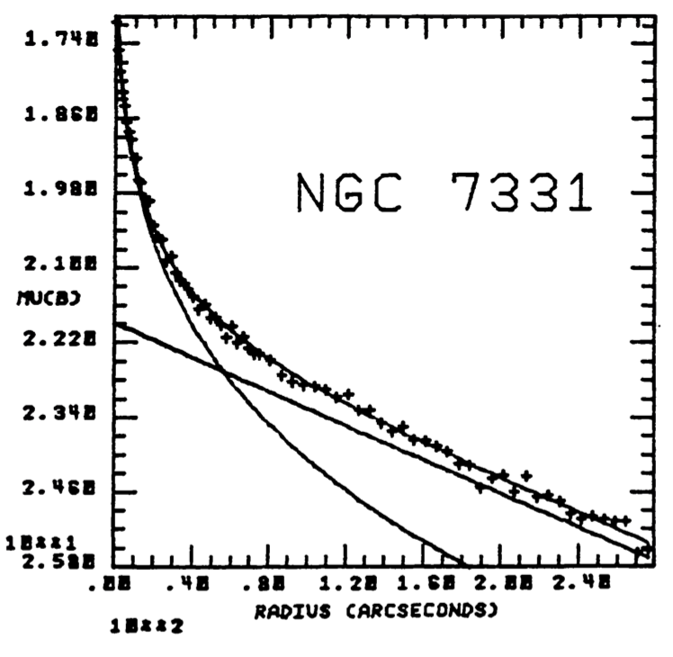
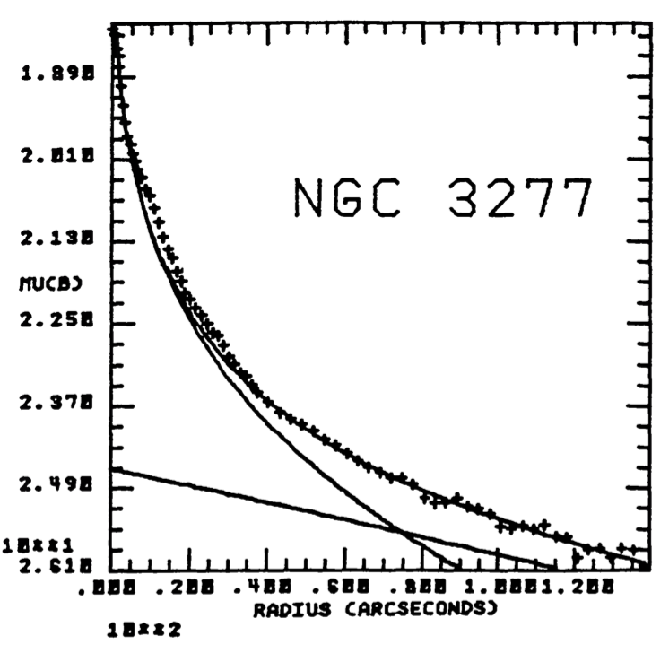
Spiral Bulges
Boroson (1981)

Slide 9
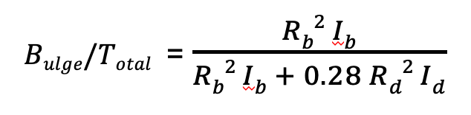
Spiral Brightness Profiles
brightness profiles I (R) of spirals can be reasonably well modeled using the sum of
(a) pure de Vaucouleurs (R^{-1/4}) bulge +
(b) an exponential disk:
I(R) = I_{b} exp{ −7.67 [(R/R_{b})^{1/4}−1] } + I_{d} exp{ −R/R_{d} }
4-parameter fit with:
I_{b} : central brightness of the bulge
R_{b} : radial scale of the bulge
I_{d} : central brightness of the disk
R_{d} : radial scale of the disk
We can define the bulge fraction:

Slide 10
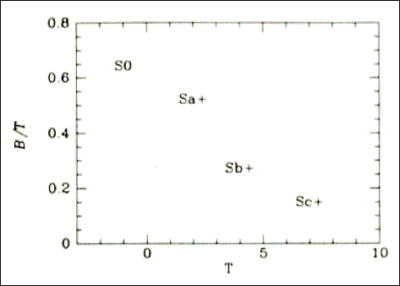
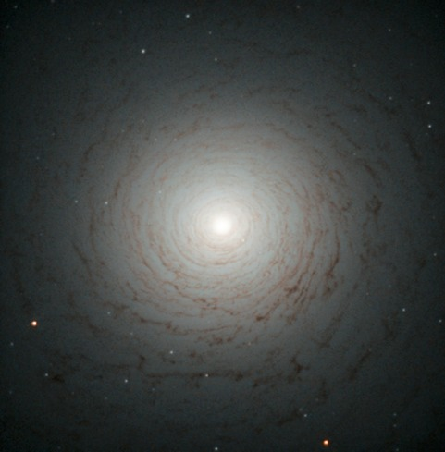
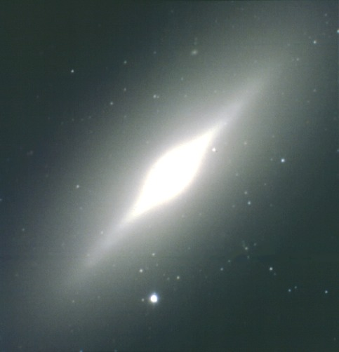
Spiral Bulges
bulge to disk ratio defines Hubble sequence
S0 (lenticular) galaxies have more bulge
Sc/SBc have more disk

Slide 11
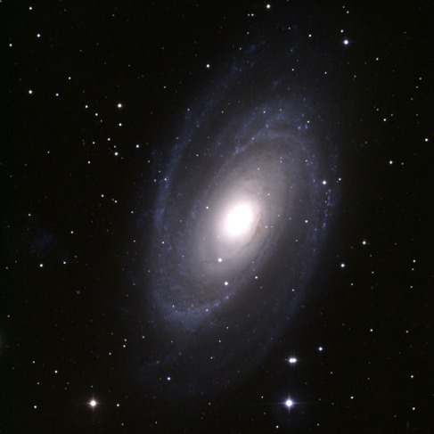
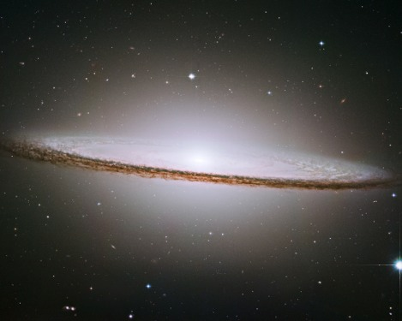
Spiral Bulges
bulge to disk ratio defines Hubble sequence
S0 (lenticular) galaxies have more bulge
Sc/SBc have more disk

Slide 12
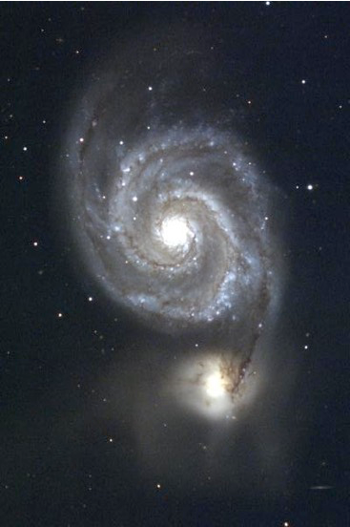
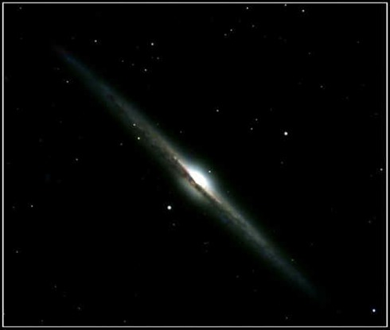
Spiral Bulges
bulge to disk ratio defines Hubble sequence
S0 (lenticular) galaxies have more bulge
Sc/SBc have more disk

Slide 13
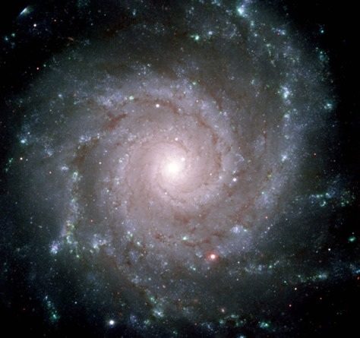
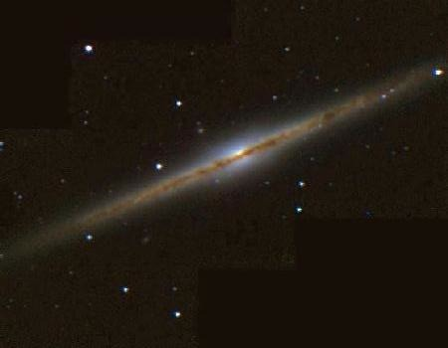
Spiral Bulges
bulge to disk ratio defines Hubble sequence
S0 (lenticular) galaxies have more bulge
Sc/SBc have more disk

Slide 14
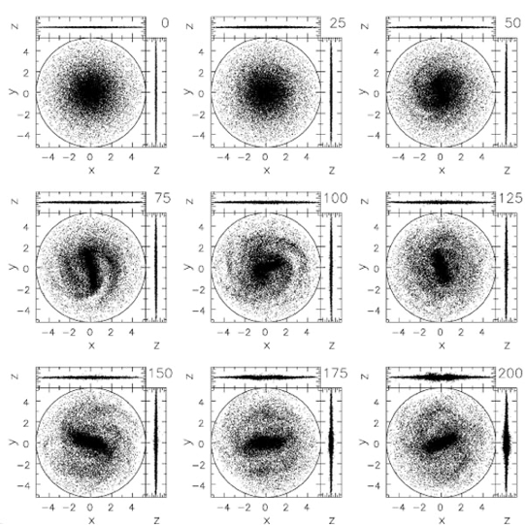
Bulges and Bars
Density Wave Theory … 2 ideas:
1. spiral patterns created by a density wave that propagates through the disk and does not follow the motion of the individual stars
2. disks are dynamically unstable, so spiral patterns are transient and can (a) be induced, and (b) dissipate over time
disk simulations with > 10⁶ particles:
gravitational potential time-dependent
bars and spiral patterns appear and disappear on 100 Myr timescales
Sellwood (2013)
Notes:
numbers in upper right are Myr

Slide 15
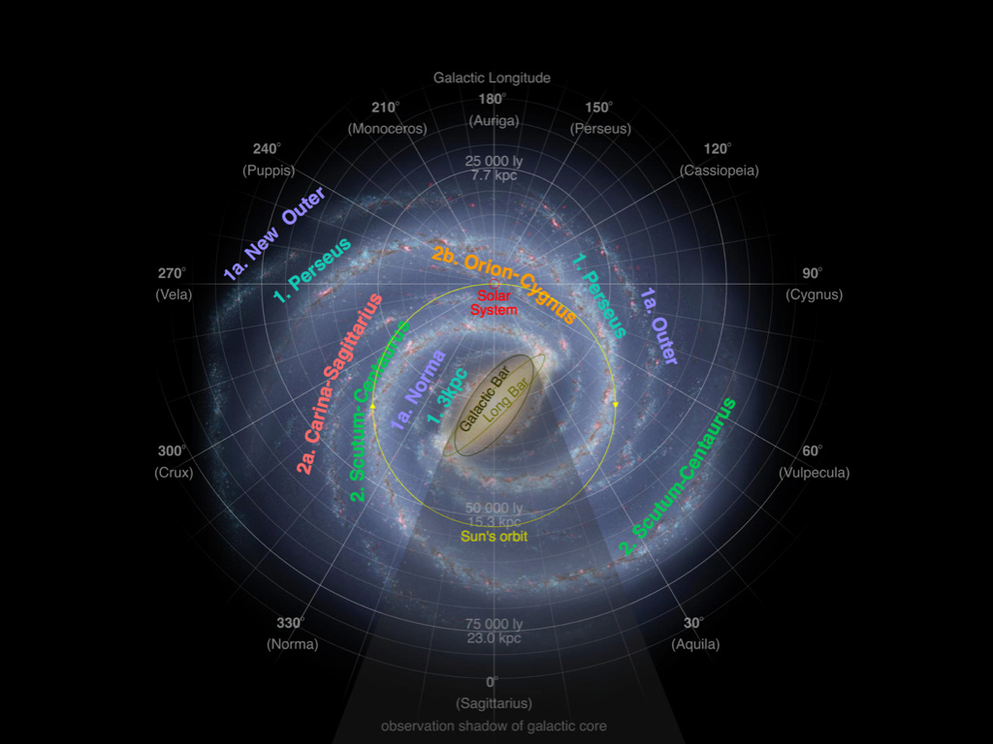
MW Bulge/Bar

Slide 16
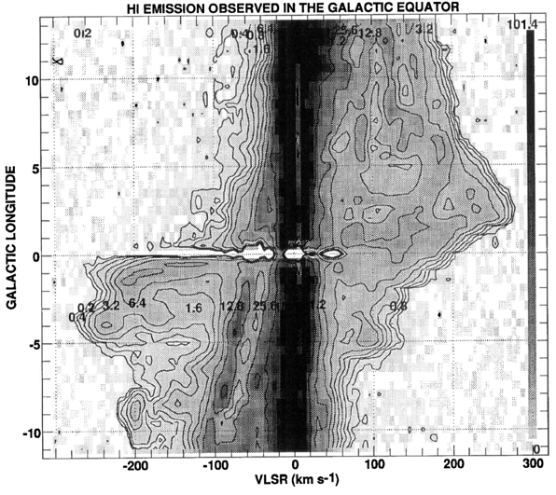
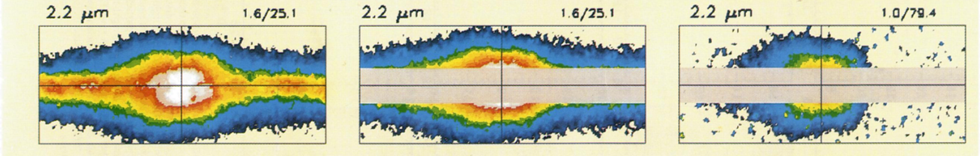
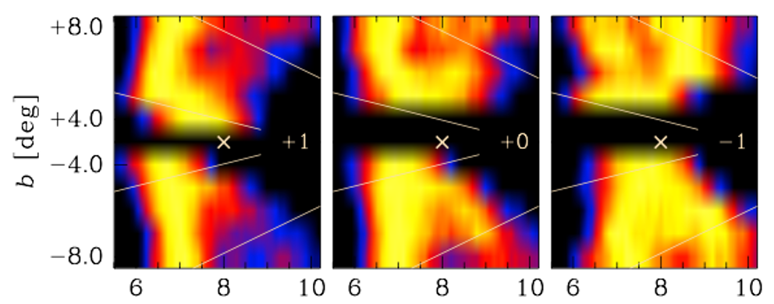
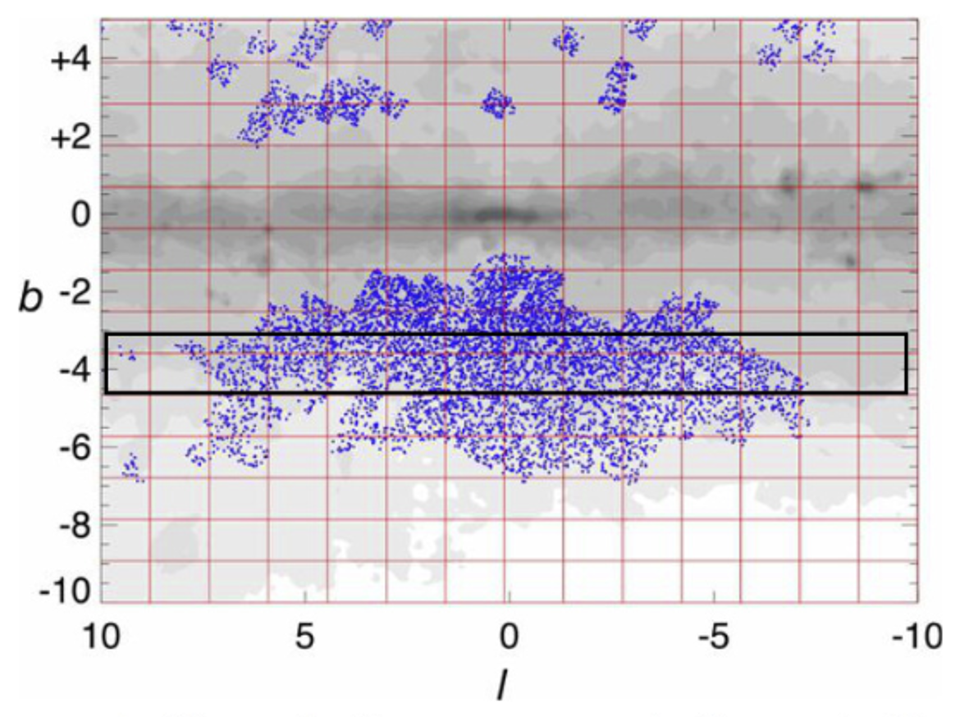
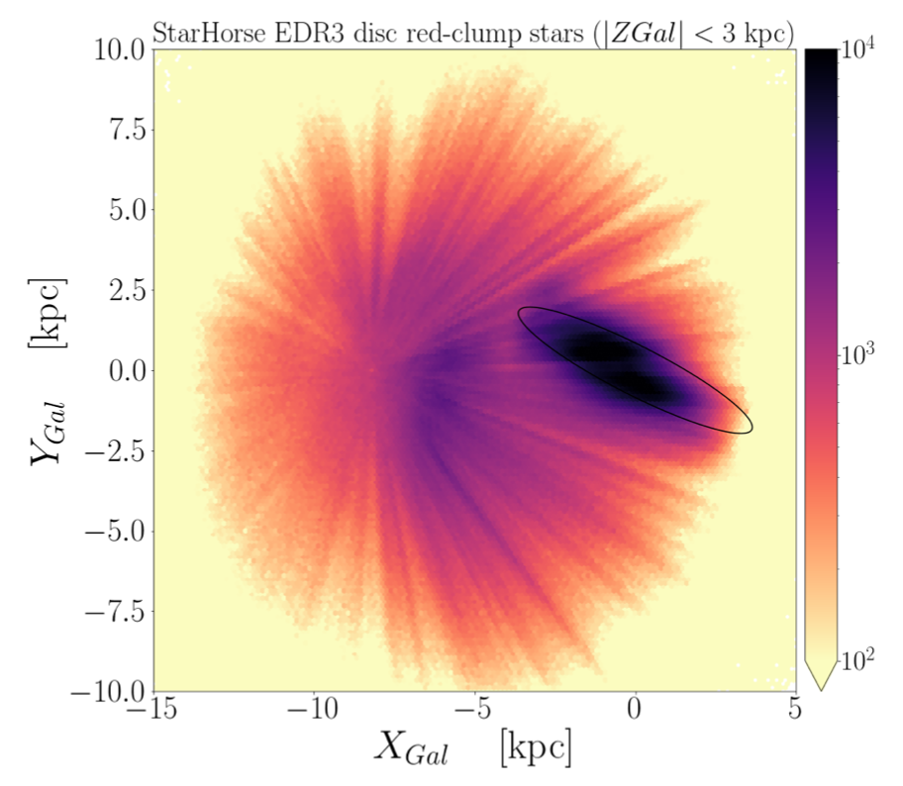
MW Bulge/Bar: Mapping
Various Techniques
infrared star counts
Red Clump stars
moving HI gas
Gaia +
infrared surveys
RR Lyraes
Notes:
HI is cold neutral hydrogen

Slide 17
MW Bulge/Bar
ANSWERS:
Bulge = YES … you can SEE it
Bar = YES …
Bulge stretched to Box-Peanut (B/P)
+ X structure (likely)
+ spheroid component (maybe)
+ double bar (unlikely)

Slide 18
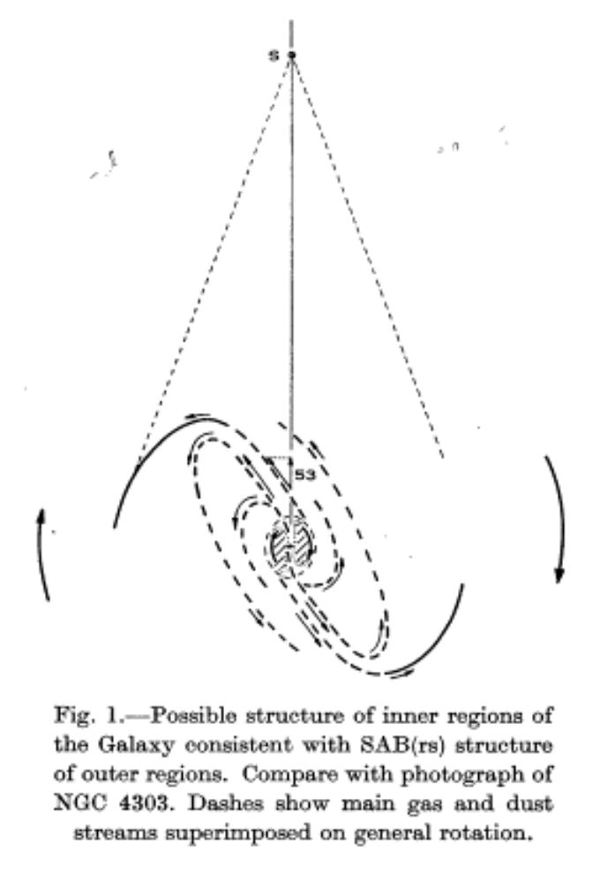
MW Bulge/Bar: HI gas
Bar first postulated by de Vaucouleurs (1964)
HI large velocities near GC
gas flow along Bar

Slide 19
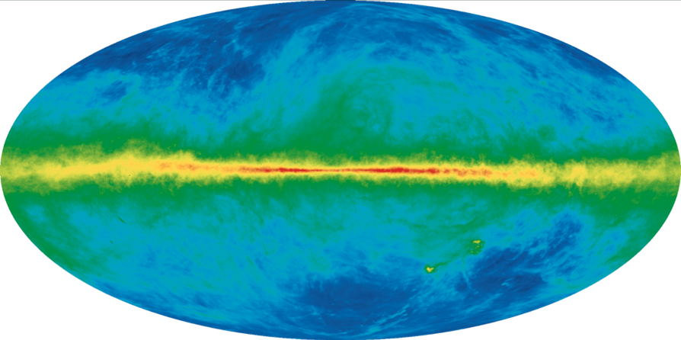
MW in Radio: HI gas
HI at 21 cm measure radial velocities of gas vs. Galactic longitude l

Slide 20
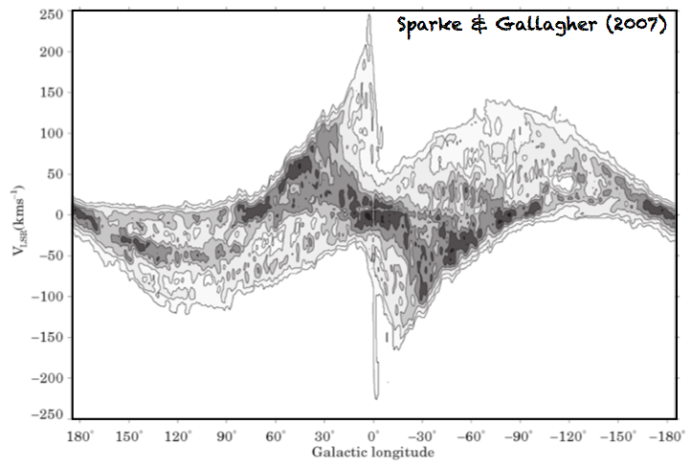
MW in Radio: HI gas
HI at 21 cm measure radial velocities of gas IN PLANE vs. Galactic longitude l

Slide 21
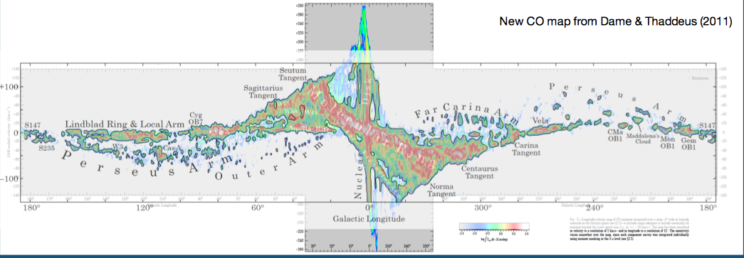
MW in Radio: CO
488,000 radio spectra
Dame, Hartmann, Thaddeus (2001)
Notes:
Molecular Ring is 3.5 to 7.5 kpc … NOT the same as the CircumNuclear Ring (CNR) only a few pc around SMBH

Slide 22
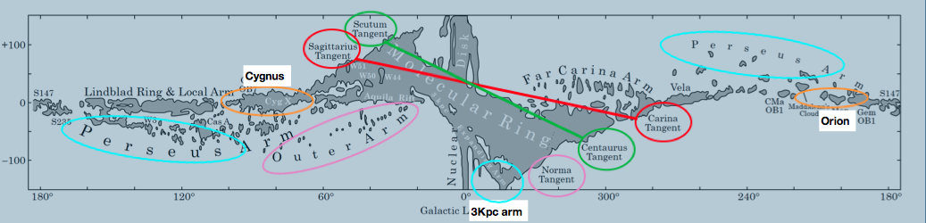
MW Disk in Radio: Spiral Arms
Outer Outer
Perseus Outer
Orion …us…
Scutum-Centaurus Inner
Sagittarius-Carina Inner
UM… Uther Stuff (Norma … Outer)
+ Molecular Ring ???

Slide 23
MW in Radio: HI gas
HI at 21 cm measure radial velocities of gas vs. Galactic longitude l

Slide 24
MW in Radio: HI gas
HI at 21 cm measure radial velocities of gas IN PLANE vs. Galactic longitude l

Slide 25
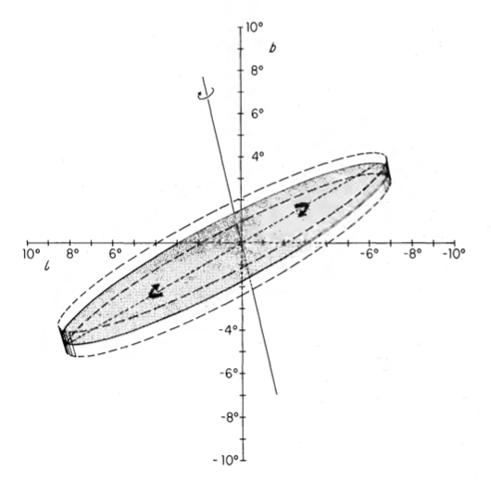
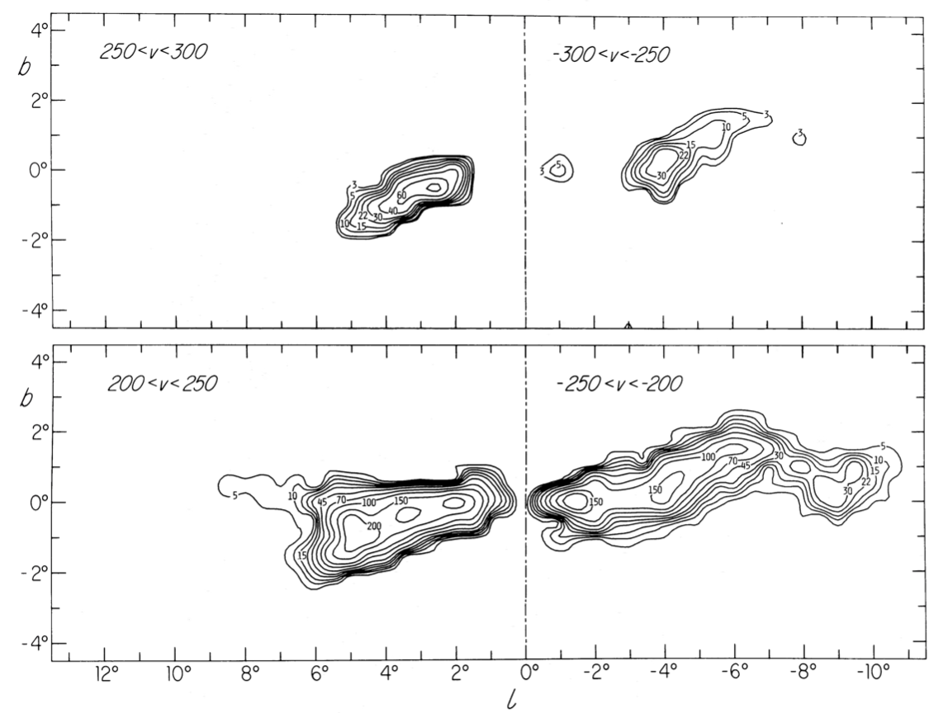
MW Bulge/Bar: HI
model by Liszt and Burton (1980) --- Bar with 24º tilt
HI gas within 2 kpc of GC
motions along ellipses …
no mass flow out
explains mini-disk
connecting arm
molecular ring
tilt turns out to be wrong …

Slide 26
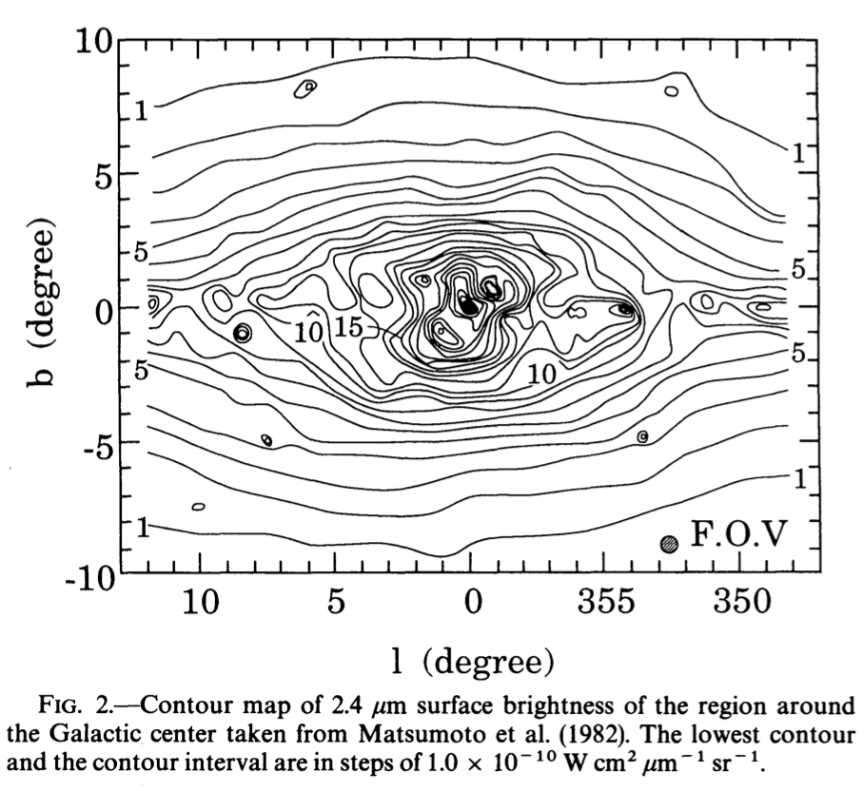
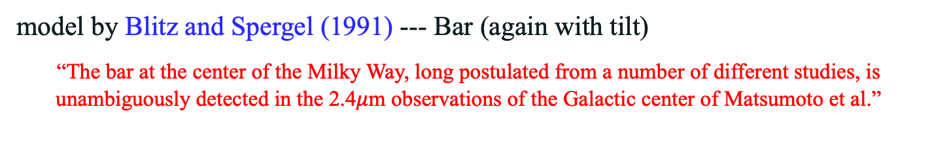
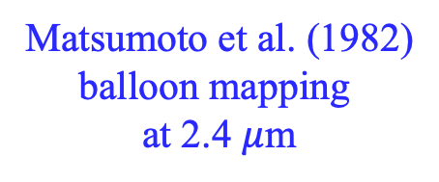
MW Bulge/Bar: HI
model by Blitz and Spergel (1991) --- Bar (again with tilt)
“The bar at the center of the Milky Way, long postulated from a number of different studies, is unambiguously detected in the 2.4$μ$m observations of the Galactic center of Matsumoto et al.”
Matsumoto et al. (1982)
balloon mapping
at 2.4 $μ$m

Slide 27
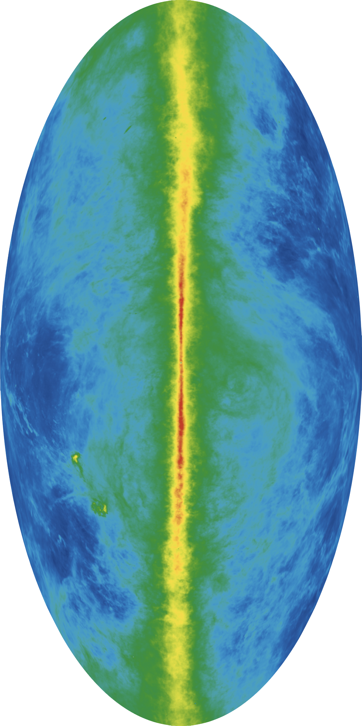
MW Bulge/Bar: Velocity Map
MW Bulge + Bar
expansion OR
non-circular?
absorption
expansion OR
non-circular?
Notes:
Zoom-in of previous neutral H map

Slide 28
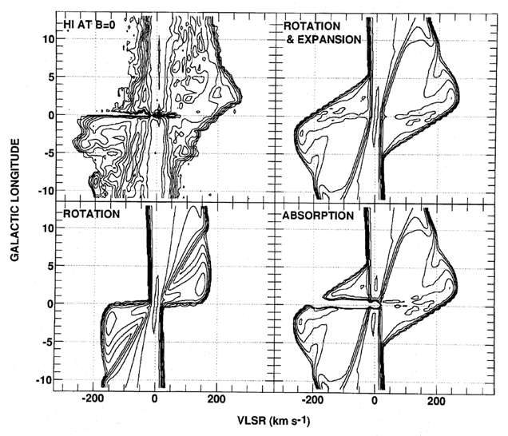
MW Bulge + Bar
OBSERVED
non-circular and expansion
rotation
only
non-circular and expansion
+ absorption
Bar exists

Slide 29
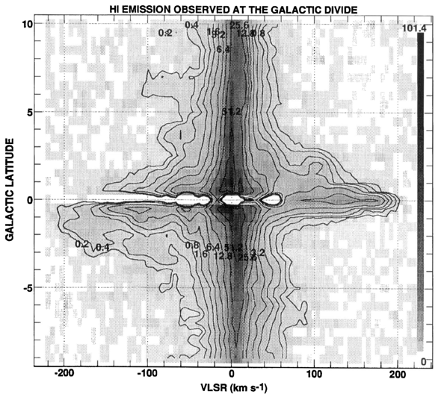
MW Bulge/Bar: Velocity Map
MW Bulge + Bar
Bar (rotated)
absorption
Bar (rotated)

Slide 30
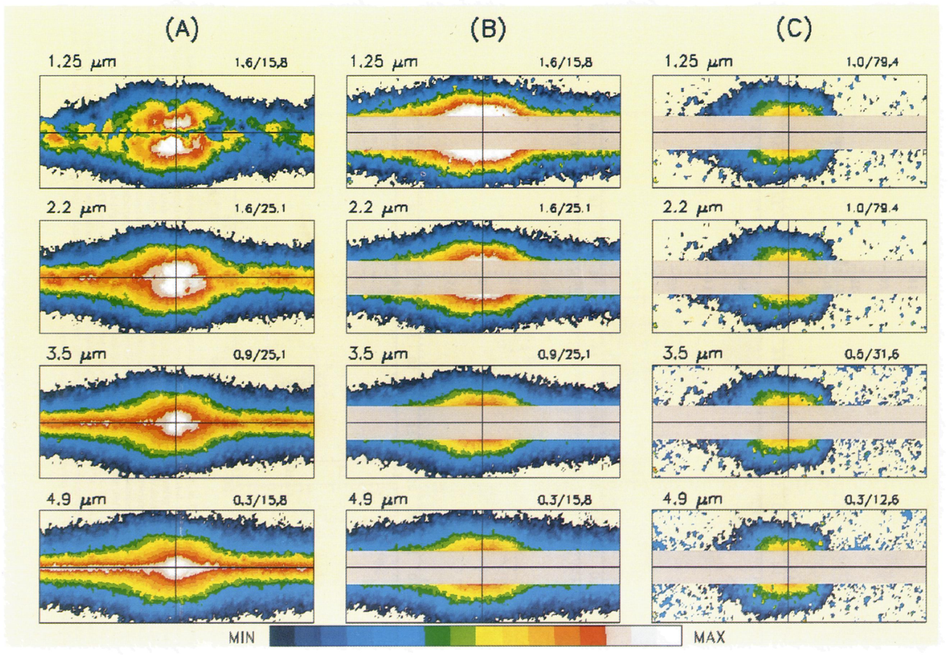
MW Bulge/Bar: Star Counts
Weiland+ (1994)
bulge is flattened ellipse … asymmetries due to bar
mapping with
DIRBE on COBE
4 near-IR wavelengths
sampling stars, not gas
What do you see?
model by Dwek+ (1995)
boxy Bar
rotated by 20º
to Sun-GC line of sight
NO tilt, peanut
SS dust removed ISM extinction removed Disk model removed

Slide 31
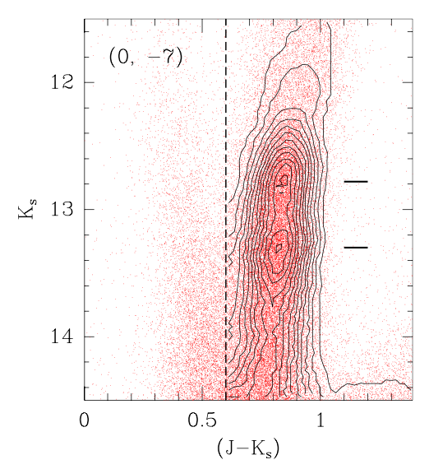
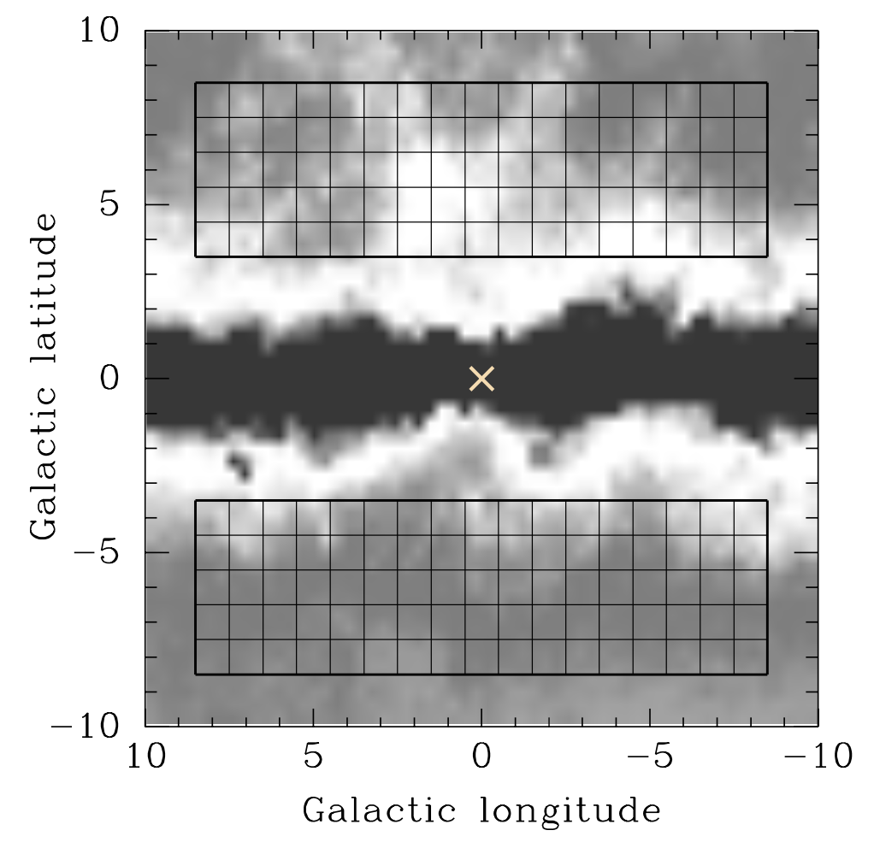
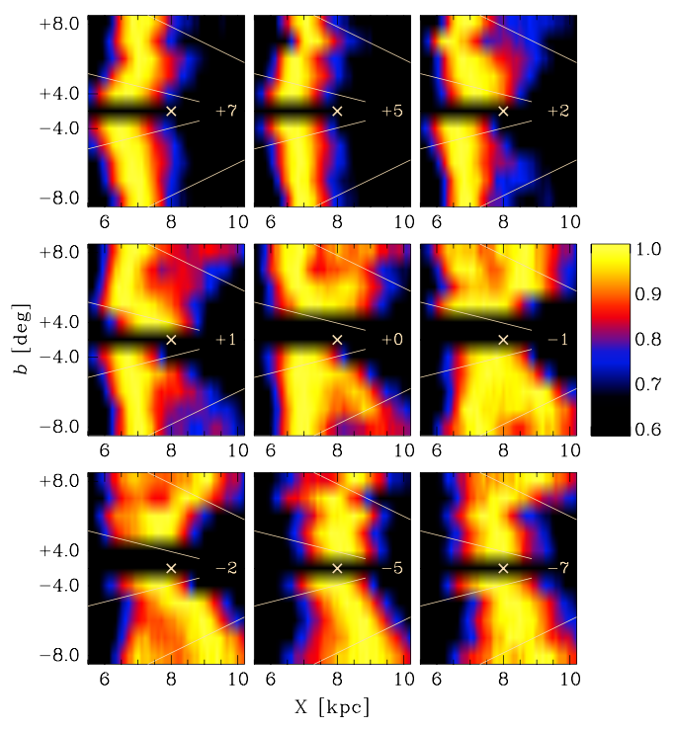
MW Bulge/Bar: Red Clump Stars
Saito+ (2011)
mapping with
2MASS
170 fields 1º square
X is Galactic Center
sampling Red Clump stars
RC sample splits by distance
X-shaped Bar (twisted)
within 2º of l = 0
Notes:
Color-mag diagram is for two Red Clump star (horizontal branch giants fusing He) populations at different distances.
Top Figure: Density maps showing the structures traced by the RC in the
(X, b) plane. Each panel corresponds to a different longitude (see labels),
with l = 0◦ in the central, middle one. A cross marks the Galactic center
(assuming R0 = 8 kpc), with the Sun far in the left side, outside the figure, at
(X, Z) = (0, 0). Individual lines of sight, at different latitudes, correspond to
horizontal color strips, merged together to form the panels. The color scale has
been normalized so that the histogram peak in each horizontal strip has density
= 1. Note that the region close to the Galactic plane, for which we have no data,
has been compressed here, and shown as a single, horizontal black strip. Thin
white lines are lines of constant Z coordinate. The X-shape is clearly visible for
longitudes |l| 1◦ (middle row panels).

Slide 32


MW Bulge/Bar: Boxy Peanut with X
putting it all together …
Gonzalez and Gadotti (2016)
Laurikainen and Salo (2015)
Notes:
Right: Examples of boxy (NGC 4565) and peanut (NGC 3628) shape bulges, using the 3.6μm Spitzer space telescope images. Also shown are the unsharp mask images of the same galaxies, which in both galaxies show an X-shape morphology. The units of the x- and y-axis are in arcseconds.

Slide 33

MW Bulge/Bar: Boxy Peanut with X
putting it all together … (Gonzalez and Gadotti review 2016)
3.6 x 1.1 x 0.6 in
1.0 x 0.3 x 0.2 !!!
length 3.1 to 3.5 kpc
near end pointing toward positive l
axial ratios of bar ~ 1.0 x 0.4 x 0.3
angle Sun-GC ~ 20-40º
long bar (?) 4.0 to 4.5 kpc … ratios ~ 1.0 x 0.15 x 0.03 at ~ 45º
or maybe just transition to spiral arms
(double bars not seen in external galaxies)
but wait … RR Lyraes

Slide 34



MW Bulge/Bar: RR Lyraes
Dekany+ (2013)
RR Lyraes 7663 OGLE-III RRab in (mostly) southern sky bulge
VVV infrared survey (not Gaia)
black box: mean distances of star samples
Red Clump (red, mixed ages) trace the bar
RR Lyrae (black, all old) no distance trend ~ spheroidal
composite bulge with two stellar populations?
Notes:
Vista Variables in the Via Lactea

Slide 35

MW Bulge/Bar: Gaia
Anders+ (2019)
Anders+ (2022)
mapping with
Gaia DR2 / EDR3
+
Pan-STARRS
2MASS
WISE
150 million stars
use ~10 million Red Clump stars
stellar colors + reddening
estimated types and distances
https://sci.esa.int/web/gaia/-/61461-revealing-the-galactic-bar

Slide 36

MW Bulge/Bar: Gaia
Anders+ (2019) … Gaia DR2 … G < 18.0
10.8 million Red Clump stars
Bar ~4 kpc long
Bar ~40º twisted from Sun-GC line
Anders+ (2022) … Gaia EDR3 … G < 18.5
13.8 million Red Clump stars
Bar 4.07 kpc long / 0.76 kpc wide
Bar 27º twisted from Sun-GC line

Slide 37
MW Bulge/Bar
ANSWERS:
Bulge = YES … you can SEE it
Bar = YES …
Bulge stretched to Box-Peanut (B/P)
+ X structure (likely)
+ spheroid component (maybe)
+ double bar (unlikely)

Slide 38


MW Bulge/Bar
Milky Way model

