Slide 1
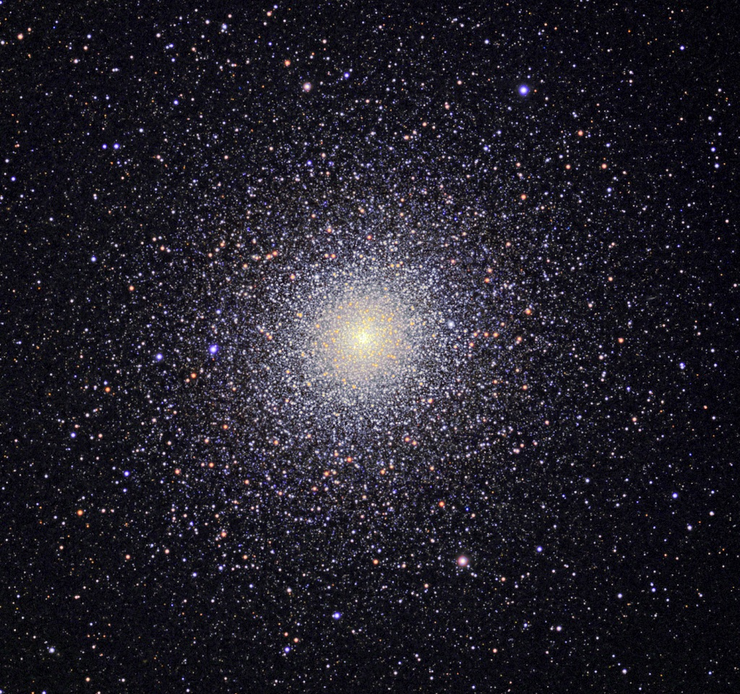
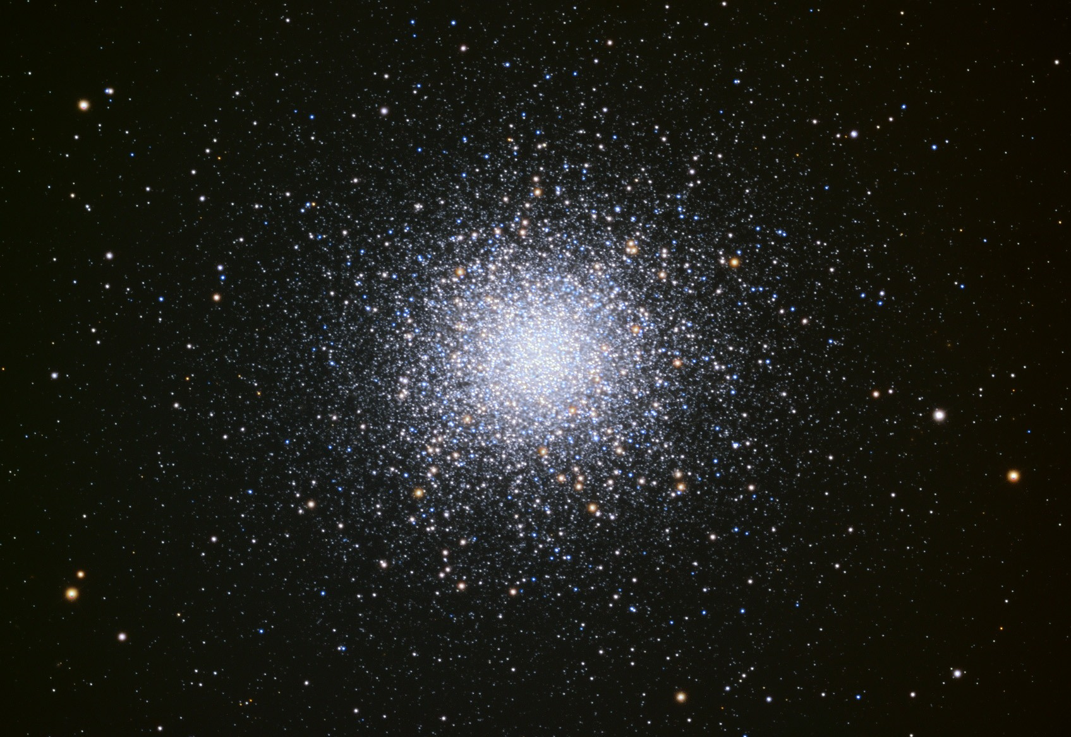
MW Globular Clusters
M13 in Hercules 47 Tuc in Tucana
(north) (south)
Notes:
THIS SEEMS LIKE A SHORT LECTURE, BUT WE ONLY MADE IT TO SLIDE 20

Slide 2
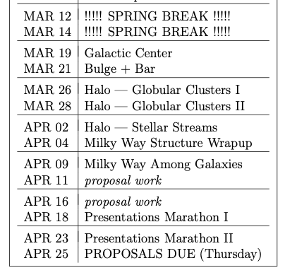
Proposal Future Bits
Thursday 28 MAR
Level 2 … 1st Draft
Thursday 04 APR
Budget and Justification
Thursday 11 APR
Facilities and Mentoring
Thursday 25 APR
Final Proposal = 5 pieces

Slide 3
MW Globular Clusters
M13 in Hercules 47 Tuc in Tucana
(north) (south)
Notes:
Virialized means KE = -1/2 PE … GC is bound … as many stars moving in as out … GC is not rotating

Slide 4
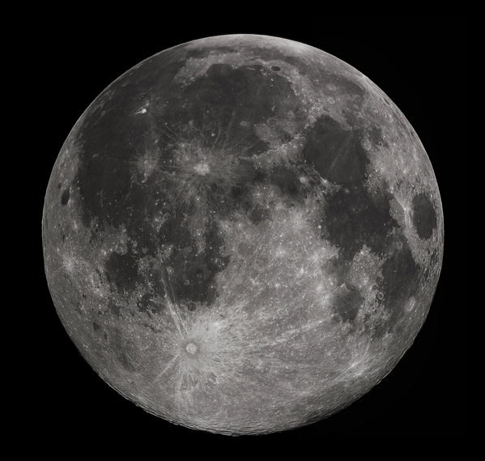
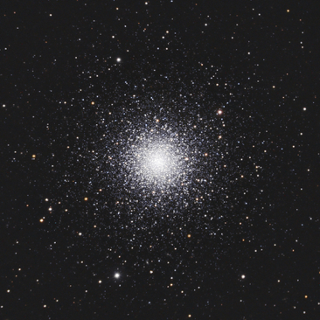
MW Globular Clusters
M3 at ~10 kpc
15’

Slide 5
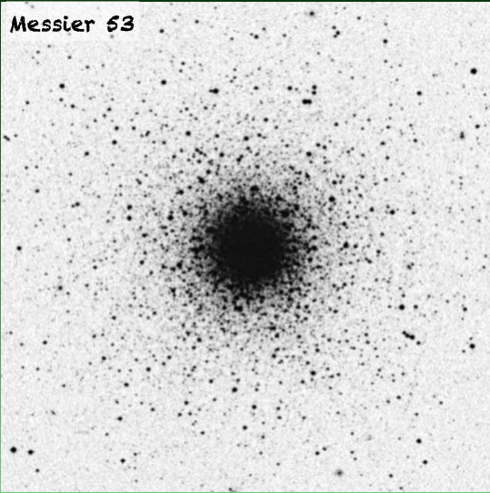
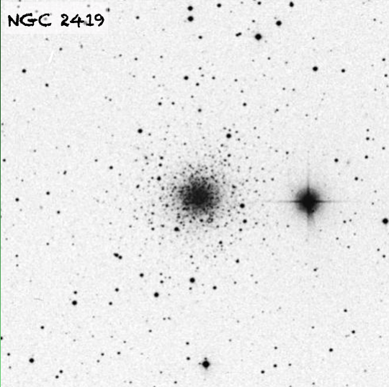
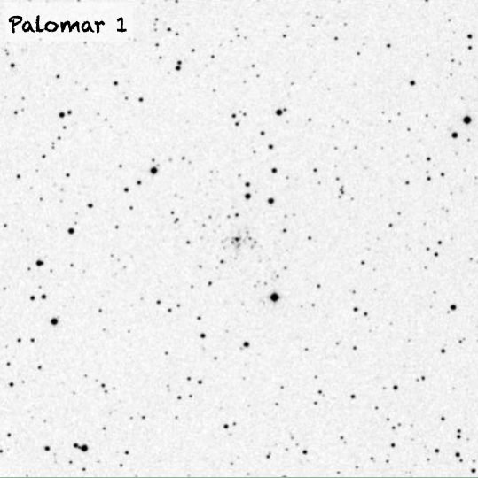
MW Globular Clusters
15’
29 globulars in Messier Catalog
+ various sources with NGC and IC names (Dreyer 1888 … 1908)
+ ~dozen more from Palomar Sky Survey
+ other efforts
= 168 total GCs now known around MW
… maybe a dozen more behind disk/bulge
Notes:
NGC = New General Catalogue … Dreyer in 1888 with updates IC = Index Catalogues by Dreyer in 1895 and 1908

Slide 6
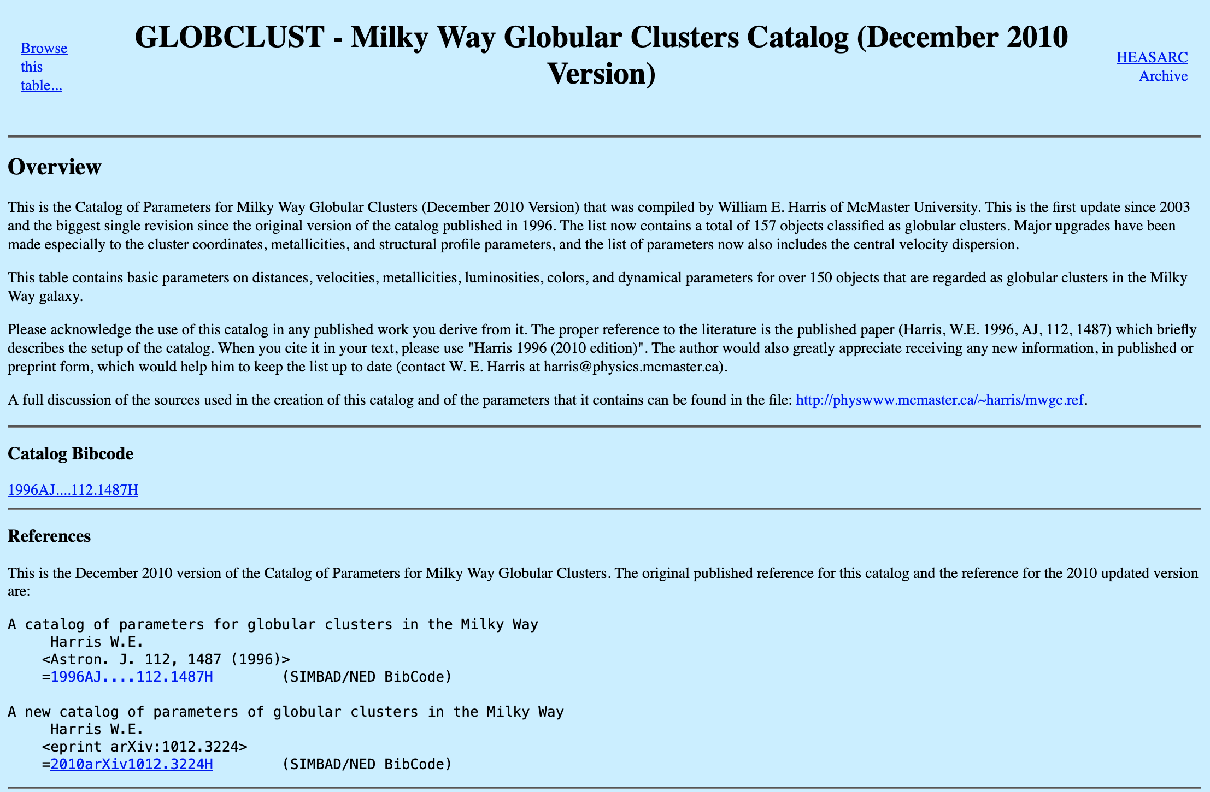
MW Globular Clusters
https://heasarc.gsfc.nasa.gov/w3browse/all/globclust.html

Slide 7
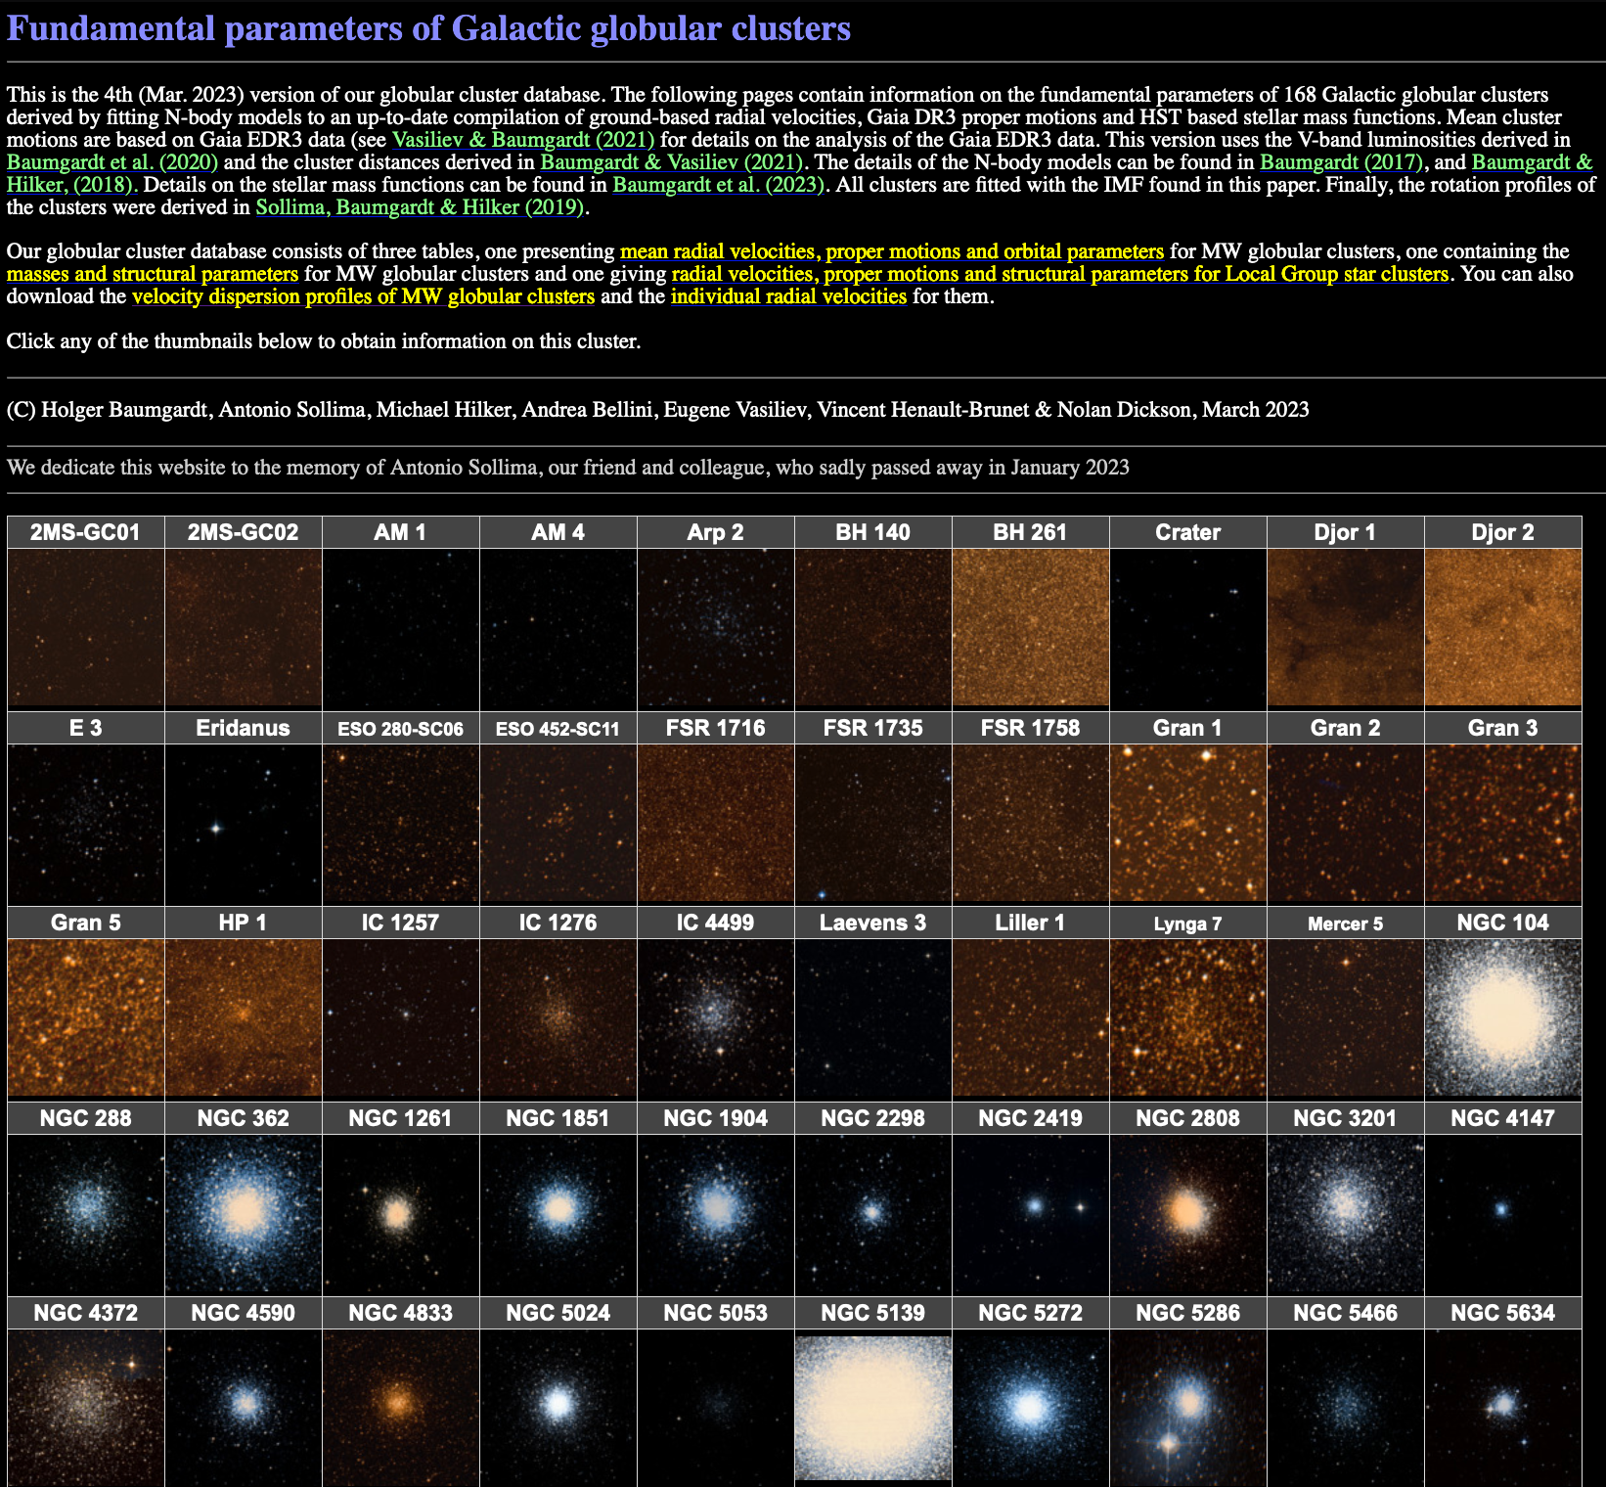
MW Globular Clusters
Baumgardt Catalog as of March 2023 has 168 MW globulars
https://people.smp.uq.edu.au/HolgerBaumgardt/globular/
Notes:
NGC 104 = 47 Tuc
NGC 5139 = omega Cen

Slide 8
MW Globular Clusters
Baumgardt Catalog as of March 2023 has 168 MW globulars
https://people.smp.uq.edu.au/HolgerBaumgardt/globular/
Notes:
omega Cen is the brightest GC … next is 47 Tuc at V = 4.1 … M13 at V = 5.8

Slide 9
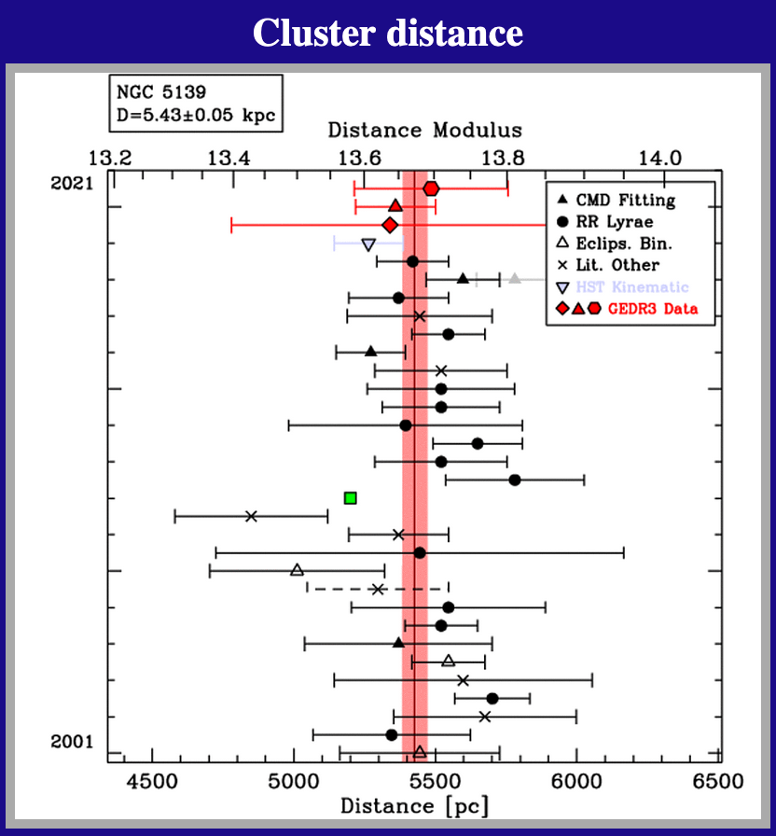
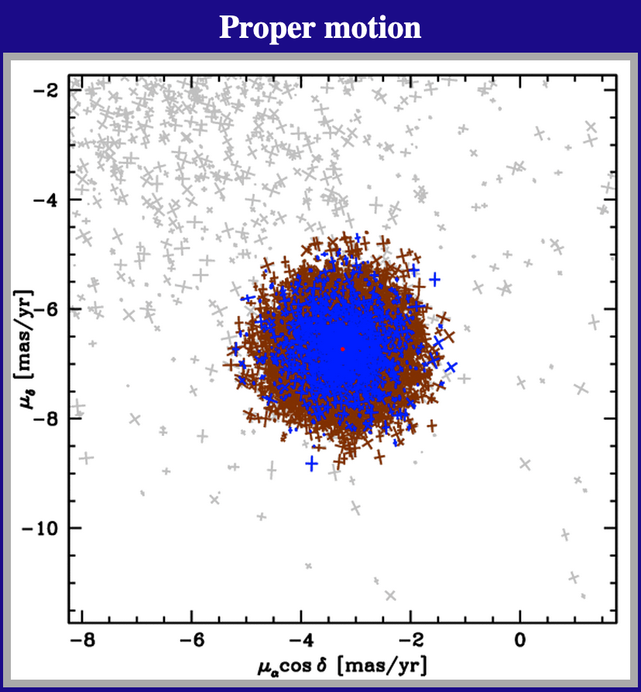
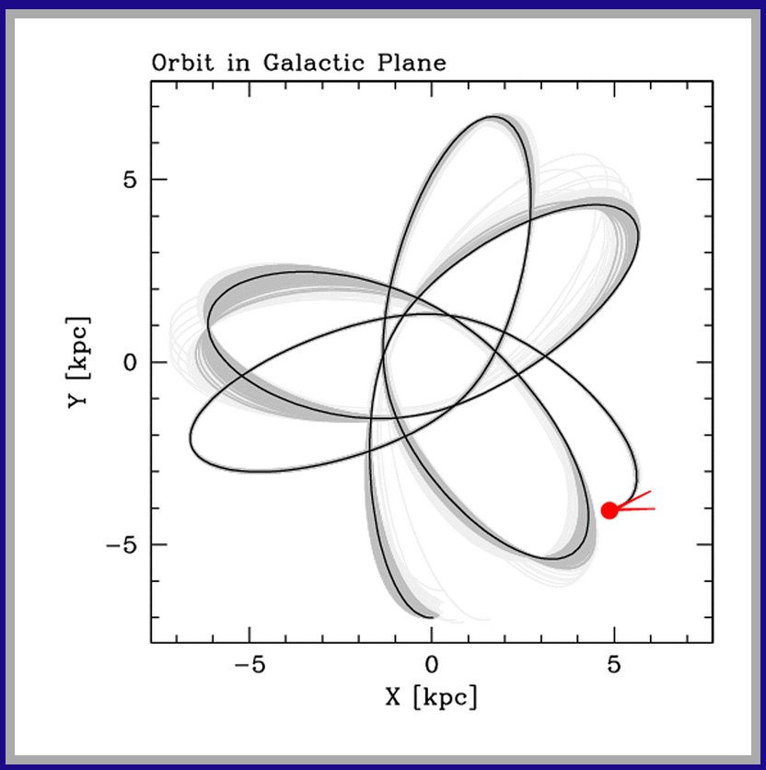
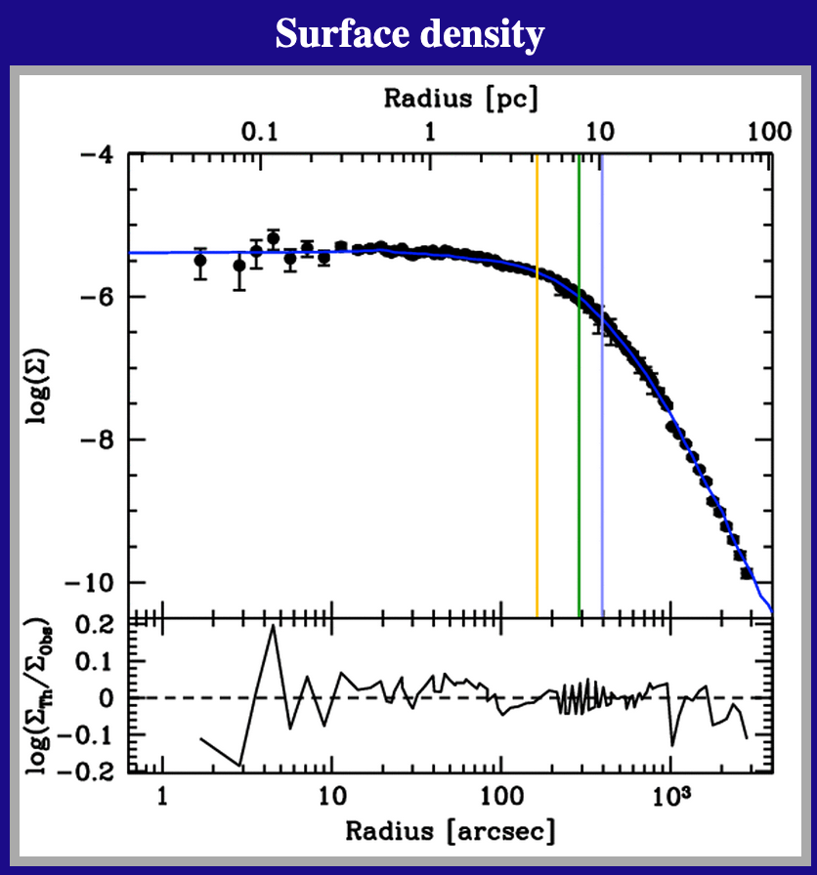
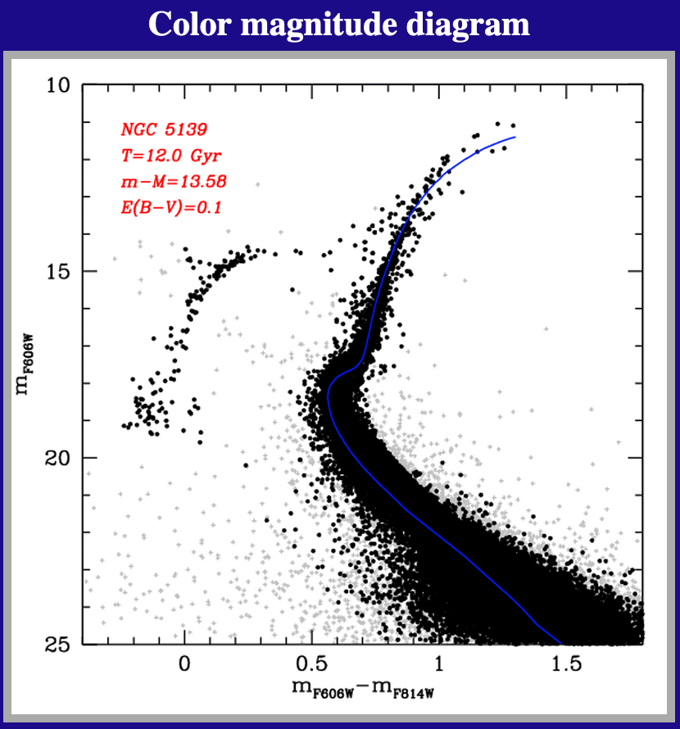
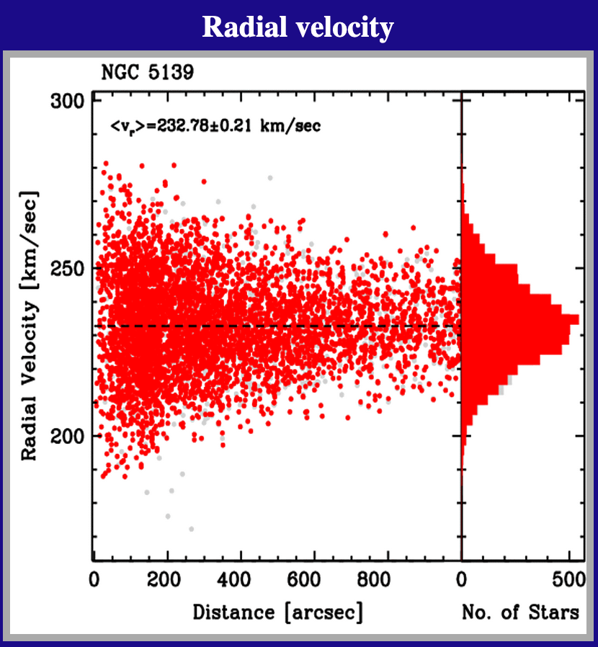
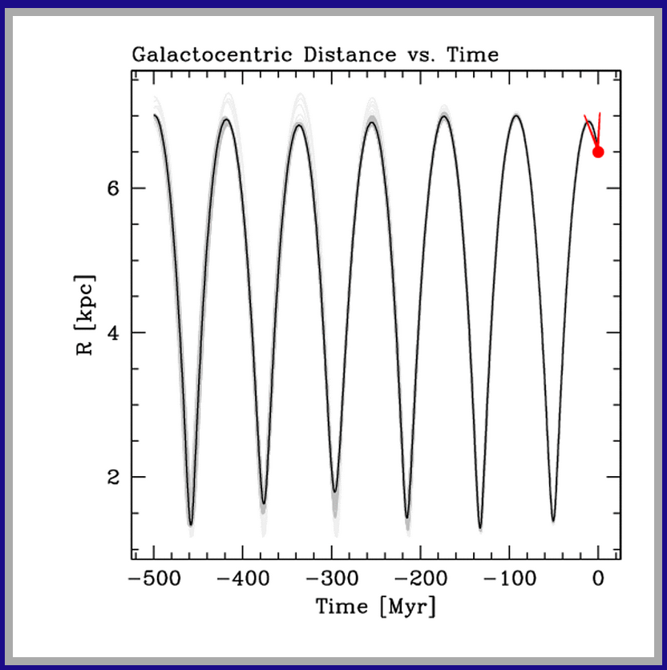
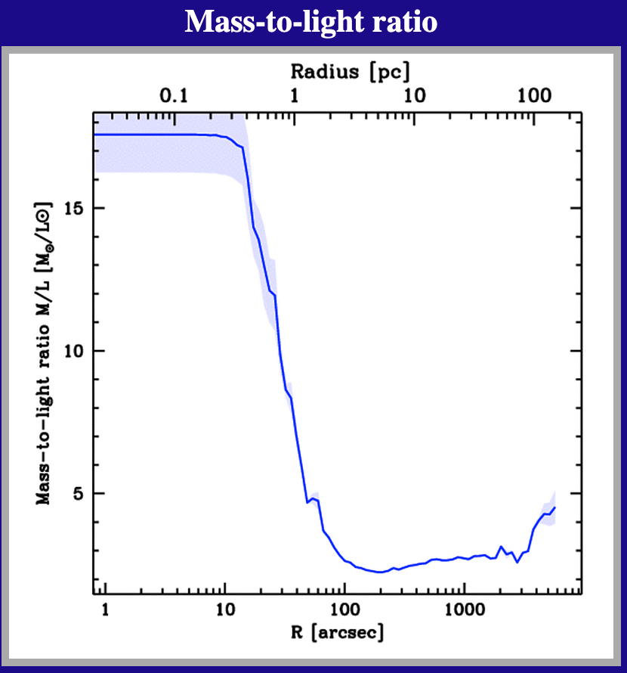
MW Globular Clusters
Baumgardt Catalog as of March 2023 has 168 MW globulars
https://people.smp.uq.edu.au/HolgerBaumgardt/globular/
Notes:
THESE PLOTS TOO SMALL … GO INTERACTIVE VIA WEBSITE
This is only 8 of 18 (!) plots available on the website.
Huge M/L drop due to compact remnants in close? … other GCs have rises by factors of a few

Slide 10
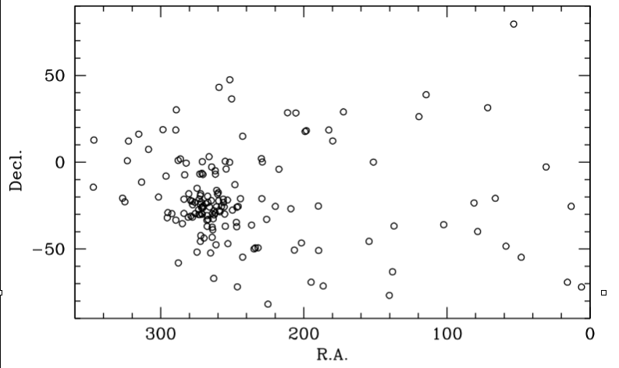
GCs: Location
concentrated near Galactic center, in Sagittarius
“GCs surround GC”

Slide 11
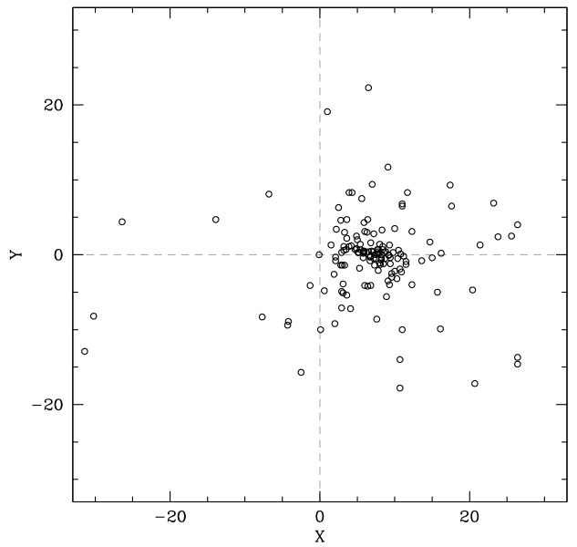
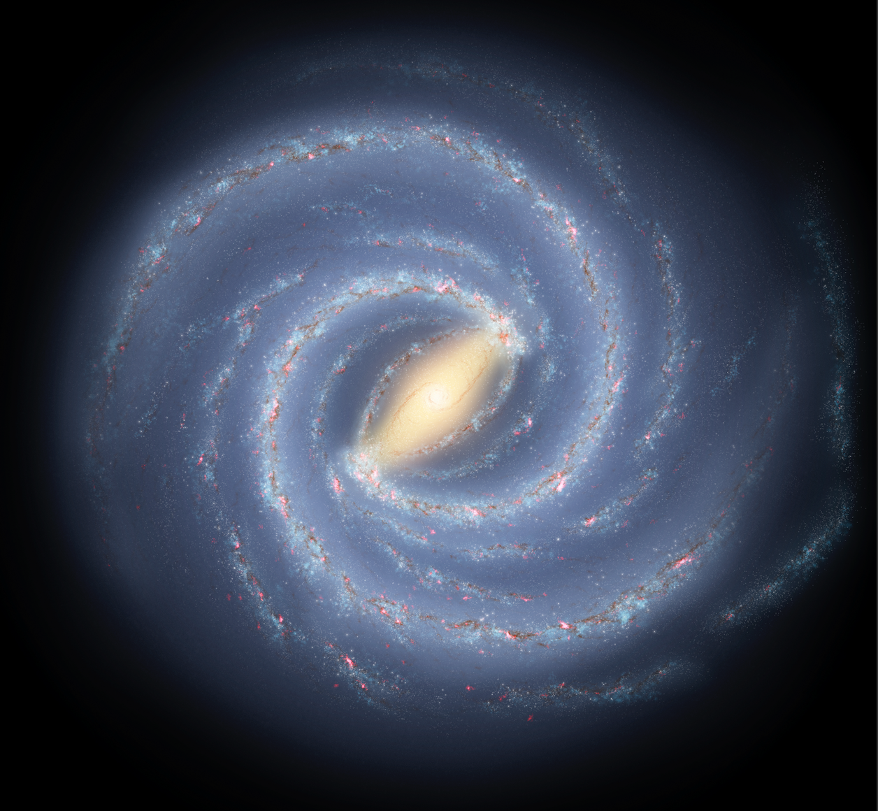
GCs: Location
adding physical distances indicates center ~8 kpc away
… thank you Shapley

Slide 12
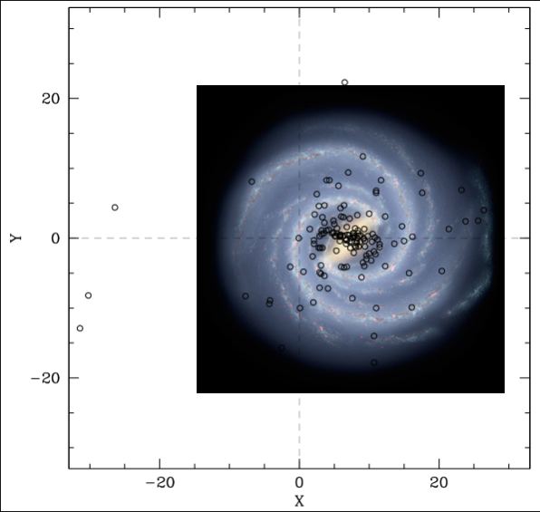
GCs: Location
adding physical distances indicates center ~8 kpc away
… thank you Shapley

Slide 13
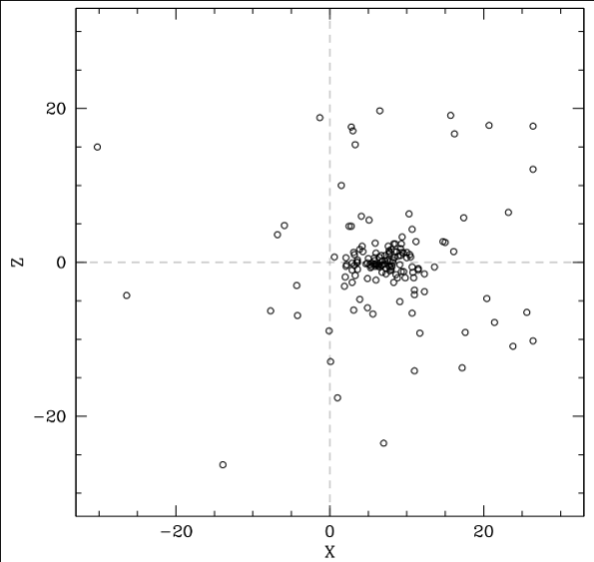
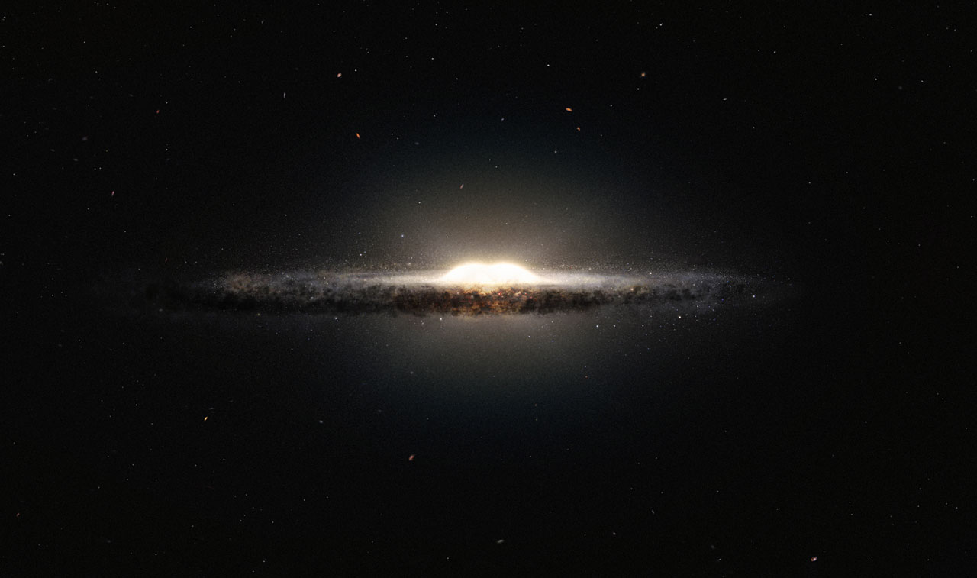
GCs: Location
most globulars within 4 kpc of GC … spherical distribution
“a super-globular made up of mini globulars”

Slide 14
GCs: Location
most globulars within 4 kpc of GC … spherical distribution
“a super-globular made up of mini globulars”

Slide 15
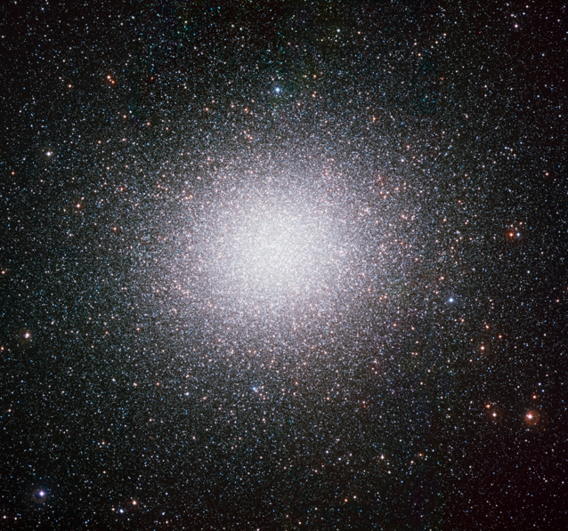
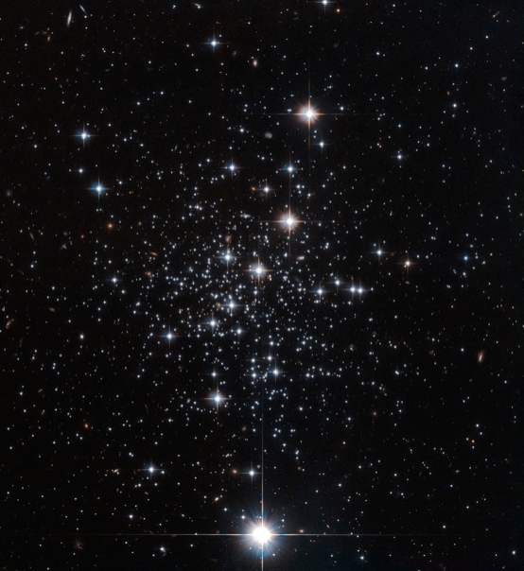
GCs: Sizes/Shapes
$ω$Cen
most massive … 10⁷ stars
M_{v} = $−$10.26
Palomar 12
one of smallest … few 1000 stars
M_{v} = $−4.47$

Slide 16
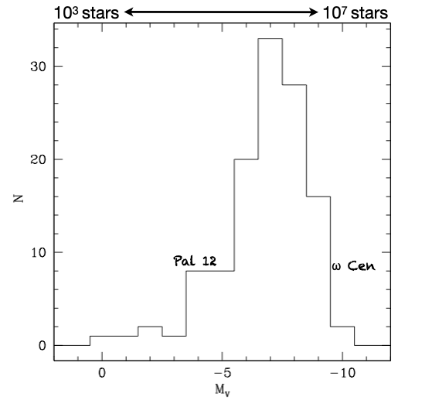
GCs: Sizes/Shapes
GC luminosity function
most have 10⁵ – 10⁷ stars
smaller cluster deficit real

Slide 17
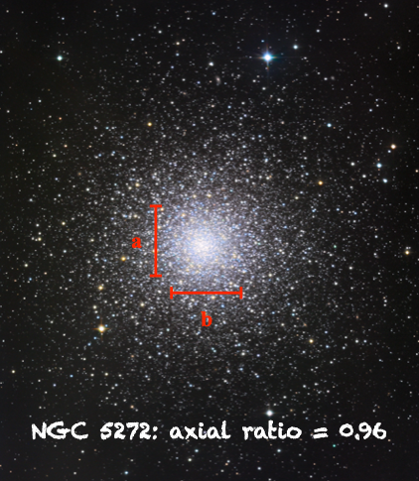
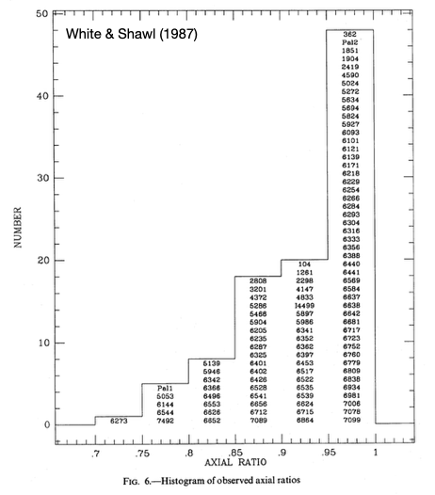
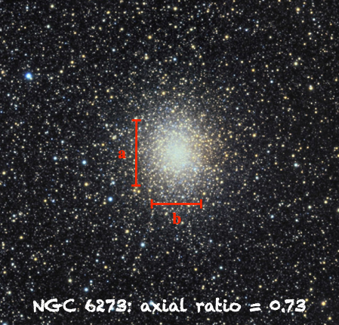
GCs: Sizes/Shapes
axial ratios [b/a] typically ~1
NGC 6273 most elliptical … possible systemic rotation

Slide 18
GCs: Sizes/Shapes
M3 is ~15’ across, about 10 kpc away,
and contains about 500,000 stars.
How many stars?
1. measure GC total luminosity
2. assume a mass function
3. use a mass-luminosity relation
4. get estimate of total # stars
How large is M3 in parsecs?
What is the stellar density, assuming
uniformly filled (obviously not true)?
What is the stellar density within
the half-mass radius of 1 arcmin?
M3 at ~10 kpc
15’

Slide 19
M3 Globular Fun
M3 is ~15’ across, about 10 kpc away, and contains about 500,000 stars.
How large is M3 in parsecs?
15 arcmin = 900 arcsec
1 arcsec at 1 parsec = 1 AU
900 arcsec at 1 parsec = 900 AU
900 arcsec at 10 kpc = 900 AU x 10⁴ = 9 x 10⁶ AU
convert 1 pc / 206265 AU = 44 pc across
What is the stellar density, assuming uniformly filled (obviously not true)?
density = # stars / volume
volume = $\frac{4}{3}$ $π R3$ … 44 pc across implies R = 22 pc
volume = 45000 pc³
density = 500,000 stars / 45000 pc³ = 11 stars/pc³
What is the stellar density within the half-mass radius of 1 arcmin?
density = 250,000 stars / ( $\frac{45000}{153}$ pc³) ~ 20000 stars/pc³ in sphere 3 pc across!

Slide 20
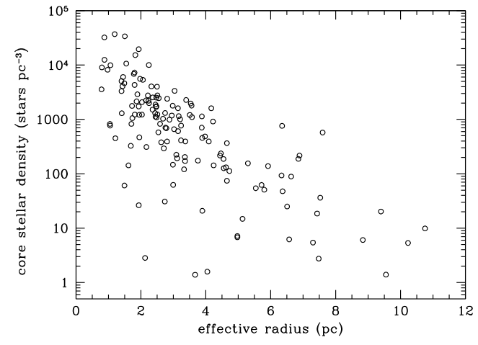
GCs: Sizes/Shapes
larger clusters tend to have lower central densities … more diffuse
compare: solar neighborhood 373 stars within 10 pc … density is ~0.1 stars/pc³
Notes:
red circle is M3

Slide 21
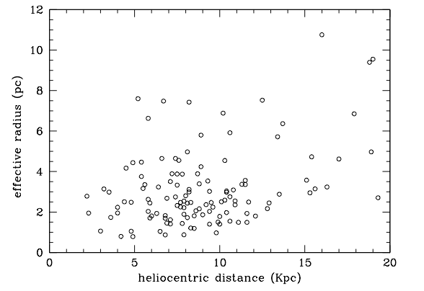
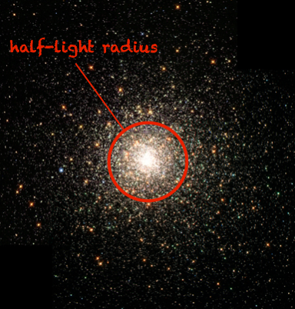
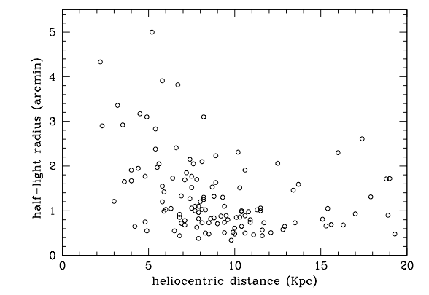
GCs: Sizes/Shapes
half-light radius often used to characterize GCs
nearby GCs have larger radii (duh), but ~all have R_{hl} > 20 arcsec
from R_{hl} and distance …derive effective radii R_{e}
most GCs have R_{e} ~ 1$−$5 pc

Slide 22
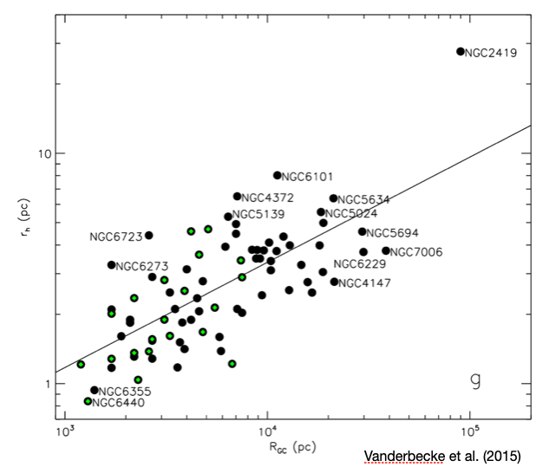
GCs: Sizes/Shapes
GC size related to distance from Galactic center
small/dense clusters survive larger tidal forces … or have been stripped

Slide 23
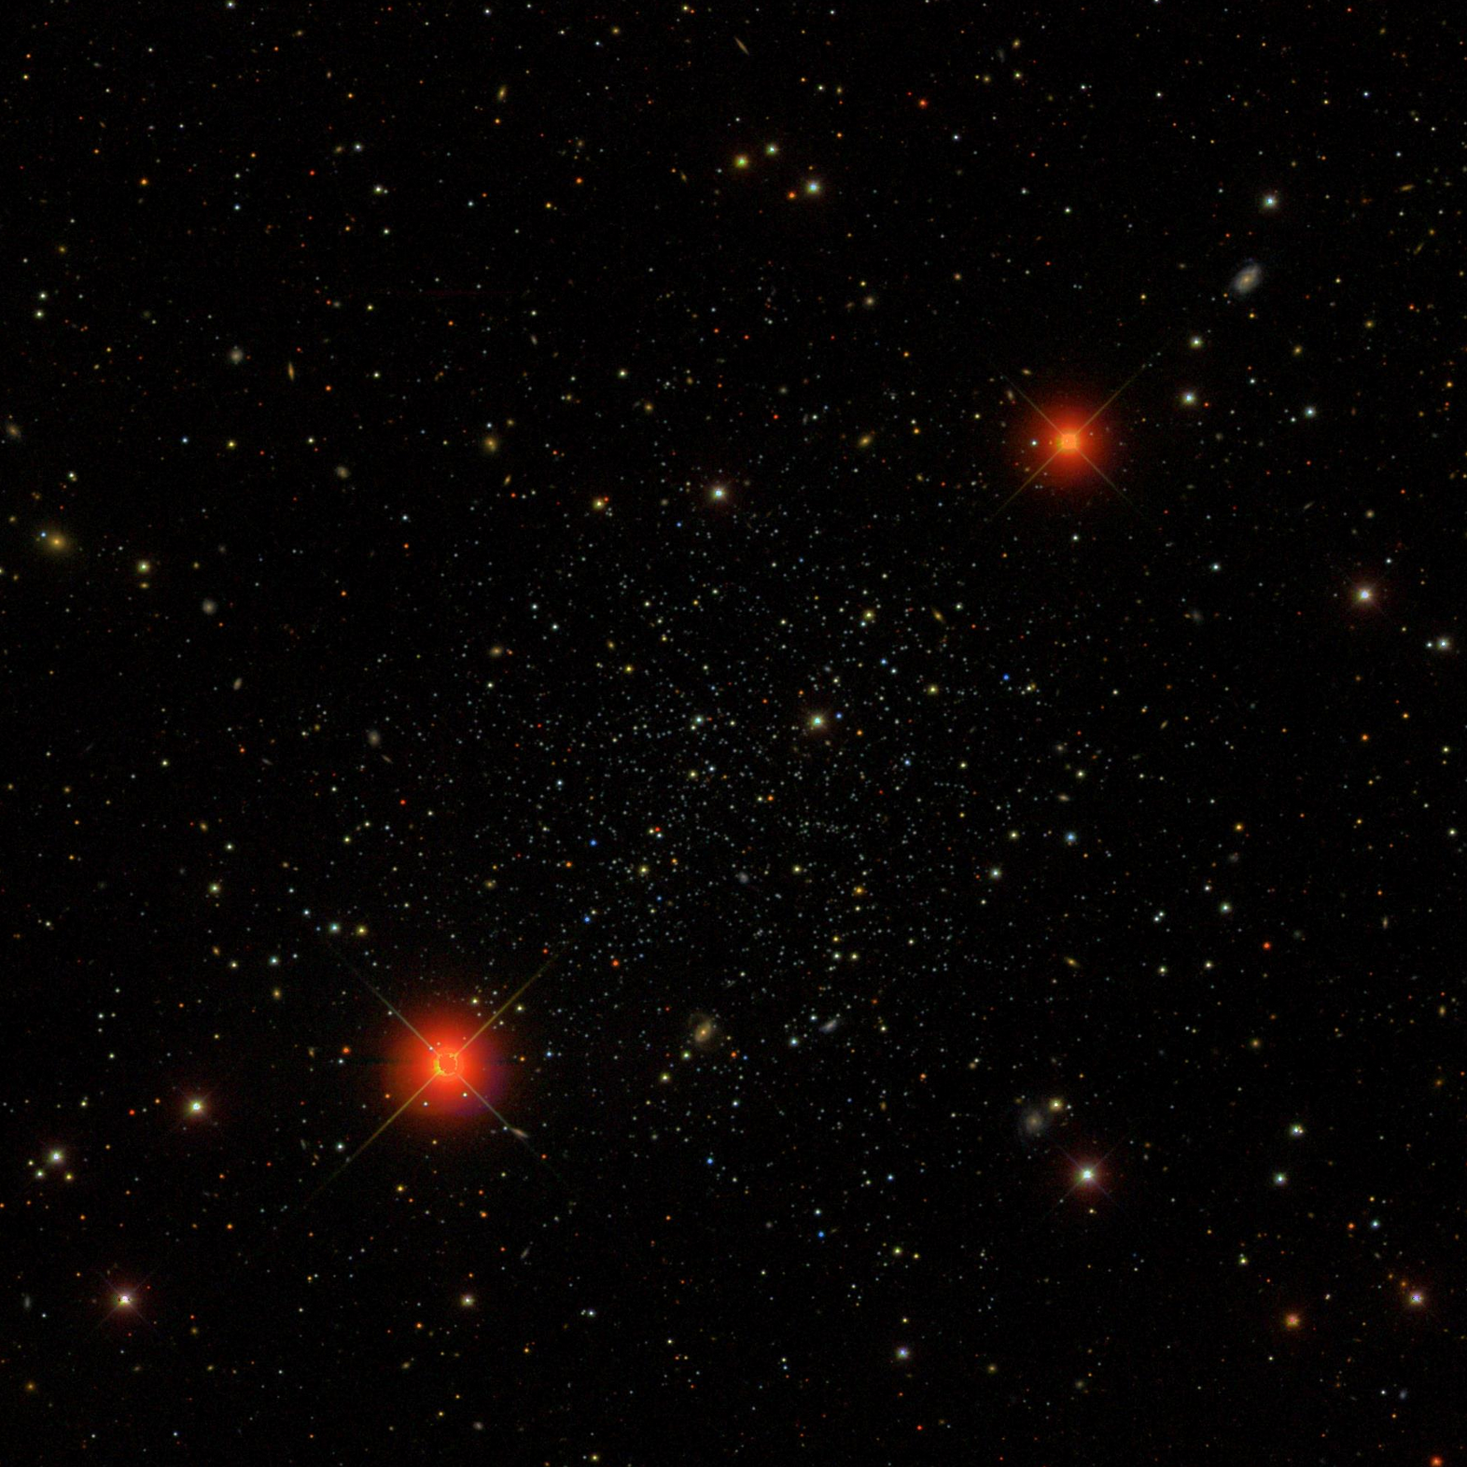
GCs: Sizes/Shapes
Palomar 5
SDSS commissioning data
tidal tails stretching 2.6º on sky
heavy mass loss … ~1/3 of cluster stars
can use to determine orbit around MW
stars become members of halo or bulge
Odenkirchen+ (2001)
Notes:
Palomar 5 has effective radius of ~35 pc (?)

Slide 24
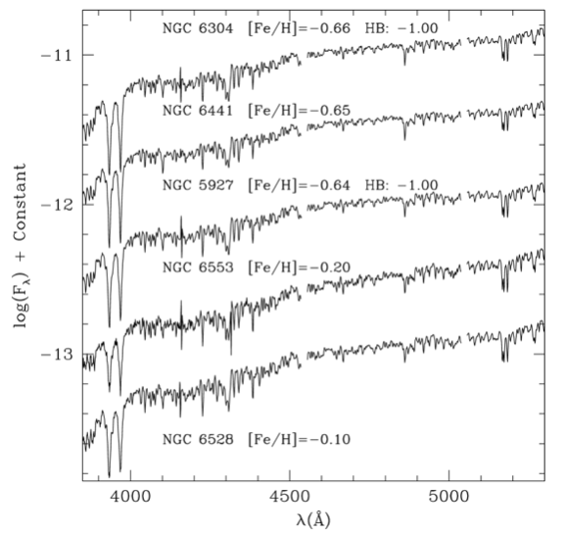
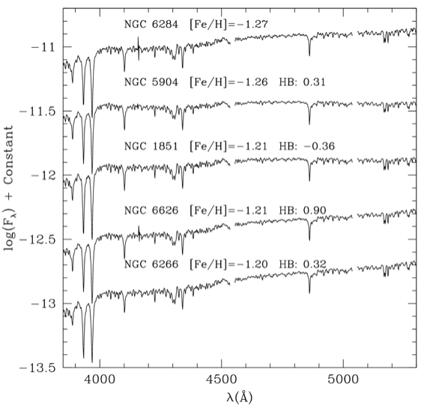
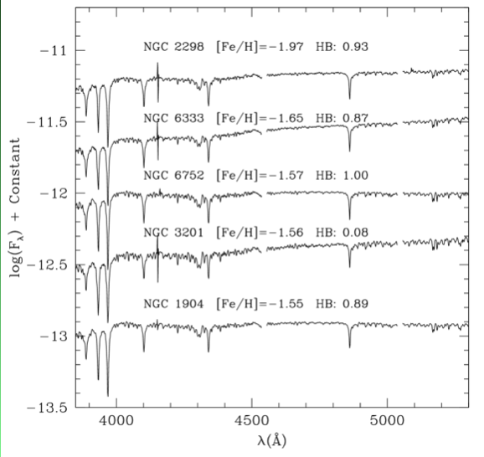
GCs: Metallicities
chemical composition estimated using spectra of cores
metal-rich
[Fe/H] > $−$0.7
SpType G2$−$G4
average
[Fe/H] ~ $−$1.2
SpType F7$−$F9
metal-poor
[Fe/H] < $−$1.5
SpType F2$−$F5
Schiavon+ (2005)

Slide 25
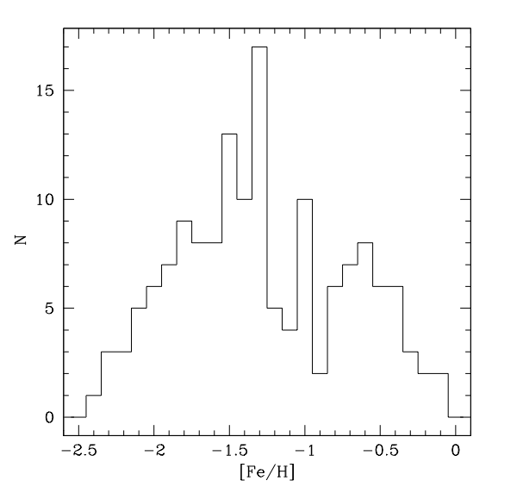
GCs: Metallicities
solar
neighborhood
very metal-poor compared to SN and MW disk … likely much older

