Slide 1
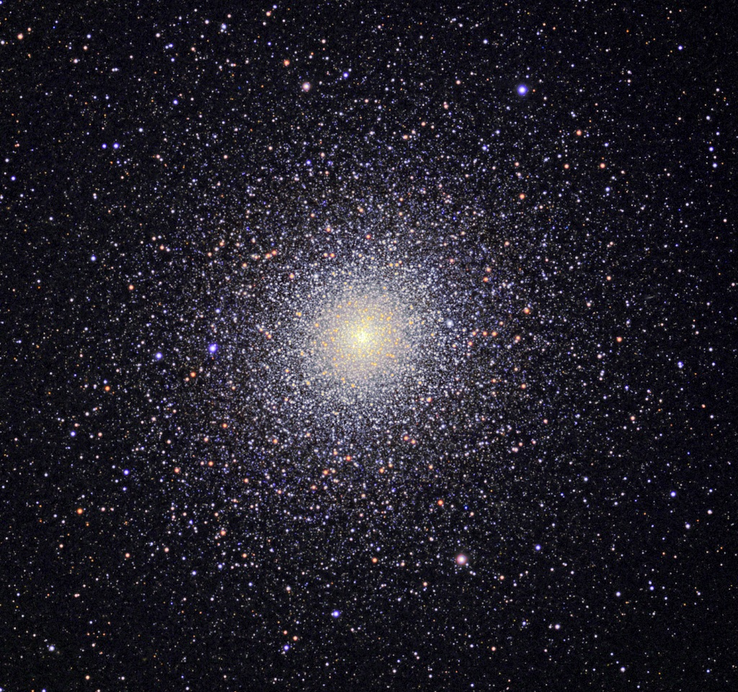
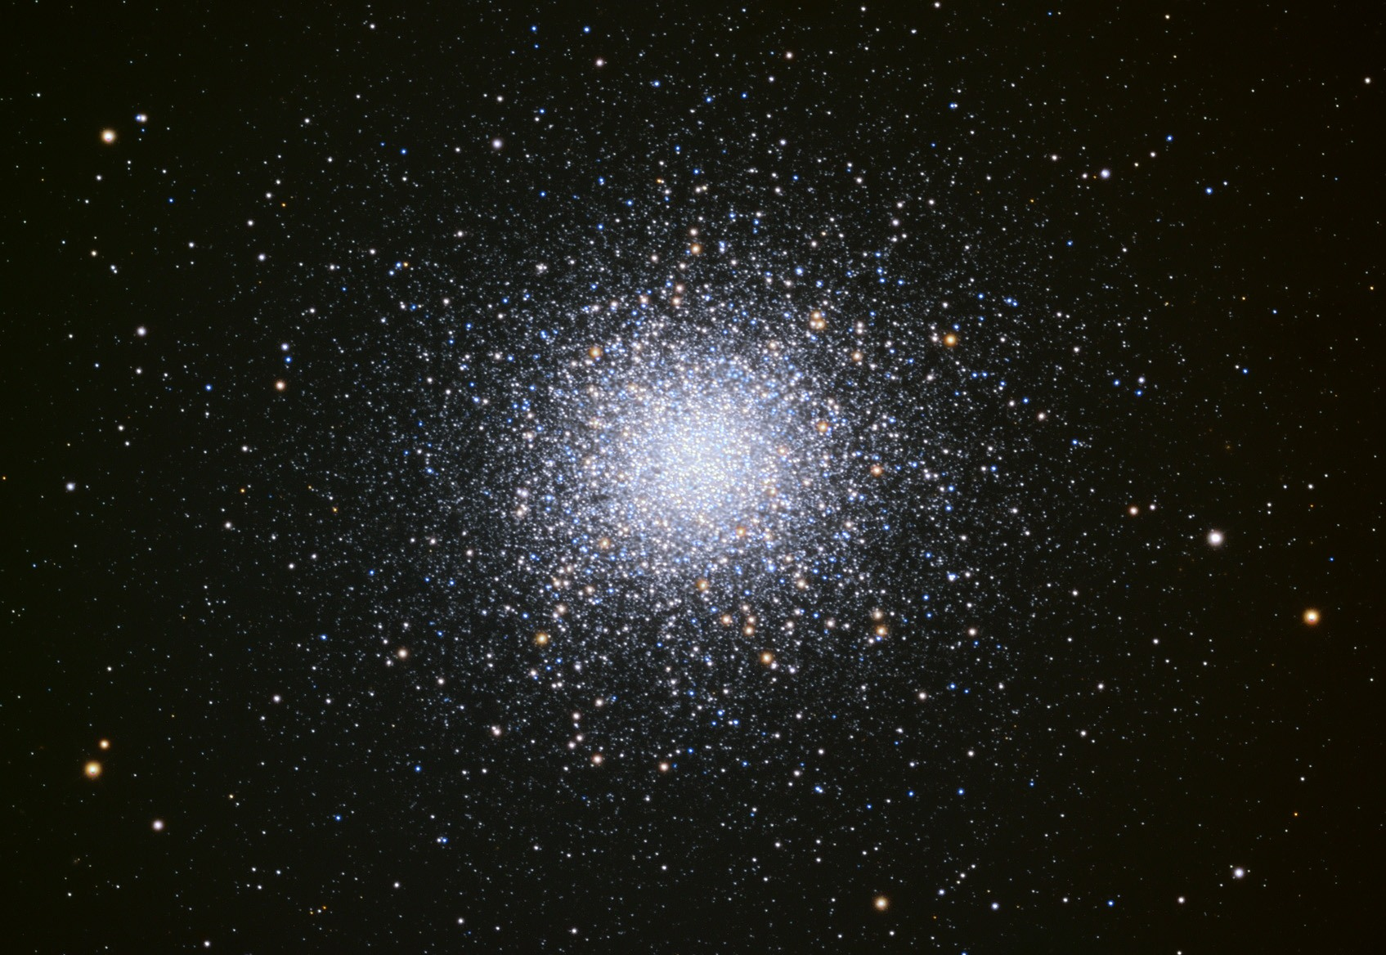
MW Globular Clusters
M13 in Hercules 47 Tuc in Tucana
(north) (south)
Notes:
This would be short without continuation from last globular cluster lecture.

Slide 2
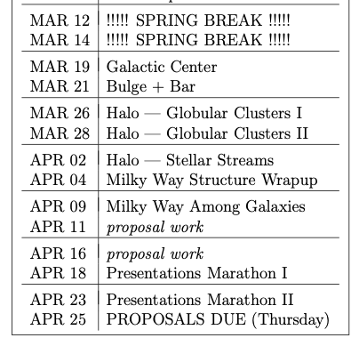
Proposal Future Bits
Thursday 28 MAR
Level 2 … 1st Draft
Thursday 04 APR
Budget and Justification
Thursday 11 APR
Facilities and Mentoring
Thursday 25 APR
Final Proposal = 5 pieces

Slide 3
Proposal Budget
Thursday 04 APR
Budget Spreadsheet = 1 page
Budget Justification = 2 pages
templates on course website
http://www.astro.gsu.edu/~thenry/GALACTIC
painful details
https://ursa.research.gsu.edu/proposals-awards/develop-proposal-budget/

Slide 4
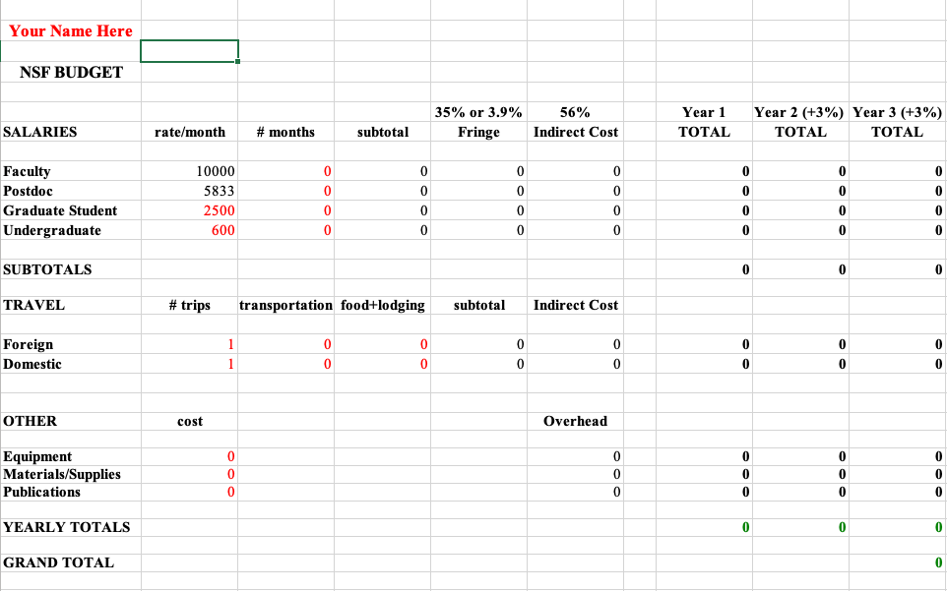
Proposal Budget

Slide 5
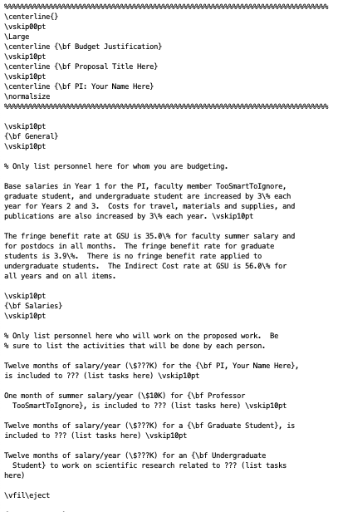
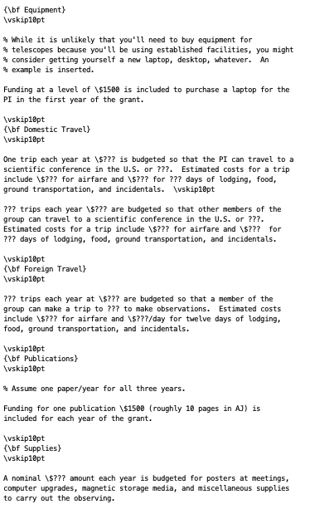
Proposal Budget

Slide 6
MW Globular Clusters
M13 in Hercules 47 Tuc in Tucana
(north) (south)

Slide 7
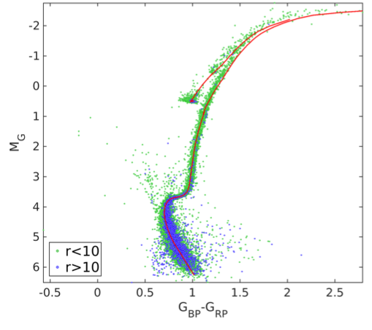
GC HR Diagrams
47 Tuc
green < 10 arcmin = 3X half-light radius
blue > 10 arcmin
Babusiaux+ (2018)

Slide 8
GC HR Diagrams
asymptotic giant branch
6
horizontal branch
5
4
red giant branch
blue
stragglers
7
3
subgiant branch
main seq turnoff
2
1
main sequence
Babusiaux+ (2018)

Slide 9
GC HR Diagrams
AGB
MSTO: used to determine age
SGB: narrow … stars of same
mass evolving off simultaneously
= all stars have same age
RGB H shell only
HB He → C core
H → He shell
AGB He → C shell
H → He shell
BS mass exchange
HB
RGB
BS
MSTO
SGB
Babusiaux+ (2018)

Slide 10
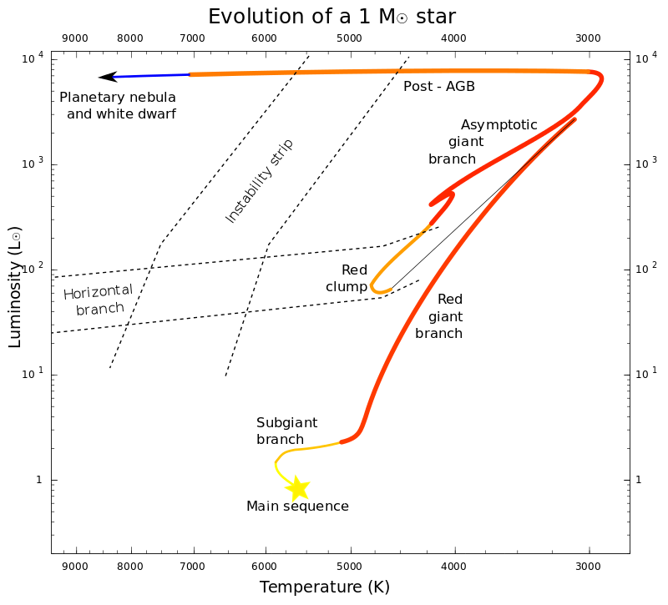
Sun *DOES* go AGB
~ 200 R$⊙$
helium flash
He → C shell
H → He shell
~ 150 R$⊙$
He → C core
H shell only
Notes:
Sun *DOES* go AGB

Slide 11
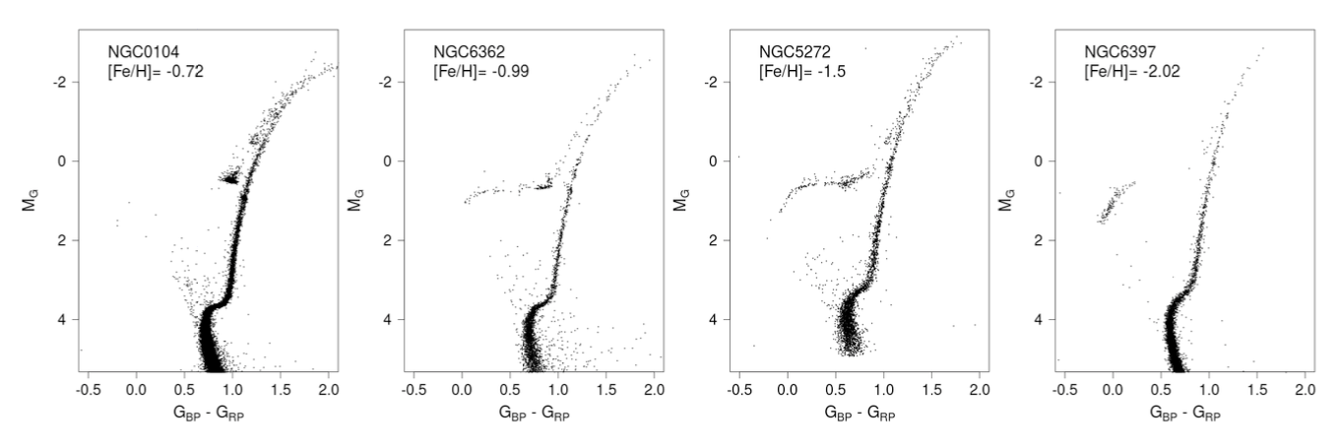
GC HR Diagrams
47 Tuc
M 3
Which cluster is furthest?
M 3 at 10.4 kpc
Which cluster is closest?
NGC 6397 at 2.4 kpc
How do the MSTOs compare?
higher metallicity … redder
How do the RGBs compare?
higher metallicity … redder
How do the HBs compare?
lower metallicity … stretches blueward
Babusiaux+ (2018)
Notes:
NGC 104 = 47 Tuc … 4.5 kpc
NGC 6362 … 7.6 kpc
NGC 5272 = M3 … 10.4 kpc
NGC 6397 … 2.4 kpc

Slide 12
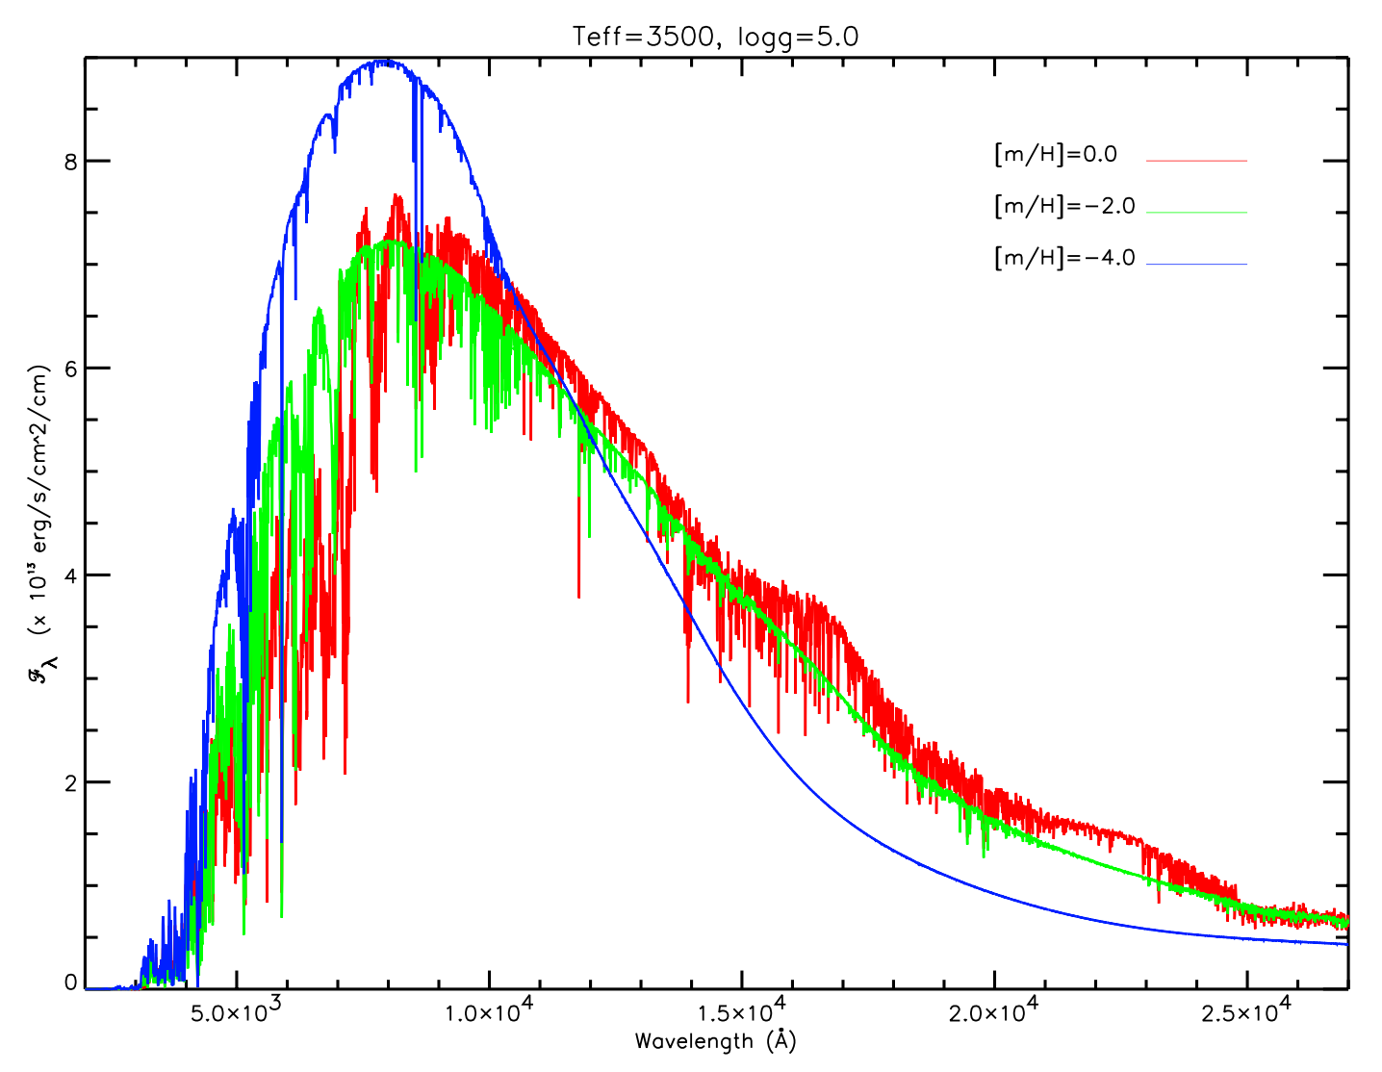
1,865 × 2,560
GC Colors
Why are high metallicity stars RED
and low metallicity stars BLUE?
star
star
Jao+
(2008)
Line blanketing: many metals (particularly Fe)
in stellar atmospheres of stars absorb
blue light, so the star looks redder.
Opacity: more metals absorb energy from the
stellar interior, making red giants “swell up”
more, causing cooler (redder) temperatures.
Metal poor stars are blue … Metal rich stars are red
WHY?
Notes:
NGC 104 = 47 Tuc … 4.5 kpc
NGC 6362 … 7.6 kpc
NGC 5272 = M3 … 10.4 kpc
NGC 6397 … 2.4 kpc

Slide 13
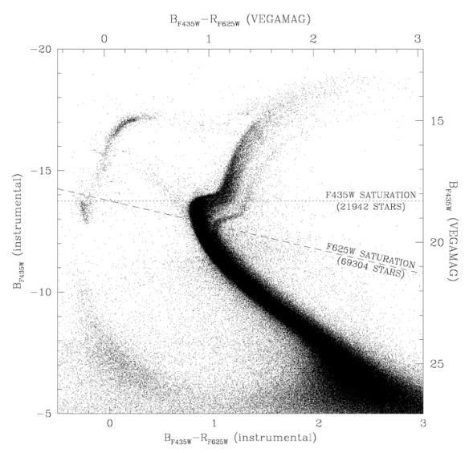
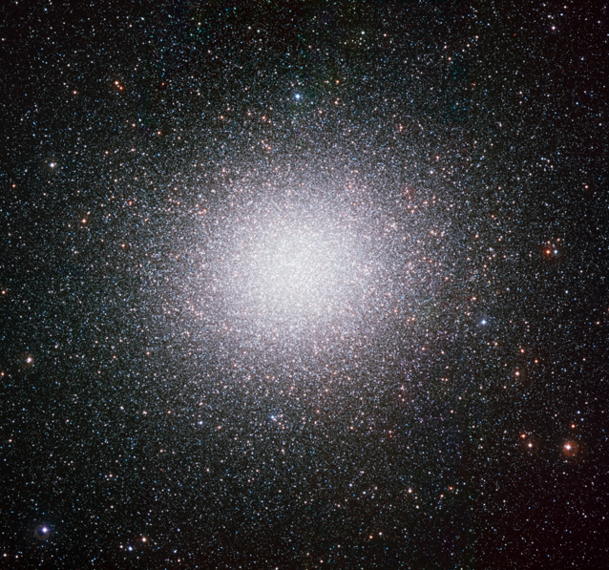
GC HR Diagrams
most GCs are “single population” clusters … stars have = ages, metallicities, but …
$ω$Cen
most massive GC … 10⁷ stars
multiple MS, SGB, RGB, …
What might cause this?
dwarf galaxy core?
merged GCs?
Anderson+ (2010)

Slide 14
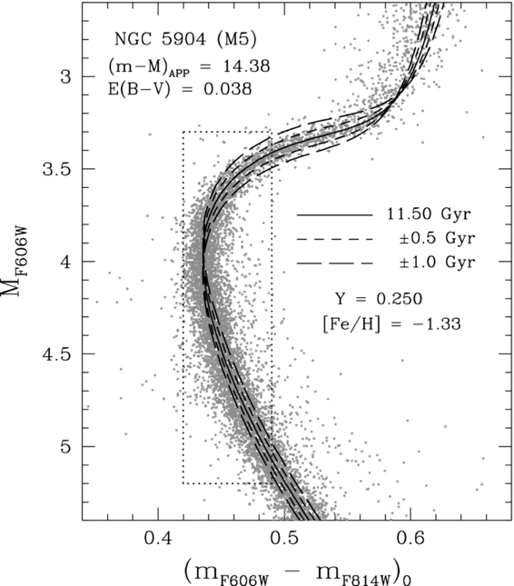
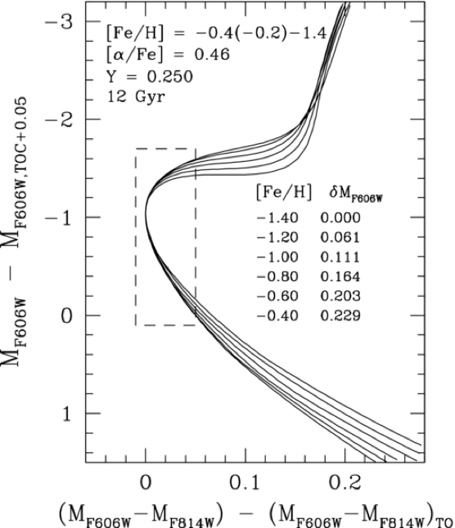
GC Ages
distance … vertical shift to fit
age… $±$0.5 Gyr via shape of MS/SGB/RGB
(not really just location of MSTO)
adjustments by changing
metallicity
Van den Berg+ (2013)

Slide 15
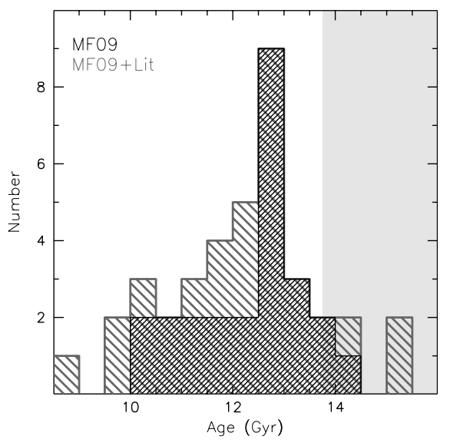
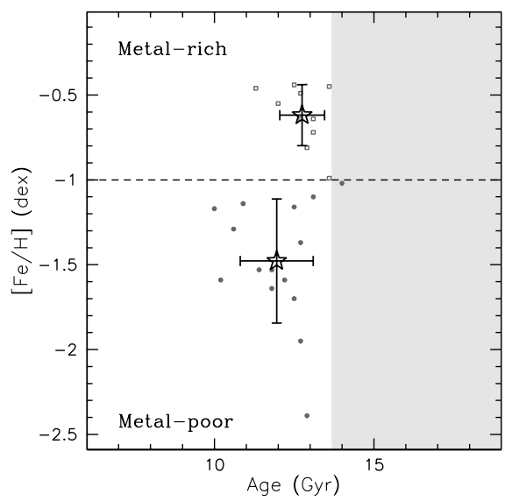
GC Ages
ages from isochrone fits
a few ages > 13.7 Gyr
GCs are oldest MW components
more metal rich are older
say what?
another factor at play …
Roediger+ (2014)
Notes:
Left: Adopted age distribution for the S05 GGC sample based on either MF09 alone (black), or MF09 plus additional sources of age information in the literature (for those clusters not studied by MF09; dark gray). The shaded region corresponds to ages in excess of that of the universe (Komatsu et al. 2011).

Slide 16
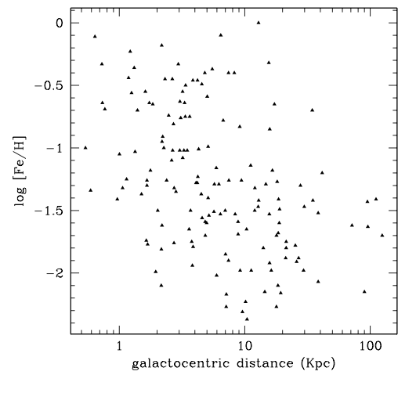
GC Ages
slight correlation:
higher metallicity when closer to Galactic Center
Why might that be?
GCs near GC had (slightly) enriched metal content from early star formation (?)
BUT!!! GCs are moving in/out of Galactic potential
GC metallicity depends more on environment than age
location, location, location
bottom line: GCs are not older than the Universe …
Roediger+ (2014)

Slide 17
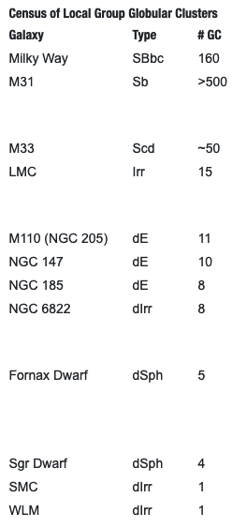
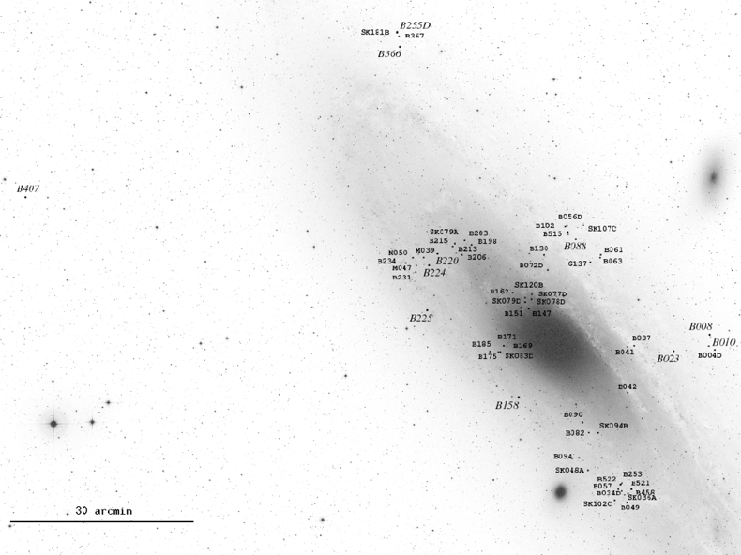
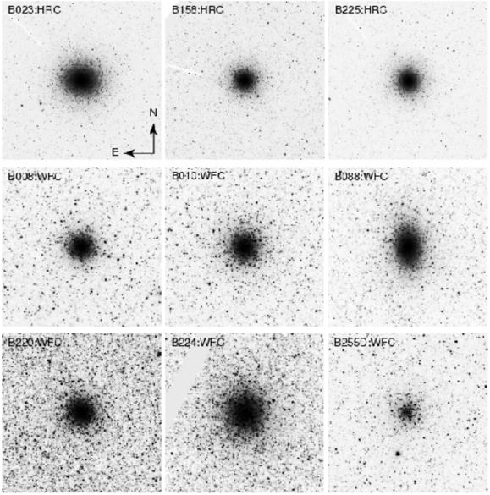
Andromeda Globular Clusters
Andromeda
Triangulum
And+
HST images
all Local Group galaxies
with GCs as of 2018
https://skyandtelescope.org/sky-and-telescope-magazine/extragalactic-globular-clusters/
Sibila+ (2009)
Notes:
We don’t really know why Andromeda has 3X the globulars as the MW.
M33 = Triangulum
M110 = larger And satellite
M32 = brighter And satellite … no GCs listed

