Slide 1
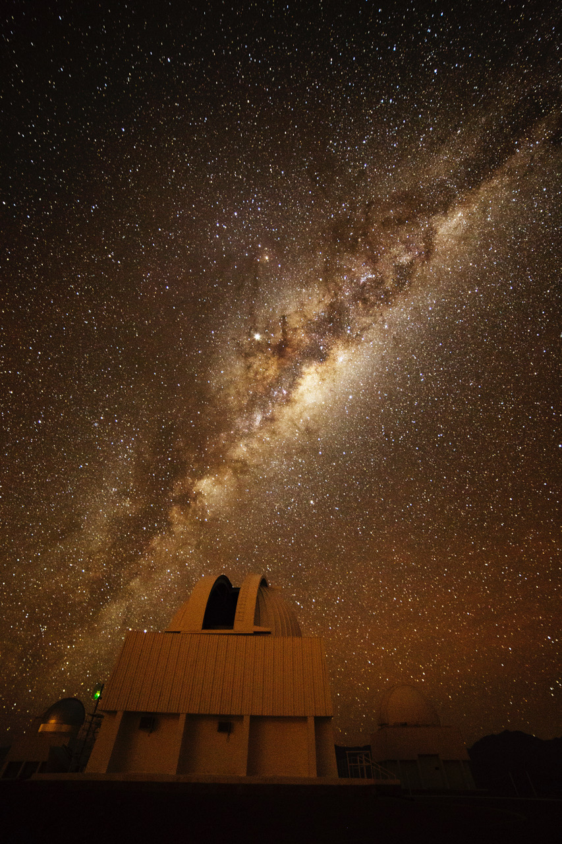
ASTR 8200
Galactic
Structure
Review
photo: Travis Rector
Notes:
Might want to add a few more slides

Slide 2
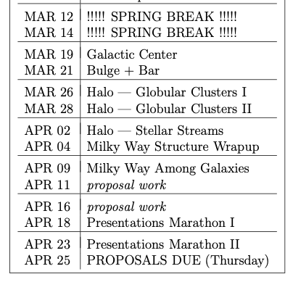


Proposal Future Bits
Thursday 04 APR
Budget and Justification
Thursday 11 APR
Facilities and Mentoring
Thursday 25 APR
Final Proposal = 5 pieces

Slide 3
Proposal Future Bits
NEED TO CHECK FONT SIZE
should be 11pt

Slide 4
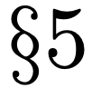
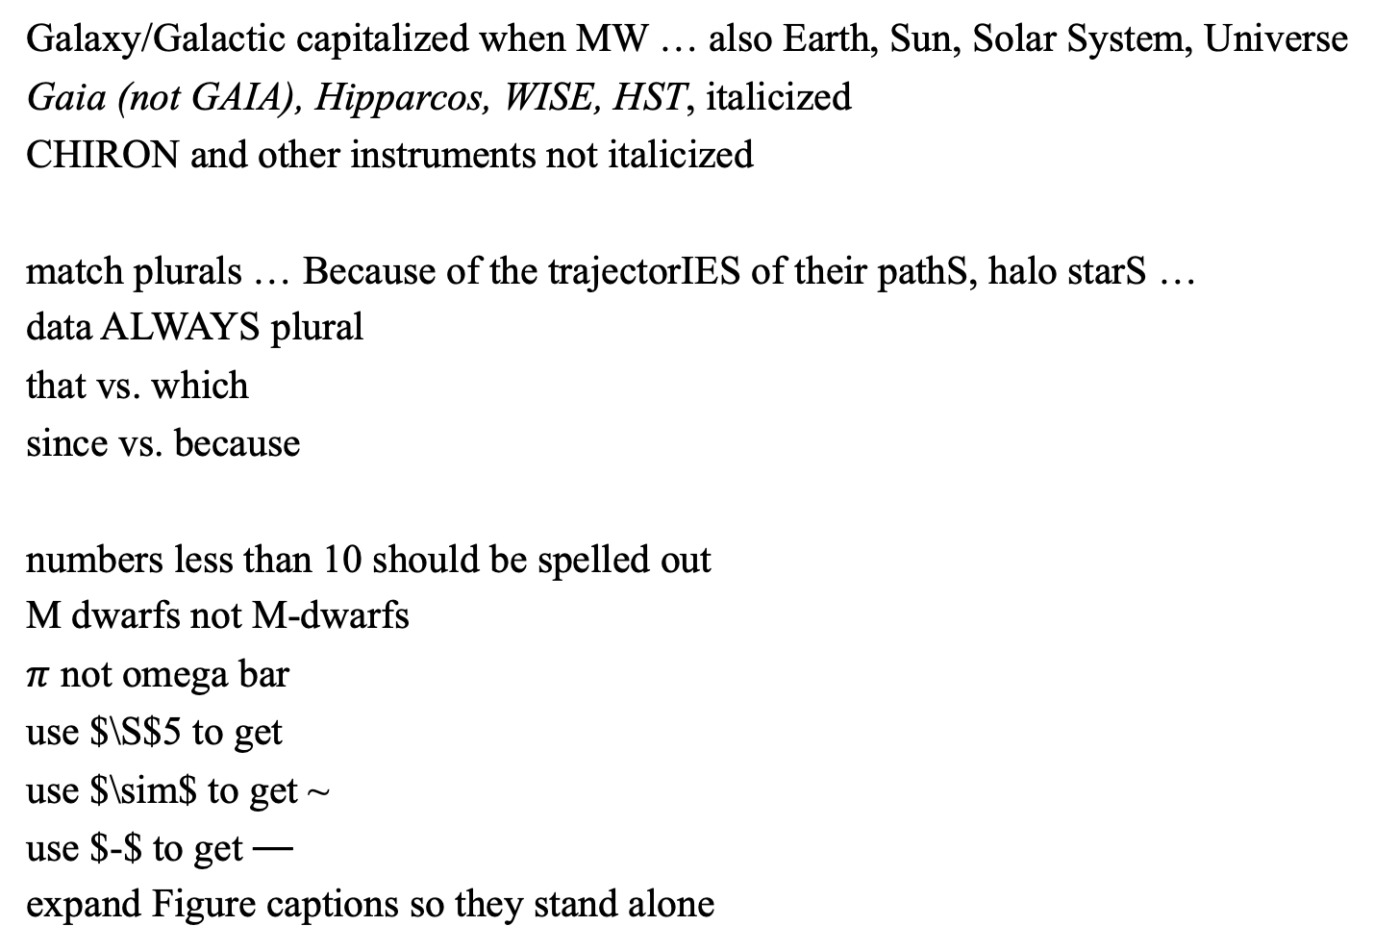
Proposals
Galaxy/Galactic capitalized when MW … also Earth, Sun, Solar System, Universe
Gaia (not GAIA), Hipparcos, WISE, HST, italicized
CHIRON and other instruments not italicized
match plurals … Because of the trajectorIES of their pathS, halo starS …
data ALWAYS plural
that vs. which
since vs. because
numbers less than 10 should be spelled out
M dwarfs not M-dwarfs
$π$ not omega bar
use $\S$5 to get
use $\sim$ to get ~
use $-$ to get ⏤
expand Figure captions so they stand alone
ALWAYZ
SPELCHEK!

Slide 5
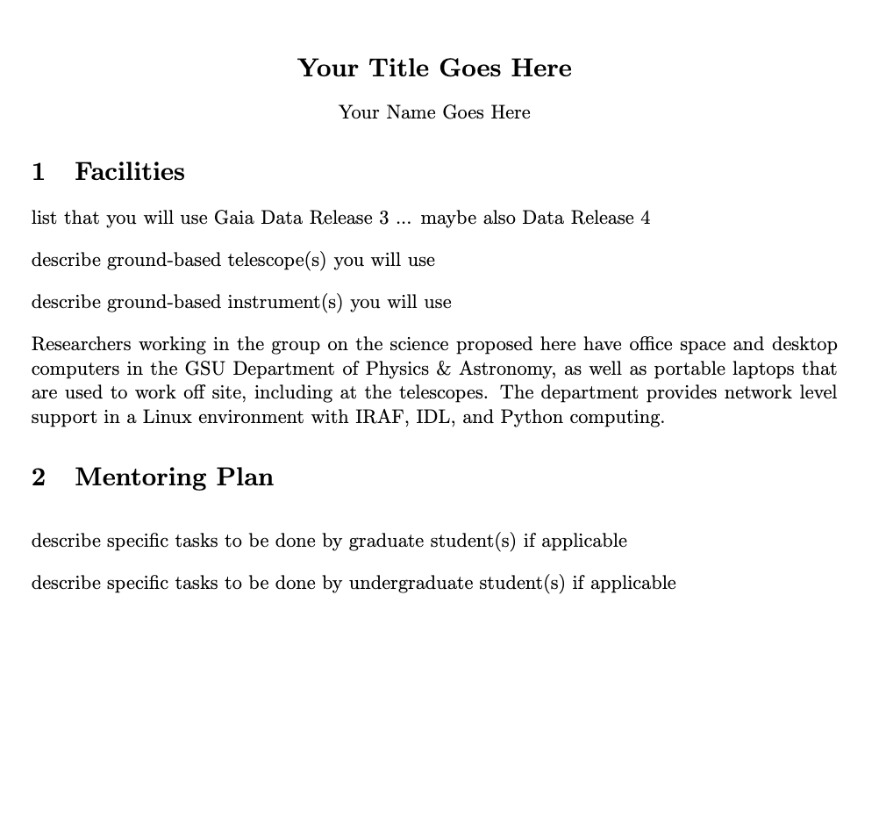
Facilities + Mentoring

Slide 6
Proposal Pitches (15 min)
Thursday 18 APR
Jessica
Melodie
Isaac
Madison
Griffin
Kayvon
Colin
Tuesday 23 APR
Naba
Jacob
Tim
Sebas
Matthew
Saba

Slide 7
Galactic Explorers 3
Write down one correct thing you learned about
1. the Milky Way’s Disk
2. the Milky Way’s Bulge/Bar/Center
3. the Milky Way’s Halo
4. the Milky Way’s Population of Objects
5. any other galaxy
BONUS 1: something else you want to remember from the course
BONUS 2: another something else you want to remember from the course
Notes:
X. How many months of observations were included in Gaia DR2? … 22 months
X. What types of objects are used to tie the Gaia grid to ICRS? … quasars
X. Are the positions and parallaxes known to better or worse than 1 milliarcsecond at G = 17? … better: 0.04 mas for G < 14, 0.1 mas at G = 17, 0.7 mas at G = 20

Slide 8
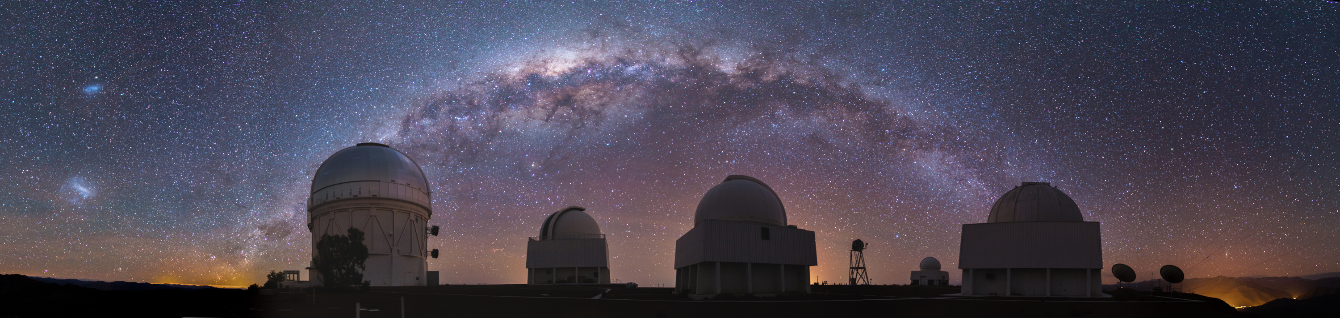
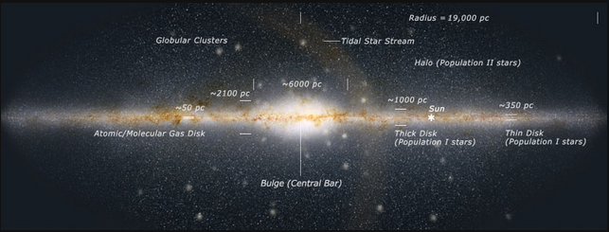
Milky Way Home
1

Slide 9
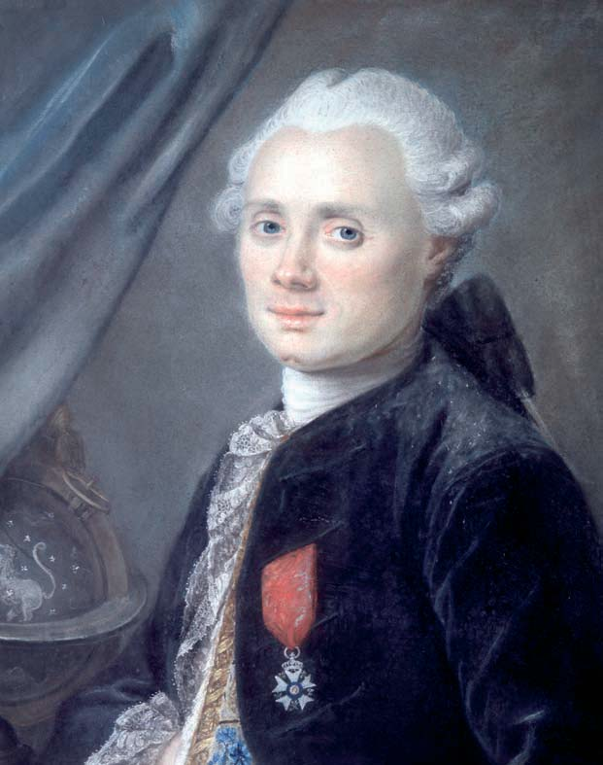
1771+: Messier Catalog
was looking for comets with 4in tel
with assistant Pierre Méchain
northern hemisphere to DEC −36
1771: preliminary version
1774: 45 objects
1780: 80 objects
1781: 103 objects (… really 102)
1967: 110 objects (using their notes)
What is the Messier number for Andromeda?
Charles Messier
Catalogue des Nébuleuses et des Amas d'Étoiles (1771)
(Catalogue of Nebulae and Star Clusters)
2
Notes:
French
102 vs. 103 (by Messier in 1781) due to confusion about entry 102, which was duplication of 101 or new NGC 5866

Slide 10
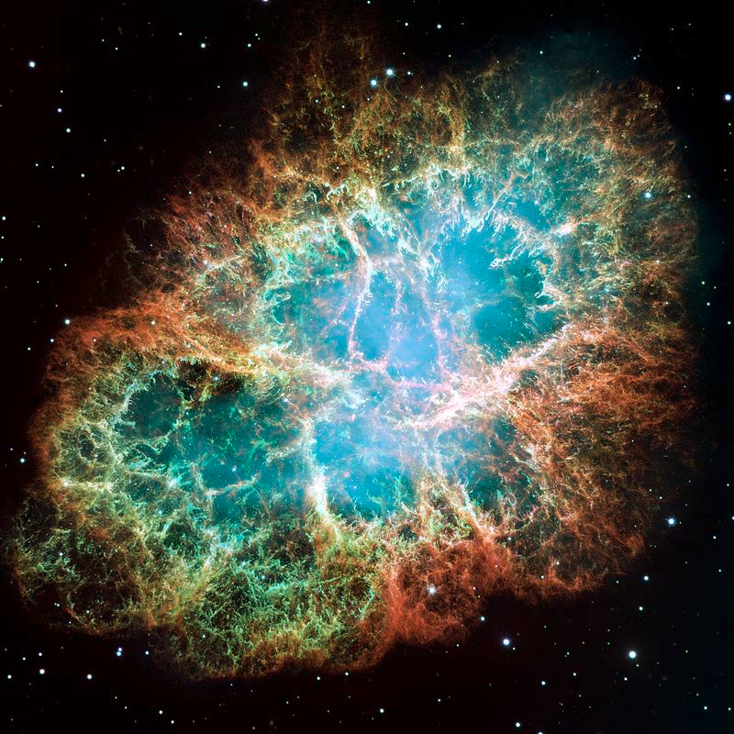
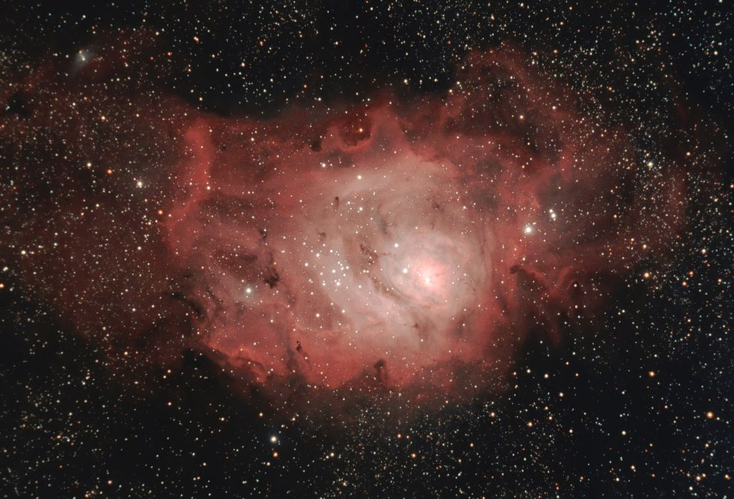
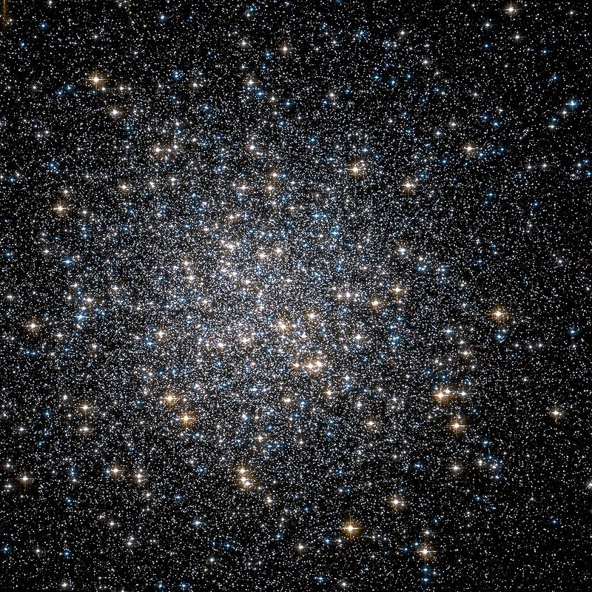
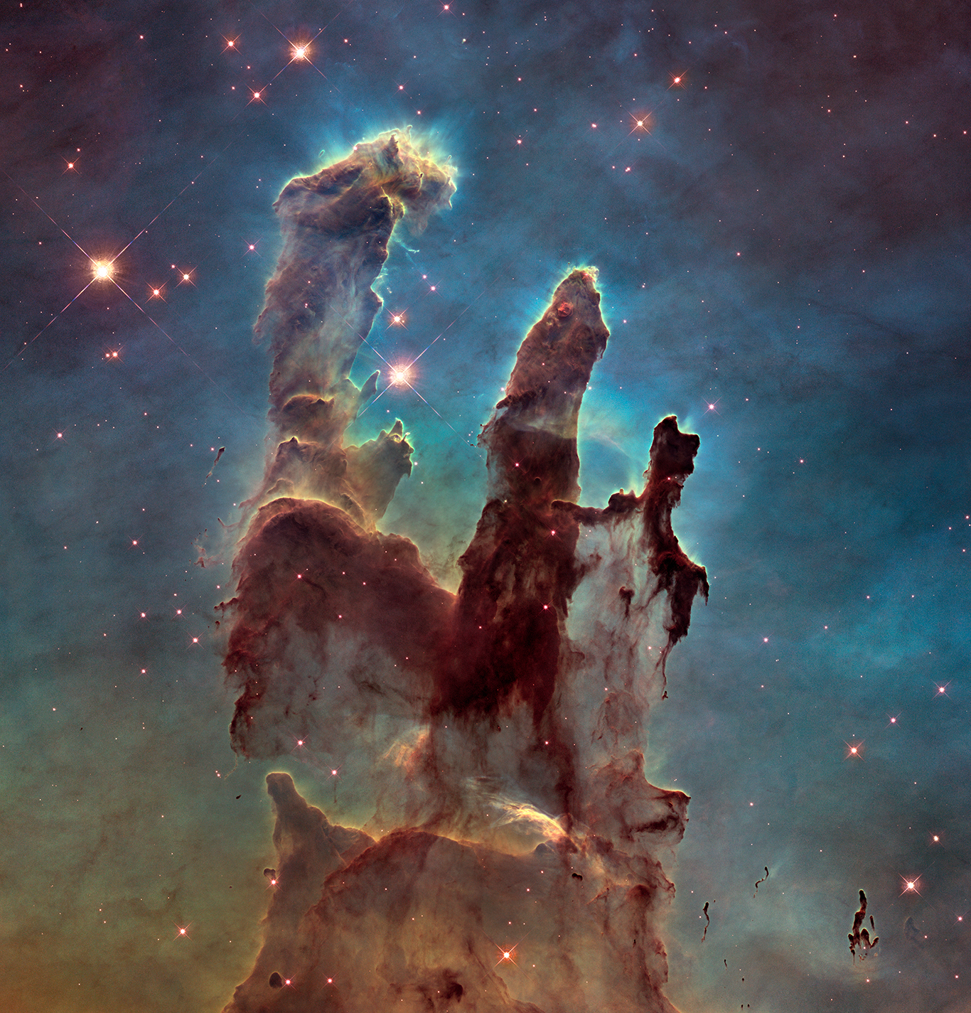
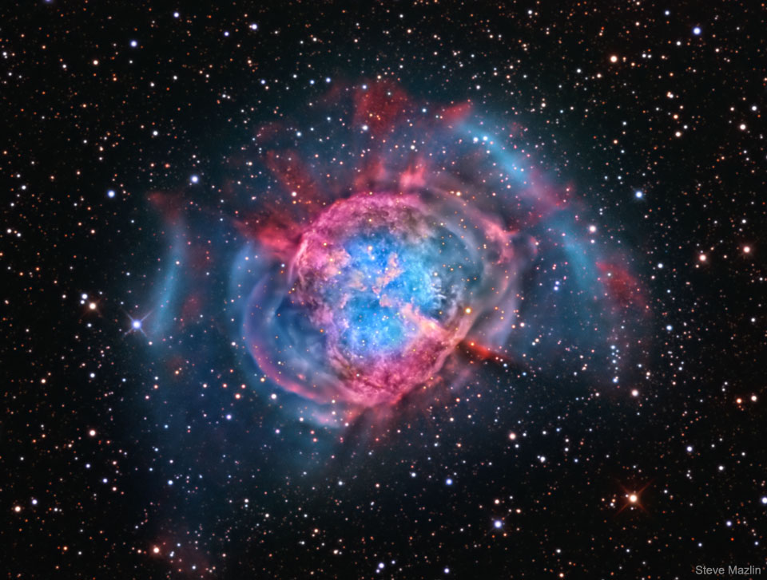
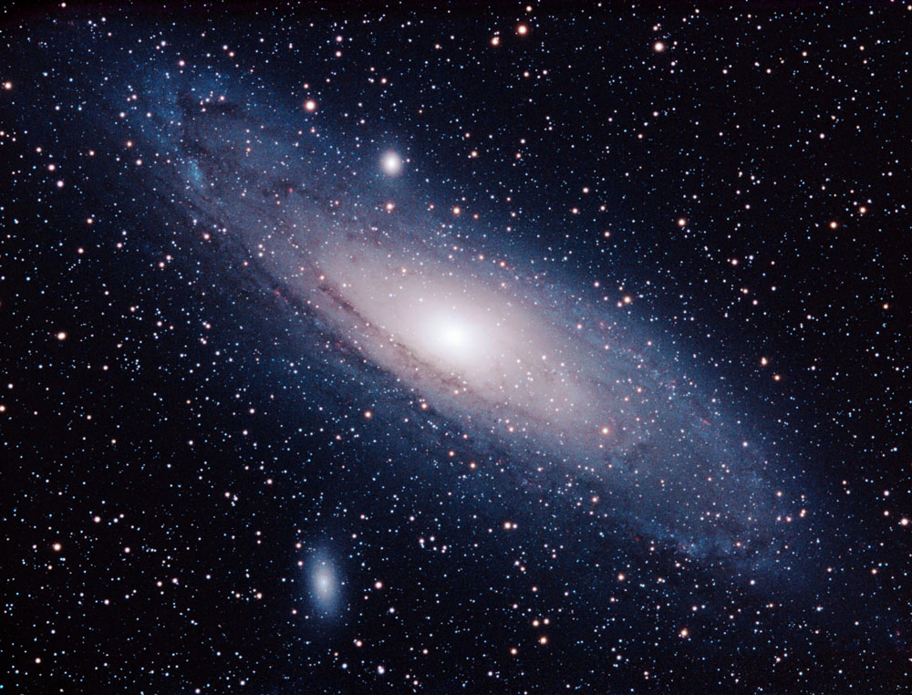
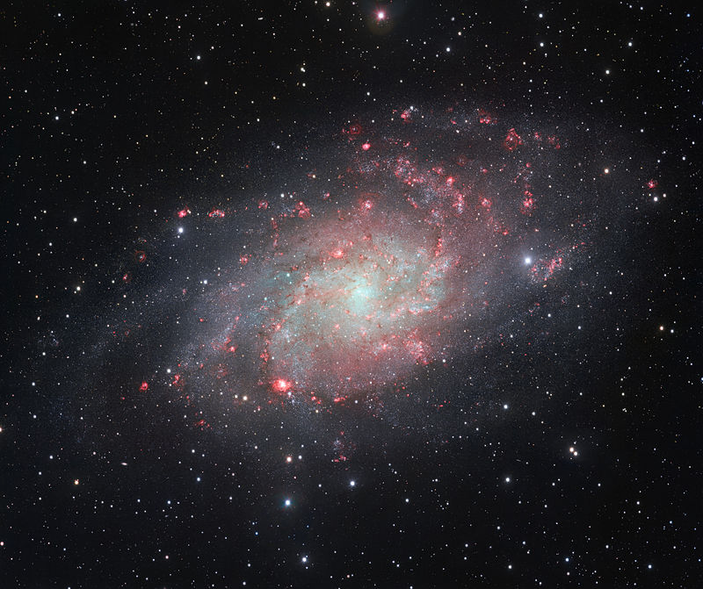
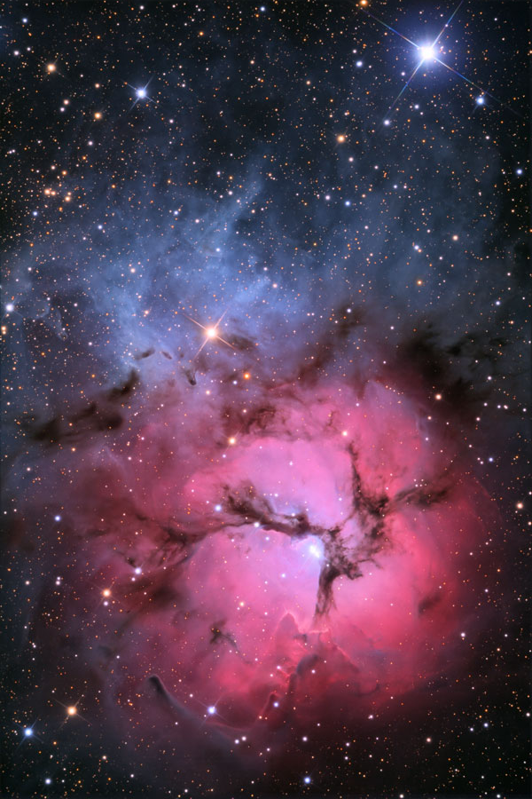
Messier Catalog Greatest Hits
M1
Crab Nebula
M8
Lagoon Nebula
M13
Hercules Globular
M16
Eagle Nebula
M20
Trifid Nebula
M27
Dumbbell Nebula
M31
Andromeda Galaxy
M33
Triangulum Galaxy

Slide 11
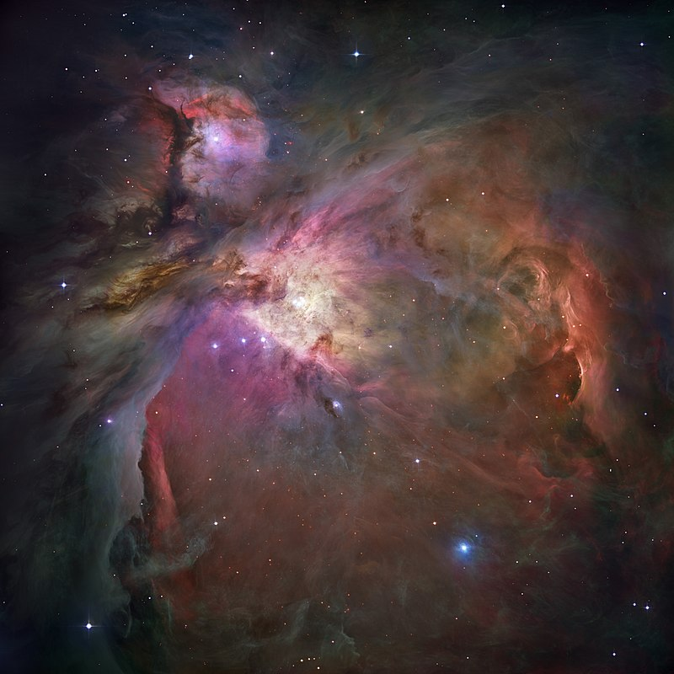
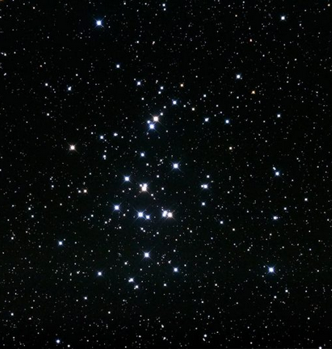
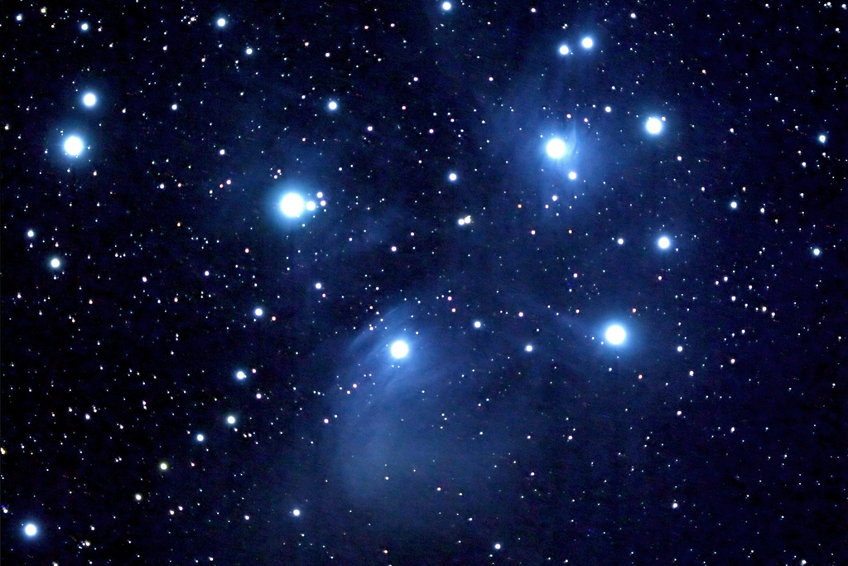
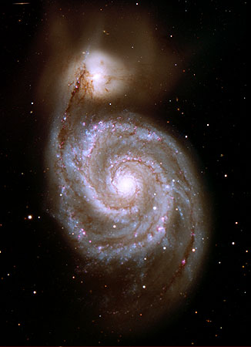
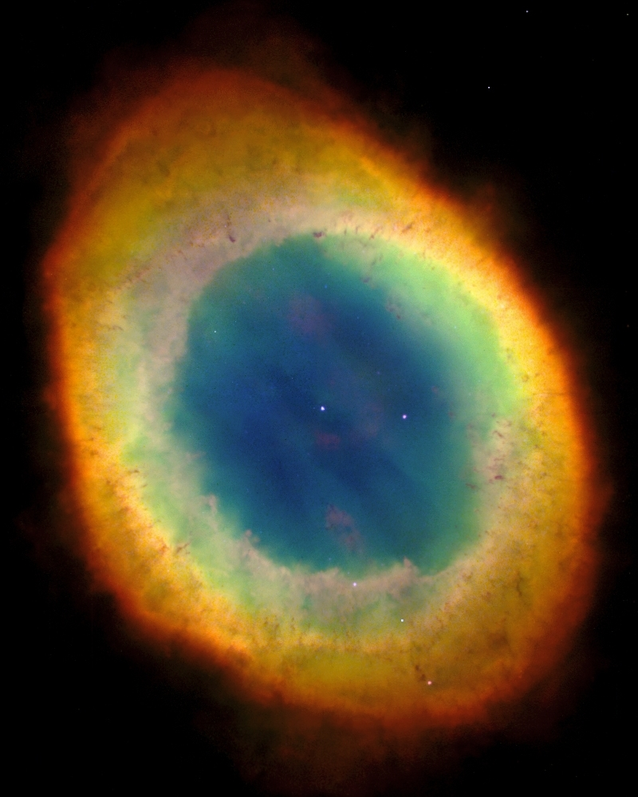
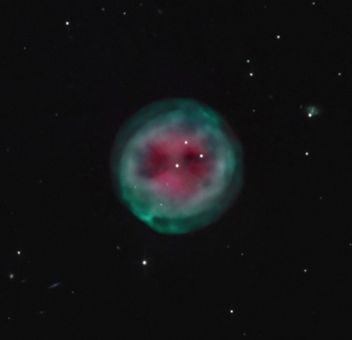
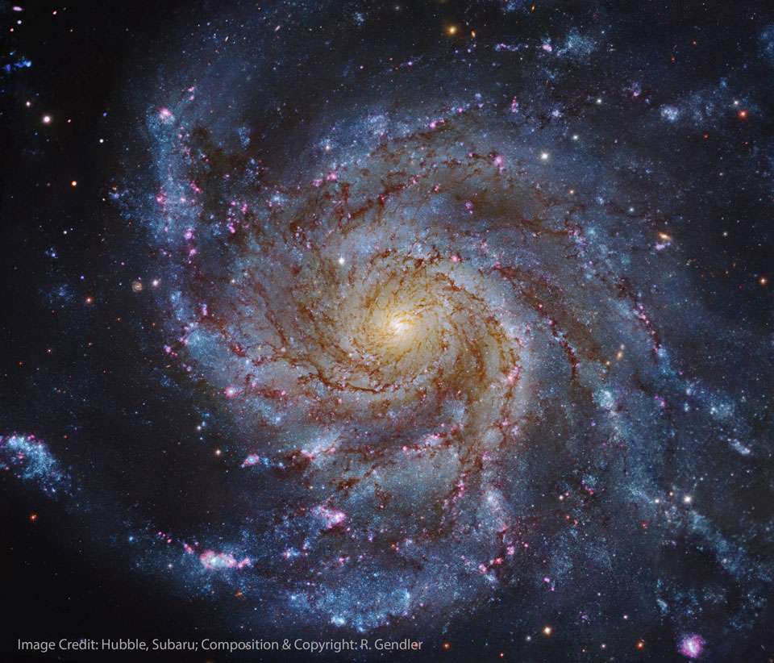
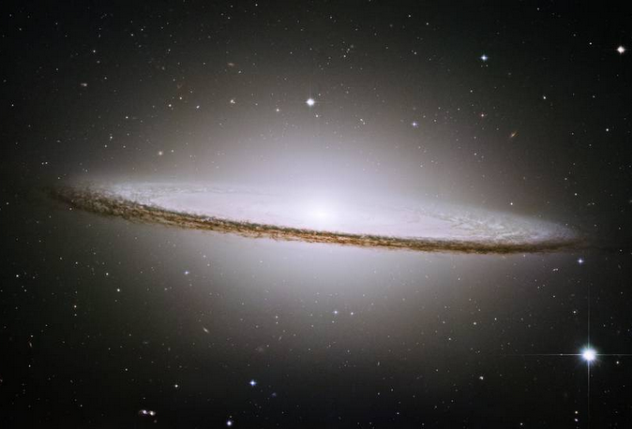
Messier Catalog Greatest Hits
M42
Orion Nebula
M44
Beehive Cluster
M45
Pleiades Cluster
M51
Whirlpool Galaxy
M57
Ring Nebula
M97
Owl Nebula
M101
Pinwheel Galaxy
M104
Sombrero Galaxy

Slide 12
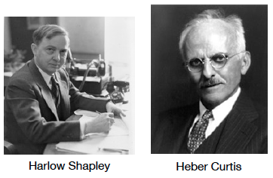
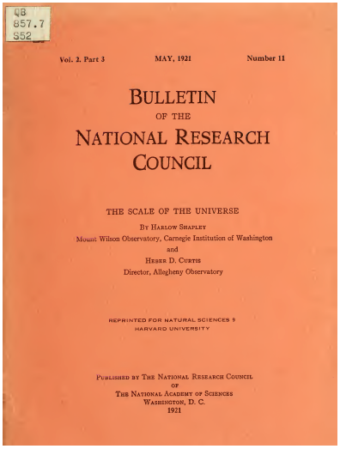
1920: The Great Debate
large MW small MW
Sun offset Sun centered
single galaxy many galaxies
3

Slide 13
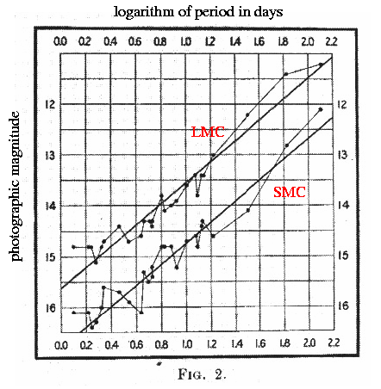
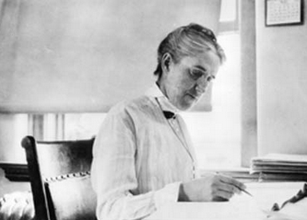
1912: Leavitt’s Law of Cepheids
Henrietta Leavitt
classified 1777 variables in LMC and SMC
47 as Cepheids
brighter ones had longer periods
the first standard candle
4
Notes:
delta Cephei (265 pc) is prototype, only closer Cepheid is Polaris (133 pc)

Slide 14
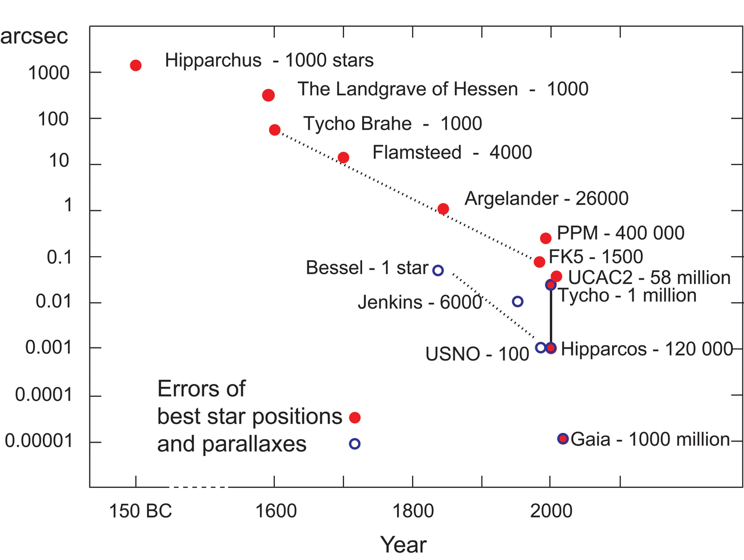
Gaia Leap
RECONS - 800
T
Notes:
Jenkins is 1952 YPC

Slide 15
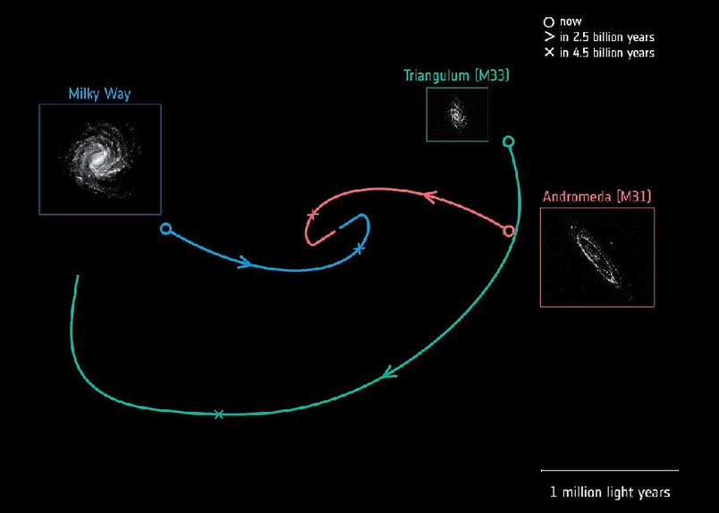
Gaia Predicts the Future
previously …
MW+And head-on in 3.9 Gyr
Tri+And first infall … or not?
1000s of stars in And+Tri
proper motions
new
MW+And
4.5 Gyr first pass
near miss at 120 kpc
Tri on first infall
also, And+Tri rotations
5
https://www.youtube.com/watch?v=nzhL4bgqkJY
van der Marel+ (2019)
Notes:
van der Marel predicted head-on collision at 3.9 Gyr … WRONG
The future orbital trajectories of three spiral galaxies: our Milky Way (blue), Andromeda, also known as M31 (red), and Triangulum, also known as M33 (green). The circle indicates the current position of each galaxy, and their future trajectories have been calculated using data from the second release of ESA's Gaia mission. The Milky Way is shown as an artist's impression, while the images of Andromeda and Triangulum are based on Gaia data. Arrows along the trajectories indicate the estimated direction of each galaxy's motion and their positions, 2.5 billion years into the future, while crosses mark their estimated position in about 4.5 billion years. Approximately 4.5 billion years from now, the Milky Way and Andromeda will make their first close passage around one another at a distance of approximately 400,000 light-years. The galaxies will then continue to move closer to one another and eventually merge to form an elliptical galaxy (image credit: Orbits: E. Patel, G. Besla (University of Arizona), R. van der Marel (STScI)

Slide 16
Milky Way Territories
DISK
30 x 0.3 kpc
100:1
arms
young
blue/white
2% metals
open clusters
gas/dust/* formation
merry-go round
last
BULGE
4 x 6 kpc
football
bar
mixed
yellow
massive BH
gas/dust ring
tilted ellipses
HALO
~ 100 kpc
~ spherical
edge?
old
red
0.02% metals
globular clusters
no gas/dust/planets
giant electron-like
first
size
details
stars
contents
motion
origin
6
Notes:
Sun is 98% H and He
As of 2019, lowest metallicity stars were SMSS 0313-6708 with Fe/H = -7.3 (Fe not detected) and SMSS 1605-1443 = -6.2 (Fe detected)

Slide 17
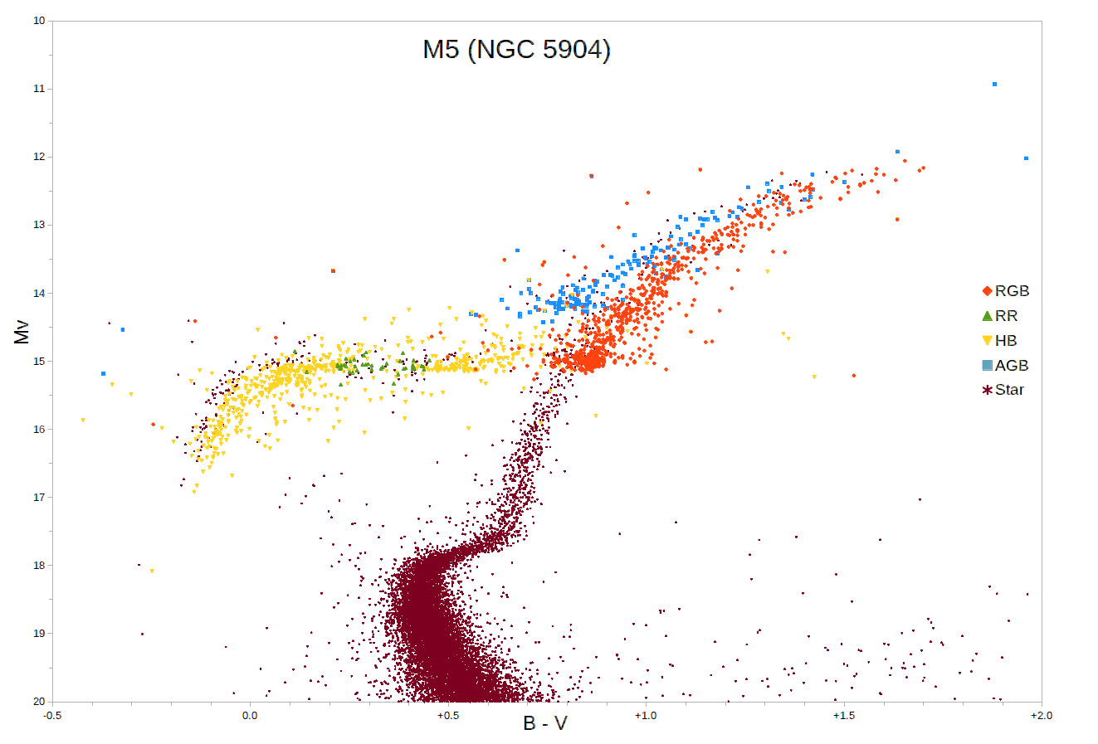
RR Lyraes
MW disk, globulars
P < 1 day
140,000 in Gaia DR2
35% new
(Clementini+ 2019)
297,000 in Gaia DR3
were:
G or K dwarfs
metal poor Pop II
shed mass in RG phase
now:
A or F subgiants
horizontal branch stars
~ 0.5 M
10^{1.5} L
3 types:
RRab steep rise (91%)
RRc sinusoidal
RRd double-mode pulsators
issues:
relatively faint
crowded fields/blending problems
diff metallicities … metal poor, longer P
7
Notes:
M5 is a globular cluster
note WRONG vertical axis … should be V (?)

Slide 18
Stellar Populations I
1 million stars
super
giant
I
bright
giant
II
(reg)
giant
III
sub
giant
IV
(reg)
dwarf
V
sub
dwarf
VI
O
B
A
F
G
K
M
< 1
300
10,000
18,000
50,000
110,000
750,000
300
1,000
5,000
10?
10?
8,000
20,000
W (Wolf Rayet) < 1
S+C (AGB )stars < 1
white dwarfs 55,000
neutron stars unknown
black holes unknown
T
Notes:
O stars --- maybe 20,000 in entire MW
B stars --- 4 within 100 light years = 30.7 pc

Slide 19
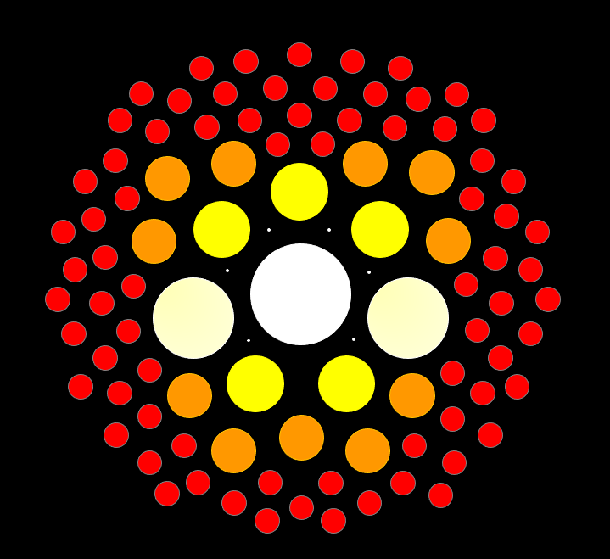
Stellar Populations
5 Characteristics
mass
age
composition
magnetism
rotation/convection
…
temperature
luminosity class
evolutionary state
…
(multiplicity)
T

Slide 20
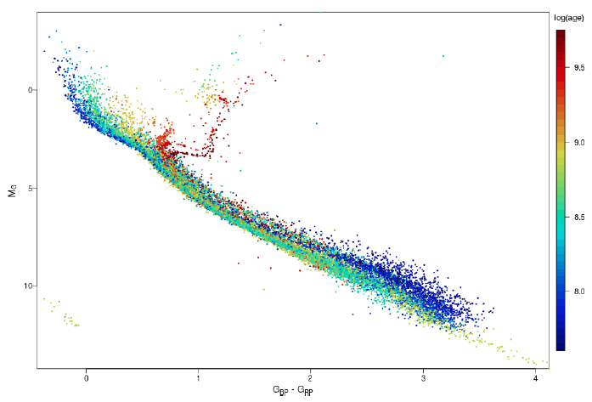
32 Open Clusters in Gaia
1
old clusters have RG branches
young clusters have
M dwarfs settling
onto main sequences
3
2
young clusters have
no white dwarfs yet
4
8
K0
M0
M3
Hyades
M5
GC/Babusiaux+ (2018)
Notes:
Red clump stellar properties vary depending on their metallicities, but typically have early K spectral types and T~5000 K. There is a considerable spread in the properties of red clump stars even within a single population of similar stars such as an open cluster, due to variations in temperatures and luminosities of horizontal branch stars when they form and as they evolve. Although red clump stars are generally hotter than red-giant-branch stars, the two regions overlap and the status of individual stars can only be assigned with a detailed chemical abundance study.

Slide 21
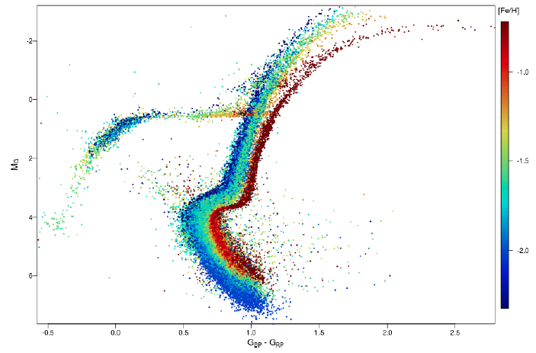
14 Globular Clusters in Gaia
metal-poor clusters have
blue horizontal branches
metal-rich clusters
have redder RG branches
1
2
1
3
blue
stragglers
formed later
not cluster members
collision/merger
mass transfer
formed later
not cluster members
collision/merger
mass transfer
9
Babusiaux+ (2018)

Slide 22
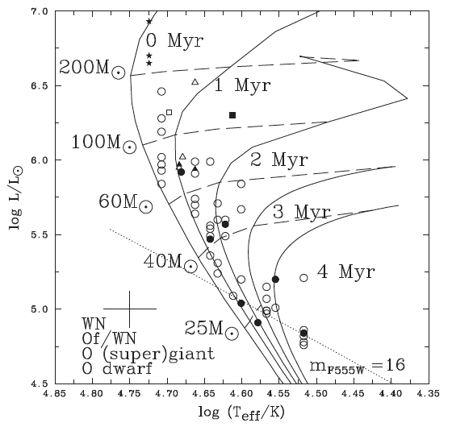
Largest Stars: HR Diagram
★
○
10
Notes:
starred points are Wolf-Rayet (WR) stars … WN = spectra dominated by nitrogen … WC = spectra dominated by carbon/oxygen
filled points are optical spectral types … open points are UV spectral types … both yield temperatures

Slide 23
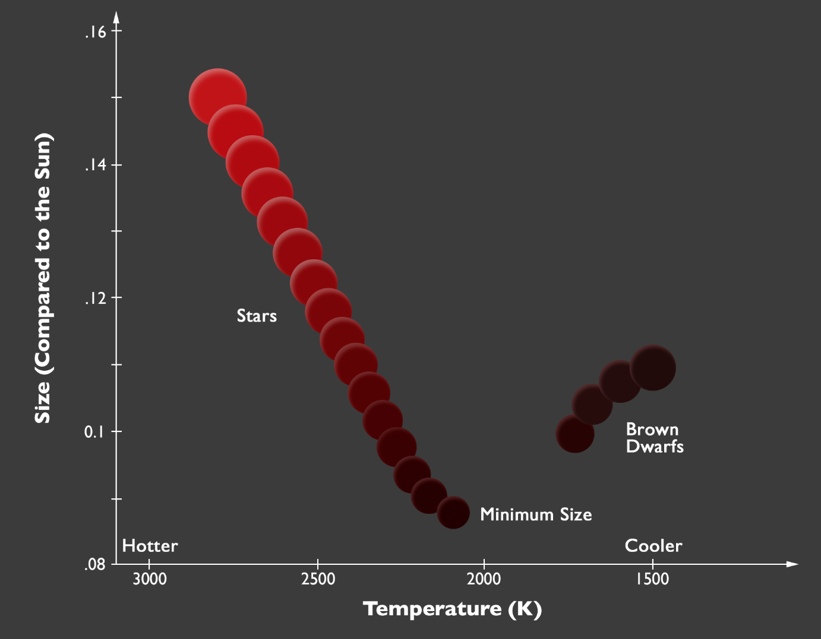
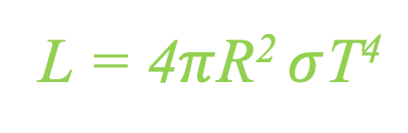
Smallest Stars
thermo equil e⁻ degeneracy
hydrogen
burning
limit
T
… or Luminosity
Dieterich/NOAO
Notes:
Stefan-Boltzmann Law

Slide 24
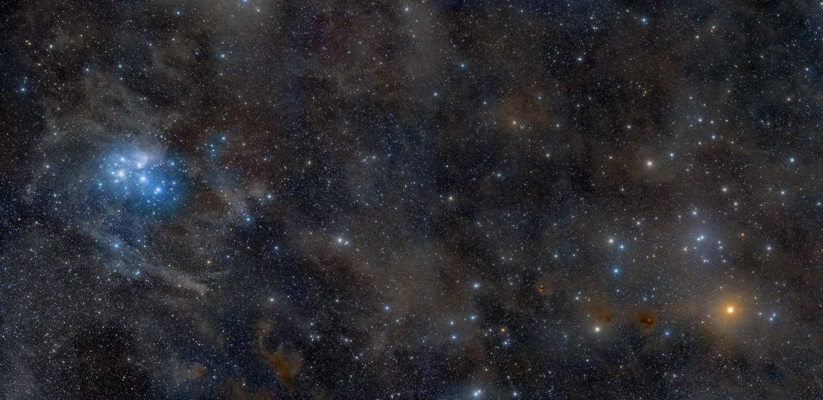
Milky Way Disk: Clusters
X
brightest *
B stars
brightest *
A/G/K giants
Hyades
47 pc (#1)
700 Myr
N ~ 700 within 30 pc of center
[Fe/H] = 0.05 to 0.14
image: Rogelio Bernal Andreo
Pleiades (M45)
135 pc (#2)
120 Myr
N ~ 850
[Fe/H] = 0.03 to 0.04
11
Notes:
Aldebaran K5III at 20 pc (1 of 24 giants within 25 pc), Hyades at 47 pc

Slide 25
Open Clusters
HOW MANY
1610: Galileo in Sidereus Nuncius
“the galaxy is nothing else but a mass of innumerable stars planted together in clusters”
1771: Messier had 26 open clusters
2020: ~ 2000 known in Milky Way … and 2000 more?
LABORATORIES
SAME DIFFERENT
age masses
metallicity evolutionary states
proper motions/RVs
distance/extinction
ATTRIBUTES
form via Giant Molecular Clouds … > 100,000 M… ~1000 in spiral
typical cluster output ~few hundred M
~ 10% efficiency rate of material conversion to stars
disrupted by GMCs, other clusters, themselves … old open clusters rare
12
Notes:
range of molecular cloud masses and cluster output … giants are enormous

Slide 26
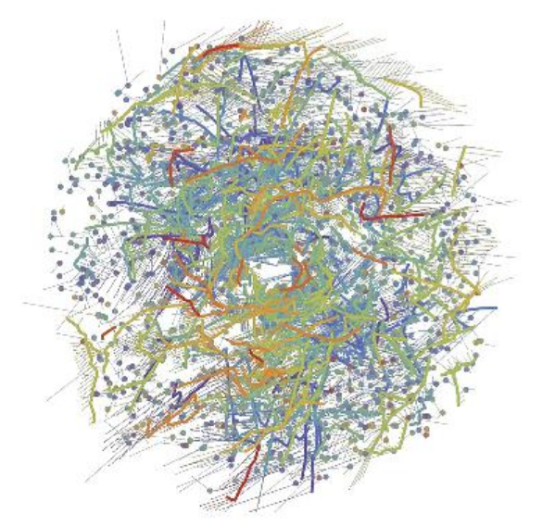
Gaia Clusters + Moving Groups
dots stellar clusters
lines comoving groups
dashed 5 Myr trajectories
(gap is artefact)
purple oldest … 1 Gyr
red youngest … < 100 Myr
1312 clusters/associations/groups
328 strings
1 kpc
13
Kounkel & Covey (2019)
Notes:
This diagram shows a face-on view of stellar ‘families’ – clusters (dots) and co-moving groups (thick lines) of stars – within about 3000 light-years from the Sun, which is located at the center of the image. The diagram is based on data from the second data release of ESA’s Gaia mission. Each family is identified with a different color and comprises a population of stars that formed at the same time. Purple hues represent the oldest stellar populations, which formed around 1 billion years ago; blue and green hues represent intermediate ages, with stars that formed hundreds of millions of years ago; orange and red hues show the youngest stellar populations, which formed less than a hundred million years ago. Thin lines show the predicted velocities of each group of stars over the next 5 million years, based on Gaia’s measurements. The lack of structures at the center is an artefact of the method used to trace individual populations, not due to a physical bubble. Image credit: M. Kounkel & K. Covey (2019)

Slide 27
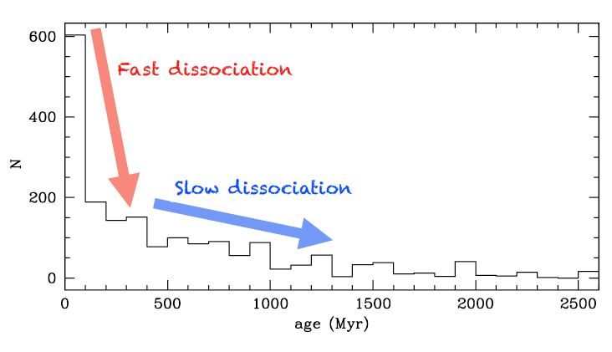
Cluster Dispersal
MASS LOSS
dying stars ~ 30% mass lost
winds, SNe
STELLAR EVAPORATION
mass segregation
star-star scattering
tidal stripping
linear ages
14
Why do clusters disperse?

Slide 28
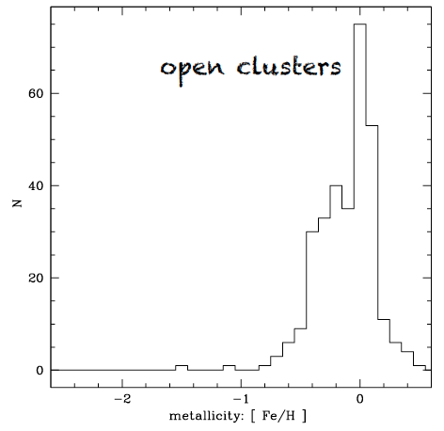
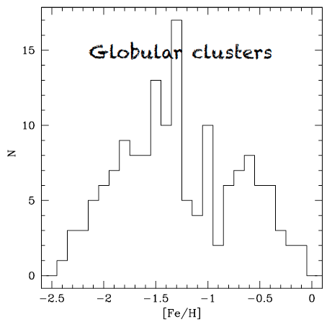
Cluster Metallicities
What do you conclude?
1
open clusters MUCH more metal rich than (most) globulars

Slide 29
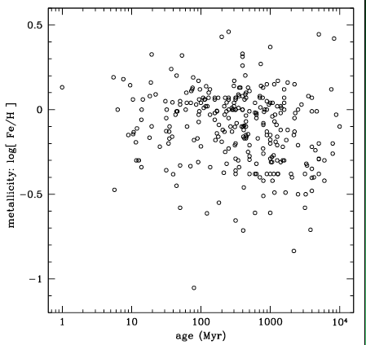
Open Cluster Metallicities
What do you conclude?
2
no clear correlation between metallicity and age

Slide 30
Milky Way Neighborhood (2024)
 | RA | DEC | Size (kpc) | Dist (kpc) | Bits / # Globulars / References
Milky Way | --- | --- | 40 | 0 | warp, bar, 2-4 arms, LMC, SMC, Sgr dSph, ~150 globulars
Andromeda M31 | 00:43 | +41:16 | 50 | 730 | warp, bar, 2? arm / ring, M32, M110, ~460 globulars
Triangulum M33 | 01:33 | +30:39 | 19 | 912 | AGN, flocculent, 54 globulars
Bode’s M81 | 09:55 | +69:03 | 27 | 3675 | AGN low-luminosity, thick disk only?, N globulars
Pinwheel M101 | 14:03 | +54:20 | 59 | 6500 | Nearly face-on, circular, > 10^12 stars, 150 globulars
Whirlpool M51 | 13:30 | +47:13 | 38 | 7800 | M52 companion, bridge starburst
3

Slide 31
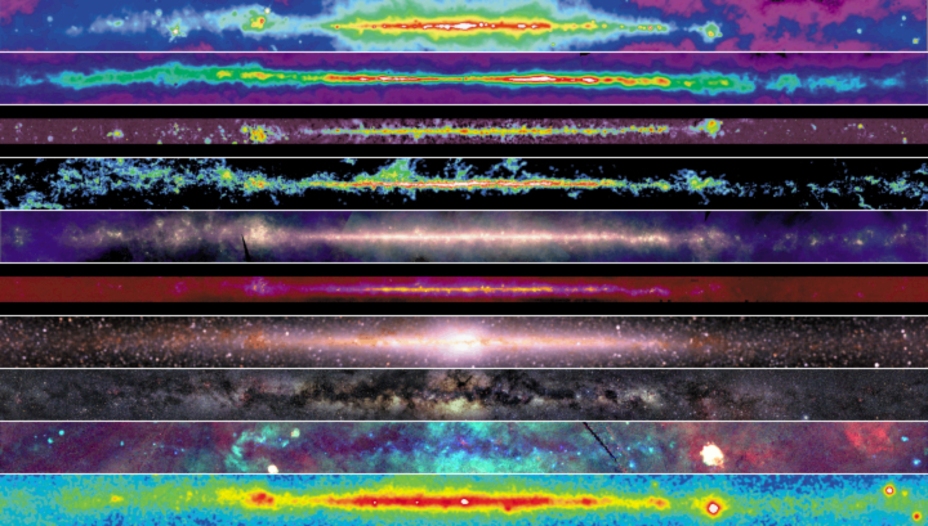
Milky Way Disk
R
R
R
R
I
I
I
V
X
G
4

Slide 32
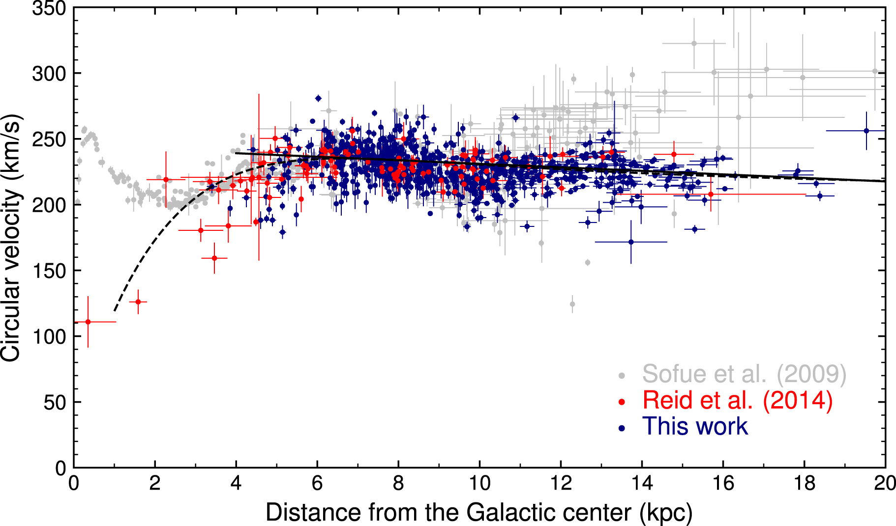
Rotation Curve
3 kpc dip
9 kpc dip
sum
bulge disk
halo
5
773 Cepheids
distances from infrared P-L relations (WISE and Spitzer)
Gaia proper motions and radial velocities
Mroz+ (2019)
Notes:
mid-infrared P-L relations key … you can see the Cepheids far away
Rotation curve of the Milky Way for Cepheids assuming R₀ = 8.09 kpc and Θ₀ = 233.6 km s⁻¹ (model 2). Red data points represent high-mass star-forming regions (Reid et al. 2014). Gray data points are taken from Sofue et al. (2009) and are rescaled to new (R₀, Θ₀) using formula . Solid and dashed lines show the best-fitting models (linear and universal, respectively).

Slide 33
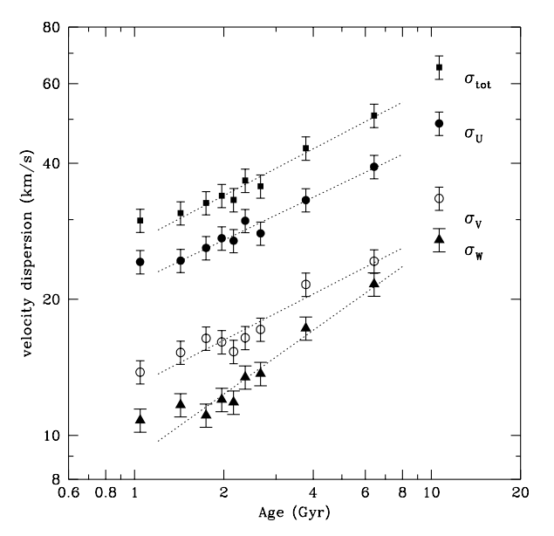
Ages ~ Velocity Dispersion
~ 14000 F/G dwarfs
Hipparcos/Tycho astrometry
~ 63000 RV measurements
ages from isochrone fits
Nordstrom et al. 2004
6
What is this process called?
ANSWER: thin disk heating by GMCs and spiral arms
Notes:
bubble data not fit --- unrelaxed young structures and thick disk stars

Slide 34
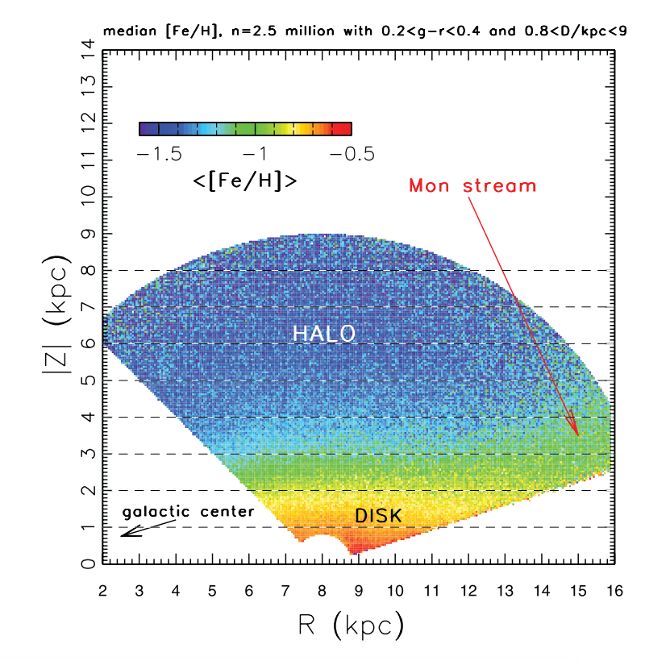
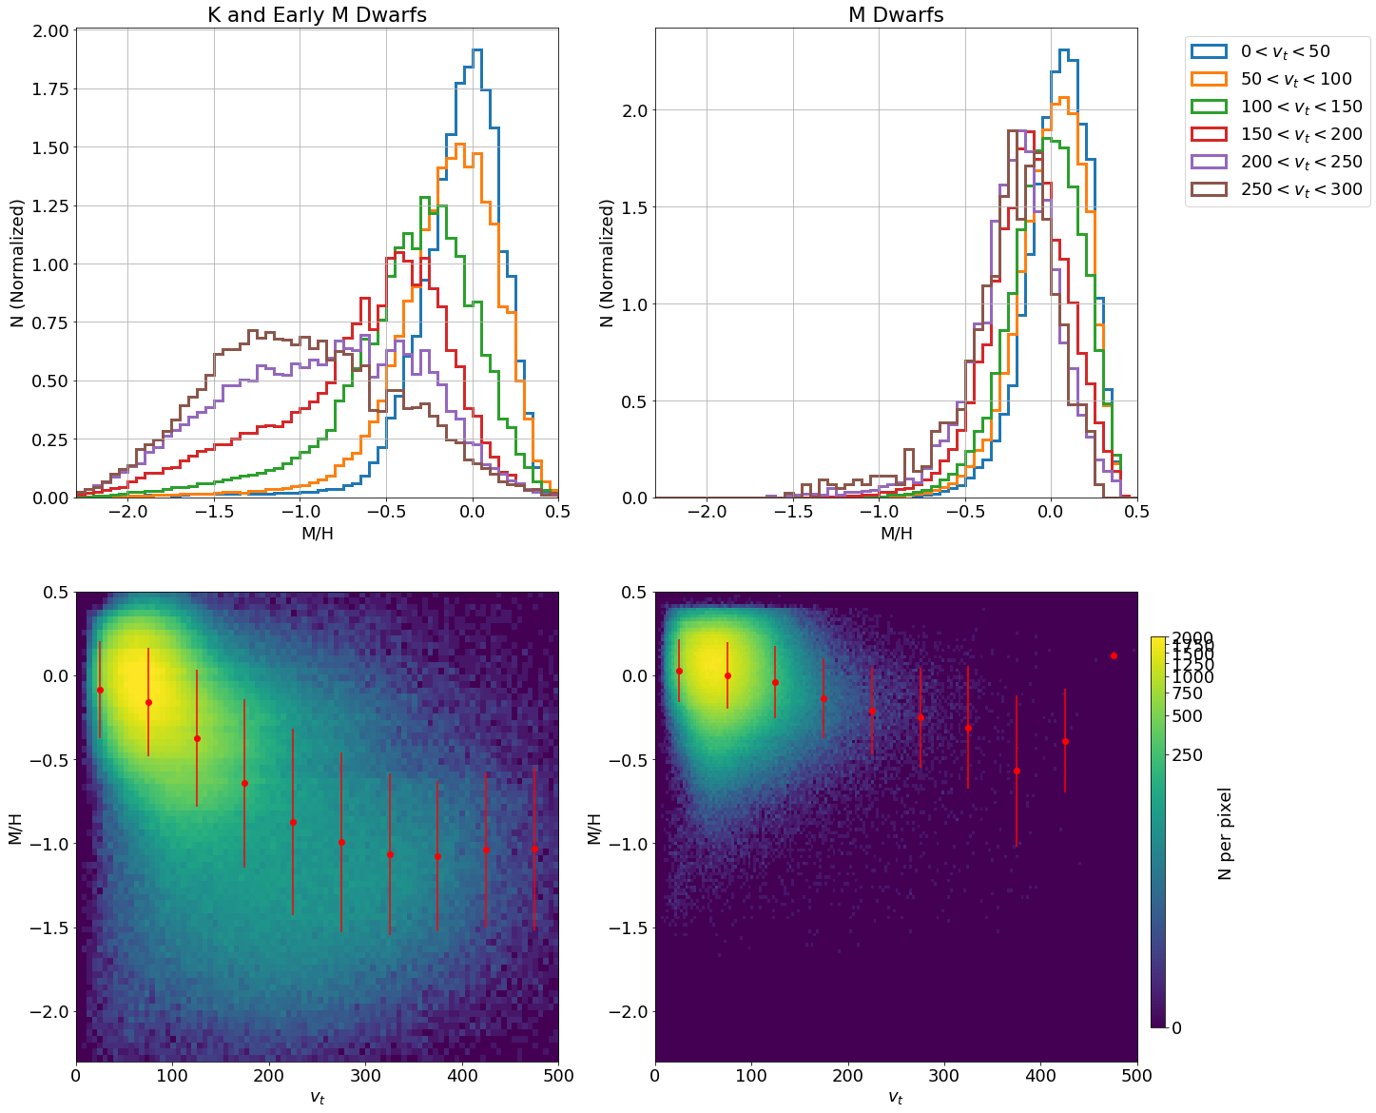
Metallicities and Motions
Ivezic et al. 2008
Medan et al. 2021
How does metallicity change vertically?
How does metallicity change horizontally?
What does this plot show?
What would it look like for OB stars?
7

Slide 35
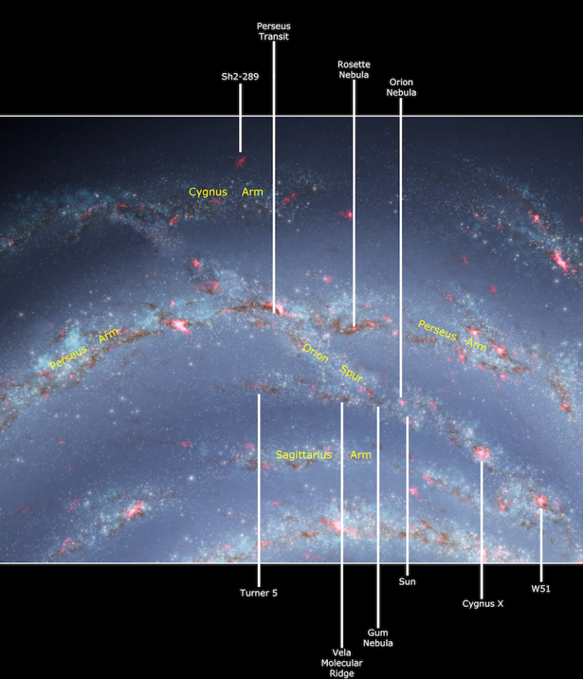
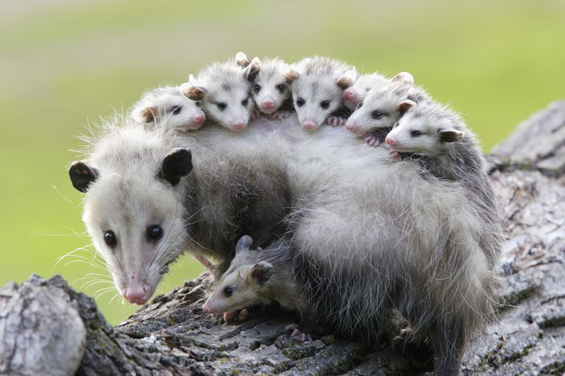
You Are
Here
Outer
Outer
Perseus*
Orion
Sagittarius
Scutum*
UM …
(Norma/Molec.Ring)
*major arms
= OPOSSUM
8
Scutum
Notes:
alphabetical except for Orion Spur

Slide 36

Arms via Masers
Reid+ (2009) … 18 masers
Reid+ (2014) … 103 masers
4 kpc … bar region
8 kpc … solar circle
12 kpc… co-rotation of spiral
pattern and star orbits
Outer Arm
Perseus Arm
Orion Arm
Sagittarius Arm
Scutum Arm
4 kpc 8 kpc 12 kpc 16 kpc
9
Notes:
long vectors radiate from Sun for distance uncertainties
yellow = inner Galaxy sources … open circles = arm assignment unclear

Slide 37


Galactic Center: 2002
astrometry 1992-2002
SO-2 orbital P = 15.2 yr
pericenter 17 light hours
M_{BH} = 3.7 (1.5) X 10⁶ M⦿
10

Slide 38

MW Bulge/Bar: Star Counts
Weiland+ (1994)
bulge is flattened ellipse … asymmetries due to bar
mapping with
DIRBE on COBE
4 near-IR wavelengths
sampling stars, not gas
What do you see?
model by Dwek+ (1995)
boxy Bar
rotated by 20º
to Sun-GC line of sight
NO tilt, peanut
11
SS dust removed ISM extinction removed Disk model removed

Slide 39

MW Bulge/Bar: Boxy Peanut with X
putting it all together … (Gonzalez and Gadotti review 2016)
3.6 x 1.1 x 0.6 in
1.0 x 0.3 x 0.2 !!!
length 3.1 to 3.5 kpc
near end pointing toward positive l
axial ratios of bar ~ 1.0 x 0.4 x 0.3
angle Sun-GC ~ 20-40º
long bar (?) 4.0 to 4.5 kpc … ratios ~ 1.0 x 0.15 x 0.03 at ~ 45º
or maybe just transition to spiral arms
(double bars not seen in external galaxies)
T
but wait … RR Lyraes

Slide 40


MW Bulge/Bar: Gaia
Anders+ (2019) … Gaia DR2 … G < 18.0
10.8 million Red Clump stars
Bar ~4 kpc long
Bar ~40º twisted from Sun-GC line
Anders+ (2022) … Gaia EDR3 … G < 18.5
13.8 million Red Clump stars
Bar 4.07 kpc long / 0.76 kpc wide
Bar 27º twisted from Sun-GC line
12

Slide 41

GCs: Sizes/Shapes
13
GC size related to distance from Galactic center
small/dense clusters survive larger tidal forces … or have been stripped

Slide 42


GC Ages
ages from isochrone fits
some ages > 13.7 Gyr
GCs are oldest MW components
more metal rich are older
say what?
another factor at play …
14
Roediger+ (2014)
Notes:
Left: Adopted age distribution for the S05 GGC sample based on either MF09 alone (black), or MF09 plus additional sources of age information in the literature (for those clusters not studied by MF09; dark gray). The shaded region corresponds to ages in excess of that of the universe (Komatsu et al. 2011).

Slide 43

SDSS Tidal Streams
SDSS “Field of Streams”
halo stars … color indicates distance, intensity indicates #stars
Sagittarius … from dwarf galaxy
Orphan … from Ursa Major dwarf galaxy (maybe)
Monoceros Ring … encircles MW disk
Palomar 5 … shown in GC discussion
+ new MW companions in circles (2 GCs + dwarf galaxies)
+
Notes:
Hercules and Virgo have overdensities

Slide 44


MW Construction
Gaia-Enceladus = Gaia-Sausage
SDSS + Gaia DR2
orbits have e ~ 0.9
[Fe/H] > -1.7
merger 8-11 Gyr ago
+ 5 X 10⁹ M $⊙$ in stars
+ at least 8 globulars to MW
puffed up thin disk to thick disk
new gas collapsed to thin disk
Helmi+ (2018)
Deason+ (2018)
Myeong+ (2018)
Belokurov+ (2018)
+
Notes:
Enceladus was offspring of Gaia (but so were a lot of folks … dumb name)
more mass added in gas and dark matter

Slide 45
A Better Galactic Structure Course
Milky Way Components
Disk
Stars and Gas
Populations
Arms/Warp
Thin vs. Thick
Bulge
Bar
X
Galactic Center
Halo
LMC/SMC
Globular Clusters
Tidal Streams
Dwarf Galaxies
Dark Matter

