Slide 1
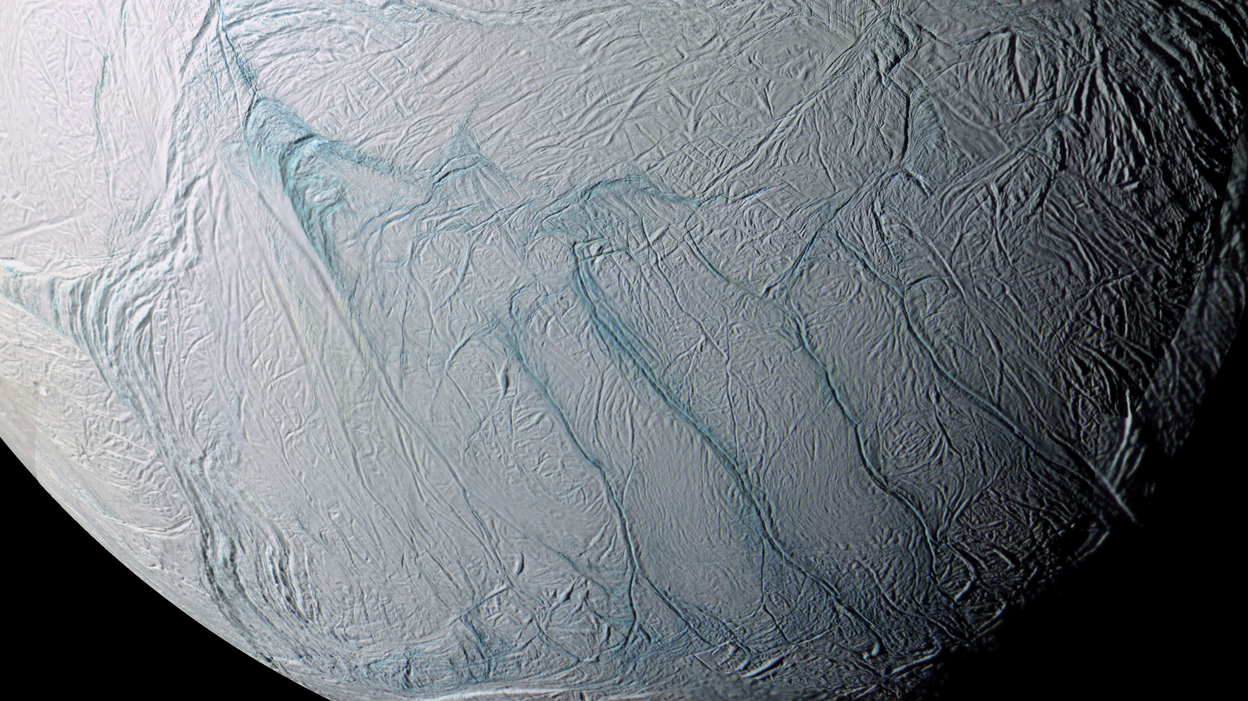
Where is this?
Notes:
ENCELADUS by CASSINI

Slide 2
ASTRONOMY 8850:
Planetary Sciences
Why Sciences?

Slide 3
How to do well in
Planetary Sciences
1. show up to class … on time
2. participate in class
3. get/borrow the book Planetary Sciences by de Pater and Lissauer
4. find course website: www.astro.gsu.edu/~thenry/PLANETS
5. find Icarus and Planetary Science Journal (AAS) online
6. do homework --- Solar System Explorers, quiz preparation, etc.
7. choose 2 planetary topic(s) of interest to you
write down 3 sentences for each topic
DUE THURSDAY, 03 SEP
8. NAIL THE SEMESTER PROJECT --- start EARLY

Slide 4
Grades in
Planetary Sciences
class participation 10%
Solar System Explorers (SSE!) 10%
paper Levels (drafts) 20%
presentation 20%
referee reports (colleagues) 20%
referee report (Henry) 20%

Slide 5
Solar System Explorers 2026
Rules:
Goal is roughly once each week (Thursdays).
You will know the topic a week in advance.
You will draw one mini-Mars each week. You will answer the week’s question in order of your mini-Mars values. The value on your mini-Mars determines the number of points you can earn that round: 1-5 earns 1 point, 6-10 earns 2 points, 11-15 earns 3 points, mega-Mars 16 earns 4 points.
You may not re-use or re-attempt an answer already mentioned. Be careful not to effectively repeat an answer already given.
5. You must be clear in your answer, and I will be the final judge of whether points will be awarded. Partial points may be awarded.
Results will be posted on the course website.
This game is for learning and fun,
NOT for bickering, backstabbing, or browbeating …
but it does affect your grade (slightly).

Slide 6
Solar System Explorers 01
Welcome to the realm of mini-Mars(es) and mega-Mars …
Tell us something about the Solar System we should all know.
DUE NOW! 25 AUG

Slide 7
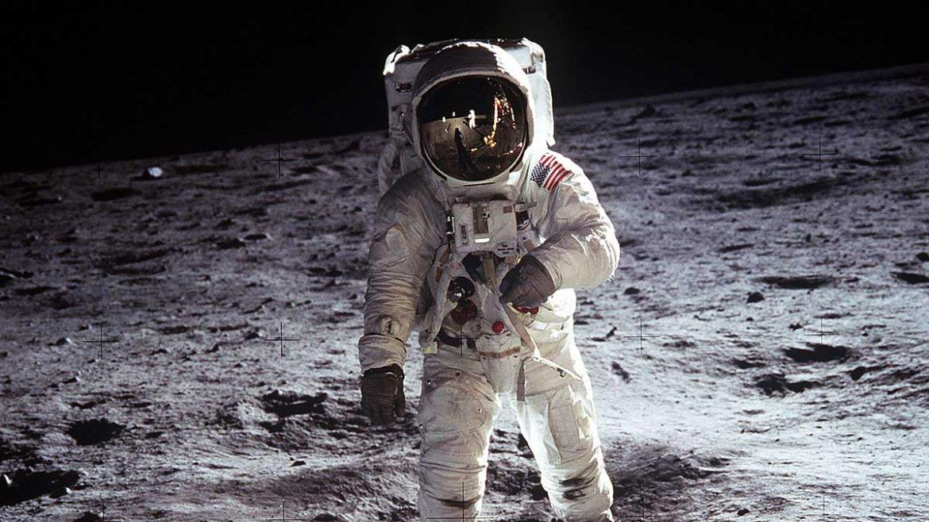
Solar System Overview I

Slide 8
Solar System Inventory
stars
planets
moons
ring systems
minor planets
Centaurs
Trans-Neptunian Objects
comets (any type)
dust
1
8
456ª JPL 2026 AUG 24
4 (+2)
1,558,811 JPL 2026 AUG 24
785,048 JPL 2018 AUG 20
1,045 JPL 2026 AUG 24
432 JPL 2018 AUG 20
7,285 JPL 2026 AUG 24
2,559 JPL 2018 AUG 20
4,073 JPL 2026 AUG 24
3,535 JPL 2018 AUG 20
some
Jup 115
Sat 293
ª add 5 for Pluto
Notes:
2024: 288 from EAR = 1 … MAR = 2 … JUP = 95 … SAT = 145 … URA = 29 … NEP = 16 … (PLU = 5)
2026: 456 from EAR = 1 … MAR = 2 … JUP = 115 … SAT = 293 … URA = 29 … NEP = 16 … (PLU = 5)
2026: rings … Centaur Chariklo and TNO Haumea confirmed to have rings … Centaur Chiron does not have stable rings. Rhea does not have rings.
via JPL 2015 JAN 12:
670,480 minor planets
295 Centaurs
1644 TNOs
3319 comets

Slide 9
Nomenclature
terrestrials
Mercury, Venus, Earth, Mars
many moons
jovians
gas giants
Jupiter, Saturn
ice giants
Uranus, Neptune
minor planets
asteroids
Main Belt
Near-Earth Objects (NEOs)
Trojans and Greeks (SSE!) … and Hildas
Trans-Neptunian Objects (TNOs)
Plutinos (Classical) Kuiper Belt Objects (KBOs)
Centaurs Scattered Disk Objects (SDOs)
comets
Jupiter-family, Chiron-type, Halley-type …
Notes:
Jupiter family < 20 years … Chiron-type T_Jup > 3 and a > a_Jup … Halley 20-200 years

Slide 10
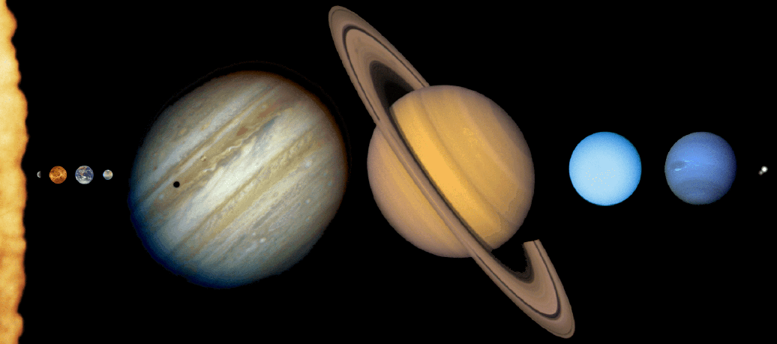
Solar Family
How are they different?

Slide 11
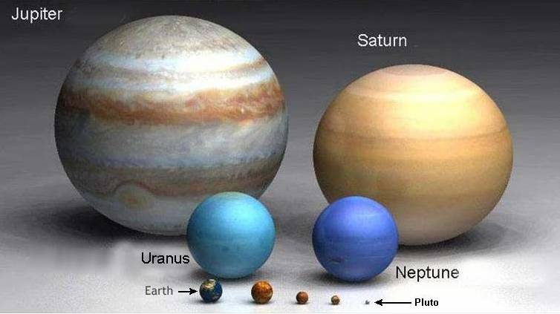
Jovians and Terrestrials
Notes:
naked Saturn is useful

Slide 12
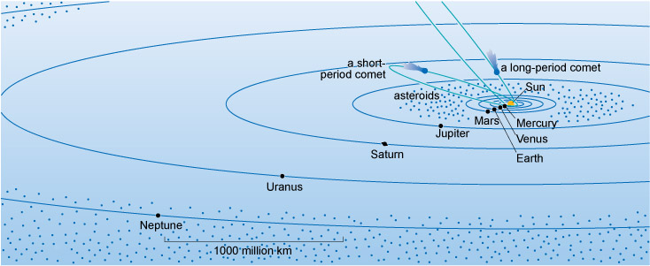
Planet Spacing

Slide 13
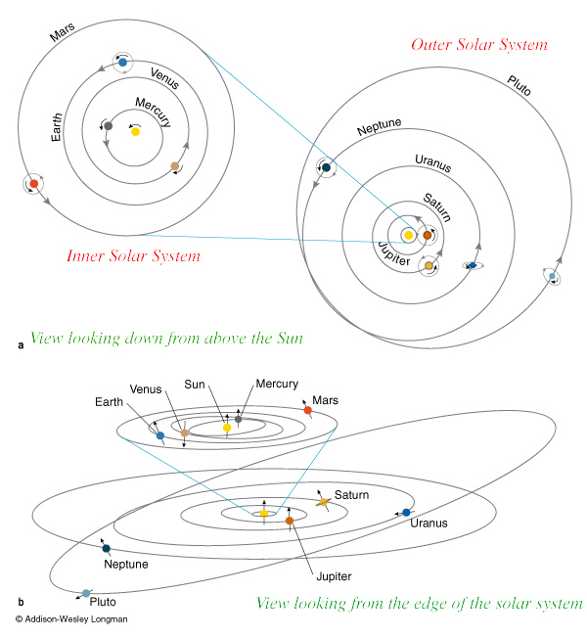
Planet Orbits
Notes:
Venus is most circular with e = 0.007

Slide 14
Planet Orbits
Mercury
Venus
Earth
Mars
Jupiter
Saturn
Uranus
Neptune
a (AU)
0.39
0.72
1.00
1.52
5.20
9.54
19.19
30.07
SSE! (hands up!)
Which equation on the sheet would you use to get orbital periods?
Notes:
Venus is most circular with e = 0.007

Slide 15
Planet Orbits
Notes:
Venus is most circular with e = 0.007

Slide 16
Planet Orbits
Mercury
Venus
Earth
Mars
Jupiter
Saturn
Uranus
Neptune
a (AU)
0.39
0.72
1.00
1.52
5.20
9.54
19.19
30.07
P (yr)
0.24
0.62
1.00
1.88
11.86
29.46
84.01
164.79
e
0.206
0.007
0.017
0.093
0.048
0.056
0.046
0.009
SSE! (hands up!)
Which equation on the sheet would you use to get orbital periods?
Notes:
Venus is most circular with e = 0.007

Slide 17
Solar System Explorers 02
Tell us something ELSE about the Solar System we should all know.
DUE NOW! 25 AUG

Slide 18
Solar System Explorers 03
Find any Icarus or Planetary Science Journal article relevant to one of your 2 topics of interest.
Email me a .pdf of the full article by the beginning of class:
DUE THURSDAY, 03 SEP
Get 5 points in Solar System Explorers.

Slide 19
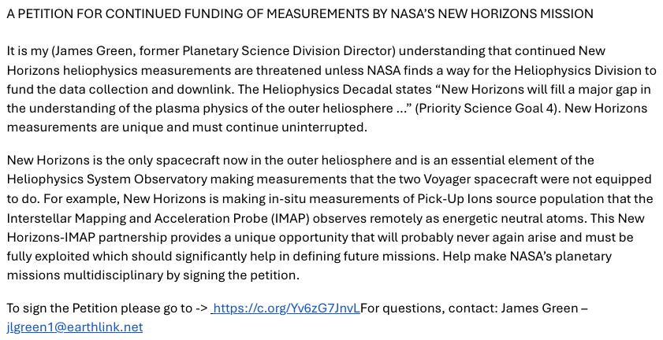
Save New Horizons Data!
map of where things are
https://eyes.nasa.gov/apps/solar-system/#/home
Notes:
Venus is most circular with e = 0.007

Slide 20
…………………………

