Slide 1
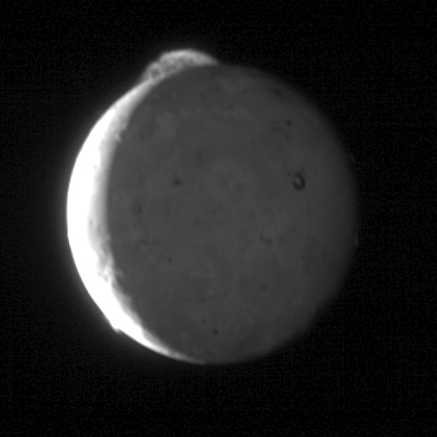
Where is this?
Notes:
This five-frame sequence of New Horizons images captures the giant plume from Io's Tvashtar volcano. Snapped by the probe's Long Range Reconnaissance Imager (LORRI) as the spacecraft flew past Jupiter over an 8-minute span, with two minutes between frames, from 23:50 to 23:58 Universal Time on March 1, 2007. Io was 3.8 million kilometers (2.4 million miles) from New Horizons.
This first-ever "movie" of an Io plume clearly shows motion in the cloud of volcanic debris, which extends 330 kilometers (200 miles) above the moon's surface. Only the upper part of the plume is visible from this vantage point -- the plume's source is 130 kilometers (80 miles) below the edge of Io's disk, on the far side of the moon. The knots and filaments that allow us to track the plume's motion are still mysterious, but this movie is likely to help scientists understand their origin, as well as provide unique information on the plume dynamics.
Io's hyperactive nature is emphasized by the fact that two other volcanic plumes are also visible off the edge of Io's disk: Masubi at the 7 o'clock position, and a very faint plume, possibly from the volcano Zal, at the 10 o'clock position. Jupiter illuminates the night side of Io, and the most prominent feature visible on the disk is the dark horseshoe shape of the volcano Loki, likely an enormous lava lake. Boosaule Mons, which at 18 kilometers (11 miles) is the highest mountain on Io and one of the highest mountains in the solar system, pokes above the edge of the disk on the right side.
The pictures were part of a sequence designed to look at Jupiter's rings, but planners included Io in the sequence because the moon was passing behind Jupiter's rings at the time.

Slide 2
Homework
THURSDAY, 03 SEP --- HAND IN
write 3 sentences each on 2 topics
you might want to explore for your project
THURSDAY, 03 SEP --- EMAIL
.pdf of Icarus or Planetary Science Journal article
by the beginning of class
5 SSE! points

Slide 3
Spaceship Name!
TUESDAY, 08 SEP
5 SSE! points

Slide 4
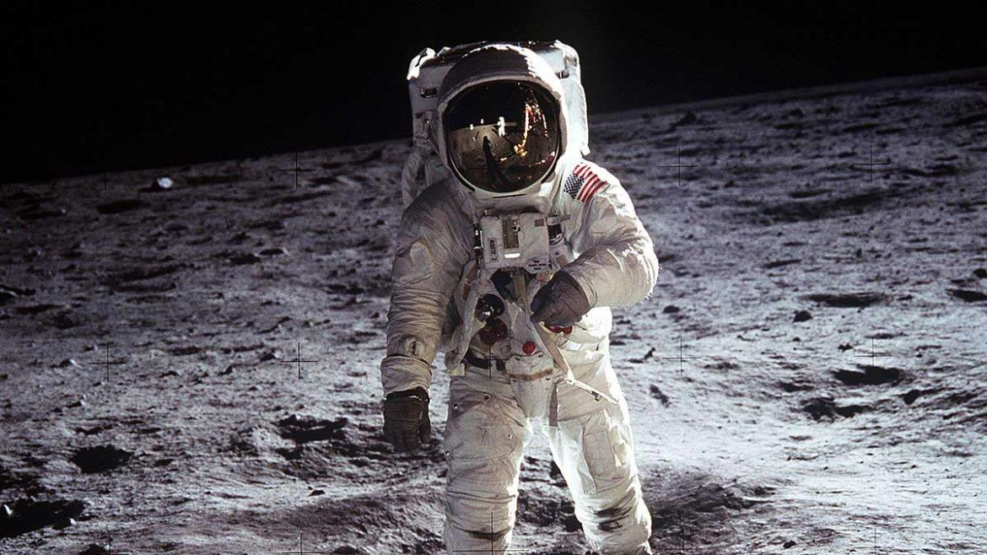
Solar System Overview III
Notes:
Buzz Aldrin Apollo 11

Slide 5
Planet Characteristics
Characteristic Terrestrial Jovian
location
spacing
mass
size
density
composition
surface
albedo
rotation
magnetics
moons
rings
0.4-1.5 AU 5.2-30.1 AU
close wide
0.05-1.0 Earths 14.5-318 Earths
0.4-1.0 Earth radii 3.9-11.2 Earth radii
3.9-5.5 g/cm³ 0.7-1.6 g/cm³
rocky gaseous/icy
solid any?
0.1-0.7 0.4-0.5
slow fast
none/weak strong (integrated)
none/few many
none all
Notes:
0.05 Earth masses = Mercury
Jupiter rotates in 9:56 hours … Saturn 10:42 … Uranus 17:14 … Neptune 16:06

Slide 6
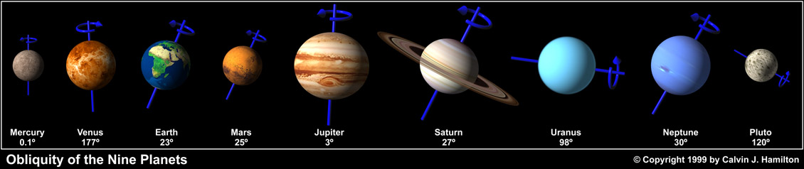
obliquities (tilts)
SSE! (hands up!)
What is the technical term for what we are measuring here?

Slide 7
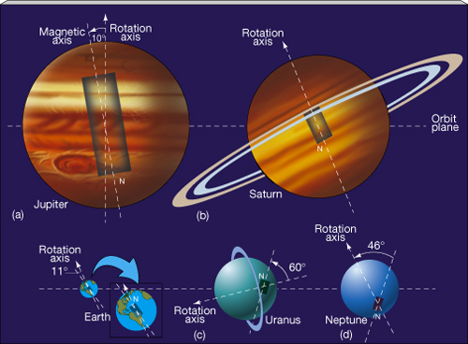
bizarre bar magnets

Slide 8
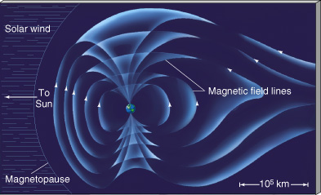
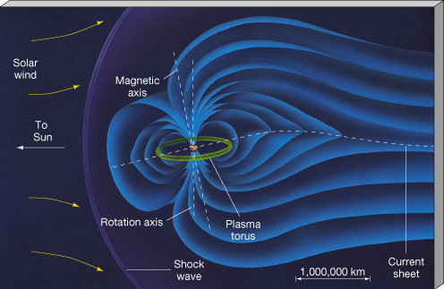
magnetospheres
Earth has strongest terrestrial
surface mag field = 0.3 G
mag moment = 8x10²⁵ G/cm³
enough to protect us from charged particles
Mercury, Ganymede wimpy
Venus, Io, Europa, Callisto induced
Mars patchy crustal
Jupiter has strongest jovian
surface mag field = 4.3 G
mag moment = 20000X Earths
affects all Galilean satellites
Io plasma torus complicates
Sat/Ura/Nep surface mag fields similar strength to Earth’s
Notes:
solar UV releases electrons to create Venusian ionosphere, which interacts with solar wind

Slide 9
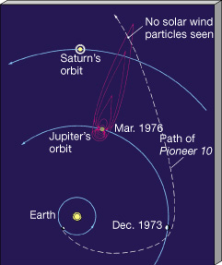
Jupiter’s magnetotail

Slide 10
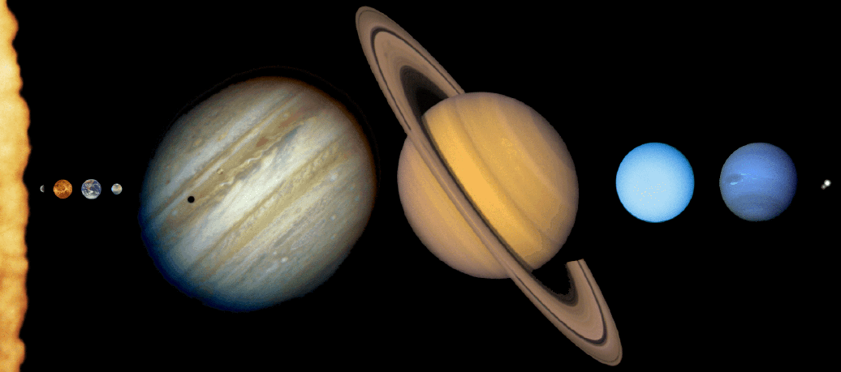
trends in the Solar System
size with distance from the Sun
composition with distance
spacing of planets with distance
# moons with planet mass
rotation speeds with mass
integrated magnetic fields with mass
non-trends in the Solar System
surface gravities not radically different
obliquities do not behave
7 large moons are worlds of their own: SSE! (hands up!)
Moon, Io, Europa, Ganymede, Callisto, Titan, Triton
What about the small bodies?

Slide 11
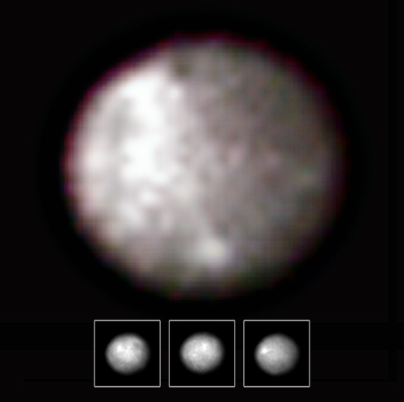

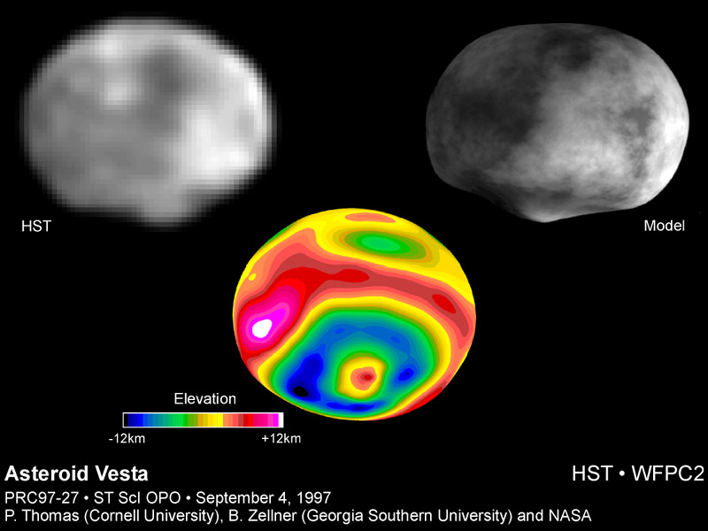
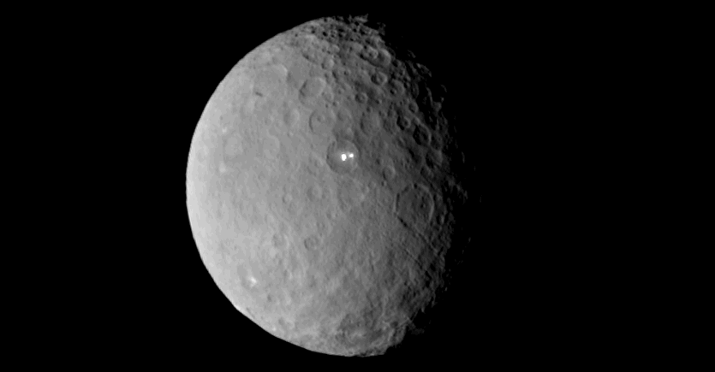
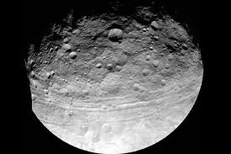
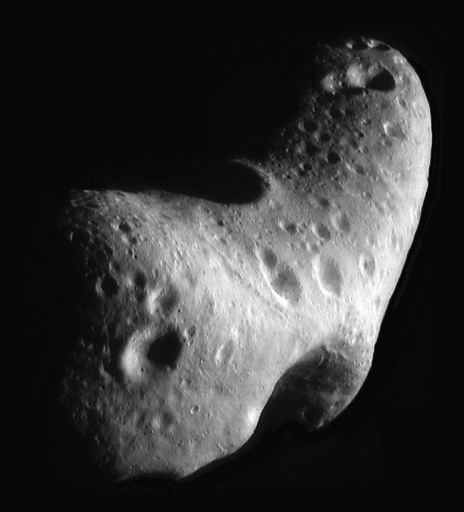
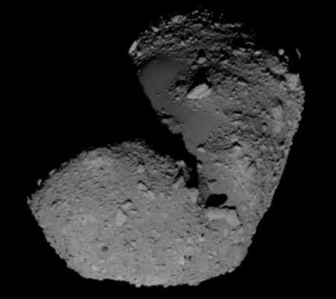
Asteroids
Ceres
940 km
Vesta
530 km
SSE! hands up!
Eros
33x13x13 km
Itokawa
0.5x0.3x0.2 km
Notes:
DAWN took Ceres and Vesta movies.
Ceres white spots are sodium carbonate, good for washing clothes …
NEAR spacecraft took Eros image.
HAYABUSA spacecraft took Itokawa image.

Slide 12
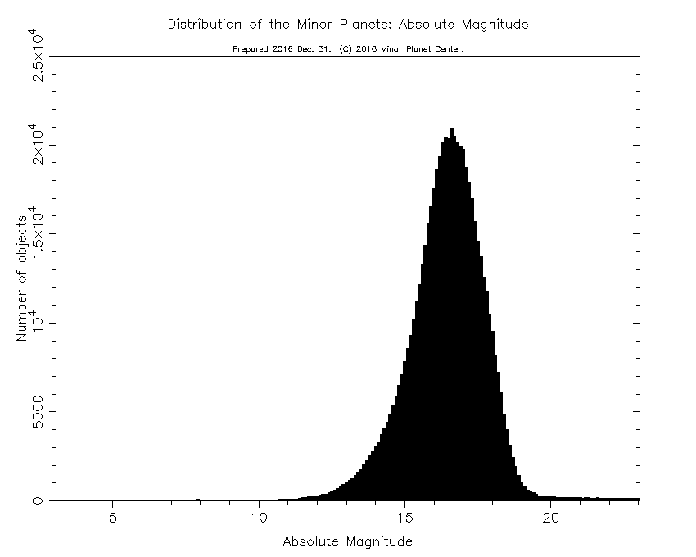
Absolute Magnitude = H
V magnitude if 1 AU from Earth and 1 AU from Sun
while having phase angle of 0 degrees
(an impossible scenario)
H = 16 means diameter of 2-4 km
Notes:
estimate size from H, but varying albedos lead to different size estimates

Slide 13
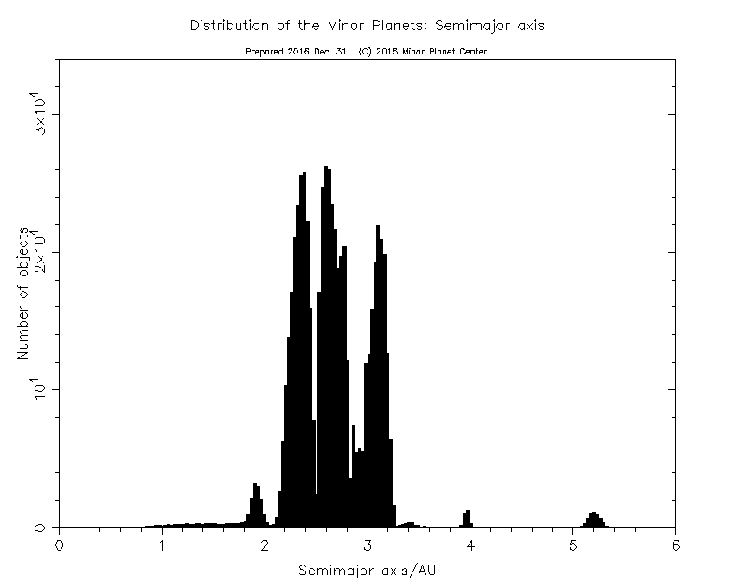
Asteroids
semimajor axis
Asteroid
orbital
semimajor axes
Trojans L4 + L5
Venus has 1?
Earth has 1 + 0 2?
Mars has 2 + 16
Jupiter has 9823 + 5942
Saturn has 0?
Uranus has 2?
Neptune has 28 + 7
Trojans
Earth has 1
Mars has 6 +
Jupiter has 6609 +
Neptune has 7 +
?!
Hildas
Hildas
SSE!
SSE!
Notes:
Hildas are in 3:2 resonance with Jupiter
Trojan counts:
Venus 2026: Wikipedia
Earth 2026: 1 on MPC … Wikipedia says 2: 1 by WISE in 2010 = 300m … 1 by Pan-STARRS in 2020 = 1100m
Mars 2026: 18 on MPC
Jupiter 2026: 15765 on MPC
Uranus 2026: Wikipedia
Neptune 2026: 35 on MPC
\Jupiter perturbs Saturn’s Trojans and maybe Neptune perturbs Uranus’ Trojans so they do not have stable Trojan orbits/populations on timescales over the age of the SS.

Slide 14
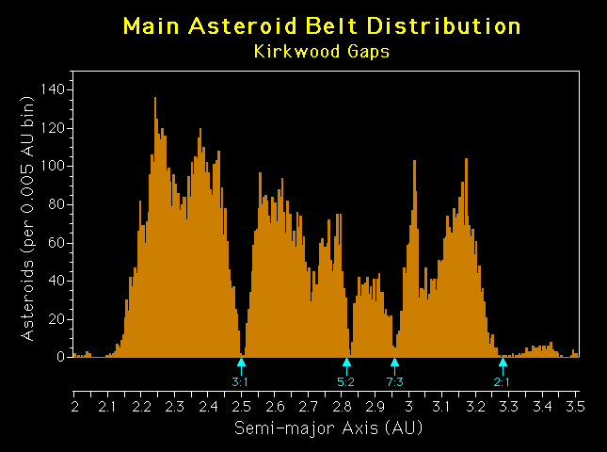
Main Belt

Slide 15
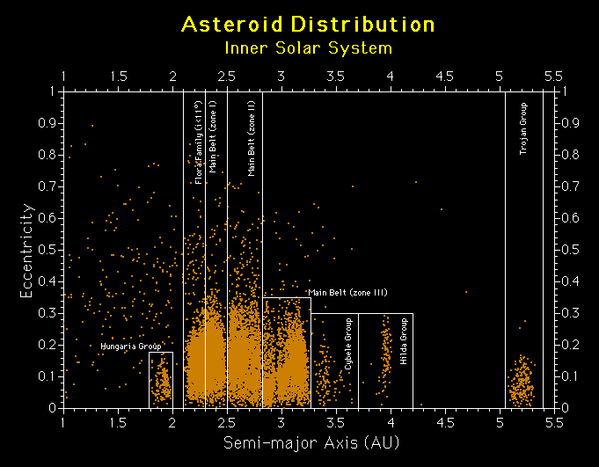

Slide 16
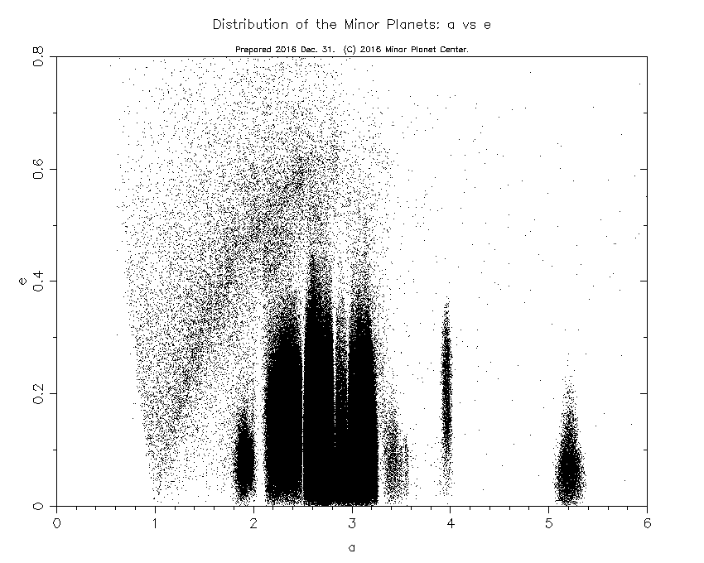

Slide 17
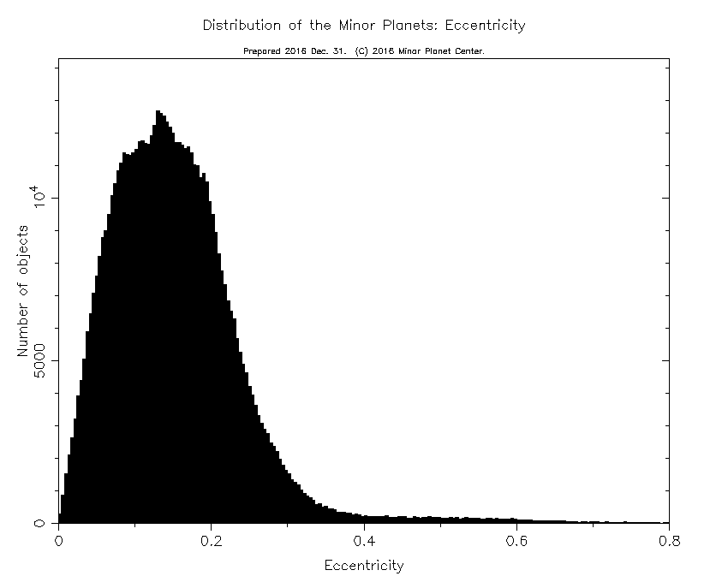
Asteroid
orbital
eccentricities

Slide 18
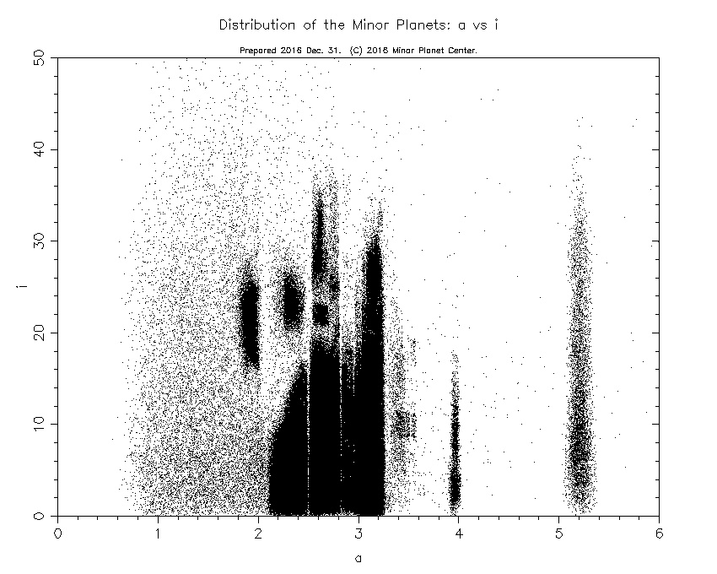
Notes:
inclination really splits out the groups

Slide 19
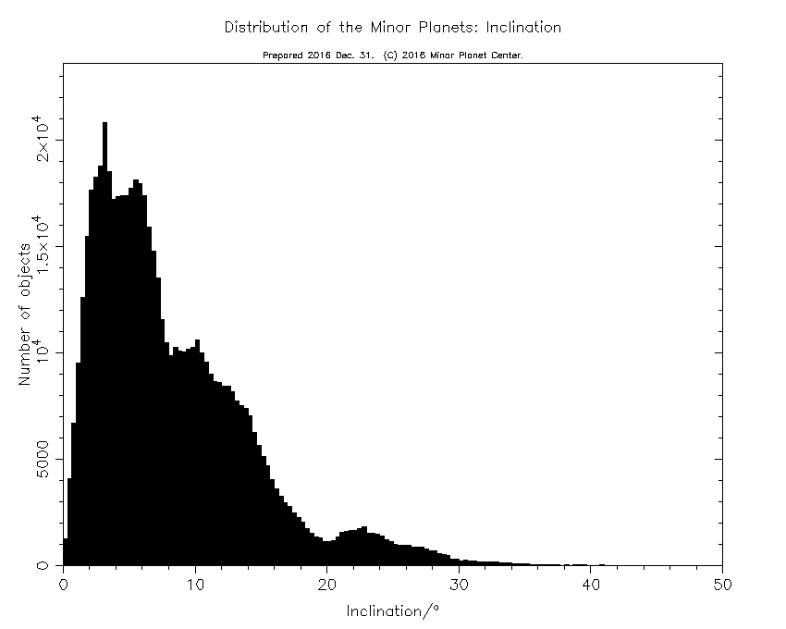
Asteroid
orbital
inclinations

Slide 20
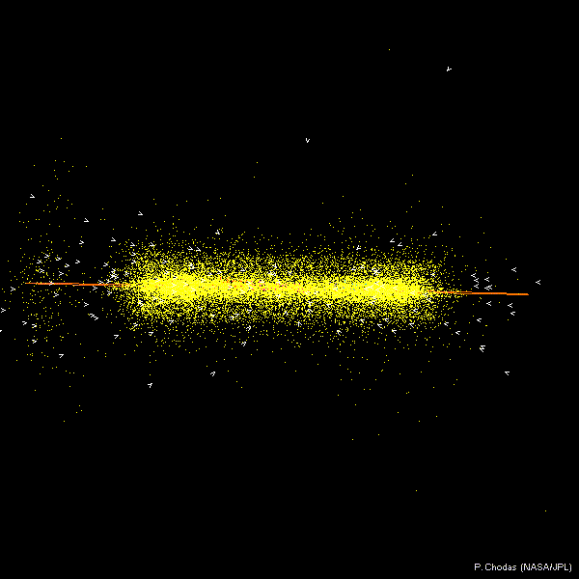

Slide 21
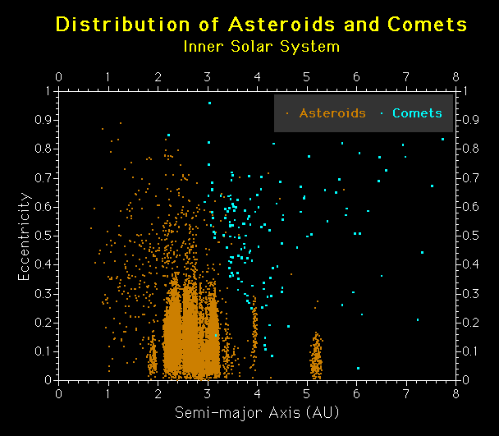

Slide 22
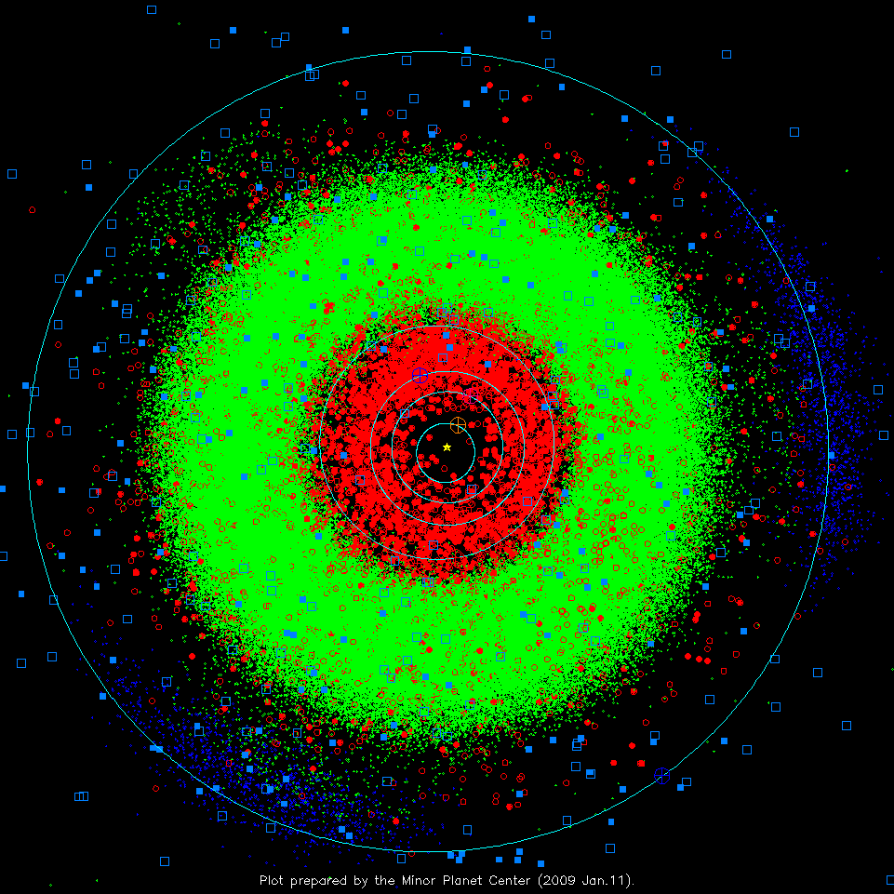
Inner S.S.
2009
ASTEROIDS
green dots: “normal” m.p.
red dots: < 1.3 AU periastron
filled: > 1 opposition obs.
blue dots: Jupiter Trojans
COMETS
solid blue sqr: numbered
open blue sqr: others
Notes:
3 sprays of green dots at 4 AU are the Hildas in 3:2 resonance with Jupiter … eccentric orbits with P = 7.9 years = 2/3 Jupiter’s

Slide 23
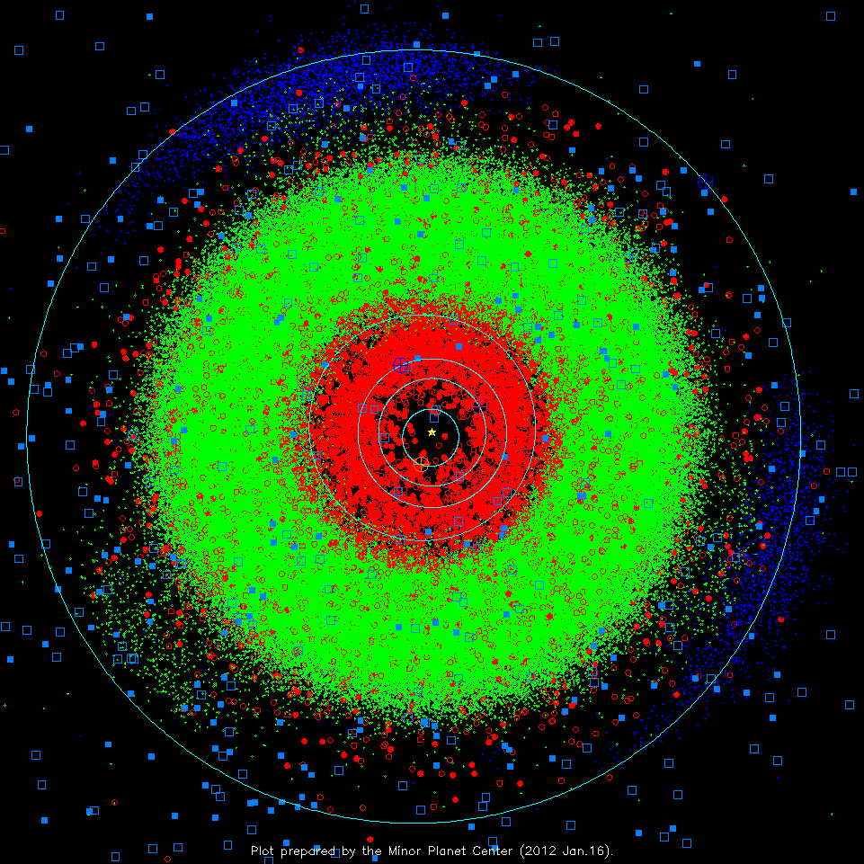
Inner S.S.
2012
ASTEROIDS
green dots: “normal” m.p.
red dots: < 1.3 AU periastron
filled: > 1 opposition obs.
blue dots: Jupiter Trojans
COMETS
solid blue sqr: numbered
open blue sqr: others
Notes:
3 sprays of green dots at 4 AU are the Hildas in 3:2 resonance with Jupiter

Slide 24
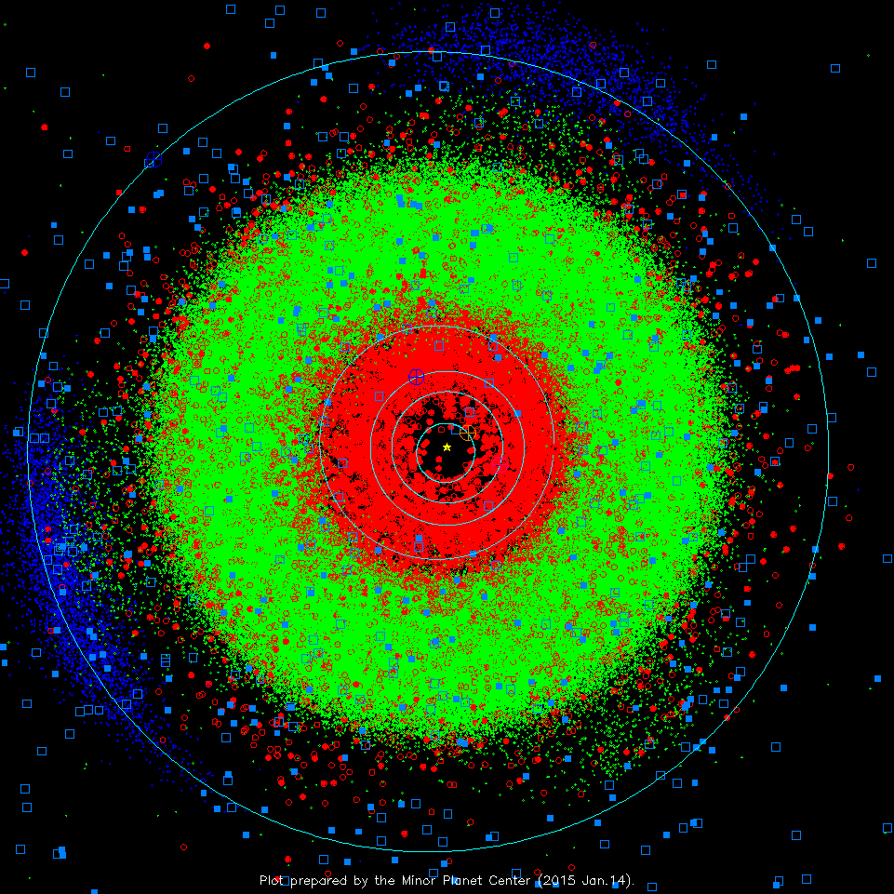
Inner S.S.
2015
ASTEROIDS
green dots: “normal” m.p.
red dots: < 1.3 AU periastron
filled: > 1 opposition obs.
blue dots: Jupiter Trojans
COMETS
solid blue sqr: numbered
open blue sqr: others
Notes:
3 sprays of green dots at 4 AU are the Hildas in 3:2 resonance with Jupiter

Slide 25
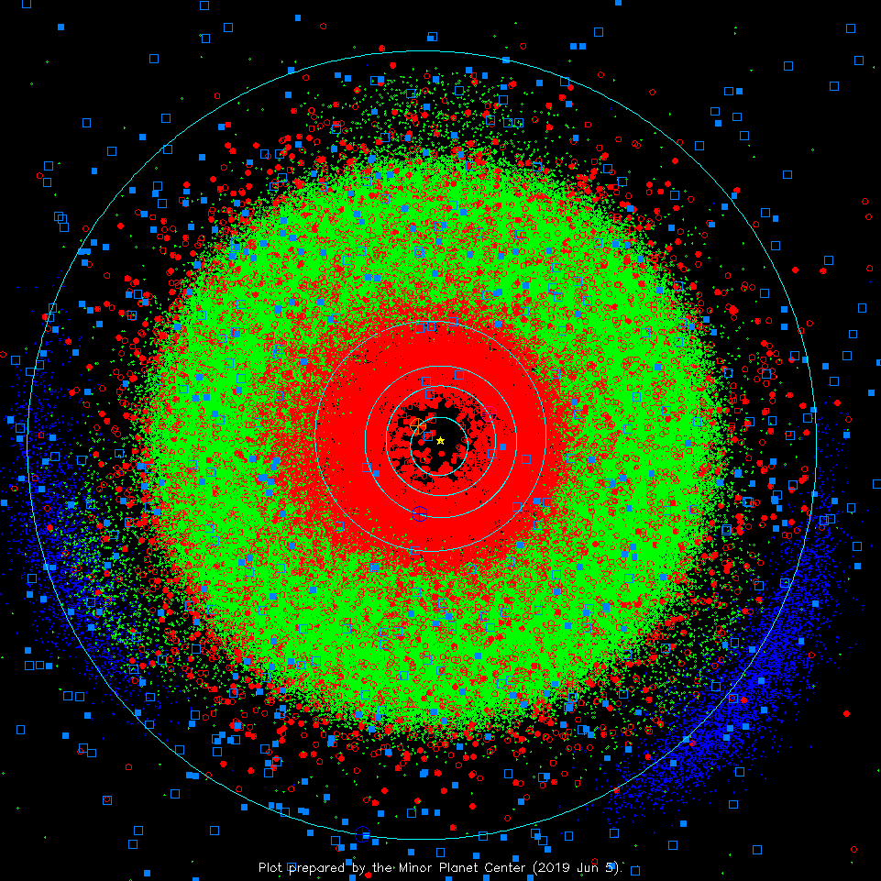
Inner S.S.
2019
ASTEROIDS
green dots: “normal” m.p.
red dots: < 1.3 AU periastron
filled: > 1 opposition obs.
blue dots: Jupiter Trojans
COMETS
solid blue sqr: numbered
open blue sqr: others
Notes:
3 sprays of green dots at 4 AU are the Hildas in 3:2 resonance with Jupiter
check on 29 AUG 2022 gave no more recent plot than this one

Slide 26
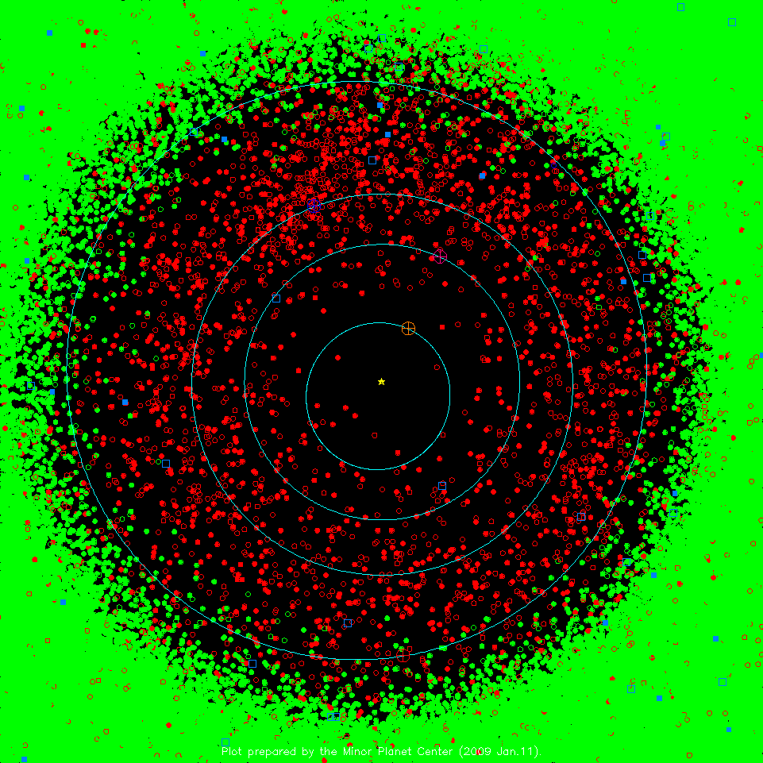
Zoom-in
2009
ASTEROIDS
green dots: “normal” m.p.
red dots: < 1.3 AU periastron
filled: > 1 opposition obs.
blue dots: Jupiter Trojans
COMETS
solid blue sqr: numbered
open blue sqr: others

Slide 27
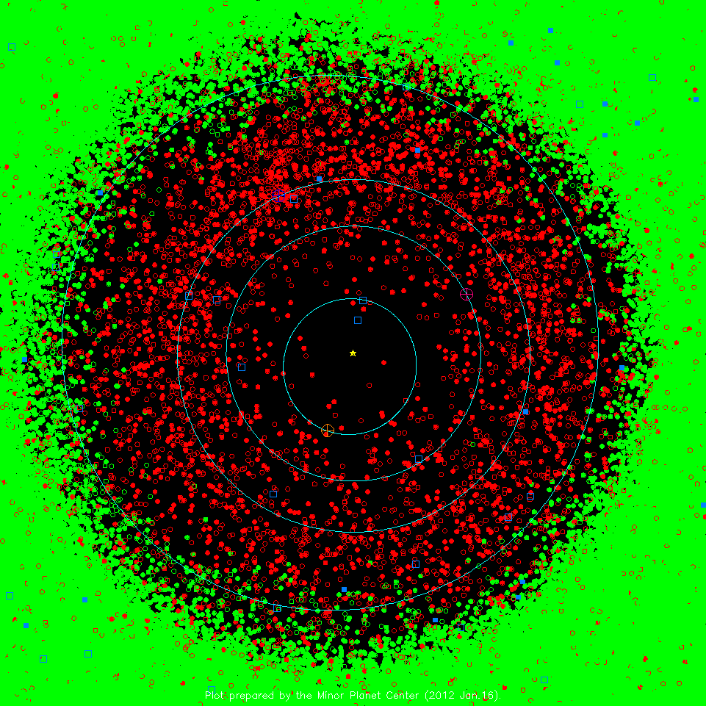
Zoom-in
2012
ASTEROIDS
green dots: “normal” m.p.
red dots: < 1.3 AU periastron
filled: > 1 opposition obs.
blue dots: Jupiter Trojans
COMETS
solid blue sqr: numbered
open blue sqr: others

Slide 28
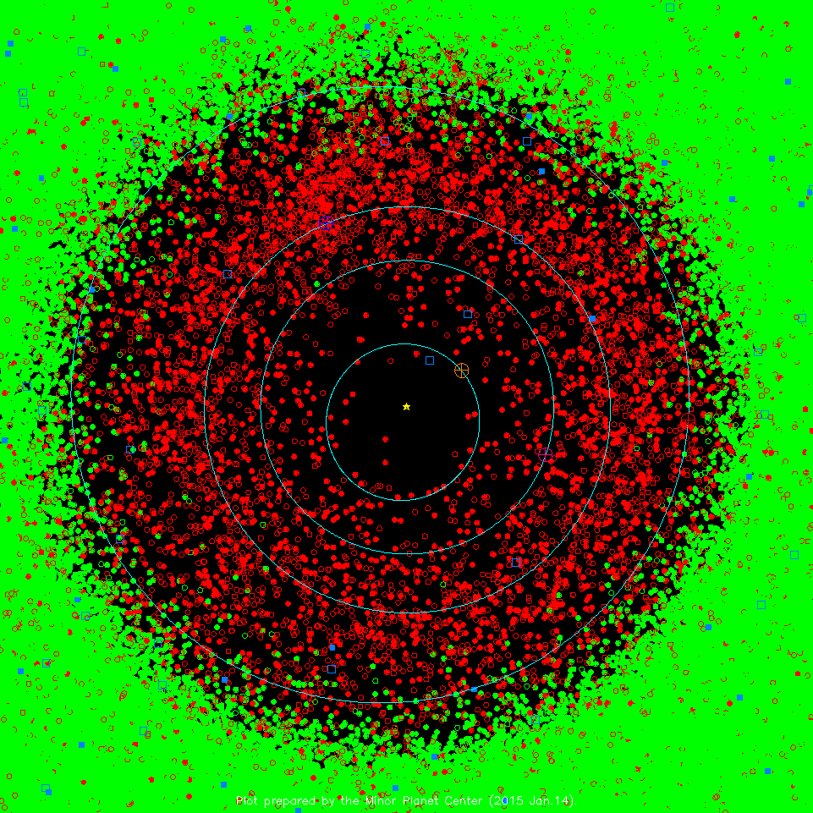
Zoom-in
2015
ASTEROIDS
green dots: “normal” m.p.
red dots: < 1.3 AU periastron
filled: > 1 opposition obs.
blue dots: Jupiter Trojans
COMETS
solid blue sqr: numbered
open blue sqr: others

Slide 29
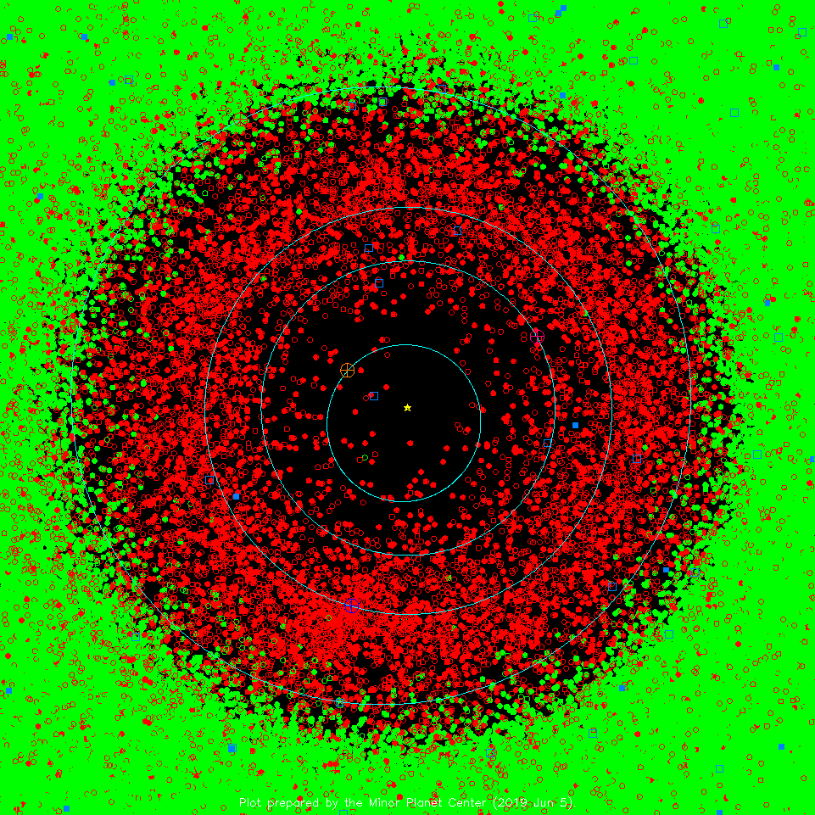
Zoom-in
2019
ASTEROIDS
green dots: “normal” m.p.
red dots: < 1.3 AU periastron
filled: > 1 opposition obs.
blue dots: Jupiter Trojans
COMETS
solid blue sqr: numbered
open blue sqr: others
Notes:
check on 29 AUG 2022 gave no more recent plot than this one

Slide 30
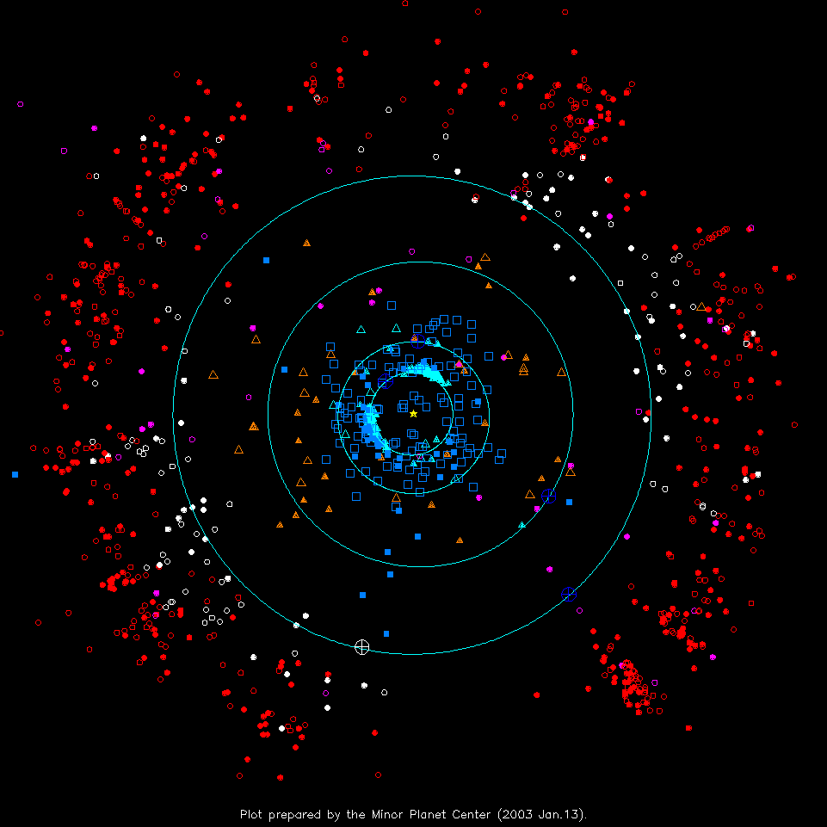
Outer S.S. 2003
TNOs
red: classical KBOs
white: Plutinos
magenta: scattered disk
OTHERS
orange tri: Centaurs
cyan tri: “unusual”
COMETS
solid blue sqr: numbered
open blue sqr: others
Notes:
Pluto at perihelion in 1989
cyan tri: “unusual” have high eccentricities

Slide 31
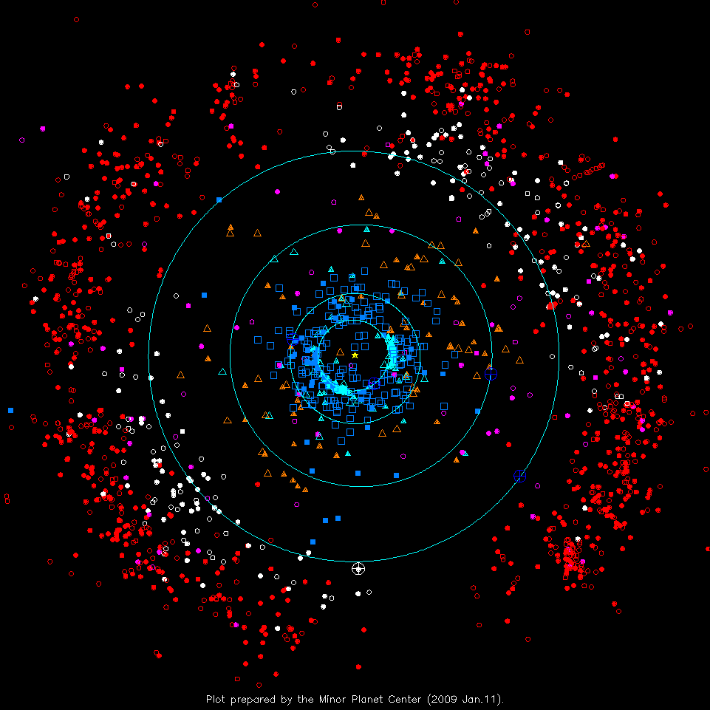
Outer S.S. 2009
TNOs
red: classical KBOs
white: Plutinos
magenta: scattered disk
OTHERS
orange tri: Centaurs
cyan tri: “unusual”
COMETS
solid blue sqr: numbered
open blue sqr: others
Notes:
more objects, not just pencil beams, pencil beams have spread, blue planets have moved,Pluto/KBOs have moved
cyan tri: “unusual” have high eccentricities

Slide 32
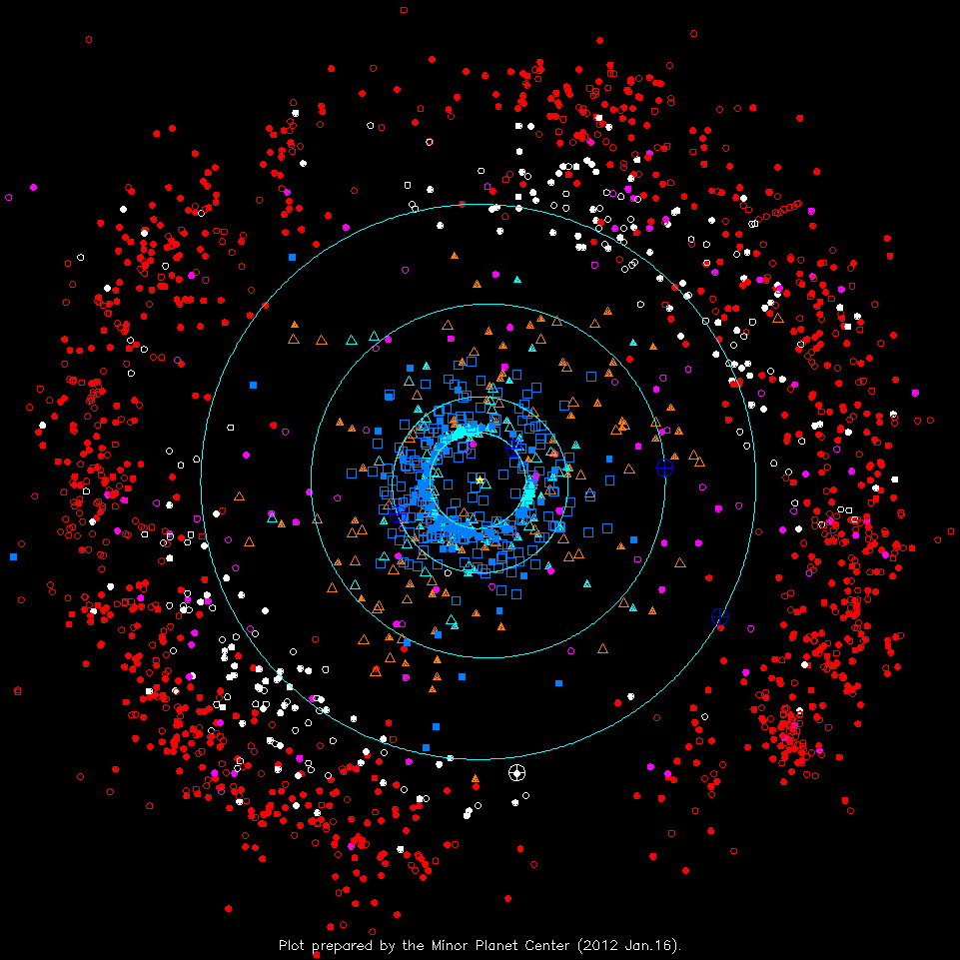
Outer S.S. 2012
TNOs
red: classical KBOs
white: Plutinos
magenta: scattered disk
OTHERS
orange tri: Centaurs
cyan tri: “unusual”
COMETS
solid blue sqr: numbered
open blue sqr: others
Notes:
more objects, not just pencil beams, pencil beams have spread, blue planets have moved,Pluto/KBOs have moved
cyan tri: “unusual” have high eccentricities

Slide 33
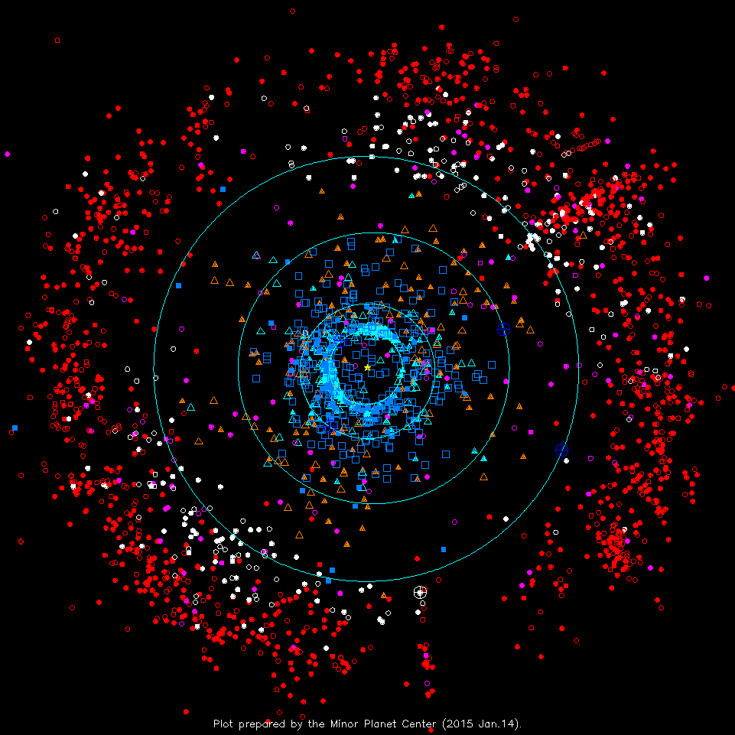
Outer S.S. 2015
TNOs
red: classical KBOs
white: Plutinos
magenta: scattered disk
OTHERS
orange tri: Centaurs
cyan tri: “unusual”
COMETS
solid blue sqr: numbered
open blue sqr: others
Notes:
more objects, not just pencil beams, pencil beams have spread, blue planets have moved,Pluto/KBOs have moved
cyan tri: “unusual” have high eccentricities

Slide 34
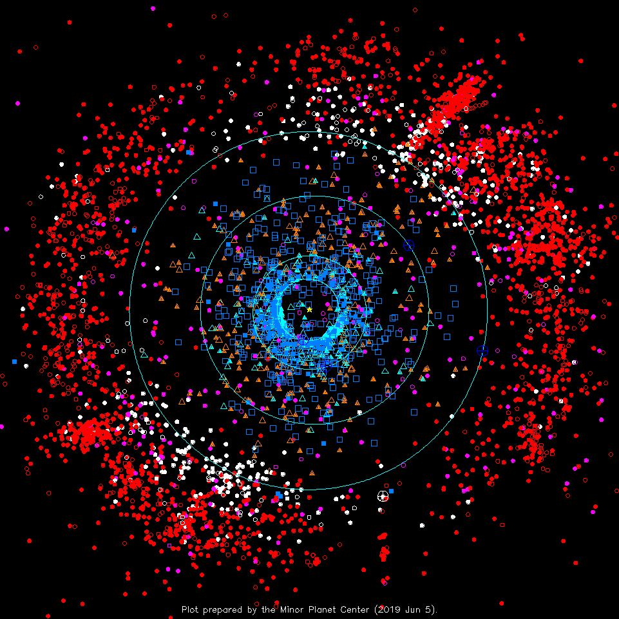
Outer S.S. 2019
TNOs
red: classical KBOs
white: Plutinos
magenta: scattered disk
OTHERS
orange tri: Centaurs
cyan tri: “unusual”
COMETS
solid blue sqr: numbered
open blue sqr: others
Notes:
SDO = Scattered Disk Object
2P Encke has shortest period 3.3yr of any comet known

Slide 35
Outer S.S. 2019
Plutinos/KBOs
Pluto
Quaoar
Ixion
Varuna
Orcus
Centaurs/SDOs
Chiron
Sedna
Nessus
Asbolus
Eris
Comets
1P Halley
2P Encke
Notes:
SDO = Scattered Disk Object
2P Encke has shortest period 3.3yr of any comet known
check on 29 AUG 2022 gave no more recent plot than this one

Slide 36
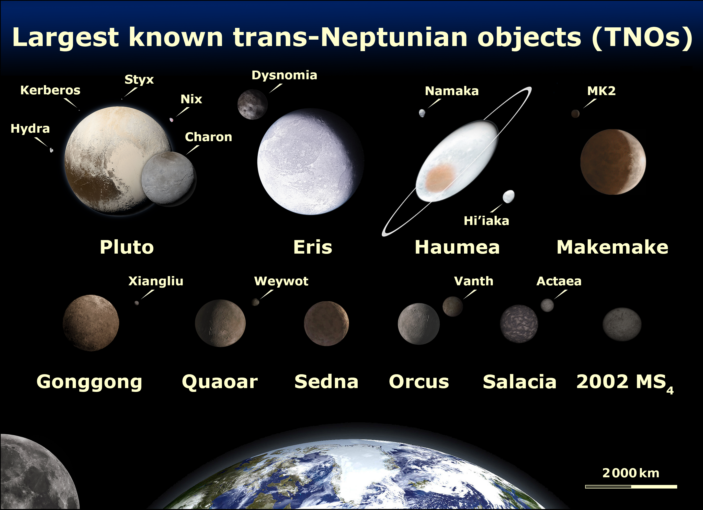
Styx
Hydra
Kerberos
Nix
Notes:
TNOs are Pluto, Charon, Nix (goddess of night), Hydra (water monster), Makemake
SDOs are Eris, Dysnomia
Haumea spins in 4 hours

Slide 37
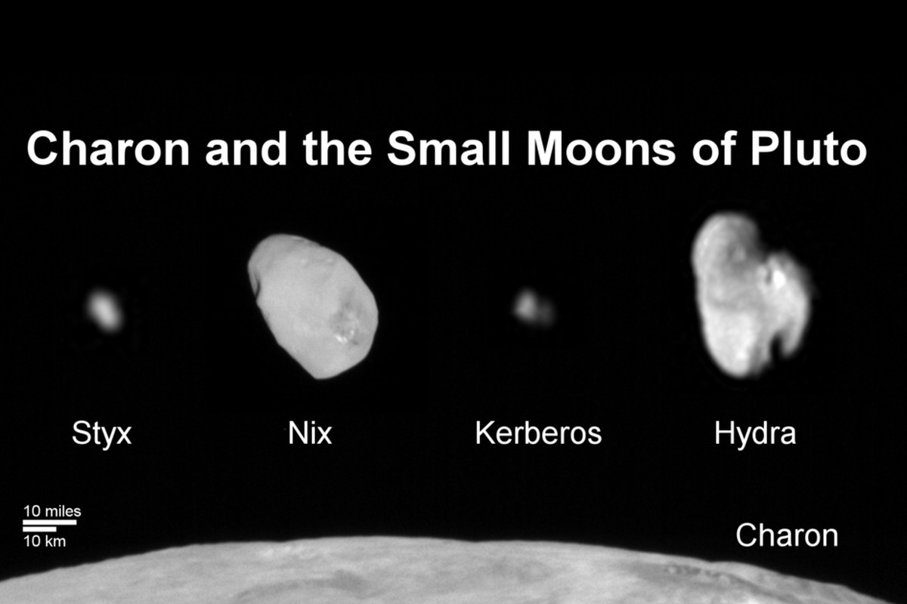
The Pluto System: 2012
Pluto Has 5 Moons
SSE! SSE! SSE! SSE!

Slide 38
The Pluto System: 2012
Pluto Has 5 Moons

Slide 39
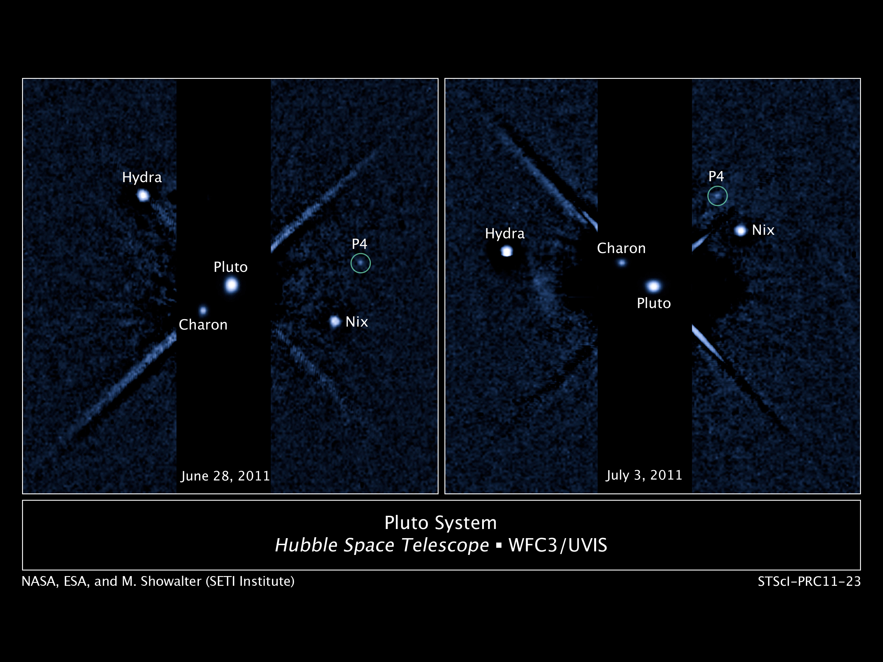
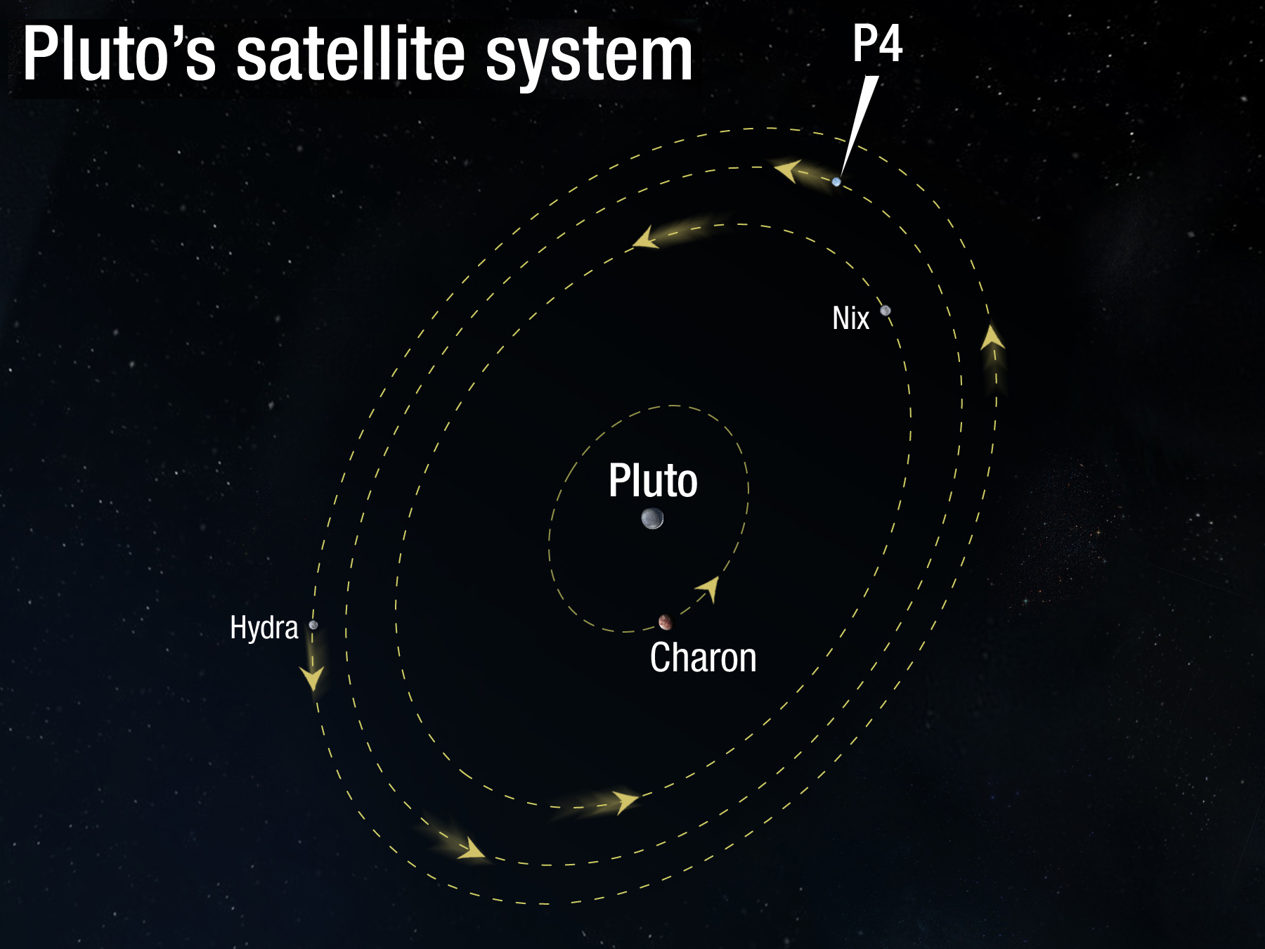
The Pluto System: 2011
Hydra
Nix
Notes:
Charon = 1043 km
Hydra ~ 113 km
Nix ~ 32 km
P4 = Kerberos ~ 13-34 km

Slide 40
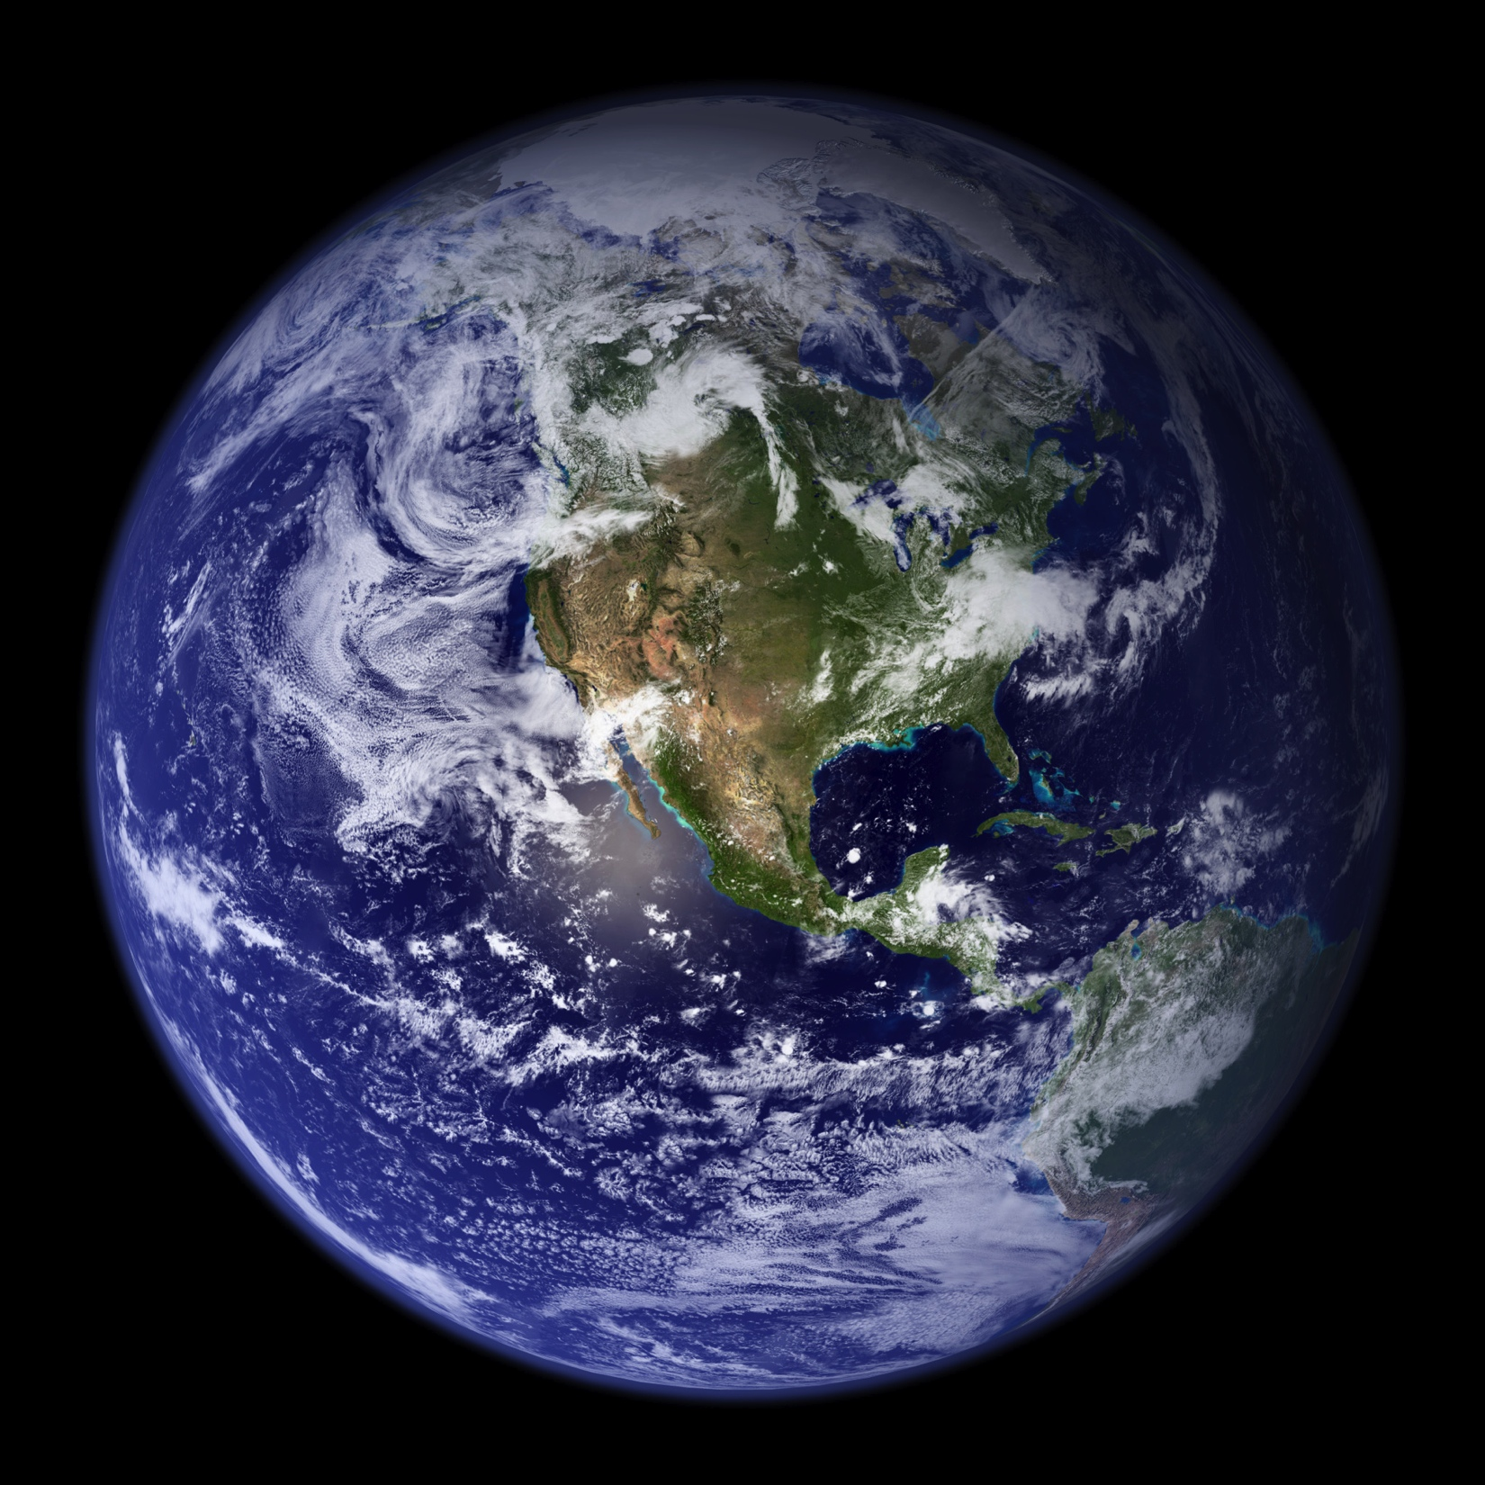
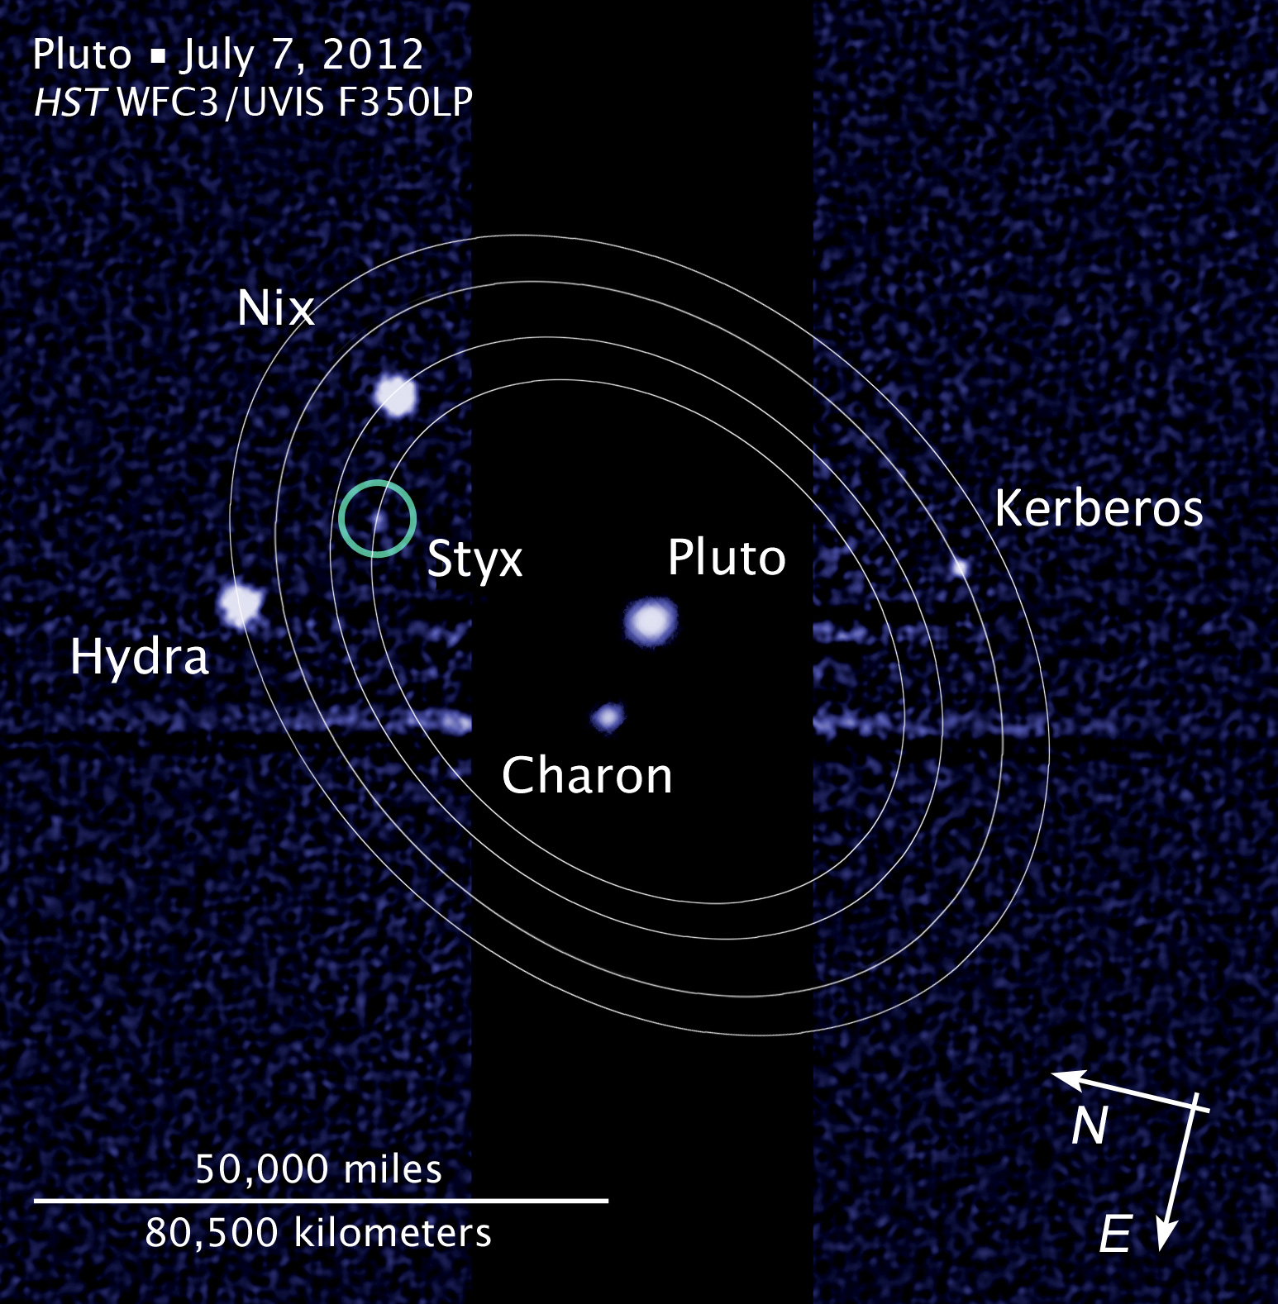
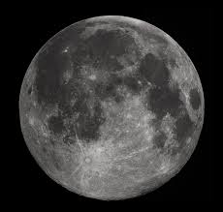
The Pluto System: 2012
The Pluto System: 2012
dist X 2
Notes:
Earth-Moon distance needs to be doubled to be to scale

Slide 41
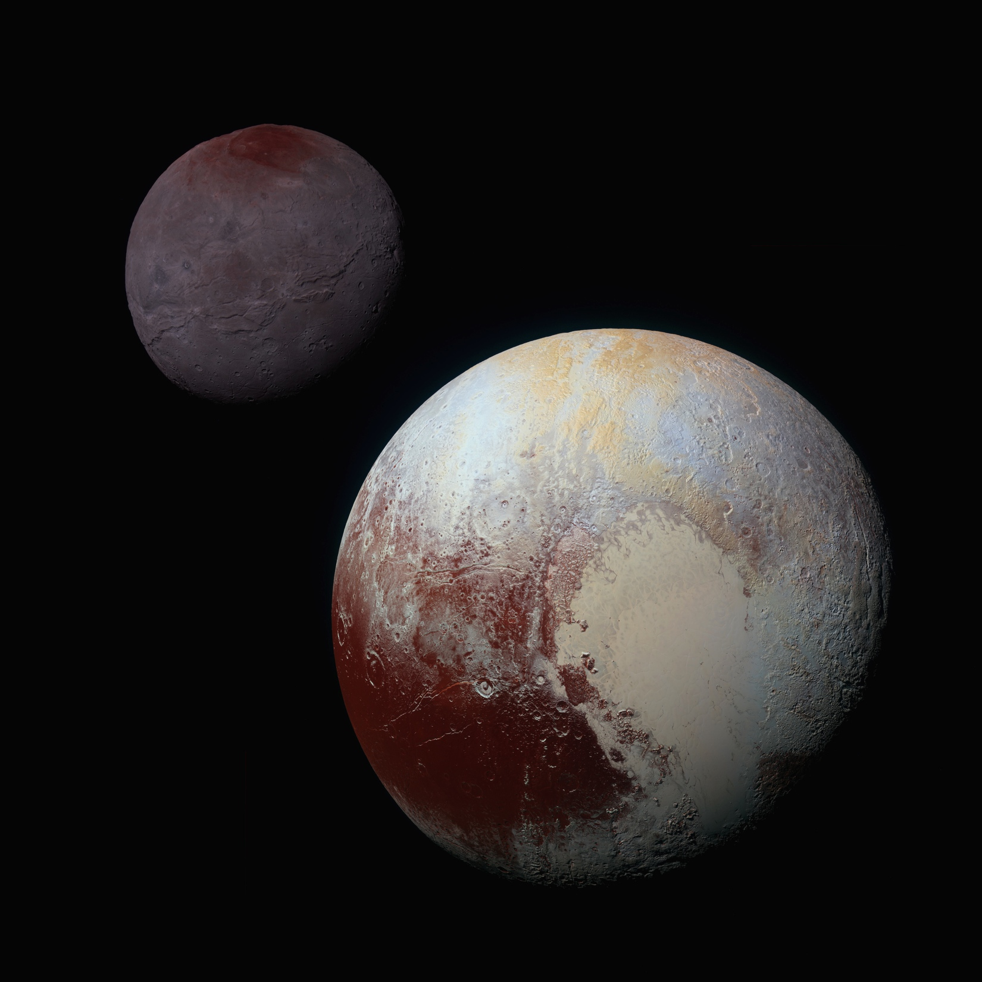
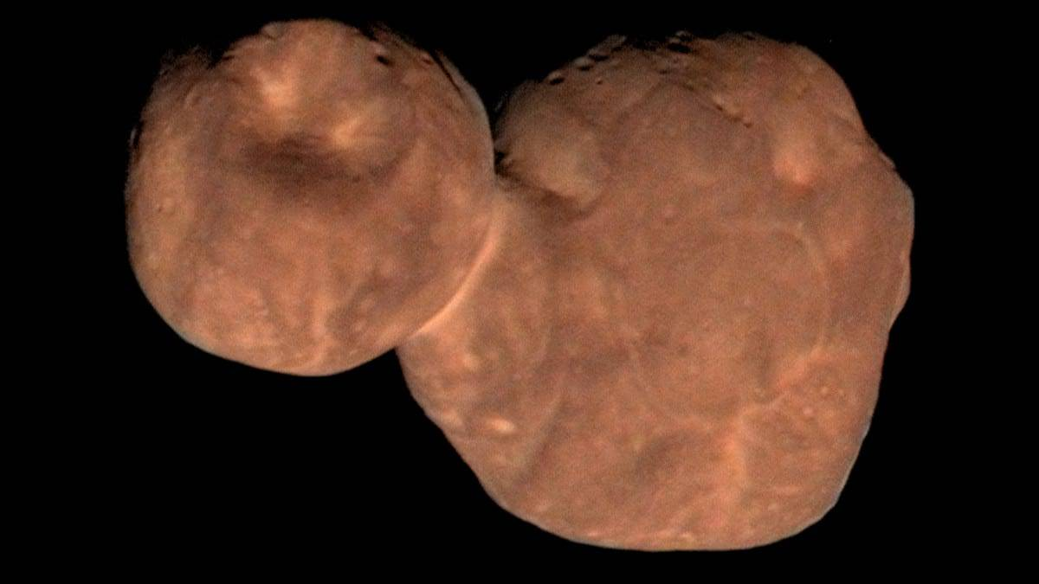
The Pluto System: 2012
The Pluto System: 2015
Arrokoth

Slide 42
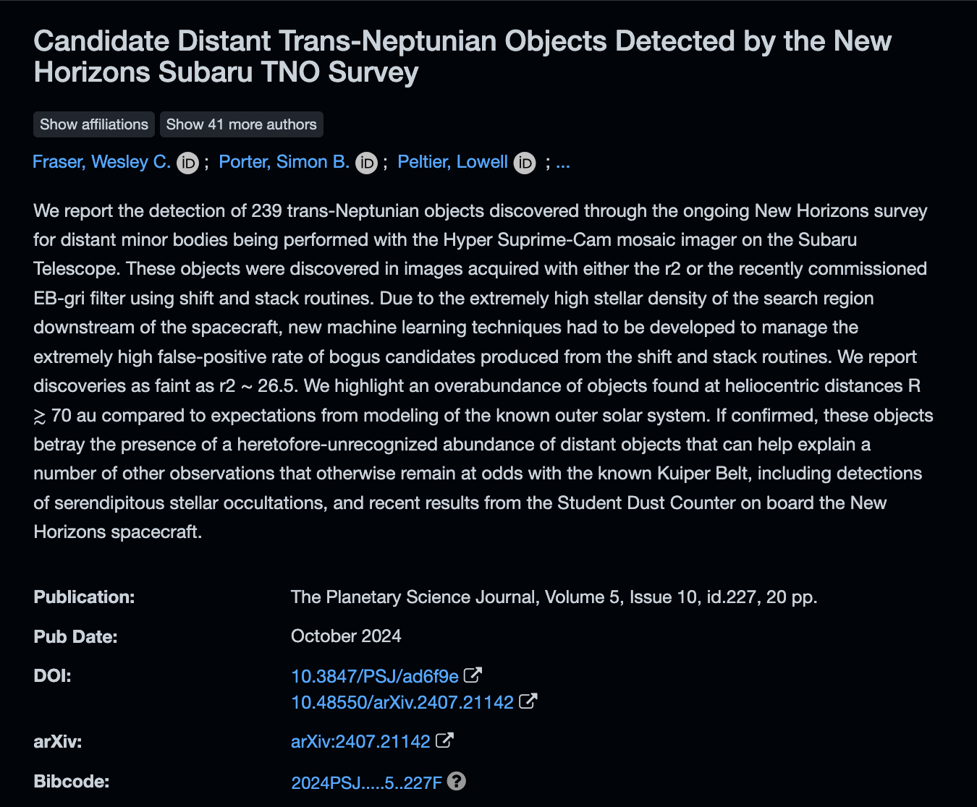
The Pluto System: 2012
Another Belt?

Slide 43
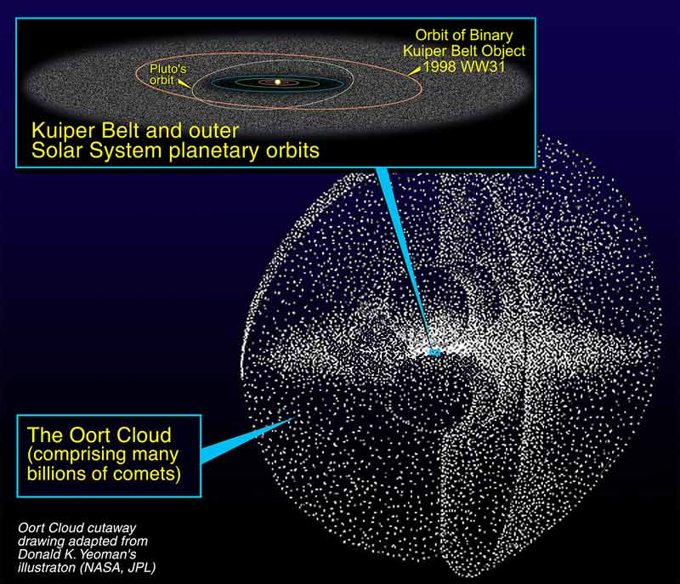
The Outer Limits
PAPER TOPIC: Where is the Oort Cloud really?

Slide 44
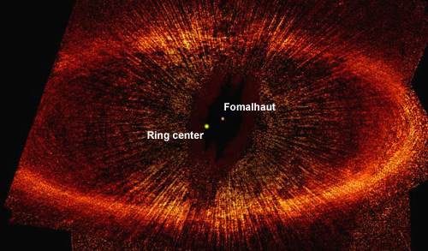
Disk: Protostellar or Debris?

Slide 45
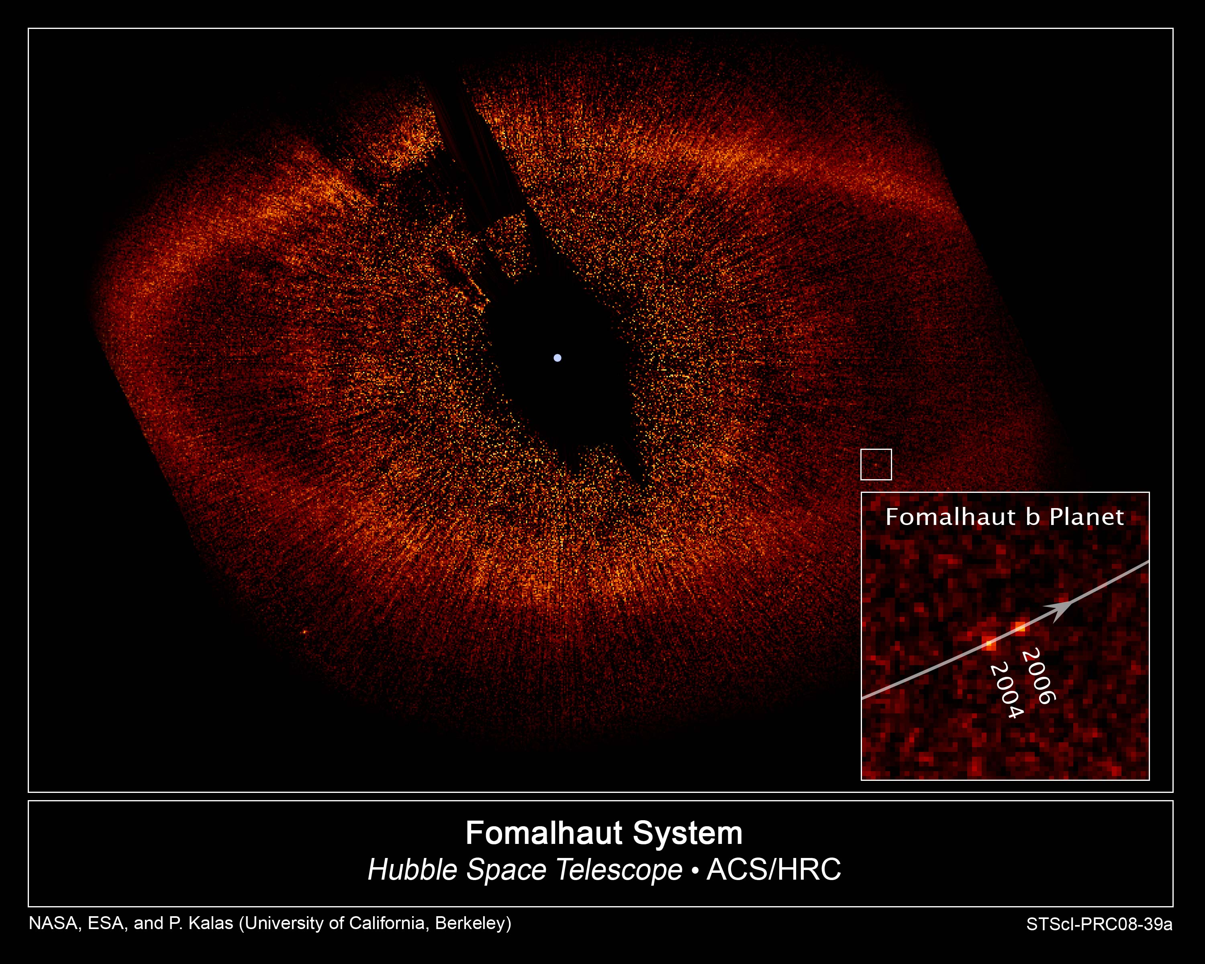
Fomalhaut Planet
NOT A PLANET
background star
movie
Notes:
Planetary Sciences
45
“planet” just inside ring and would have orbital period 872 years … turns out to be dust cloud from collision

Slide 46
…………………………

