Slide 1
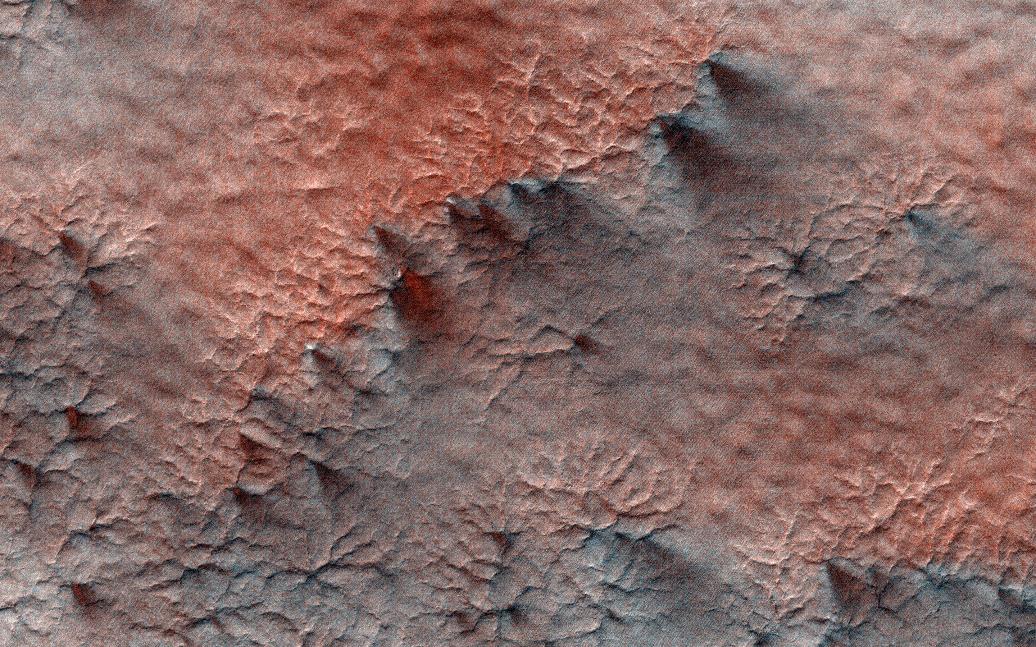
Where is this?
Notes:
This terrain looks like lumpy sediment on top of patterned ground. The lumpy sediment is likely just loosely consolidated because it is covered with spidery channels. This landform is uniquely Martian, formed in the spring as seasonal dry ice turns directly into gas that erodes channels in the surface.

Slide 2
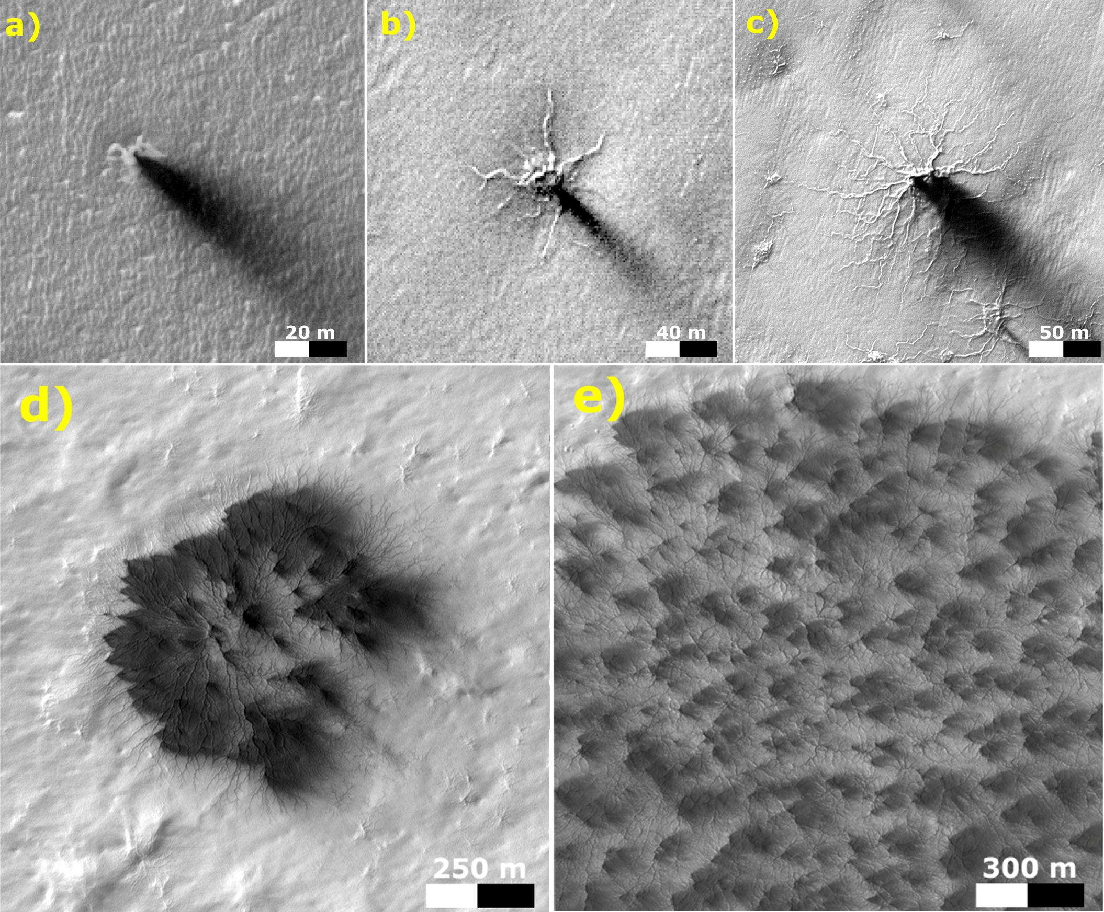
Where is this?
Notes:
MARS by MARS RECONNAISSANCE ORBITER: These five images from the High Resolution Imaging Science Experiment (HiRISE) camera on NASA's Mars Reconnaissance Orbiter show different Martian features of progressively greater size and complexity, all thought to result from thawing of seasonal carbon-dioxide ice that covers large areas near Mars' south pole during winter. The sequence illustrates possible stages in development of a type of Martian terrain called "araneiform," from Latin for spider-shaped. They range from a depression with one trough (upper left) to a broad network of "spiders" (lower right). Each image has a scale bar in meters, from 20 meters (66 feet) in the upper-left image to 300 meters (984 feet) in the lower-right one. Each image also includes dark "fans" that result from the same thawing process. Carbon-dioxide ice, better known as "dry ice," does not occur naturally on Earth. On Mars, sheets of it cover the ground during winter in areas near both poles, including the south-polar regions with spidery terrain. The dark fans appear in these areas each spring.
Spring sunshine penetrates the ice to warm the ground underneath, causing some carbon dioxide on the bottom of the sheet to thaw into gas. The trapped gas builds pressure until a crack forms in the ice sheet. Gas erupts out, and gas beneath the ice rushes toward the vent, picking up particles of sand and dust. This erodes the ground and also supplies the geyser with particles that fall back to the surface, downwind, and appear as the dark spring fans.
These five images are excerpts from HiRISE observations PSP_002718_0950, taken Feb. 24, 2007, at 85 degrees south latitude, 82 degrees east longitude, and ESP_011842_0980, taken Feb. 4, 2009, at 81 degrees south latitude, 76 degrees east longitude.

Slide 3
Homework
TODAY --- HAND IN PRINTED
write 3 sentences each on 2 topics
you might want to explore for your project
MONDAY, 05 SEP --- SPACESHIP NAME SSE!
send candidate names
THURSDAY, 08 SEP
SSE!

Slide 4
Solar System Explorers 2022
Rules:
Goal is roughly once each week (Thursdays).
You will know the topic a week in advance.
You will draw one mini-Mars each week. You will answer the week’s question in order of your mini-Mars values. The value on your mini-Mars determines the number of points you can earn that round: 1-5 earns 1 point, 6-10 earns 2 points, 11-15 earns 3 points, and wild Mars 16 earns 4 points.
You may not re-use or re-attempt an answer already mentioned. Be careful not to effectively repeat an answer already given.
5. You must be clear in your answer, and I will be the final judge of whether points will be awarded. Partial points may be awarded.
Results will be posted on the course website.
This game is for learning and fun,
NOT for bickering, backstabbing, or browbeating …
but it does affect your grade (slightly).

Slide 5
Solar System Explorers: 08 SEP
Describe something you have already learned in this course that you did not know previously (you may use information from Chapter 1 of the book).
1.
2.
3.
4.
5.
6.
7.
8.
9.
10.
11.
12.
13.
14.
15.
16.
17.
18.
19.
20.

Slide 6
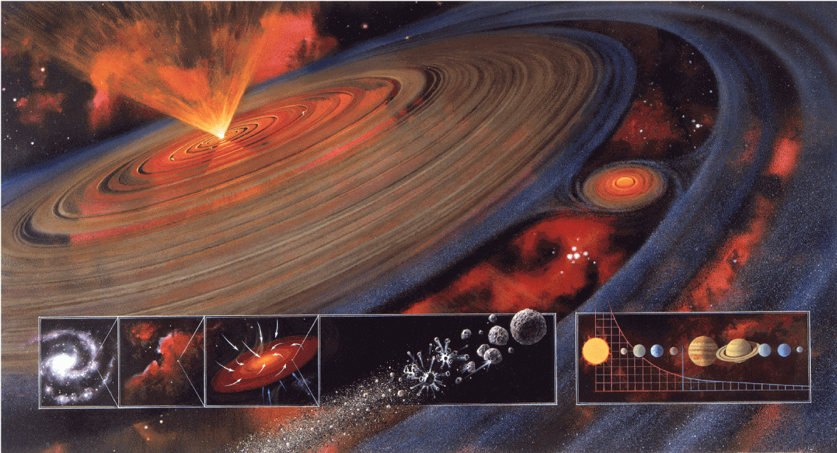
Solar System Formation II

Slide 7
Clues to Solar System Formation
Internal Motion Clues
Internal Bodies Clues
External Clues

Slide 8
Formation Scenarios
1. CAPTURE free floaters, planet theft
2. COLLISION passing star, Sun fragmented
3. CONDENSATION nebular hypothesis

Slide 9
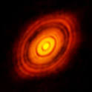
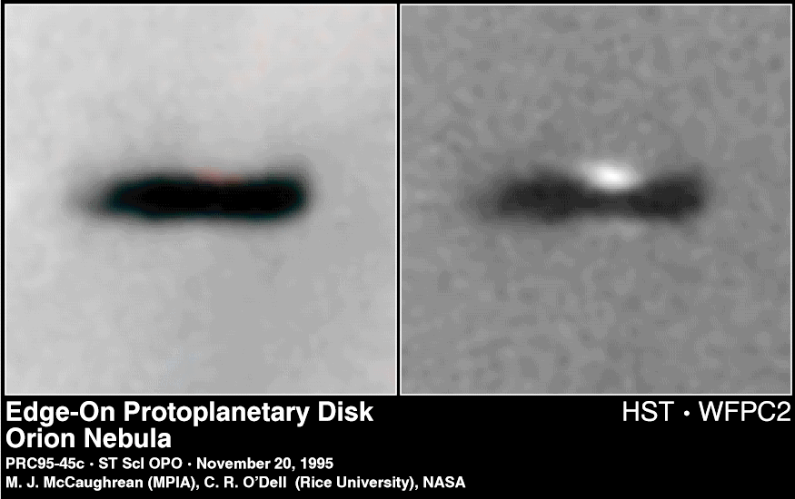
Orion Proplyd
HL Tau
1 Myr
res ~5AU

Slide 10
Condensation to a Solar System
I. molecular cloud core before t = 0
II. freefall collapse t = 0.1 to 1 Myr
III. protostar / disk evolution t ~ 1 to 10+ Myr
IV. baby star / clearing / planet building t ~ 100 Myr
V. evolution of Solar System t > 100 Myr

Slide 11
Solar System Construction

Slide 12
I. Molecular Cloud Core
T ~ 10-30 K
primarily H₂ and He, traced by CO, CN, OH, HCN, H₂O, etc.
Jeans mass is minimum mass for collapse (PE in vs. KE out):
M_{J} ~ (k/G μ m)^{3/2} T^{3/2} / ρ^{1/2}
assumes thermal pressure only (no turbulence, rotation, mag fields)
key attributes temperature and density
shock mechanism is needed to start the process …
invoke hot star outflows, supernovae, spiral density waves
Notes:
cloud will collapse if the potential energy holding it together exceeds kinetic (thermal) energy trying to make it expand
k = Boltzmann constant, T = temp, G = grav constant, u = mean particle weight, m = mass of H, p = density
for typical molecular cloud conditions, Jeans mass is 100 Mo and Jeans radius is 1 pc

Slide 13
II. Freefall Collapse
0.1 to 1 Myr
timescale for collapse, t_{ff} ~ ρ^{-1/2} (inside-out collapse)
angular momentum problem results in disk formation
fragmentation may occur if cloud rotating
… multiple star system
contraction by a factor of 1000X is likely

Slide 14
III. Protostar / Disk Evolution
1 to 1000 Myr (mass-dependent)
vertical collapse of disk
protostar stage occurs when infrared radiation trapped
magnetic braking of protostar when gas becomes ionized
viscous torques move material in and out
chemical evolution
Sun reflects initial elemental composition of disk
but … disk chemistry depends on distance from Sun

Slide 15
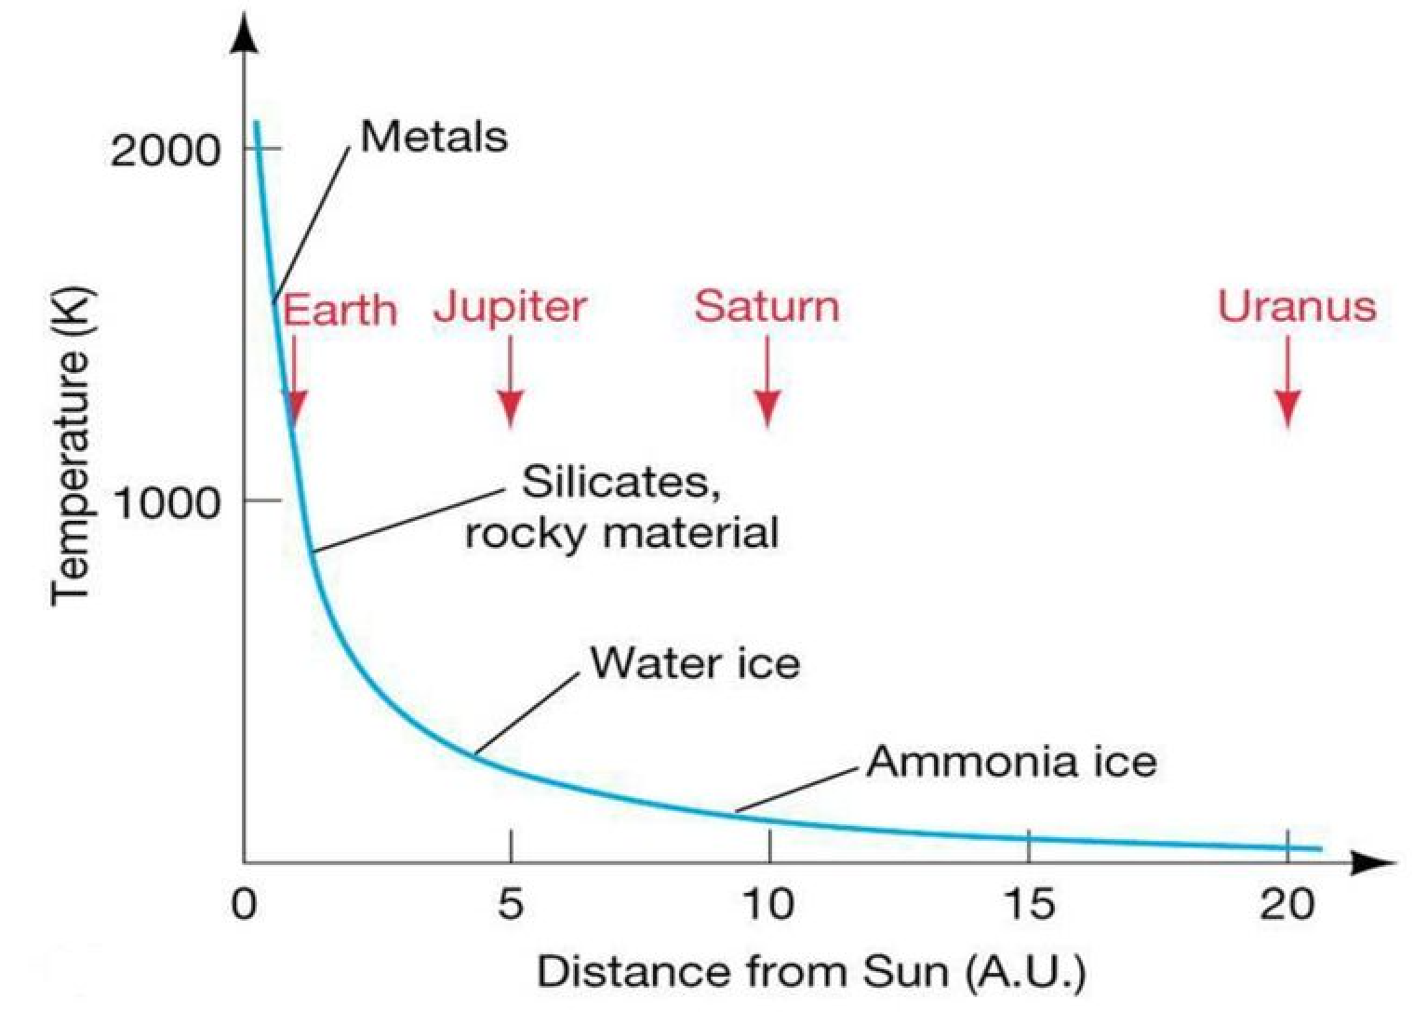
Differentiation in Solar Nebula
Notes:
uncompressed (zero pressure) density decreases from Mercury through Earth

Slide 16
Disk Condensation Chemistry
*** assumes chemical equilibrium, low pressures of solar nebula ***
2000K pretty much everything vaporized
1400K Fe and Ni form an alloy
1300K magnesium silicates (Mg/Si/O)
1200K feldspars (Ca/Na/K/Al/Si/O)
700K 1 AU carbon form transition CO → CH₄ (beware Pluto … solneb not eq)
500K iron oxide (FeO), olivines/pyroxenes (Mg/Fe/Si/O)
[ 373K 2 AU H₂O liquid ]
300K nitrogen form transition N₂ → NH₃ (beware Triton … solneb not eq)
[ 273K H₂O ice ]
180K 3 AU pure H₂O ice (hydrated silicates at warmer temps)
120K 4 AU ammonia clathrate (NH₃ . H₂O)
[ 77K N₂ liquid ]
70K methane clathrate (CH₄ . 6H₂O)
40K CH₄ and Ar ices
25K CO and N₂ ices
*** disequilibrium chemistry is norm beyond several AU ***
Notes:
Mercury has Fe core; Venus has Fe-Ni; Earth has Fe-Ni; Mars has Fe-Ni or Fe-FeS
Pluto has N2 ice with traces of CO and CH4

Slide 17
Ices/Liquids in the Solar System
phase transitions at one atmosphere pressure while cooling
373K H₂O liquid
273K H₂O ice
240K NH₃ liquid
195K NH₃ ice
194K CO₂ ice (sublimates)
111K CH₄ liquid
90K CH₄ ice
77K N₂ liquid
63K N₂ ice
331K Earth (hot)
268K Mars (hot)
186K Mars (cold)
185K Earth (cold)
124K Jupiter
95K Saturn
72K Enceladus
59K Uranus, Neptune
45Kv Pluto
38Kv Triton

Slide 18
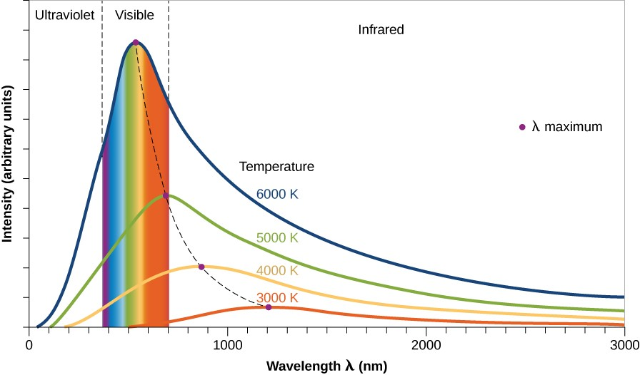
III. Protostar / Disk Evolution
BLACKBODIES yield TEMPERATURES, imply WAVELENGTHS

Slide 19
IRAS (1983): The Turning Point
IRAS excesses at 12, 25, and 60 microns over stellar photosphere
Aumann (1985) gives nice statistics of IRAS catalog:
756 sources corresponding to stars
504 dwarfs or subgiants
267 have 12 and 25 micron fluxes
36 have 12, 25, and 60 micron fluxes
12 are “Vega-like” with significant 60 micron fluxes
14% of A-type stars (N = 6)
3% of F-type stars (N = 4)
< 1% of G/K-type stars (N = 2)
detecting protostellar disks or cold debris disks?
Notes:
IRAS also had 100 micron band
those percentages must be out of the 504 dwarfs or subgiants because the numbers are about 42 A stars, 132 F stars, > 200 G/K stars, ## M stars
protoplanetary disk = massive, hot … debris disk = low mass, cold

Slide 20
beta Pictoris Disk
A5V star, 19.3 pc, 20 (?) Myr old
brightest infrared excess of any main sequence star detected by IRAS
circumstellar debris disk first imaged by Smith & Terrile (1984)
disk almost edge on, extends beyond 2000 AU (!) at optical wavelengths
temperature/color profile indicates large blackbodies not present
two (or more) disks, clear within 80 AU (inner void from 10 micron flux)
… ice sublimates in inner disk leaving grains, or planet clearing?
bottom line: beta Pic has (at least) double disk,
cleared in 20 (?) Myr
Notes:
emission intensity transition at 100 AU … models indicate albedo ~0.35 for grains in outer disk

Slide 21
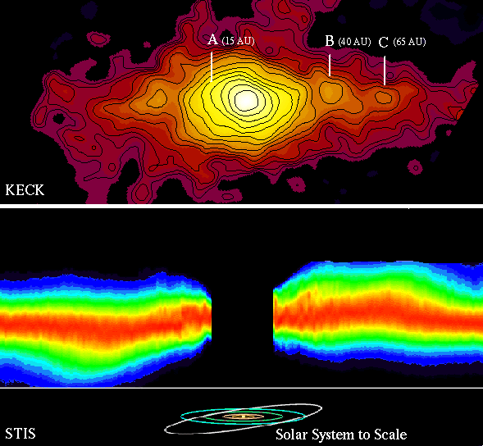
beta Pictoris Disk
MIRLIN map:
15 AU ring tilted
40 AU ring opp. tilt
65 AU ring asymmetric
STIS image:
warp in disk is real
(exaggerated here)

Slide 22
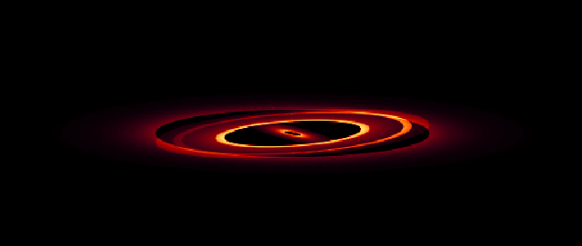
beta Pictoris Disk Model
model must match:
brightness
color (temps)
inclination
extent
(don’t forget star)
80 deg
89 deg

Slide 23
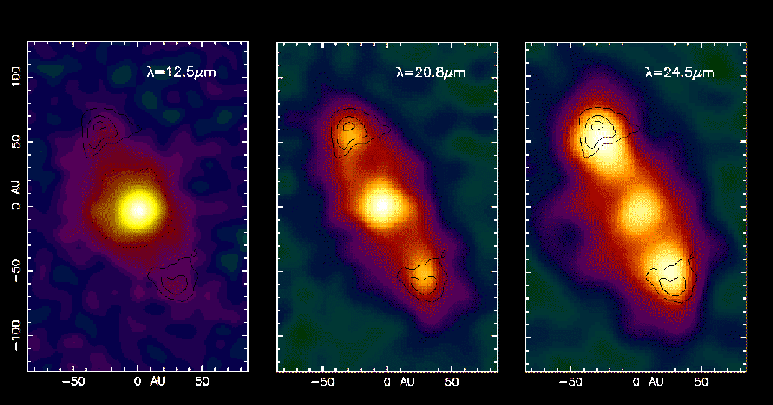
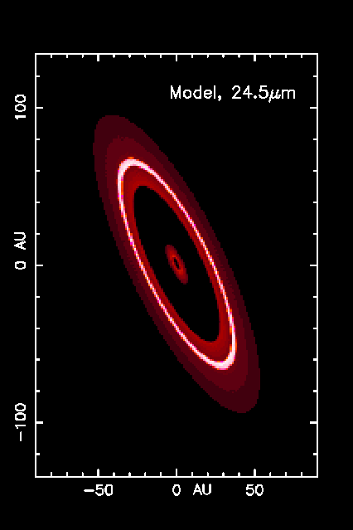
HR 4796A Disk
A0 star, 67 pc, 10 (?) Myr old discovered by Koerner et al. (1998)
outer ring structure from different temp samples
stellar photosphere fades (but still there)
dust brightens … disk stretches
central star has excess flux … hot dust in close, cleared to Kuiper Belt
10 (?) Myr double disk … transition between protostellar + debris disks

Slide 24
The IRAS Fab Four
Name SpType L distance age i r_{in} r_{out} T_{dust} M_{dust}
(suns) (pc) (deg) (AU) (AU) (K) (Moons)
Vega | A0V | 60 | 7.8 | 200 Myr | 85 | 80 | 120 | 80 | 0.2
Fomalhaut | A3V | 13 | 7.7 | 200 Myr | < 30 | 100 | 140 | 40 | 1.4
beta Pic | A5V | 9 | 19.3 | 20 Myr | > 80 | 20 | 2000+ | 85 | 3.0
eps Eri | K2V | 0.3 | 3.2 | 500 Myr | 70 | 50 | 80 | 35 | 0.1
The Fab Fifth
HR 4796A | A0 | 18 | 67 | 10 Myr | 72 | 55 | 80 | 65: | ?

Slide 25
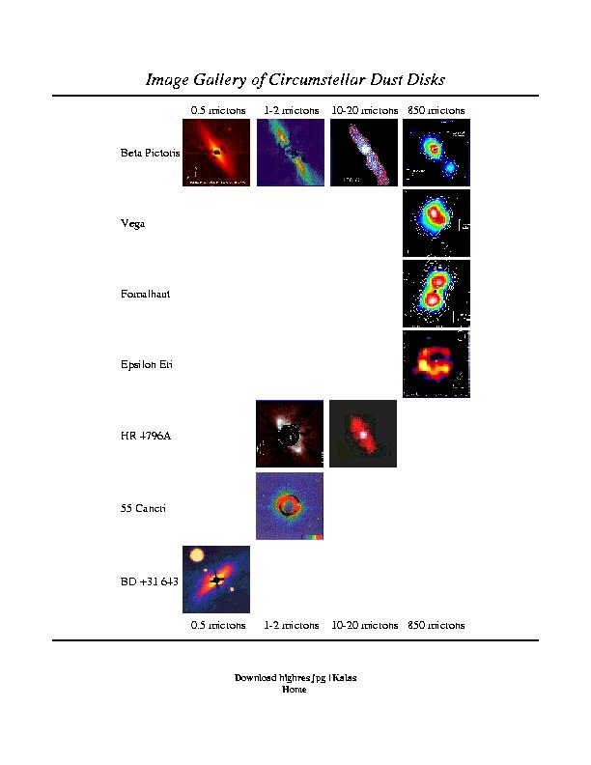
Disk Photo Gallery
multi-wavelength study crucial
optical: stellar photosphere
near-IR: warm dust
far-IR: cool dust
sub-mm: very cold dust
radio: molecular contents
high resolution
flows

Slide 26
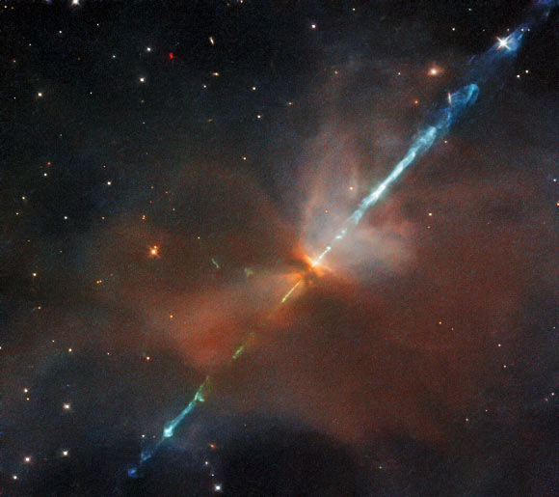
IV. Baby Star / Planet Building
THE STAR
core temp reaches 10⁶ K, deuterium burns…10⁷ K, H burns
T Tauri phase --- bipolar outflow, gas cleared
HH (Herbig-Haro) objects --- gas jettisoned
disk details become visible --- gaps? warps?
HST image of HH 24
in Orion
Notes:
T Tauri stars have conical jets
HH objects are bright blobs of nebulosity where jets collide with ISM, typically found near the youngest T Tauri stars

Slide 27
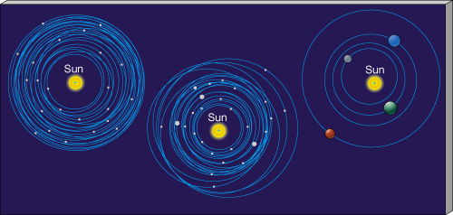
IV. Baby Star / Planet Building
THE PLANETS
buildup of terrestrial planets took ~ 100 Myr
slow accumulation of small bodies
not much mass involved
buildup of giant planets took ~ 10 Myr (need to have gas around)
all giant planets have roughly the same heavy element mass…
5, 15, 300, 300 X solar heavy/light element ratios in J/S/U/N
H and He total mass varies wildly!
fraction of total mass: 90% J, 75% S, 10% U, 10% N
PAPER TOPIC: Why two kinds of giant planets?
Notes:
98% of Sun’s mass is H+He
Jup mass 2x10^27 ~ 20X Nep
Nep mass 1x10^26

Slide 28
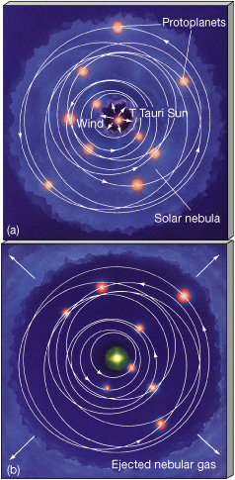
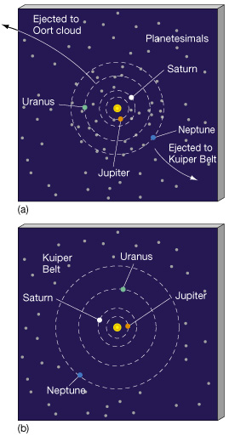
Clearing of Debris
GAS
“DUST”

Slide 29
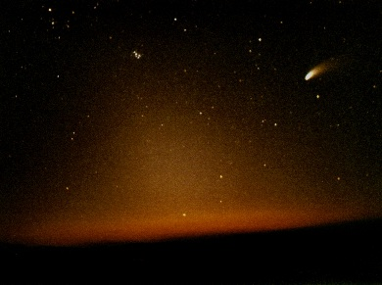
Continuous Cleaning Required

Slide 30
V. Evolution of Solar System
SSE! SSE! SSE!
Name any characteristic of the SS that is different today than how the SS looked at age 5 Myr.

Slide 31
V. Evolution of Solar System
continuous bombardment (craters, regolith, oceans?)
giant impacts (Moon origin, Venus retrograde?, Uranus tilt?)
tidal locking of moons (many)
resonances that cause evolution (Io-Eur-Gany, Kirk gaps, Plutinos)
“the Nice Model”
happens in the first ~10 million years

Slide 32
The Nice Model
problem: Jupiter, Saturn, Uranus, Neptune
NOT in circular, coplanar orbits
 | a (AU) | e | i (deg)
Jupiter | 5.20 | 0.048 | 1.30
Saturn | 9.54 | 0.056 | 2.49
Uranus | 19.19 | 0.046 | 0.77
Neptune | 30.07 | 0.009 | 1.77
solution: wandering giant planets (Tsiganis et al. 2005)
interactions with disk of planetesimals

Slide 33
The Nice Model
details: start with 4 Jovians with e and i ~ 0.001
Jupiter 5.45 AU
Saturn < 8.65 AU (1:2 resonance)
Ice Giant 1 11-13 AU
Ice Giant 2 13.5-17 AU
add 1000-5000 bodies with total mass 30-50 Earths
located beyond Jovians, extends to 30-35 AU
EVOLVE!
http://lucy.swri.edu/2018/04/24/Nice-Model.html
Jupiter moves in … Saturn drifts out
Jup:Sat resonance 1:2 strongest ... kaboom!
Ice Giants migrate out wildly
Ura/Nep swap in 50% of simulations
Notes:
those 3000 bodies have masses ¼ Mercury or 6XPluto

Slide 34
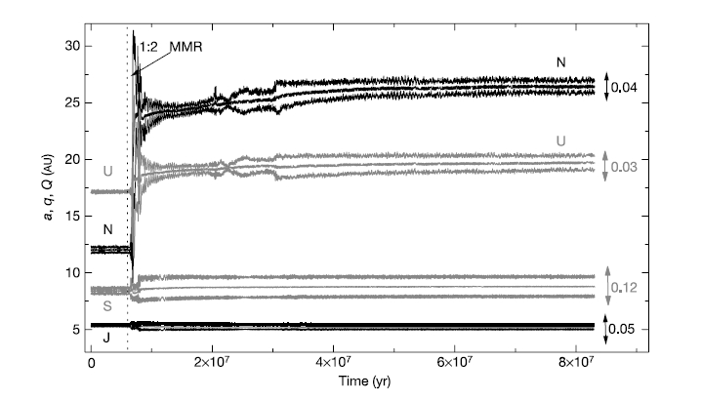
The Nice Model
Tsiganis et al. 2005
Notes:
this is one simulation … note short period of time
a is semimajor axis, q is perihelion, Q is aphelion
e noted on right = maximum during the last 2 Myr evolution

Slide 35
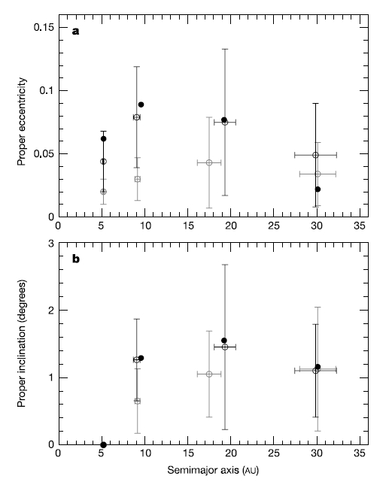
migration stops when
disk nearly depleted
→ present day
solid: today
gray: 0 Sat-IG encounters
black: ≥ 1 Sat-IG encounter
more disk mass?
more stability
Jup-Sat too far apart
final e too small
Tsiganis et al. 2005
Notes:
final Jup-Sat separation depends on initial mass of disk
IG = Ice Giant

Slide 36
The Nice Model
“Our model
statistically reproduces all aspects of the orbits of the giant planets.
[a, e, i for Jup/Sat/Ura/Nep]
It is consistent with the existence of regular satellites,
with the observed distributions of Jupiter’s Trojans,
perhaps with the existence of Neptune’s Trojans, and
does not contradict the distribution of main-belt asteroids.”
Tsiganis et al. 2005

Slide 37
V. Evolution of Solar System
continuous bombardment (craters, regolith, oceans?)
giant impacts (Moon origin, Venus retrograde?, Uranus tilt?)
tidal locking of moons (many)
resonances that cause evolution (Io-Eur-Gany, Kirk gaps, Plutinos)
“the Nice Model”
happens in the first ~10 million years
captures (asteroids, Triton)
changing atmospheres (Venus, Earth, Mars, Titan, Pluto)
ring systems/toroids (Io)
icecaps (Mercury, Earth, Moon, Mars)
erosion (Earth, Mars, Titan)
vulcanism (Venus, Earth, Mars, Io, Enceladus, Triton)
life

Slide 38
…………………………
Notes:
38

Slide 39
HR 4796A Disk Details
A0 star, 67 pc, ~10 Myr old
circumstellar disk discovered by Koerner et al. (1998)
… disk inclined by 72 deg
emission intensity increases (!) with radius, implying inner hole 40-70 AU
… clearance out to Kuiper Belt?
ring width is < 17 AU from NICMOS observations
… corresponding to thin Kuiper Belt, or shepherding planets?
dust beyond clearing could be due to smashing comets
8.8/10.3/12.5 micron flux excess implies inner disk with T ~ 160 K at ~10 AU
… similar temp to zodiacal dust in our Solar System
bottom line: HR 4796A has double disk in a transition state at 10 Myr
… between massive protostellar disks and more tenuous debris disks

Slide 40
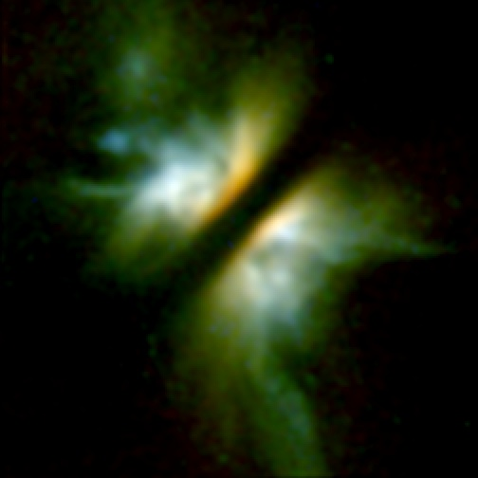
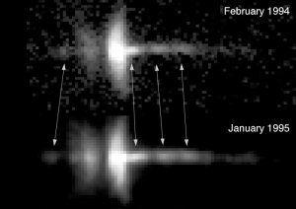
Clearing of Debris
HH-30
disk 225 AU across
knots moving at 200 km/sec

