Slide 1
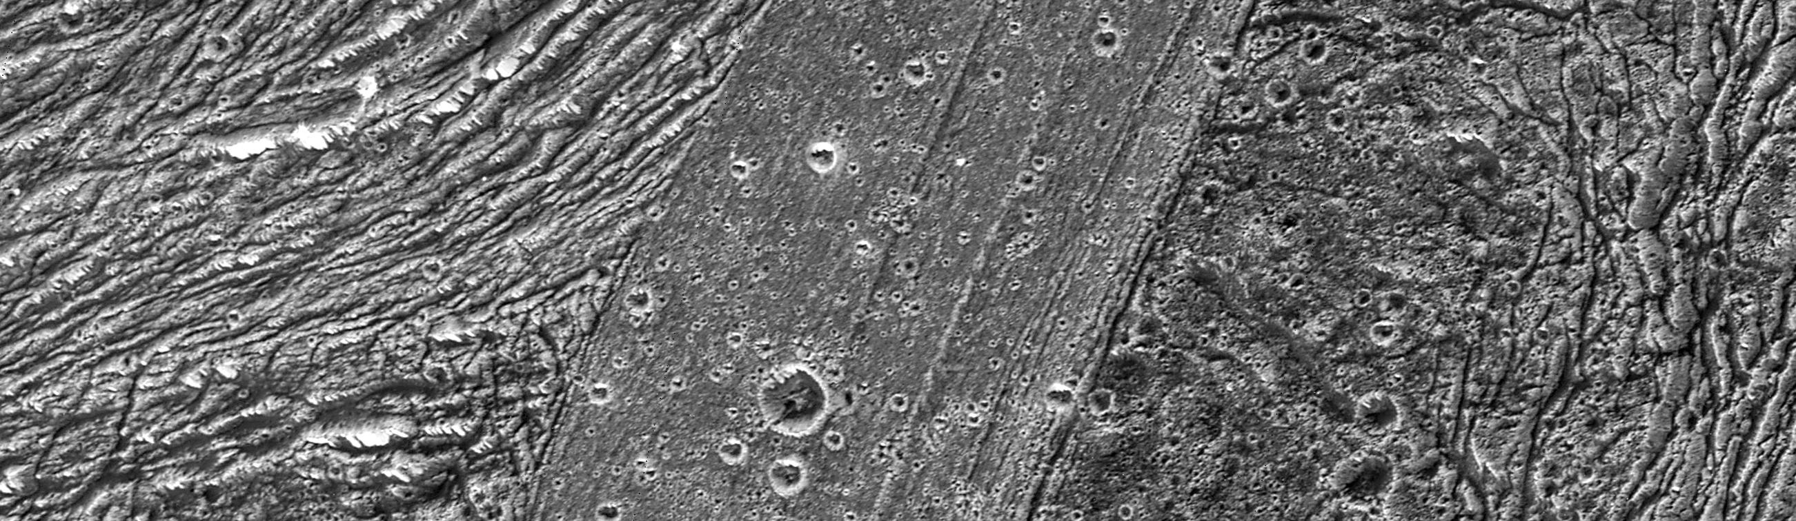
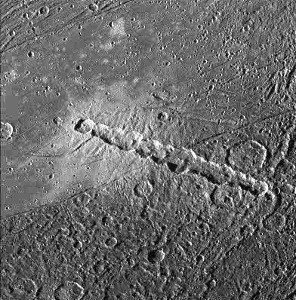
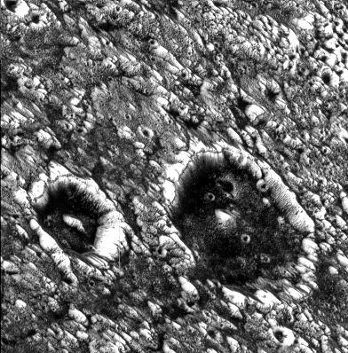
Where is this?
Notes:
GANYMEDE BY GALILEO: The area of Nicholson Regio and Arbela Sulcus illustrates many of the diverse terrain types on Jupiter's moon Ganymede, as seen in this image taken by NASA's Galileo spacecraft. The bright terrain of Arbela Sulcus is the youngest terrain here, slicing north-south across the image. It is finely striated, and relatively lightly cratered. To the east (right) is the oldest terrain in this area, rolling and relatively densely cratered Nicholson Regio. To the west (left) is a region of highly deformed grooved terrain, intermediate in relative age. In this area of grooved terrain, stretching and normal faulting of Nicholson Regio has deformed it beyond recognition.
North is to the top of the picture and the Sun illuminates the surface from the west. The image, centered at -15 degrees latitude and 347degrees longitude, covers an area approximately 89 by 26 kilometers (55by 16 miles). The resolution is 34 meters (112 feet) per picture element. The images were taken on May 20, 2000, at a range of 3,350 kilometers (2,082 miles).
View of a chain of craters named Enki Catena on Jupiter's moon, Ganymede. This chain of 13 craters probably formed by a comet which was pulled into pieces by Jupiter's gravity as it passed too close to the planet. Soon after this breakup, the 13 fragments crashed onto Ganymede in rapid succession. The Enki craters formed across the sharp boundary between areas of bright terrain and dark terrain, delimited by a thin trough running diagonally across the center of this image. The ejecta deposit surrounding the craters appears very bright on the bright terrain. Even though all the craters formed nearly simultaneously, it is difficult to discern any ejecta deposit on the dark terrain. This may be because the impacts excavated and mixed dark material into the ejecta and the resulting mix is not apparent against the dark background.
North is to the bottom of the picture and the sun illuminates the surface from the left. The image, centered at 39 degrees latitude and 13 degrees longitude, covers an area approximately 214 by 217 kilometers. The resolution is 545 meters per picture element. The image was taken on April 5, 1997 at 6 hours, 12 minutes, 22 seconds Universal Time at a range of 27282 kilometers by the Solid State Imaging (SSI) system on NASA's Galileo spacecraft.
View of two impact craters that are superimposed on Memphis Facula, a large bright circular feature in the otherwise generally dark terrain in Galileo Regio on Jupiter's moon, Ganymede. These are thought to be impact craters because they share many of the features of such structures on other planets, including steep walls, flat floors, and central mountain peaks. Bright icy material is exposed on the walls, rims and peaks of these features and darker material can be seen covering the floors and streaming down the inner walls of the craters. The dark material may have been concentrated on the crater floors during the impact events. A dark line near the crater rim may be exposures of layered bedrock which has been uplifted. These craters have been degraded to the degree that their ejecta and surrounding secondary crater fields are no longer visible. The crater on the left (Chrysor) is about 6 kilometers (km) in diameter and the larger one on the right (Aleyn) is about 12 km wide. Smaller craters are seen as bright circles on the crater floors and in the surrounding areas. The density of these superposed impact features allows scientists to estimate the age of the surface and the age of the craters, thought to be many hundreds of millions of years old. Memphis Facula, a large 350 km diameter bright feature on which the craters are situated, appears to have formed from the excavation of bright water ice material during an ancient, large impact event.
North is to the top left of the picture and the sun illuminates the surface from the bottom. The image, centered at 15 degrees latitude and 134 degrees longitude, covers an area approximately 23 by 23 kilometers. The resolution is 59 meters per picture element. The image was taken on June 27, 1996 at 6 hours, 21 minutes, 19 seconds Universal Time at a range of 2849 kilometers by the Solid State Imaging (SSI) system on NASA's Galileo spacecraft.

Slide 2
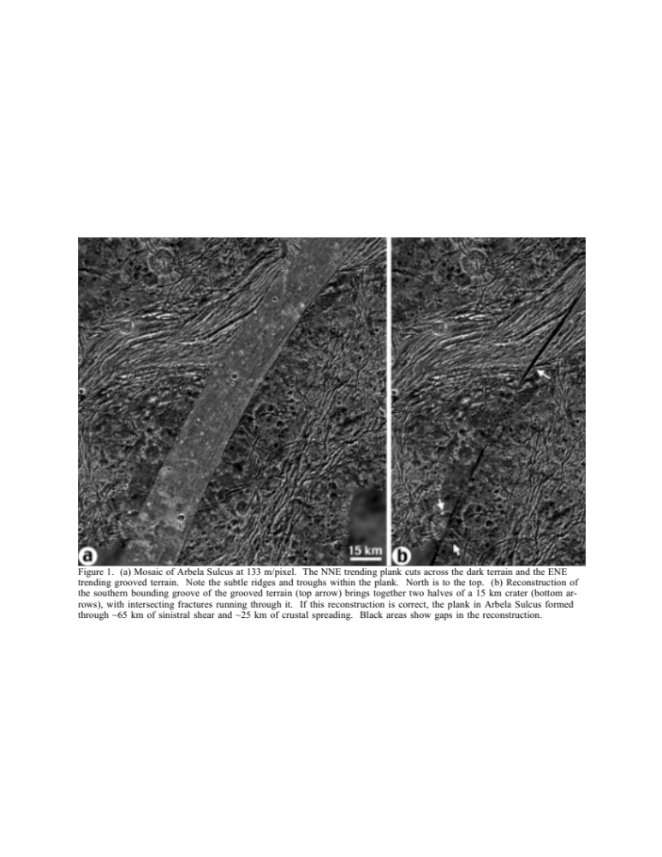
Where is this?
Notes:
This is a zoom-out of the previous slide. Sulcus could be formed by spreading and shear with upwelling … or … volcanism, but the latter implies peaked volcanic structures or caldera … the puzzle fit supports the former, not the latter

Slide 3
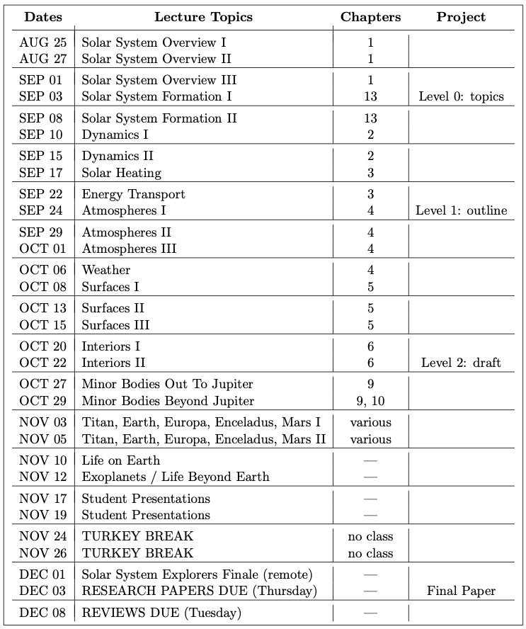
Syllabus Update

Slide 4
Planetary Sciences Project
Level 0 … Topics … Thu 03 SEP
Level 1 … Outline … Thu 24 SEP
Level 2 … Draft #1 … Thu 22 OCT
Level 3 … Draft #2 … [skipped]
Presentations … in class … 10+12 NOV
Level 4 … Final Paper … Tue 03 DEC

Slide 5
Research Paper Level 1
due Thursday, 24 SEP
Outline of your research project (worth 10 points)
use AAS Overleaf LaTeX link on website
the more original, the better
hand in printed version
10 pieces for points required:
1. Abstract 2+ sentences
2. Introduction 2+ sentences … why do we care? (include refs!)
3. Motivation 2+ sentences … why do YOU care?
4. Sections listed … Sample, Observations/Data, Results …
X. Discussion [maybe nothing here, yet]
5. Tables 1+ listed
6/7. Figures 2+ listed
8/9/10. three REFEREED references

Slide 6
Solar System Explorers: 17 SEP
Describe a dynamical situation in the Solar System involving 2 or more bodies that is unusual, in the sense that it is not a simple orbit.
1.
2.
3.
4.
5.
6.
7.
8.
9.
10.
11.
12.
13.
14.
15.
16.
17.
18.
19.
20.

Slide 7

Dynamics II

Slide 8
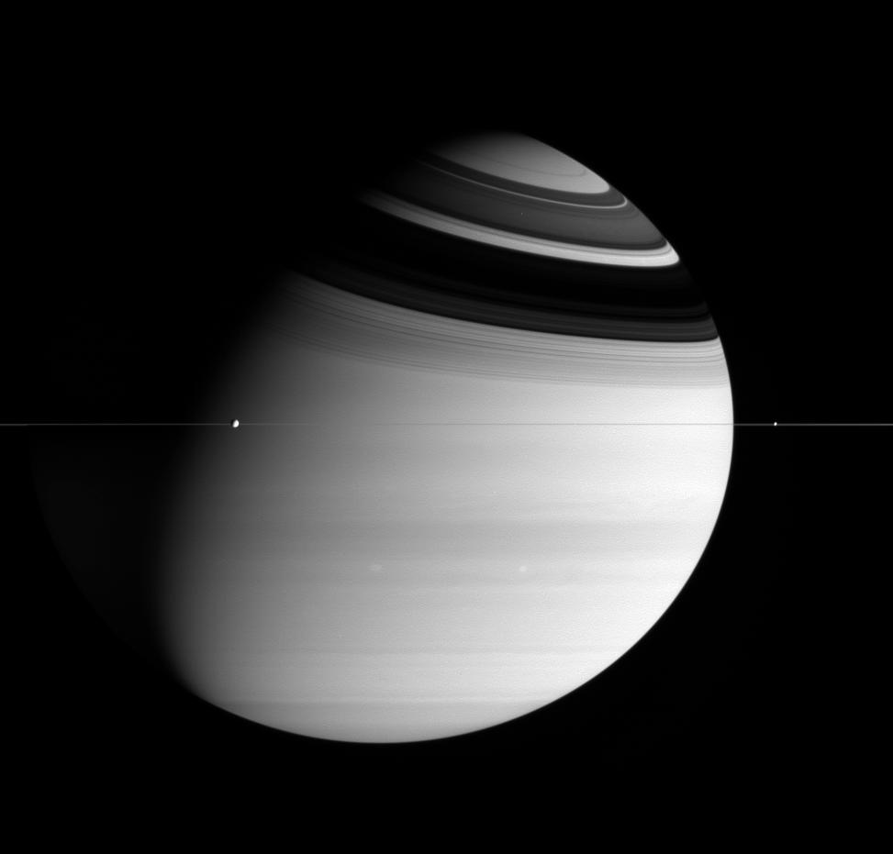
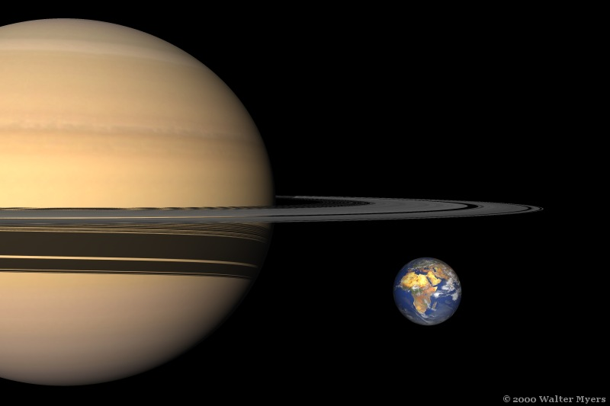
Saturn’s Rings
300,000 km wide and ~10 m (!) thick via spacecraft
Notes:
~1 km thick number comes from Earth-based observations … there are ”walls” of material that are ~1km high

Slide 9
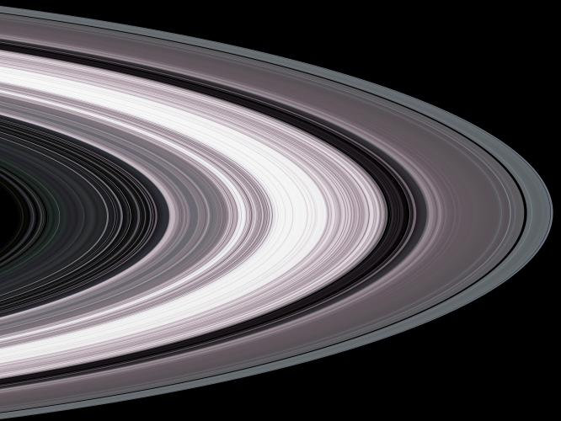
Saturn’s Rings
particles forced into plane by orbits
albedo 0.8 … shiny snowballs of H₂O
total mass only that of small moon
young … likely formed by Roche limit crossing

Slide 10
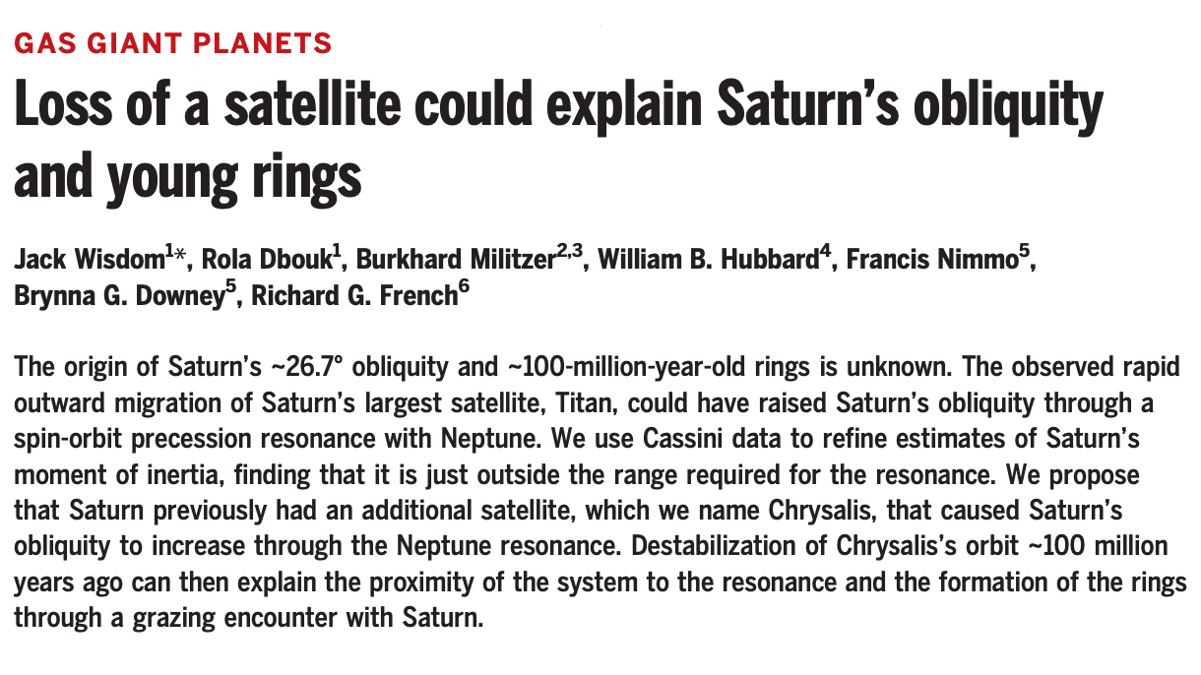
Saturn’s Rings: Origin
Science … 16 SEP 2022
https://www.reddit.com/r/space/comments/16fhldk/saturns_rings_are_mostly_around_10m_thick_but/

Slide 11
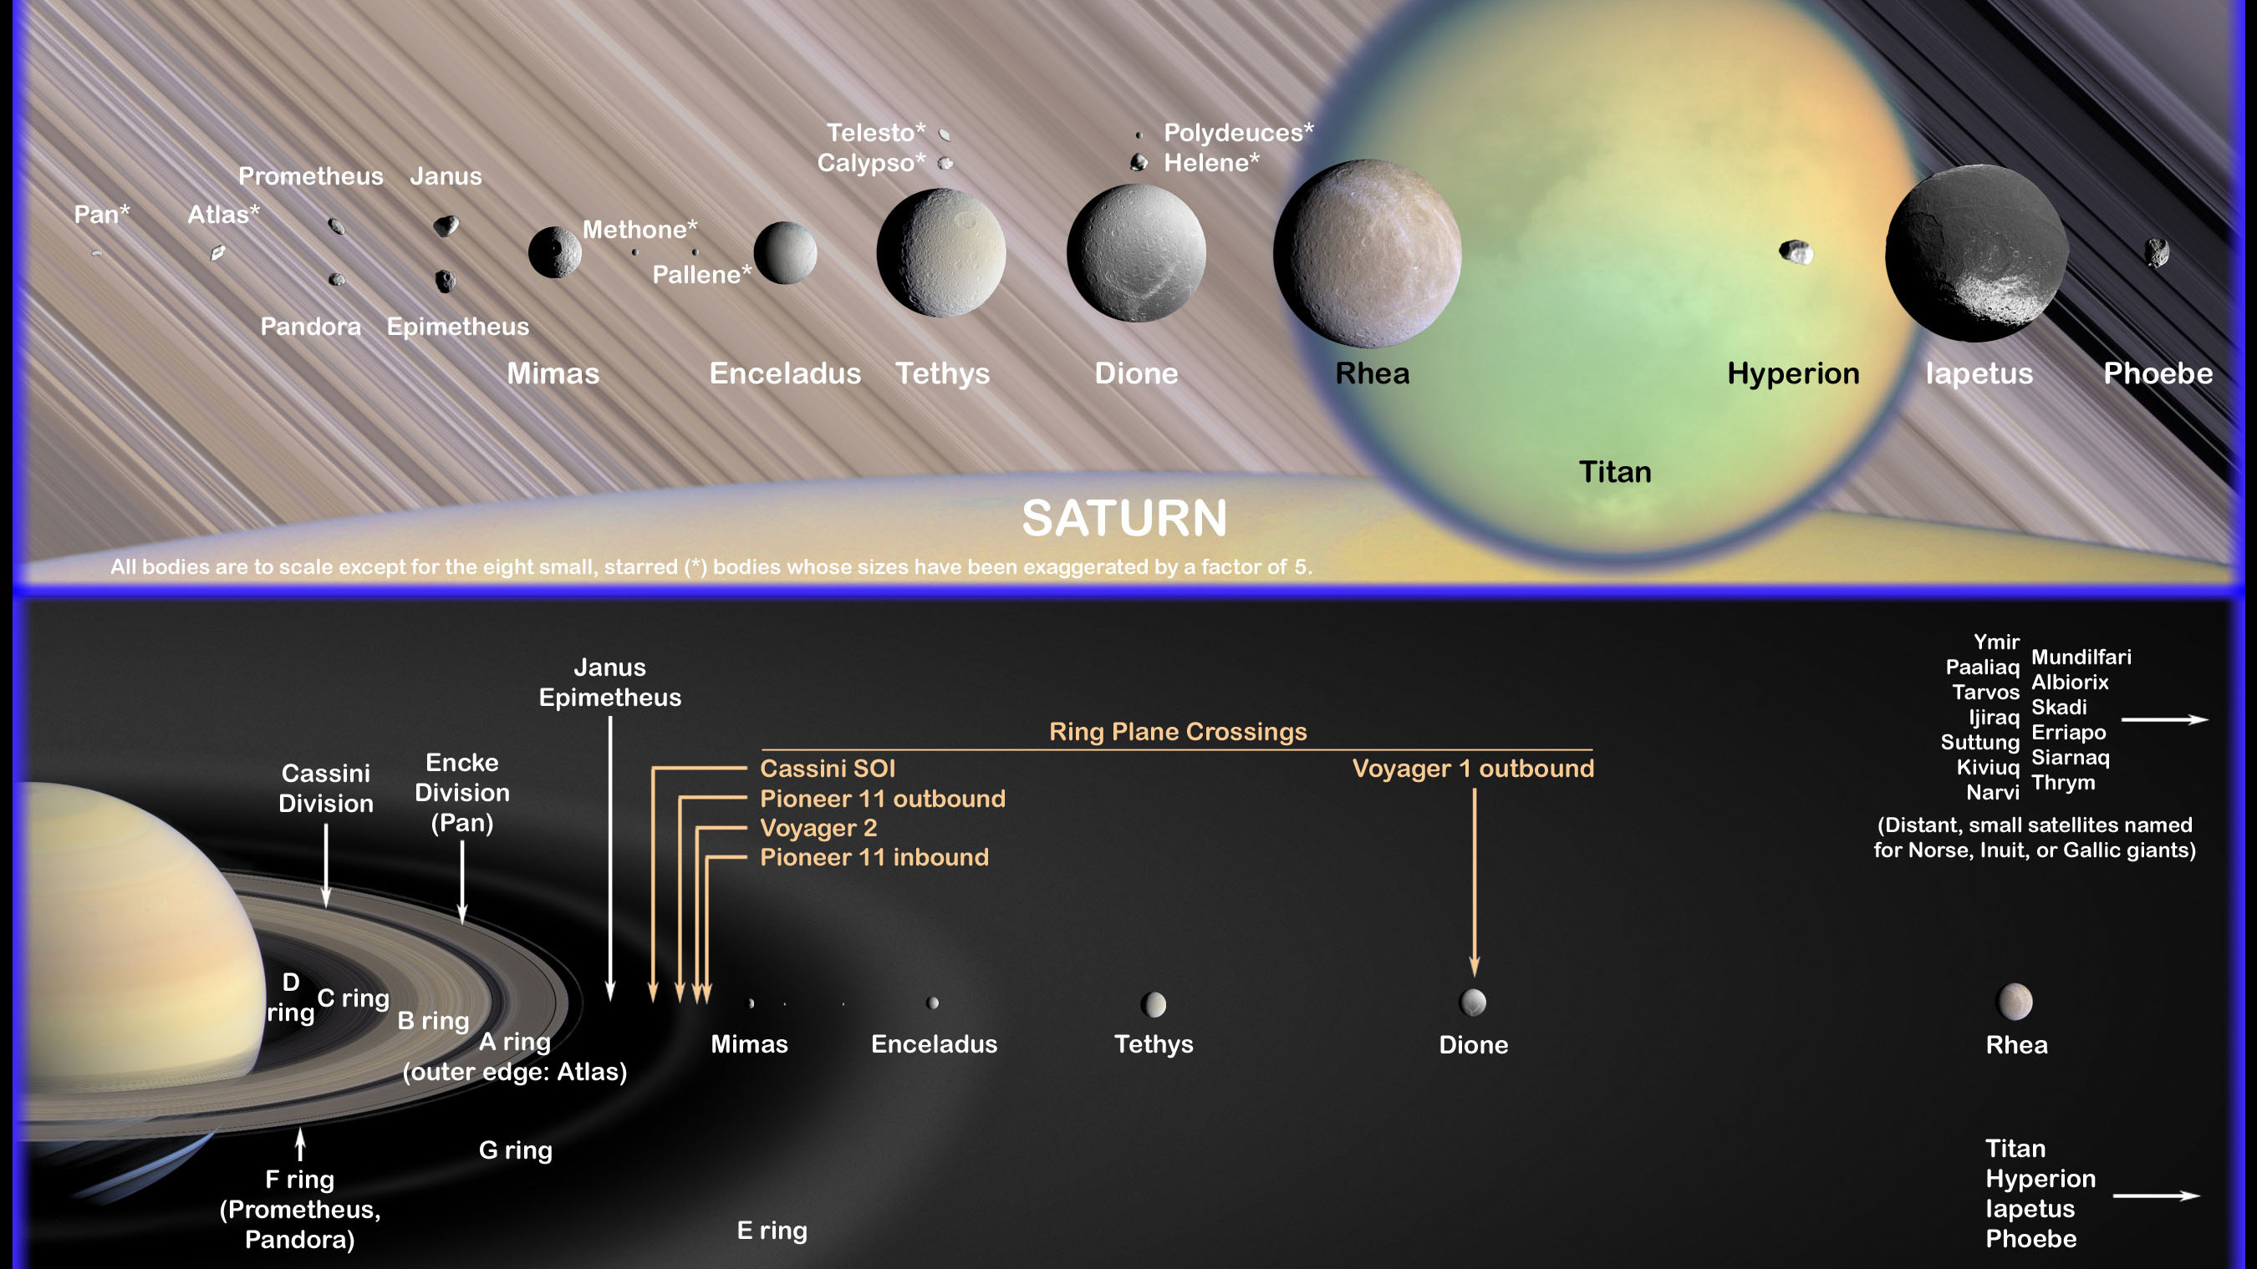
7 major rings … 2 major divisions … 1000s of ringlets
ABC rings seen from ground … major
DEFG rings seen from Voyager/Cassini … minor
Cassini Division Mimas 2:1 resonance
Encke Division Pan within A ring
A ring Atlas on edge (in 3:2 with Mimas)
F ring (braided) shepherds Prometheus + Pandora
E ring Enceladus volcanism (outside Roche)
G ring Mimas drives lumps of grinding dust
spokes … collisions in rings
Notes:
2007.0802: Cassini scientists may have identified the source of one of Saturn's more mysterious rings. Saturn's G ring likely is produced by relatively large, icy particles that reside within a bright arc on the ring's inner edge. The particles are confined within the arc by gravitational effects from Saturn's moon Mimas. Micrometeoroids collide with the particles, releasing smaller, dust-sized particles that brighten the arc. The plasma in the giant planet's magnetic field sweeps through this arc continually, dragging out the fine particles, which create the G ring.

Slide 12
The Saturn System
Notes:
all of circled moons affect rings

Slide 13
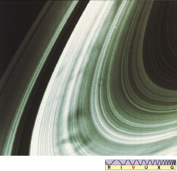
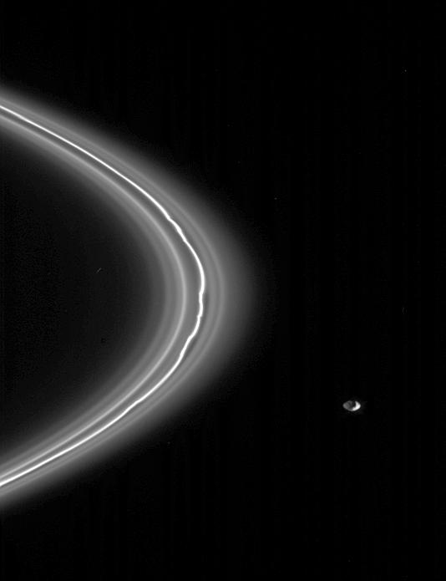
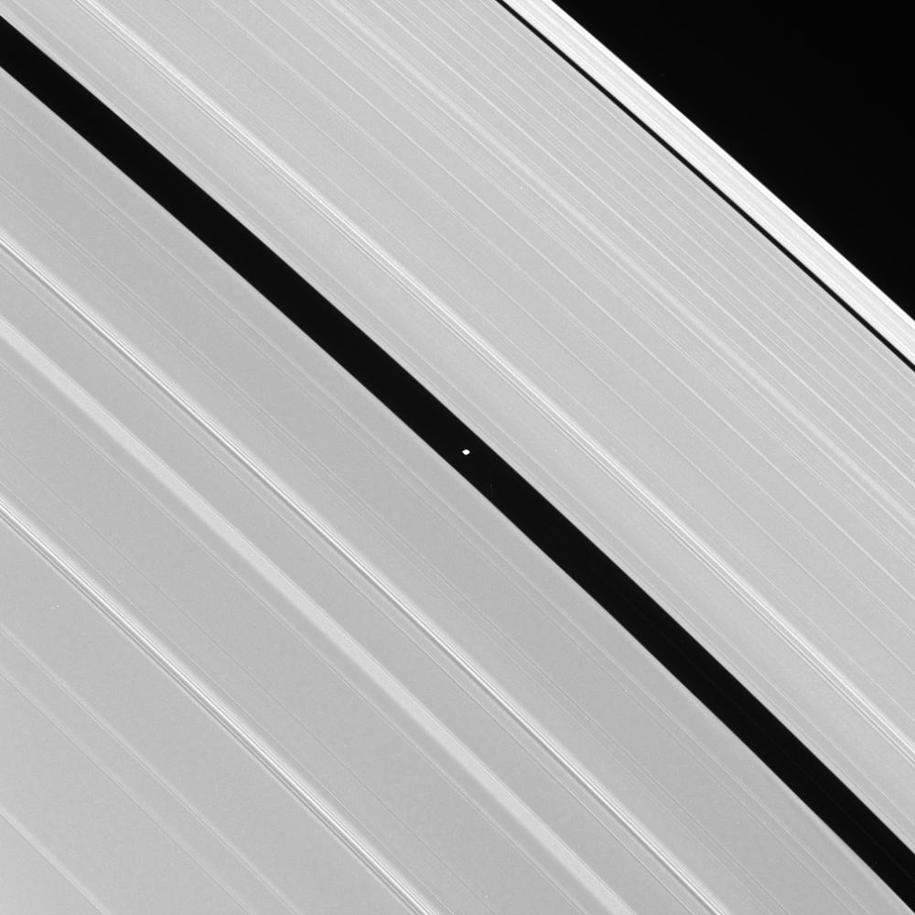
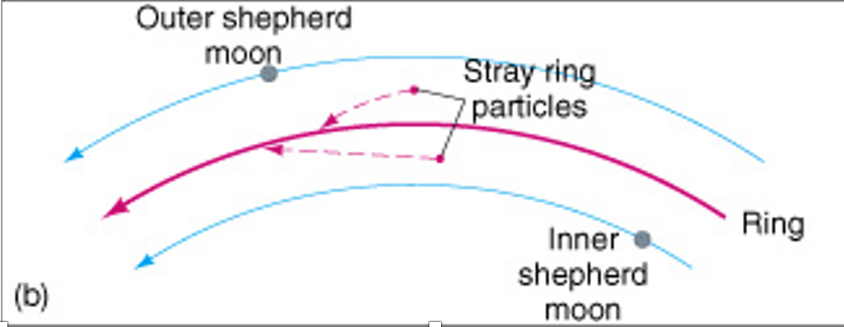
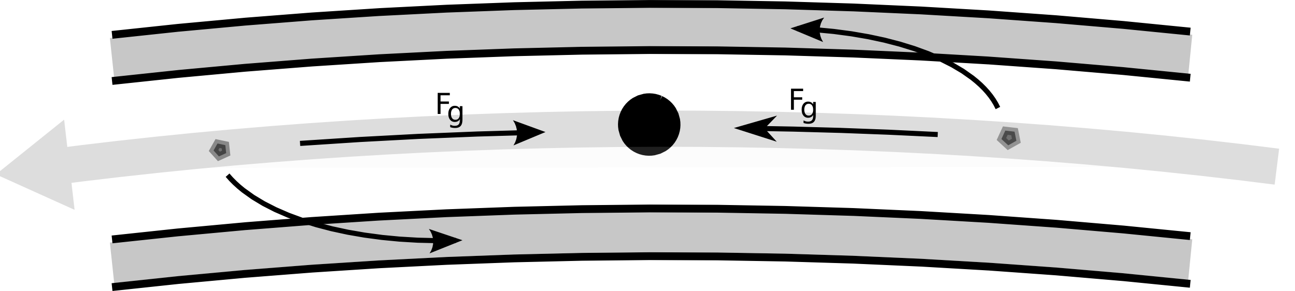
Saturn’s Rings Details
Pan
Prometheus
Pandora
Notes:
We still don't know for sure how the spokes are formed, but scientists suspect that the interaction between the solar wind and the magnetic field generates electrostatic, levitating ice or dust above the rings to form the spokes. see https://www.iflscience.com/hubble-photos-show-mysterious-dark-spokes-moving-in-saturns-rings-72297
braided F ring has Pandora to the right … Prometheus inside, not shown
Encke Gap has Pan in it … Gap formed because a particle behind the moon is pulled forward and accelerated outward, a particle ahead of the moon is pulled back and decelerated

Slide 14
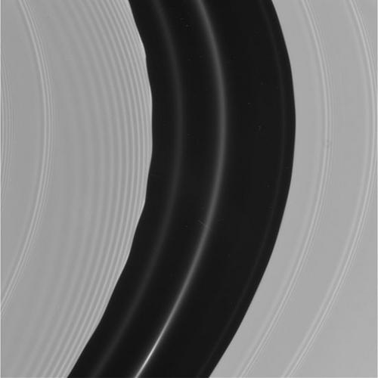
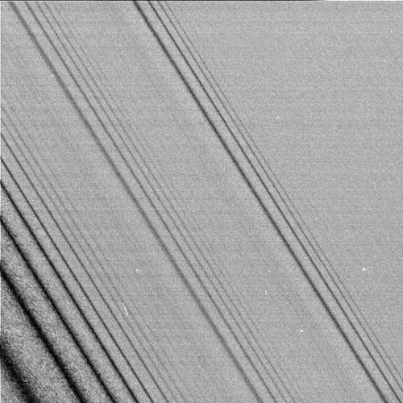
Saturn’s Rings Details

Slide 15
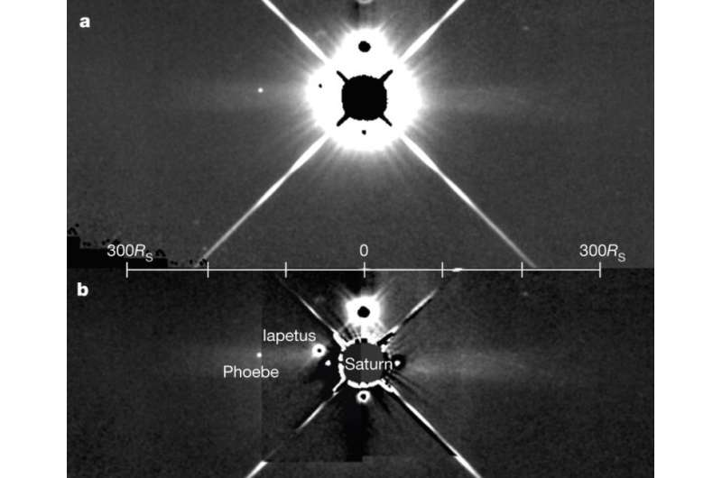
Saturn’s Rings Extent
infrared images with WISE … Saturn is a basketball in a football field
Notes:
Dark particles … small ones from Phoebe? … large soccer ball-sized ones leftover from formation?

Slide 16
Tides
tides are a differential gravitational force ~ 1 / r³
cause bulk motions of fluid components ocean tides, moonquakes, Io volcanoes
2 reasons --- bulge amplitude changes, position of bulge changes
b. cause torques (~1 / r⁶) that lead to rotational changes
Earth day lengthening, Pluto-Charon locked,
Mercury 3:2 spin:orbit resonance
eccentric orbit … spin can’t change …resonance
c. cause shape changes if tidal force > tensile strength/self-gravity
evidence for Moon’s shape --- closer in the past
d. likely creates rings
Notes:
2 reasons for Io both linked to eccentricity --- position shifts because Io doesn’t QUITE have correct rotation as it changes speed in its orbit
UGH?!? torque goes as 1/r^6 because … tide goes as 1/r^3 … those bulges then have gravitational effect on the primary as 1/r^2, but there effect is ALSO differential by 1/r because of the distance ~r between the bulges

Slide 17
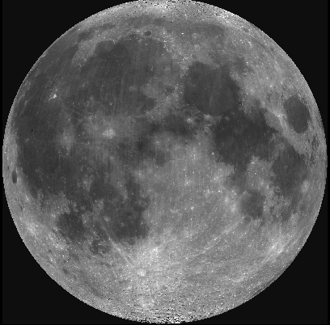
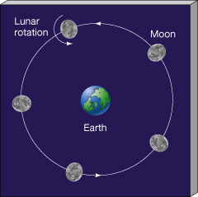
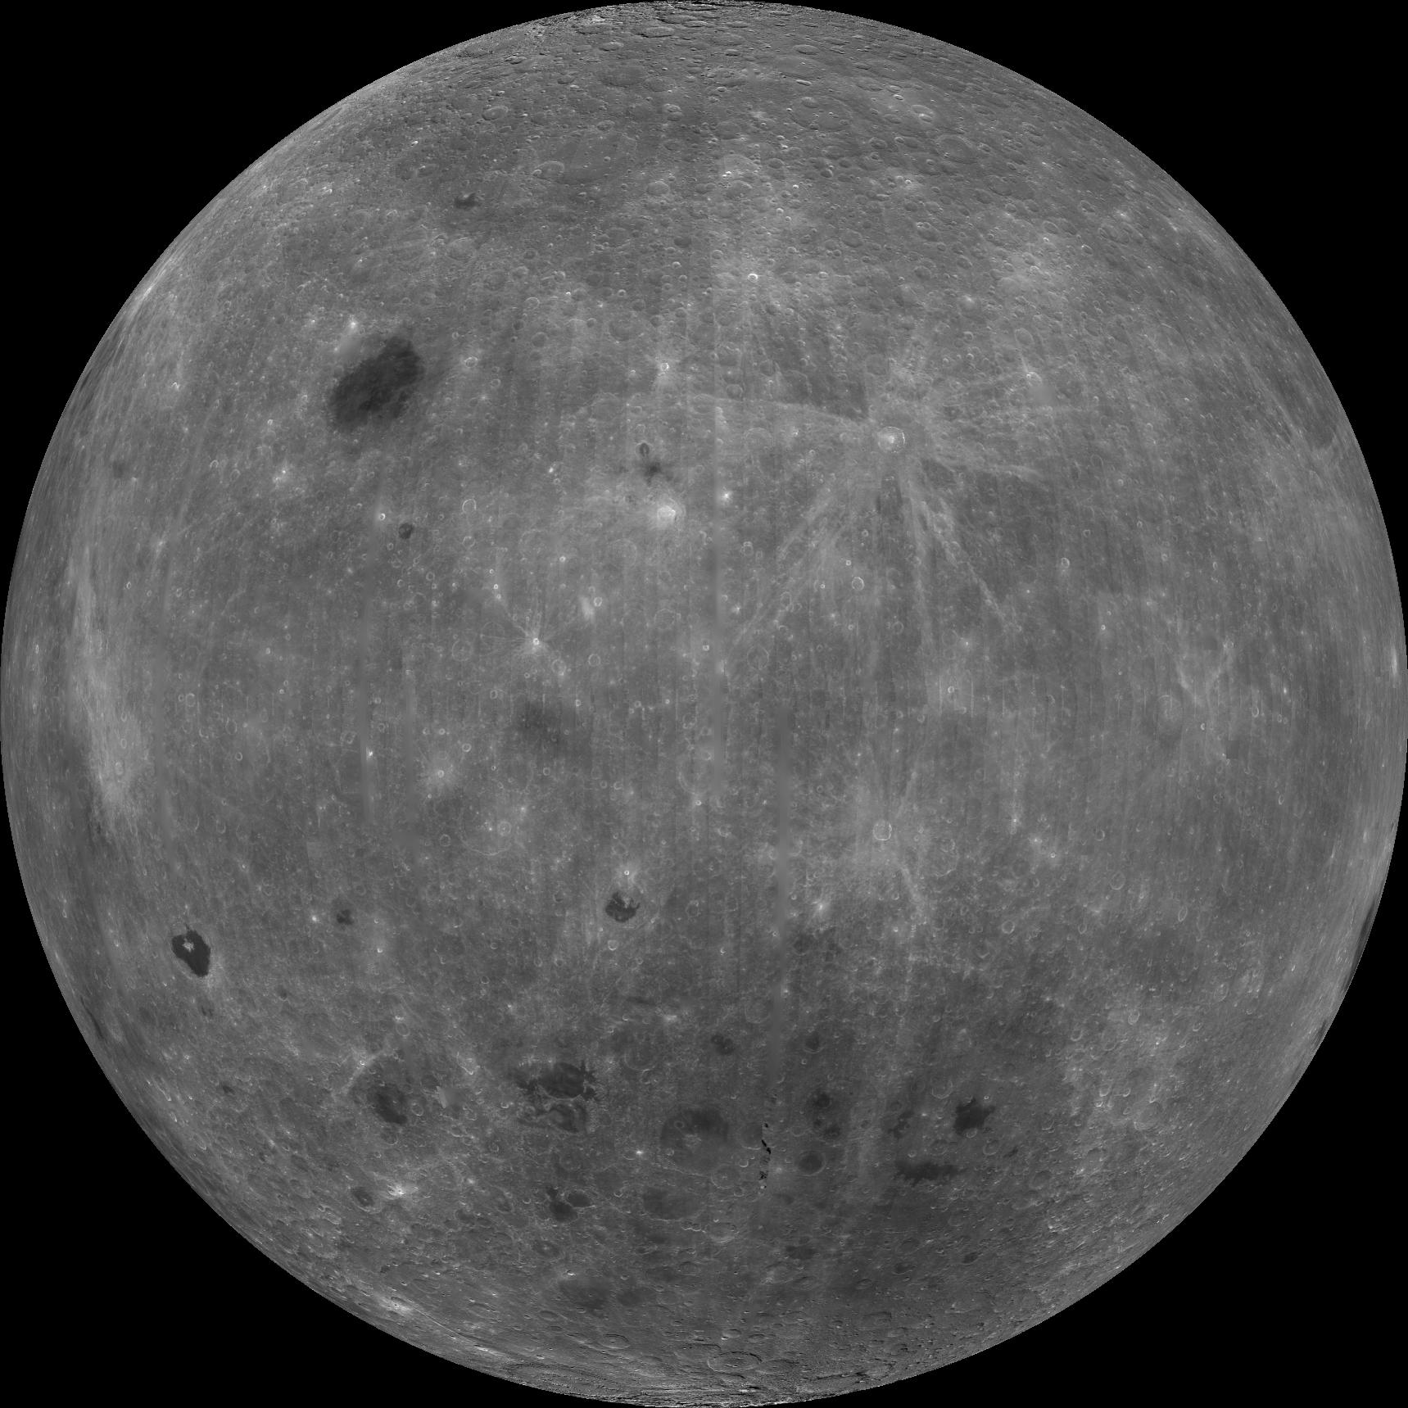
Moon’s Shape
bulge frozen at 2/3 current Moon distance

Slide 18
Tidal Forces
2 R G m₂
F _{tidal} ≈ ______________
r³
r is distance between two bodies
R is distance from center of stressed body
tides on Earth | m₂ (kg) | r (km) | F_{tidal/}2R⊕G
Sun | 1.99e30 | 1.50e08 | 5.90e05
Venus | 4.87e24 | 4.14e07 | 6.86e01
Moon | 7.35e22 | 3.84e05 | 1.30e06 | Winner! | 2.2 X Sun
Jupiter | 1.90e27 | 6.29e08 | 7.63e00
Earth-Moon tidal force is 22 X Moon-Earth tidal force
Jupiter-Io tidal force is 20,000 X Moon-Earth tidal force
Notes:
Earth’s mass is 81X Moon’s mass, but Earth is 3.67X Moon’s diameter, so tidal force is 81/3.67 = 22X more on Moon than Earth

Slide 19
Tides in Earth-Moon System
angular momentum is conserved, but …
can be swapped between rotation and revolution via tidal torques
on Earth: twice per 25 hours due to Moon
twice per 24 hours due to Sun (1/2 strength)
SSE! What are the two extreme tides called in the Earth-Moon system?
… not talking about daily tides, but monthly tides

Slide 20
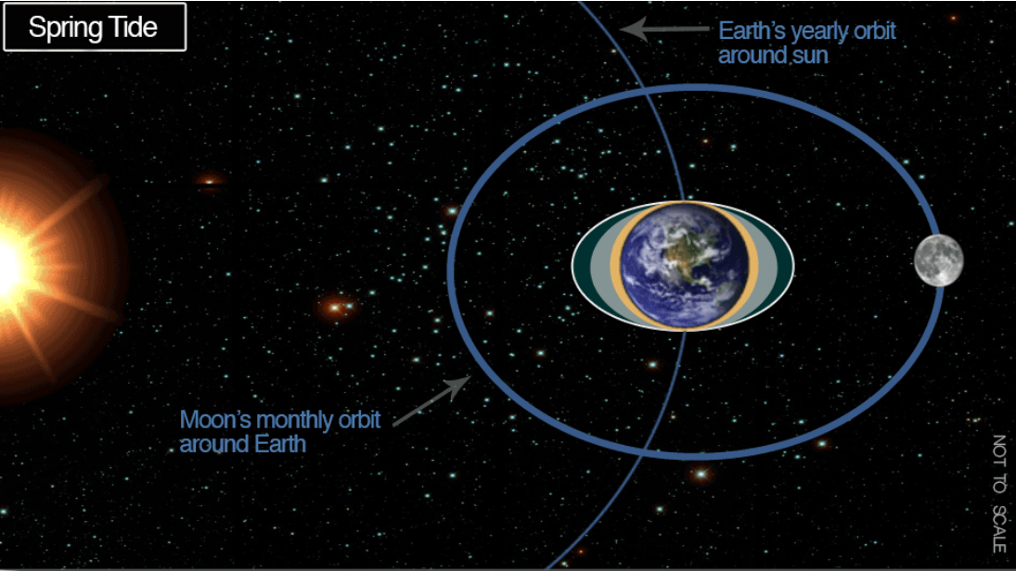
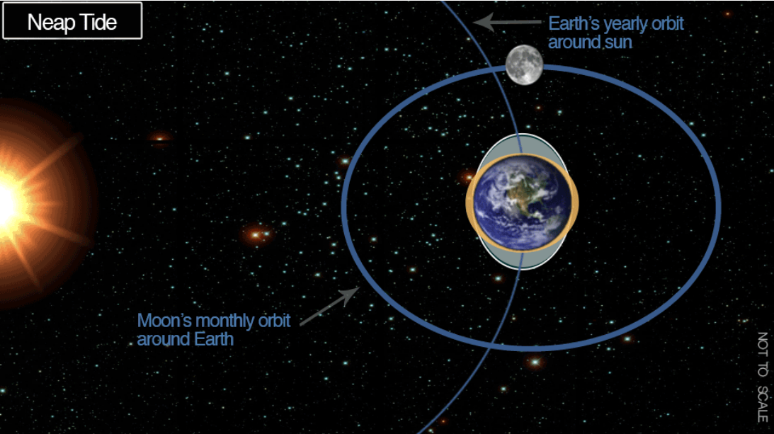
Tides in Earth-Moon System

Slide 21
Tides in Earth-Moon System
angular momentum is conserved, but …
can be swapped between rotation and revolution via tidal torques
on Earth: twice per 25 hours due to Moon
twice per 24 hours due to Sun (1/2 strength)
on Moon: mostly fixed because of synchronous rotation
but not entirely because of eccentricity … nutation
bulge torque: Earth rotates faster than Moon orbits
Earth not perfectly elastic, so bulge not on Earth-Moon line
Moon pulls back on bulge --- Earth slows down
Earth bulges pull on Moon --- torque acc. Moon outward ~ 1/r⁶
death spirals: moons moving retrograde, or faster than planet rotates

Slide 22
Roche Limit
Roche limit: point beyond which an object is ripped apart by tidal forces
a_{Roche} = 2.456 R_{p} (ρ_{p}/ρ_{s})^{1/3}
moons inside Roche limit !?!?!
Jupiter has 3 +
Saturn has ~ 0
Uranus has 8 +
Neptune has 4 +
assumes fully deformable (fluid) moon
(2) assumes no “tensile strength”
… moving inward, resulting orbital systems have …
… large moons … small moons … ring particles
Notes:
p = planet … s = satellite, moon counts inside Roche limit from Figure 11.5 in Planetary Sciences, 2nd edition

Slide 23
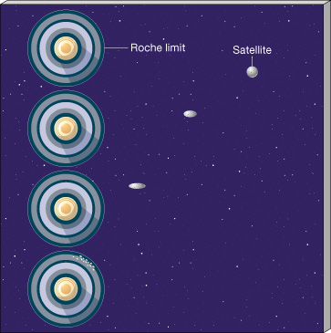
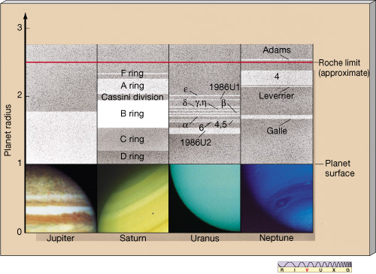
Roche Limits and Ring Systems
Notes:
moon Galatea likely drives arcs in Neptune’s Adams ring -- shepherds the Adams ring

Slide 24
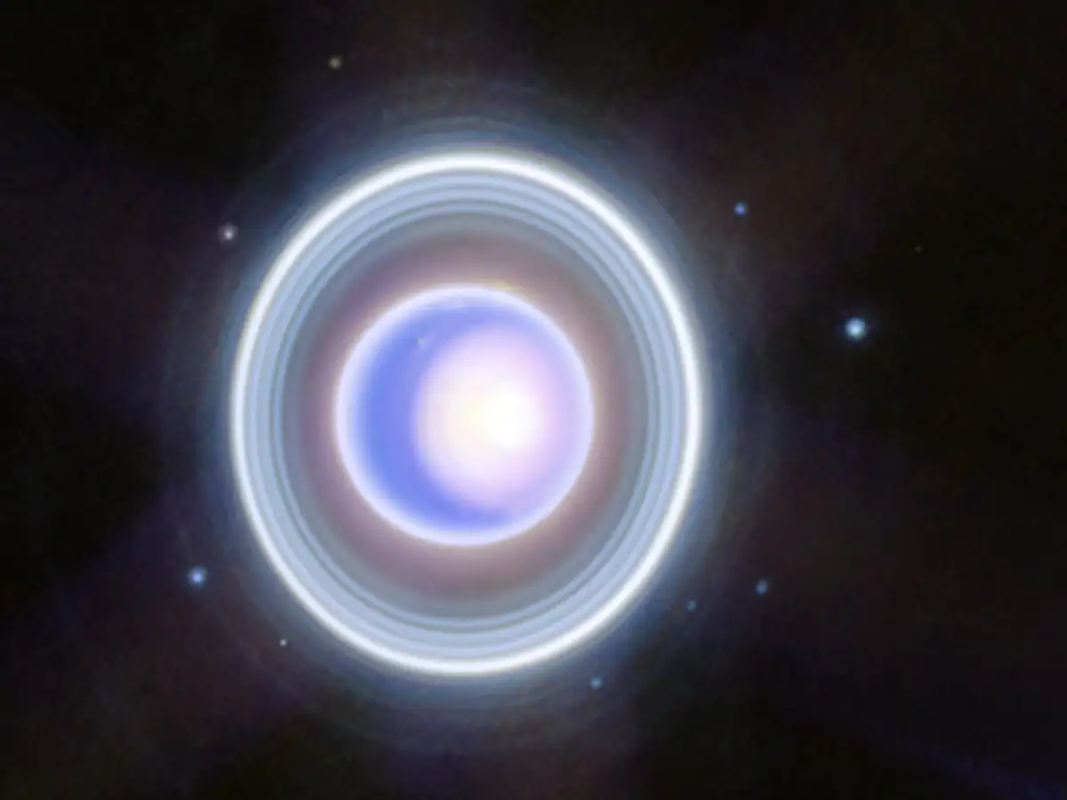
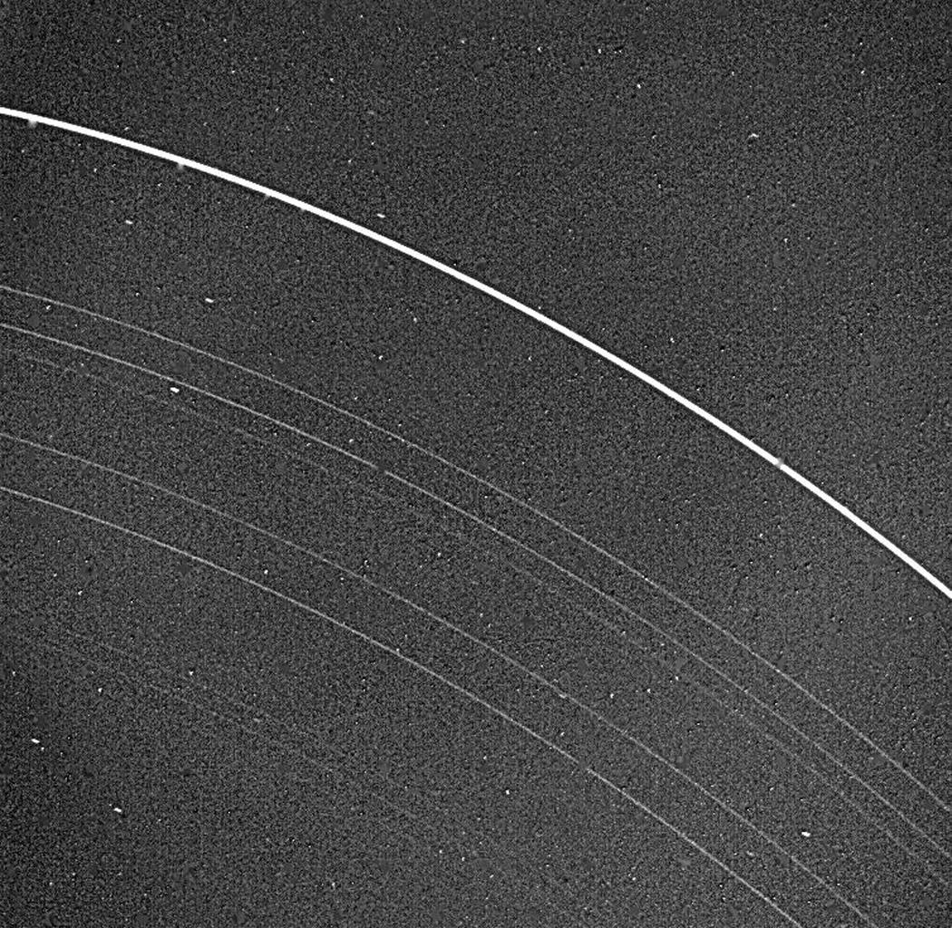
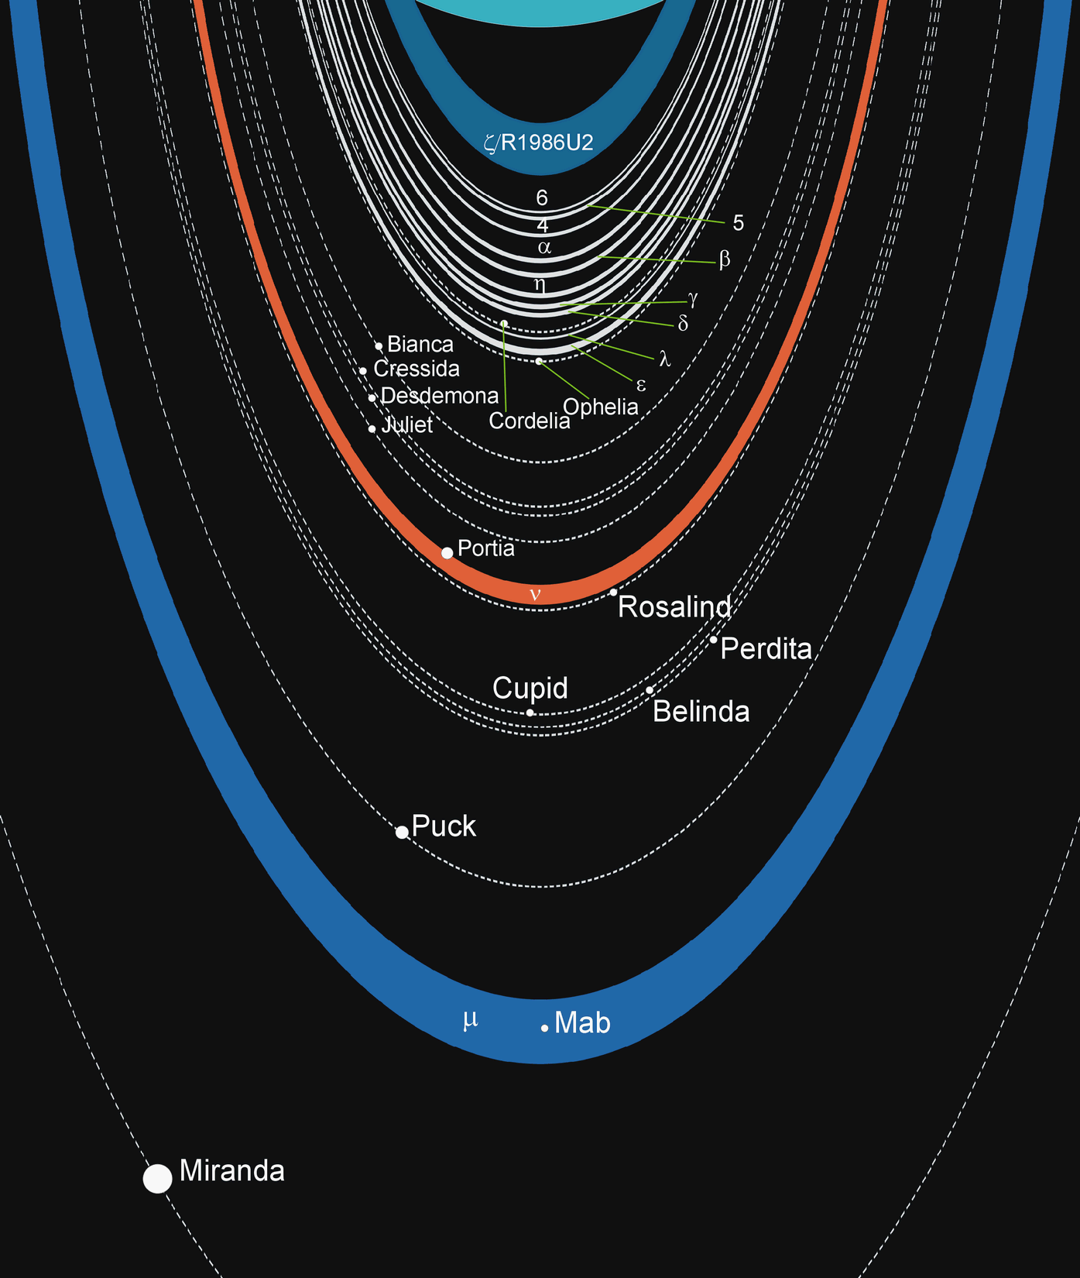
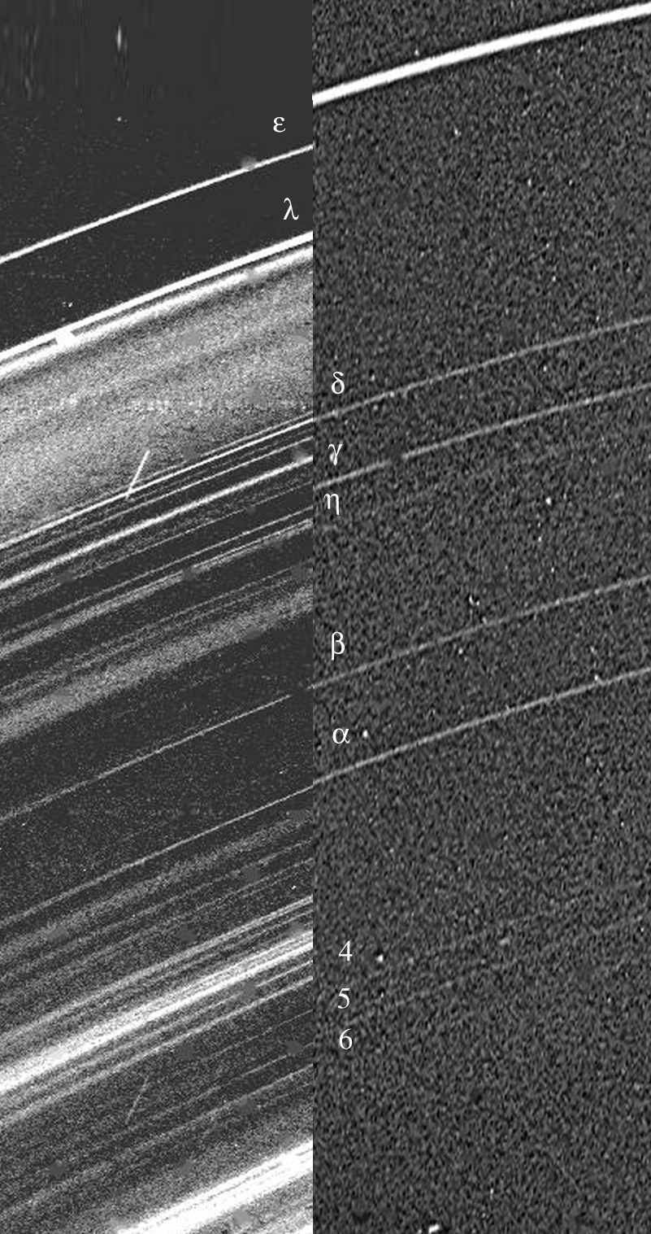
Uranus’ 13 Rings
5 rings from ground
+ 4 imaged by Voyager 2
albedo ~ 0.02
+ 2 more by V2
+ 2 more by HST
= 13 rings
Notes:
1977: 5 rings … found via occultation (alpha through epsilon)
1978: 9 rings … via picture from Voyager 2, 15 second image … but, compare forward scatter (clean) vs. backscatter (messy!)
1986: 11 rings … 9 rings via 15 second pic by Voyager 2 + 2 more rings = lambda and R1986U2
2003-2005: 2 more (largest) rings via HST
final image is from JWST

Slide 25
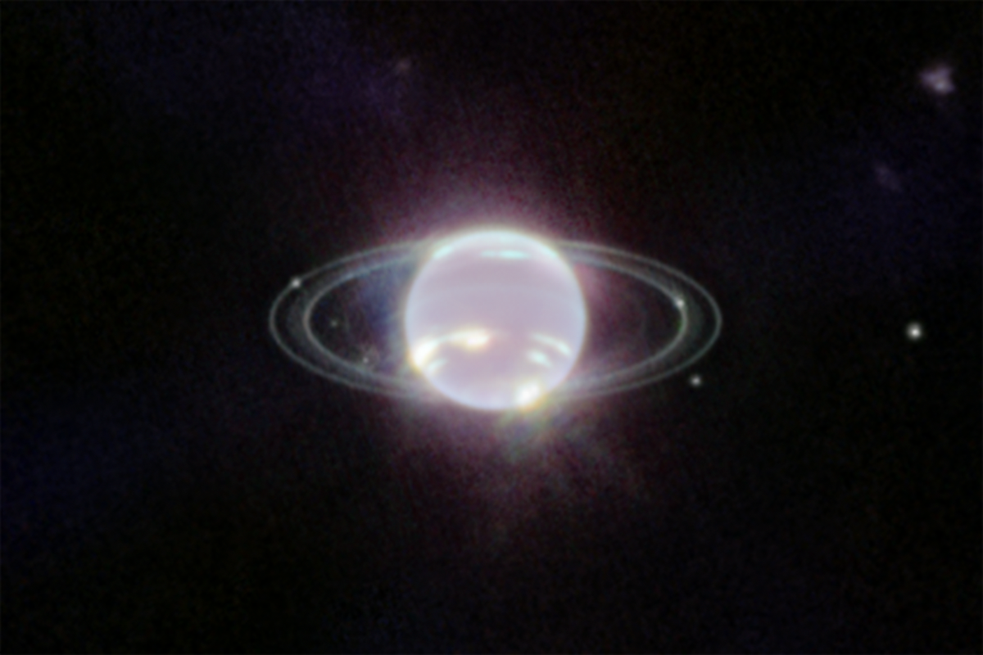
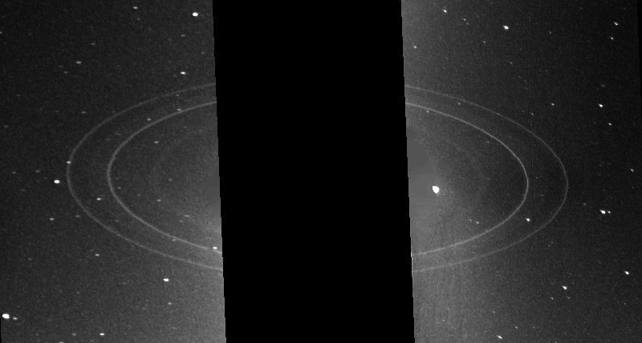
Neptune’s 4 Rings
hints via occultations
but nothing definitive
until Voyager 2
Adams
predicted
Lassell
found Triton
LeVerrier
predicted
Galle
observed
Notes:
Adams + LeVerrier + Galle credited with discovering Neptune
picture from Voyager 2
outside to inside --- Adams … Lassell (fuzzy)… LeVerrier … Galle
moon Galatea bright spot at 9:30 in Adams ring likely drives arcs and shepherds Adams ring
moon Despina bright spot at 2:30 in Leverrier ring

Slide 26
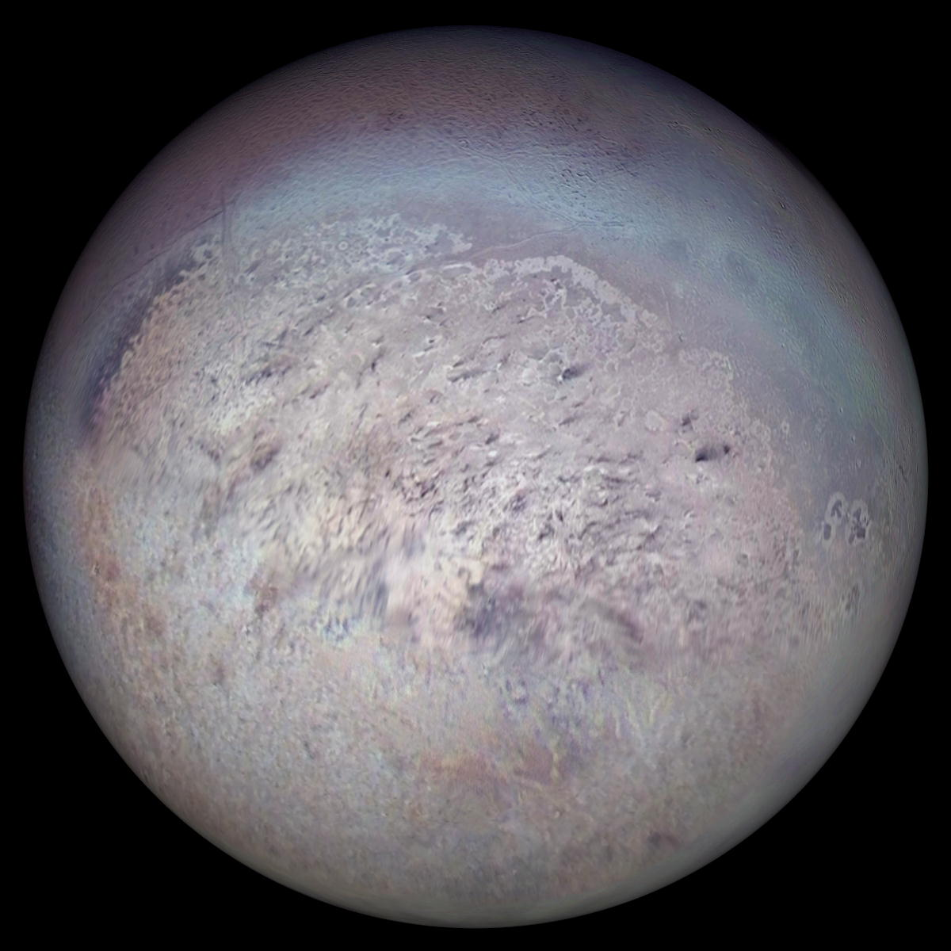
Billions of Years from Now…
Lassell
discovers
the
very
first
TNO in
OCT 1846!
~3.6 Gyr
until
ring
or
impact
Notes:
Lassell discovered Triton in 1846 … 150 years before Aman was born

Slide 27
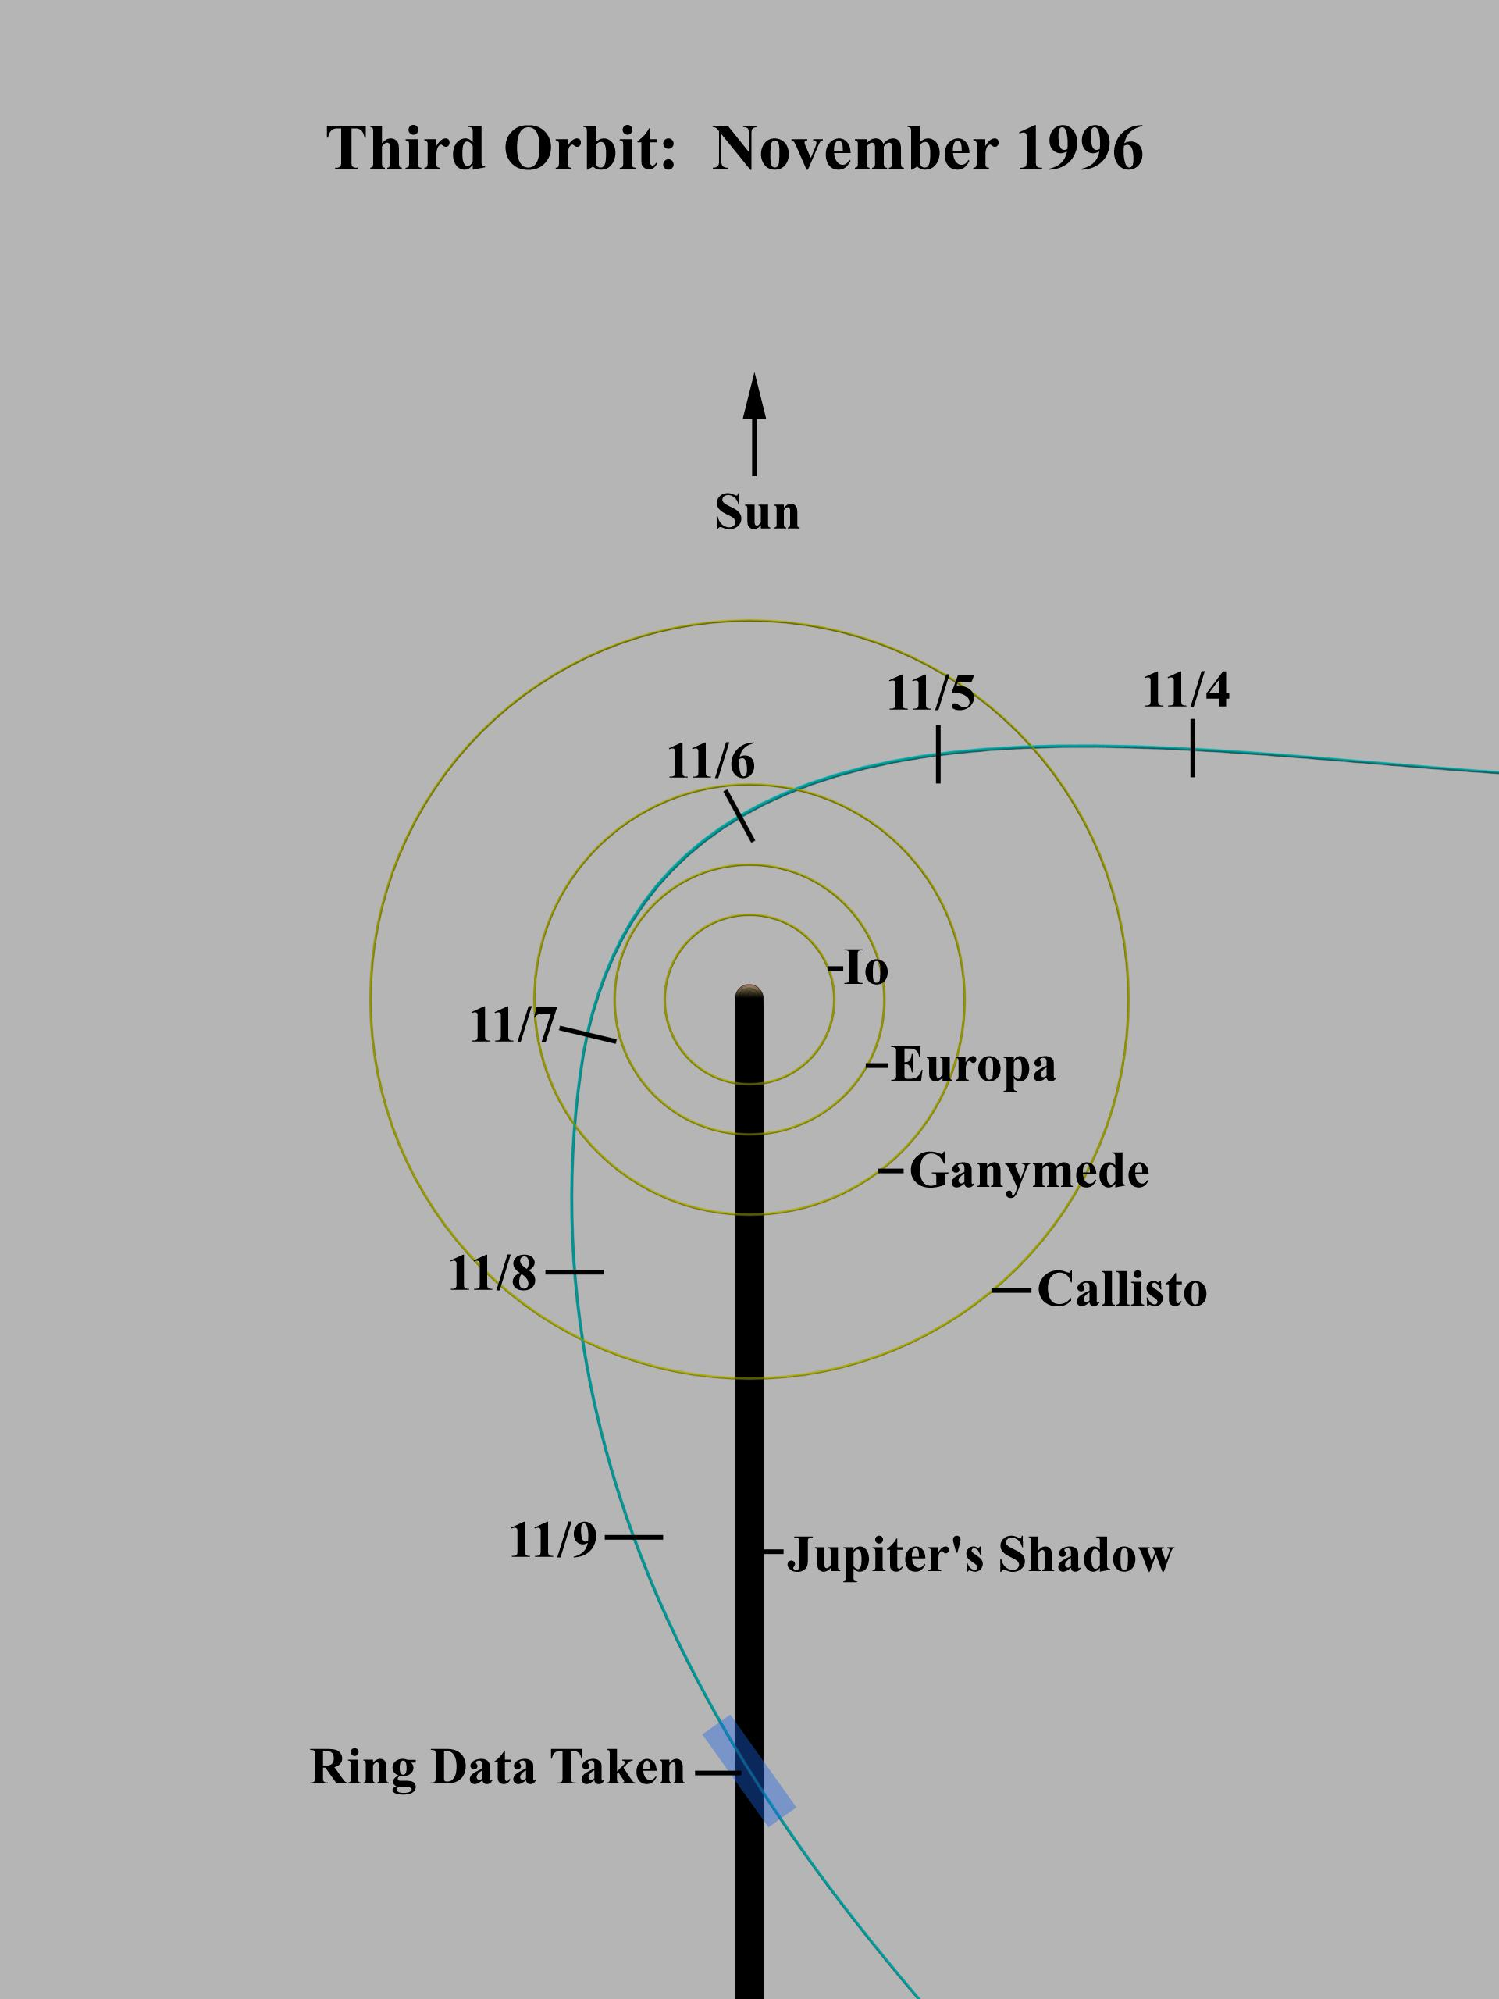
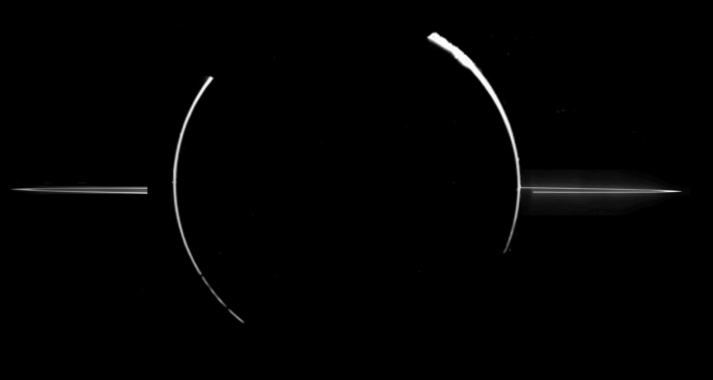
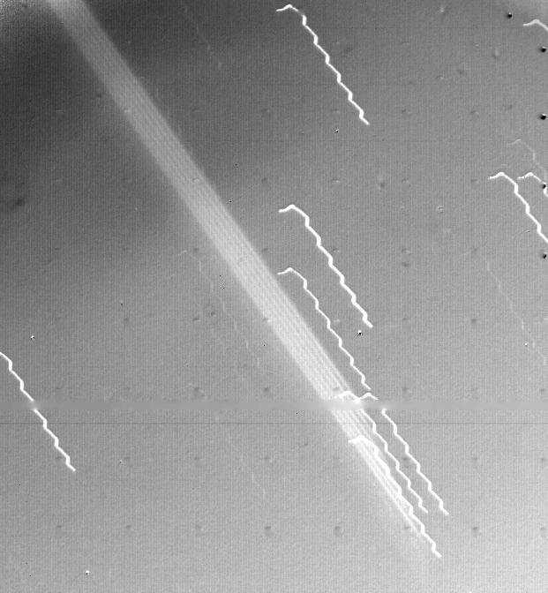
Jupiter’s Rings
discovered by Voyager 1 in 1979
imaged by Galileo in 1996
Notes:
wiggly lines are 78 sec drift of Voyager 1 during 11+ min exposure

Slide 28
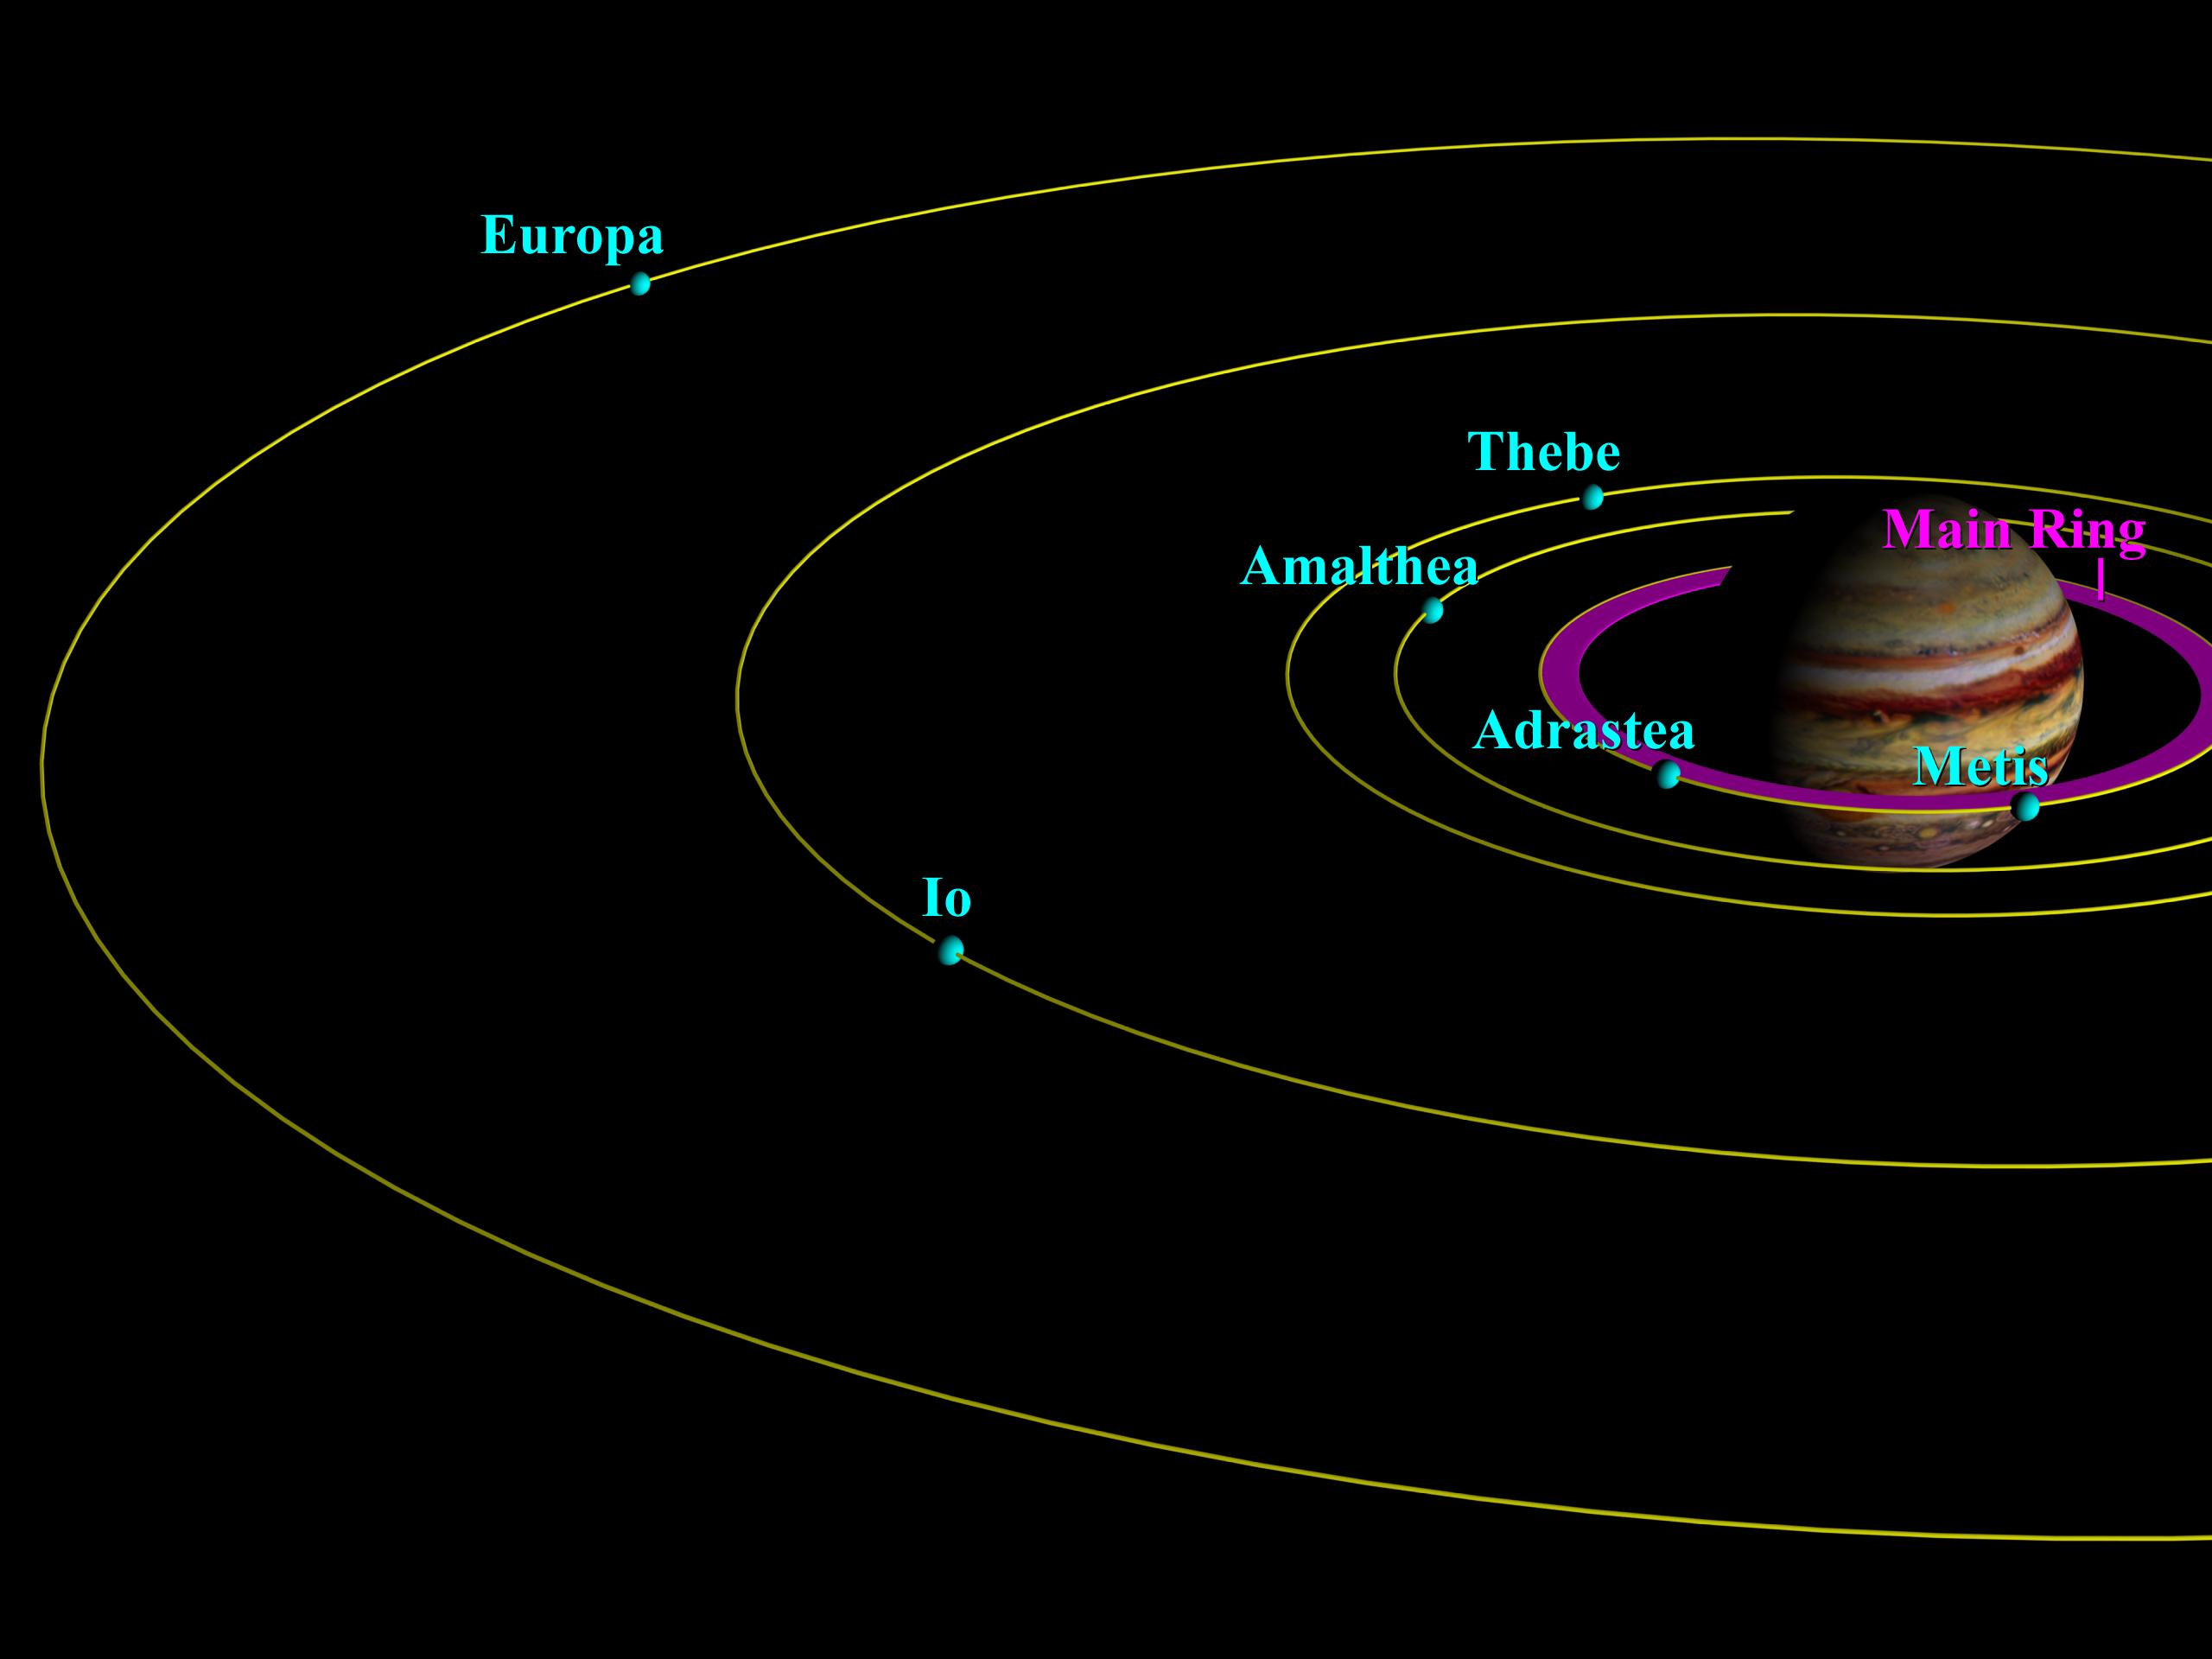
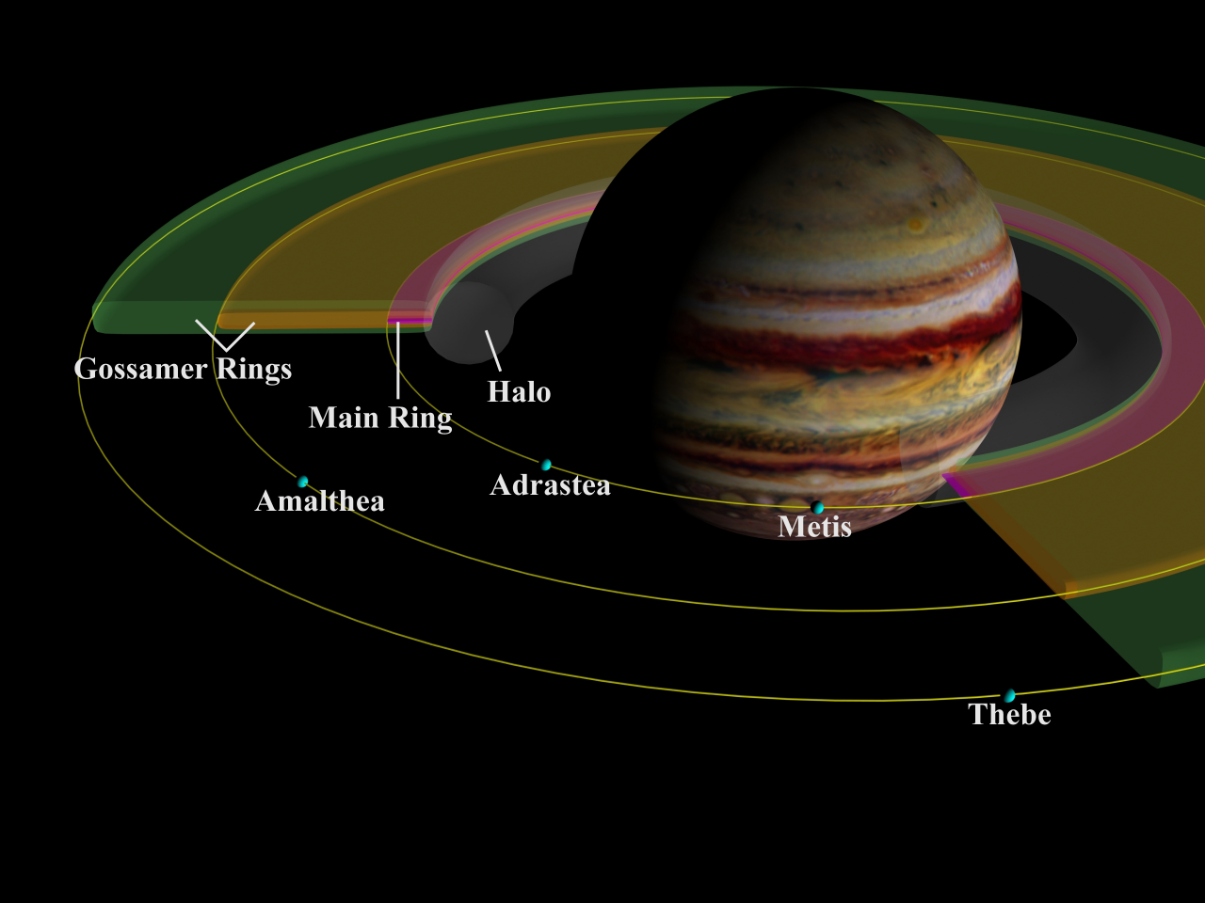
Jupiter’s Rings Details
Notes:
rings formed from impact debris of meteoroids slamming into Jupiter’s four small inner satellites
Metis (a = 128000 km) and Adrastea (a = 129000 km) are in i~0 orbits so the red ring is thin
Amalthea and Thebe are in inclined orbits, so their rings are thick

Slide 29
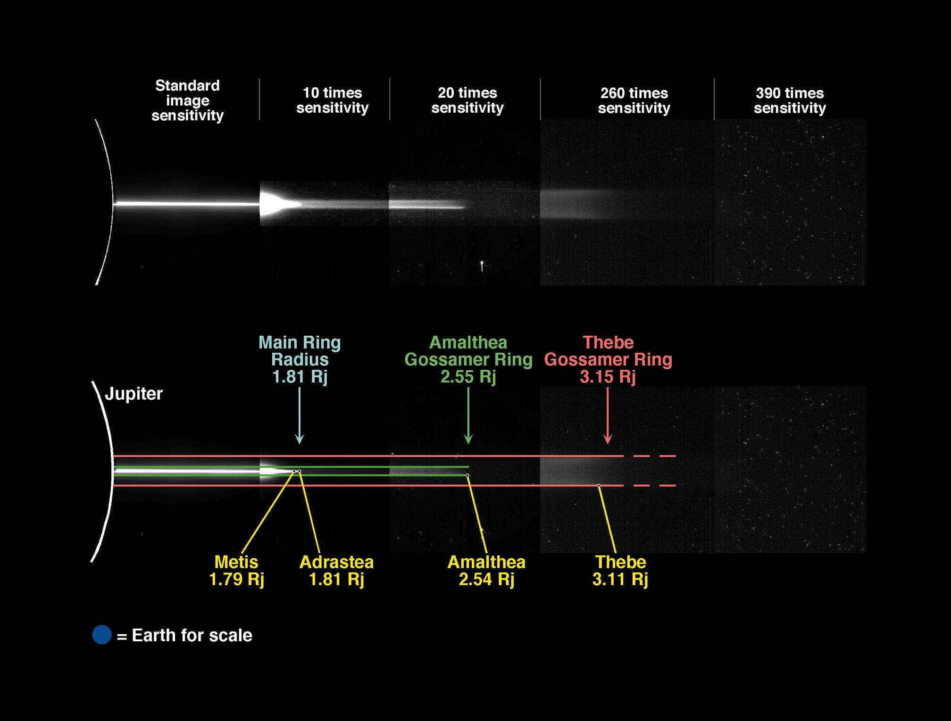
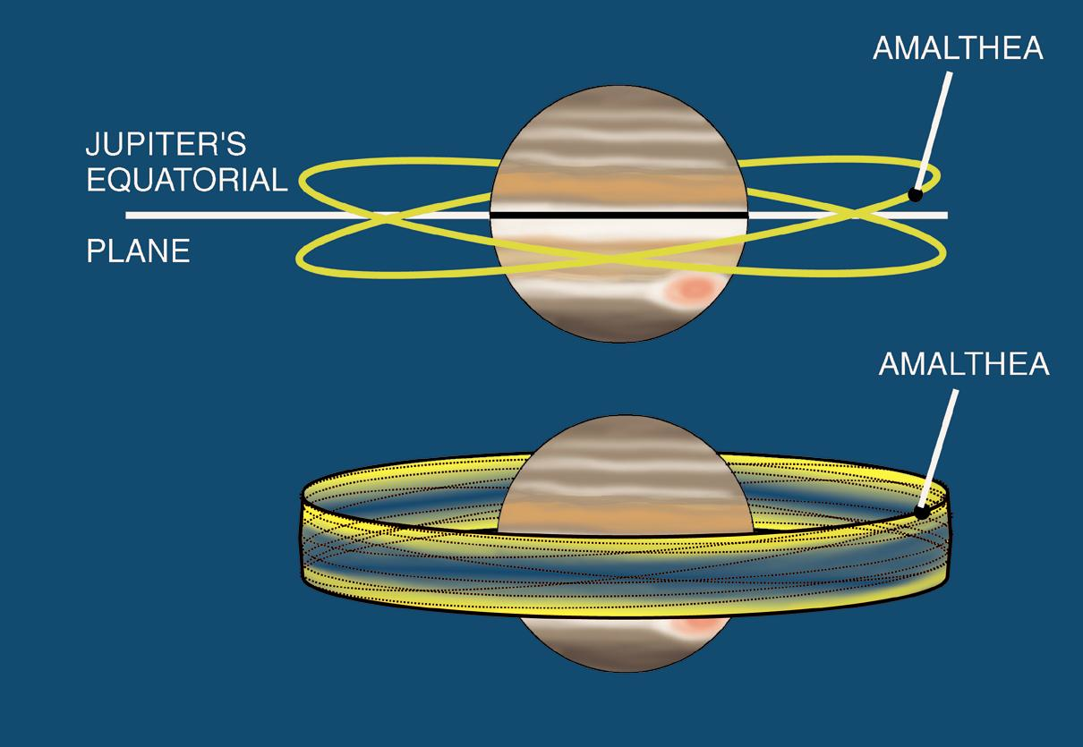
Jupiter’s Rings Details
Notes:
rings formed from impact debris of meteoroids slamming into Jupiter’s four small inner satellites
Metis (a = 128000 km) and Adrastea (a = 129000 km) are in i~0 orbits so the red ring is thin
Amalthea and Thebe are in inclined orbits, so their rings are thick

Slide 30
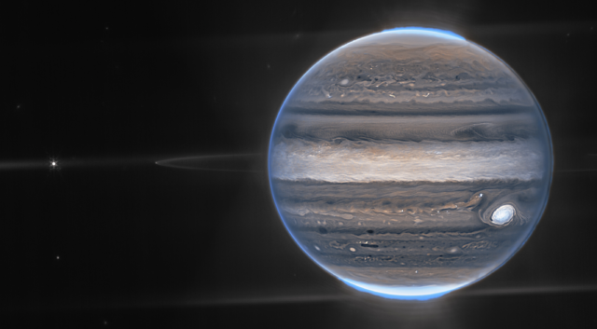
Jupiter’s Rings Details
northern aurora
Amalthea
Adastrea
stupid
photobombing
galaxies
southern aurora
Notes:
streaks in north and south are diffractions from aurorae
streak on left is diffraction from Io

Slide 31
Why Detectable in Infrared?
Amalthea
Adastrea
Notes:
streaks in north and south are diffractions from aurorae
streak on left is diffraction from Io

Slide 32
…………………………
Notes:
32

Slide 33
Solar System Explorers: 24 SEP
How does the Sun affect objects in the Solar System?
1.
2.
3.
4.
5.
6.
7.
8.
9.
10.
11.
12.
13.
14.
15.
16.
17.
18.
19.
20.

Slide 34
Solar System Explorers
1. What three ices dominate the ice giants’ composition (that is ice)?
…
2. Do terrestrial or jovian planets have a larger range in albedo?
…
3. If Enceladus’ tiger stripes have a temperature of 180 K, at what wavelength do they emit the most photons?
…
4. Do protoplanetary disks last roughly 10⁵, 10⁷, or 10⁹ years?
…
5. What particular problem does the Nice Model solve in the Solar System?
…
B. Name any moon of Uranus.
…

Slide 35

Solar System Explorers

Slide 36
Solar System Explorers
1. What three ices dominate the ice giants’ composition (that is ice)?
H₂O … NH₃ … CH₄
2. Do terrestrial or jovian planets have a larger range in albedo?
terrestrial = 0.1 to 0.7 … jovian = 0.4 to 0.5
3. If Enceladus’ tiger stripes have a temperature of 180 K, at what wavelength do they emit the most photons?
16 microns
4. Do protoplanetary disks last roughly 10⁵, 10⁷, or 10⁹ years?
10⁷ years
5. What particular problem does the Nice Model solve in the Solar System?
4 giant planets are not in circular, coplanar orbits
B. Name any moon of Uranus.
Juliet, Portia, Miranda, Titania, Oberon, Puck, Cordelia, Ophelia, Bianca, Cressida, Desdemona, Rosalind, Ariel, Belinda, Umbriel …
Notes:
25 of 27 from Shakespeare
Juliet = Romeo and Juliet
Portia = Merchant of Venice
Miranda = The Tempest
Titania + Oberon + Puck = Midsummer Night’s Dream
Ariel = The Tempest and AP’s poem …
Umbriel = Alexander Pope’s poem The Rape of the Lock … meaning the theft of a lock of hair

