Slide 1
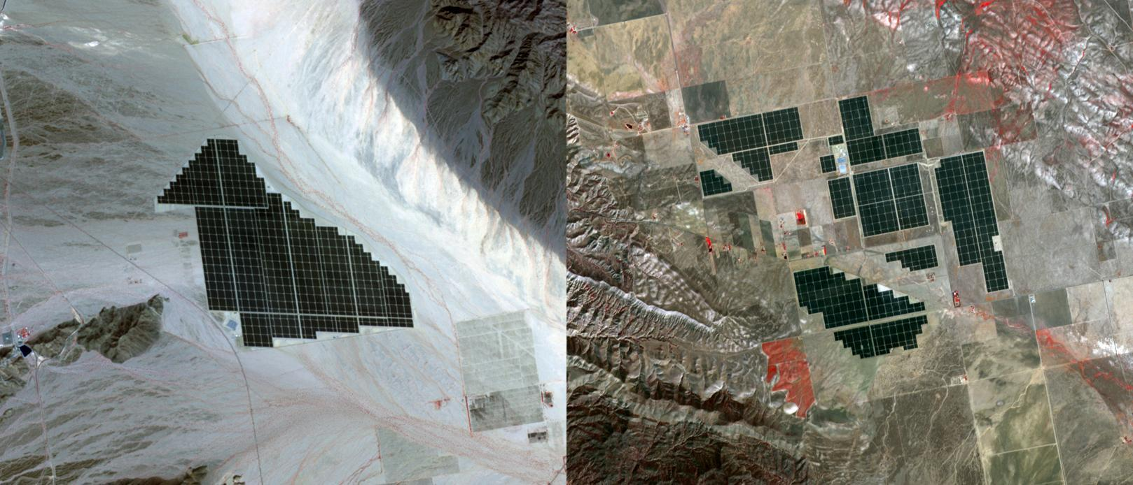
Where is this?
12 km
12 km
Notes:
EARTH BY TERRA: On February 15, 2015 the Desert Sunlight solar project in California's Mojave Desert became operational. The 550-megawatt plant generates enough electricity to power 160,000 average homes. Covering an area of 16 km2, the 8.8 million cadmium telluride photovoltaic modules take advantage of the more than 300 days of sunshine. Desert Sunlight joins the similar-sized Topaz Solar Farm in San Luis Obispo County, CA, that became operational in June, 2014. The Desert Sunlight image (left) was acquired March 12, 2015 and is located at 33.8 degrees north, 115.4 degrees west; the Topaz image (right) was acquired September 11, 2014 and is located at 35.4 degrees north, 120.1 degrees west. Each image covers an area of 10.5 x 12 km.

Slide 2
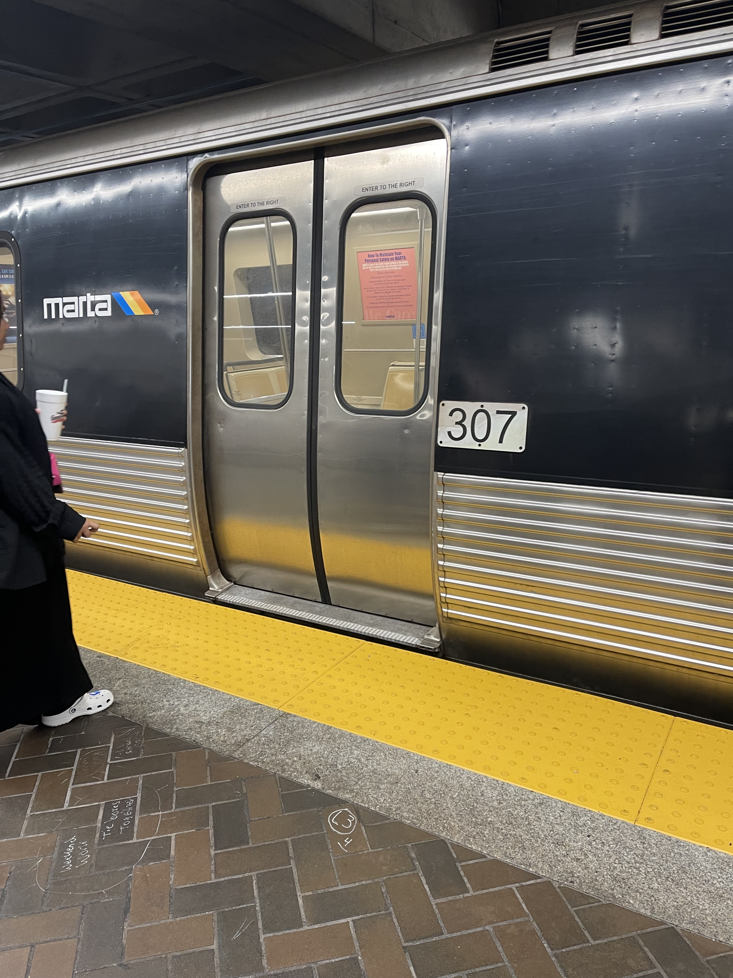
Where is this?
Notes:
Five Points station

Slide 3
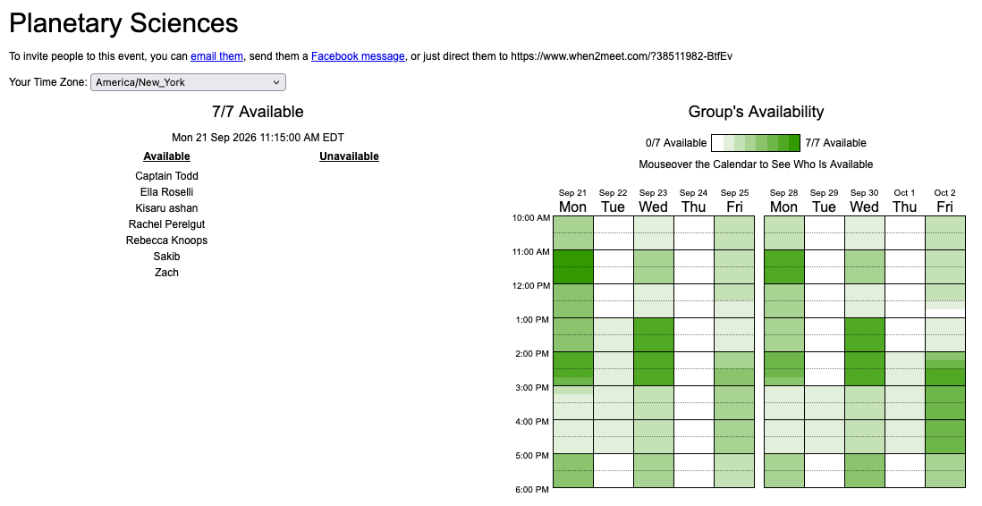
Extra Discussions
Fri 18 SEP … 1pm … Aderhold 212
Mon 21 SEP … 11am … here

Slide 4
Planetary Sciences Project
Level 0 … Topics … Thu 03 SEP
Level 1 … Outline … Thu 24 SEP
Level 2 … Draft #1 … Thu 22 OCT
Level 3 … Draft #2 … [skipped]
Presentations … in class … 10+12 NOV
Level 4 … Final Paper … Tue 03 DEC

Slide 5
Research Paper Level 1
due Thursday, 24 SEP
Outline of your research project (worth 10 points)
use AAS Overleaf LaTeX link on website
the more original, the better
hand in printed version
10 pieces for points required:
1. Abstract 2+ sentences
2. Introduction 2+ sentences … why do we care? (include refs!)
3. Motivation 2+ sentences … why do YOU care?
4. Sections listed … Sample, Observations/Data, Results …
X. Discussion [maybe nothing here, yet]
5. Tables 1+ listed
6/7. Figures 2+ listed
8/9/10. three REFEREED references

Slide 6
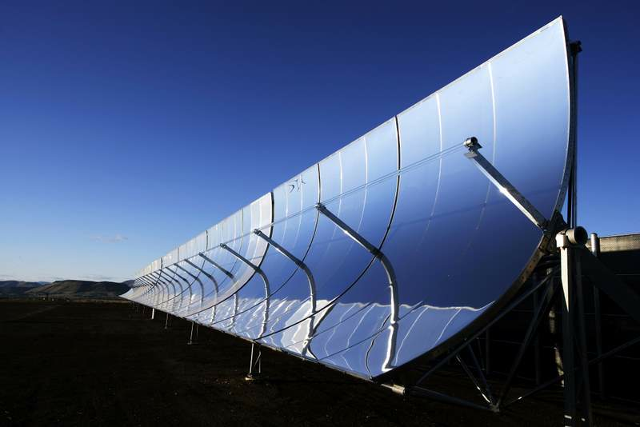
Solar Heating

Slide 7
Solar Heating
TEMPERATURE
4 phases of substances … pressure effects
solid orbiting bodies
liquid ocean currents, volcanism, tectonics
gas weather, atmospheric chemistry
plasma Sun, Jovian interiors
temperature gradients important in Solar System … location³
planetary atmospheric structures and motions
planetary internal structures … (not caused by Sun)
“temperature” is used to describe the random kinetic energy of molecules, atoms, ions, etc. … for a perfect gas, the energy is:
KE = 3/2 N k T
N = number of particles/volume k = Boltzmann’s constant
Notes:
plasma = distinct phase of matter; a collection of charged particles that responds strongly to electromagnetic fields

Slide 8
Solar Radiation Effects
1. Corpuscular drag --- sub-micron-sized particles fall into the Sun because they
  they are “missed” by photons, but hit by solar wind particles (i.e. electrons and protons)
2. Radiation pressure --- micron-sized dust particles pushed away from Sun because they are “hit” by photons
F_{rad} ~ L_{sun}A_{particle}Q / 4πr²c and F_{grav} ~ GmM / r²
Q = radiation pressure coeff
independent of distance from the Sun!
3. Poynting-Robertson drag --- mm to cm sized particles spiral inward toward the
Sun due to absorption followed by isotopic radiation of a moving particle
4. Yarkovsky effect --- meter to ~20 km sized objects change orbits because of different temps on different parts (push direction depends on rotation)
5. YORP effect --- changes rotation rates of asteroids up to ~20 km in size because
of torques due to asymmetric heating of rotating, non-triaxial bodies,
i.e. shadows … reflected/reradiated photons not uniformly distributed
Notes:
1. smallest particles fall in because they are smaller than the wavelengths of most solar photons, so the photons “miss” them
2. Q = radiation pressure coefficient
3. Like running in vertical rain … front side gets hit by more raindrops
4. Yarkovsky --- prograde rotation expands orbits, retrograde rotation shrinks orbit

Slide 9
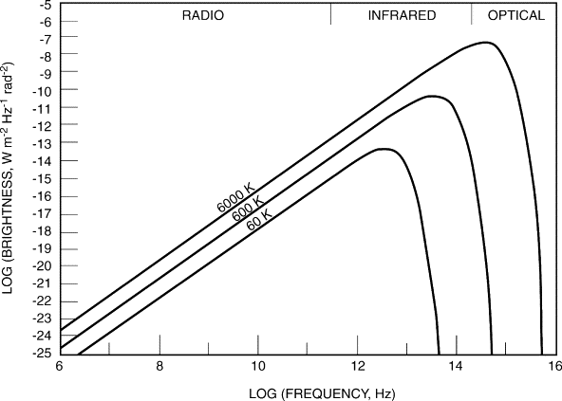
What is this?

Slide 10
Blackbody Equation
Planck radiation law (Planck Function)
2hν³ 1
B_{ν}(T) = ________ _______________
c² e^{(hν/kT)} - 1
brightness B_{ν}(T) has units of erg s ⁻¹ cm⁻² Hz ⁻¹ ster ⁻¹
Rayleigh-Jeans tail hν << kT B_{ν}(T) ~ (2ν²/c²) kT … ~ ν² decreasing freq … shallow second power drop
Wien cliff hν >> kT B_{ν}(T) ~ (2hν³/c²) e^{-(hν/kT)} … ~ ν³/ e^{ν}
increasing freq … steep exponential drop
Notes:
for hv << kT → the (exponential – 1) is ~ hv/kT
4pi steradians in the sky, steradian defined as r^2

Slide 11
Using Blackbody Equation
Two important applications of the blackbody equation:
1. Wein’s Law --- peak wavelength of emission
differentiate the blackbody equation with respect to λ
λ _{max (microns)} = 2900 / T_{(Kelvin)}

Slide 12
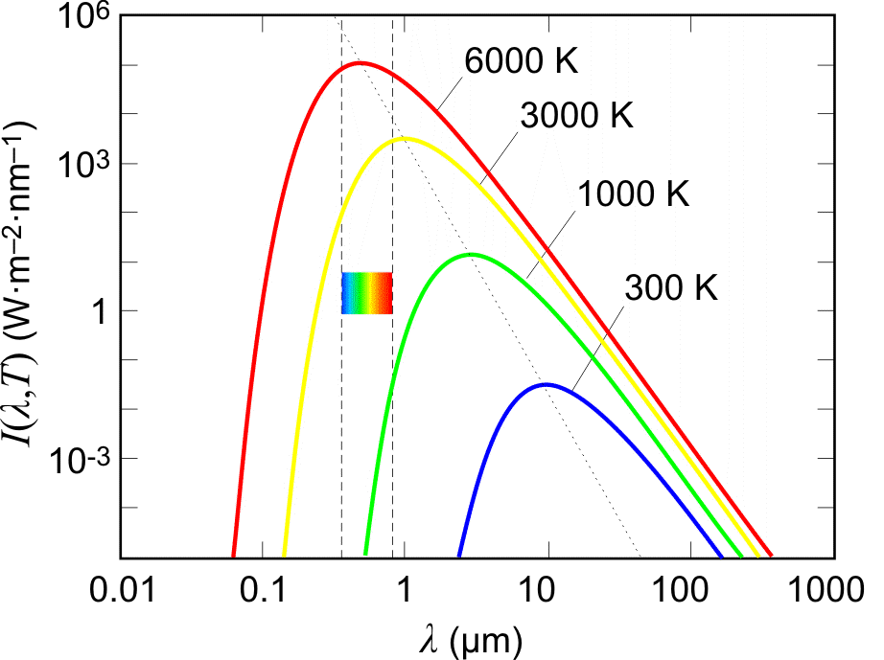
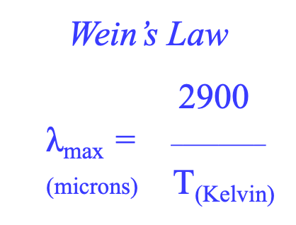
Blackbodies ~ Temperature !!!
Wein’s Law
2900
$\text{λ}$_{max} = ________
(microns) T_{(Kelvin)}

Slide 13
Using Blackbody Equation
Two important applications of the blackbody equation:
1. Wein’s Law --- peak wavelength of emission
differentiate the blackbody equation with respect to λ
λ _{max (microns)} = 2900 / T_{(Kelvin)}
2. Stefan-Boltzmann Law --- flux and luminosity
brightness integrated over entire solid angle … flux density
F_{ν} = B_{ν} Ω (erg s ⁻¹ cm⁻² Hz ^{–1})
integrate flux density over all frequencies … flux
flux F = σ T⁴ (erg s ⁻¹ cm⁻²)
luminosity SSE! (erg s ⁻¹)

Slide 14
Using Blackbody Equation
Two important applications of the blackbody equation:
1. Wein’s Law --- peak wavelength of emission
differentiate the blackbody equation with respect to λ
λ _{max (microns)} = 2900 / T_{(Kelvin)}
2. Stefan-Boltzmann Law --- flux and luminosity
brightness integrated over entire solid angle … flux density
F_{ν} = B_{ν} Ω (erg s ⁻¹ cm⁻² Hz ^{–1})
integrate flux density over all frequencies … flux
flux F = σ T⁴ (erg s ⁻¹ cm⁻²)
luminosity L = 4πR² σ T⁴ (erg s ⁻¹)

Slide 15
Blackbodies --- SS Applications
Object | Temp (K) | Flux (W/m²) | Radius (m) | L (W) | λ_{max} (microns)
Sun | 5800 | 6.4e7 | 7.0e8 | 3.9e26 | 0.5
Venus | 733 | 1.6e4 | 6.1e6 | 7.7e18 | 4.0
Earth | 288 | 3.9e2 | 6.4e6 | 2.0e17 | 10.1
Jupiter | 124 | 1.3e1 | 7.1e7 | 8.5e17 | 23.4
Neptune | 59 | 0.7 | 2.5e7 | 5.4e15 | 49.2
Pluto | 45 | 0.2 | 1.1e6 | 3.5e12 | 64.4
We have ignored reflected light.
Notes:
Watt = Joule/second = 10^7 erg/second

Slide 16
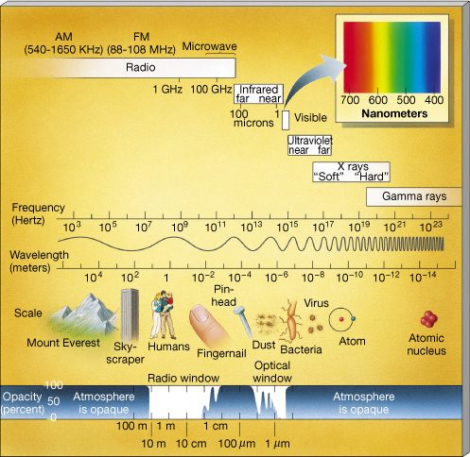
R I V U X G.
ROY G. BIV
PE S
↓
↓
↓
Notes:
S = Sun
E = Earth
P = Pluto

Slide 17
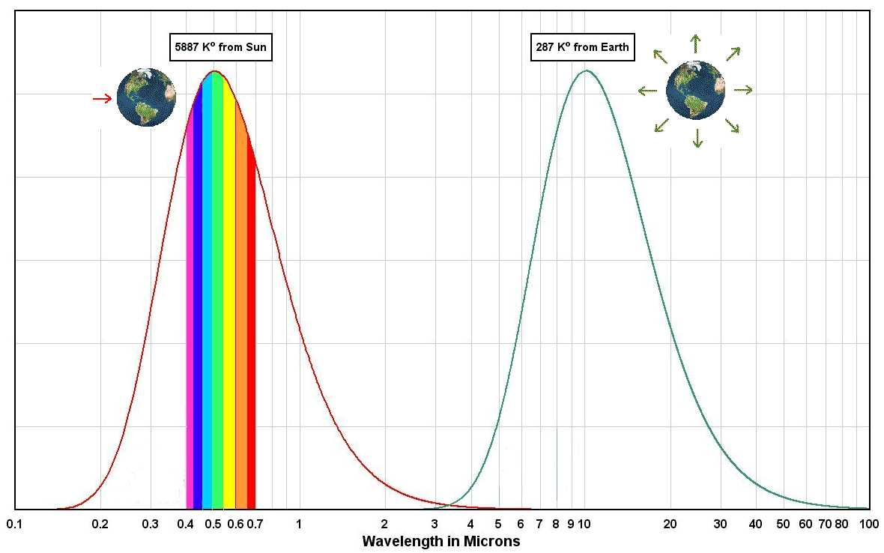
Blackbodies Make Life Easy
but Earth
should be
255K
SSE! hands up!
Why isn’t it?
peak ~ 0.5μm peak ~ 10.1μm

Slide 18
SSE! … hands up!
What are the five primary greenhouse gases in Earth’s atmosphere?
1. ?
2. ?
3. ?
4. ?
5. ?

Slide 19
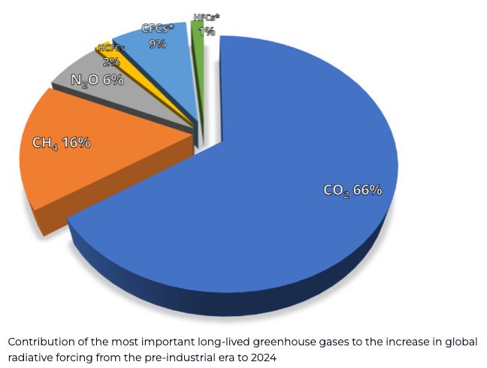
SSE!
What are the five primary greenhouse gases in Earth’s atmosphere?
1. H₂O
2. CO₂
3. CH₄
N₂O
XFCs
Notes:
N2O = nitrous oxide = laughing gas

Slide 20
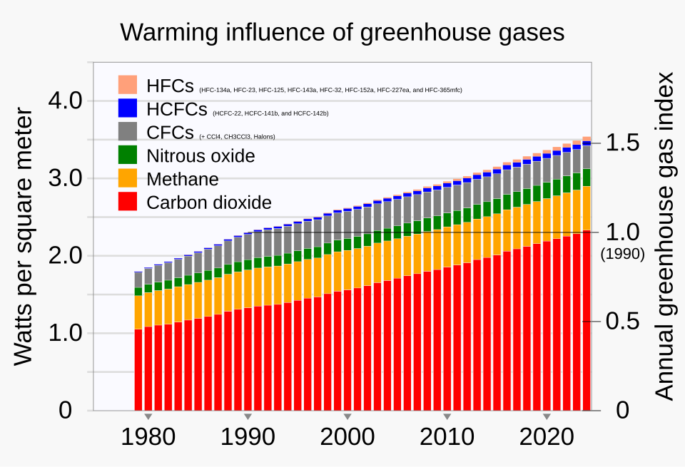
Earth Greenhouse Gases
0.4 ppm
2 ppm
430 ppm
National Oceanic and Atmospheric Administration Earth System Research Laboratory

Slide 21
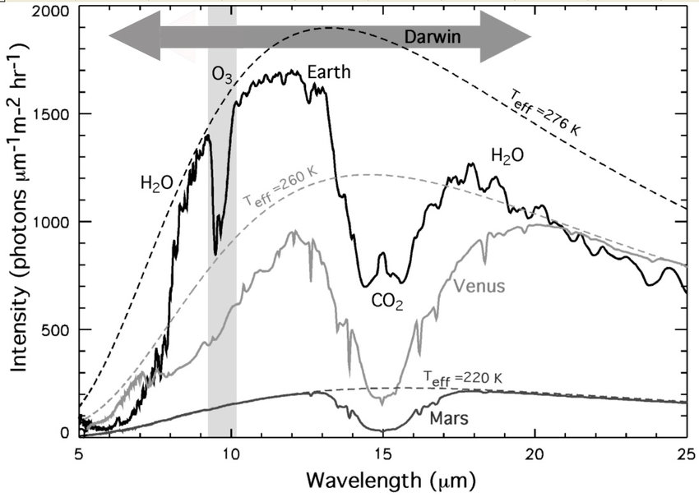
Blackbodies are a Big Fat Lie!
SSE!
Notes:
DARWIN was a mission to detect life on exoplanets … never happened
Venus temp is at TOP of clouds, Earth and Mars are surface temps

Slide 22
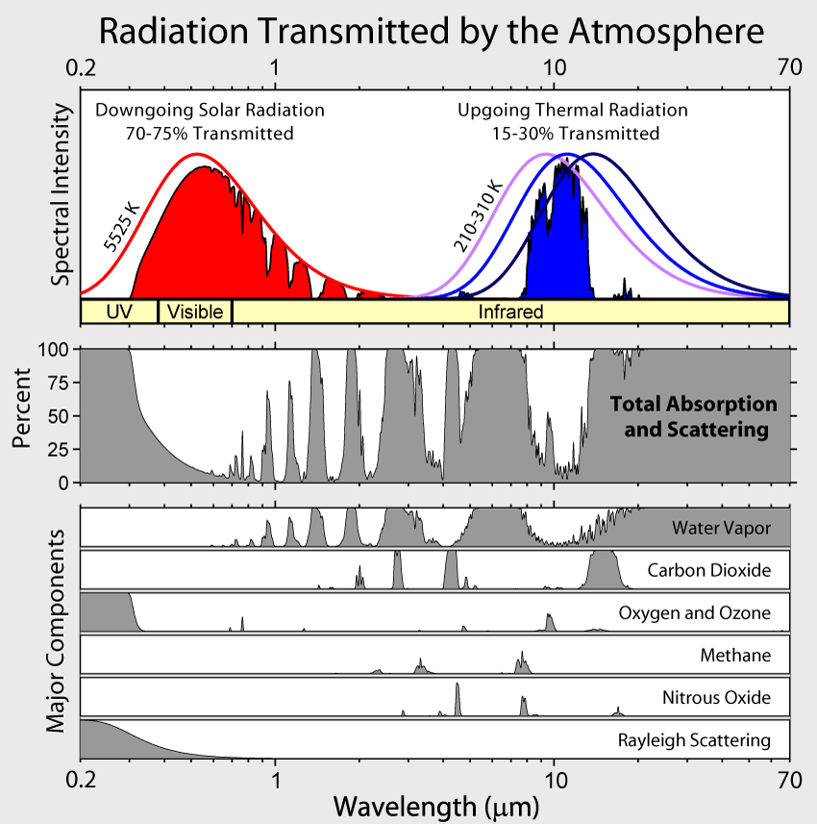
Sun+Earth Radiation
J H K L M N
UBVRI
trace gas < 3% variable
trace gas 430 ppm
21% and 10 ppm
trace gas 2 ppm
trace gas 0.4 ppm
Notes:
Nitrous oxide = N2O
Earth black body peak really around 12 microns … as heating occurs, BB peak moves to shorter wavelengths, away from CO2 absorption so safety valve occurs as more radiation can leak out through N window
BUT! H2O is major absorber and with more heat comes more H2O in atmosphere … we’re screwed

Slide 23
Non-Blackbody Features: Reflection
remember, blackbodies are big fat lies
geometric albedo --- [A] ratio of emitted/incident energy if you are looking at the object head-on (zero phase angle for the Sun)
A ~ 0.1 Mer/Mars/Moon
A ~ 0.3 Ear
A ~ 0.5 Jup/Sat/Ura/Nep
A ~ 0.7 Ven
monchromatic albedo --- [A_{λ}] ratio of emitted/incident energy at a specific wavelength (emitted = reflected + scattered)
Bond albedo --- [A_{b}] ratio of total emitted/total incident energy,
integrated over all wavelengths
albedo leads to implications for planet observability…

Slide 24
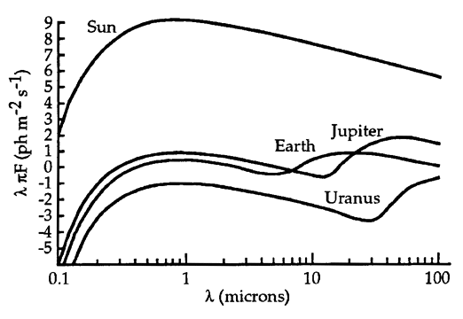
Star vs. Planet
10⁸:1
10⁴:1
reflected
emitted

Slide 25
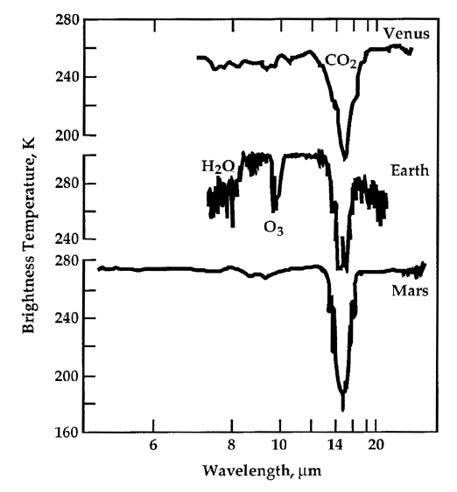
Temp, Temp, Temp
brightness temperature (T_{b}) --- measured if you fit a small bit of spectrum with a flux for a blackbody curve that matches that bit of spectrum
effective temperature (T_{eff}) --- measured by matching the total flux under a non-blackbody spectrum to a blackbody that has the same total flux under its curve
equilibrium temperature (T_{eq}) --- for planets, anticipated assuming the emitted radiation depends only on the energy received from the Sun … energy in = energy out
any discrepancies between the effective temperature
and the equilibrium temperature
contain valuable information about the object
Notes:
picture is shown as example of brightness temp --- flattened curve rather than blackbody

Slide 26
Tweaks to Planet T_{eff}
The Planet
solar irradiation is not uniform across planetary surface
albedo is not constant due to surface features
albedo is not constant due to clouds
reradiation will certainly be at different wavelengths than incident
The Dynamics
planet’s rotation is assumed to be fast
planet’s obliquity will change energy deposition/emission
planet’s orbital eccentricity will affect radiation input
The Sun
solar constant is not constant
… but pretty close (0.1% through cycle)
Notes:
solar irradiation … because the planet is spherical

Slide 27
Planet Temperatures (in K)
T_{equil} T_{surf} or T_{eff} causes of differences
Mercury | 446 | 100-700 | slow spin: complete reradiation of heat
Venus | 232 | 737 | runaway greenhouse
Earth | 255 | 288 | moderate greenhouse
Mars | 210 | 215 | micro greenhouse
Jupiter | 110 | 124 | heat source: continuing differentiation
Saturn | 81 | 95 | heat source: helium rain
Uranus | 58 | 59 | no heat source: complete reradiation
Neptune | 46 | 59 | heat source: continuing settling? (CH₄ blanketing?)
SSE!
Notes:
Tsurf for terrestrials; Teff for Jovians, assumes emissivity = 1.00
excess heat: J = 1.61X, S = 1.89X, U = 1.07X, N = 2.71!

Slide 28
Solar System Explorers: 17 SEP
Describe a dynamical situation in the Solar System involving 2 or more bodies that is unusual, in the sense that it is not a simple orbit.
1. I-E-G in 4-2-1 resonance
2. Venus retrograde rotation
3. Triton has retrograde orbit
4. 3-2 resonance Neptune-Plutinos
5. Hyperion in chaotic rotation because of Titan and Saturn
6. Mimas is the powermoon in Saturnian system with multiple resonances
7. Jup-Sat have near 5-2 resonance that causes perturbations on 900-year period
8. Kirkwood gaps because of resonance with Jupiter
9. Horseshoe orbit of weirdo Earth “moon” has large vertical component
10. Trojans and Greeks exist around Jupiter in tadpole orbits
11. Desdemona and Cressida in a 43-44 resonance that will lead to collision
12. Janus and Epimetheus swap orbits
13. Earth-Moon tides exist slow Earth rotation, spiral Moon out
14. Nice Model says it’s like that Uranus and Neptune swapped positions
15.
16.
17.
18.
19.
20.

Slide 29
Solar System Explorers: 01 OCT
How does the Sun affect objects in the Solar System?
1.
2.
3.
4.
5.
6.
7.
8.
9.
10.
11.
12.
13.
14.
15.
16.
17.
18.
19.
20.
IN 2 WEEKS
CONCENTRATE
ON PAPER OUTLINE

Slide 30
…………………………
Notes:
30

Slide 31
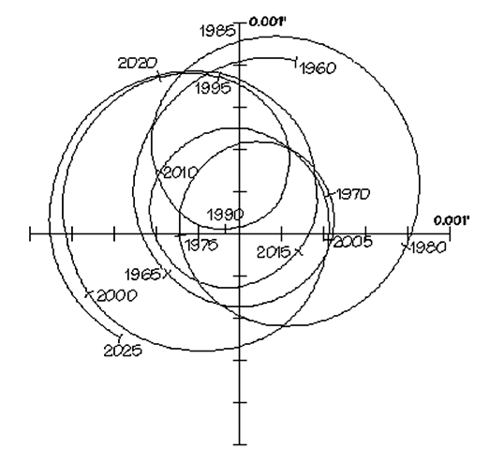
Astrometry Instead?
Sun as seen from 10 parsecs over 65 years
1 mas
Jupiter 11.9 yrs 0.52 milliarcsec
Saturn 29.4 yrs 0.95 milliarcsec
Uranus 83.8 yrs 1.91 milliarcsec

