Slide 1
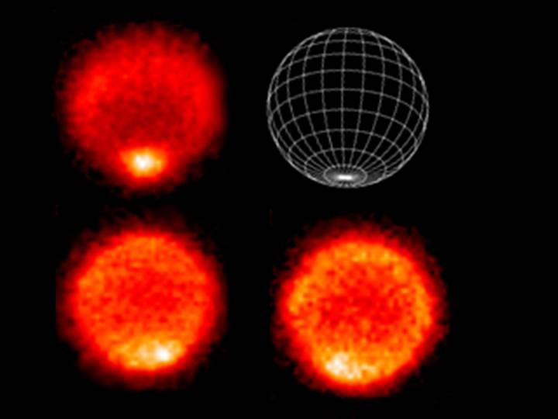
Where
is
this?
Notes:
These thermal images show a "hot" south pole on the planet Neptune (10K hotter than elsewhere). These warmer temperatures provide an avenue for methane to escape out of the deep atmosphere.
The upper left image samples temperatures near the top of Neptune's troposphere (near 100 millibar pressure, which is one-tenth the Earth atmospheric pressure at sea level). The hottest temperatures are indicated at the lower part of the image, at Neptune's south pole. The lower two images, taken 6.3 hours apart, sample temperatures at higher altitudes in Neptune's stratosphere. They do show generally warmer temperatures near, but not at, the south pole. They also show a distinct warm area which can be seen in the lower left image and rotated completely around the back of the planet and returned to the earth-facing hemisphere in the lower right image.
The images were obtained with the Very Large Telescope in Chile, using an imager/spectrometer for mid-infrared wavelengths on Sept. 1 and 2, 2006.

Slide 2
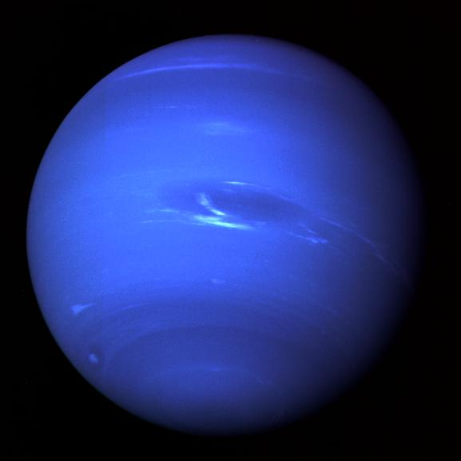
Planetary Atmospheres II
Notes:
spot has vanished
white clouds are methane

Slide 3
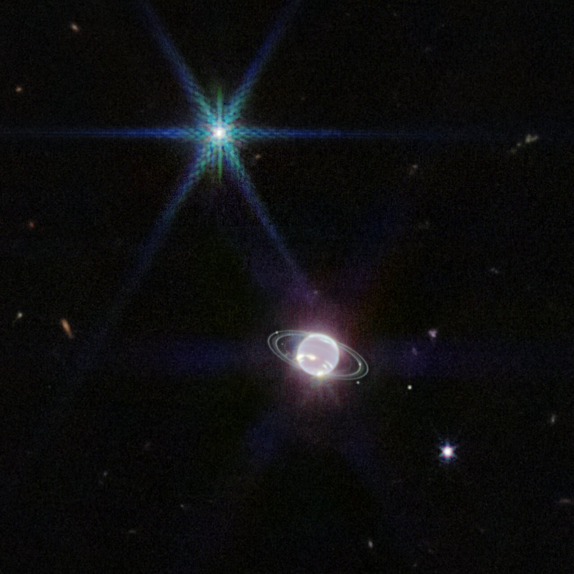
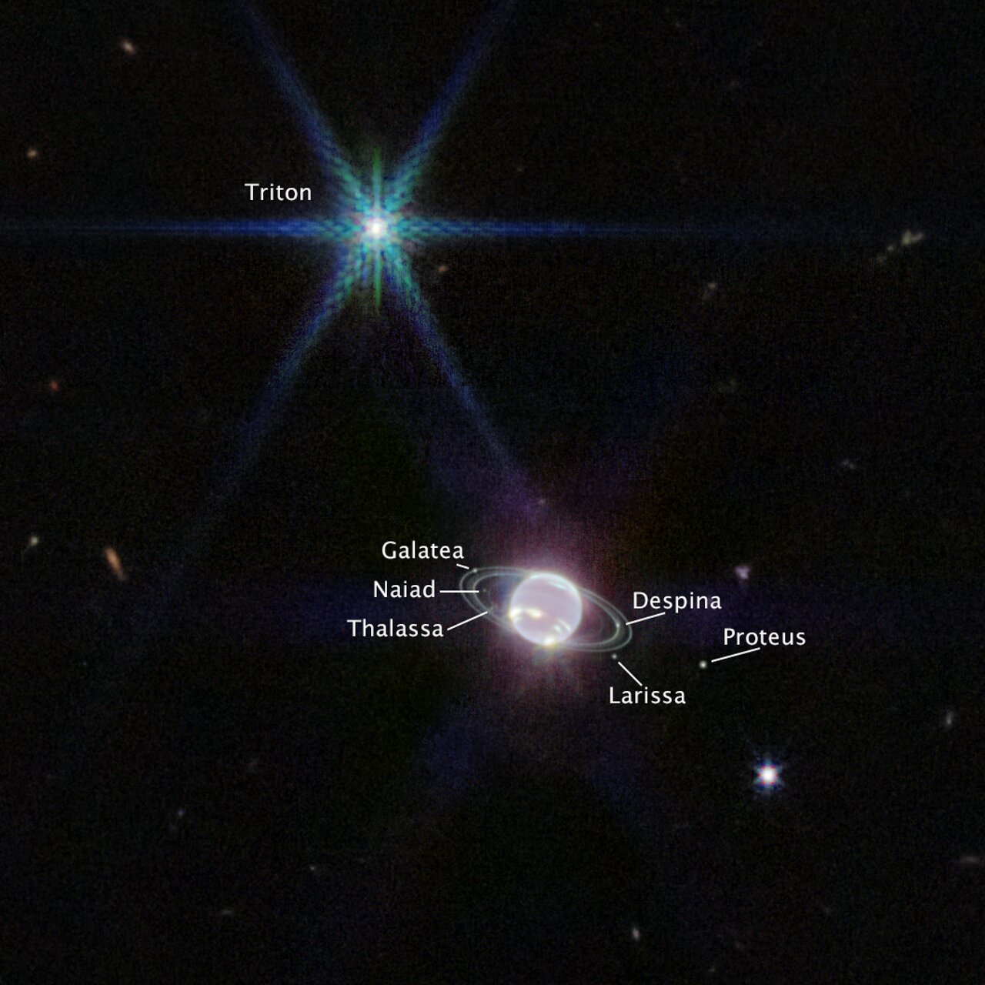
Planetary Atmospheres II
Notes:
Triton is brighter than Neptune … Neptune dark regions due to methane GAS absorption, bright spots and streaks are methane ICE clouds
Proteus is 2nd largest moon found by Voyager 2 … closer to Neptune than Nereid 3rd largest

Slide 4
Solar System Explorers: 29 SEP
Give any feature seen in the spectrum of a Solar System object (not the Sun) that
makes that object’s emitted spectrum NOT a blackbody. Give the atomic/molecular
species and wavelength affected, e.g., CO2 as an absorber on Earth at 15 microns.
1.
2.
3.
4.
5.
6.
7.
8.
9.
10.
11.
12.
13.
14.
15.
16.
17.
18.
19.
20.

Slide 5
SSE!
In which layer of the Earth’s atmosphere do we live?
…
troposphere
Which Jovian planet has the deepest atmosphere
relative to planet radius?
…
Saturn
What molecule comprises more than 1% of
Titan’s and Uranus’ atmospheres?
…
CH4

Slide 6
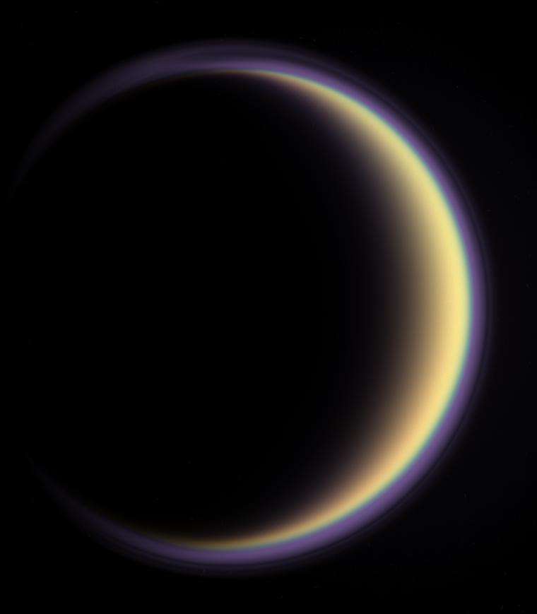
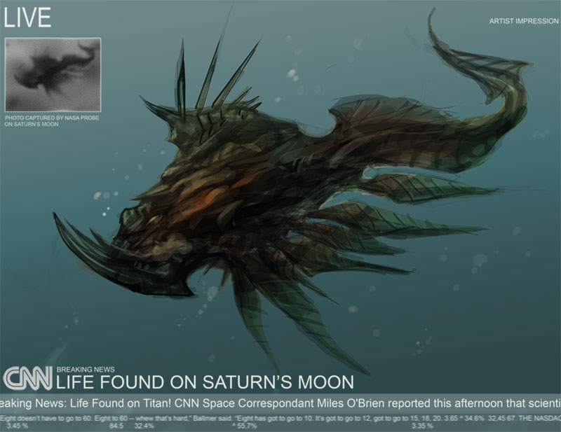
Titan

Slide 7
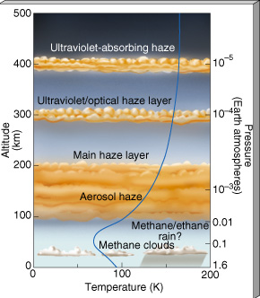
Titan
MESO/THERMO: hydrocarbon cooling, (HCN) so T drops
STRATO: up to 177K
TROPO: clouds … and rain?
similar overall atm structure to Earth
although deeper

Slide 8
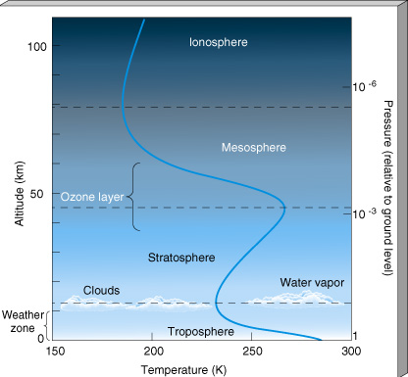
Titan vs. Earth : height

Slide 9
Titan vs. Earth : pressure

Slide 10
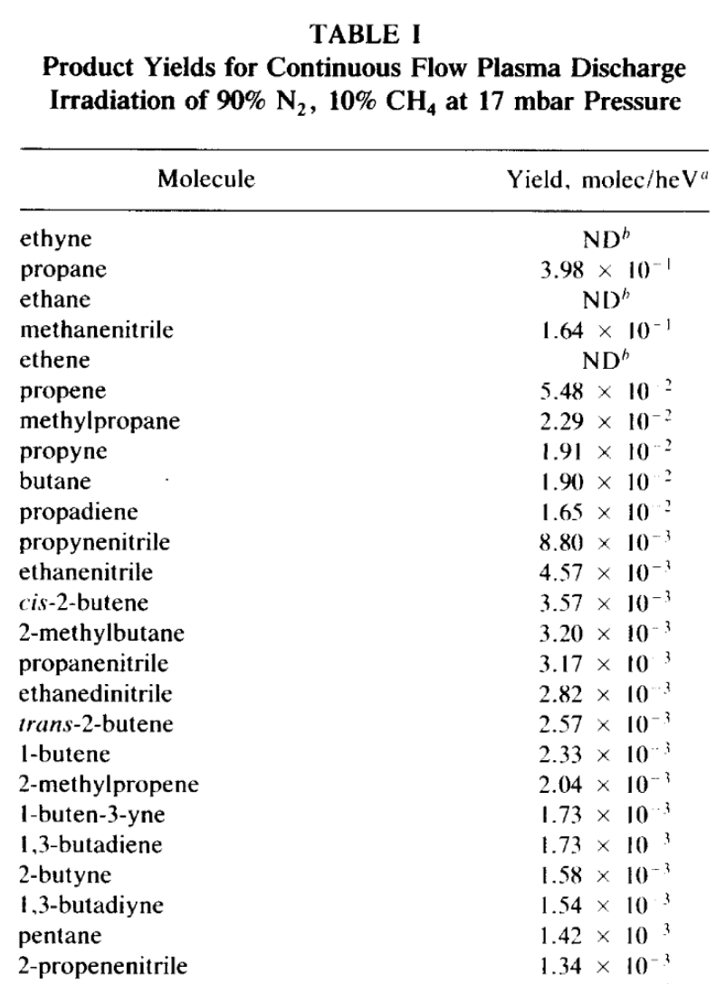
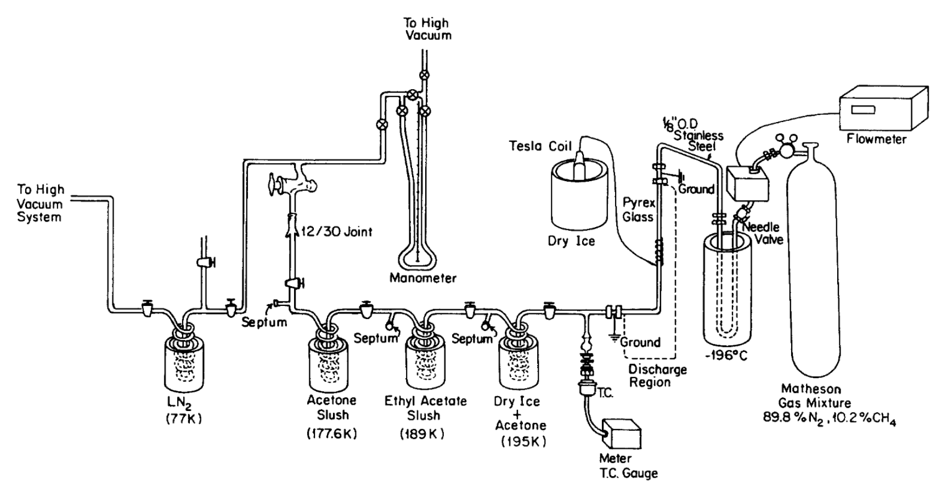
Titan’s Atmosphere
and many more

Slide 11
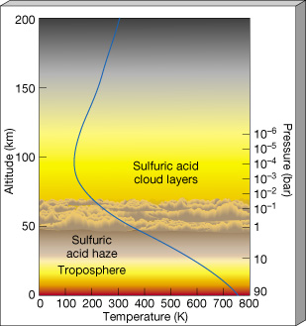
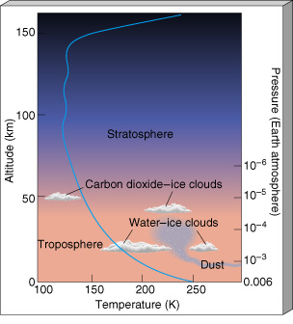
Terrestrial Atmospheres
note temperature structures --- Earth’s O3 causes stratopause
pressure scale height: HP(z) = kT(z) / g(z) μ m
μ = mean molecular weight (in amu)
m = 1.67 x 10⁻²⁴ g (one amu)
Venus Earth Mars Titan
Hsurf 16 km 8.5 11 20
P100 km 10⁻⁴ bar 10⁻⁶ 10⁻⁸ 10⁻²

Slide 12
Atmospheric Composition
SPECTROSCOPY
line position … which gas?
line depth … how much?
line shape … moving? T? P?
WHAT TO LOOK FOR, WHERE TO LOOK
excitation/de-excitation typically in ultraviolet or visible
vibration typically in infrared
rotation typically in radio
GO THERE!
(GC)MS = (gas chromatograph) mass spectrograph
Earth, Moon, Venus, Mars, Jupiter, Titan
particularly good for He, Ne, Ar, N2
Notes:
N2 has some emission lines in UV but nothing (?) in VIS/IR

Slide 13
Terrestrial Compositions
Earth Venus Mars Titan
N₂ 78% | CO₂ 97% | CO₂ 95% | N₂ 95-99%
O₂ 21% | N₂ 3% | N₂ 3% | CH₄ 1-5%
H₂O < 3% |  | Ar 2%
Ar 1%
at least
1%
CO₂ 421+ | SO₂ 100 | O₂ 1300 | H₂ 4000
Ne 18 | Ar 70 | CO 700 | C₂H₂ 189
O₃ 10 | H₂O 30 | H₂O < 100 | C₂H₆ 121
He 5 | CO 20 | H₂ 10 | CO 45
CH₄ 2 | He 12 | NO 3 | C₂H₄ 40
Kr 1 | O₂ 10 | Ne 3 | Ar 28
 | Ne 7 |  | C₃H₄ 4
ppm
Notes:
I have to keep updating CO2 on Earth …
C2H2 = acetylene, ethyne
C2H4 = ethylene
C3H4 = methylacetylene

Slide 14
SSE!
For each of the following worlds,
describe 2 aspects of the atmosphere that makes it unique
(compared to the others):
…
Venus
…
Mars
…
Titan
…
Earth

Slide 15
Terrestrial Atm Highlights
Earth
O2 out of equilibrium + O3 blanket
largest % atmospheric H2O in Solar System
6 greenhouse gases
Venus
~100X Earth pressure
SO2 from vulcanism
Mars
~1% Earth pressure … wimpy O3 blanket, H2O content
sublimation/condensation cycles
dust a major component
Titan
Earthlike structure and pressure, but puffed up
hydrocarbons + nitriles

Slide 16
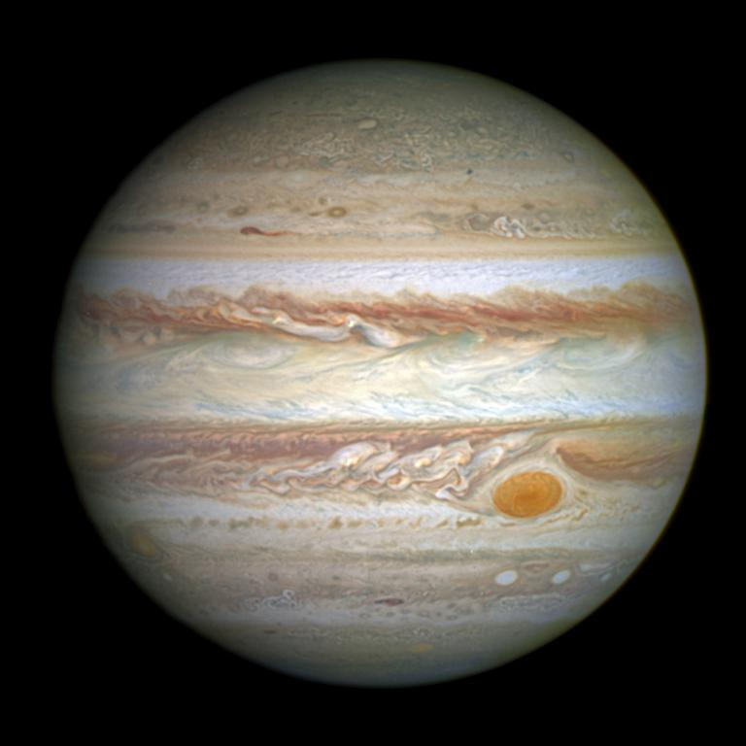
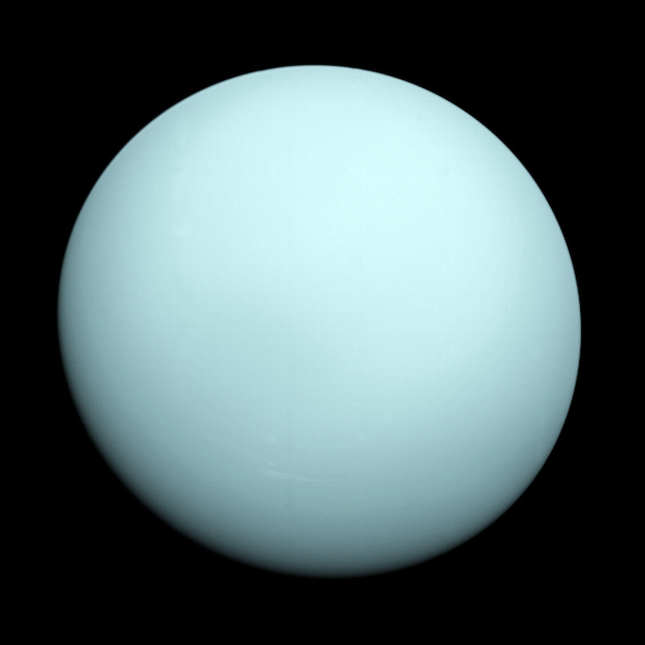
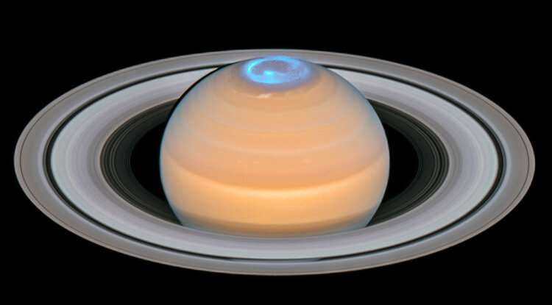
H₂
and
He
Notes:
shown to scale

Slide 17
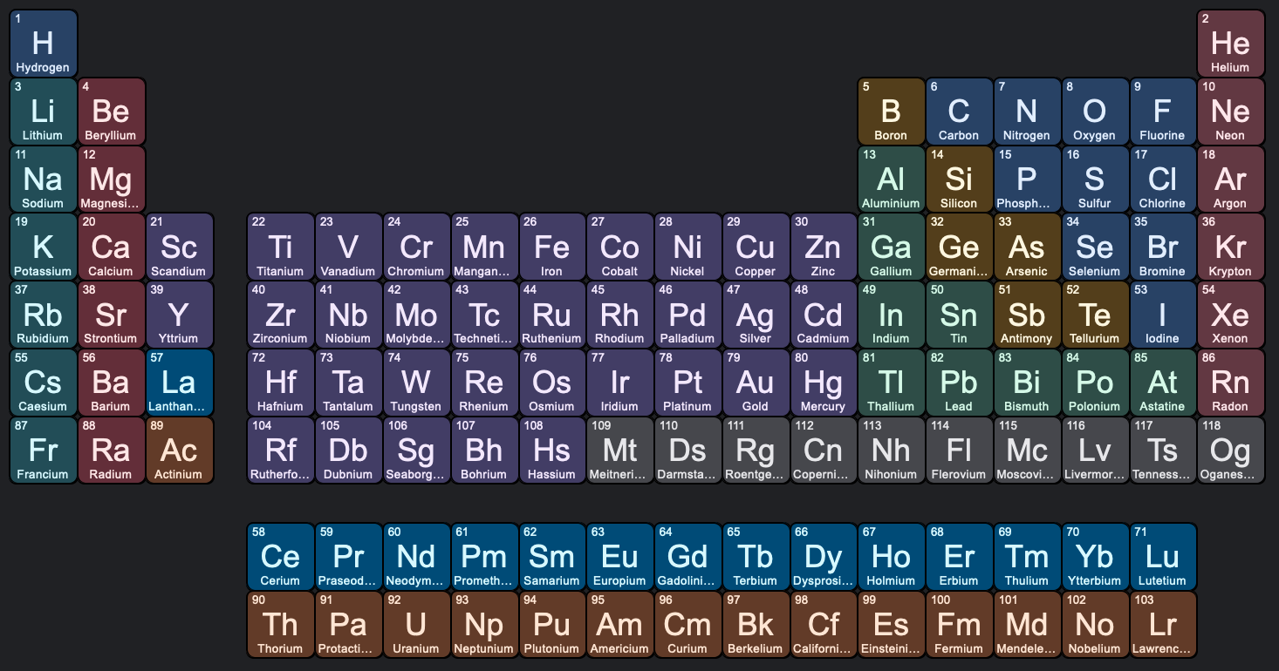
Jupiter
Other Key Gases
[CH₄]
NH₃
H₂O
P ?
PH₃
S ?
H₂S
Notes:
CH4 not on Jup and Sat … too warm
PH3 = phosphine
H2S = hydrogen sulfide, rotten eggs

Slide 18
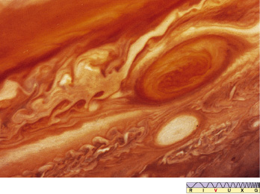
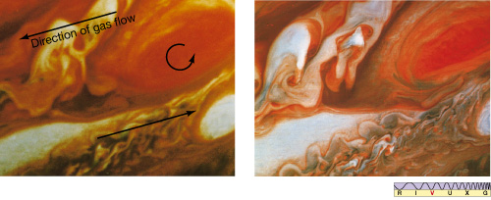

Slide 19
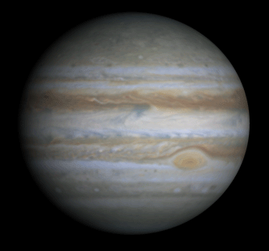
Jupiter
Notes:
video created from images taken by NASA's Cassini spacecraft

Slide 20
Jupiter

Slide 21
Galileo Probe into Jupiter
RESULTS
atm denser/hotter than expected at top
2 patchy cloud layers
NH₃
NH₄SH (?)
less H₂O
higher winds
powered from interior
large
thunderstorms
fewer, more powerful
bolts than Earth
425K
probe went in at hotspot with thin clouds
Notes:
During the first two minutes of entry, the probe experienced temperatures twice as hot as the Sun's surface and deceleration forces as great as 230 g's as it was slowed by the atmosphere. The Galileo Orbiter, which entered orbit around Jupiter a few hours after the Probe's descent, recorded 57.6 minutes of data from instruments before the Probe fell silent. Because of an unexplained 53-second delay at the start of transmission, direct atmospheric measurements started deeper in the atmosphere than originally planned (0.35 bars instead of 0.1 bars). All six scientific instruments onboard the Probe operated properly.
upper atmospheric densities and temperatures that are significantly higher than predicted by most models --- an additional source of heating besides sunlight appears necessary to account for them
deep atmosphere is drier than expected and is convective
data transmission ended at an atmospheric pressure of 23 bars and a temperature of 305 F (152 C) --- upward and downward winds appear to be much stronger than expected, requiring a revision of ideas about the escape of heat from Jupiter's interior
visibility much greater than expected, no thick clouds --- laser beam to small mirror attached to probe used
high winds at depth powered by Jupiter not Sun
no optical lightning flashes observed, but many discharges were observed at radio frequencies at distances about an Earth-diameter away from the craft --- bolts are much stronger than Earth's, but radio wave intensity suggests lightning activity is 3-10 times less than on Earth

Slide 22
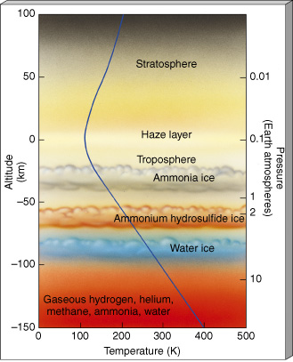
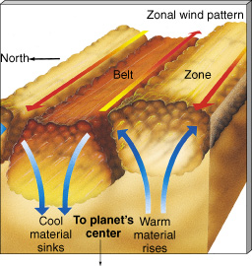
Jupiter
STRATO/MESO: ~ 150K, temp balance
heating of photochemical smog
cooling by CH₄ C₂H₂ C₂H₆ 8-14 μm
TROPO: multiple cloud layers
we see convection
Notes:
C2H2 is acetylene

Slide 23
Jupiter

Slide 24
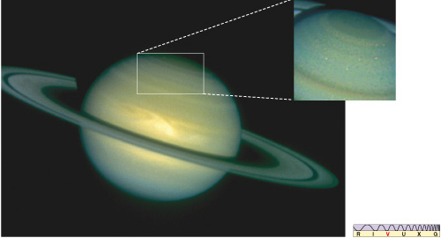
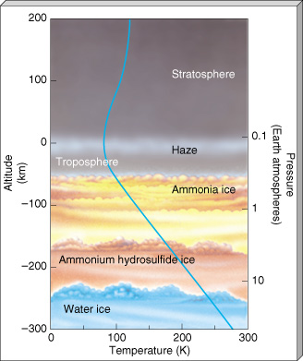
Saturn
similar to Jupiter, except
less convection … weaker internal heat
colder by ~ 30K
He 12% (Sat) vs. 14% (Jup) vs. 16% (protosun)
C, N, S species enhanced by 2-3X
puffed out atm results in lower density

Slide 25
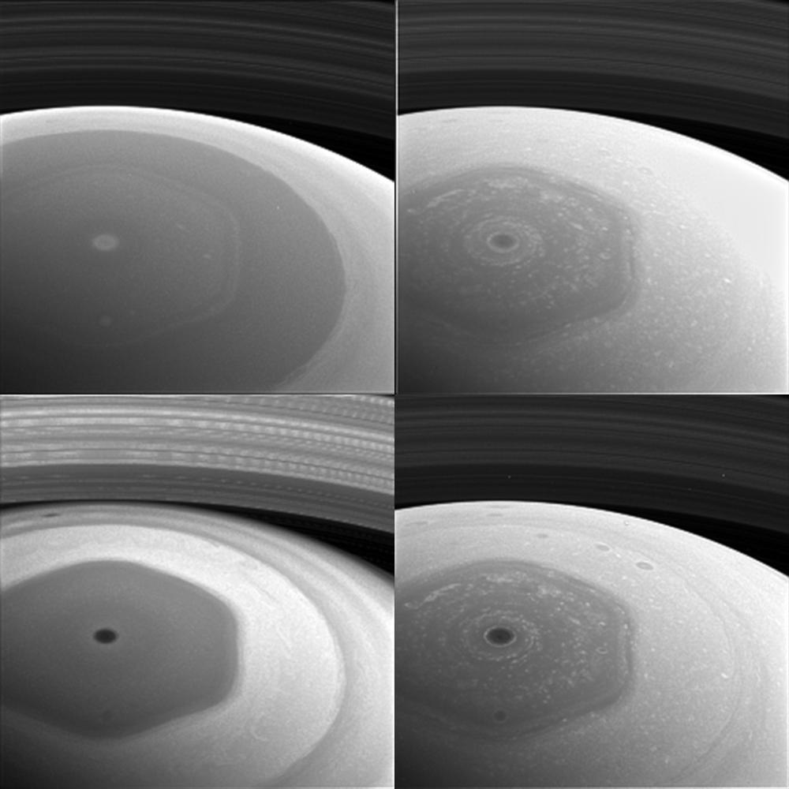
Saturn’s North Pole
420 nm
628 nm
939 nm
728 nm
Notes:
long-lived jet stream that has swirled around the ringed planet's north pole for more than 30 years
first spotted by NASA's Voyager mission in the early 1980s, still there when Cassini arrived in 2004
20,000 miles (32,000 kilometers) wide, and thermal images show that it reaches roughly 60 miles (100 km) down into Saturn's atmosphere
Why? computer simulations of a jet stream flowing in a curving path near Saturn's north pole affected by small perturbations in the jet — the kind one might expect from jostling with other air currents — make it meander into a hexagonal shape … best hexagonal involves shallow jets at the cloud level … winds below the cloud level apparently help keep the shape of the hexagon sharp and control the rate at which the hexagon drifts
SATURN BY CASSINI: This collage of images from NASA's Cassini spacecraft shows Saturn's northern hemisphere and rings as viewed with four different spectral filters. Each filter is sensitive to different wavelengths of light and reveals clouds and hazes at different altitudes. Clockwise from top left, the filters used are sensitive to violet (420 nanometers), red (648 nanometers), near-infrared (728 nanometers) and infrared (939 nanometers) light. The image was taken with the Cassini spacecraft wide-angle camera on Dec. 2, 2016, at a distance of about 400,000 miles (640,000 kilometers) from Saturn. Image scale is 95 miles (153 kilometers) per pixel. The images have been enlarged by a factor of two. The original versions of these images, as sent by the spacecraft, have a size of 256 pixels by 256 pixels. Cassini's images are sometimes planned to be compressed to smaller sizes due to data storage limitations on the spacecraft, or to allow a larger number of images to be taken than would otherwise be possible. These images were obtained about two days before its first close pass by the outer edges of Saturn's main rings during its penultimate mission phase.

Slide 26
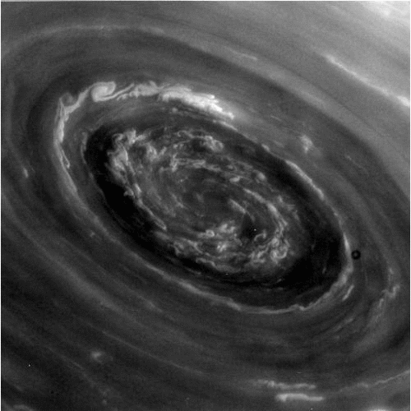
Saturn’s Polar Vortex
Notes:
SATURN BY CASSINI: eye of the hexagonal cloud structure at Saturn’s north pole

Slide 27
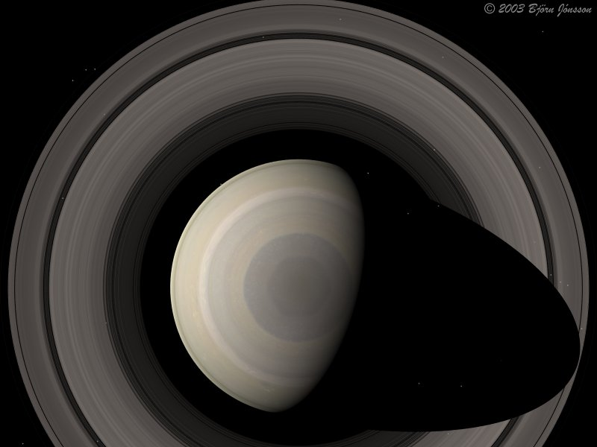
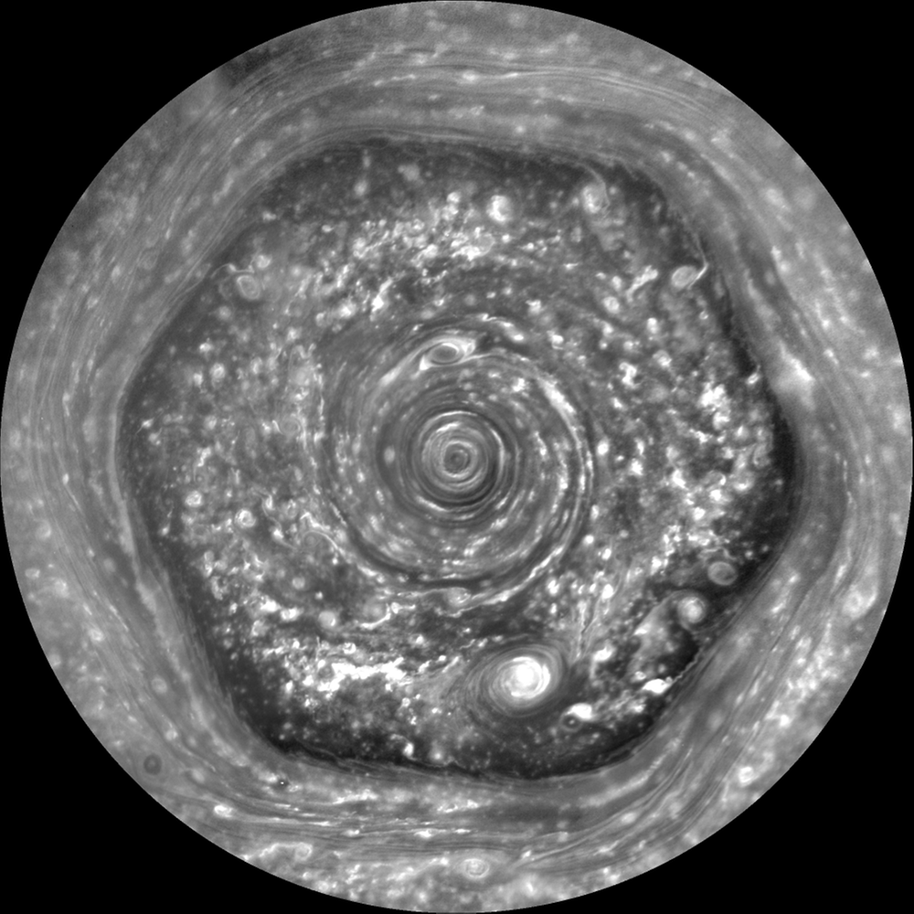
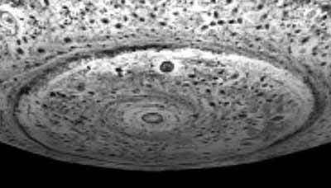
Weather: Jovians
N
S

Slide 28
Jupiter vs. Saturn: pressure

Slide 29
Jupiter vs. Saturn: height
H_{P}(z) = kT(z) / g(z) μ m
at 1 bar
H_{Jup} = 24 km
H_{Sat} = 47 km

Slide 30
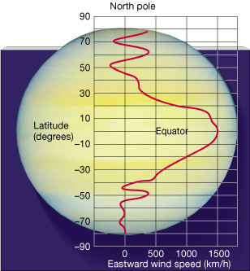
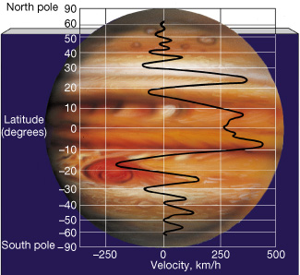
Wind Speeds
relatively stable over 20+ years of Voyager to Cassini and HST

Slide 31
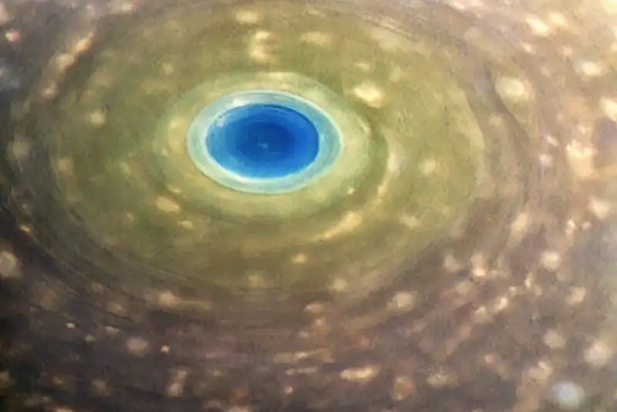
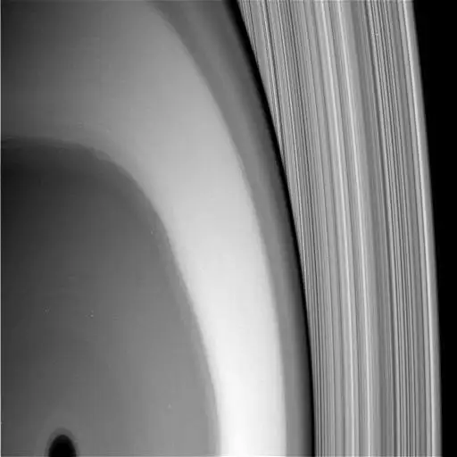
Cassini Grand Finale
biggest atm result … ring rain
cocktail of dust from rings
H₂O CH₄ NH₃ CO N₂ CO₂
Notes:
spectrometer was designed to investigate gases, measured the ring particles because they hit the spacecraft at such high velocities they vaporized
laser+mirror-on-arm experiment revealed possible NH3 patchy clouds

Slide 32
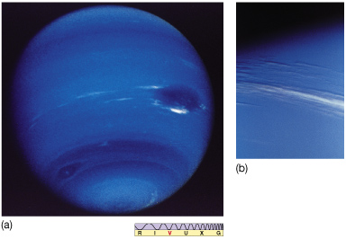
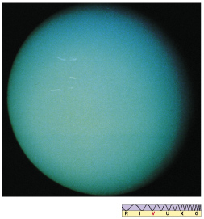
Neptune and Uranus
significant cloud features super bland!
internal heat source no internal heat source
no NH₃ clouds observed (as seen on Jup and Sat)
CH₄, H₂S, and NH₄SH clouds instead
H + He only ~10% mass of planet, unlike Jup and Sat at ~90%
Notes:
H2S = hydrogen sulfide
NH4SH = ammonium hydrosulfide

Slide 33
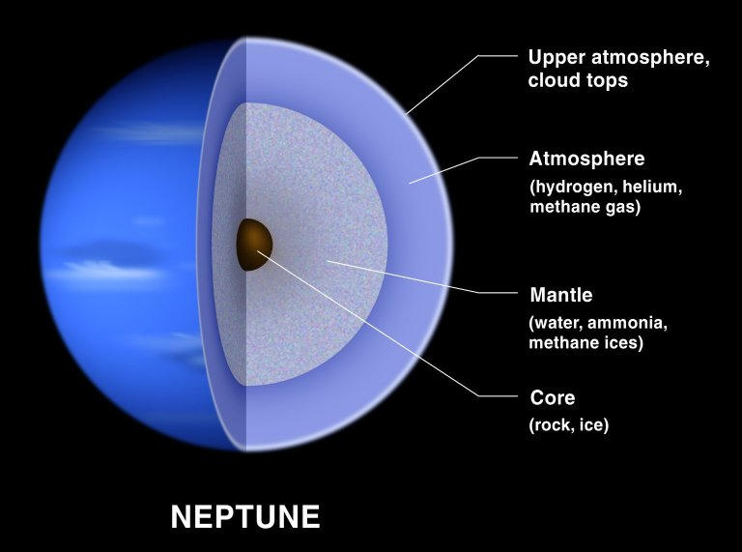
Ice Giant Structure
Notes:
NEPTUNE BY HST:

Slide 34
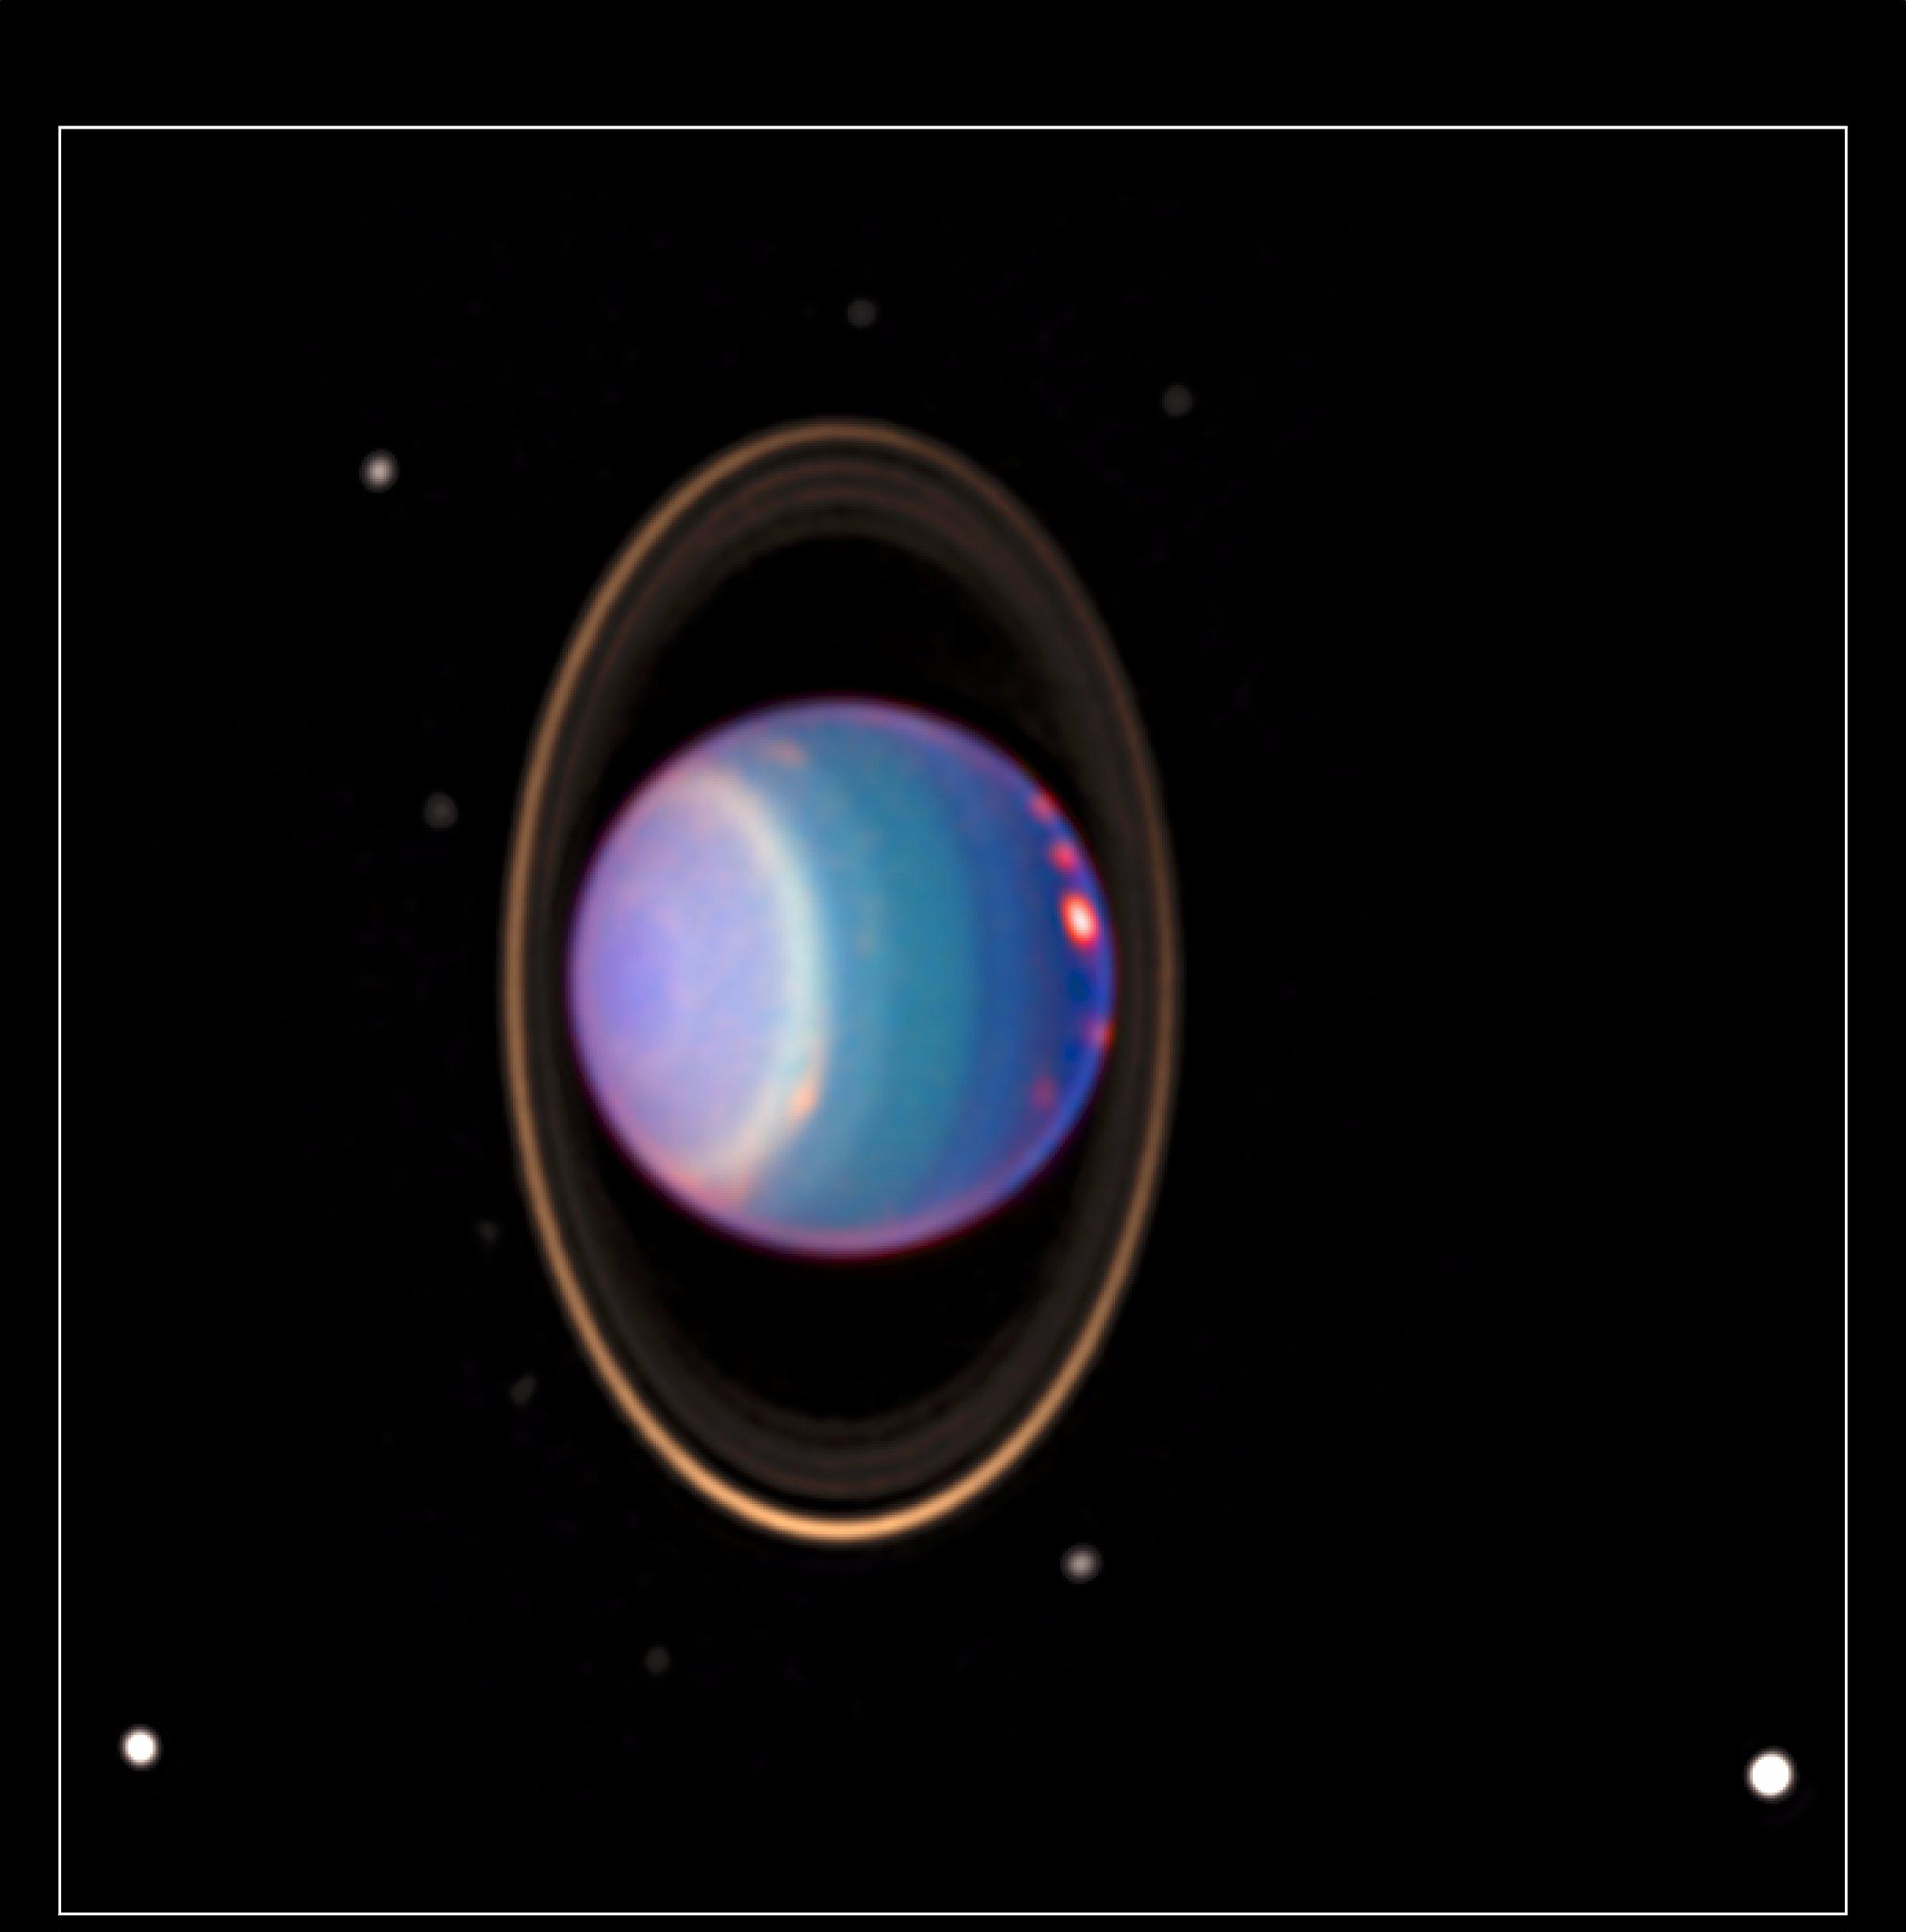
Uranus
HST
NICMOS
1998
Notes:
URANUS BY HST: four major rings and by 8 of its 17 known satellites … taken 8/8/98 with NICMOS
HST found about 20 clouds - nearly as many clouds on Uranus as the previous total in the history of modern observations
orange-colored clouds near the prominent bright band circle the planet at more than 300 mph (500 km/h)
one of the clouds on the right-hand side is brighter than any other cloud ever seen on Uranus
colors indicate altitude:
green and blue regions show where the atmosphere is clear and sunlight can penetrate deep into Uranus
yellow and gray regions the sunlight reflects from a higher haze or cloud layer
orange and red colors indicate very high clouds, such as cirrus clouds on Earth.
The Hubble image is one of the first images revealing the precession of the brightest ring with respect to a previous image [PRC97-36a]. Precession makes the fainter part of the ring (currently on the upper right-hand side) slide around Uranus once every nine months. The fading is caused by ring particles crowding and hiding each other on one side of their eight-hour orbit around Uranus.
The blue, green and red components of this false-color image correspond to exposures taken at near-infrared wavelengths of 0.9, 1.1, and 1.7 micrometers. Thus, regions on Uranus appearing blue, for example, reflect more sunlight at 0.9 micrometer than at the longer wavelengths. Apparent colors on Uranus are caused by absorption of methane gas in its atmosphere, an effect comparable to absorption in our atmosphere which can make distant clouds appear red.

Slide 35
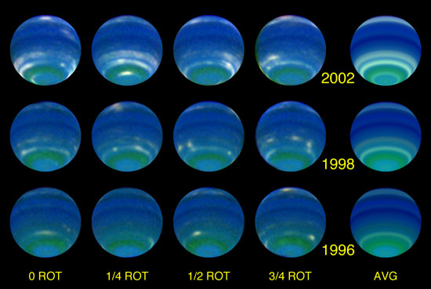
Neptune
Neptune: fastest winds in SS > 2000 km/hr
HST
Notes:
NEPTUNE BY HST: Comparing August 2002 observations to similar observations in 1996, the authors found that Neptune’s reflectivity averaged across the planet’s face (disk-averaged) increased by 3.2% at 467 nm (blue), 5.6% at 673 nm (red), and 40% in the 850 nm–1000 nm band (near infrared). These changes result from even larger brightness increases in restricted latitude bands, reaching 100% in some cases. The reason for the increases may be seasonal forcing, which is the seasonal variation in local solar heating.
Because Neptune’s equatorial plane is inclined 29º to its orbit plane, it is subject to seasonal solar forcing during its 164.8-year orbit of the sun. The resulting local variation in incident sunlight is similar in fractional amplitude to that on the earth, which has a 23.5º inclination, but the absolute variation is 900 times smaller and the rate of change is slower by an additional factor of 165. Remarkably, there is now evidence that Neptune is responding measurably to this weak forcing (of the sun’s heat). The long record of disk-averaged observations from Earth provides a key piece of evidence. When blue-filter (467-nm) observations with the Hubble Space Telescope from 1994 to 2002 are added to blue-filter (472-nm) Earth-based results of Lockwood and Thompson, the combined disk-averaged variation from 1972 to 2002 is consistent with a simple seasonal model having a hemispheric response delay relative to solar forcing of ~30 years (~73% of a full season).

Slide 36
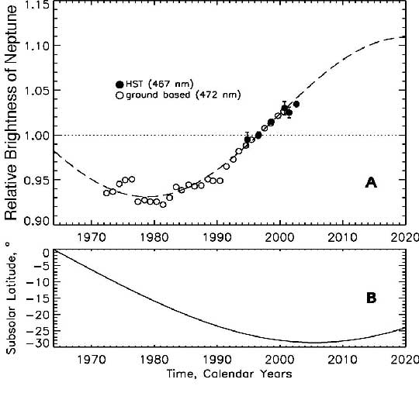
Seasonal Forcing at Neptune
1/900th Earth solar flux:
Sun’s effect much weaker
165 year orbit:
changes slower than Earth
obliquity 29º:
hemisphere toward Sun
brightens
temp 59K:
cannot reach rapid thermal
equilibrium … delayed
dynamic response of 15 yr
Sromovsky et al. 2002
Notes:
The best-fit seasonal model (dashed curve) has its peak delayed 15.1 years relative to the upcoming hemispheric solar forcing peak in 2005, when the subsolar latitude will be at its southern extreme, as shown in the lower plot (B).

Slide 37
…………………………
Notes:
37

Slide 38
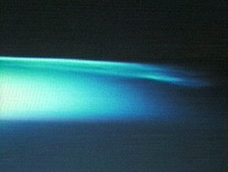
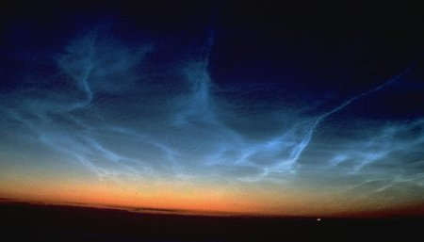
Earth Clouds
very highest clouds noctilucent
50-100 km altitude mesosphere
composition ice crystals
(nucleation on dust)
summer only H2O convected
dust (from volcanoes? meteorites?)
spreading south (global warming?)

