Slide 1
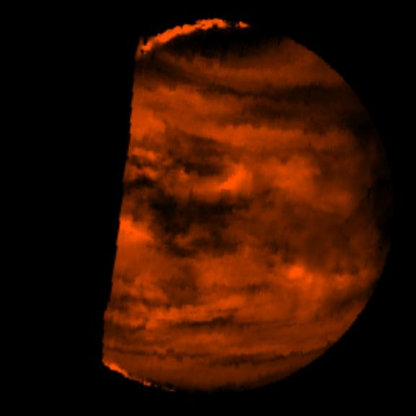
Where is
this?
high sunlit clouds
night side
at 2.3 microns
cold clouds
lower atm
Notes:
VENUS BY GALILEO: This false-color image is a near-infrared map of lower-level clouds on the night side of Venus, obtained by the Near Infrared Mapping Spectrometer aboard the Galileo spacecraft as it approached the planet's night side on February 10, 1990. Bright slivers of sunlit high clouds are visible above and below the dark, glowing hemisphere. The spacecraft is about 100,000 kilometers (60,000 miles) above the planet. An infrared wavelength of 2.3 microns (about three times the longest wavelength visible to the human eye) was used. The map shows the turbulent, cloudy middle atmosphere some 50-55 kilometers (30- 33 miles) above the surface, 10-16 kilometers or 6-10 miles below the visible cloudtops. The red color represents the radiant heat from the lower atmosphere (about 400 degrees Fahrenheit) shining through the sulfuric acid clouds, which appear as much as 10 times darker than the bright gaps between clouds. This cloud layer is at about -30 degrees Fahrenheit, at a pressure about 1/2 Earth's surface atmospheric pressure. Near the equator, the clouds appear fluffy and blocky; farther north, they are stretched out into East-West filaments by winds estimated at more than 150 mph, while the poles are capped by thick clouds at this altitude.

Slide 2
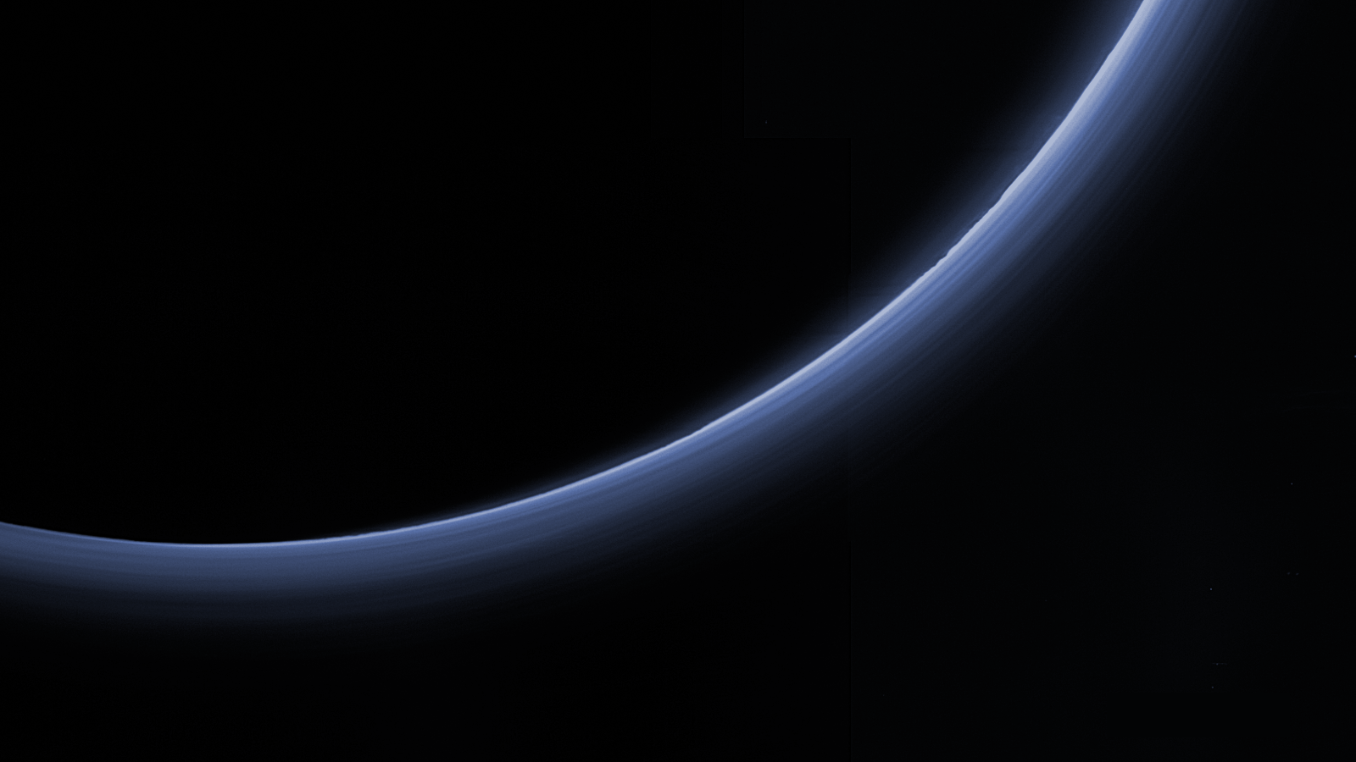
Where is this?
Notes:
Pluto by New Horizons
The upper left image samples temperatures near the top of Neptune's troposphere (near 100 millibar pressure, which is one-tenth the Earth atmospheric pressure at sea level). The hottest temperatures are indicated at the lower part of the image, at Neptune's south pole. The lower two images, taken 6.3 hours apart, sample temperatures at higher altitudes in Neptune's stratosphere. They do show generally warmer temperatures near, but not at, the south pole. They also show a distinct warm area which can be seen in the lower left image and rotated completely around the back of the planet and returned to the earth-facing hemisphere in the lower right image.
The images were obtained with the Very Large Telescope in Chile, using an imager/spectrometer for mid-infrared wavelengths on Sept. 1 and 2, 2006.

Slide 3
Planetary Sciences Project
Level 0 … Topics … Thu 03 SEP
Level 1 … Outline … Thu 24 SEP
Level 2 … Draft #1 … Thu 22 OCT
Level 3 … Draft #2 … [skipped]
Presentations … in class … 10+12 NOV
Level 4 … Final Paper … Tue 03 DEC

Slide 4
Solar System Explorers: 01 OCT
How does the Sun affect objects in the Solar System?
1.
2.
3.
4.
5.
6.
7.
8.
9.
10.
11.
12.
13.
14.
15.
16.
17.
18.
19.
20.

Slide 5
Planetary Atmospheres III
Notes:
Pluto by New Horizons

Slide 6
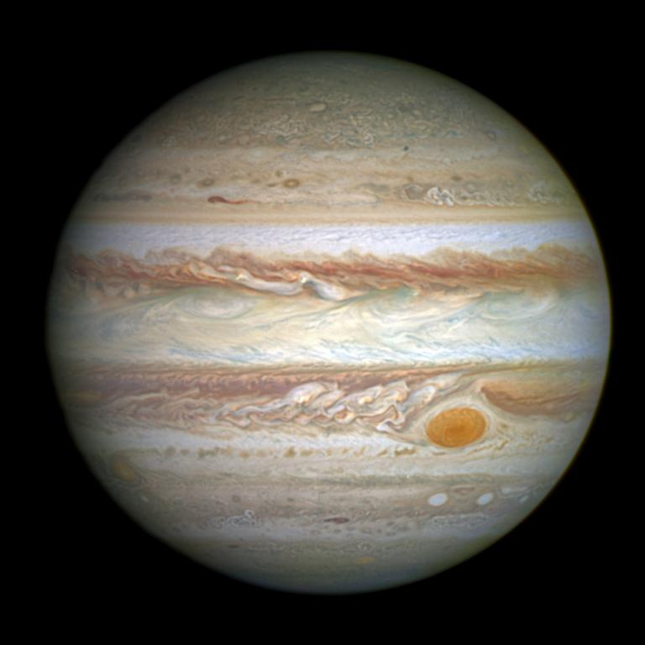
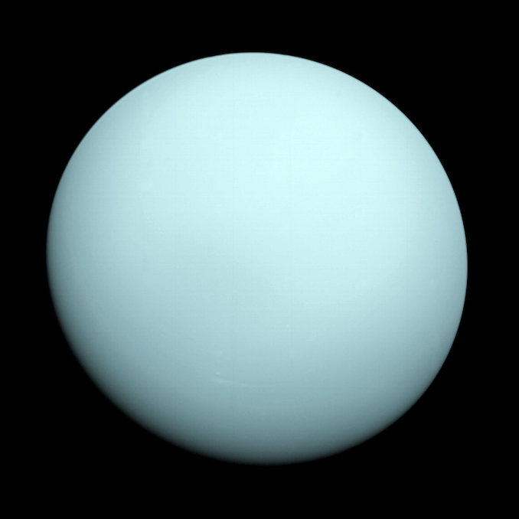
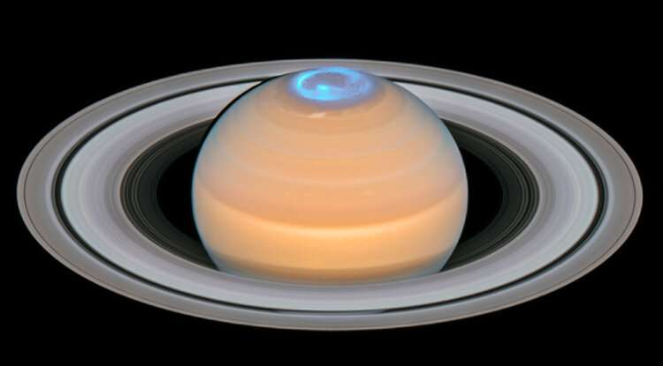
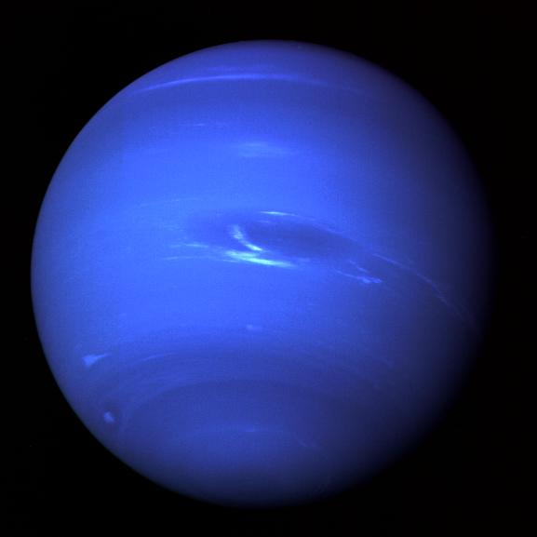
H₂
and
He
Notes:
shown to scale

Slide 7
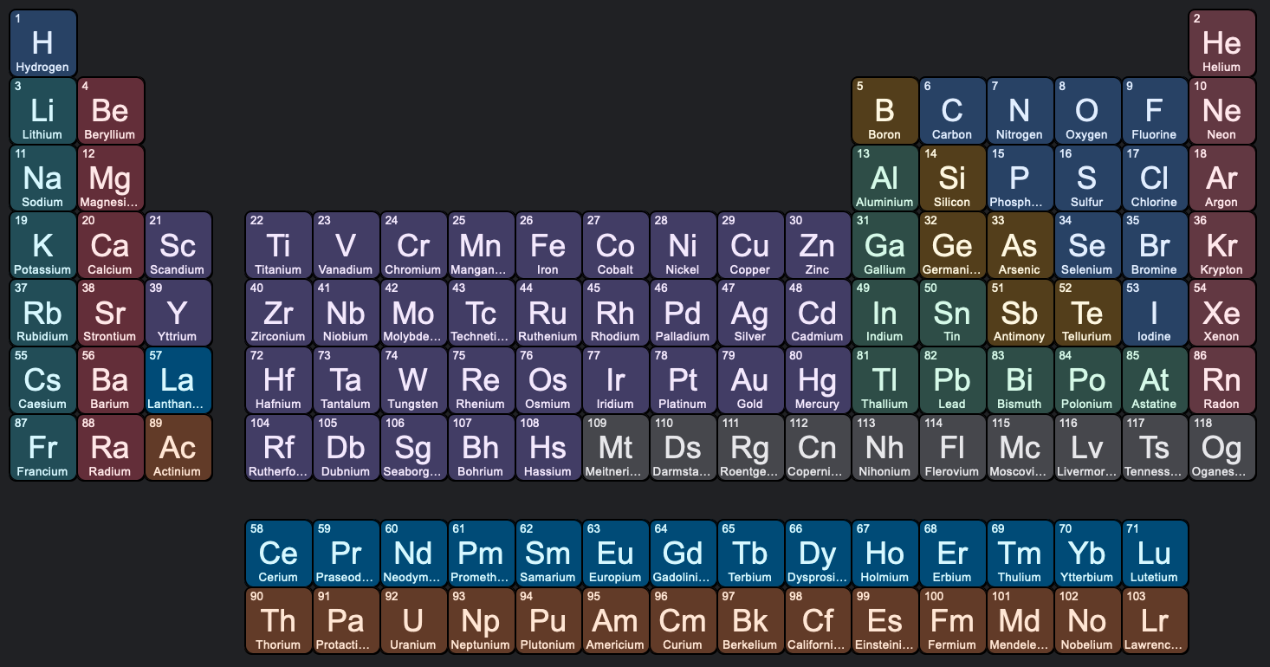
Jupiter
Other Key Gases
[CH₄]
NH₃
H₂O
Si?
[SiH₄]
P?
PH₃
S?
H₂S
Notes:
CH4 not on Jup and Sat … too warm
SiH4 = silane … not known in jovian atm because Si combines with O to make silicates that drop down into atm … has been detected in one weird brown dwarf called “The Accident” that is old with maybe very low O
PH3 = phosphine … in Jup and Sat … probably not Venus
H2S = hydrogen sulfide, rotten eggs

Slide 8
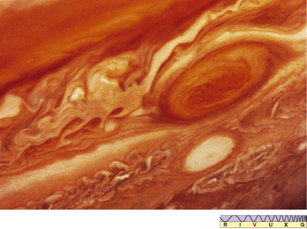
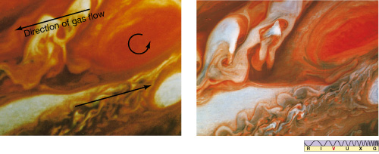

Slide 9
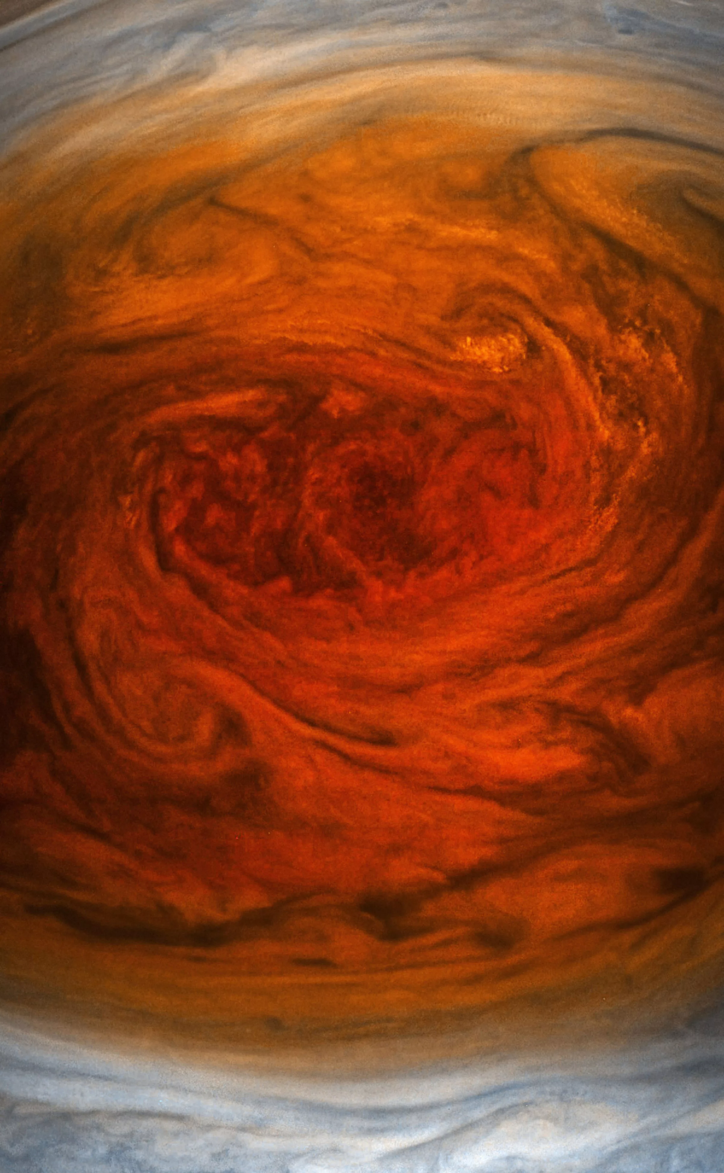
Why is the Spot Red?
upwelling material?
sunburn?
Io contribution(s)?
red phosphorus?

Slide 10
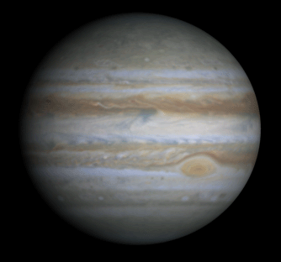
Jupiter
Notes:
video created from images taken by NASA's Cassini spacecraft

Slide 11
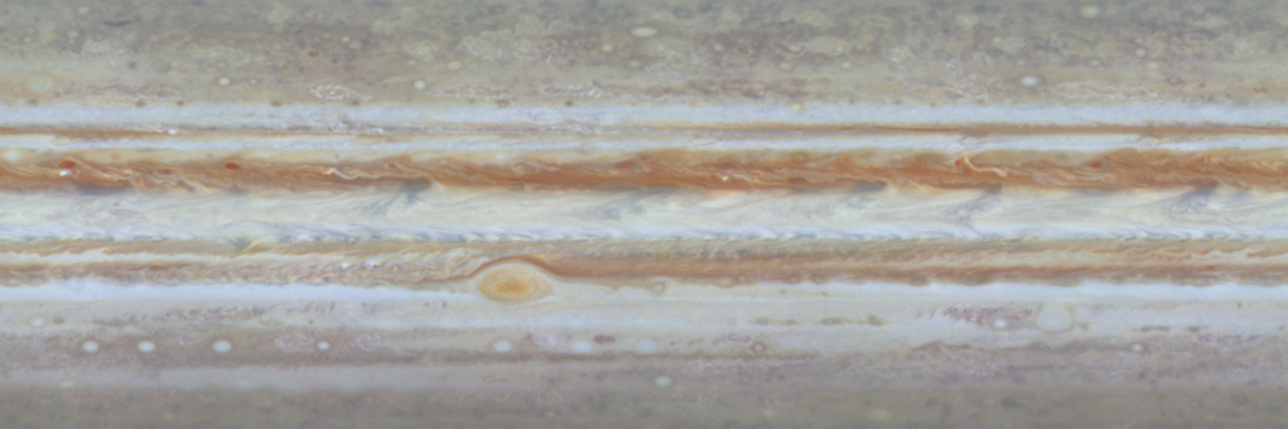
Jupiter

Slide 12
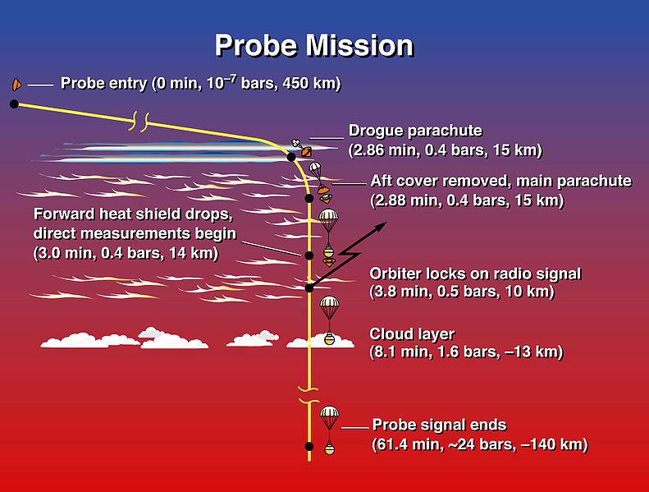
Galileo Probe into Jupiter
RESULTS
atm denser/hotter than expected at top
2 patchy cloud layers
NH₃
NH₄SH (?)
less H₂O
higher winds
powered from interior
large
thunderstorms
fewer, more powerful
bolts than Earth
425K
probe went in at hotspot with thin clouds
Notes:
During the first two minutes of entry, the probe experienced temperatures twice as hot as the Sun's surface and deceleration forces as great as 230 g's as it was slowed by the atmosphere. The Galileo Orbiter, which entered orbit around Jupiter a few hours after the Probe's descent, recorded 57.6 minutes of data from instruments before the Probe fell silent. Because of an unexplained 53-second delay at the start of transmission, direct atmospheric measurements started deeper in the atmosphere than originally planned (0.35 bars instead of 0.1 bars). All six scientific instruments onboard the Probe operated properly.
upper atmospheric densities and temperatures that are significantly higher than predicted by most models --- an additional source of heating besides sunlight appears necessary to account for them
deep atmosphere is drier than expected and is convective
data transmission ended at an atmospheric pressure of 23 bars and a temperature of 305 F (152 C) --- upward and downward winds appear to be much stronger than expected, requiring a revision of ideas about the escape of heat from Jupiter's interior
visibility much greater than expected, no thick clouds --- laser beam to small mirror attached to probe used
high winds at depth powered by Jupiter not Sun
no optical lightning flashes observed, but many discharges were observed at radio frequencies at distances about an Earth-diameter away from the craft --- bolts are much stronger than Earth's, but radio wave intensity suggests lightning activity is 3-10 times less than on Earth

Slide 13
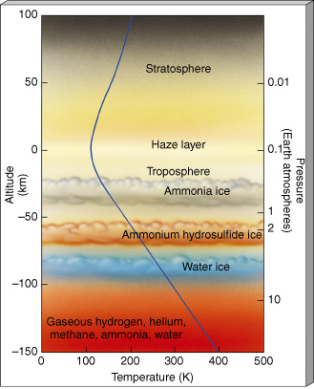
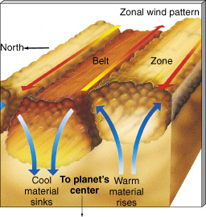
Jupiter
STRATO/MESO: ~ 150K, temp balance
heating of photochemical smog
cooling by CH₄ C₂H₂ C₂H₆ 8-14 μm
TROPO: multiple cloud layers
we see convection
Notes:
C2H2 is acetylene

Slide 14
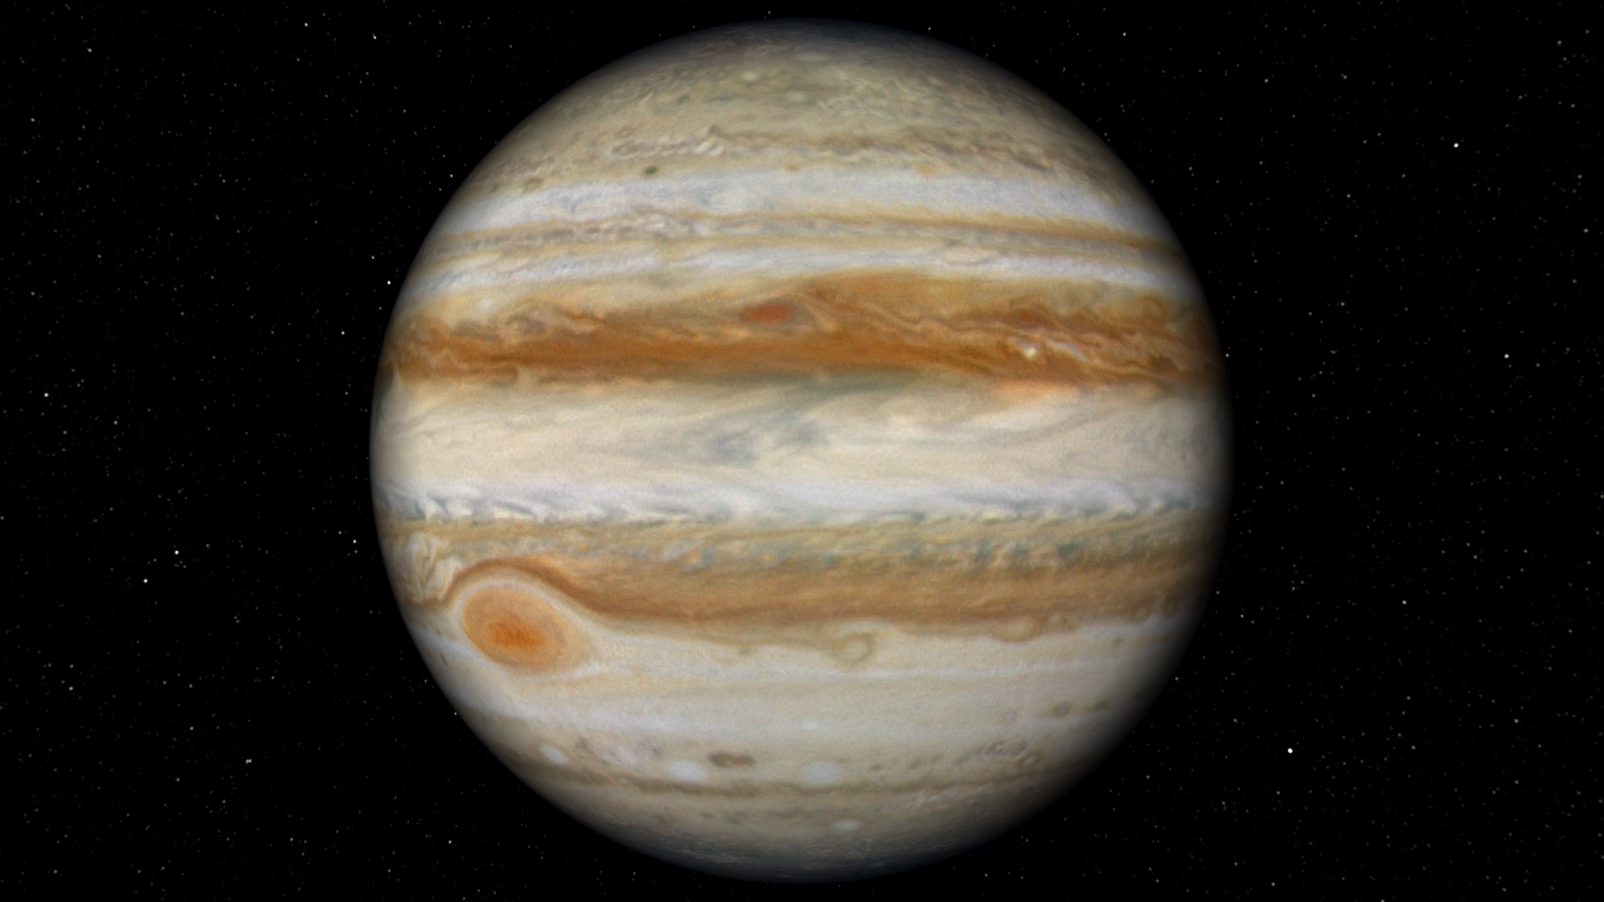
Jupiter

Slide 15
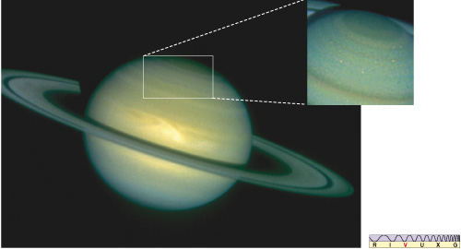
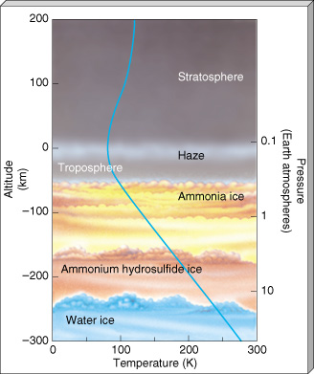
Saturn
similar to Jupiter, except
less convection … weaker internal heat
colder by ~ 30K
He 12% (Sat) vs. 14% (Jup) vs. 16% (protosun)
C, N, S species enhanced by 2-3X
puffed out atm results in lower density

Slide 16
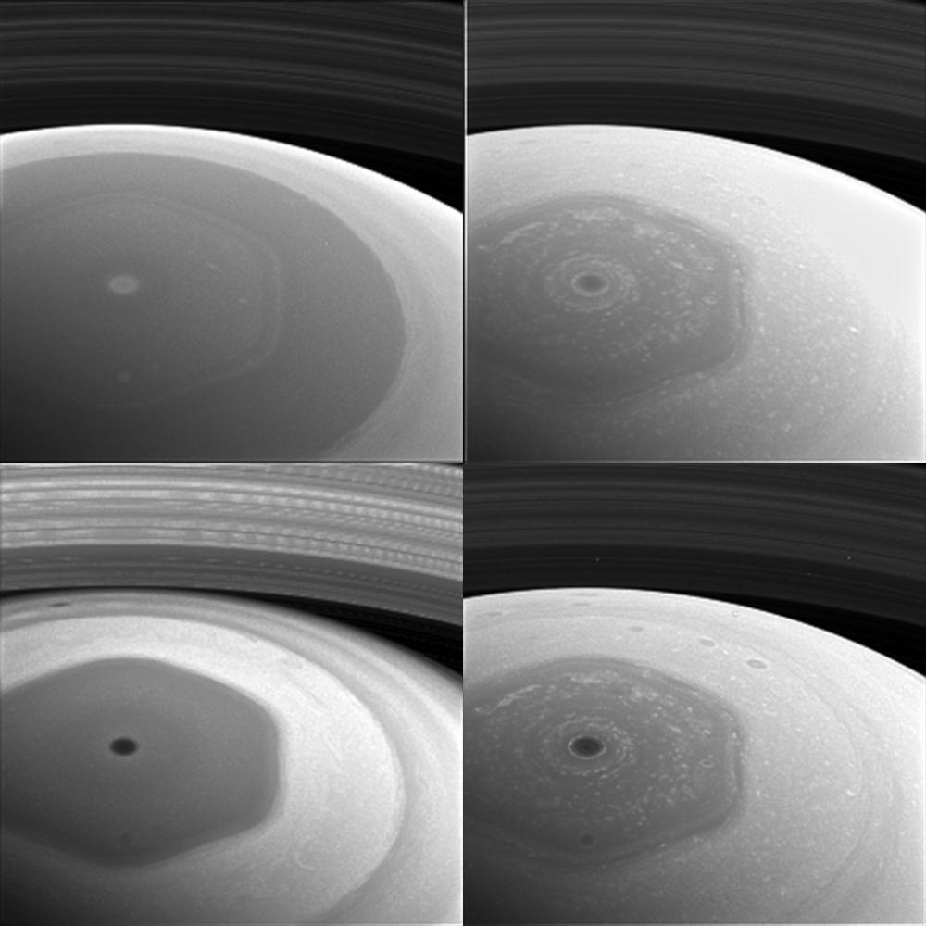
Saturn’s North Pole
420 nm
628 nm
939 nm
728 nm
Notes:
long-lived jet stream that has swirled around the ringed planet's north pole for more than 30 years Voyager in the early 1980s, still there when Cassini arrived in 2004
20,000 miles (32,000 kilometers) wide, and thermal images show that it reaches roughly 60 miles (100 km) down into Saturn's atmosphere
Stability: The six-sided jet stream stays fixed in longitude and does not drift like normal atmospheric clouds … rotates in 10h 39m = mag field
Why? computer simulations of a jet stream flowing in a curving path near Saturn's north pole affected by small perturbations in the jet — the kind one might expect from jostling with other air currents — make it meander into a hexagonal shape … best hexagonal involves shallow jets at the cloud level … winds below the cloud level apparently help keep the shape of the hexagon sharp and control the rate at which the hexagon drifts
SATURN BY CASSINI: This collage of images from NASA's Cassini spacecraft shows Saturn's northern hemisphere and rings as viewed with four different spectral filters. Each filter is sensitive to different wavelengths of light and reveals clouds and hazes at different altitudes. Clockwise from top left, the filters used are sensitive to violet (420 nanometers), red (648 nanometers), near-infrared (728 nanometers) and infrared (939 nanometers) light. The image was taken with the Cassini spacecraft wide-angle camera on Dec. 2, 2016, at a distance of about 400,000 miles (640,000 kilometers) from Saturn. Image scale is 95 miles (153 kilometers) per pixel. The images have been enlarged by a factor of two. The original versions of these images, as sent by the spacecraft, have a size of 256 pixels by 256 pixels. Cassini's images are sometimes planned to be compressed to smaller sizes due to data storage limitations on the spacecraft, or to allow a larger number of images to be taken than would otherwise be possible. These images were obtained about two days before its first close pass by the outer edges of Saturn's main rings during its penultimate mission phase.

Slide 17
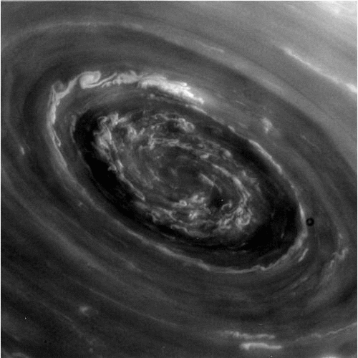
Saturn’s Polar Vortex
Notes:
SATURN BY CASSINI: eye of the hexagonal cloud structure at Saturn’s north pole

Slide 18
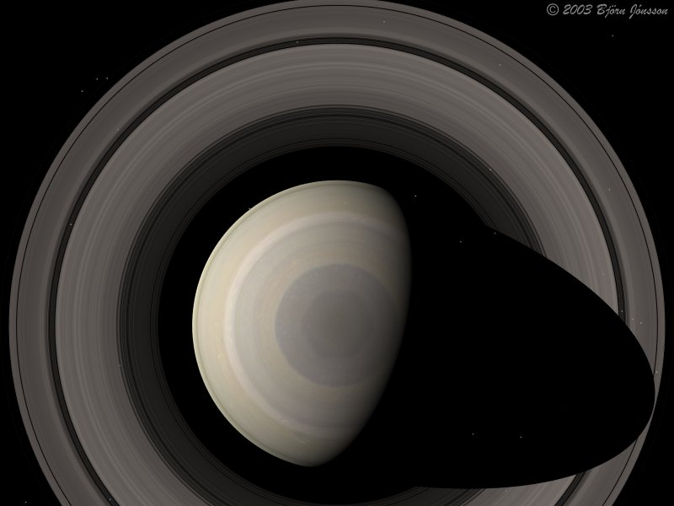
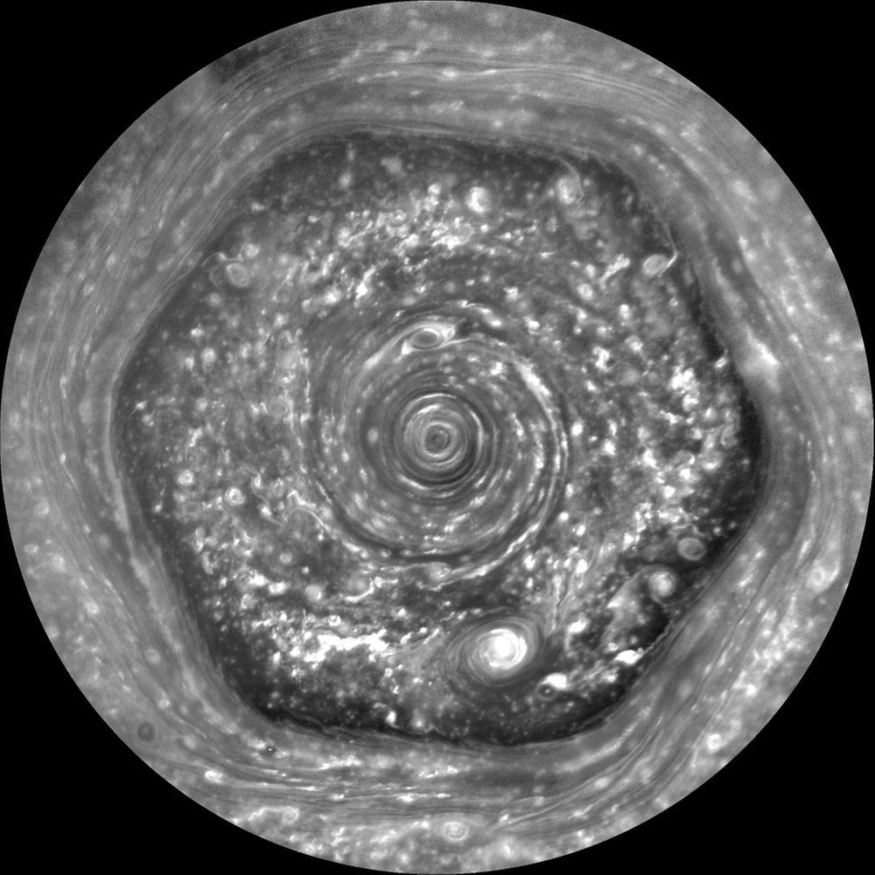
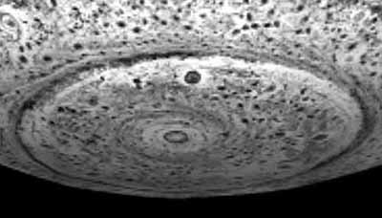
Weather: Jovians
N
S
Notes:
The new discovery: Observations using the Hubble Space Telescope revealed a giant, newly evolving 10-sided decagon taking shape around Saturn's south pole.
Why it's different: The wind speed gradients, temperatures, and atmospheric dynamics at the south pole differ from the north. Laboratory simulations demonstrate that changing the speed and shear of a rotating fluid ring alters the number of polygon sides it produces—faster or different wind contrasts favor more sides, yielding 10 sides in the south instead of 6 in the north.

Slide 19
Jupiter vs. Saturn: pressure

Slide 20
Jupiter vs. Saturn: height
H_{P}(z) = kT(z) / g(z) μ m
at 1 Earth atm
H_{PJup} (125K, 2.5g) = 24 km
H_{PSat} (95K, 1.1g) = 47 km
Notes:
Jup gravity = 25 m/s2 at cloud tops … T = 125K
Sat gravity = 10 m/s2 at cloud tops … T = 95K

Slide 21
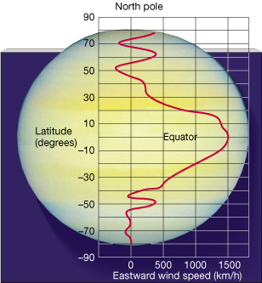
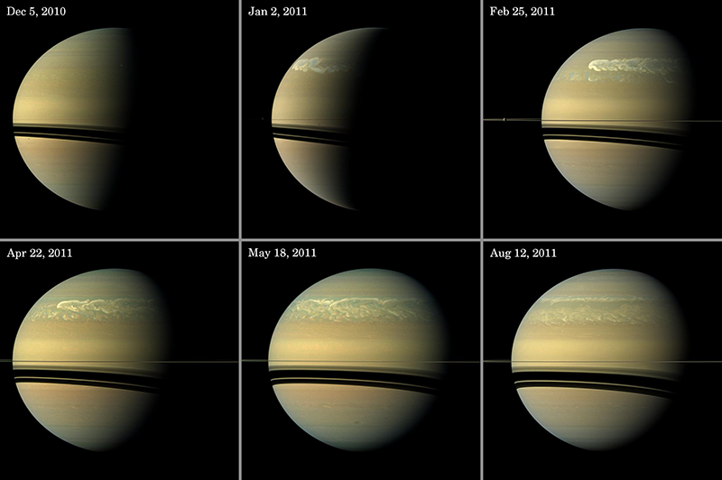
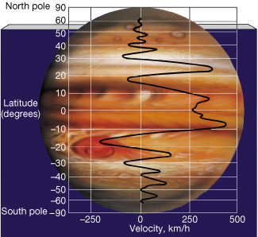
Wind Speeds
both relatively stable over 20+ years of Voyager to Cassini and HST
Notes:
Saturn storm --- As Saturn rotated, the storm continued to drag around the planet like a ribbon, covering 5 billion square kilometers, until one day the tail of the storm collided with the head of the storm and they annihilated each other. Then, over just a week, the storm’s activity ceased. Scientists still aren’t sure why the storm abruptly ended, he noted.

Slide 22
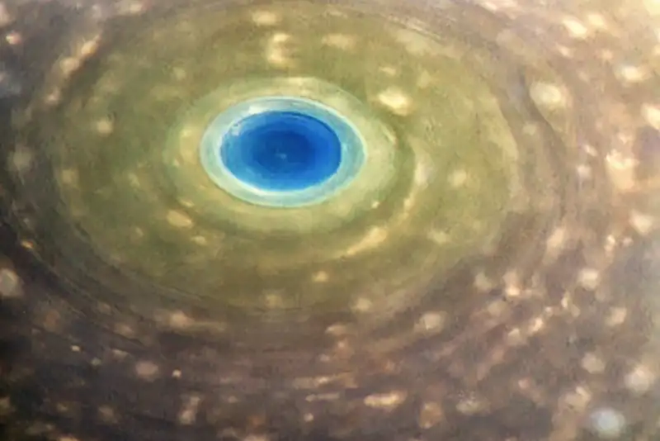
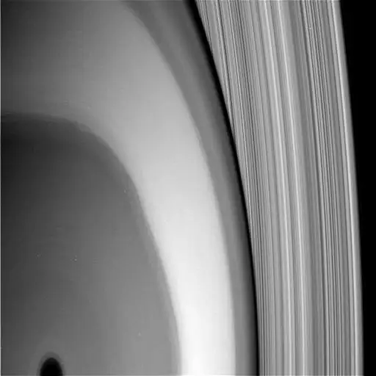
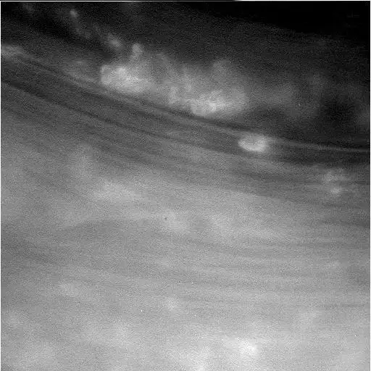
Cassini Grand Finale
biggest atm result … ring rain
cocktail of dust from rings
H₂O CH₄ NH₃ CO N₂ CO₂
Notes:
spectrometer was designed to investigate gases, measured the ring particles because they hit the spacecraft at such high velocities they vaporized
laser+mirror-on-arm experiment revealed possible NH3 patchy clouds

Slide 23
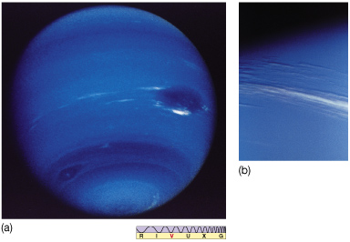
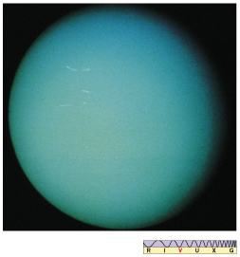
Neptune and Uranus
significant cloud features super bland!
internal heat source no internal heat source
H + He only ~10% mass of planet, unlike Jup and Sat at ~90%
no NH₃ clouds observed (as seen on Jup and Sat)
CH₄, H₂S, NH₄SH, and H₂O clouds instead
Notes:
H2S = hydrogen sulfide
NH4SH = ammonium hydrosulfide

Slide 24
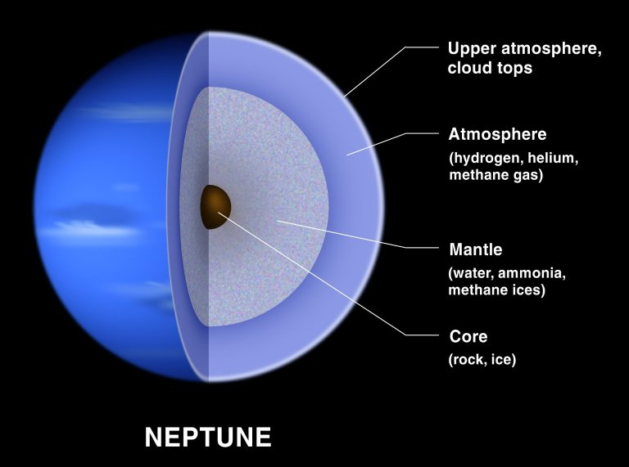
Ice Giant Structure
Notes:
NEPTUNE BY HST:

Slide 25
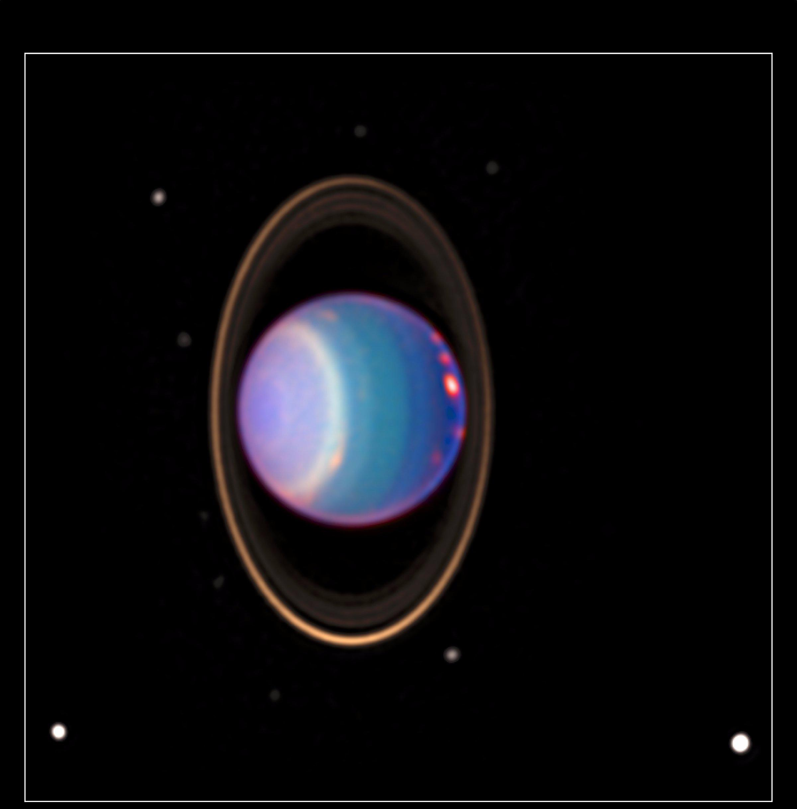
Uranus
obliquity
98 deg
HST
NICMOS
1998
Notes:
URANUS BY HST: four major rings and by 8 of its 17 known satellites … taken 8/8/98 with NICMOS
HST found about 20 clouds - nearly as many clouds on Uranus as the previous total in the history of modern observations
orange-colored clouds near the prominent bright band circle the planet at more than 300 mph (500 km/h)
one of the clouds on the right-hand side is brighter than any other cloud ever seen on Uranus
colors indicate altitude:
green and blue regions show where the atmosphere is clear and sunlight can penetrate deep into Uranus
yellow and gray regions the sunlight reflects from a higher haze or cloud layer
orange and red colors indicate very high clouds, such as cirrus clouds on Earth.
The Hubble image is one of the first images revealing the precession of the brightest ring with respect to a previous image [PRC97-36a]. Precession makes the fainter part of the ring (currently on the upper right-hand side) slide around Uranus once every nine months. The fading is caused by ring particles crowding and hiding each other on one side of their eight-hour orbit around Uranus.
The blue, green and red components of this false-color image correspond to exposures taken at near-infrared wavelengths of 0.9, 1.1, and 1.7 micrometers. Thus, regions on Uranus appearing blue, for example, reflect more sunlight at 0.9 micrometer than at the longer wavelengths. Apparent colors on Uranus are caused by absorption of methane gas in its atmosphere, an effect comparable to absorption in our atmosphere which can make distant clouds appear red.

Slide 26
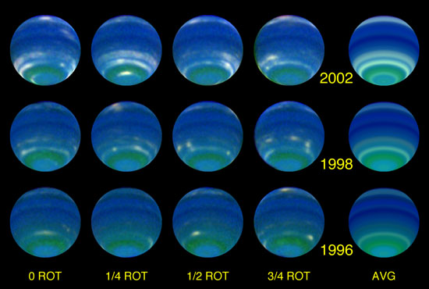
Neptune
Neptune
fastest winds in SS > 2000 km/hr
HST
Notes:
NEPTUNE BY HST: Comparing August 2002 observations to similar observations in 1996, the authors found that Neptune’s reflectivity averaged across the planet’s face (disk-averaged) increased by 3.2% at 467 nm (blue), 5.6% at 673 nm (red), and 40% in the 850 nm–1000 nm band (near infrared). These changes result from even larger brightness increases in restricted latitude bands, reaching 100% in some cases. The reason for the increases may be seasonal forcing, which is the seasonal variation in local solar heating.
Because Neptune’s equatorial plane is inclined 29º to its orbit plane, it is subject to seasonal solar forcing during its 164.8-year orbit of the sun. The resulting local variation in incident sunlight is similar in fractional amplitude to that on the earth, which has a 23.5º inclination, but the absolute variation is 900 times smaller and the rate of change is slower by an additional factor of 165. Remarkably, there is now evidence that Neptune is responding measurably to this weak forcing (of the sun’s heat). The long record of disk-averaged observations from Earth provides a key piece of evidence. When blue-filter (467-nm) observations with the Hubble Space Telescope from 1994 to 2002 are added to blue-filter (472-nm) Earth-based results of Lockwood and Thompson, the combined disk-averaged variation from 1972 to 2002 is consistent with a simple seasonal model having a hemispheric response delay relative to solar forcing of ~30 years (~73% of a full season).

Slide 27
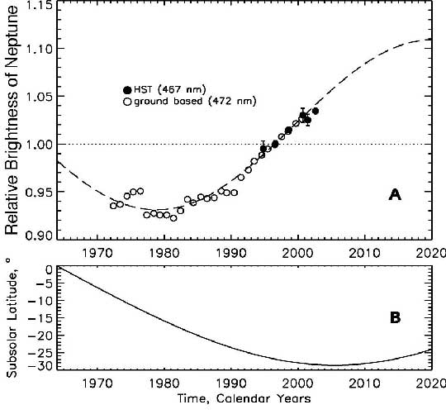
Seasonal Forcing at Neptune
obliquity
29º
1/900th Earth solar flux:
Sun’s effect much weaker
165 year orbit:
changes slower than Earth
obliquity 29º:
hemisphere toward Sun
brightens
temp 59K:
cannot reach rapid thermal
equilibrium … delayed
dynamic response of 15 yr
Sromovsky et al. 2002
Notes:
The best-fit seasonal model (dashed curve, A) has its peak ~2020, which is delayed 15.1 years relative to the hemispheric solar forcing peak in 2005 (B), when the subsolar latitude will be at its southern extreme.

Slide 28
Jovian Compositions
Jupiter Saturn Uranus Neptune
H₂ 86% | H₂ 88% | H₂ 83% | H₂ 82%
He 14% | He 12% | He 15% | He 15%
 |  | CH₄ 2% | CH₄ 3%
at least
1%
CH₄ 2000 | CH₄ 4500
H₂O > 400 | H₂O ? | H₂O ? | H₂O ?
NH₃ 700 | NH₃ 500 | NH₃ < 150 | NH₃ < 150
H₂S 80 | H₂S 460 | H₂S 300 | H₂S 1000
Ne 20 | Ne ? | Ne ? | Ne ?
Ar 16 | PH₃ 7 |  | C₂H₆ 2
PH₃ 5 | C₂H₆ 3 |  | CO 1
ppm

Slide 29
Jovian Atm Highlights
Jupiter
extreme convection … belts/zones … Great Red Spot
enrichment of atmosphere by Io
Saturn
puffiest atmosphere of jovians
He rain has depleted He from outer layers
Uranus
cold enough for CH₄ clouds to condense
NH₃ condensed out/into NH₄SH clouds, so not observed
Neptune
CH₄ trend continues … increases from Jup min to Nep max
NH₃ condensed out/into NH₄SH clouds, so not observed
recall conditions in solar nebula …
CO preferred above 700 K, CH₄ preferred below 700 K, CH₄ ice below 80 K
N₂ preferred above 300 K, NH₃ preferred below 300 K, NH₃ ice below 150 K

Slide 30
Tenuous Atmospheres
SSE!
temporary, due to …
sputtering --- physical lifting off surface (but not v_{esc})

Slide 31
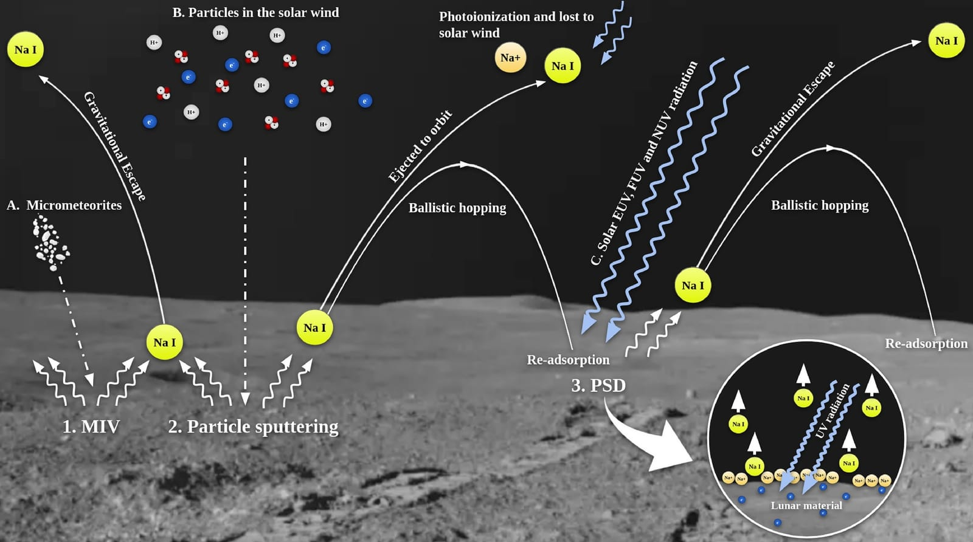
Sputtering +

Slide 32
Tenuous Atmospheres
temporary, due to
sputtering --- physical lifting off surface (but not v_{esc})
energetic particles from solar wind
energetic particles from nearby planet/magnetosphere
micrometeorite bombardment
… all 8 tenuous atmospheres
capture of solar wind … Mercury, Moon
volcanoes (Io … SO₂) and/or geysers (Enceladus … H₂O … Triton … N₂)
sublimation of ices … Mars, Io, Triton, Pluto

Slide 33
16 Atmospheres
PLANETS OTHERS
comp (> 1%) P (bar) H (km) comp (> 1%) P (bar) H (km)
Mercury | O Na He | < 10 ⁻¹² | 13 to 95 | Moon | He Ar Na | 10 ⁻¹⁵ | 65
Venus | CO₂ N₂ | 92 | 16 | Io | SO₂ | 10 ⁻⁸
Earth | N₂ O₂ H₂O | 1.0 | 8.5 | Europa | O₂ | 10 ⁻¹²
Mars | CO₂ N₂ | 0.006v | 11 | Ganymede | O₂ | < 10 ⁻¹¹
Jupiter | H₂ He | 10 ⁺⁶ | 24 | Callisto | CO₂ O₂? | 10 ⁻¹¹
Saturn | H₂ He | 10 ⁺⁶ | 47 | Titan | N₂ CH₄ Ar | 1.5 | 20
Uranus | H₂ He CH₄ | 10 ⁺⁵ | 25 | Triton | N₂ | 10 ⁻⁵
Neptune | H₂ He CH₄ | 10 ⁺⁵ | 23 | Pluto | N₂ | 10 ⁻⁵ | 33
H_{P}(z) = kT(z) / g(z) μ m
Notes:
Terrestrial pressures at surface … Jovian pressures at base of molecular layers shown on p 276-277 figures in 2nd edition
Terrestrial scale heights at surface … Jovian scale heights at 1 bar
N2 has triple bond, so very stable
O2 has double bond
Titan has 98.4% N2, 1.6% CH4
Jovian scale heights larger because H2 and He are so light

Slide 34
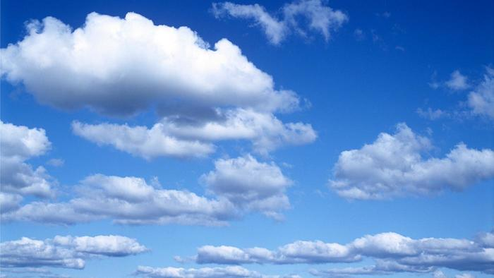
Clouds
Venus H₂SO₄ (sulfuric acid)
evaporates
Earth H₂O
Mars CO₂ (high, 50 km)
H₂O (low, 10 km)
Titan hydrocarbon smog
CH₄ below
Jupiter NH₃
+ NH₄SH
Saturn H₂O
“solution cloud”
Uranus CH₄
+ H₂S
Neptune NH₄SH
H₂O
“solution cloud”
form on all planets where the temp
drops below condensation point of
gases in atmosphere
1. non-equilibrium conditions in atm
2. absorbed incoming radiation heats
3. can alter surface heating pattern
4. can block outgoing infrared photons
theoretical for Jovians!
NH₃ + H₂S → NH₄SH
“solution cloud” = H₂O+NH₃+H₂S
KEY TREND:
further from Sun … colder
more cloud decks
Notes:
see/read first paragraph of section 4.4 on page 100
NH4SH = ammonium hydrosulfide
H2S = hydrogen sulfide

Slide 35
…………………………
Notes:
35

Slide 36
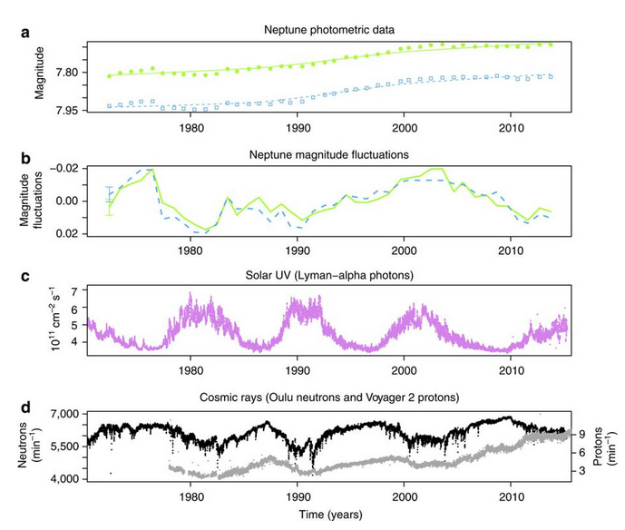
Seasonal Forcing at Neptune
atmospheric aerosols created
165 yr cycle
UV photons: 11 yr cycle
Galactic cosmic rays: 1-2 yr cycle
Aplin & Harrison 2016
Notes:
Galactic cosmic ray signal on 1-2 yr cycle is set of wiggles in mid 1980s
(a) Neptune brightnesses at 472 nm (blue squares) and 551 nm (green circles)
(b) Magnitude fluctuations after detrending (a) with the fit --- errorbars represent maximum offsets. (c)
(c) Solar Lyman-alpha (ultraviolet) radiation at 121.5 nm.
(d) Cosmic ray count rate at Earth’s surface (neutrons from Oulu, Finland and Voyager counts for cosmic ray protons >70 MeV (grey).

