Slide 1
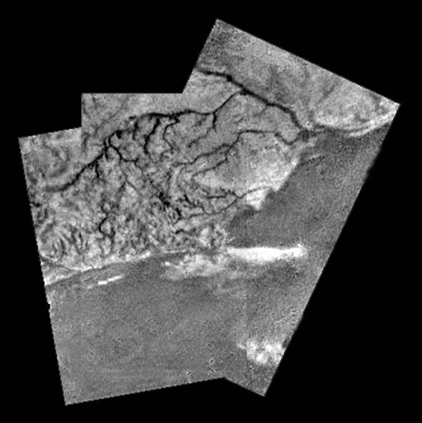
Planetary Surfaces III
Where
is this?
Notes:
2 h 30 min in atm, then ~30 min on ground
500X brighter than full Moon on surface … about 10 min after sunset on Earth

Slide 2
Planetary Sciences Project
Level 0 … Topics … Thu 01 SEP
Level 1 … Outline … Thu 22 SEP
Level 2 … Draft #1 … Thu 13 OCT
Thu 20 OCT
Level 3 … Draft #2 … Thu 03 NOV
Presentations … in class … 15+17 NOV
Level 4 … Final Paper … Tue 29 NOV

Slide 3
Research Paper Level 2
due Thursday, 20 OCT (before class)
paper starting to take shape (worth 10 points +2 points if in 13 OCT)
use AAS LaTeX template on website
email .pdf
10 pieces required:
1. Abstract full draft
2. Introduction 8+ sentences, major references included
3. Motivation YOU
4/5. Sections all have bullets
6/7. Discussion 8+ sentences
8. Tables 2+ formatted with columns identified
9. Figures 2+ outlined/sketched, captions given
10. References at least 5

Slide 4
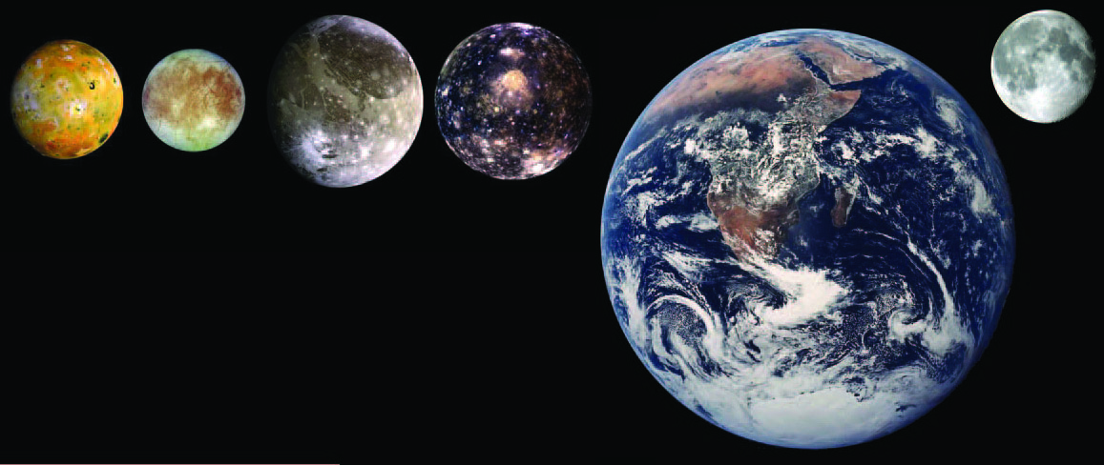
Galileans
3.53 g/cm³ 3.02 g/cm³ 1.94 g/cm³ 1.85 g/cm³ 5.52 g/cm³ 3.34 g/cm³
rocky
active
volcanoes
calderas
rocky
H2O ice
floes
ridges
lenticulae
cycloids
dirty ice
craters
palimpsests
grooves
light/dark
areas
icy-est
craters
palimpsests
Notes:
lenticulae = “freckles” from convective upwelling of warm ice, like lava lamps

Slide 5
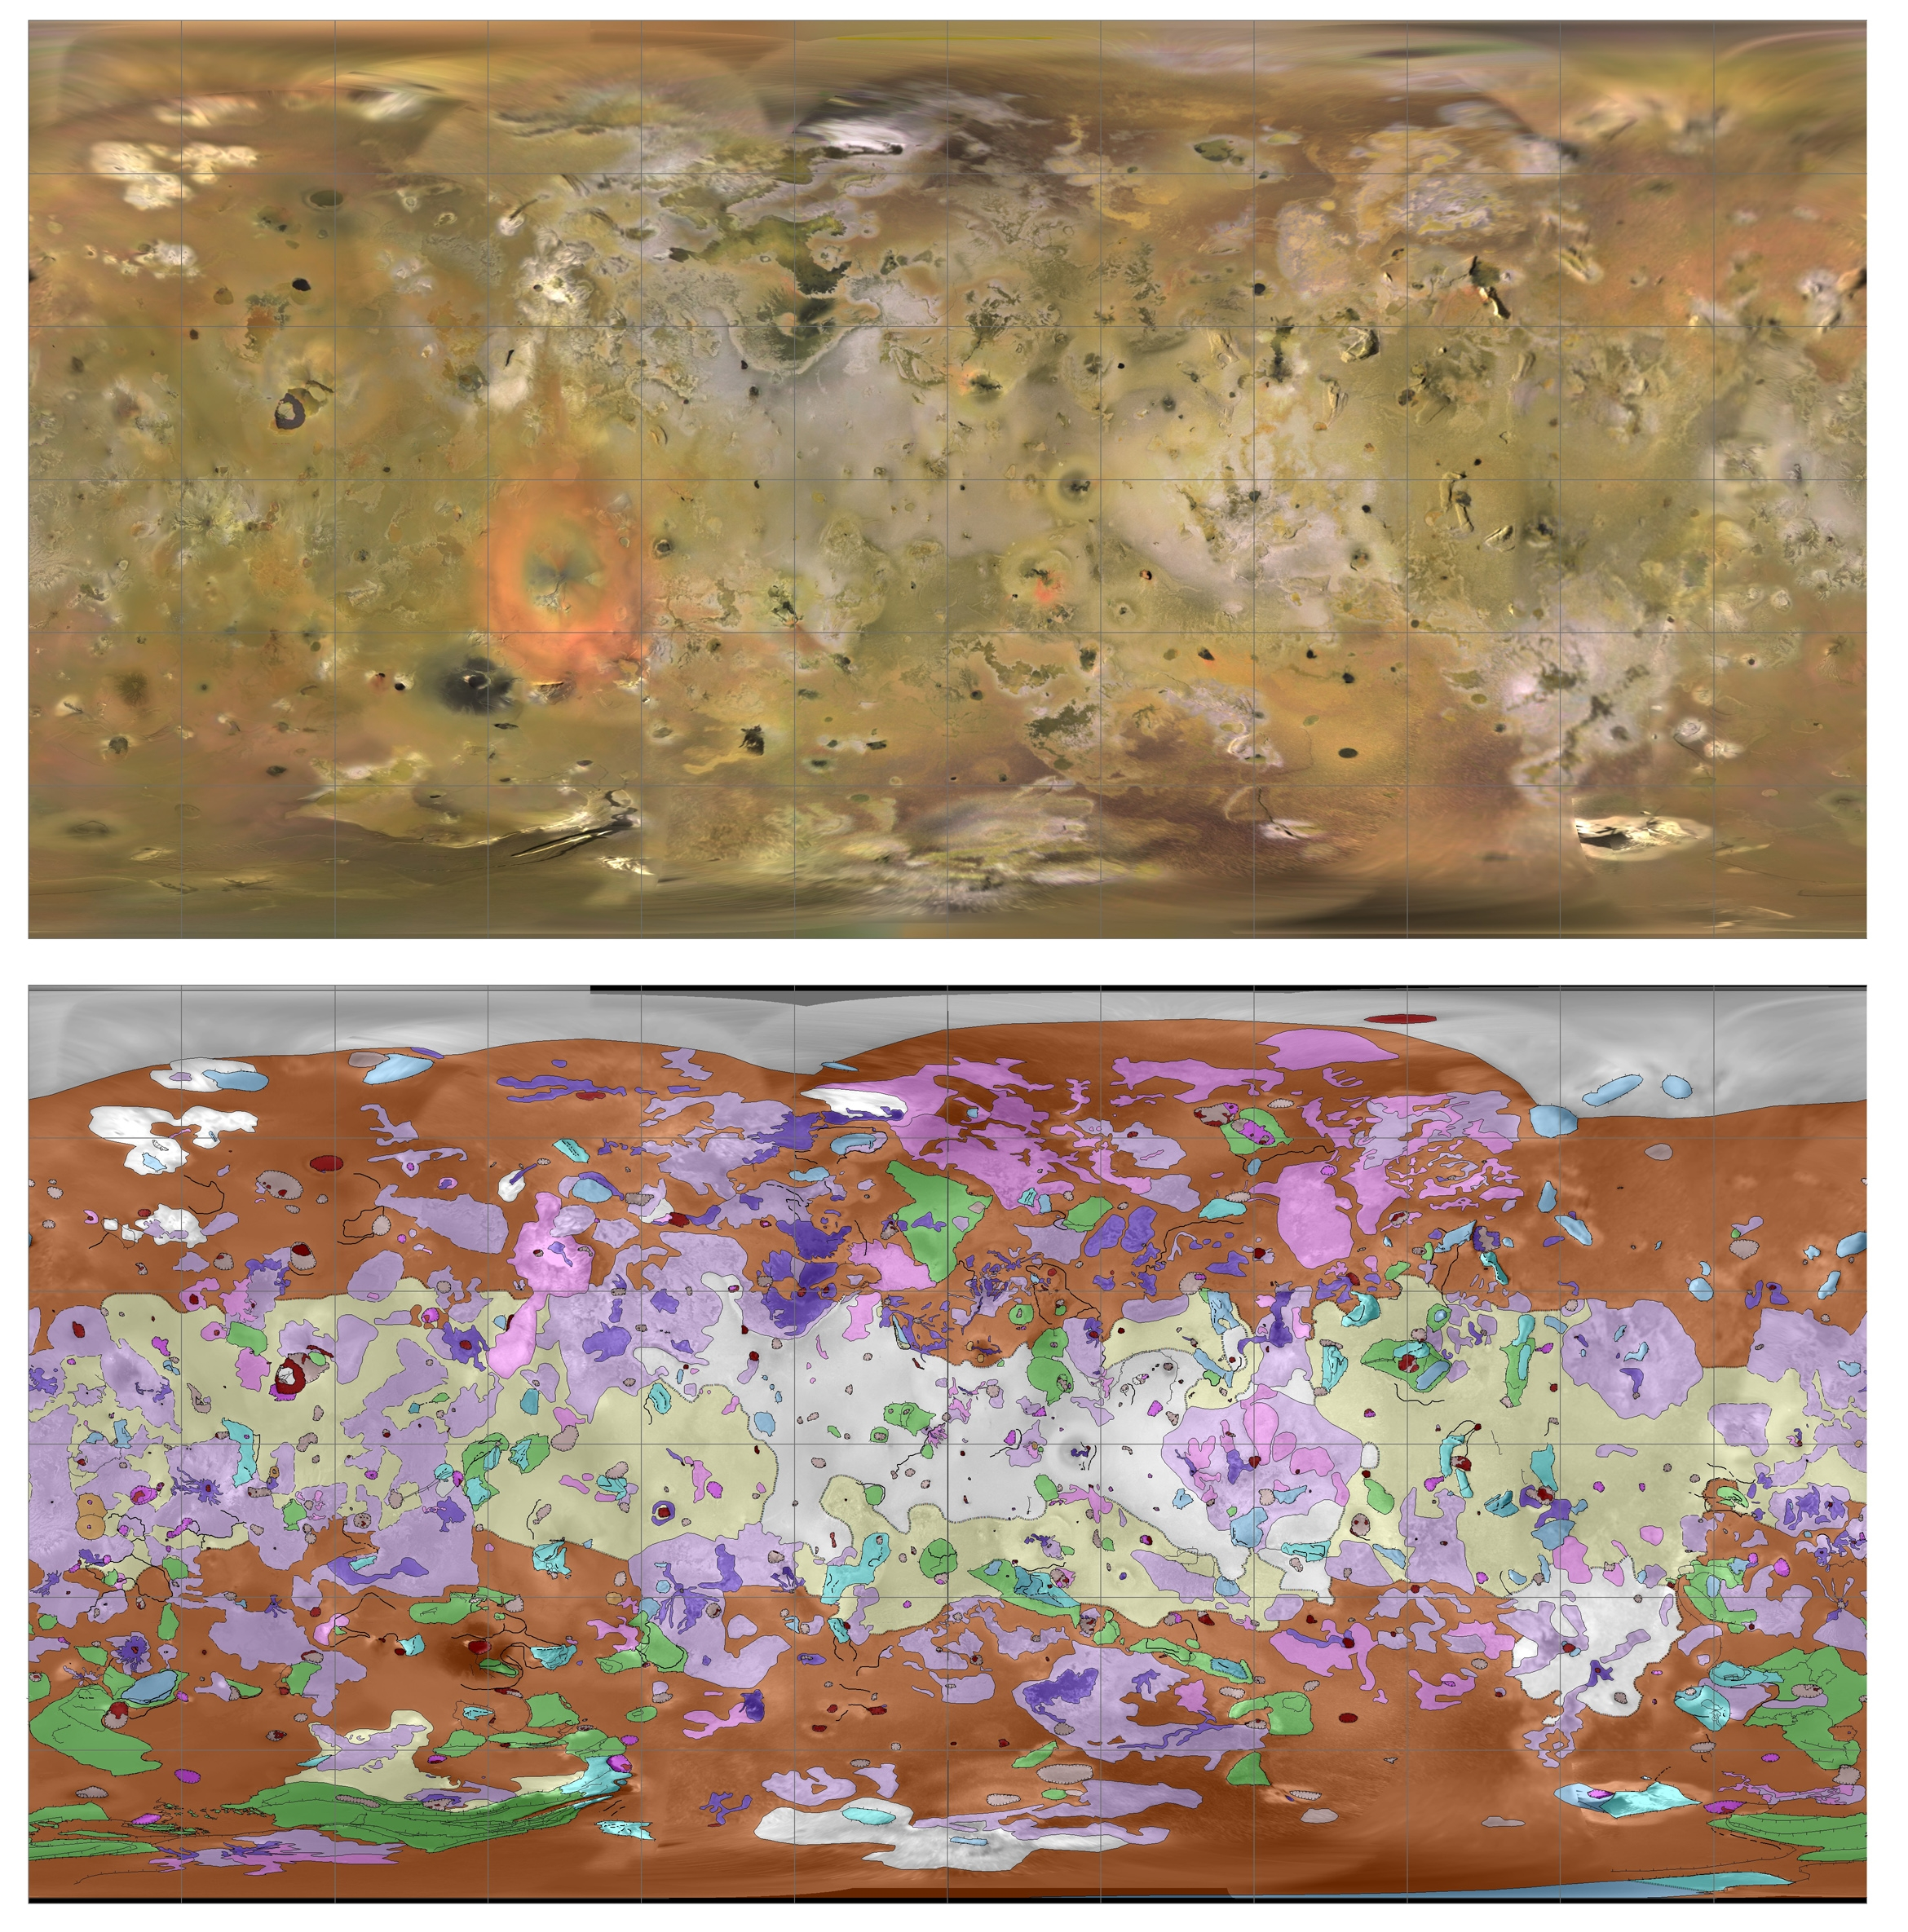
Io Map
density is 3.53 g/cm³ ≈ Moon at 3.34 g/cm³ … rock
zero craters found … surface less than a few Myr old
surface covered with SO2 frost
Notes:
light areas are sulfur compounds … dark areas are pyroxene and olivine
red ring from Pele (?) via polymeralization of S2 … fades over months, so must be recent

Slide 6
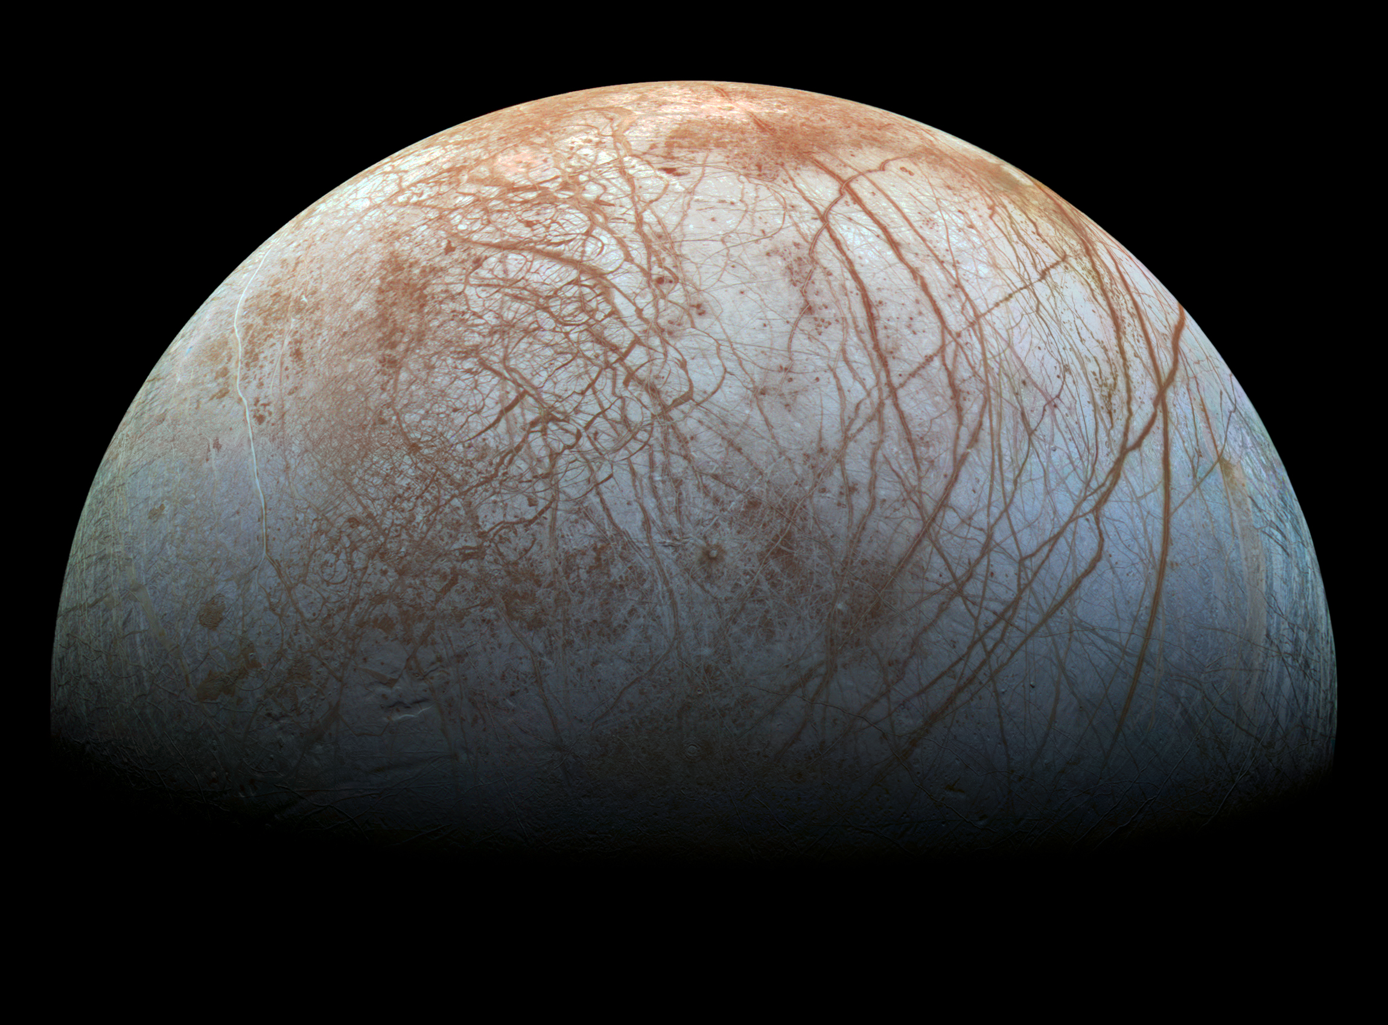
Europa
density is 3.02 g/cm³ < Moon at 3.34 g/cm³ … rock + some ice
very few craters … young surface
subsurface ocean
Notes:
The only way to get such an induced magnetic field is if there's some substance that is globally connected, and conductive — and only salty water fits the bill. Phillips noted you wouldn't get the same readings with isolated pools of water, like what's found under ice sheets on Earth. Slushy water-ice mixtures don't work, either. "Maybe graphite could get you that, but that would be ridiculous."
POSSIBLE PLUMES SEEN!

Slide 7
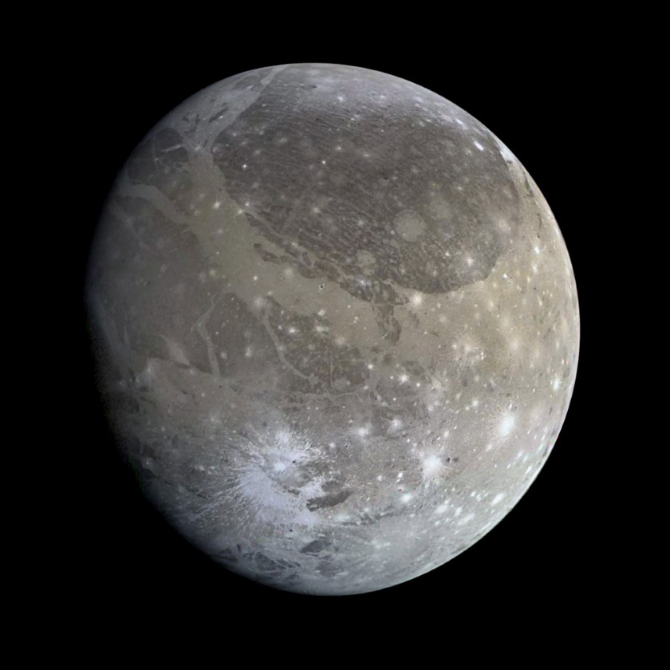
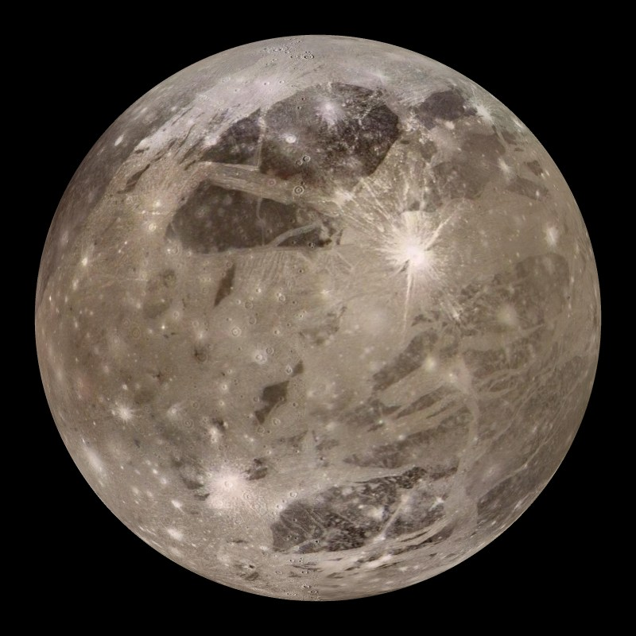
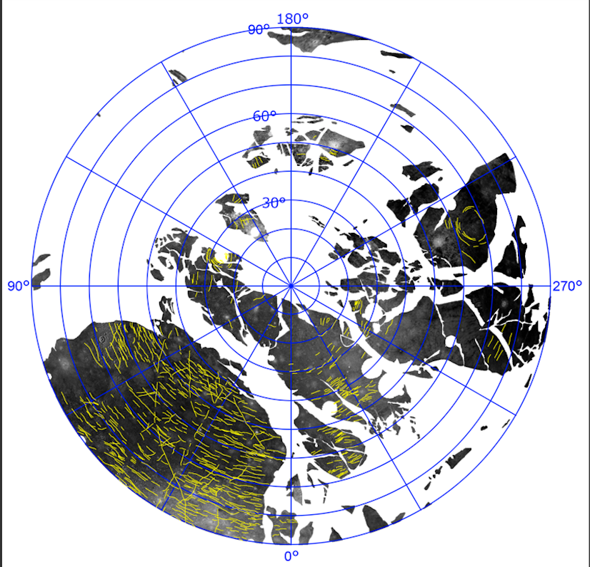
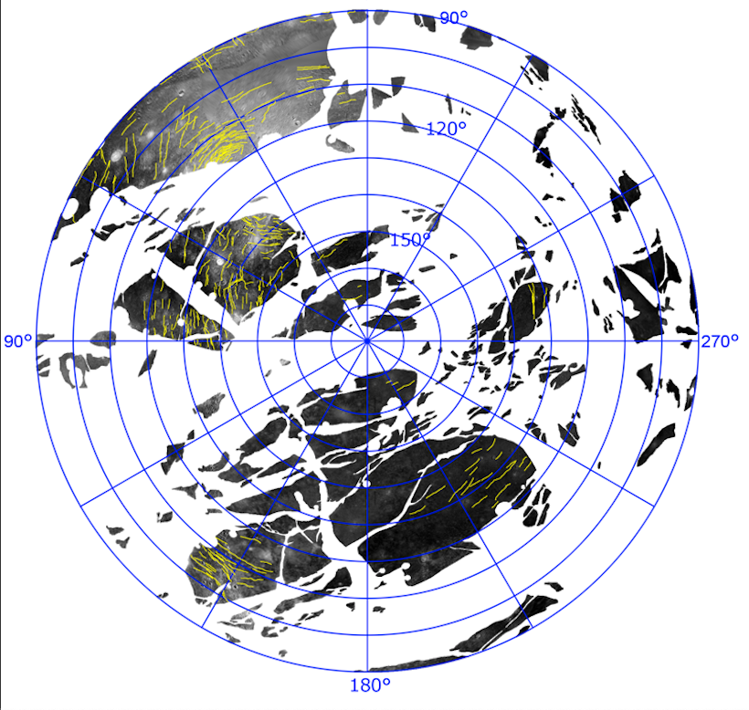
Ganymede
density is 1.94 g/cm³ << Moon at 3.34 g/cm³ … rock + ice
subsurface ocean likely
Notes:
inserts: single large impact that sent rings around Ganymede?
1. The Galileo probe measured Ganymede's magnetic field in 2002, providing some data supporting the theory that the moon has an ocean.
2. Scientists used Hubble to monitor Ganymede's auroras, ribbons of light at the poles created by the moon's magnetic field. The moon's auroras are also affected by Jupiter's magnetic field because of the moon's proximity to the huge planet. When Jupiter's magnetic field changes, so does Ganymede's. Researchers were able to watch the two auroras "rock" back and forth with Hubble. Ganymede's aurora didn't rock as much as expected, so by monitoring that motion, the researchers concluded that a subsurface ocean was likely responsible for dampening the change in Ganymede's aurora created by Jupiter.

Slide 8
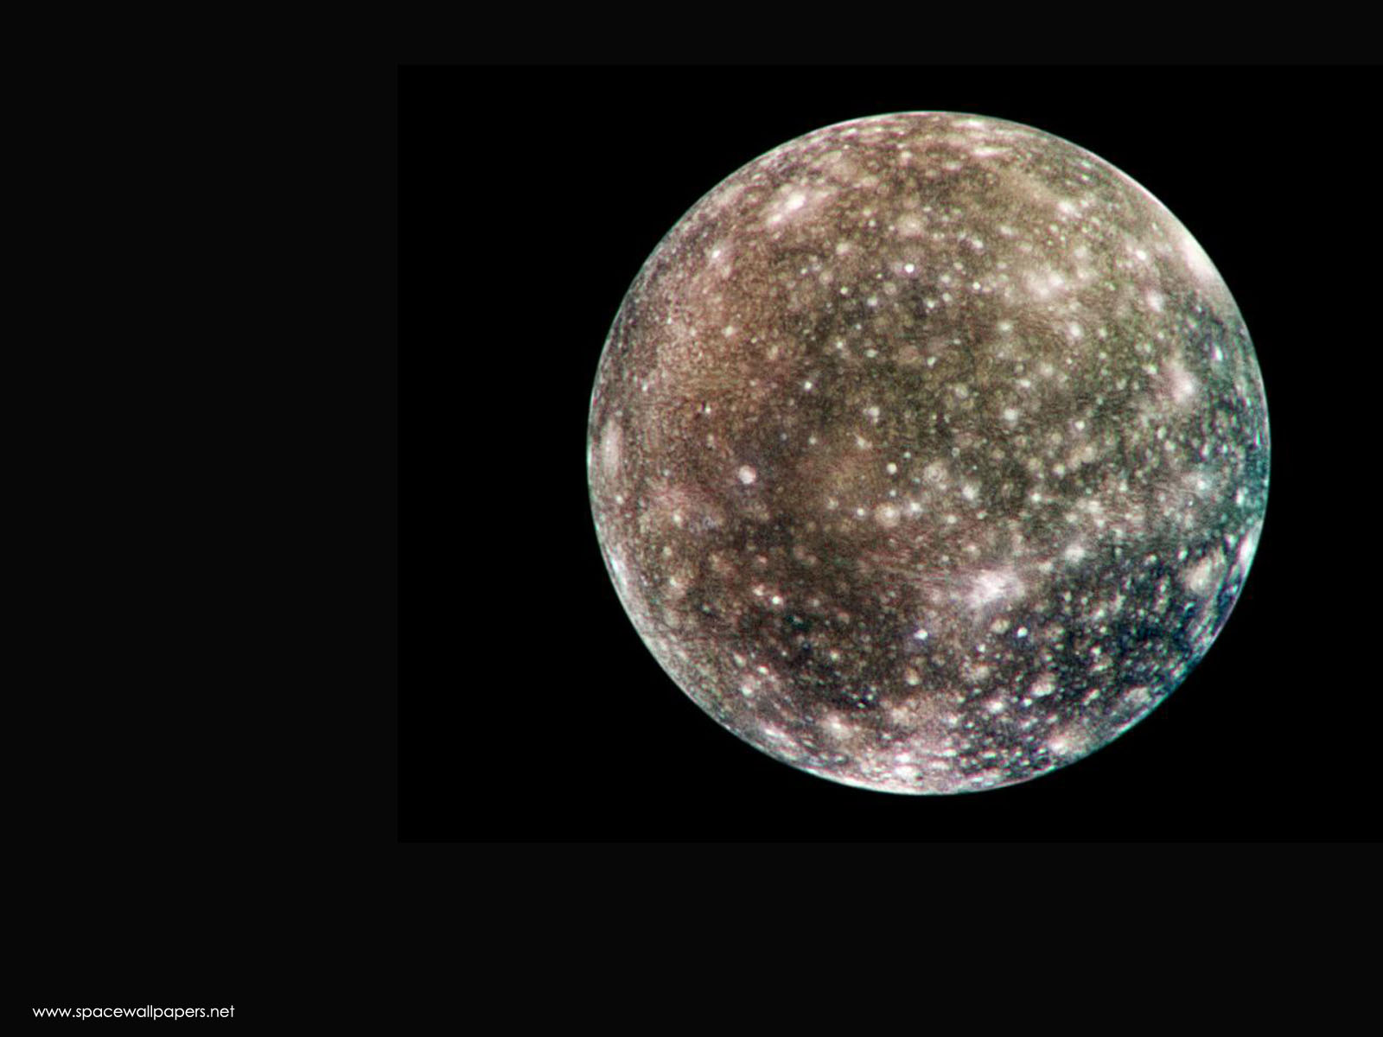
Callisto
density is 1.85 g/cm³ << Moon at 3.34 g/cm³ … rock + ice
pockmarked with craters (most heavily cratered in SS) … old(est)
subsurface ocean likely
Notes:
Kivelson and her colleagues found signs that Callisto's magnetic field, like Europa's, is variable, which can be explained by the presence of varying electrical currents associated with Jupiter that flow near Callisto's surface. Their next challenge was to discover the source of the currents. "Because Callisto's atmosphere is extremely tenuous and lacking in charged particles, it would not be sufficient to generate Callisto's magnetic field; nor would Callisto's icy crust be a good conductor, but there very well could be a layer of melted ice underneath," Kivelson said. "If this liquid were salty like Earth's oceans, it could carry sufficient electrical currents to produce the magnetic field." Lending further credence to the premise of a subsurface ocean on Callisto, Galileo data showed that electrical currents were flowing in opposite directions at different times. "This is a key signature consistent with the idea of a salty ocean," Khurana added, "because it shows that Callisto's response, like Europa's, is synchronized with the effects of Jupiter's rotation."

Slide 9
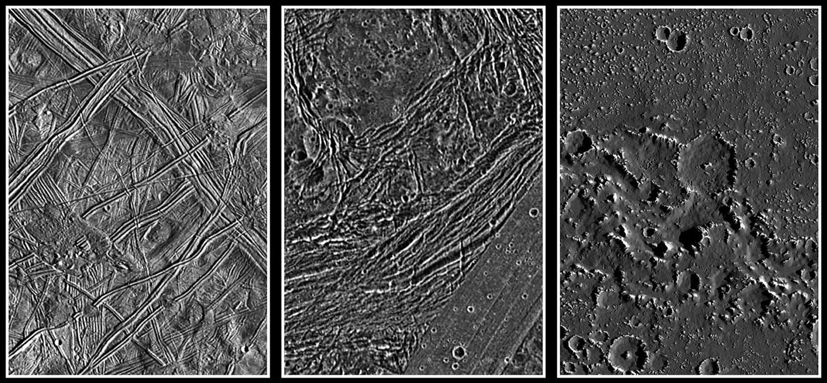
Europa Ganymede Callisto
−
10 km

Slide 10
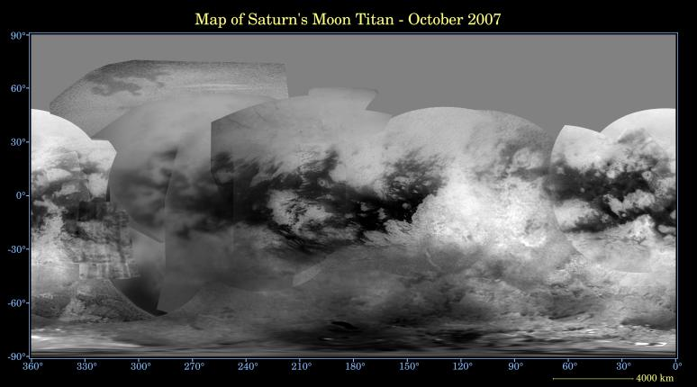
Titan Map from Cassini 2007
density is 1.88 g/cm³ … rock + ice
few craters … surface less than 1 Gyr old
liquid CH4/C2H6 lakes near poles cover ~1% of surface and change size
imaged at 9380 A

Slide 11
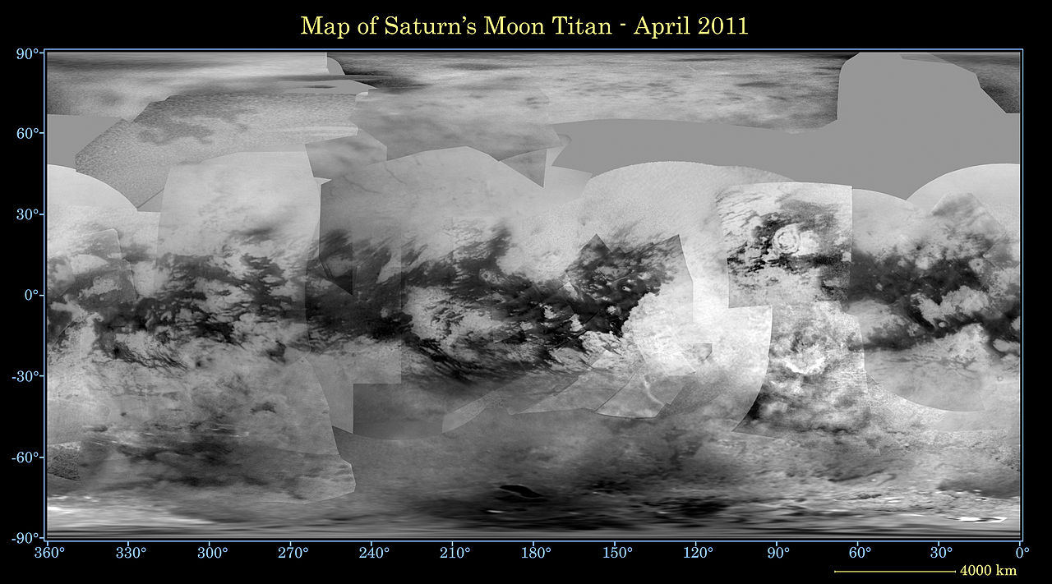
Titan Map from Cassini 2011
density is 1.88 g/cm³ … rock + ice
few craters … surface less than 1 Gyr old
liquid CH4/C2H6 lakes near poles cover ~1% of surface and change size
imaged at 9380 A

Slide 12
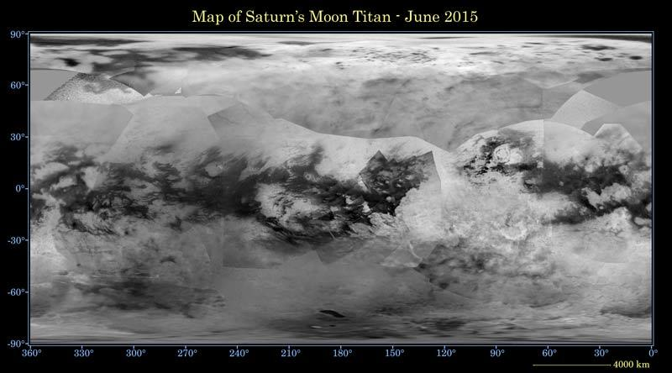
Titan Map from Cassini 2015
density is 1.88 g/cm³ … rock + ice
few craters … surface less than 1 Gyr old
liquid CH4/C2H6 lakes near poles cover ~1% of surface and change size
imaged at 9380 A

Slide 13
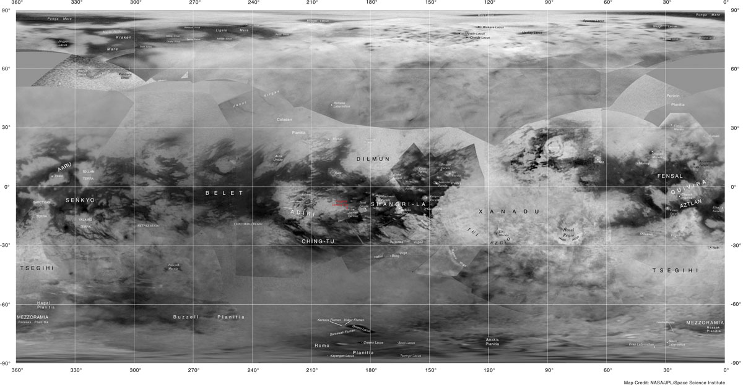
Titan Map from Cassini 2015
density is 1.88 g/cm³ … rock + ice
few craters … surface less than 1 Gyr old
liquid CH4/C2H6 lakes near poles cover ~1% of surface and change
imaged at 9380 A
Notes:
Shangri-La = beautiful imaginary place, from novel Lost Horizon by James Hilton … Xanadu = idyllic place inspired by the summer residence of Kublai Kahn (grandson of Genghis Khan) … Kraken Mare

Slide 14
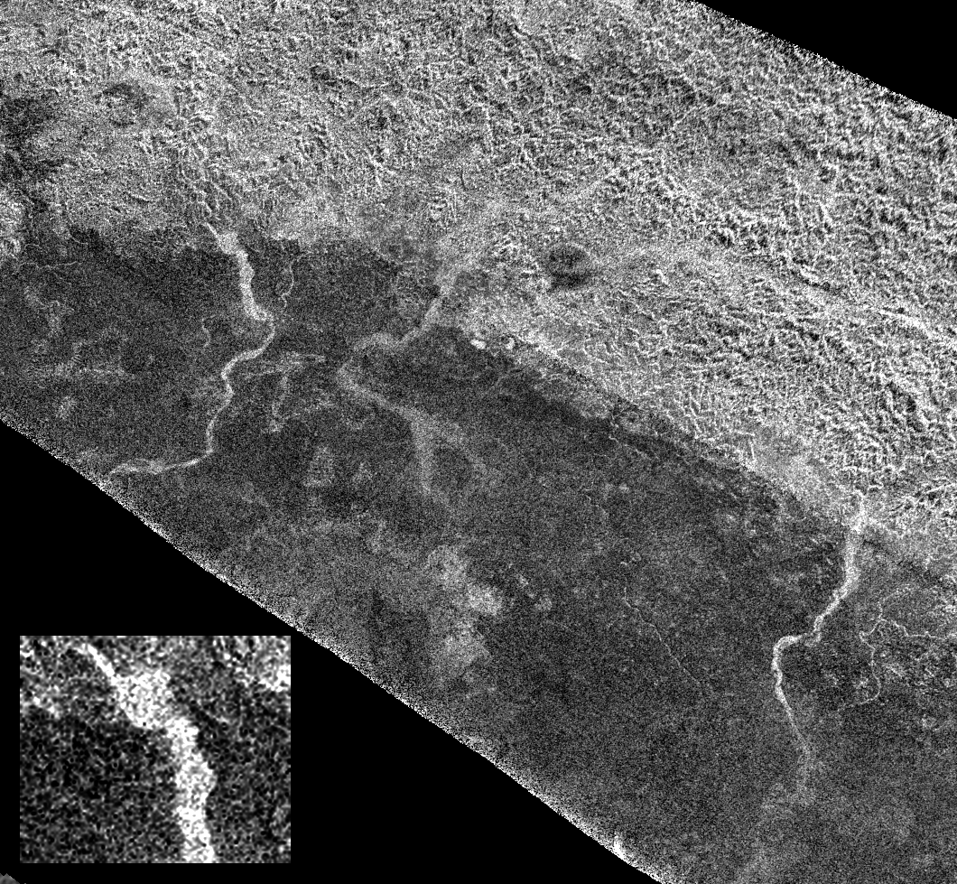
Titan: Xanadu
Xanadu
rough surface
bright in radar
5 km wide
Notes:
active riverbeds with CH4, or dry arroyos? unknown
resolution ~ 1 km

Slide 15
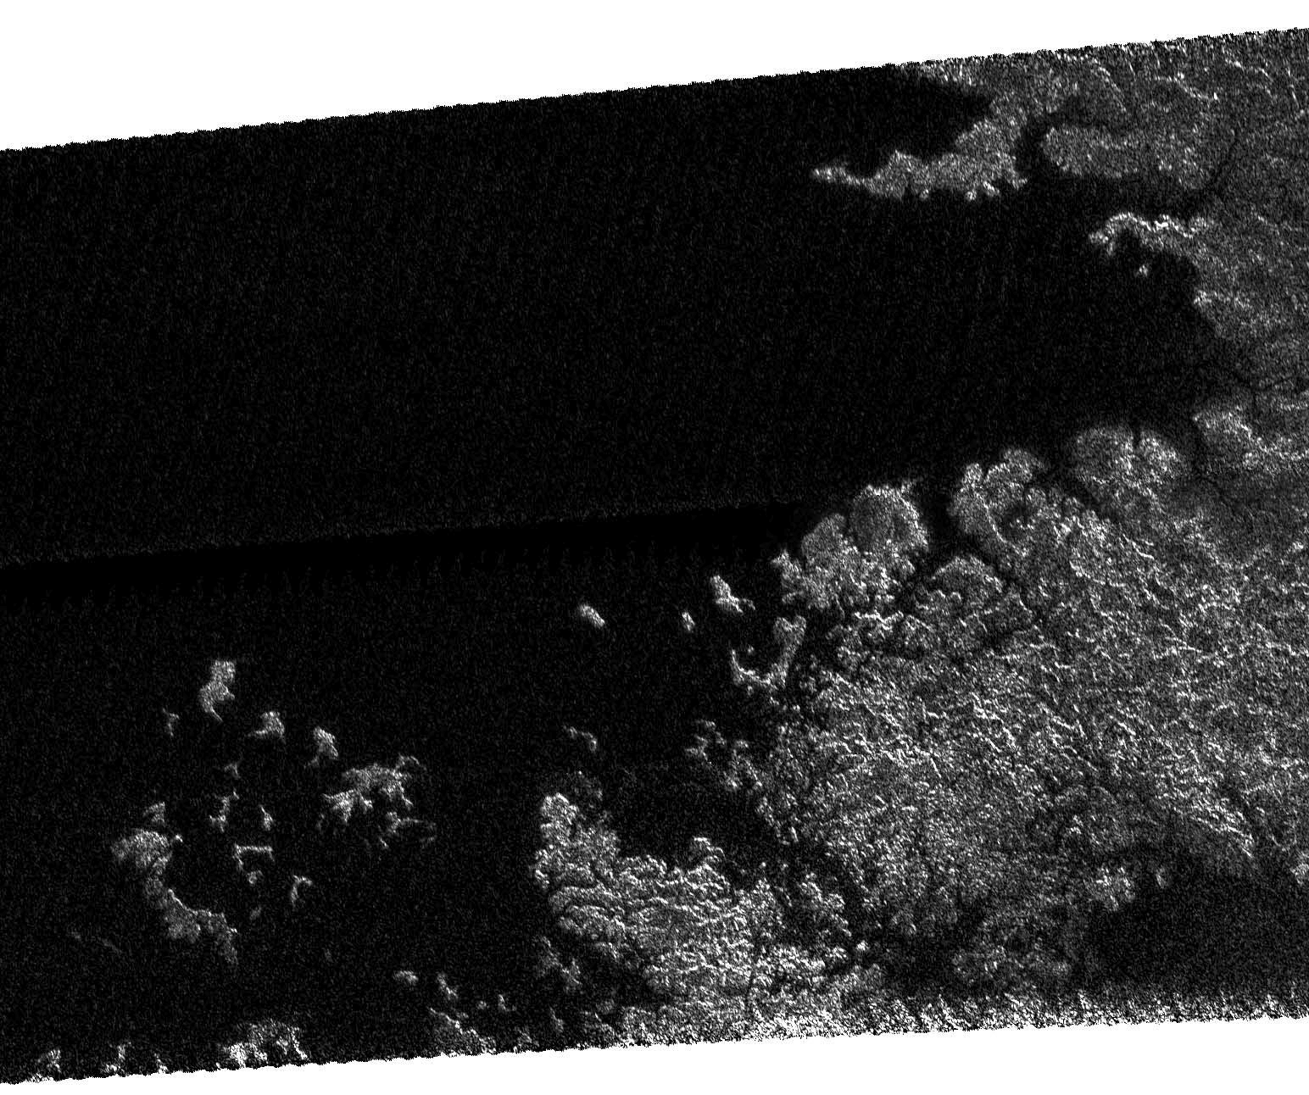
Titan: 70deg N
Titan: 70deg N
Xanadu
(M)Ethane Sea?

Slide 16
Titan Close Up
https://www.youtube.com/watch?v=svmGxFaGILY

Slide 17
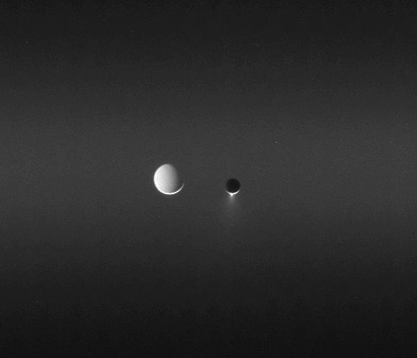
Tethys and Enceladus
Tethys and Enceladus
Notes:
Tethys much more distant … note that it’s lit up by Sun/Saturn

Slide 18
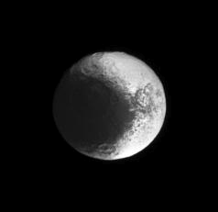
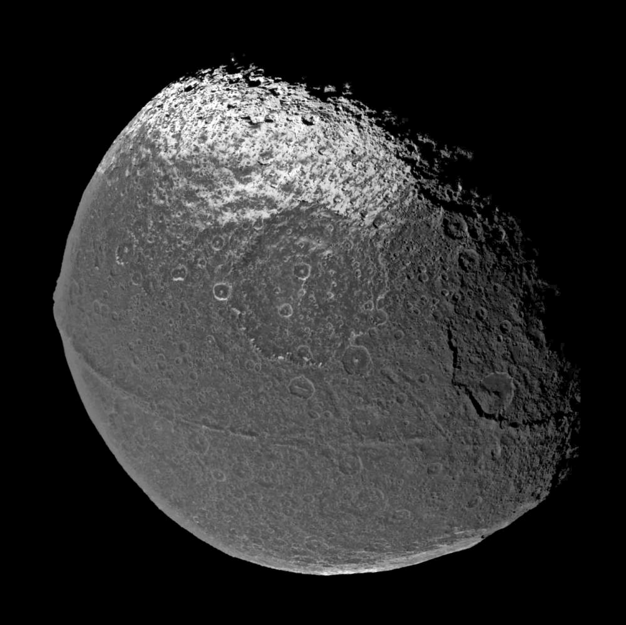
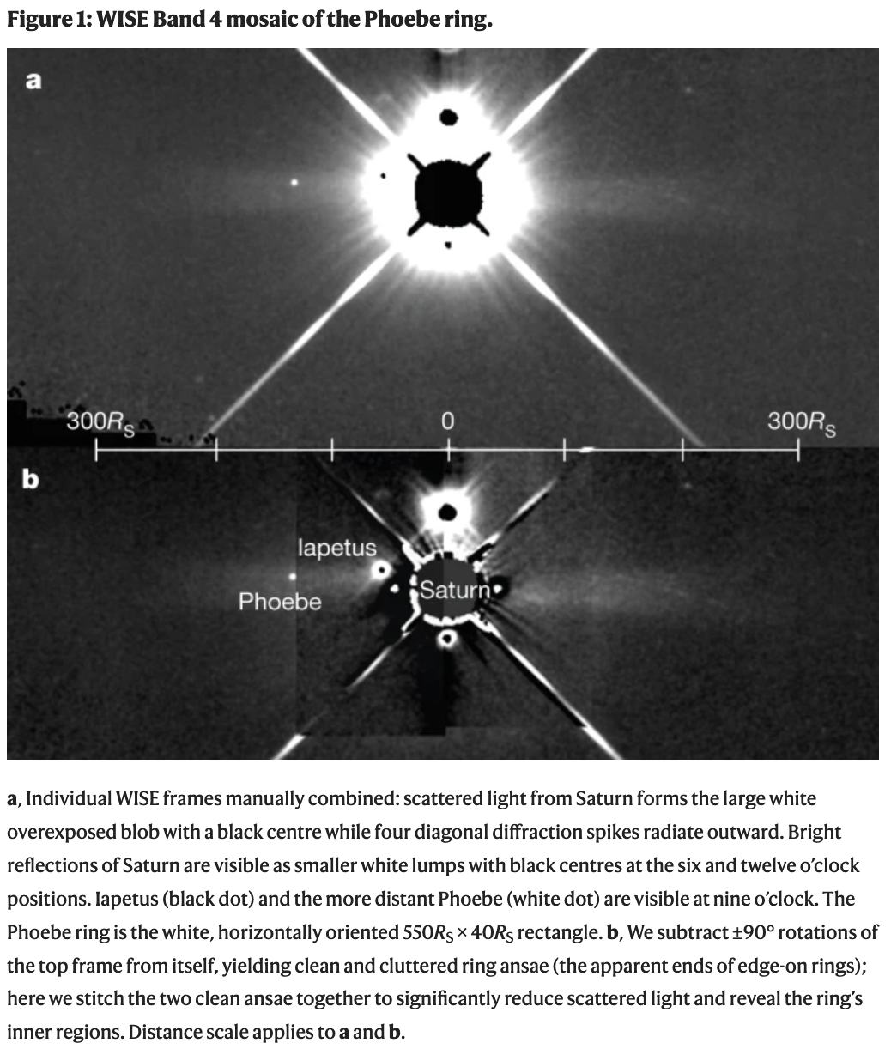
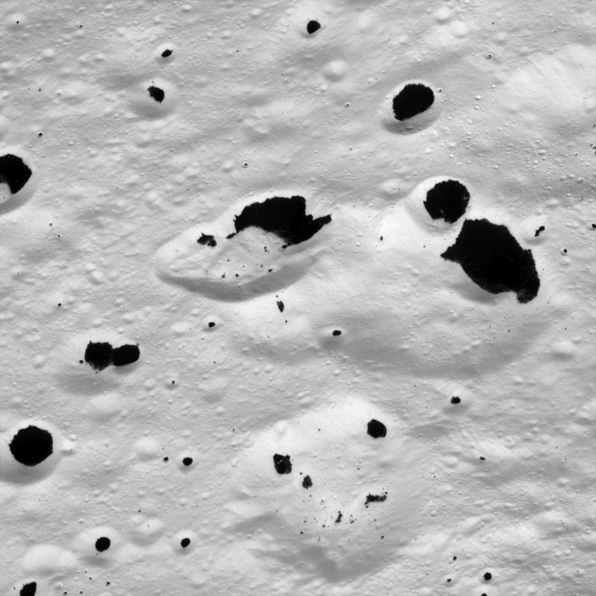
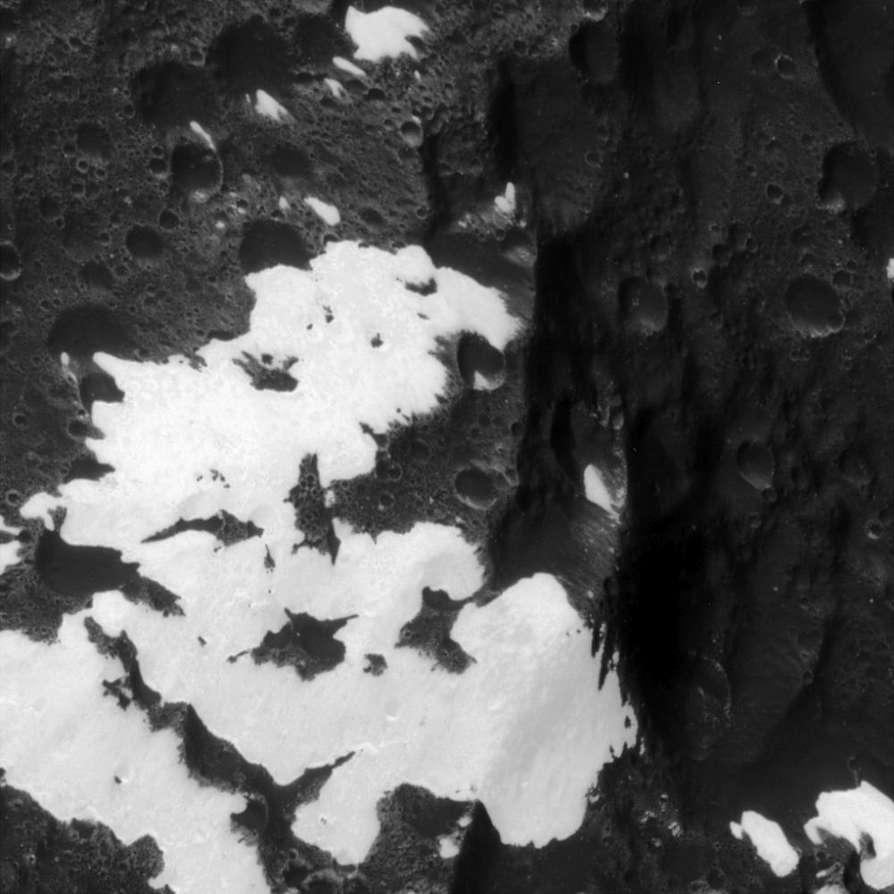
Iapetus
albedo ~ 0.60 albedo ~ 0.04
Notes:
dark region is leading hemisphere … organics including HCN-polymers … origin from Phoebe, which orbits retrograde --- debris ring has been seen!
ridge is 20 km wide

Slide 19
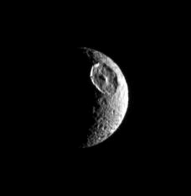
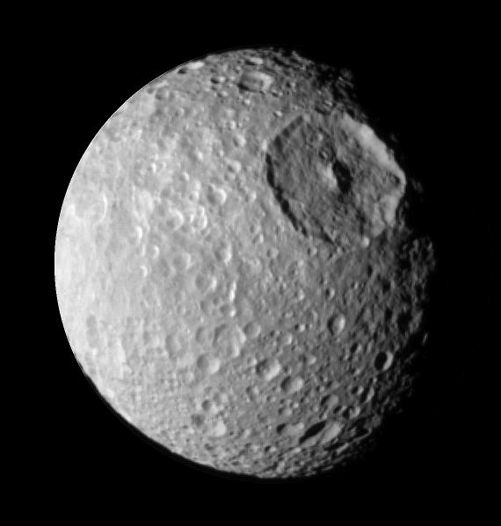
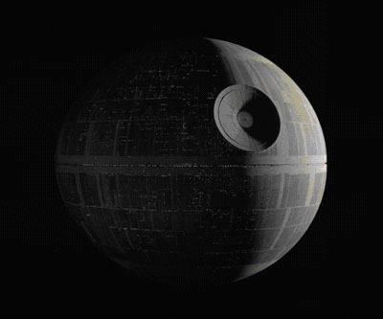
Mimas

Slide 20
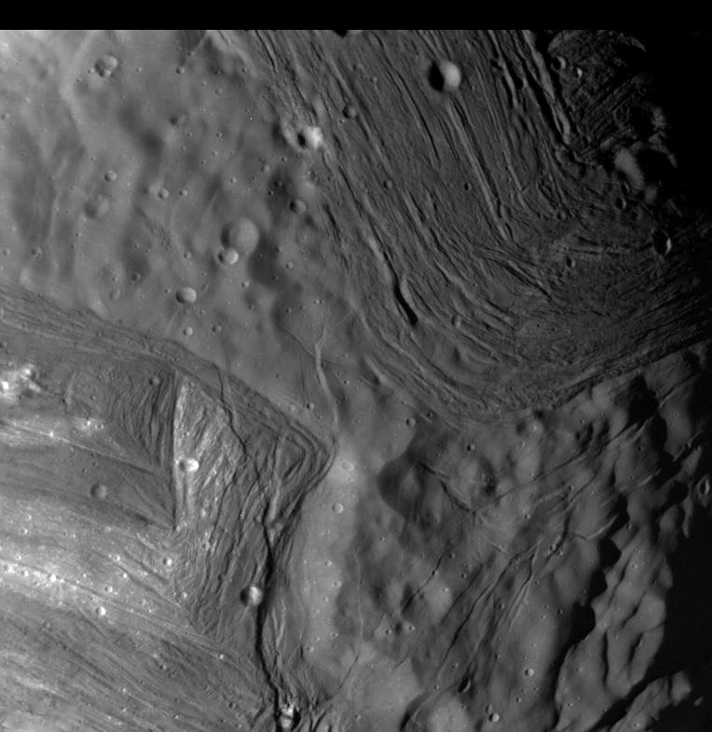
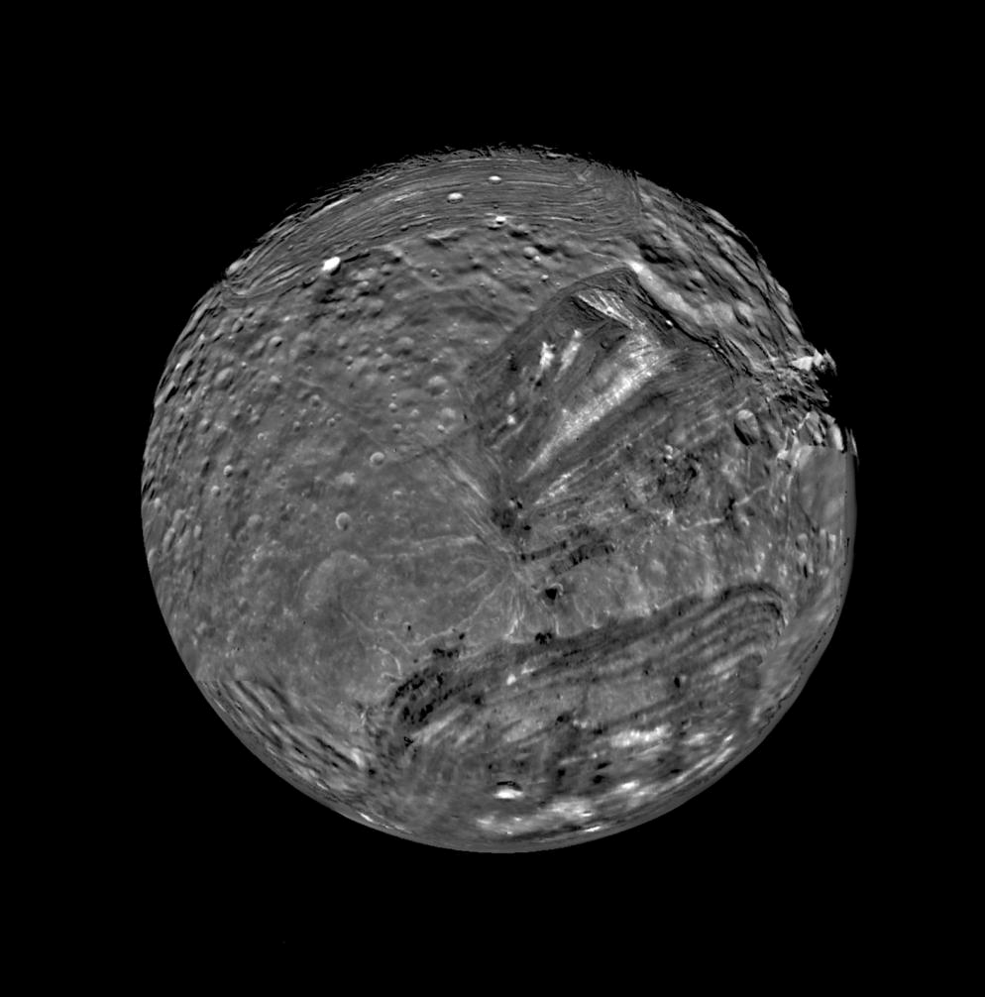
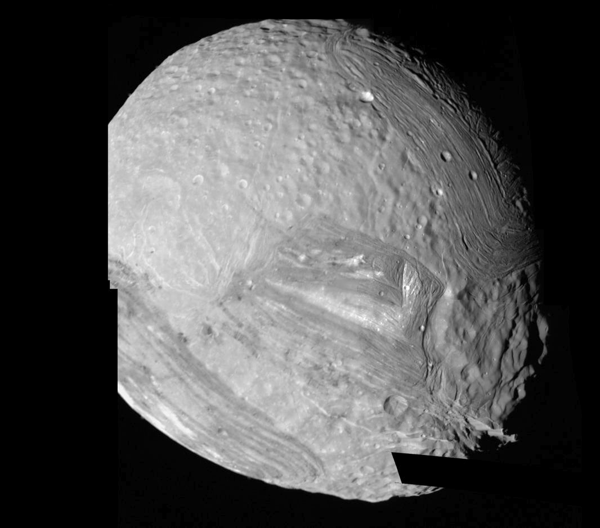
Miranda
5 km
high
D =
470 km
> 1%
… 127 km
on Earth!
Notes:
Uranian moon

Slide 21
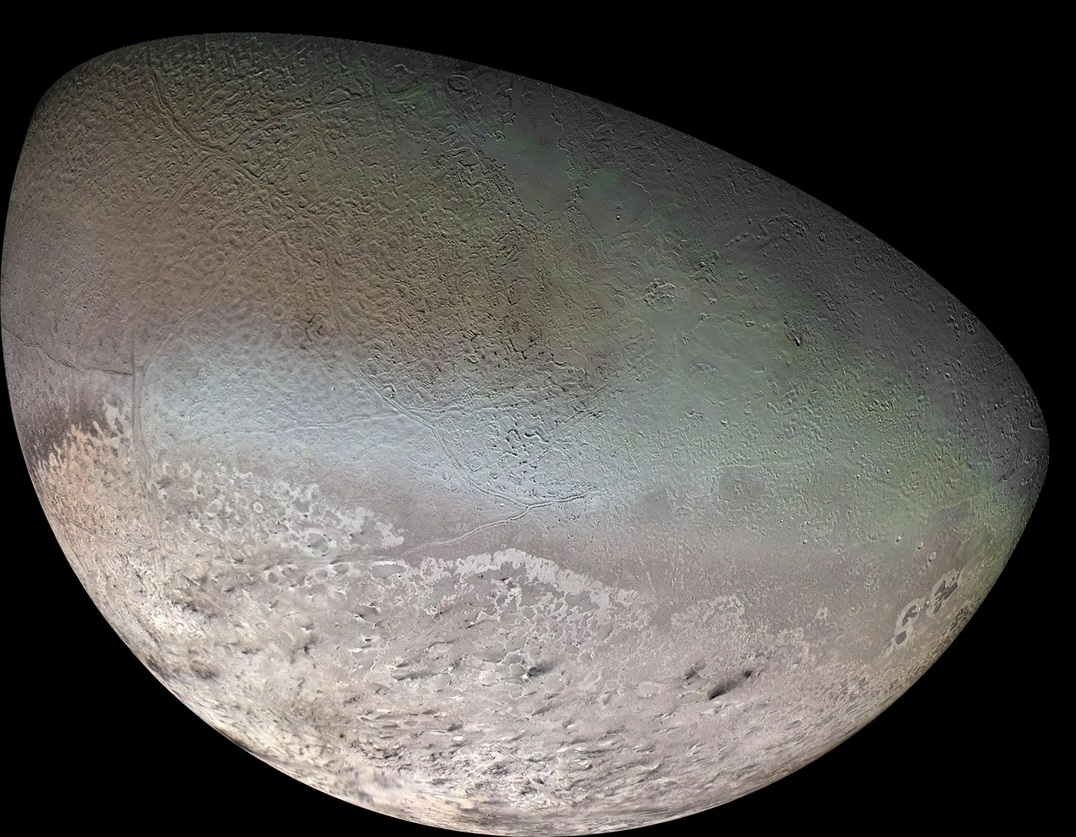
Triton
2.05 g/cm³
N₂/CH₄ ice
cantaloupe
terrain
(repeated
fracturing)
N₂ geyser
plumes

Slide 22
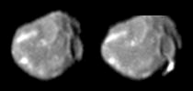
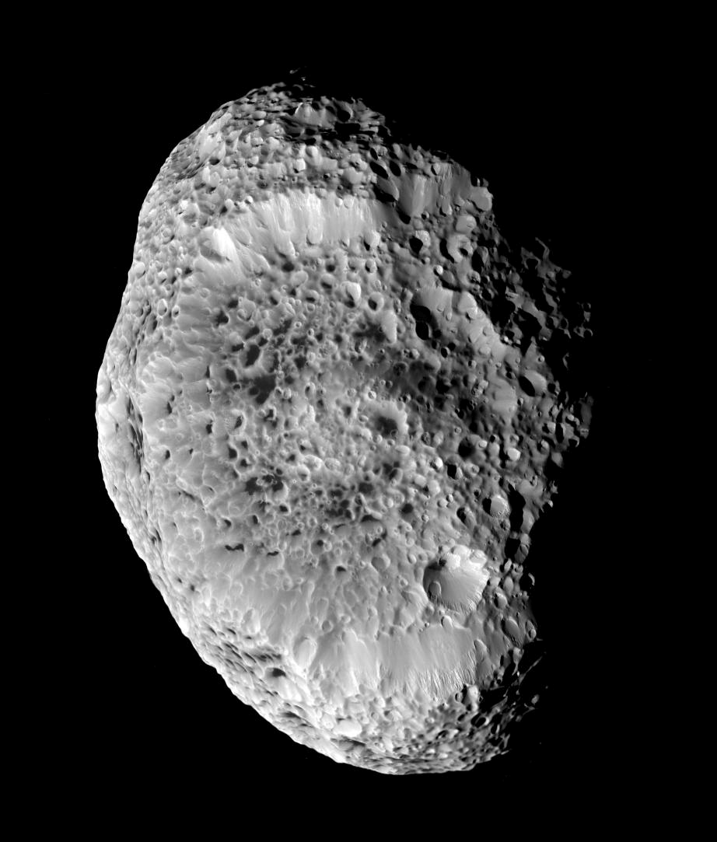
But Wait, There’s More …
We’ve talked about a bit We’ve barely mentioned
Venus Mercury
Earth Moon
Mars Io
Titan Europa (more later)
Ganymede
Callisto
Enceladus (more later)
Iapetus
Mimas
Miranda
Triton
Pluto
In a longer course, we’d also talk about
Amalthea reddest object in Solar System + some green
emits more heat than it receives from Sun
Hyperion The Sponge … with density 0.5 g/cm³
Notes:
Amalthea: red from Io’s sulfur … green unknown … heat from electric currents in core or tidal stresses?

Slide 23
Solar System Explorers 06 OCT
Name a location in the Solar System where surface processing is occurring.
Each process can be used only once. Describe how that surface is being
reprocessed, e.g. Earth’s land mass coastlines change because of liquid H₂O.
1. Mars has Olympus Mons --- unique
2. Mercury has weird terrain --- unique
3. Mars surface covered with FeO3 --- unique
4. Earth has plate tectonics --- unique
5. Pluto’s heart is N2/CO ice
6. Venus has stagnant lid and no plate tectonics
7. Io constantly resurfaced by constant volcanism --- unique
8. Enceladus has highest albedo surface --- unique
9. Mars brain terrain --- unique
10. Europa reprocesses surface due to subsurface ocean
11. Moon has substantial regolith
12. Ceres bright spot is from salt deposits
13. Mercury has scarps from shinkage
14. Iapetus has an equatorial bulget … squished?
15. Vesta has stripes because of impact … 90% of size of body
16. Titan has methane lakes
17. Enceladus has tiger stripes
18. Earth has plants … and stupid, idiotic, humans
19. Titan has methane rain
20. Earth has sunken Antarctica

Slide 24
Solar System Explorers 13 OCT
Describe an observation that yields information about a particular world’s interior, e.g. seismic data on Earth tell us that the size of the solid core is 1200 km.
1.
2.
3.
4.
5.
6.
7.
8.
9.
10.
11.
12.
13.
14.
15.
16.
17.
18.
19.
20.

Slide 25
…………………………
Notes:
25

