Slide 1
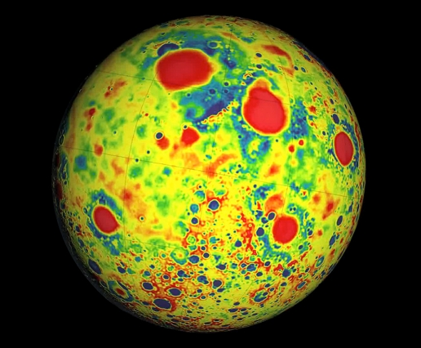
Where is this?
Variations in the lunar gravity field as measured by the Gravity Recovery
And Interior Laboratory (GRAIL).
Red corresponds to mass excesses and blue corresponds to mass deficiencies.
Image: NASA
Notes:
high-resolution map of the Moon’s gravity — a force created by surface structures such as mountains and craters, as well as deeper structures below the surface … Beneath its surface, the moon’s crust is almost completely pulverized. The finding suggests that, in its first billion years, the moon — and probably other planets like Earth — may have endured much more fracturing from massive impacts than previously thought. Compared to the surface, the map of the interior looked extraordinarily smooth. In fact, the team found that most of the moon’s local gravity is due to surface features, such as crater rims and mountains. Except for the large impact basins, the moon’s upper crust, largely lacks dense rock structures, and is instead likely made of porous, pulverized material.
Moon’s crust, ranging in thickness from 34 to 43 kilometers, is much thinner than planetary geologists had previously suspected. The crust beneath some major basins is nearly nonexistent, indicating that early impacts may have excavated the lunar mantle, providing a window into the interior.
To generate the gravity map, GRAIL’s two probes measure the changing distance between themselves as they orbit in tight formation around the Moon. As one of the probes flies over a large mass, such as a mountain or dense, underground rock, the stronger local gravity will pull that probe ahead, widening the space between the two spacecraft. Scientists can translate this changing distance into a gravitational map, representing the gravity produced by both the surface structures and the interior.
To find the gravitational field for the moon’s interior alone, Zuber’s team used topographic measurements from another of their instruments, a laser altimeter aboard the Lunar Reconnaissance Orbiter, a separate spacecraft in orbit around the moon. The scientists calculated the gravitational field expected to be produced by the moon’s topography — its surface structures alone — then subtracted that field from the field measured by GRAIL.

Slide 2
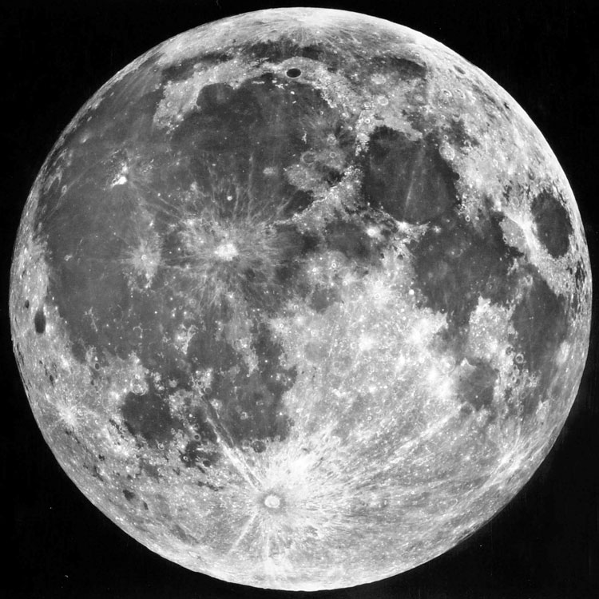
most of Moon’s gravity due to surface features
underneath surface, crust almost completely pulverized ...
smooth interior
many massive impacts
in early history

Slide 3
Level 1 Outline Comments
Font Size: FORMAT \documentclass[linenumbers]{aastex63}
GOAL is 8 pages of text + 4 pages of Figures/Tables (Refs extra)
Abstract: data rich … include NUMBERS, specific RESULTS … “Here we find that”
Keywords: http://astrothesaurus.org/thesaurus … Astrobiology (74); Mars (1007)
Introduction: sets the stage for the rest of the paper, includes key references
Motivation: YOURS, not literature’s … 4-8 sentences
Sections: need to nail down sections vs. subsections … I want to see them ALL
Results vs. Discussion
Tables/Figures: make these work for YOUR paper “… adapted from Soandso et al. (2022).”
Figures --- captions should stand alone
Tables --- might be YOURS
General: Sun, Solar System, Earth, Moon, Galaxy, Universe
that vs. which since vs. because data are
FIX TYPOS + SPELCHEK ALWAZE !!! (points off for Level 2)

Slide 4
Research Paper Level 2
due Thursday, 20 OCT (before class)
paper starting to take shape (worth 10 points +2 points if in 13 OCT)
use AAS LaTeX template on website
email .pdf
10 pieces required:
1. Abstract full draft
2. Introduction 8+ sentences, major references included
3. Motivation YOU
4/5. Sections all have bullets
6/7. Discussion 8+ sentences
8. Tables 2+ formatted with columns identified
9. Figures 2+ outlined/sketched, captions given
10. References at least 5

Slide 5
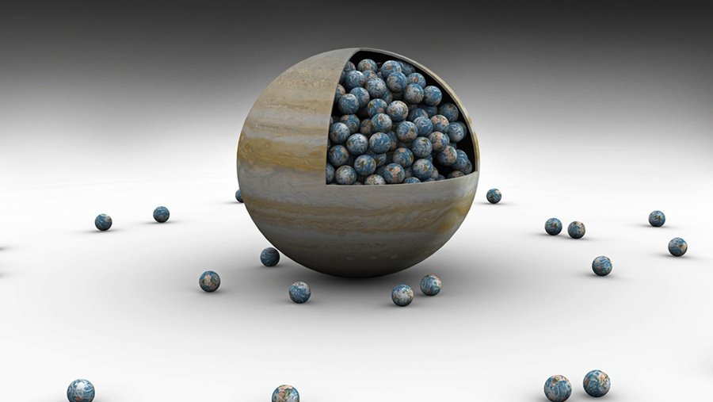
Planetary Interiors II
Discover magazine

Slide 6
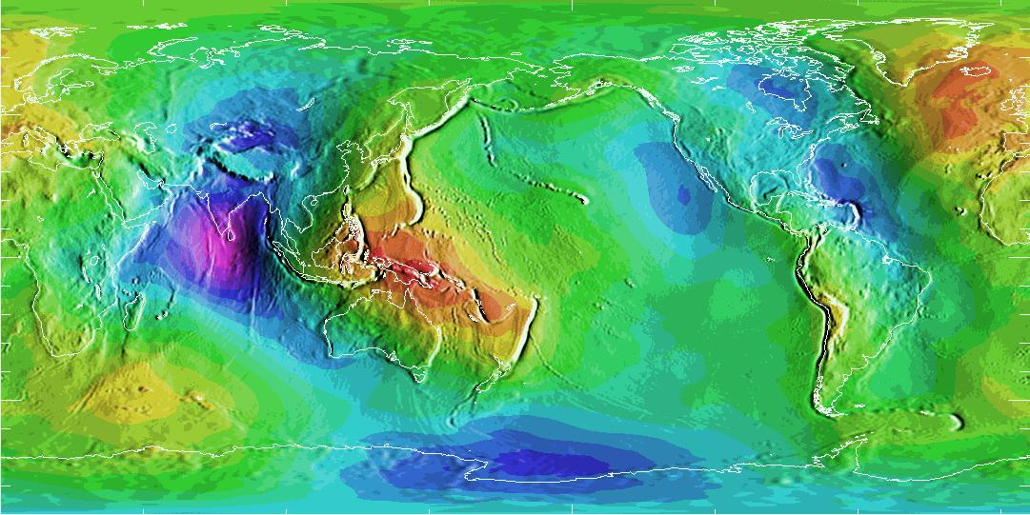
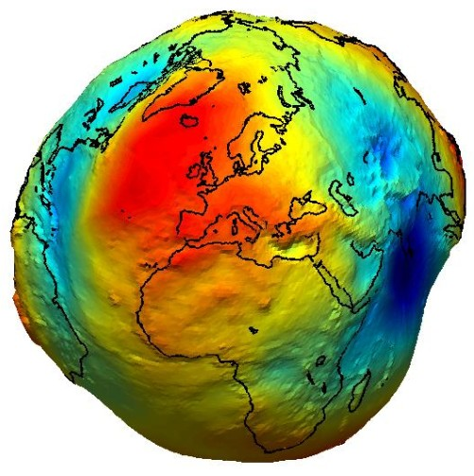
Earth’s Geoid
from –100 m (purple) to +85 m (red) relative to geoid of equal gravity
mantle sinks/depressions India, Hudson Bay, Antarctic/Pacific, subd zones
mantle upwellings/plumes New Guinea, Icelandic ridge, Yellowstone hotspot
Earth has minimal match between continents and geoid
Notes:
The surface of the geoid is higher than the reference ellipsoid wherever there is a positive gravity anomaly (mass excess) and lower than the reference ellipsoid wherever there is a negative gravity anomaly (mass deficit).
So … red is MORE gravity and blue is LESS gravity.

Slide 7
Earth’s Interior
1. thermal structure determines
chemical structure
surface structure and evolution
mantle convection … mountain building, ocean formation,
short-term earthquakes, volcanism
convection in fluid core maintains the magnetic field
cosmic radiation shield … preserves navigation, communication
2. geoid map shows
elevations/depressions relative to surface of equal gravitational potential
surface features vs. geoid reveals how “soft” mantle is
Earth has minimal match between continents and geoid
3. paleomagnetic records
magnetic field has existed for at least 3.0 Gyr
polarity reversals common, averaging every 200,000 yr
reversal events take ~few thousand years
4. seismic data
interior layers

Slide 8
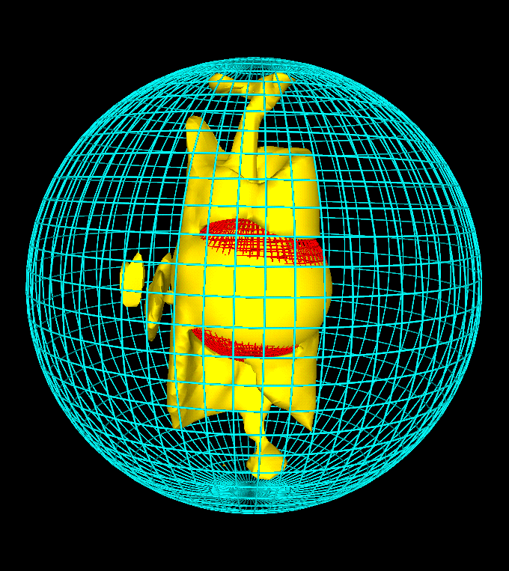
Earth’s Magnetic Field
Convective Dynamo Model
(Glatzmaier & Roberts, Los Alamos)
input:
dimensions
rotation rate
heat flow
composition
run:
20 yr increments for 300,000 yr
explains:
intensity of magnetic field
dipole structure aligned with rotation
non-dipolar drift at 0.2 deg/yr
dipole reversals

Slide 9
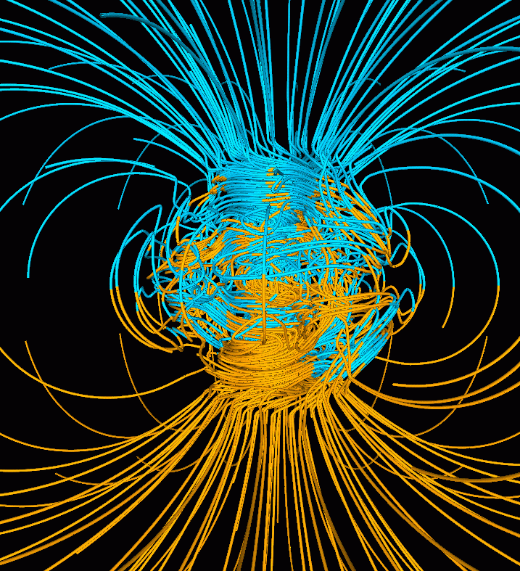
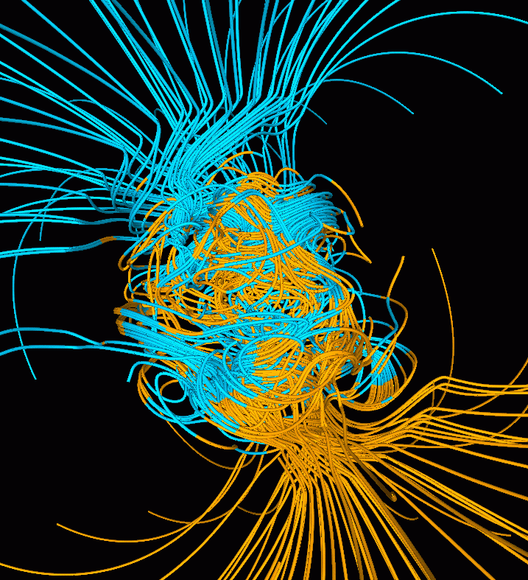
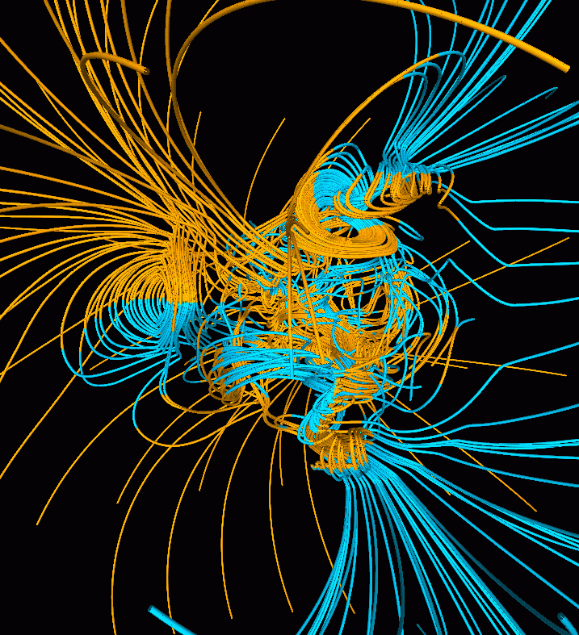
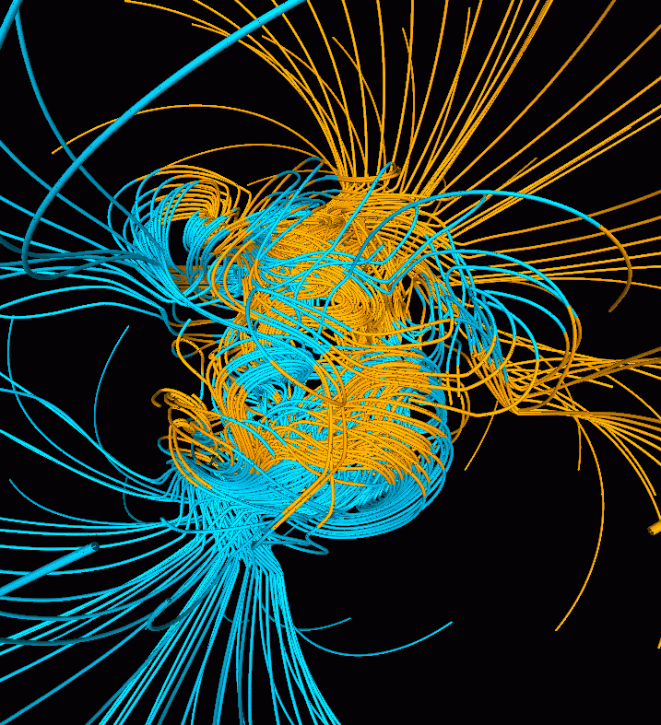
Flipping Magnetic Field!
normal flip minus 500 yr mid-flip flip plus 500 yr
(blue in, yellow out / Earth rotation is vertical / transition is at core-mantle boundary)
36,000 yr into simulation, flip!
field intensity drops by a factor of 10 and then recovers
matches what is seen in paleomagnetic record
convection in fluid outer core continually tries to reverse field, but
solid inner core inhibits reversals because it changes on long diffusion timescale
3. a reversal is successful only occasionally, therefore ~200,000 yr

Slide 10
Paleomagnetic Records

Slide 11
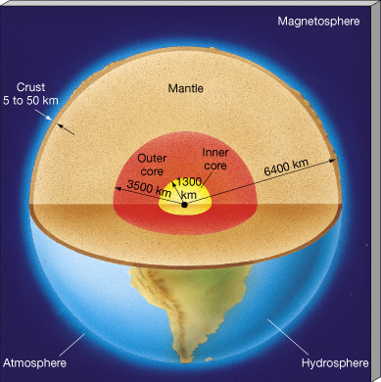
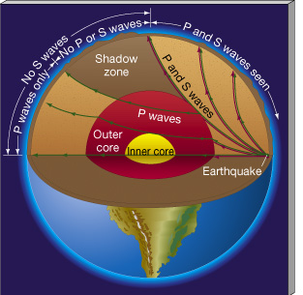
Seismic Data
Notes:
P = primary or pressure, can travel in fluid… S = secondary or shear, can’t travel in fluid

Slide 12
Seismic Data
Notes:
P = primary or pressure … S = secondary or shear

Slide 13
Earth Layers
upper mantle [ 6-65 km to 700 km]
primarily olivine (Mg,Fe)₂SiO₄ and pyroxene (Mg,Fe)SiO₃
lower mantle [700 km to 3000 km]
olivine under high P → periclase MgO + perovskite MgSiO₃
pyroxene under high P → garnet
fluid outer core [3000 km to 5200 km]
primarily Fe in composition
convective dynamo present
core temp too high for permanent mag field (decay in 20,000 yr)
as Earth cools, Fe solidifies and sinks, lighter element(s) rise
rising fluid + Earth rotation … Coriolis forces cause helical flow
→ VOILA! magnetic field generated
solid inner core [5200 km to 6400 km]
primarily Fe in composition (some Ni)
ρ is 5-10% less than pure Fe+Ni … S? O? H?
size of Moon … temp of Sun ~6000K !

Slide 14
Other Terrestrial Worlds
Moon
moment of inertia coefficient (0.393) indicates nearly uniform density
core is 13-26% R (compare Earth 19% inner and 53% outer)
gravity map attributable to different crustal thicknesses (34 to 43 km)
had magnetic field 3-4 Gyr ago
Mercury
60% of planet mass is Fe
core extends to 75% R
Venus
3% less dense than Earth … missing some heavy element?
no magnetic field … core frozen and/or lack of rotation
no tectonics … lack of H₂O … stagnant lid
heat doesn’t escape … hot mantle quenches core convection
Mars
no tectonics … heat lost in past via volcanism
geoid highly correlated with topography, so thick, rigid lithosphere
ancient magnetic field evidence now shattered
far more FeO than on Earth … Fe-Ni core or Fe-FeS core?
Notes:
Moon: no moonquakes (caused by tides/impacts) below 1000km implies molten region
Venus 3% less dense is uncompressed density, hotter formation … less S … higher melting point for Fe … frozen core … no mag

Slide 15
Earth’s Geoid
low gravity high gravity

Slide 16
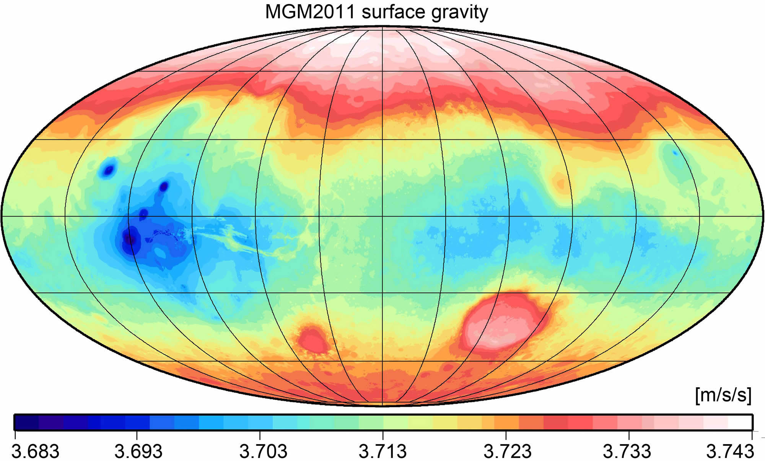
Mars’ Surface Gravity
low gravity high gravity
Notes:
unlike Earth, gravity traces features --- blue is low gravity, red is high

Slide 17
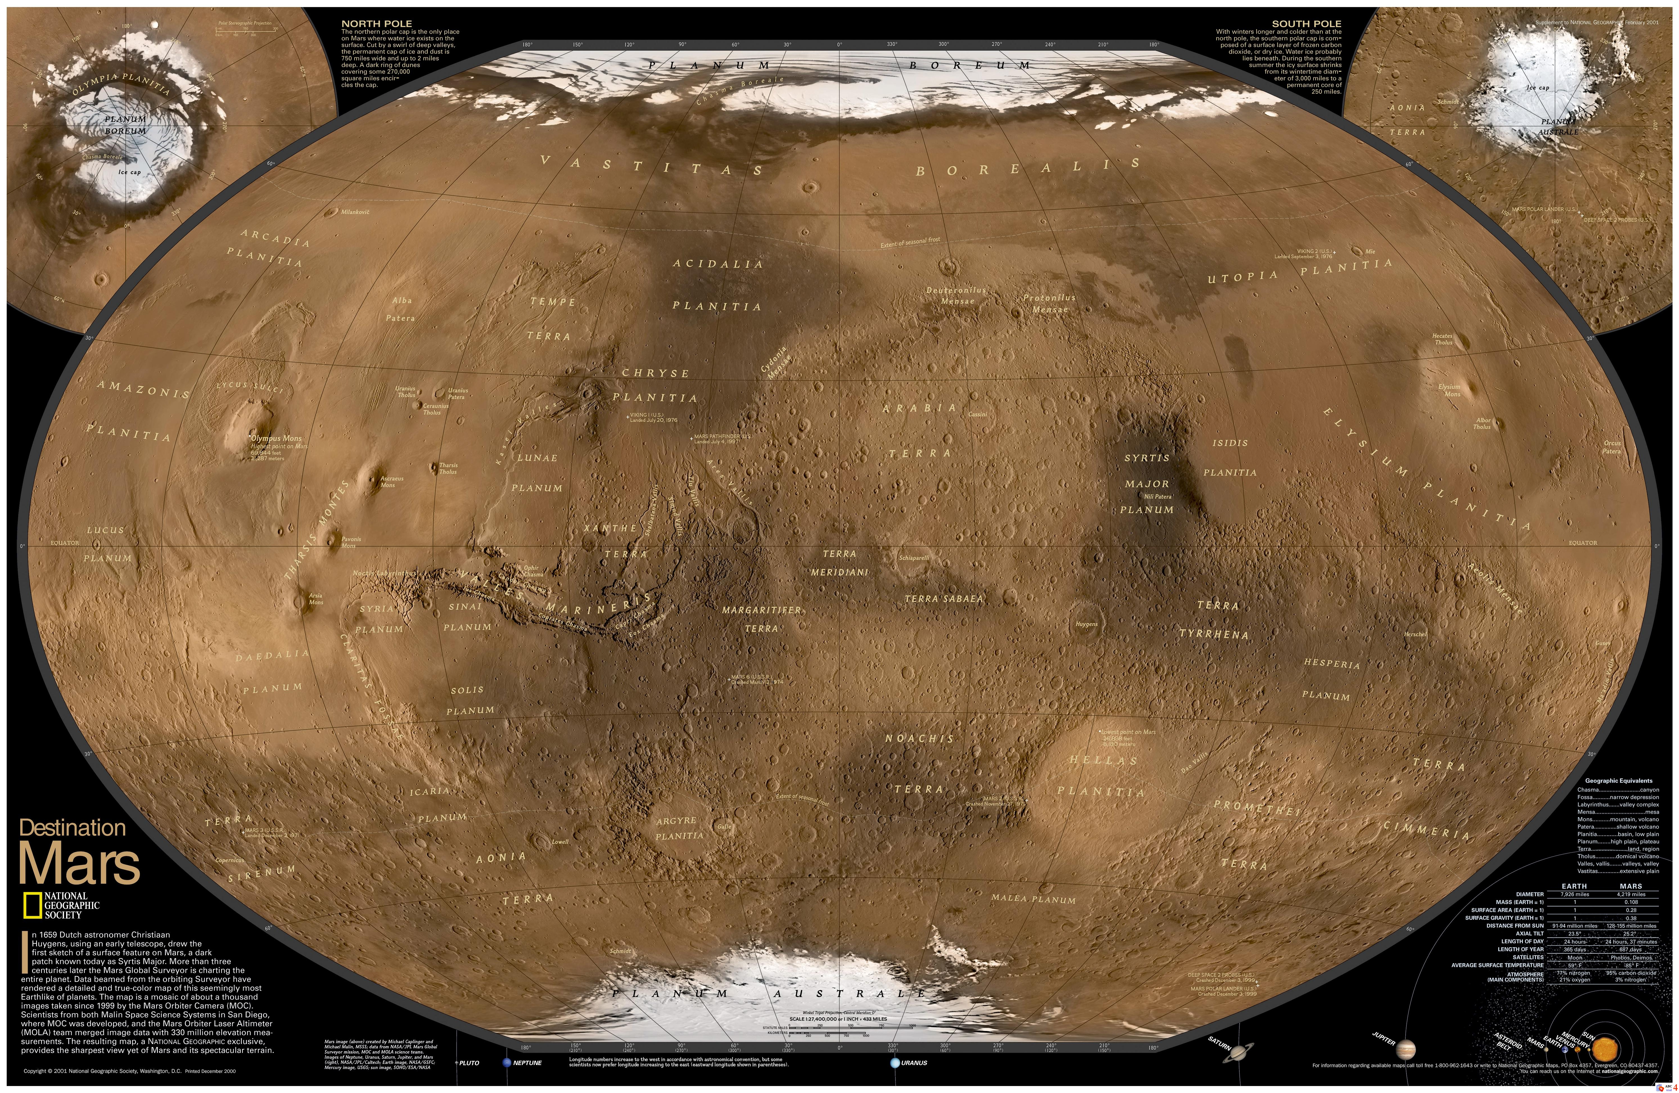
Mars’ Surface Features
rigid lithosphere
Notes:
unlike Earth, gravity traces features --- blue is low gravity, red is high

Slide 18
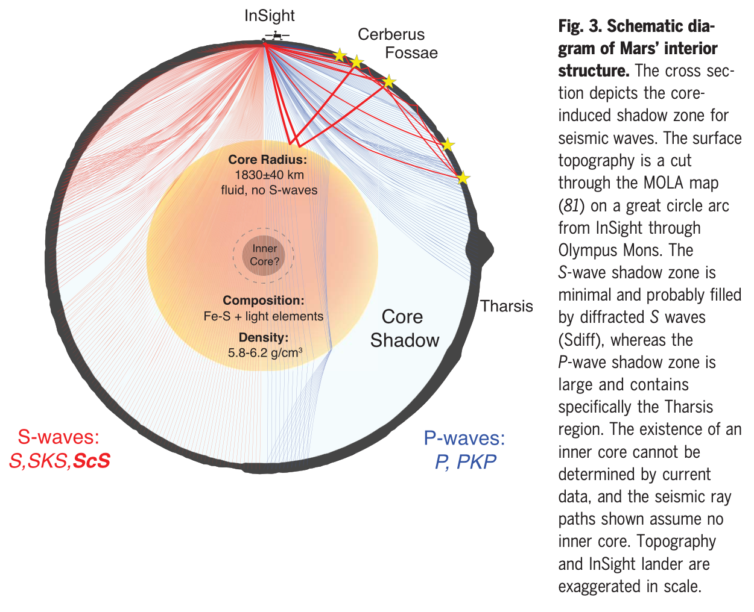
Mars’ Core
Stahler et al. 2021 … large core
Notes:
S waves can’t travel in fluid
Tharsis is in core shadow for InSight lander, so the most active part of Mars isn’t even studied from InSight’s location

Slide 19
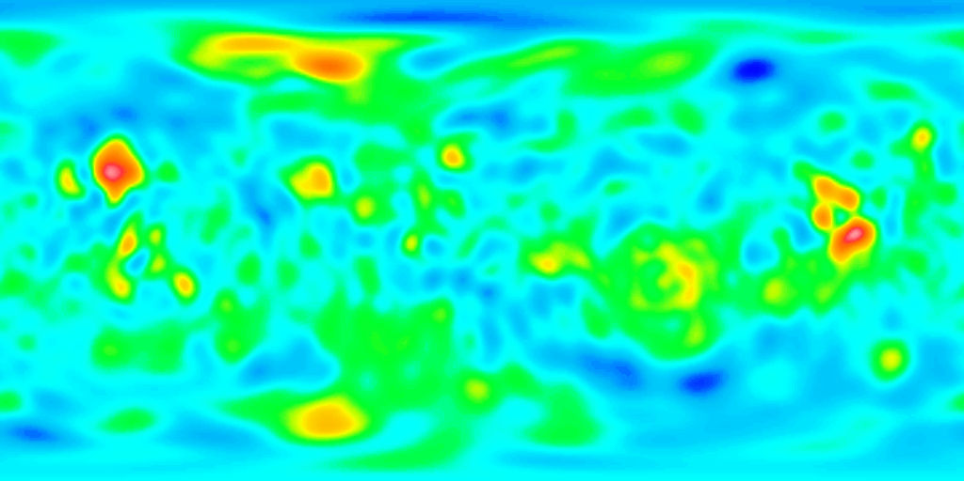
Venus’ Surface Gravity
low gravity high gravity
Notes:
done by Magellan
blue is low free-air gravity, red is high free-air gravity … opposite of Mars!

Slide 20
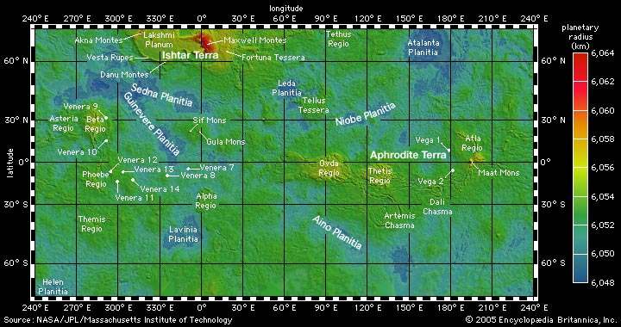
Venus’ Surface Features
high elevation ~ high gravity
Notes:
opposite of Mars!

Slide 21
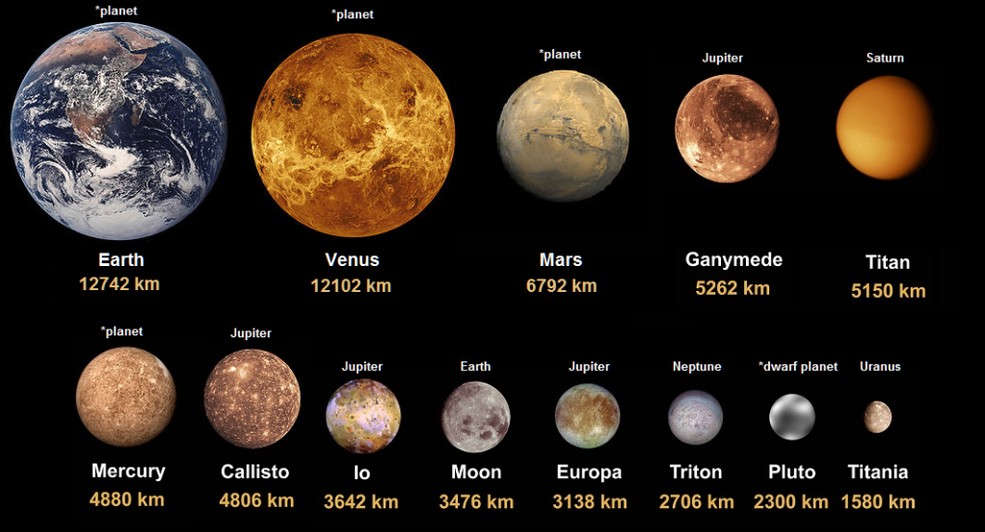
Terrestrials

Slide 22
SSE!
First 5 answers get 1(+1) points. (limit one try each)
Pick any terrestrial surface.
You are walking on it.
Other than temperature or a lack of O2 …
WAIT FOR IT …
To stay alive, WHAT should you be worried about?
For another point, WHY is that happening?
Notes:
You may experience problems on the surface, but many of them are driven by the interior … Earthquakes, volcanoes on Io, cracking on Europa, N2 plumes on Triton, charged particles on Ganymede/Callisto from Jupiter.
sandstorm on Mars, slipping into methane lake on Titan

Slide 23
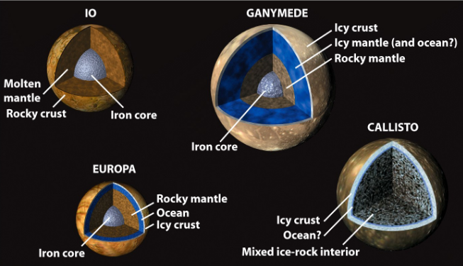
Galileans
ρ = 3.53 … I/MR² = 0.38
1.94 … 0.31
3.02 … 0.35
Earth 5.5 … 0.33
1.85 … 0.36

Slide 24
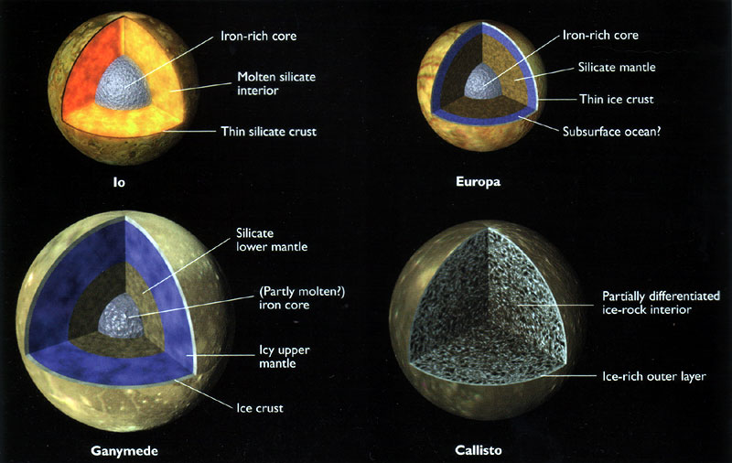
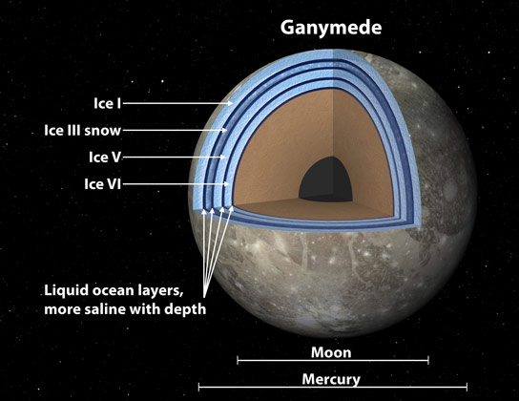
Ganymede

Slide 25
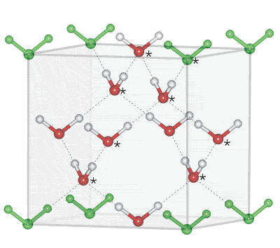
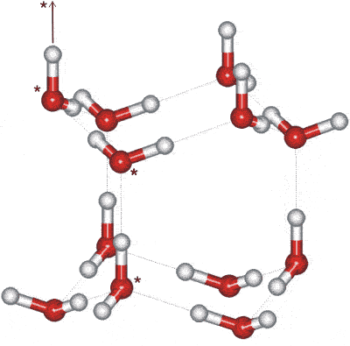
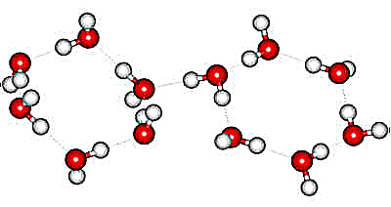
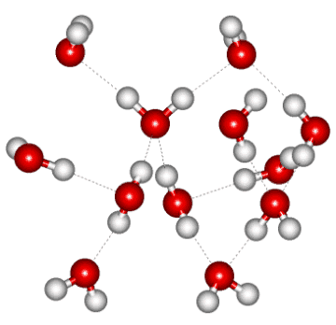
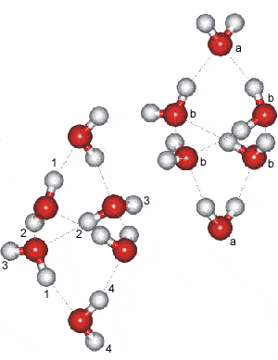
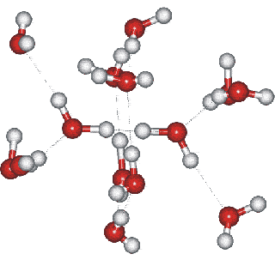
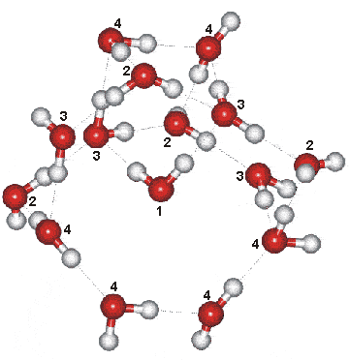
H₂O Ice
Ice Ic Ice Ih Ice II Ice III
Ice IV Ice V Ice VI
up to Ice XVII
Notes:
Ice Ic = cubic ice … Ih = hexagonal ice (natural snow and ice on Earth = snowflakes)
Ice nine is fictional solid polymorph of water from Kurt Vonnegut’s Cat’s Cradle

Slide 26
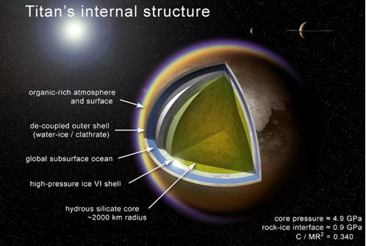
ρ = 1.88 … I/MR² = 0.34

Slide 27
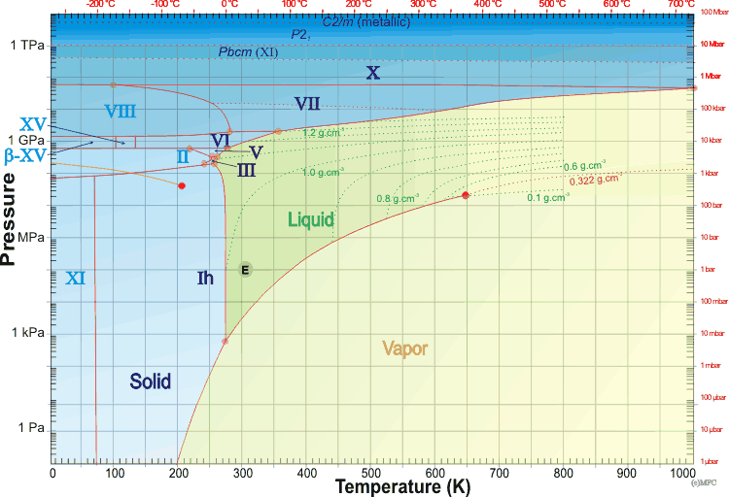
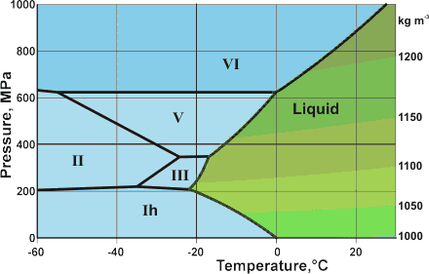
Titan?
V
Ganymede?
M
http://www1.lsbu.ac.uk/water/water_phase_diagram.html

Slide 28
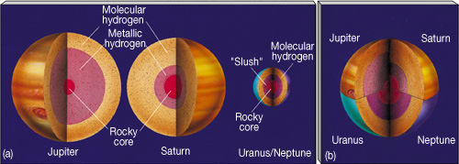
Jovian Interiors
Jovian type 1 “Gas Giants”
Jupiter atm ~ 20% radius is H2 + He
Saturn atm ~ 45% radius is H2 + He
Jovian type 2 “Ice Giants”
Uranus atm ~ 15% radius is H2 + He + CH4
Neptune atm ~ 15% radius is H2 + He + CH4
Super
Soup
-------

Slide 29
Jovian Interiors: H
hydrogen behavior
temp range: 50-150K at tropopause to 8000-20000K at center
pressure range: 0 bar to 20-80 Mbar at center
< 1 Mbar hydrogen is H2 solid or liquid
> 1 Mbar hydrogen is mixed molecular/atomic
in Jovians
fluid particles closely packed … molecules overlap … e– swap
“molecular metallic hydrogen”
deeper … H2 dissociated … H2 → 2H occurs ~0.80 R in Jup
“atomic metallic hydrogen”
convection + spin leads to magnetic fields

Slide 30
Jovian Interiors: He and H₂O
helium behavior
temp and pressure never high enough to go to metallic form
He not fully mixed in Jupiter and Saturn
Saturn has lower temp/pressure than Jupiter,
so even less mixed
water behavior
17 different crystalline forms (P,T) conditions
mixtures with trace molecules … conductive fluid
explains magnetic fields of Neptune and Uranus
Notes:
Jupiter may also have He rain

Slide 31
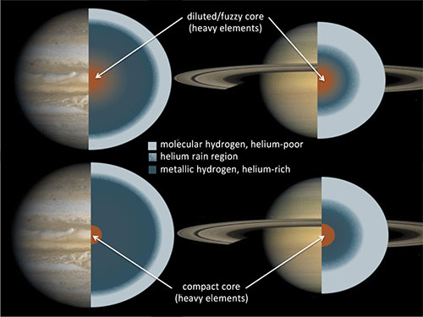
Jupiter + Saturn Interiors
gravitational
instability
core
accretion
Notes:
fuzzy or distinct layers? … unknown
Sketches of the internal structures of Jupiter and Saturn as inferred from structure models. For each planet, two possible structures are shown: one consisting of distinct layers and one with a gradual distribution of heavy elements. The core masses of Jupiter and Saturn are not well constrained; for Saturn, the inhomogeneous region could extend down all the way to the center, resulting in a “helium core.”

Slide 32
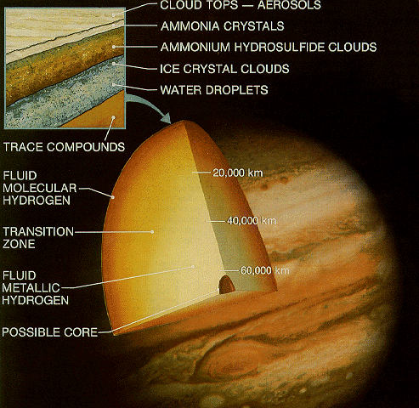
Jupiter Interior
Galileo probe
lasted 57 minutes
156 km deep
reached P = 24 bars
higher T
higher density
less H2O
less He
1 cloud deck

Slide 33
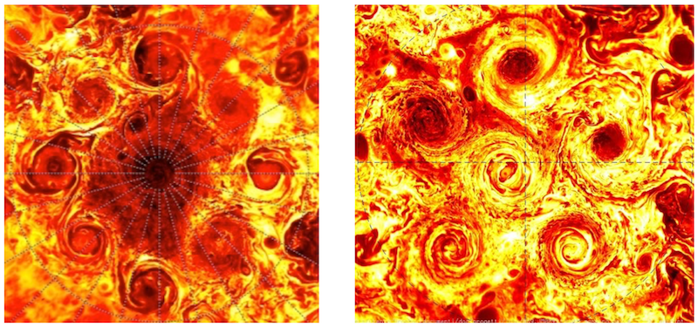
Juno Discoveries at Jupiter
1. clusters of polar cyclones
9 in north, 6 in south … don’t merge
2. asymmetric gravity field
deep flows that transport mass differently in N and S hemispheres
3. deeply organized “jetstream” stripes
belts and zones are 3000 km thick, include 1% of Jupiter’s mass
4. rotates like a solid planet
below the stripes, rotates as solid from pole-to-pole
electric+magnetic forces cause enough drag to stop differential rotation
https://www.youtube.com/watch?v=hF0UjhPSS3A&feature=youtu.be
north south

Slide 34
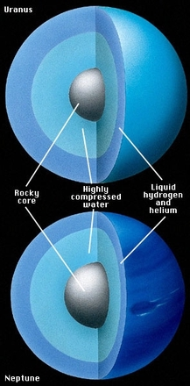
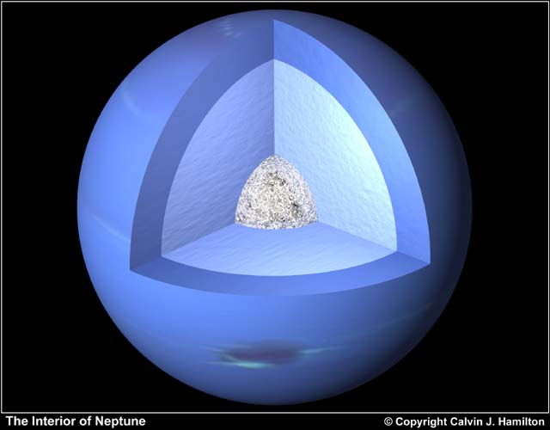
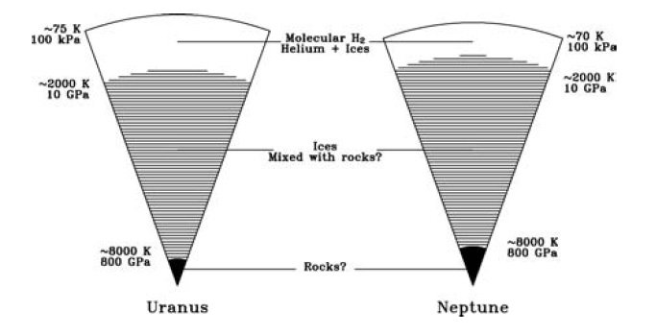
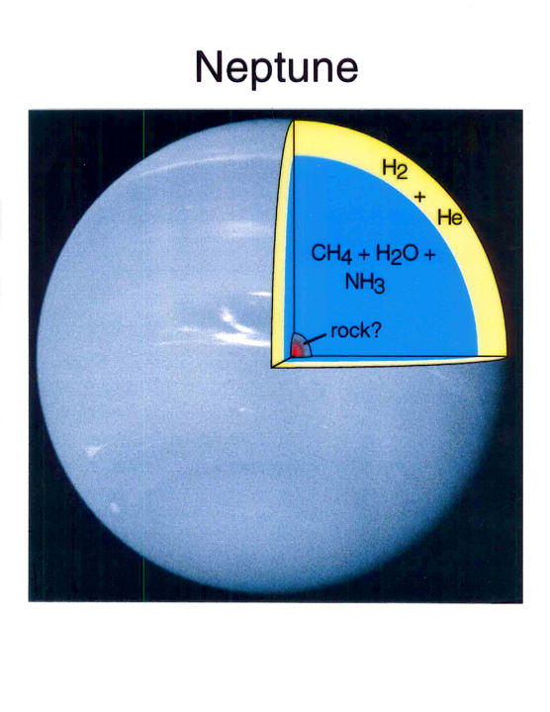
Ice Giant Interiors
lower pressures
than Jup + Sat
…
no metallic H

Slide 35
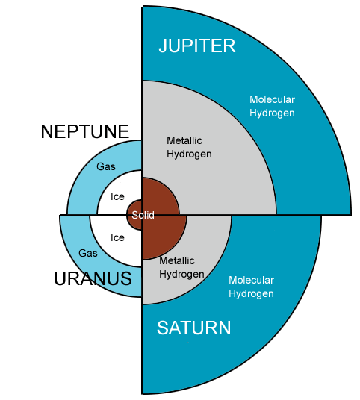
Giant Planet Interiors
Key Points:
molecules on top of atoms
Sat is puffier than Jup
Ura + Nep have ices instead of metallic H
fuzzy or layered interiors unknown
cores uncertain

Slide 36
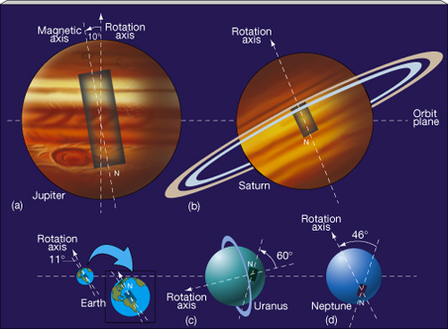
Solar System Magnetic Fields

Slide 37
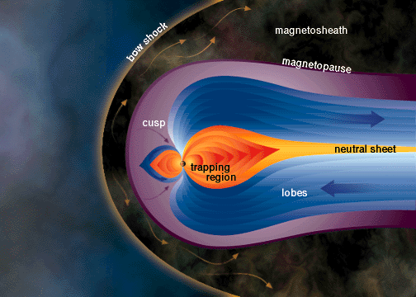
Jupiter’s Giant Magnetosphere
o
o
o
o

Slide 38
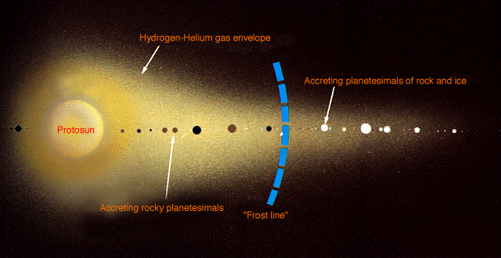
Planets in Solar Systems
Ni Fe SiO Mg FeS FeO H2O NH3 CH4 N2

Slide 39
Solar System Explorers 13 OCT
Describe an observation that yields information about a particular world’s interior, e.g. seismic data on Earth tell us that the size of the solid core is 1200 km.
1. Enceladus --- liquid under surface via Cassini gravity measurements
2. Earth --- geoid map shows mantle density
3. Mars --- crust 24-70 km thick via InSight measurements
4. Europa --- Galileo detected mag field caused by subsurface ocean
5. Moon --- Apollo seismometers reveals that Moon has fluid+solid cores
6. Venus --- radio measurements … tilted axis
7. Mars --- marsquakes happen and reveals size of core
8. Earth --- paleomagnetic records of ocean floor show flipping mag field due to fluid outer core
9. Venus --- lack of mag field implies lack of conductive layer
10. Mercury --- density indicates huge core
11. Jupiter --- Juno reveals that atm extends to 3000 km
12. Callisto --- Galileo uses gravity/mag measurements to find comparable ice and rock
13. Mars --- geoid matches surface indicates rigid lithosphere
14. Io --- eruptions indicate sulfur in interior
15. Ganymede --- rocking motion of aurorae points to subsurface ocean
16. All --- moments of inertia indicate that Jup/Sat/Ura/Nep have structure!
17. Enceladus --- plumes indicate H2O
18. Neptune --- 59K indicates internal heat source moreso than Uranus
19. Saturn --- diffuse core indicated by ring seismology
20. Hyperion --- The Giant Sponge Lives!

Slide 40
Solar System Explorers 20 OCT
What is a specific solution we have for addressing anthropogenic climate change or its impact? e.g., Convert cars from hydrocarbon fuels to electric-powered.
1.
2.
3.
4.
5.
6.
7.
8.
9.
10.
11.
12.
13.
14.
15.
16.
17.
18.
19.
20.

Slide 41
…………………………
Notes:
41

