Slide 1
10/18
Greenhouse Effect
Human-Caused Climate Change (Consequences, Solutions)
10/20
Communicating About Climate Change
Climate Change & Astronomy
Andrew Couperus
10/20/22
(credit to Travis Rector for some slides)

Slide 2
Research Paper Level 2
due Thursday, 20 OCT (before class)
paper starting to take shape (worth 10 points +2 points if in 13 OCT)
use AAS LaTeX template on website
email .pdf
10 pieces required:
1. Abstract full draft
2. Introduction 8+ sentences, major references included
3. Motivation YOU
4/5. Sections all have bullets
6/7. Discussion 8+ sentences
8. Tables 2+ formatted with columns identified
9. Figures 2+ outlined/sketched, captions given
10. References at least 5

Slide 3
Climate Change
Communication

Slide 4
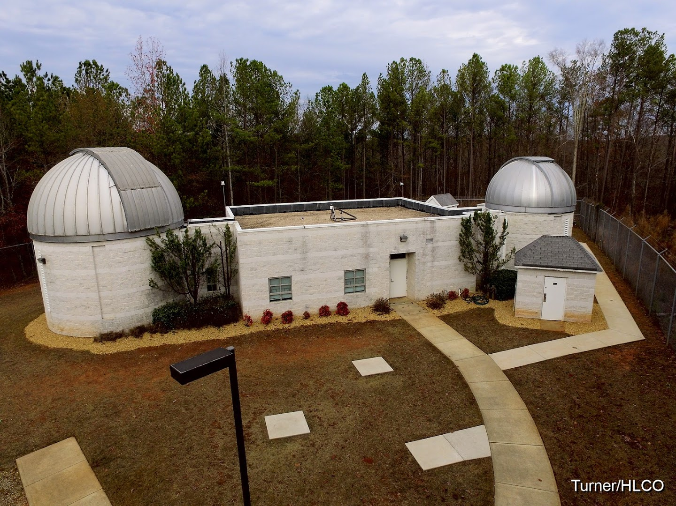
Where are we?

Slide 5
Climate vs. Weather
Climate is long-term “average” of weather in a region.
“How can there be global warming? It’s freezing outside!”
Notes:
-Someone at HLCO on a cold night says this. What’s wrong with it, and how do you respond?

Slide 6
Why astronomers?
CLIMATE CHANGE COMMUNiCATION
The perspective from astronomy is important.
Over 250,000 students in “Astro 101” each year
“Astro 101” often last science class.
No “skin in the game.”
Notes:
These are four reasons why astronomers should teach climate change. (1) Climate science is closely related to astronomy; and most astronomers already know enough about the basics to teach it. It is also closely connected to “Astro 101” topics, so much so it would be awkward to not teach it. (2) Astro 101 is hugely popular. It is estimated (Fraknoi 2001) that over a quarter million students take the class every year at U.S. institutions. For many students this is their last formal instruction in science. So make it count! (3) Astronomers are highly regarded, and in some ways more trusted than other branches of science because our research is less controversial. And (4) we cannot be accused of being “in it for the money” because we do not receive funding for climate science. Indeed, it is helpful for people to hear about climate science from all scientists, because it is connected to all branches of science. Indeed, the physics behind climate science is fundamental to all the sciences.

Slide 7
Climate change is the most important topic in your science class
Notes:
Simply put, climate change will be the defining topic of this century and beyond. Not just the most important science topic, the most important topic period. It is critical for students and the public to understand it, and astronomers have an obligation to teach it wherever possible.

Slide 8
1. know your audience
CLIMATE CHANGE COMMUNiCATION
Notes:
Next, it is important to understand your audience. If teaching a class, at what level are your students? And how can you tie this into other topics in the class? If talking to the public, know that surveys show that public opinion is changing rapidly, so it is useful to look at polling data such as that from the Yale program on Climate Change Communication.

Slide 9
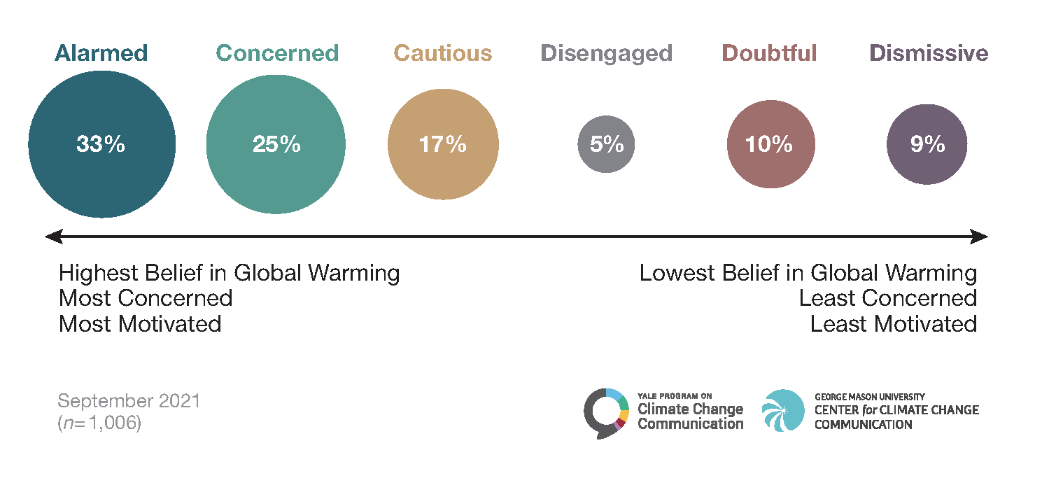
Who Cares?
Notes:
Q: Which group do you think is the largest? (show of hands for each group)
-These are the people we want to think about

Slide 10
response to climate change
Notes:
-I think the most important group to reach are those in the Alarmed and Concerned category. These are largely people who are already aware of the problem but may not yet know how to address the problem.

Slide 11
Exercise
What climate audience do you fall into?
(Alarmed > Concerned > Cautious > Disengaged > Doubtful > Dismissive)
Hand me your answer on paper
(I will tally them up and send a plot to Todd)

Slide 12
2. do no harm
CLIMATE CHANGE COMMUNiCATION

Slide 13
Radical Civility
CLIMATE CHANGE COMMUNiCATION
Listen and reflect on what the person said.
Agree where possible.
Ask meaningful (not rhetorical) questions.
Find common ground.
Treat others as you would like to be treated.
Notes:
How then can you engage people and have it be productive? “radical civility.” A key elements is to be kind and respectful. Some elements: 1. Listen to what a person says and respond in a way that shows you’ve heard them. People often want to feel validated- that is, that you don’t dismiss their thoughts, knowledge, and experience out of hand. Remember that most people do not outright deny climate change. They may have sincere questions or doubts. Coming off as arrogant or rude isn’t going to help. 2. Where possible acknowledge when someone says something that is true. But also explain where you don’t. 3. A good strategy is to ask people questions that gets them to reflect more on what they said. (For example, sometimes people post links to climate denier talking points on my Facebook posts. I sometimes ask questions like, “That’s an interesting article. What do you think is the most important take away from it.?” It’s a way to get them to reflect upon the content of the article beyond thinking “what he said.”) 4. Try to find common ground on shared values.

Slide 14
Radical Civility
CLIMATE CHANGE COMMUNiCATION
“Humans aren’t changing the climate. The Earth’s climate has always changed. There were times when the Earth was hotter than it is now.”
Notes:
Let’s do an activity: Imagine you just gave a public talk about climate change and you get this question/comment from someone in the audience. BTW, this is the most common talking point among climate change deniers. Think of a response to this person that uses radical civility. Keep in mind that you’re not just talking to this person - the rest of the audience is listening. Imagine you have plots at the ready.

Slide 15
backfire effect
CLIMATE CHANGE COMMUNiCATION
Exposure to information that contradicts worldview actually reinforces worldview.
Notes:
How should we talk about climate change? The answer is - carefully. There is psychological research that shows that simply telling people the facts about a misconception doesn’t work. In fact, doing so can actually make things worse! Known as the “backfire effect” or “doubling down,” exposure to information that contradicts a person’s worldview can actually reinforce belief in that world view, especially if it is done in a confrontational fashion. People find ways to accommodate the information, or dismiss it (e.g. conspiracy theories).

Slide 16
3. words have meaning
CLIMATE CHANGE COMMUNiCATION
Notes:
It’s also important to know that words can have different meanings to scientists than they do to the public.

Slide 17
Why?
Helping/saving us and other life – not the Earth
Protection, Responsible Management, Resilience

Slide 18
Don’t Ask: ”Did climate change cause this?”
Ask: ”did climate change make it worse?”

Slide 19
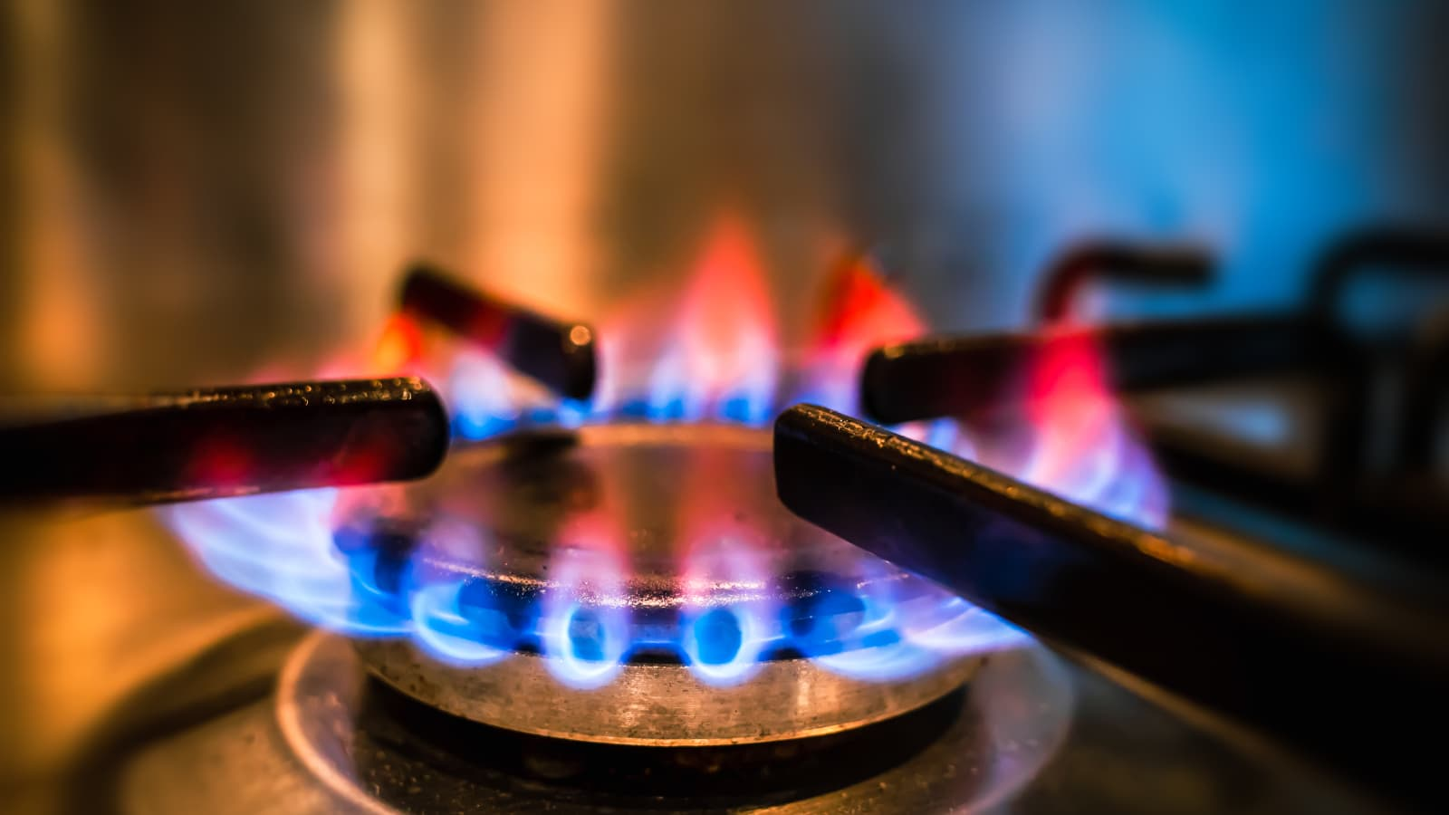
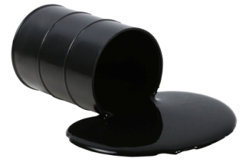
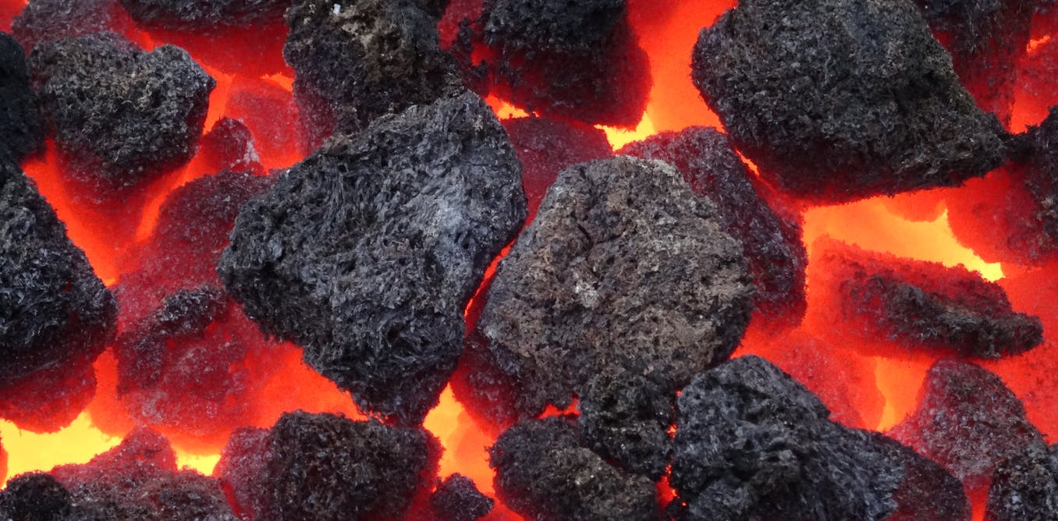
Fossil Fuels = “Hydrocarbons”
Methane
Carbon Dioxide
Notes:
-Terms that might be obvious to us are often not obvious to our audience. Take the time to carefully explain any terminology!

Slide 20
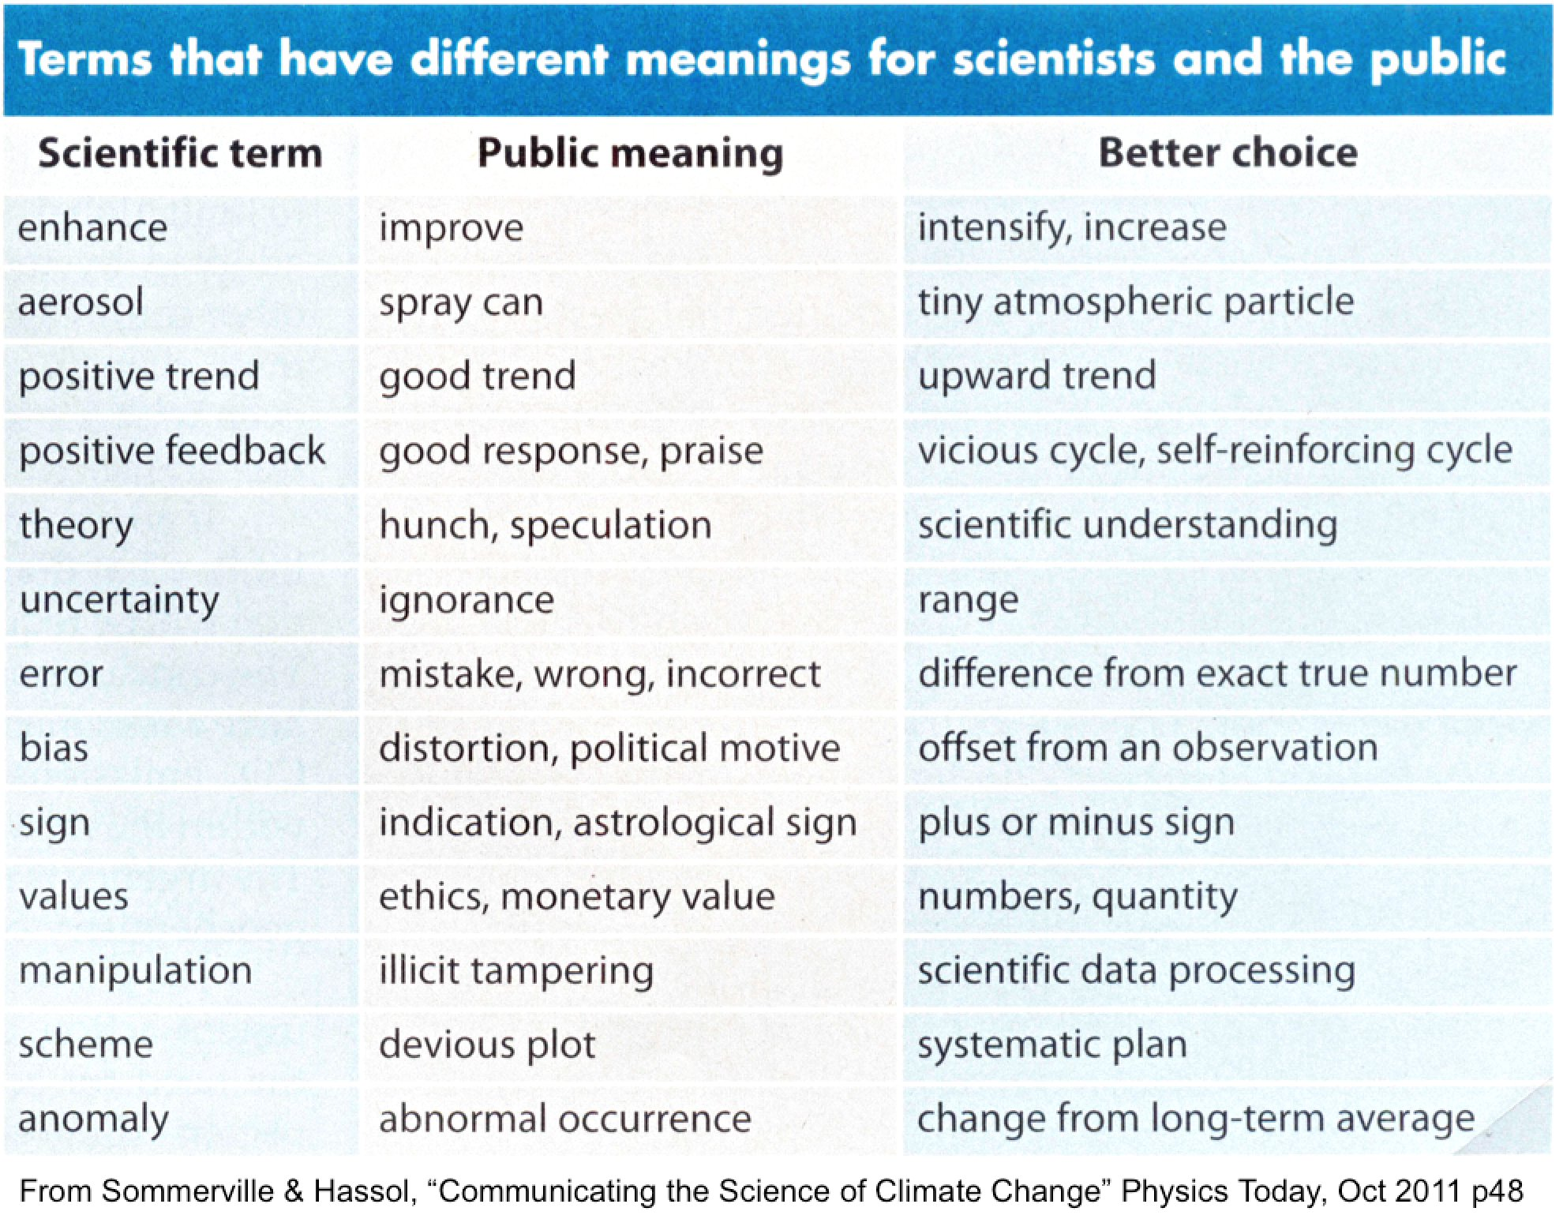
Notes:
-This is a nice list of terms that scientists use that are confusing or misleading to the public. There are other misleading terms, so be mindful of your wording.

Slide 21
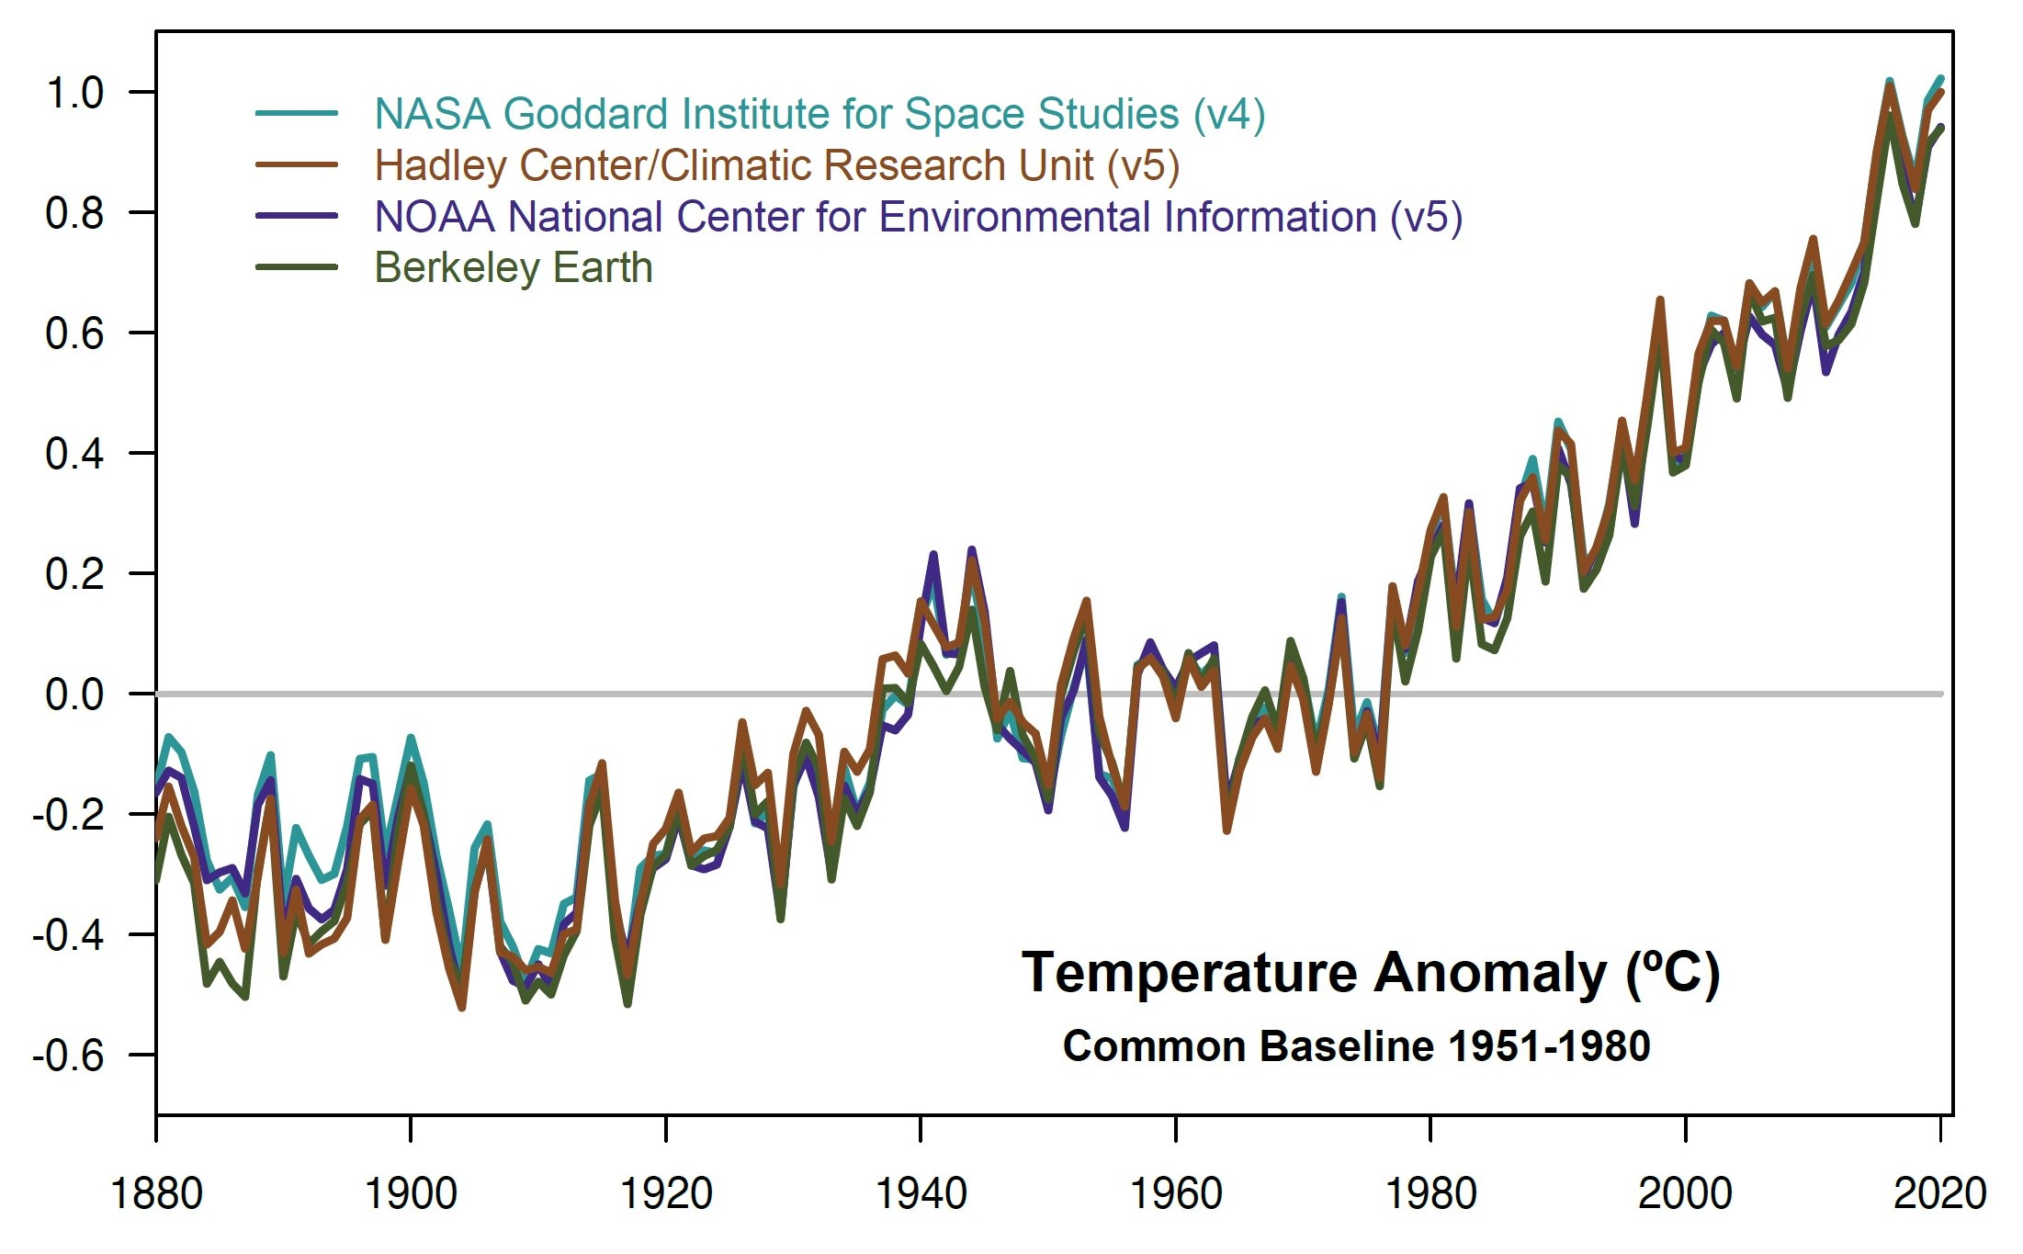
Unpack it!
CLIMATE CHANGE COMMUNiCATION
Notes:
-This graph is a lot harder to understand than you might think! What the heck is a “Temperature anomaly in degrees Celsius relative to a common baseline from 1951-1980” with 4 different lines on the plot?? Take the time to slowly walk through it and explain each part to your audience.

Slide 22
4. Pre-Teach Connections Analogies
CLIMATE CHANGE Communication

Slide 23
top five misconceptions
CLIMATE CHANGE COMMUNiCATION
Natural cycles on Earth are responsible.
It’s the Sun.
It’s not that bad.
Scientists are still unsure.
The Earth is actually cooling.
Notes:
These are the top five most common misconceptions about climate change (from https://skepticalscience.com). In teaching climate change you need to address all of these (and more).

Slide 24
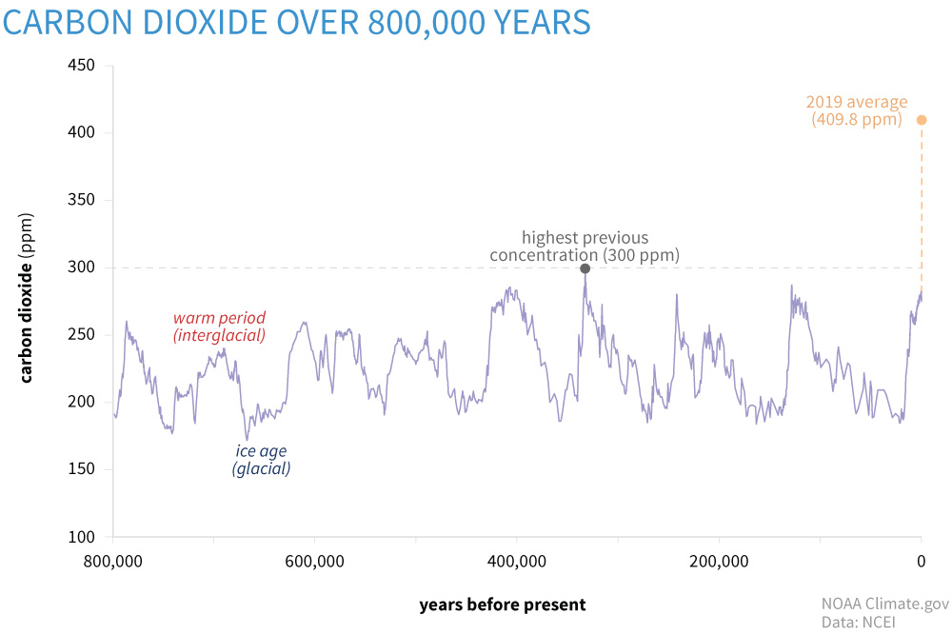
Rate vs. Amount
Notes:
-Rate vs amount, explain this to people.

Slide 25
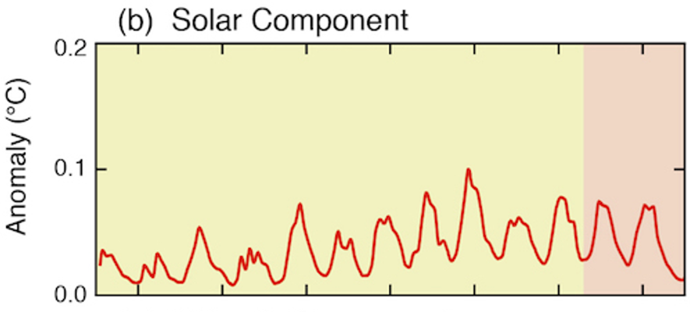
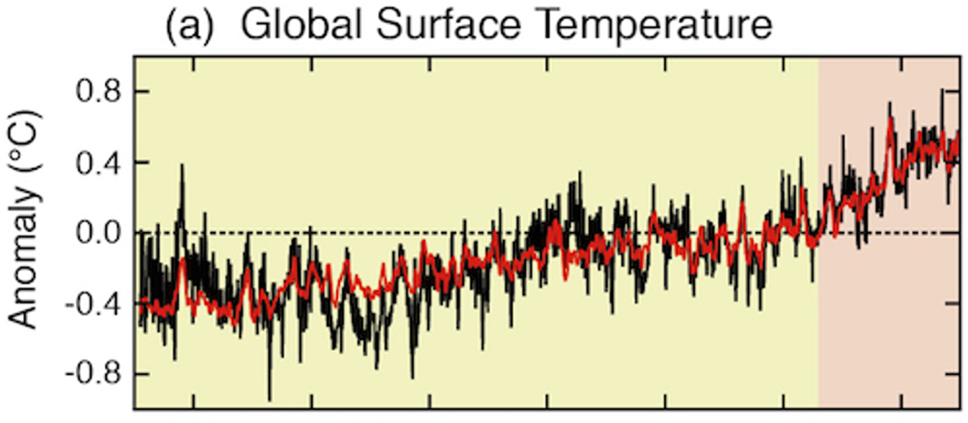
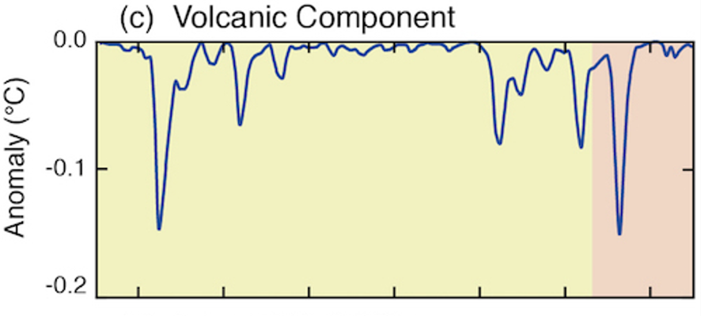
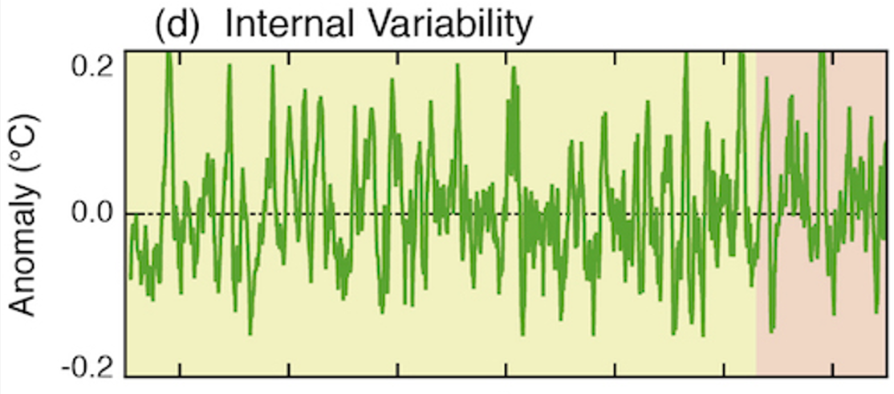
“What about…”
Notes:
Pre-Teach

Slide 26
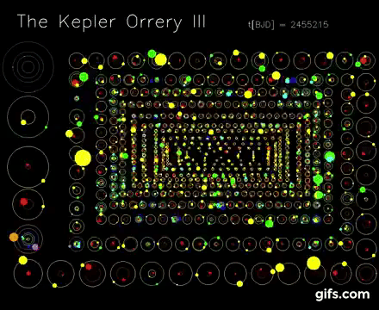
“Other Worlds”
There is No Planet B
Notes:
Pre-Teach
-Object sizes are not to scale with the orbit sizes, but otherwise this is accurate for the relative orbital periods, orbital sizes, and relative sizes of objects to each other.
-Can’t get to other star systems easily, even other planets is really hard. MARS DOESN’T COUNT EITHER. Terraforming Mars is way harder than just fixing the Earth… (and why would we do it right on Mars when we aren’t doing it right on Earth either?)

Slide 27
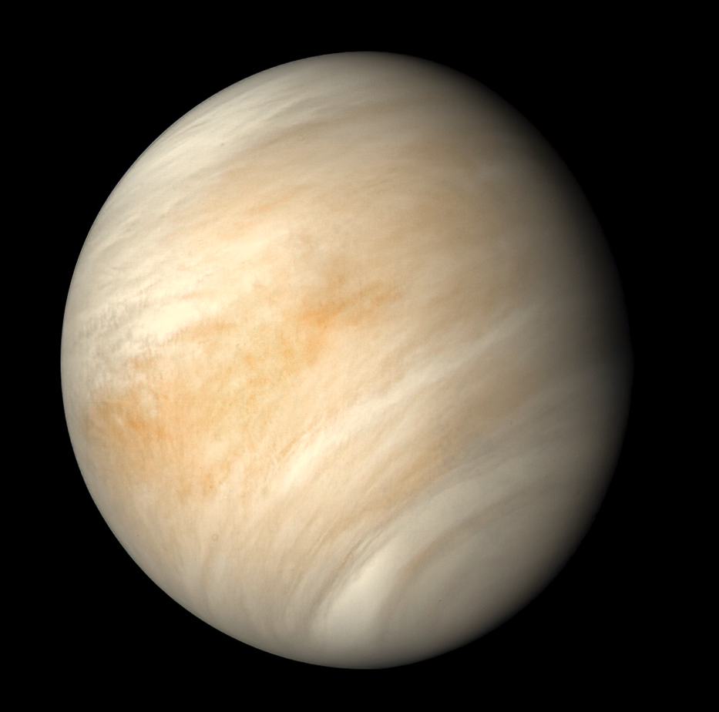
Notes:
Connections / Pre-Teach

Slide 28
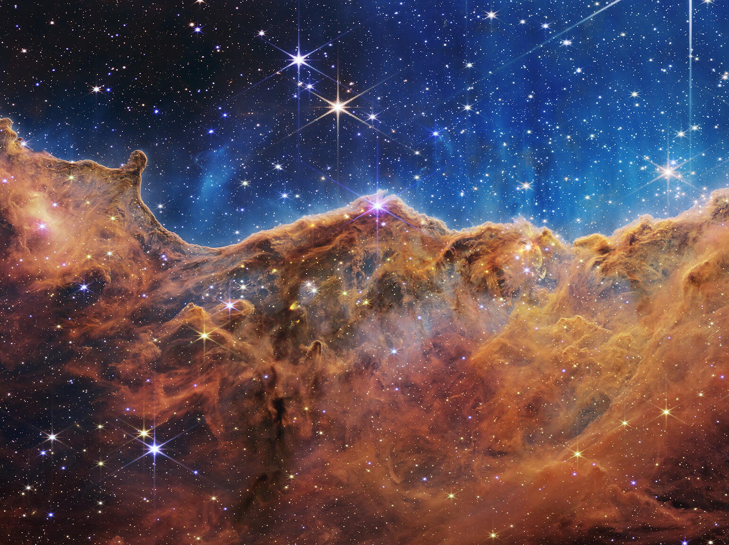
Notes:
Connections

Slide 29
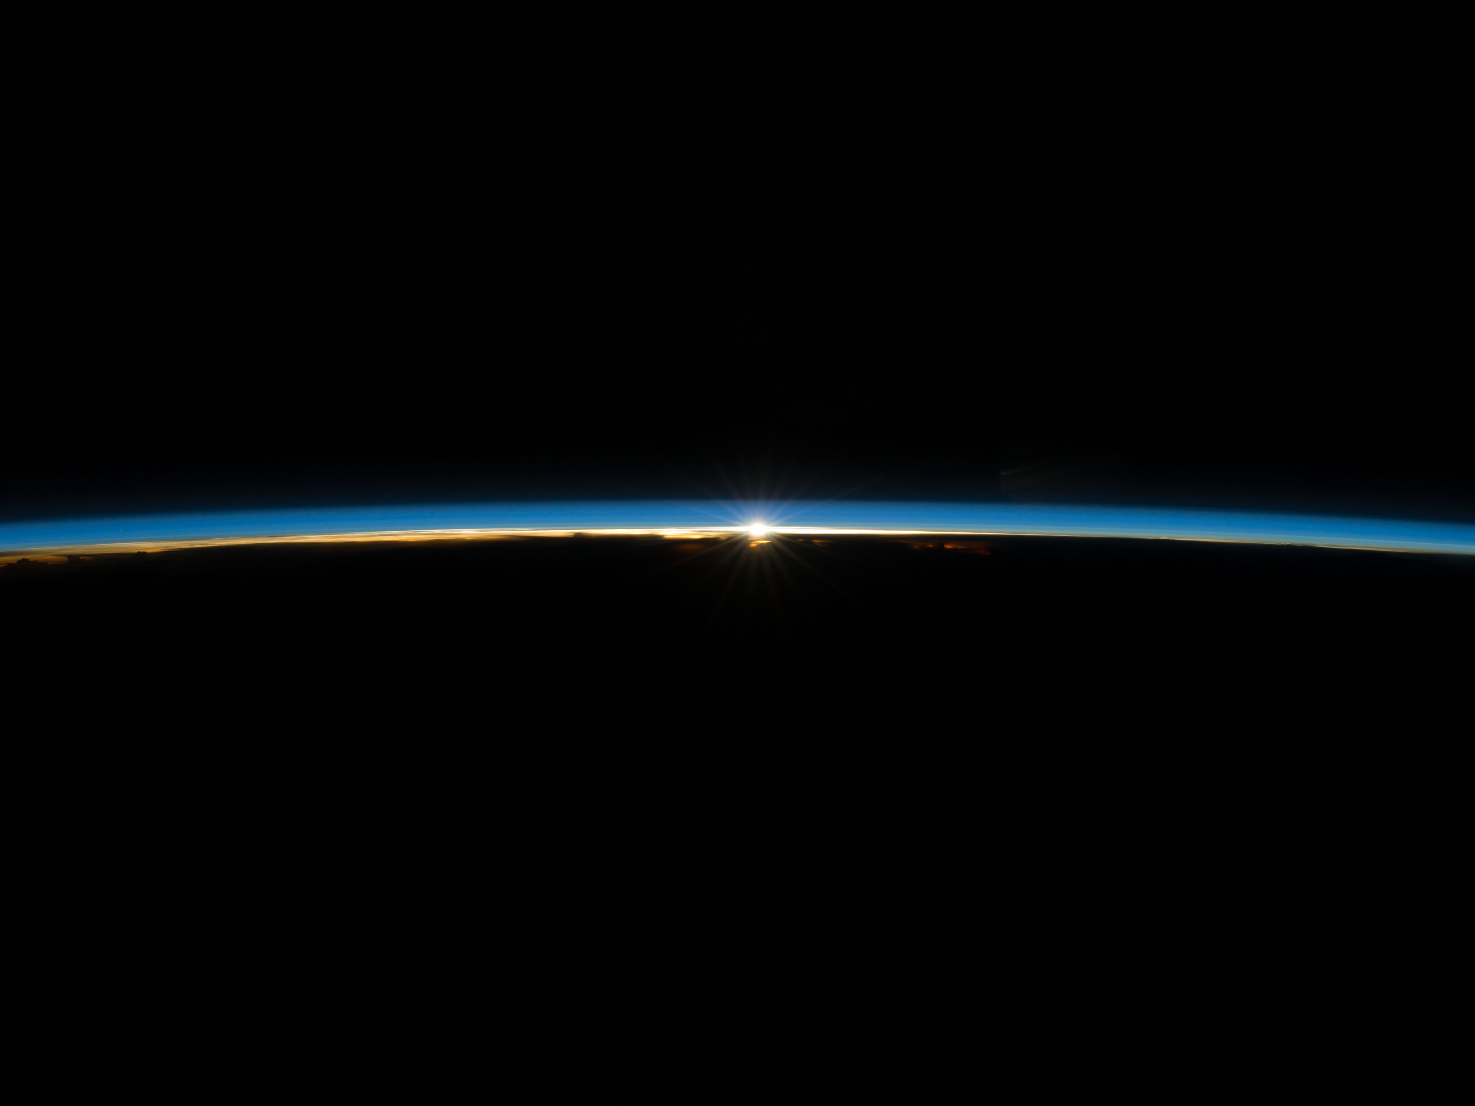
Notes:
Connections / Analogies
-If you could drive a car straight up into the air at highway speeds, you'd get to the top of the troposphere, the lower part of the atmosphere, where the greenhouse gases are trapped, in about five minutes. Helps explain how we could actually influence the atmosphere, it’s not necessarily as large as it commonly might feel.

Slide 30
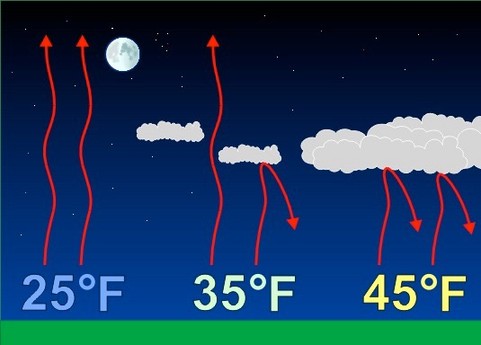
Greenhouse Effect
Notes:
Connections
-Most people have experienced the phenomenon that clear nights get colder. That’s because the water vapor in clouds trap heat. You can use this to connect the greenhouse effect to everyday experiences.

Slide 31
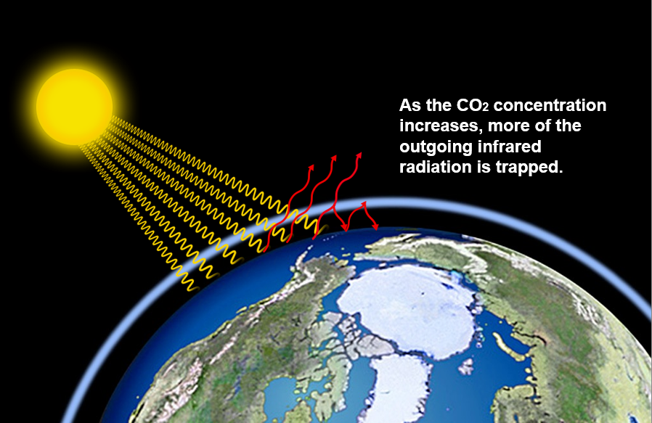
Greenhouse Effect
Notes:
Analogies
-Can describe greenhouse gases as “blankets” that cover the Earth. They make the Earth warm enough to inhabit but too much is a bad thing.

Slide 33
5. Make it relevant
CLIMATE CHANGE COMMUNiCATION
Notes:
-Keep it here and now.

Slide 34
Why?
Helping/saving us and other life – not the Earth
Protection, Responsible Management, Resilience
Climate Justice!
“Center all climate change actions on equity and community resilience. For many marginalized groups, history informs current challenges. Climate change worsens existing inequities.” – FEMA & NASA

Slide 35
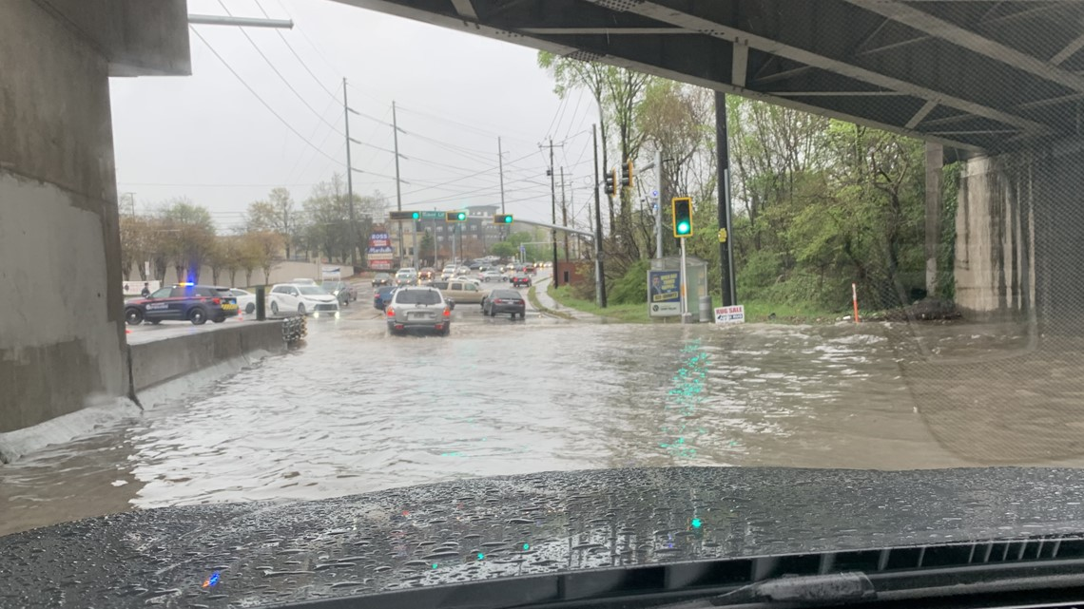
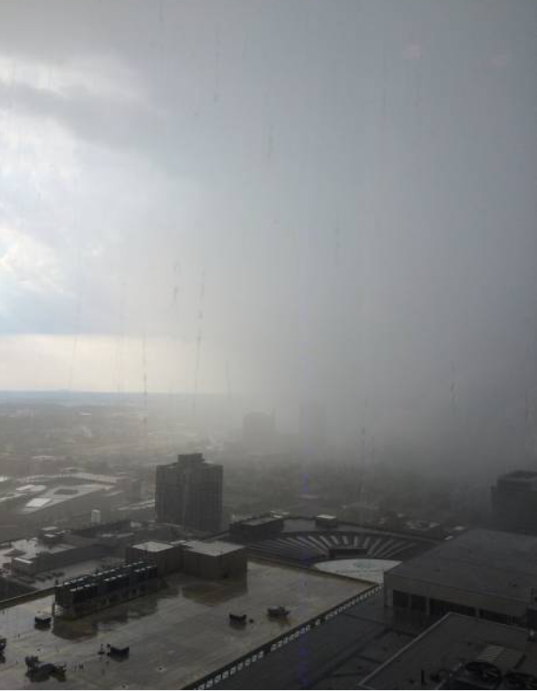
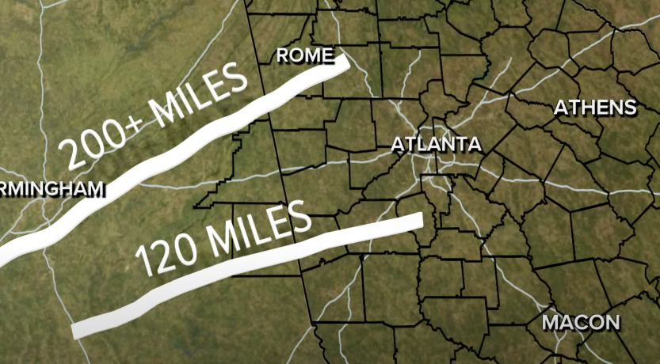
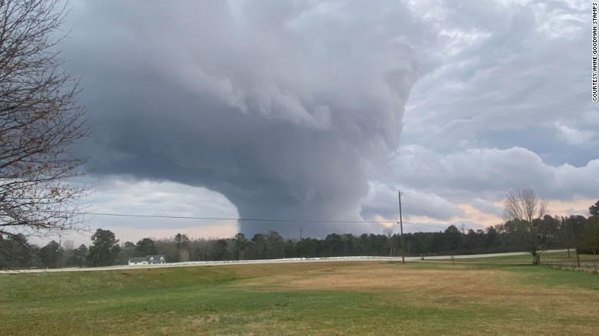
Keep It Local & Recent
Lindbergh area, April 2022
Atlanta, 2018
EF4, Newnan, March 2021
Covington, December 2021

Slide 36
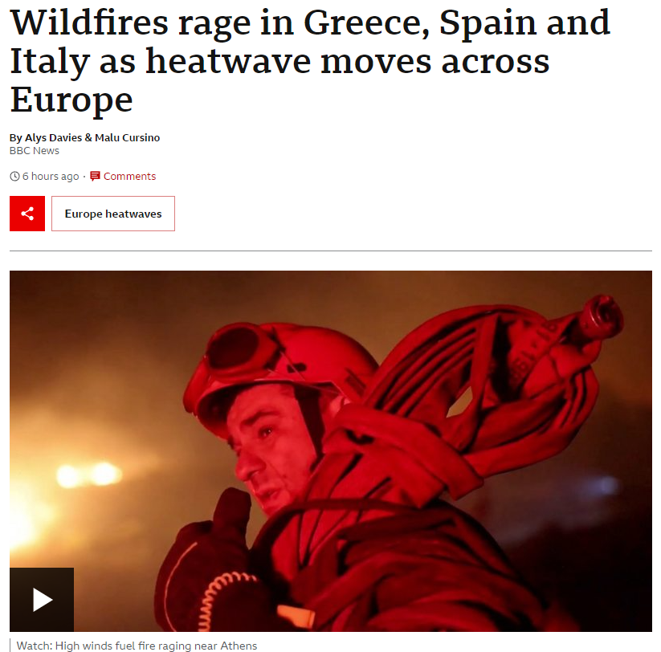
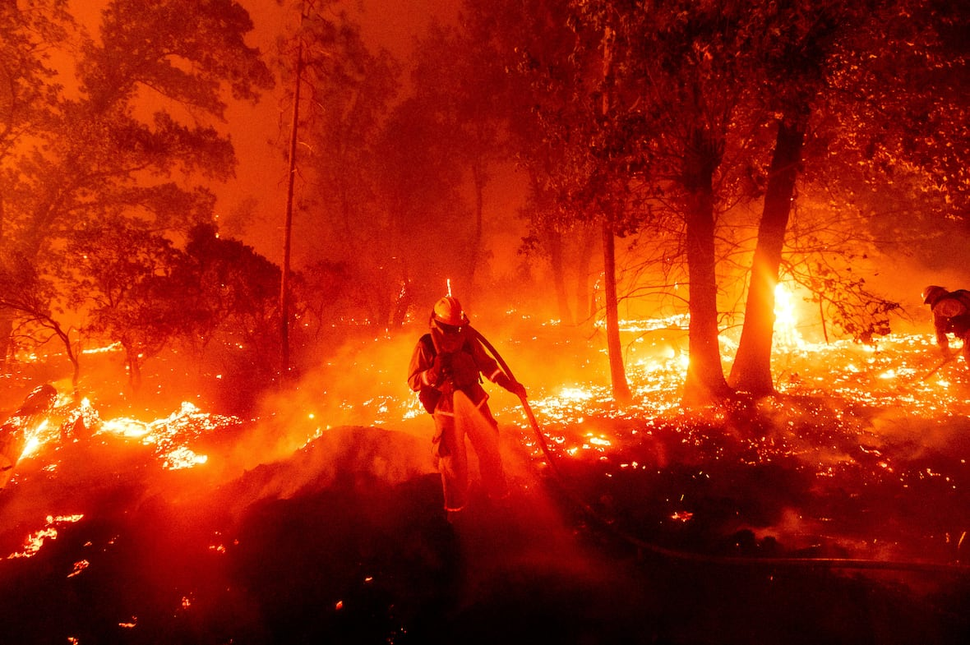
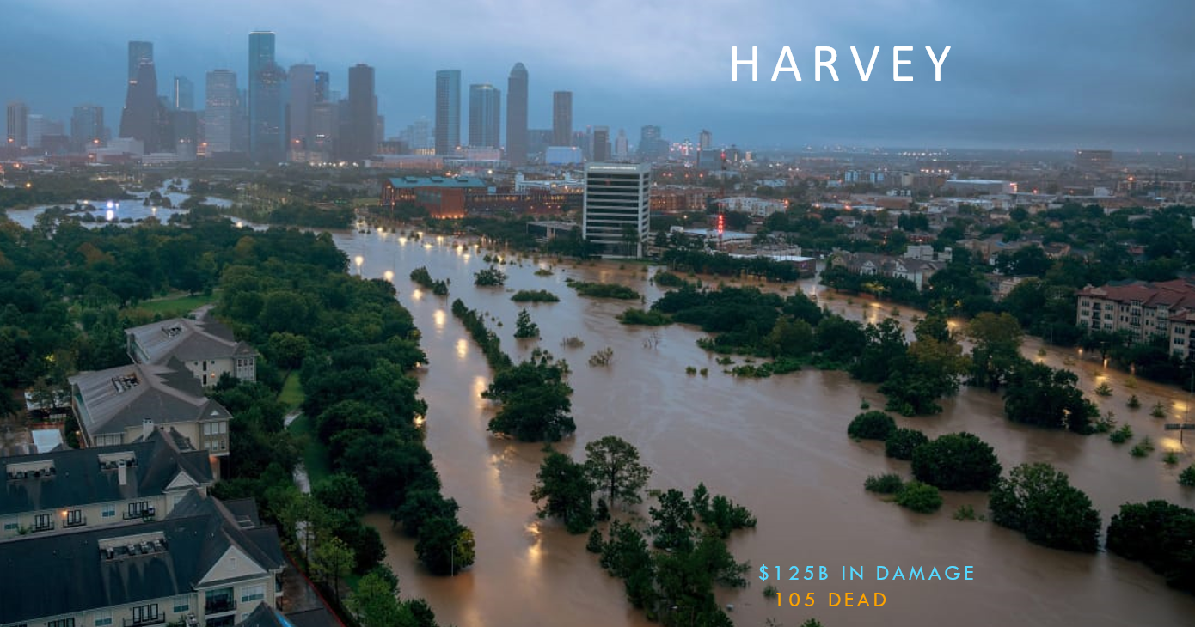
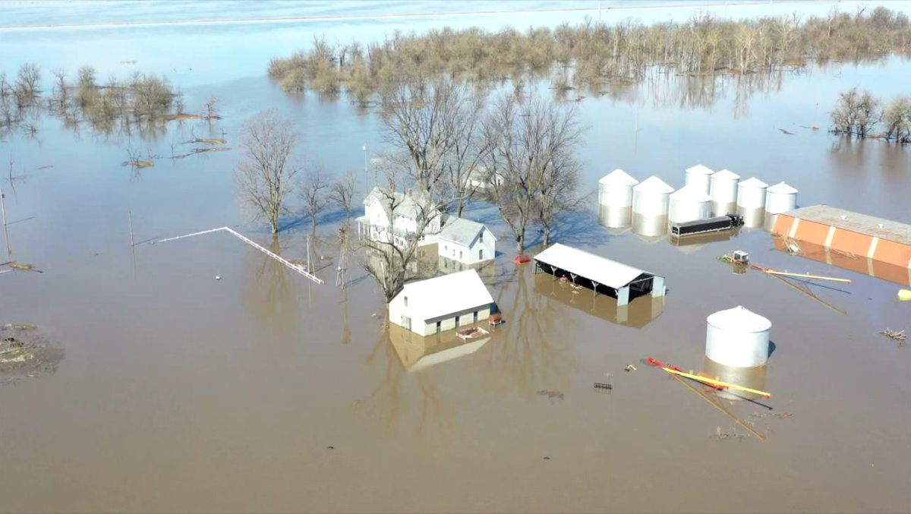
Keep It Local & Recent
Severe climate and weather events become more common and more extreme

Slide 37
6. stay positive;
talk solutions
CLIMATE CHANGE COMMUNiCATION
Notes:
The challenge of climate change communication is conveying a sense of urgency without paralyzing people with fear and guilt. The good news is that solutions are possible that will allow us to minimize the effects of climate change, but we need to act fast! In your communication you need to strike balance between urgency and overwhelming with fear. Talk solutions and stay positive. A key goal: Understand that scientists (more than 97%) are in agreement. Emphasize that many solutions (e.g., renewable energy) can be cheaper and better, which is an economic solution and a win-win.

Slide 38
Hope…
Notes:
-Have to leave some room for hope. Nothing positive happens if there isn’t room for positivity, and no one takes action if they feel completely demoralized and hopeless. Need to connect the concerned individuals with the actionable solutions they can take, both at an individual and community level.

Slide 39
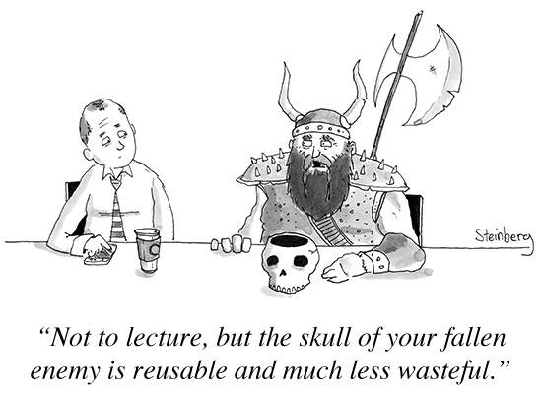
CLIMATE CHANGE COMMUNiCATION
Notes:
-Messaging about climate change solutions tend to focus on austerity measures and guilting.

Slide 40
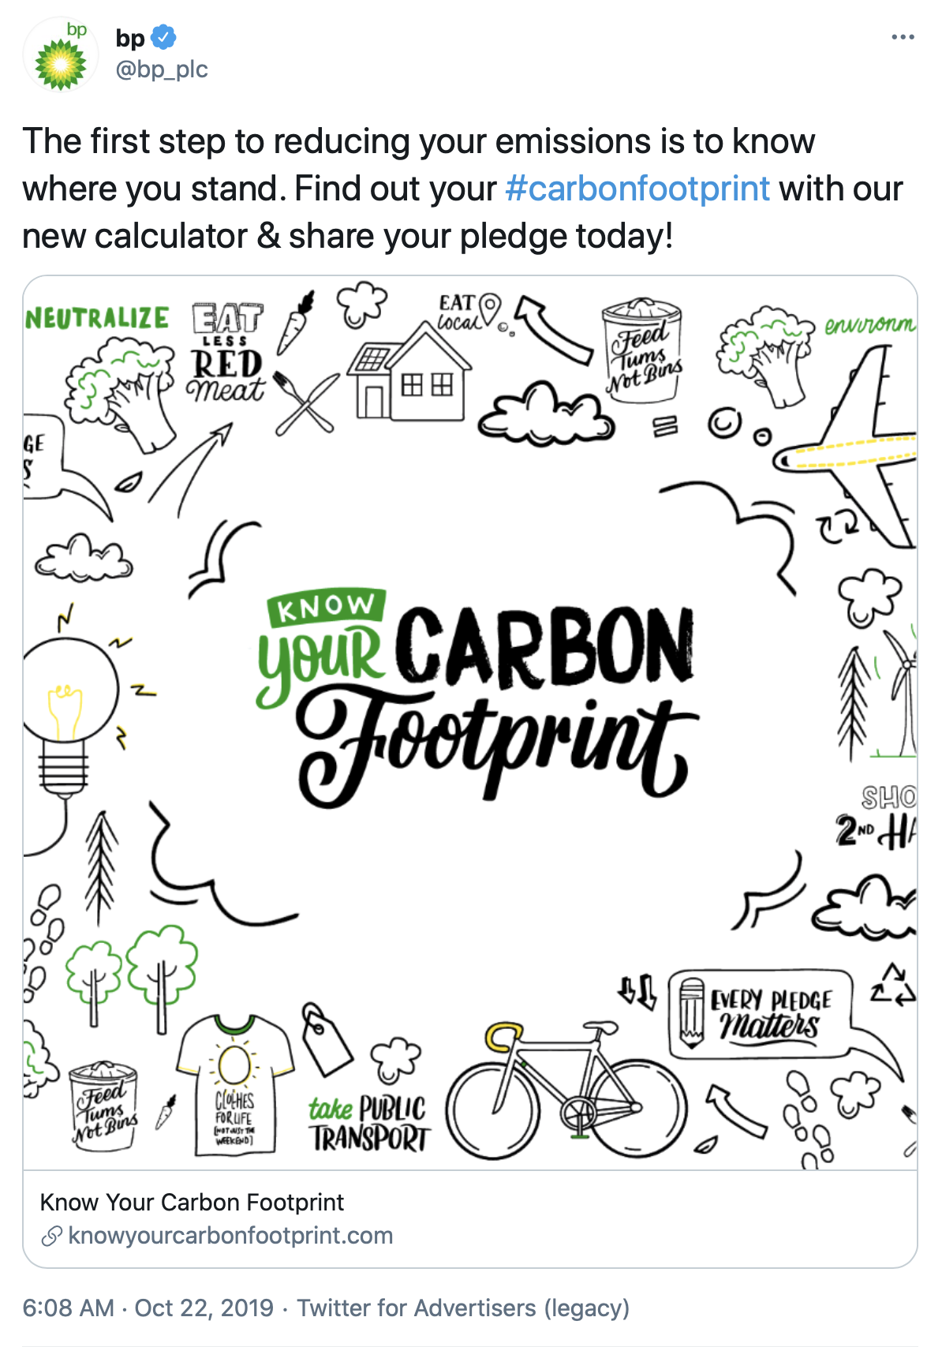

Slide 41
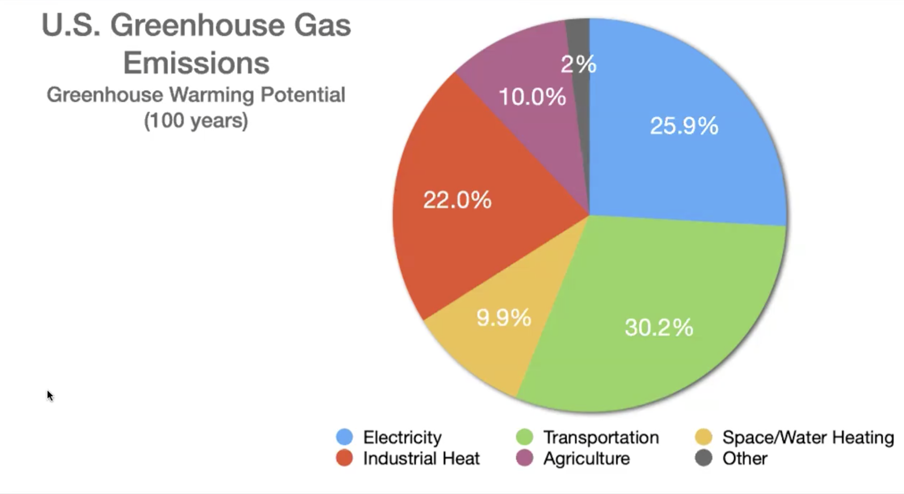
GHG Emissions

Slide 42
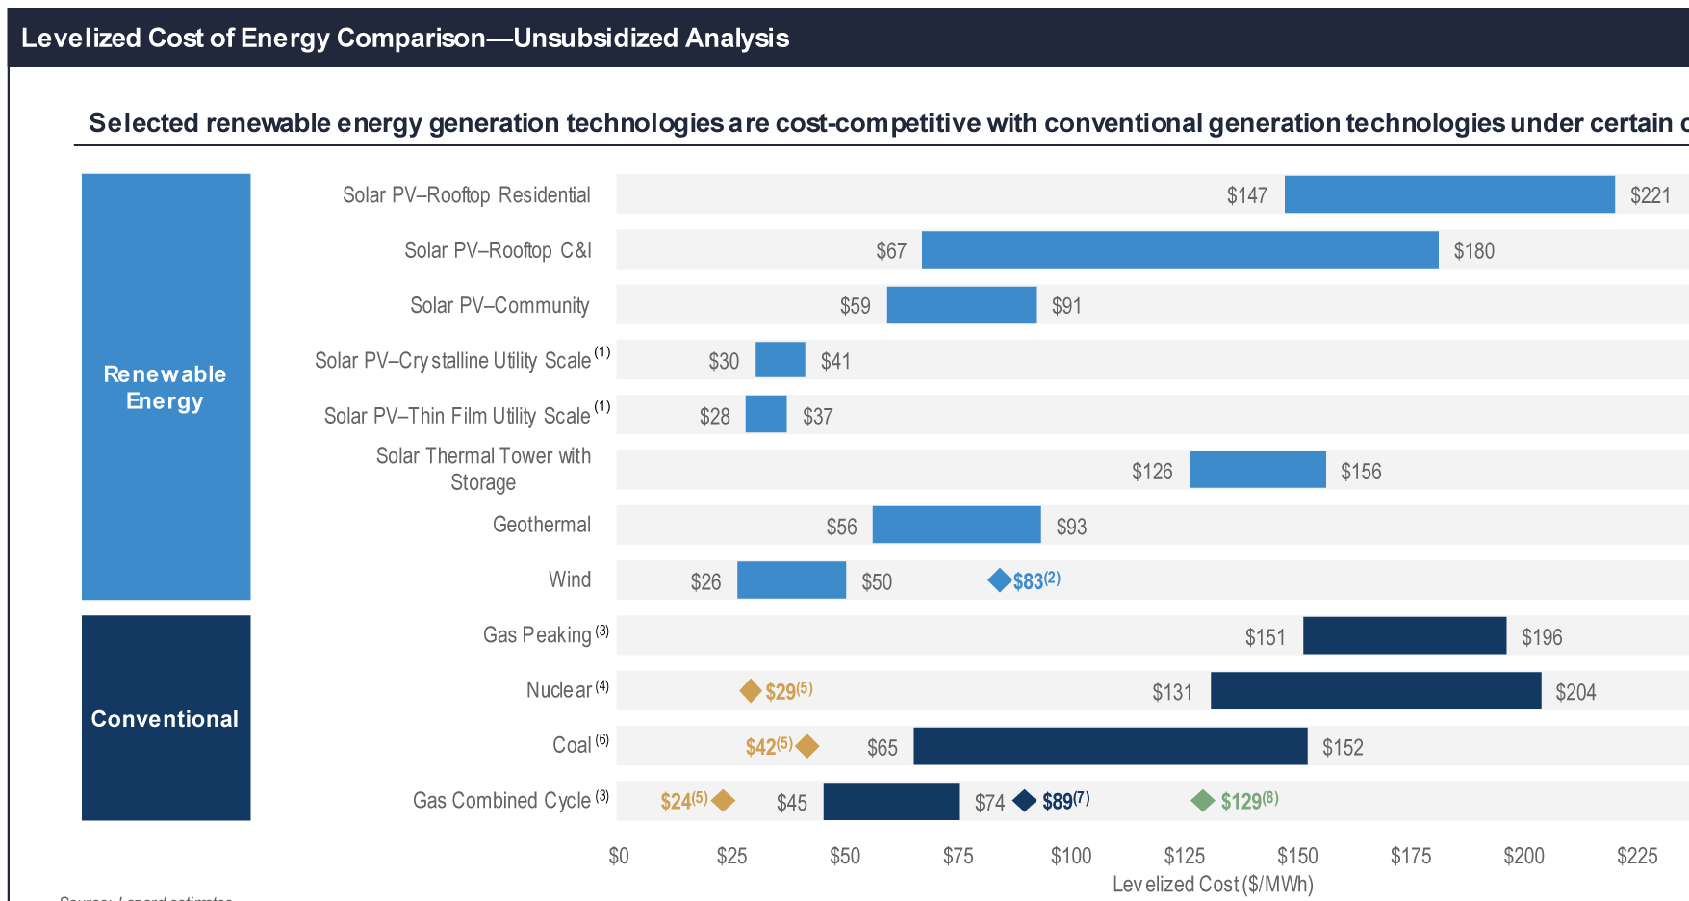

Slide 43
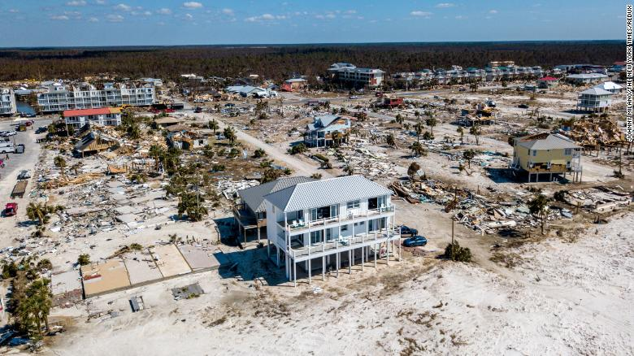
CLIMATE CHANGE COMMUNiCATION
Resiliency
Notes:
-Energy solutions are essential, but it’s important to emphasize that climate change is here and its effects are being felt now. Thus, “resiliency” will be an essential part of addressing the climate change that is already here, and what’s to come.
-For example, this is a picture of Mexico Beach after Hurricane Michael in 2018. The house at the center of the photo survived with minimal damage because the owners were aware of climate change when they built it.

Slide 44
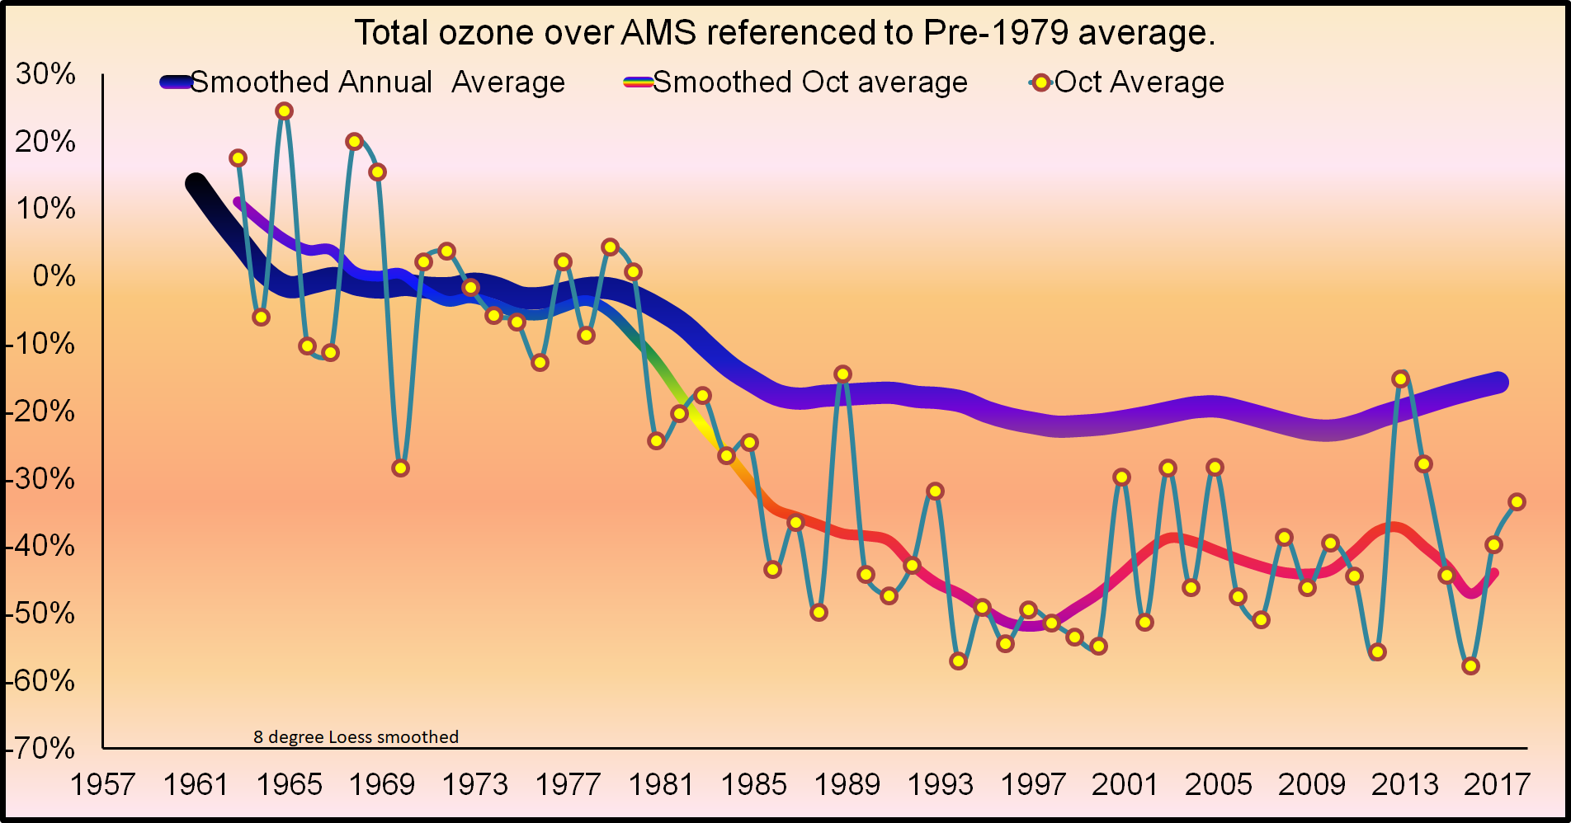
Ozone Stabilization
Montreal
Protocol

Slide 45
Personal Solutions
Here are personal choices you can make:
Fly less (virtual conferences)
Change your diet (less meat and cheese)
Divest from fossil fuels (personal bank accounts)
Reduce usage (e.g., electric cars, biking)
Install solar panels
Notes:
-Personal changes can help motivate and drive systemic changes

Slide 46
Community Solutions
You can also:
Contact your representatives
Vote! (early voting has begun)
Join a climate group (e.g., Citizens Climate Lobby)
Talk about it!
Motivate a group to which you already belong

Slide 47
7. The science is not enough
CLIMATE CHANGE COMMUNiCATION
Notes:
So how did we get to this point? For three decades climate scientists have been warning people about climate change, and it has resulted in little change in public perception. The reasons are several: First, scientists have not done a good job of communicating the problem. We’ve assumed that stating the results of our science would be enough. Second, the media has framed the issue in misleading ways. Finally, there is an active effort to discredit climate science and sow confusion. This is the elephant in the room. Teaching the science is not enough to make people immune to the disinformation. You need to bring attention to these efforts.

Slide 48
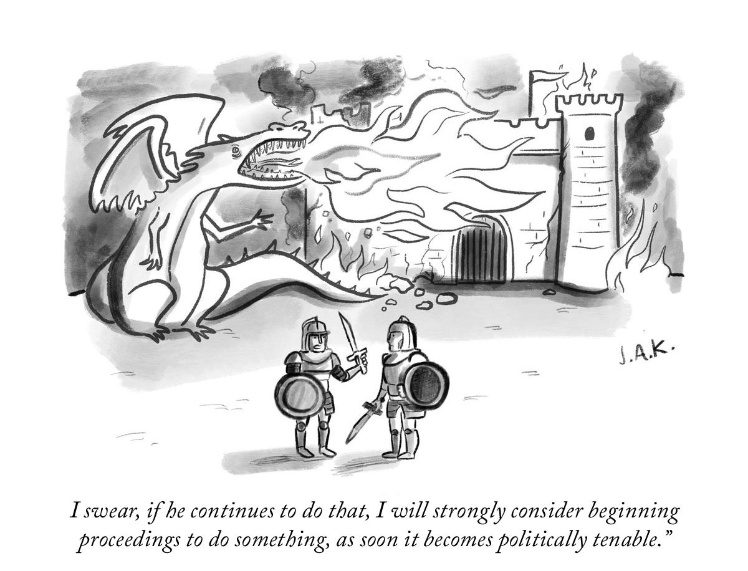

Slide 49
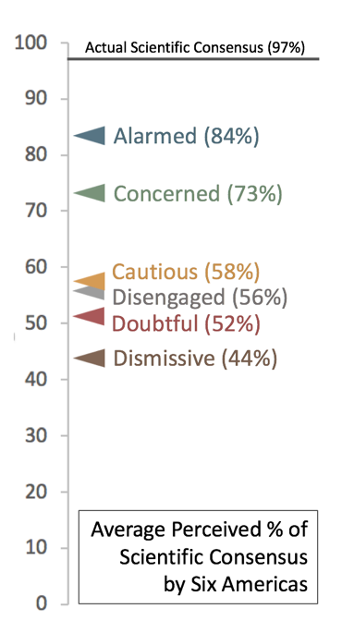
What % of scientists think climate change is real and caused by human activity?
CLIMATE CHANGE COMMUNiCATION
Notes:
https://climatecommunication.yale.edu/publications/even-americans-highly-concerned-about-climate-change-dramatically-underestimate-the-scientific-consensus/

Slide 50
Climate denialism
CLIMATE CHANGE
Misinformation is the accidental spread of incorrect information.
Disinformation is the willful spread of incorrect information with the intent to deceive.
Notes:
-Imagine how hard it is to learn something under normal circumstances in a classroom where you have a teacher helping you and clear direction, now imagine you are trying to learn something in an unstructured environment while there are powerful groups working to actively make it harder for you to learn the correct information. That is really hard!

Slide 51
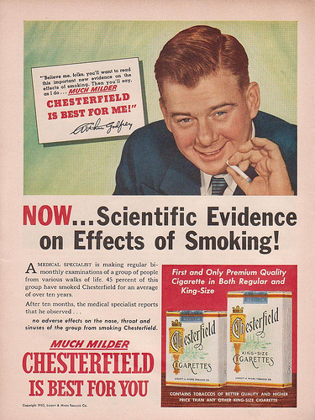
Notes:
-It is also worth showing that other industries have used disinformation to confuse the public on unwelcome scientific results. These are examples of cigarette ads that ran in the 50s, claiming doctors and scientists think smoking is ok. Imagine such a campaign now! Other examples include the sugar industry (links to obesity) and in American football (concussions). Pointing these examples out directs the attention to where it should be.

Slide 52
Notes:
-In 2016, bankruptcy filings for Peabody Energy, America’s biggest coal mining company, revealed that it has funded at least two dozen groups that cast doubt on manmade climate change and oppose environment regulations.
-This includes groups like the “Center for the Study of Carbon Dioxide and Global Change” and scientist Willie Soon.

Slide 53
Science Media Literacy
Notes:
-Can teach science media literacy, where students learn how to evaluate stories to see if they are to be trusted.

Slide 55
Astronomy &
Climate Change

Slide 56
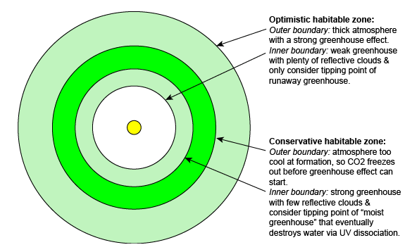
Greenhouse Effect & HZ
“Traditional” edges set by greenhouse | N2-CO2-H2O
GHG concentrations change limits
Credit: Nick Strobel - Bakersfield College - astronomynotes.com
Notes:
-Inner edge is set by either (1) runaway greenhouse effect, or (2) loss of water by UV dissociation and follow up H escape. Depends on the star temperature (spectral type).
-Remember, are setting bounds for *liquid* water to exist, assuming the water is there and there is an atmosphere.

Slide 57
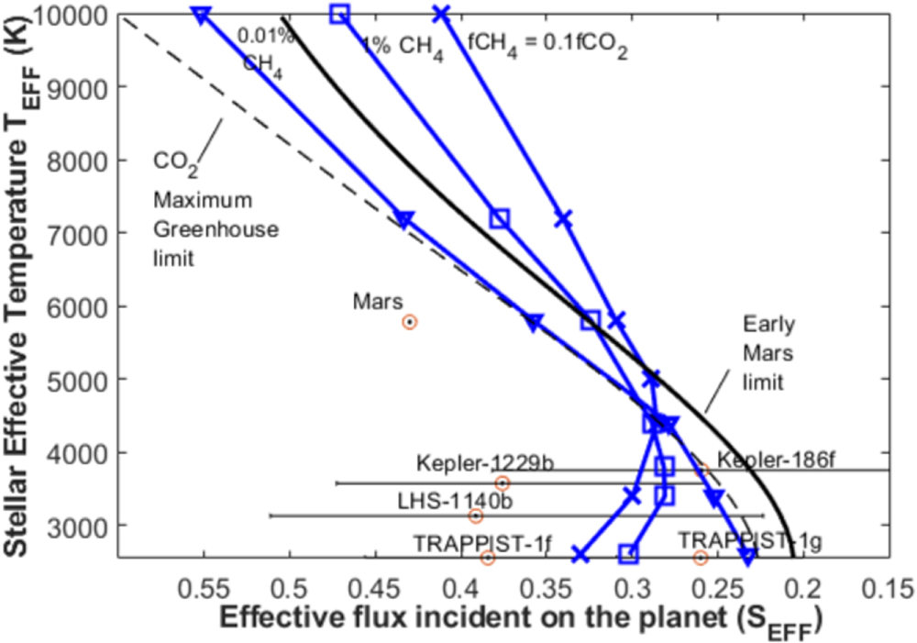
Greenhouse Effect & HZ
Earth CH4
≈ 0.0002%
Notes:
-“The effect of adding methane to the outer edge of the classical HZ. Stellar effective temperature vs. the effective stellar flux (S_{EFF}) for the outer limits of the Habitable Zone. The traditional outer HZ limit, the CO₂ maximum greenhouse limit (dashed line) is shown along with the empirical outer edge (solid black line) and outer edge limits (solid blue line) containing various amount of CH₄: 10 ppm (triangle), 1% (square), and fCH₄ = 0.1 × fCO₂. Some confirmed planets near the outer edge are included with error bars displayed.”
-“An alternative HZ limit that is not based on atmospheric models (like the classical HZ) but on empirical observations of our solar system is shown in both figures for comparison, the empirical HZ. The inner edge of the empirical HZ is defined by the stellar flux received by Venus when we can exclude the possibility that it had standing water on the surface (about 1 Gyr ago), equivalent to a stellar flux of S_{EFF} = 1.77 (Kasting et al. 1993). The "early Mars" limit is based on observations, suggesting that the Martian surface may have supported standing bodies of water ∼3.8 Gyr when the Sun was only 75% as bright as it is today. For our solar system, S_{EFF} = 0.32 for this limit, corresponding to a distance of ∼1.77 au (e.g., Kasting et al. 1993). ”

Slide 58
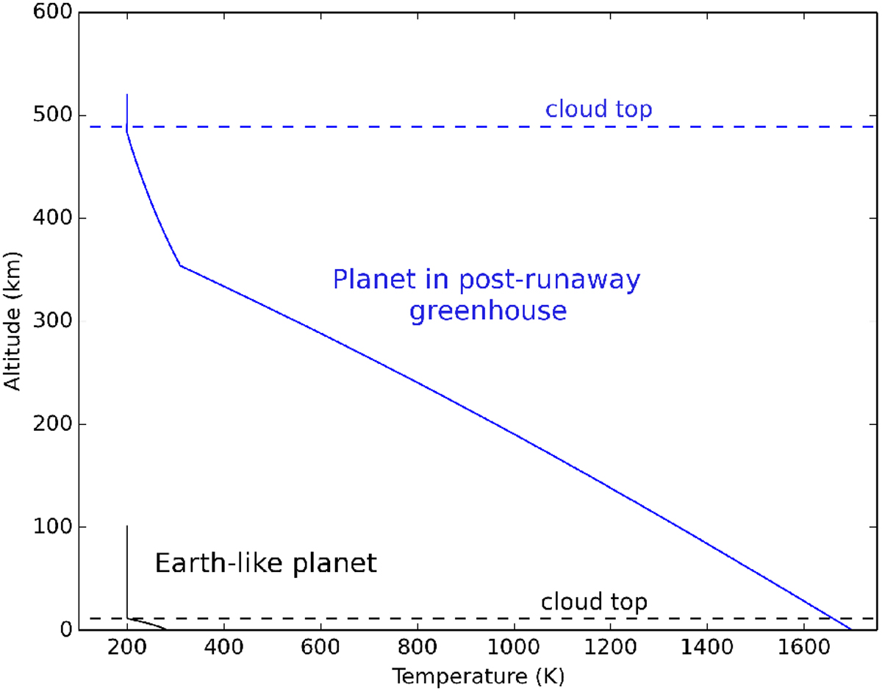
Greenhouse Effect & HZ
Notes:
-Runaway H2O greenhouse in inner HZ can puff up the atmosphere a lot, potentially observable in exoplanets to inform runaway greenhouse limits.
-First plot: “Thermal profiles of an Earth-like planet receiving the same insolation than present-day Earth (solid black curve) and receiving 6% more insolation than Earth (solid blue curve). In the latter case, the planet is in a post-runaway greenhouse climate state. The top of the cloud layer – estimated using the top of the moist convective layer – is indicated with dashed lines.”
-Second plot: “Effect of total water content … for a planet in post-runaway greenhouse climate state... In (B) is shown the net radius change.”

Slide 59
Impact of Climate Change on Astronomy
Worse PWV
Worse
Seeing
“Our results show that climate change likely increases time lost due to bad site conditions.”
Notes:
-Precipitable water vapor (PWV) is the vertically integrated amount of water vapor in the atmosphere.
-“The precipitable water vapor (PWV), which is equivalent to the depth of liquid water that would result if all the water vapor in the atmospheric column is condensed and precipitated, is used to diagnose the atmospheric humidity over a specific location.”

Slide 60
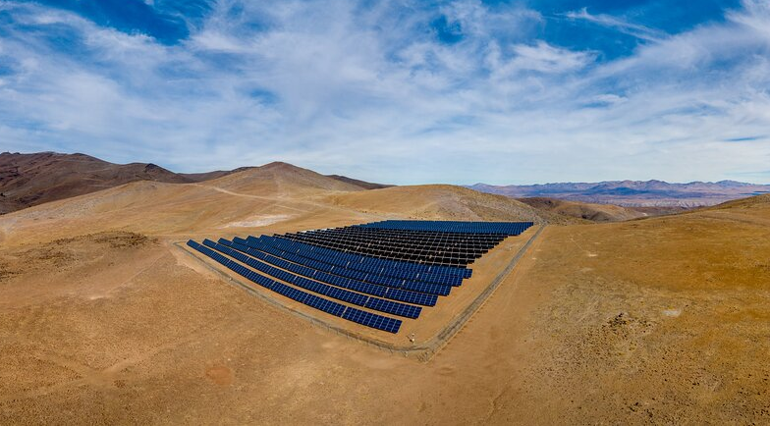
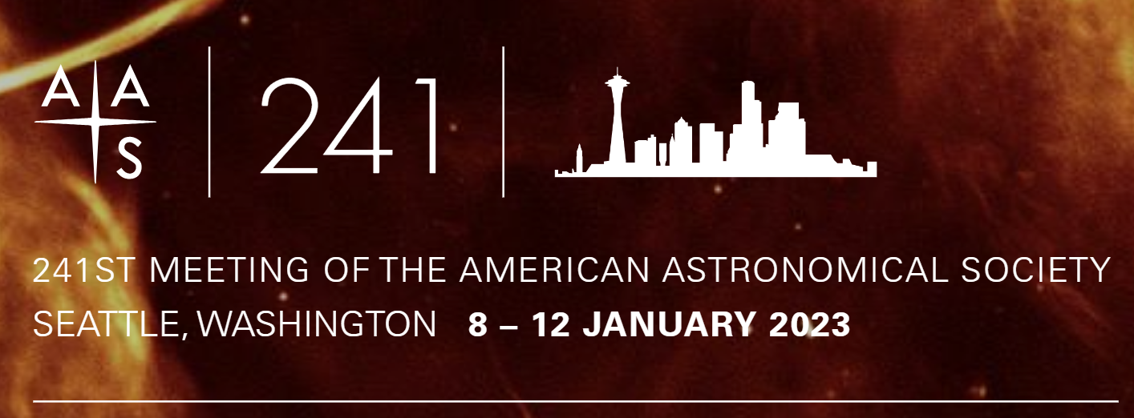
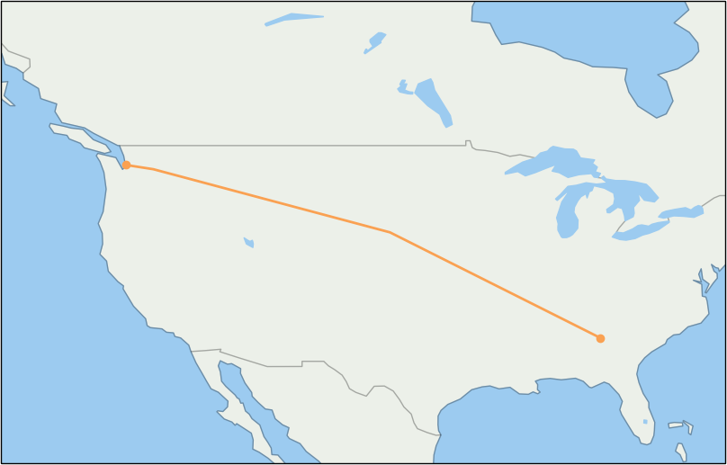
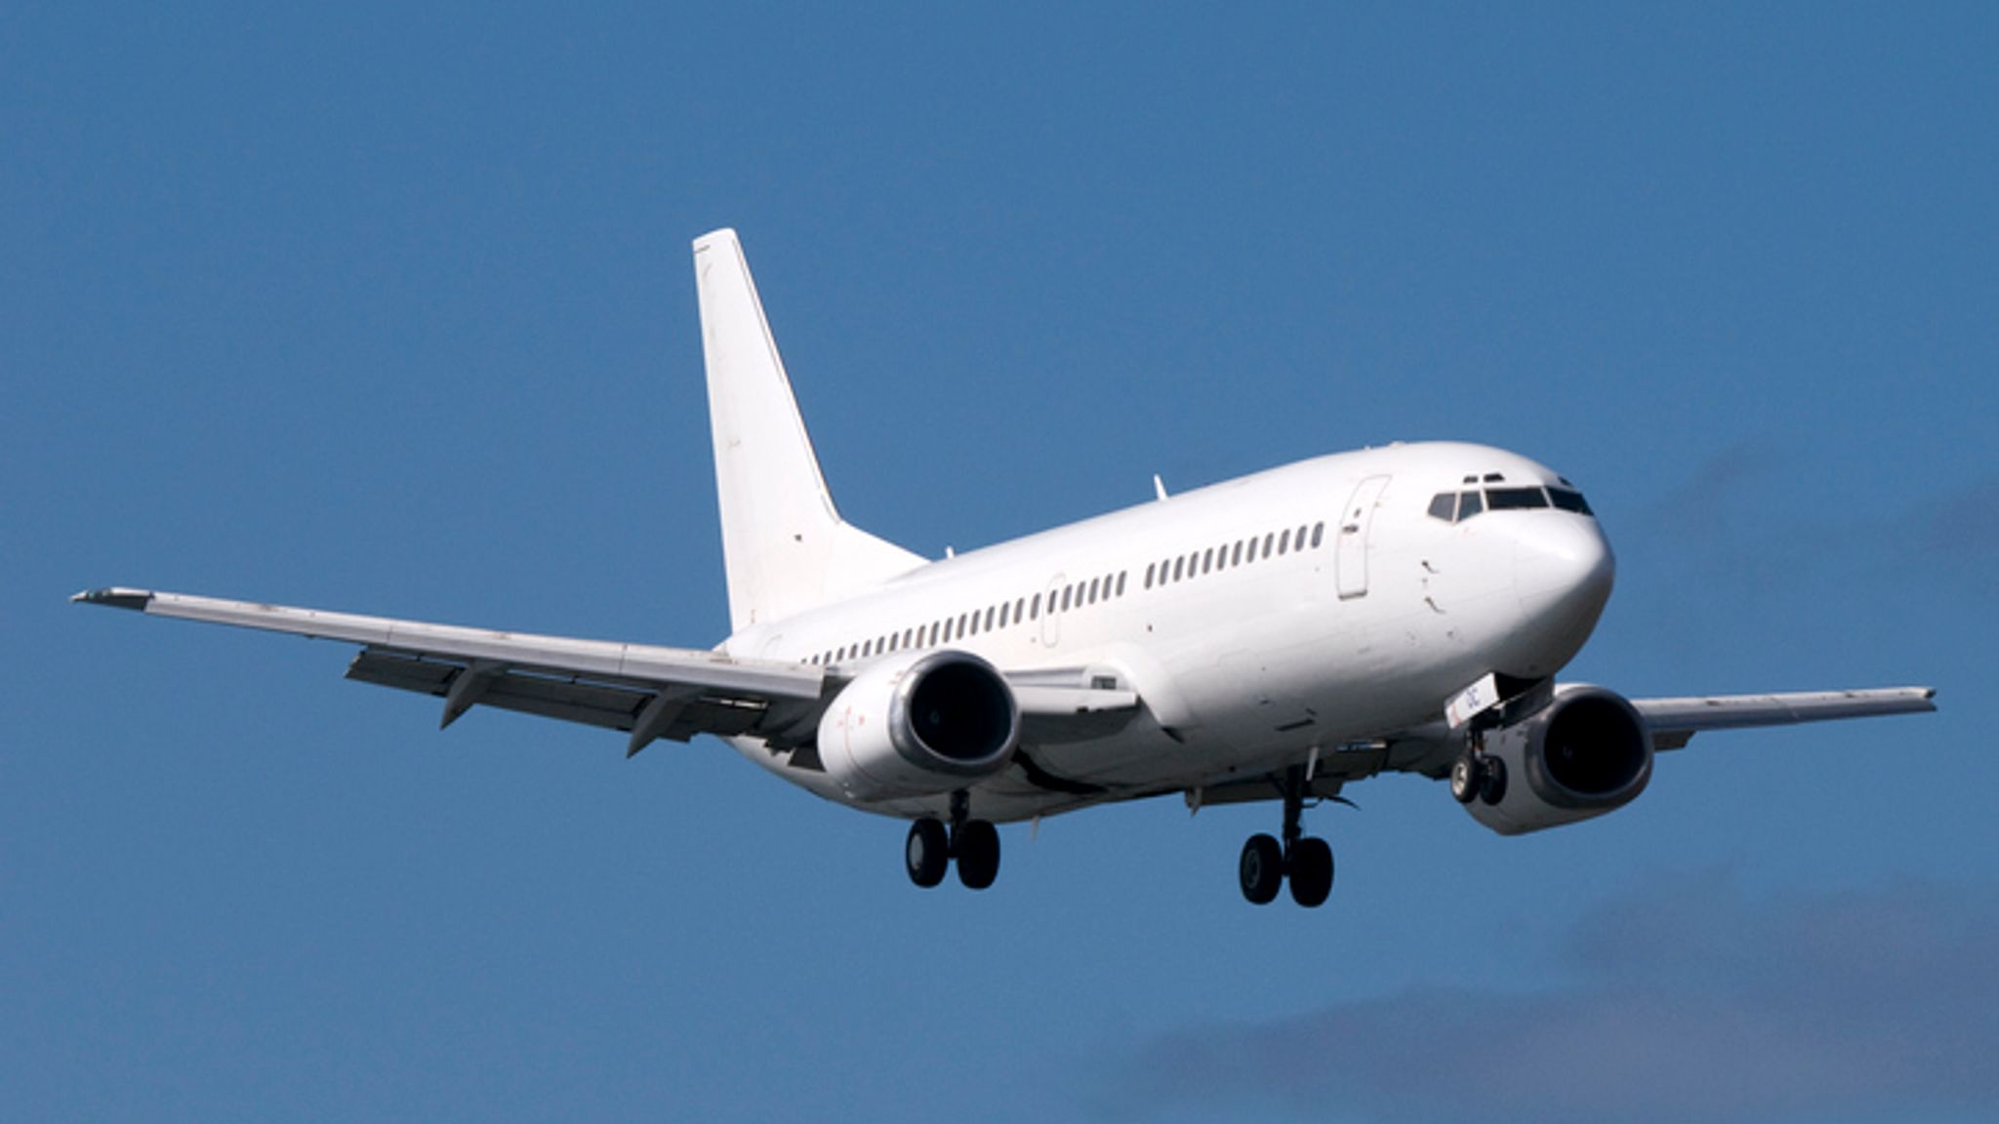
Impact of Astronomy on Climate Change
“Over their lifetimes, cutting-edge observatories combined release CO2 equivalent to the annual output of countries such as Estonia, Croatia, or Bulgaria.”
ESO’s La Silla Observatory (Chile)

Slide 61
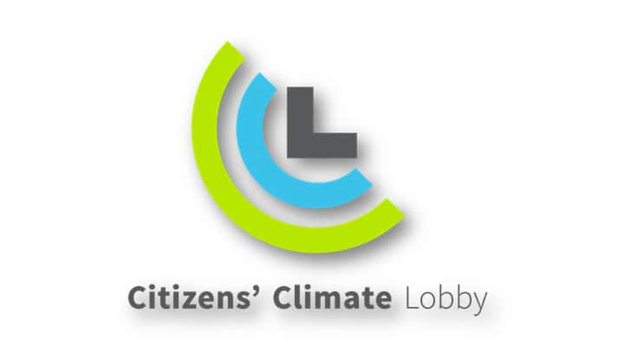
Groups
Notes:
-Sustainability committee has been around since 2010. Task force is new in 2022.

Slide 62
Resources
CLIMATE CHANGE COMMUNiCATION
Learning the Science
Princeton Primers in Climate
https://press.princeton.edu/catalogs/series/date/princeton-primers-in-climate.html
EdX (several classes)
edx.org
Notes:
A challenge for scientists is finding background knowledge. Most materials are for the public, which tends to be too basic, or for climate scientists, which assume too much a priori knowledge. The Princeton Primers in Climate are a series of books intended for fellow scientists. All are worthwhile, and provide a deep dive into the fundamentals in several realms of climate science. I would start with “The Global Carbon Cycle” by David Archer. EdX also offers several online classes on specific topics. They’re free and self-paced.

Slide 63
Resources
CLIMATE CHANGE COMMUNiCATION
Current Status of the Climate
Intergovernmental Panel on Climate Change (IPCC)
ipcc.ch
National Climate Assessment Report (NCA)
https://nca2018.globalchange.gov
Notes:
The IPCC and NCA reports give an overall status of climate change research. The IPCC and NCA are updated every few years. The NCA is especially nice in that it breaks down effects by region.

Slide 64
Resources
CLIMATE CHANGE COMMUNiCATION
Latest Data and Plots
NASA
https://climate.nasa.gov
NOAA
www.noaa.gov
Notes:
Every time you teach climate change you’ll want to have the latest plots (e.g., temperature and CO2 levels as a function of time). The NASA and NOAA sites have nice ways of generating your own plots as well.

Slide 65
Resources
CLIMATE CHANGE COMMUNiCATION
Climate Communication
Yale Program on Climate Change Communication
http://climatecommunication.yale.edu
George Mason Center for CC Communication
https://www.climatechangecommunication.org
Notes:
Most of this presentation has been about climate change communication. Both of these are invaluable resources for learning effective strategies.

Slide 66
Resources
CLIMATE CHANGE COMMUNiCATION
Climate Denialism
Skeptical Science
https://skepticalscience.com
Making Sense of Climate Denial: EdX
https://www.edx.org/course/making-sense-of-climate-science-denial-2
Notes:
There is an active campaign of climate change disinformation. Almost every time I talk about climate change a new denier talking point appears. You can learn about the most common talking points here. I look at Skeptical Science every time before I talk about climate change.

Slide 67
Resources
CLIMATE CHANGE COMMUNiCATION
Science Media Literacy
Civic Online Reasoning
https://cor.stanford.edu/
Ad Fontes Media
https://www.adfontesmedia.com/
Notes:
Both of these are valuable resources for teaching science media literacy.

Slide 68
Solar System Explorers 20 OCT
What is a specific solution we have for addressing anthropogenic climate change or its impact? e.g., Convert cars from hydrocarbon fuels to electric-powered.
1. Drive less, walk more
2. Put iron in oceans to promote more algae, captures CO2
3. Block sunlight from space (with bubbles at L1)
4. Greenroofs in cities
5. Going vegetarian
6. Use less hot water (conserves energy)
7. Don’t throw leaves in trash
8. Recycle
9. Add more solar panels to EVERYTHING!
10. Change construction materials
11. Release specific sulphates into atmosphere to stimulate cooling
12. Plant trees on Florida coast (less flooding, more carbon capture)
13. Turn off tech when not in use
14. Keep tires inflated to improve efficiency of gas usage
15. Vote green
16. Plant more trees
17. Use reusable items (water bottles, etc)
18. Change to H powered engines
19. Protecting existing forests (Amazon, etc)
20. Switch bank accounts to groups not investing in fossil fuel projects

