Slide 1
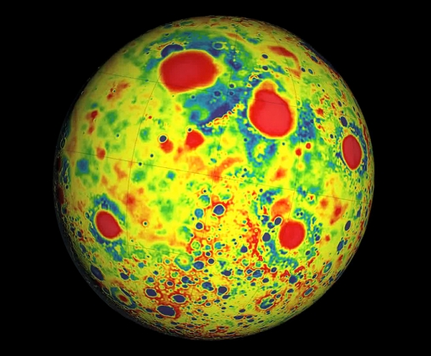
Where is this?
Notes:
high-resolution map of the Moon’s gravity — a force created by surface structures such as mountains and craters, as well as deeper structures below the surface … Beneath its surface, the moon’s crust is almost completely pulverized. The finding suggests that, in its first billion years, the moon — and probably other planets like Earth — may have endured much more fracturing from massive impacts than previously thought. Compared to the surface, the map of the interior looked extraordinarily smooth. In fact, the team found that most of the moon’s local gravity is due to surface features, such as crater rims and mountains. Except for the large impact basins, the moon’s upper crust, largely lacks dense rock structures, and is instead likely made of porous, pulverized material.
Moon’s crust, ranging in thickness from 34 to 43 kilometers, is much thinner than planetary geologists had previously suspected. The crust beneath some major basins is nearly nonexistent, indicating that early impacts may have excavated the lunar mantle, providing a window into the interior.
To generate the gravity map, GRAIL’s two probes measure the changing distance between themselves as they orbit in tight formation around the Moon. As one of the probes flies over a large mass, such as a mountain or dense, underground rock, the stronger local gravity will pull that probe ahead, widening the space between the two spacecraft. Scientists can translate this changing distance into a gravitational map, representing the gravity produced by both the surface structures and the interior.
To find the gravitational field for the moon’s interior alone, Zuber’s team used topographic measurements from another of their instruments, a laser altimeter aboard the Lunar Reconnaissance Orbiter, a separate spacecraft in orbit around the moon. The scientists calculated the gravitational field expected to be produced by the moon’s topography — its surface structures alone — then subtracted that field from the field measured by GRAIL.

Slide 2
Where is this?
lunar gravity field variations by GRAIL
(Gravity Recovery
And Interior Laboratory:
NASA)
red = mass excesses
blue = mass deficiencies
Notes:
high-resolution map of the Moon’s gravity — a force created by surface structures such as mountains and craters, as well as deeper structures below the surface … Beneath its surface, the moon’s crust is almost completely pulverized. The finding suggests that, in its first billion years, the moon — and probably other planets like Earth — may have endured much more fracturing from massive impacts than previously thought. Compared to the surface, the map of the interior looked extraordinarily smooth. In fact, the team found that most of the moon’s local gravity is due to surface features, such as crater rims and mountains. Except for the large impact basins, the moon’s upper crust, largely lacks dense rock structures, and is instead likely made of porous, pulverized material.
Moon’s crust, ranging in thickness from 34 to 43 kilometers, is much thinner than planetary geologists had previously suspected. The crust beneath some major basins is nearly nonexistent, indicating that early impacts may have excavated the lunar mantle, providing a window into the interior.
To generate the gravity map, GRAIL’s two probes measure the changing distance between themselves as they orbit in tight formation around the Moon. As one of the probes flies over a large mass, such as a mountain or dense, underground rock, the stronger local gravity will pull that probe ahead, widening the space between the two spacecraft. Scientists can translate this changing distance into a gravitational map, representing the gravity produced by both the surface structures and the interior.
To find the gravitational field for the moon’s interior alone, Zuber’s team used topographic measurements from another of their instruments, a laser altimeter aboard the Lunar Reconnaissance Orbiter, a separate spacecraft in orbit around the moon. The scientists calculated the gravitational field expected to be produced by the moon’s topography — its surface structures alone — then subtracted that field from the field measured by GRAIL.

Slide 3
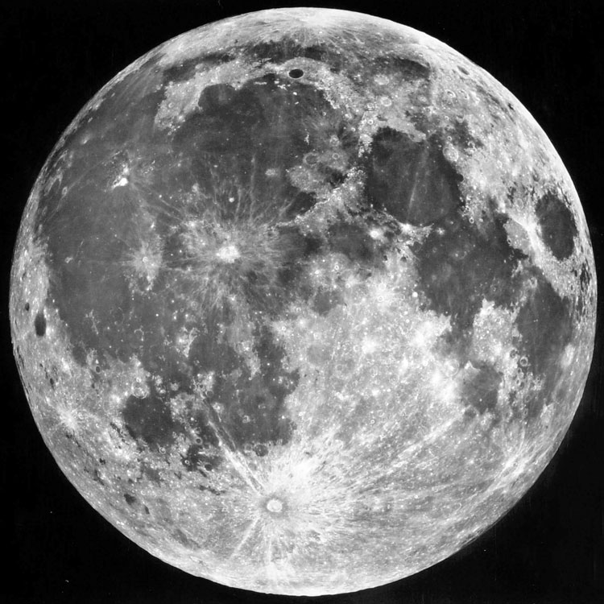
SSE!
Moon’s gravity tracks surface features
underneath surface, crust almost completely pulverized ...
smooth interior
many massive impacts
in early history
Tycho

Slide 4
Research Paper Level 2
due Thursday, 29 OCT
paper starting to take shape (worth 10 points)
hand in printed copy
ultimate goal is 10 pages of text + 5 pages of Figures and Tables
10 points:
1. Abstract full draft
2. Introduction 8+ sentences, major references included
3. Motivation YOU
4/5. Sections all have bullets
6/7. Discussion 8+ sentences
8. Tables 2+ formatted with columns identified
9. Figures 2+ outlined/sketched, captions given
10. References 10ish

Slide 5
Solar System Explorers 22 OCT
Describe an observation that yields information about a particular world’s interior, e.g. seismic data on Earth tell us that the size of the solid core is 1200 km.
1.
2.
3.
4.
5.
6.
7.
8.
9.
10.
11.
12.
13.
14.
15.
16.
17.
18.
19.
20.

Slide 6
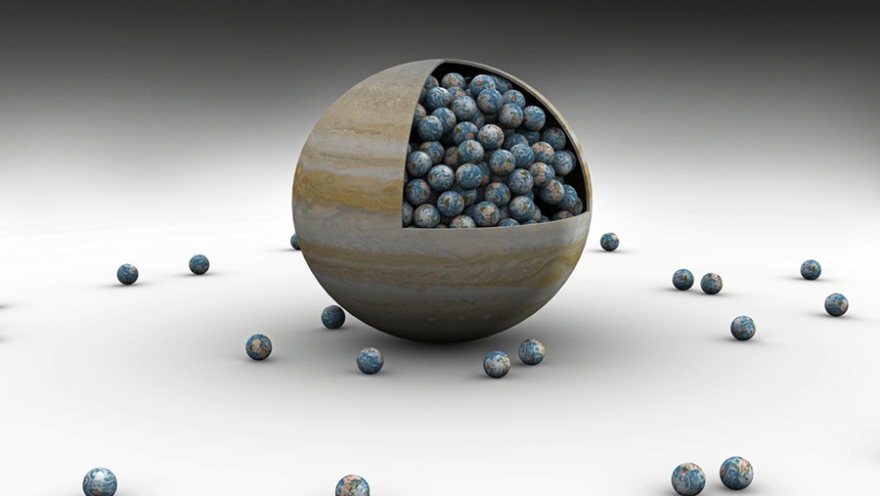
Planetary Interiors II
Discover magazine

Slide 7
SSE!
First 3 answers get 1(+1) points. (limit one try each)
Pick any terrestrial surface other than Earth.
You leave Hail Mary and are walking on it.
Other than temperature or a lack of O2 …
To stay alive, WHAT should you be worried about?
For another point, WHY is that happening?
Notes:
You may experience problems on the surface, but many of them are driven by the interior …
Earthquakes
volcanoes on Io
cracking on Europa
N2 plumes on Triton
charged particles on Ganymede/Callisto from Jupiter
sandstorm on Mars
slipping into methane lake on Titan

Slide 8
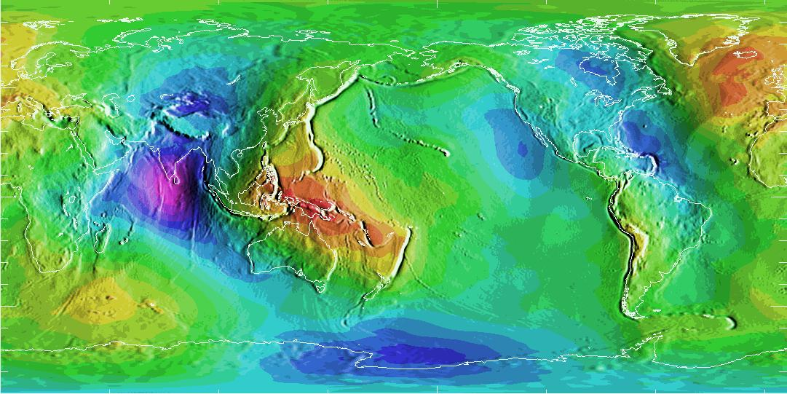
Earth’s Geoid
low gravity high gravity

Slide 9
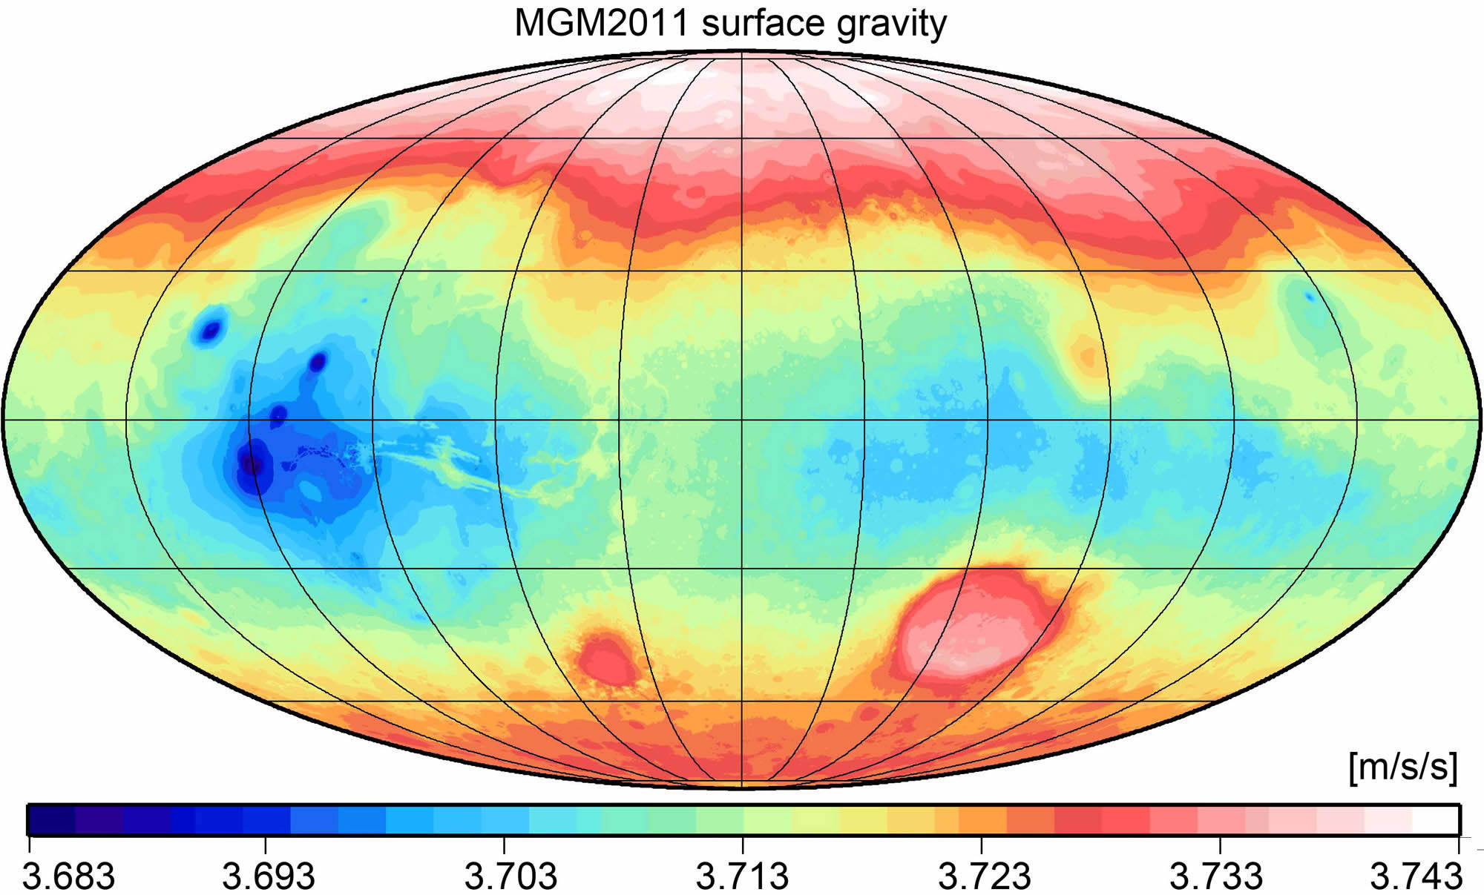
Mars’ Surface Gravity
low gravity high gravity
Notes:
unlike Earth, gravity traces features --- blue is low gravity, red is high

Slide 10
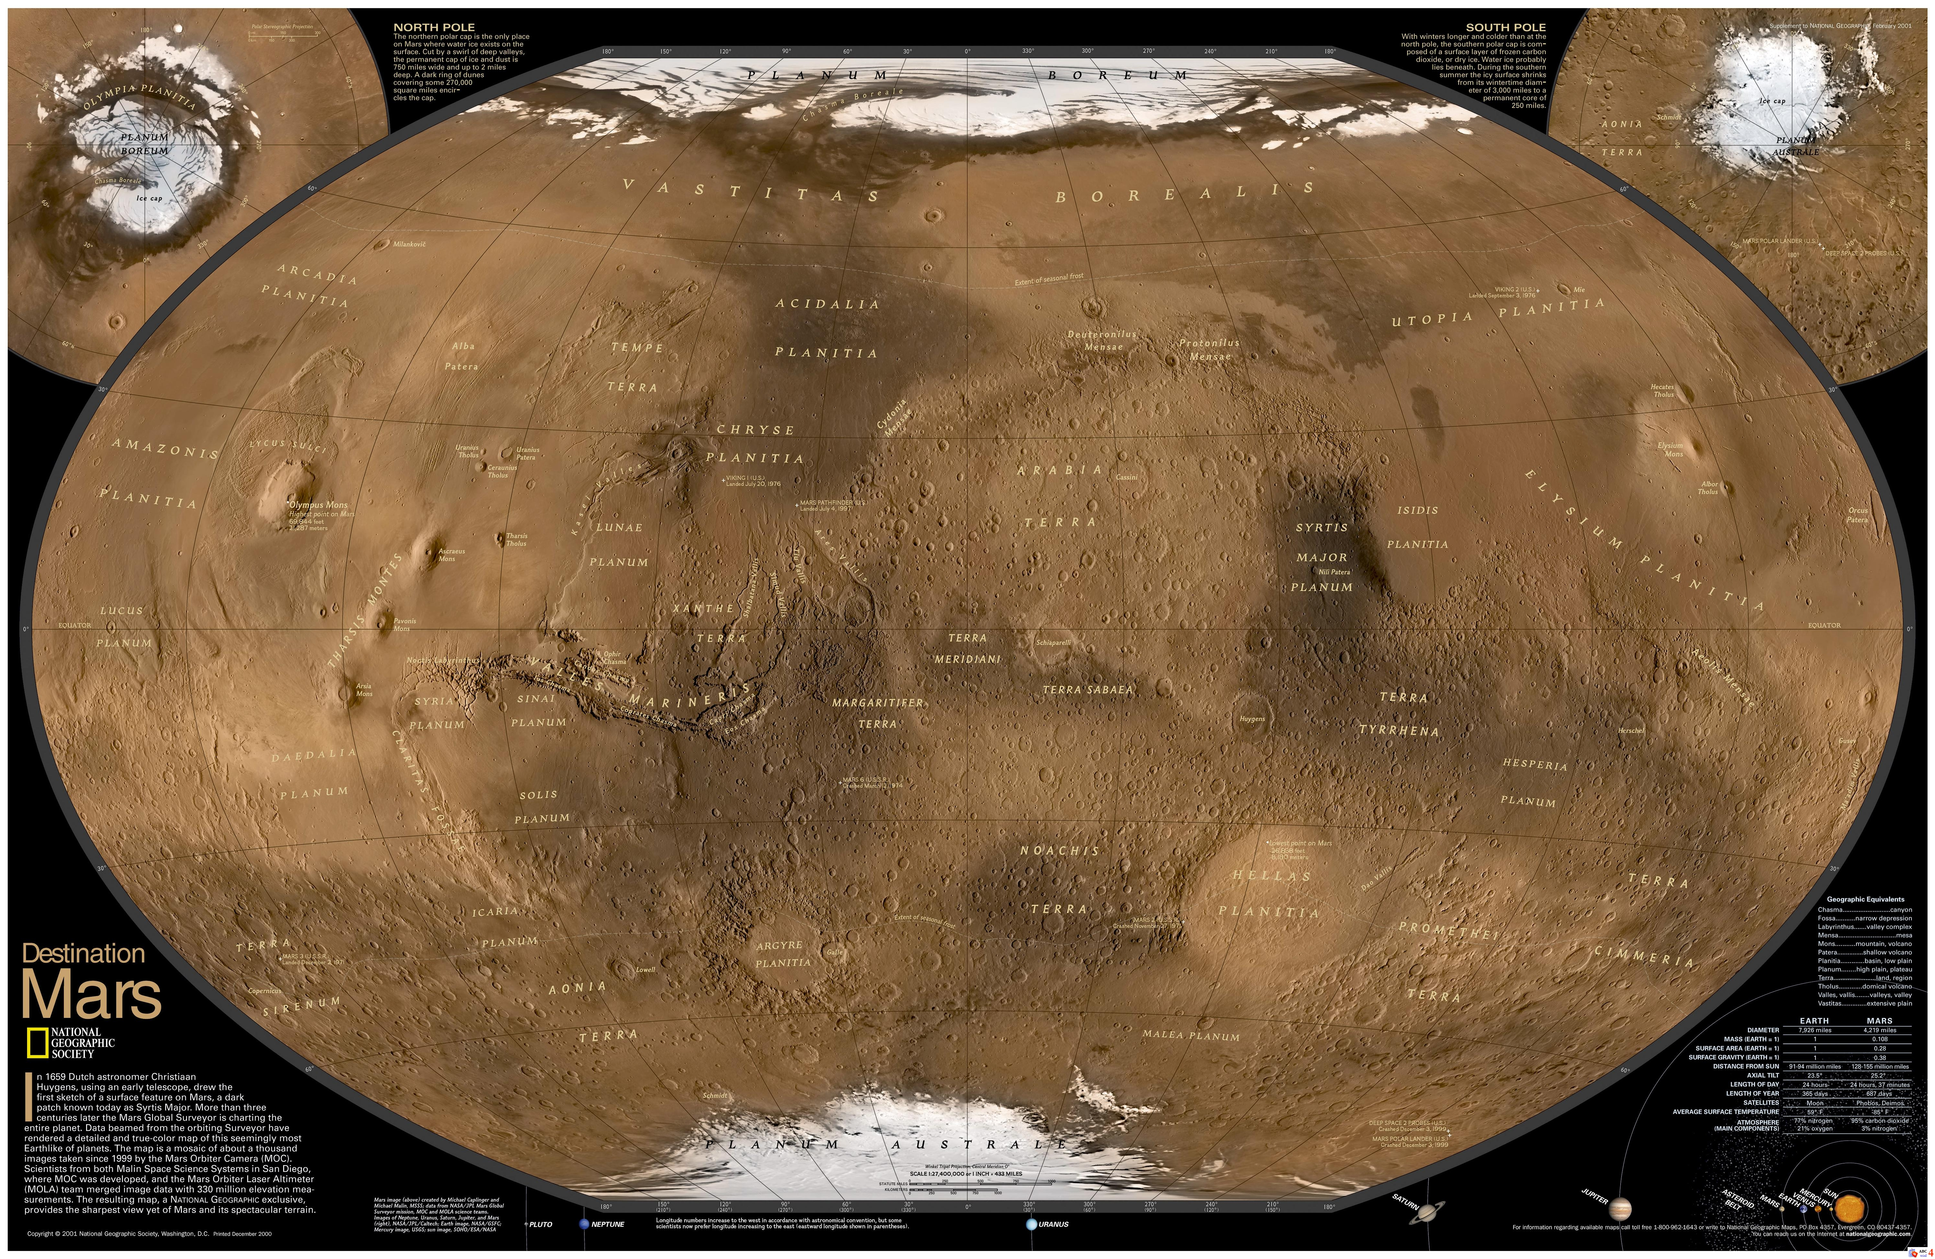
Mars’ Surface Features
rigid lithosphere
Notes:
unlike Earth, gravity traces features --- blue is low gravity, red is high

Slide 11
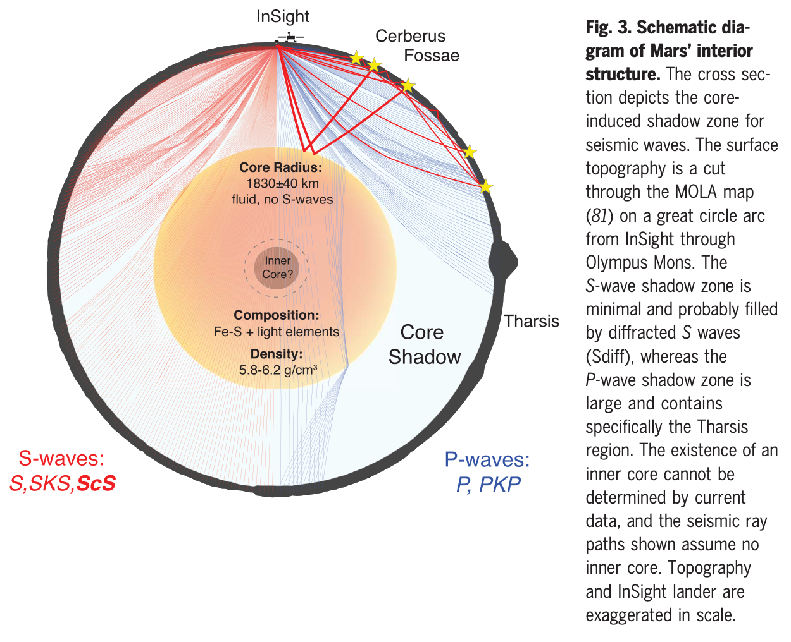
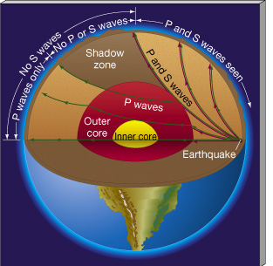
Mars’ Core
Stahler et al. 2021 … large core
Notes:
S waves can’t travel in fluid
Tharsis is in core shadow for InSight lander, so the most active part of Mars isn’t even studied from InSight’s location

Slide 12
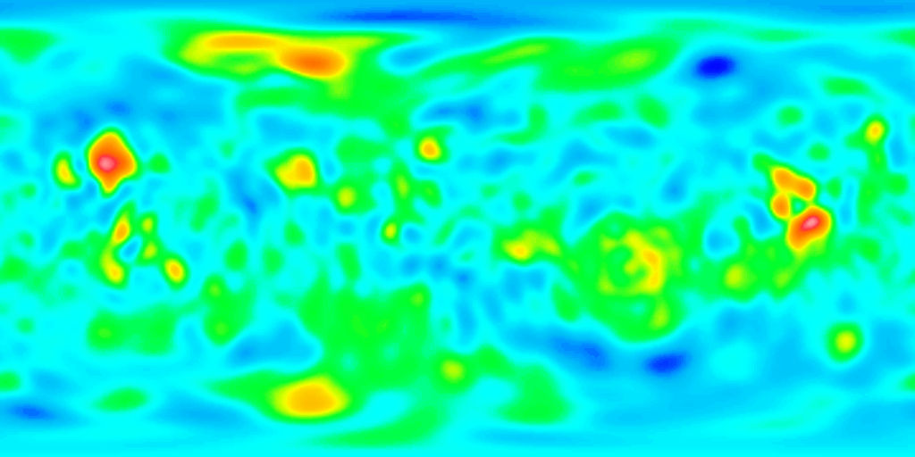
Venus’ Surface Gravity
low gravity high gravity
Notes:
done by Magellan
blue is low free-air gravity, red is high free-air gravity … opposite of Mars!

Slide 13
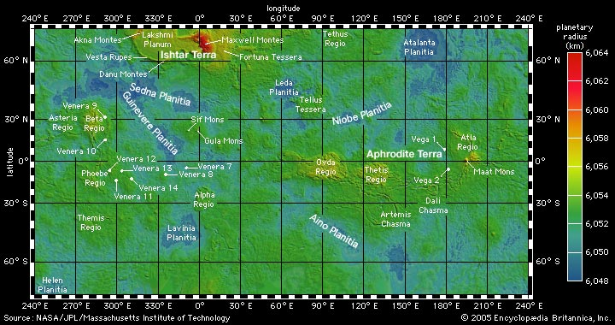
Venus’ Surface Features
high elevation ~ high gravity
Notes:
opposite of Mars!
The gravity field of Venus is highly correlated with the surface topography, which indicates the mechanism of topographic support is unlike the Earth, and may be controlled by processes deep in the interior. Details of the global tectonics on Venus are still unresolved --- https://nssdc.gsfc.nasa.gov/planetary/magellan.html

Slide 14
Venus’ Surface Gravity
low gravity high gravity
Notes:
done by Magellan
blue is low free-air gravity, red is high free-air gravity … opposite of Mars!

Slide 15
Mars’ Surface Gravity
low gravity high gravity
Notes:
unlike Earth, gravity traces features --- blue is low gravity, red is high

Slide 16
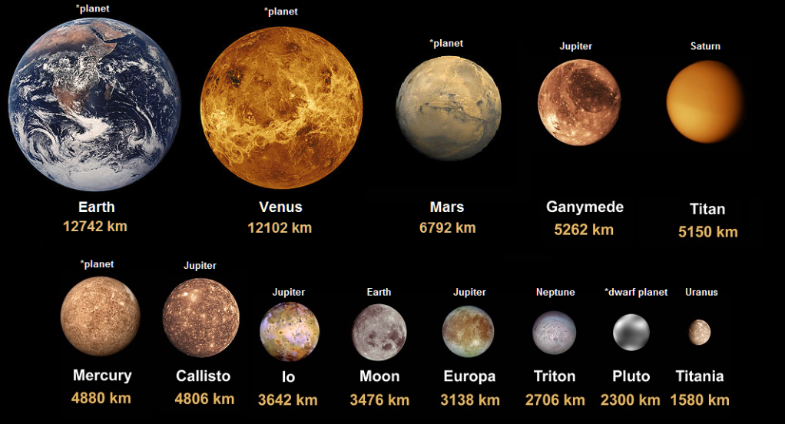
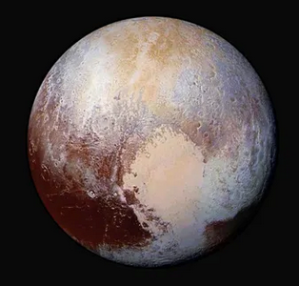
Terrestrials

Slide 17
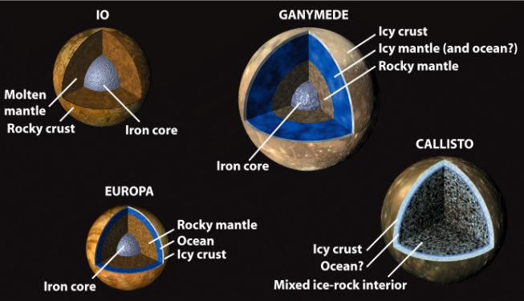
Galileans
ρ = 3.53 … I/MR² = 0.38
1.94 … 0.31
3.02 … 0.35
Earth 5.5 … 0.33
1.85 … 0.36

Slide 18
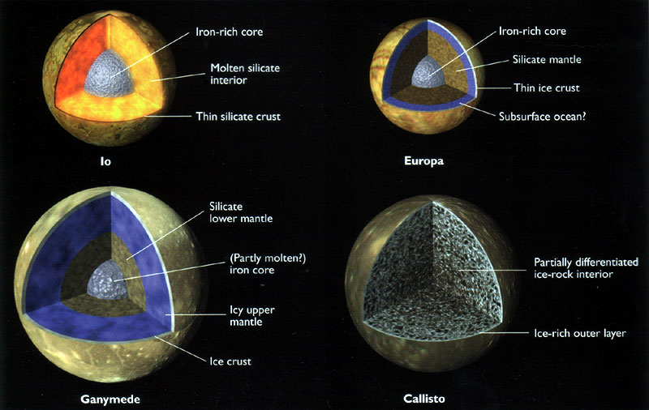
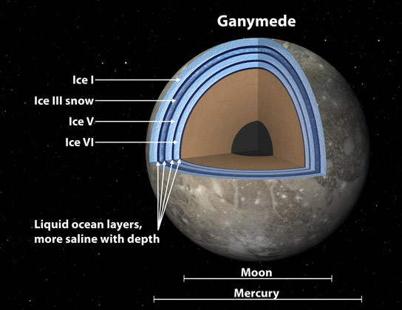
Ganymede

Slide 19
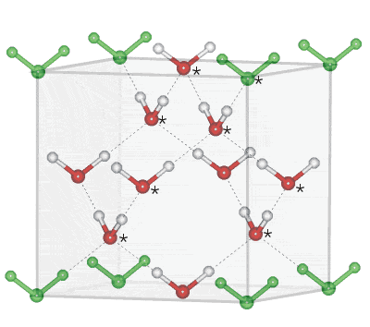
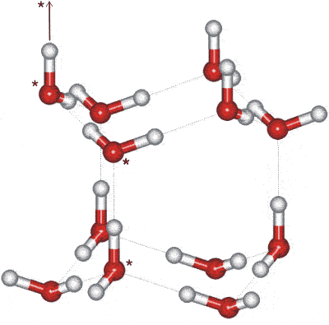
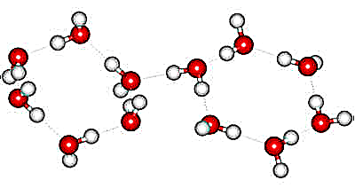
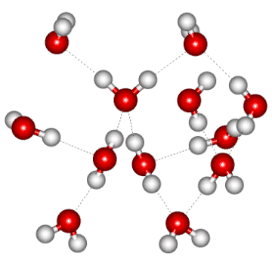
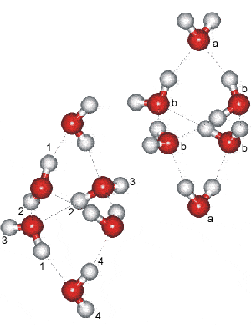
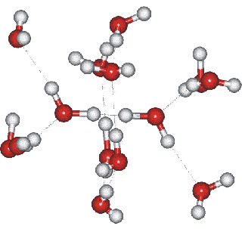
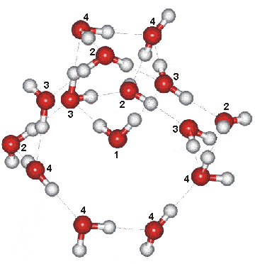
H₂O Ice
Ice Ic Ice Ih Ice II Ice III
up to Ice XXI
Ice IV Ice V Ice VI
Notes:
Ice Ic = cubic ice … Ih = hexagonal ice (natural snow and ice on Earth = snowflakes)
Ice nine is fictional solid polymorph of water from Kurt Vonnegut’s Cat’s Cradle

Slide 20
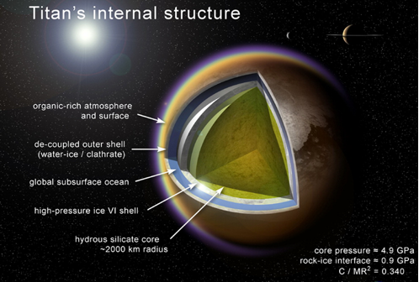
ρ = 1.88 … I/MR² = 0.34

Slide 21
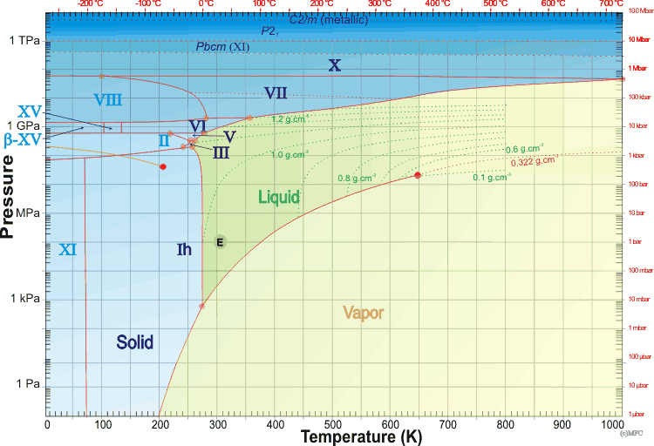
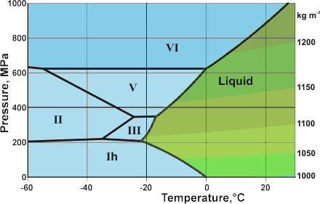
Titan?
V
Ganymede?
M
http://www1.lsbu.ac.uk/water/water_phase_diagram.html

Slide 22
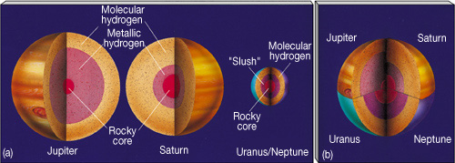
Jovian Interiors
Jovian type 1 “Gas Giants”
Jupiter atm ~ 20% radius is H2 + He
Saturn atm ~ 45% radius is H2 + He
Jovian type 2 “Ice Giants”
Uranus atm ~ 15% radius is H2 + He + CH4
Neptune atm ~ 15% radius is H2 + He + CH4
Super
Soup
-------

Slide 23
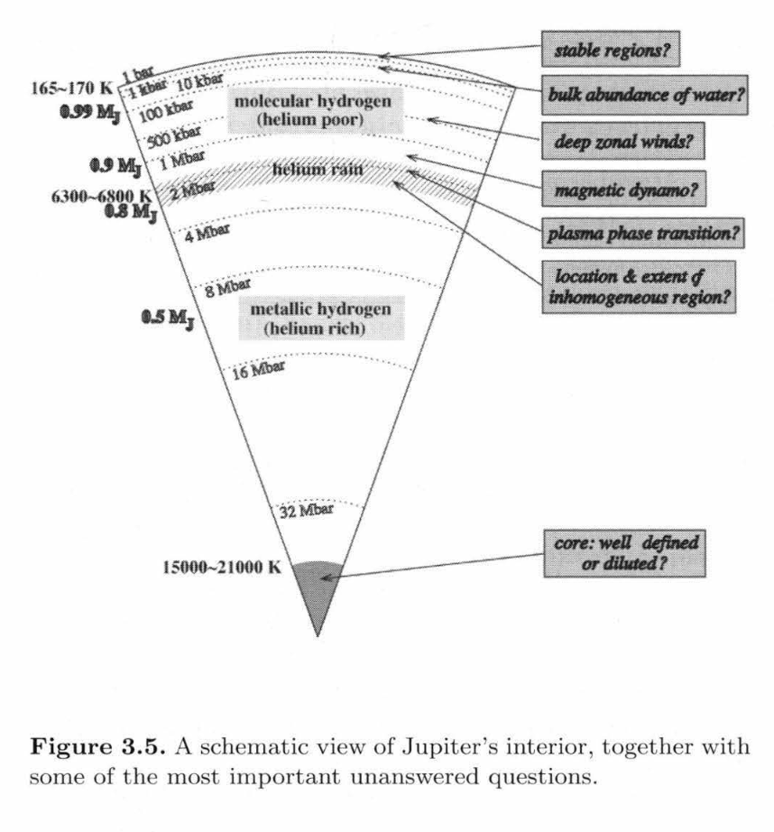
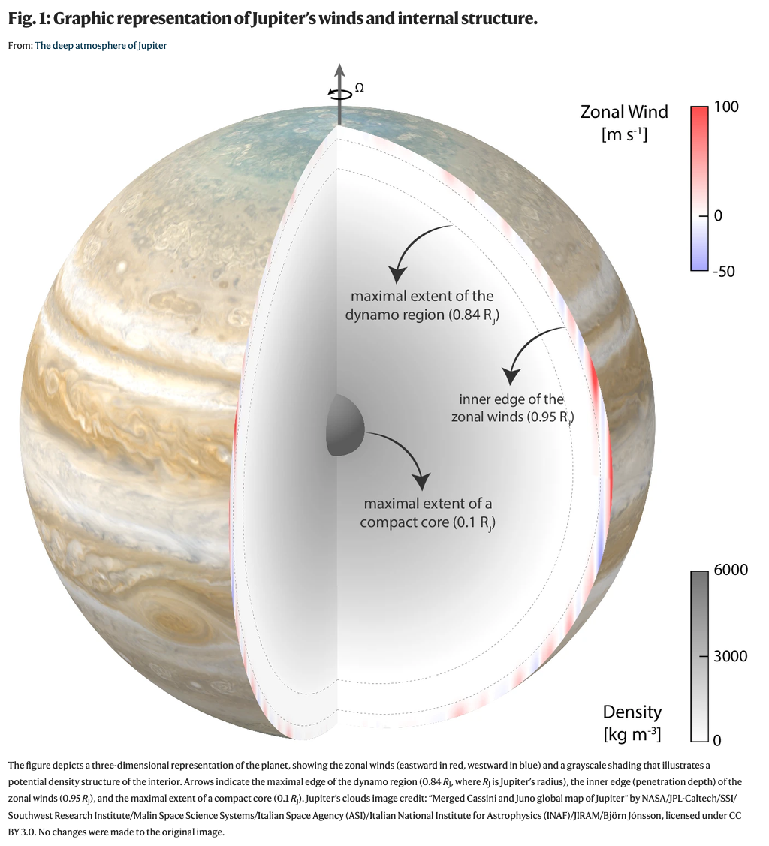
Jovian Interiors

Slide 24
Jovian Interiors: H
hydrogen behavior
temp range: 50-150K at tropopause to 8000-20000K at center
pressure range: 0 bar to 20-80 Mbar at center
< 1 Mbar hydrogen is H2 solid or liquid
> 1 Mbar hydrogen is mixed molecular/atomic
in Jovians
fluid particles closely packed … molecules overlap … e– swap
“molecular metallic hydrogen”
deeper … H2 dissociated … H2 → 2H occurs ~0.80 R in Jup
“atomic metallic hydrogen”
Jup + Sat … convection + spin leads to magnetic fields

Slide 25
Jovian Interiors: He and H₂O
helium behavior
temp and pressure never high enough to go to metallic form
He not fully mixed in Jupiter and Saturn
Saturn has lower temp/pressure than Jupiter,
so less mixed
water behavior
21 different crystalline forms (P,T) conditions
mixtures with trace molecules … conductive fluid
Ura + Nep convection + spin leads to magnetic fields
Notes:
Jupiter may also have He rain

Slide 26
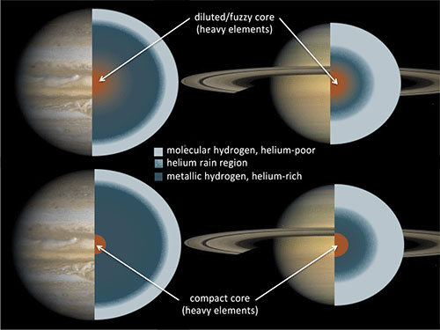
Jupiter + Saturn Interiors
gravitational
instability
core
accretion
Notes:
fuzzy or distinct layers? … unknown
Sketches of the internal structures of Jupiter and Saturn as inferred from structure models. For each planet, two possible structures are shown: one consisting of distinct layers and one with a gradual distribution of heavy elements. The core masses of Jupiter and Saturn are not well constrained; for Saturn, the inhomogeneous region could extend down all the way to the center, resulting in a “helium core.”

Slide 27
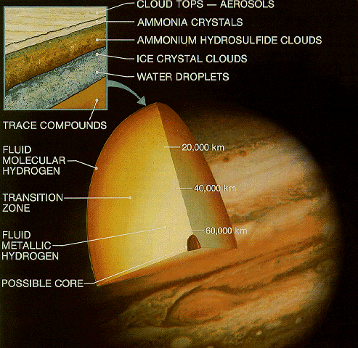
Jupiter Interior
Galileo probe
lasted 57 minutes
156 km deep
reached P = 24 bars
higher T
higher density
less H2O
less He
1 cloud deck

Slide 28
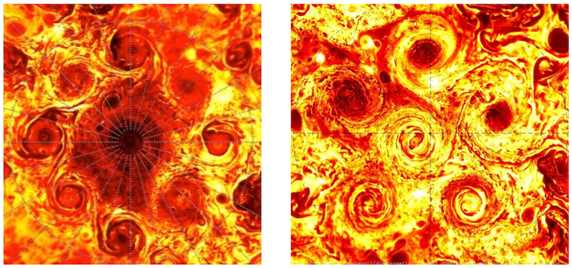
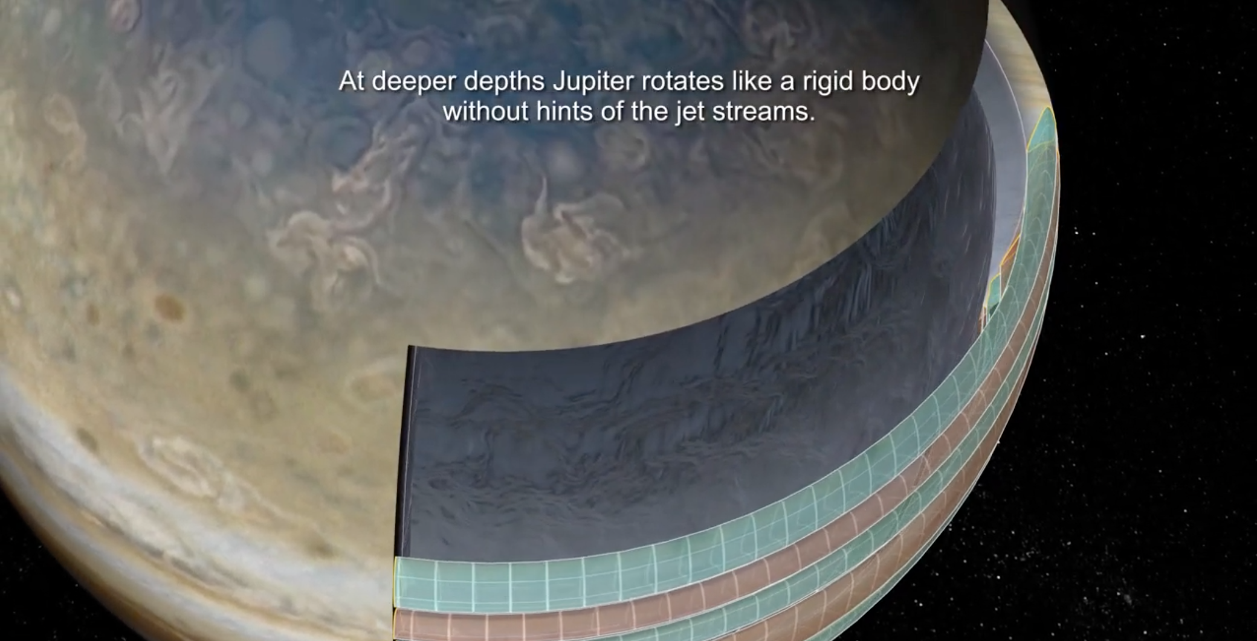
Juno Discoveries at Jupiter
1. clusters of polar cyclones
9 in north, 6 in south … don’t merge
2. asymmetric gravity field
deep flows that transport mass differently in N and S hemispheres
3. deeply organized “jetstream” stripes
belts and zones are 3000 km thick, include 1% of Jupiter’s mass
4. rotates like a solid planet
below the stripes, rotates as solid from pole-to-pole
electric+magnetic forces cause enough drag to stop differential rotation
north south
Notes:
https://www.youtube.com/watch?v=hF0UjhPSS3A&feature=youtu.be … already shown earlier in course

Slide 29
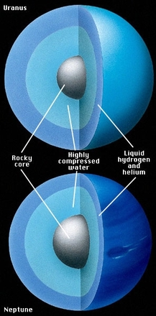
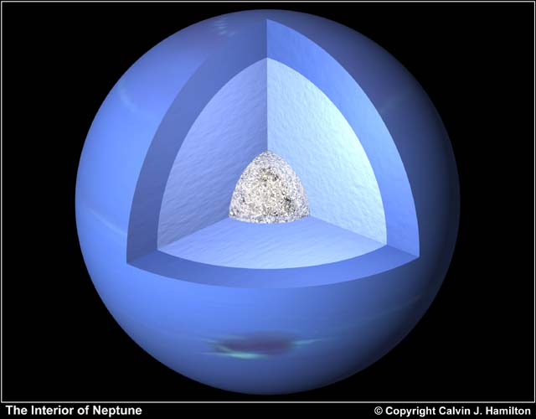
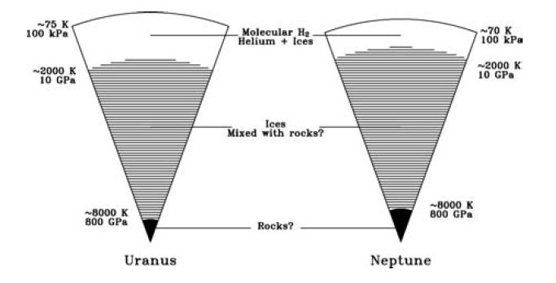
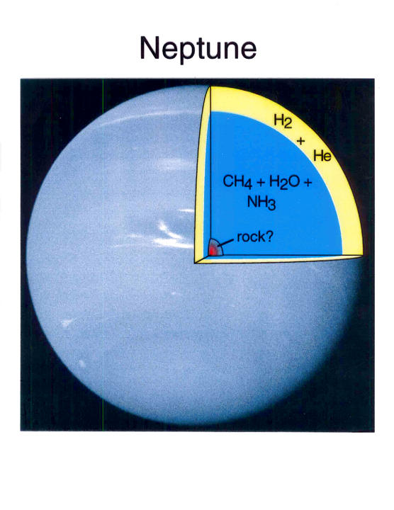
Ice Giant Interiors
lower pressures
than Jup + Sat
…
no metallic H

Slide 30
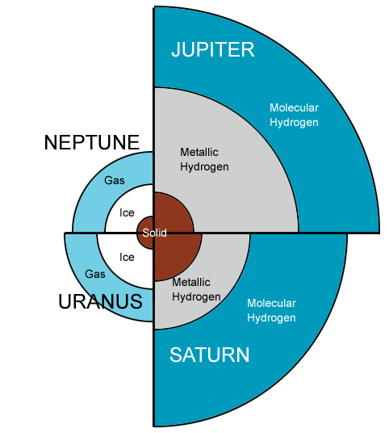
Giant Planet Interiors
Key Points:
molecules on top of atoms
Sat is puffier than Jup
Ura + Nep have ices instead of metallic H
fuzzy or layered interiors unknown
cores uncertain

Slide 31
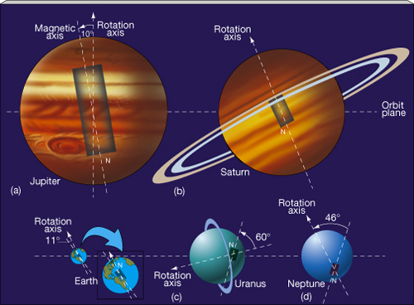
Solar System Magnetic Fields

Slide 32
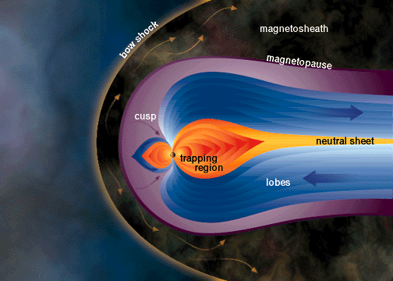
Jupiter’s Giant Magnetosphere
o
o
o
o

Slide 33
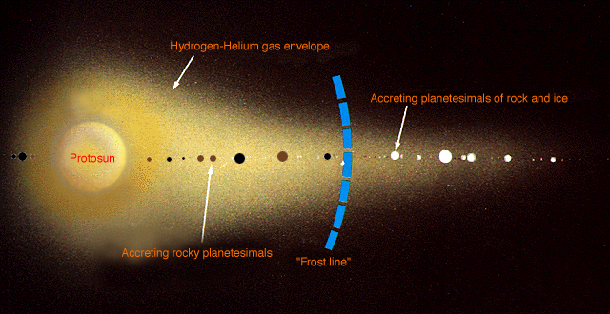
Planets in Solar Systems
Ni Fe SiO Mg FeS FeO H2O NH3 CH4 N2

Slide 34
Solar System Explorers 15 OCT
Name a location in the Solar System where surface processing is/was occurring.
Each process can be used only once. Describe how that surface is or was
reprocessed, e.g. Earth’s land mass coastlines change because of liquid H₂O.
1. Mars wind erosion from dust forms makes dunes
2. Earth has plate tectonics that recycle crust
3. Phoebe makes ring of debris that lands as black snow on Phoebe
4. Moon’s regolith from micrometeorites
5. Earth has life that affect the surface … limestone … stupid humans paving everything changing albedo
6. Europa has chaotic terrain where icebergs refreeze
7. Mercury is contracting and wrinkling as it cools
8. Earth has ice sheets/glaciers that make 10000 lakes in Zach’s home state
9. Mercury has weird terrain opposite to the Caloris impact
10. Sun has differential rotation on the surface
11. Eris has an eccentric orbit so its atmosphere N2/CH4 collapses/refreezes, ergo deposition
12. Venus has pancake structures due to leakage
13. Triton has cantaloupe terrain cracking/refreezing cycles
14. Arrokoth has radiation converting methanol, etc., to tholins
15.
16.
17.
18.
19.
20.

Slide 35
…………………………
Notes:
35

Slide 36
Solar System Explorers Boo! Day
Describe an observation that yields information about a particular world’s interior, e.g. seismic data on Earth tell us that the size of the solid core is 1200 km.
1. Europa has ice cracks indicating liquid below
2. Enceladus has plumes at south pole indicating liquid below
3. Io is inside out giving clues about interior composition
4. Earth has a 12 km hole and it got hot
5. Earth’s iron grain alignment tells us for how long we had mag field and that it flips
6. Mercury mag field indicates Fe turns from liquid to solid at a boundary
7. Callisto has a partially differentiated core because of magnetic presence
8. Jupiter had metallic stuff that rotates fast generating a mag field
9. Mercury has weird terrain indicating core size (?) that focused impact waves
10. Pluto has fractures and volcanoes indicate possible past internal heat source
11. Moon/Mars seismometers tell us about core size
12. Haumea is not a place where you should drink too much water …
13.
14.
15.
16.
17.
18.
19.
20.

Slide 37
Solar System Explorers: 07 NOV
Name a minor body (no satellites) with an orbital semimajor axis greater than Mars’ (1.52 AU) and describe three of its physical characteristics, e.g., Hektor is ~400x200x200km in size, has density 1.0-2.4 g/cm³ and albedo 0.02-0.11.
1. …
2. …
3. …
4. …
5. …
6. …
7. …
8. …
9. …
10. …
11. …
12. …
13. …
14. …
15. …
16. …
17. …
18. …
19. …
20. …

