Slide 1
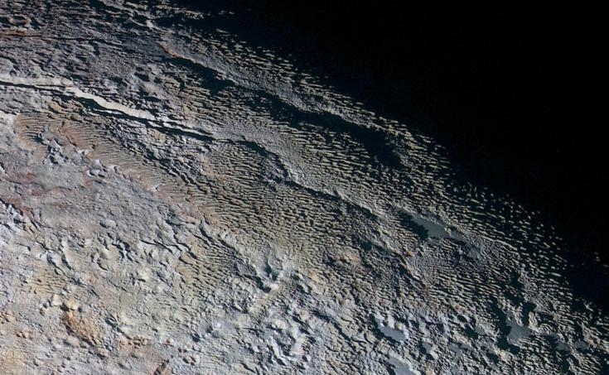
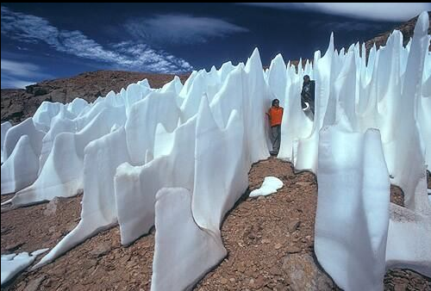
Where is this?
penitentes … only on Earth and Pluto
Notes:
Penitente
Snakeskin Terrain on Pluto: In this extended color image of Pluto taken by NASA's New Horizons spacecraft, rounded and bizarrely textured mountains, informally named the Tartarus Dorsa, rise up along Pluto's day-night terminator and show intricate but puzzling patterns of blue-gray ridges and reddish material in between. This view, roughly 330 miles (530 kilometers) across, combines blue, red and infrared images taken by the Ralph/Multispectral Visual Imaging Camera (MVIC) on July 14, 2015, and resolves details and colors on scales as small as 0.8 miles (1.3 kilometers).
The Penitentes are tall thin blades of hardened snow formation that points towards the direction of the sun. They form when the sun's rays turn snow directly into water vapor without melting it first, a process called sublimation. Penitentes are spikes of snow that form typically only in high-altitude areas, like Chile's Atacama Desert. They can get as tall as 20 feet in the right conditions. Their name comes from their resemblance to a group of monks who wear spiky hats.

Slide 2


Slide 3
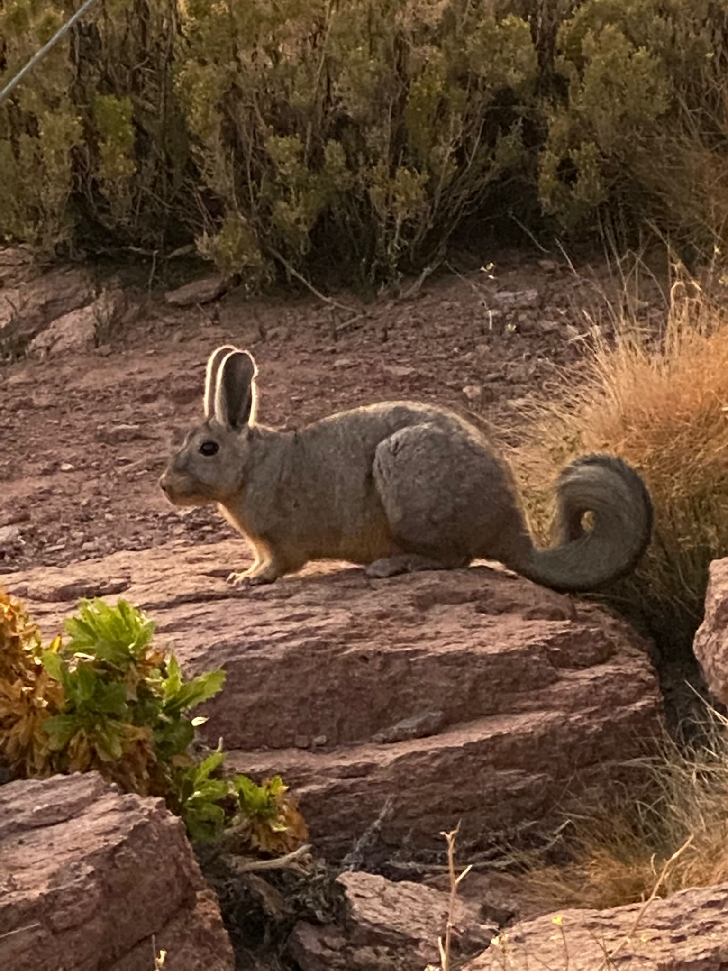
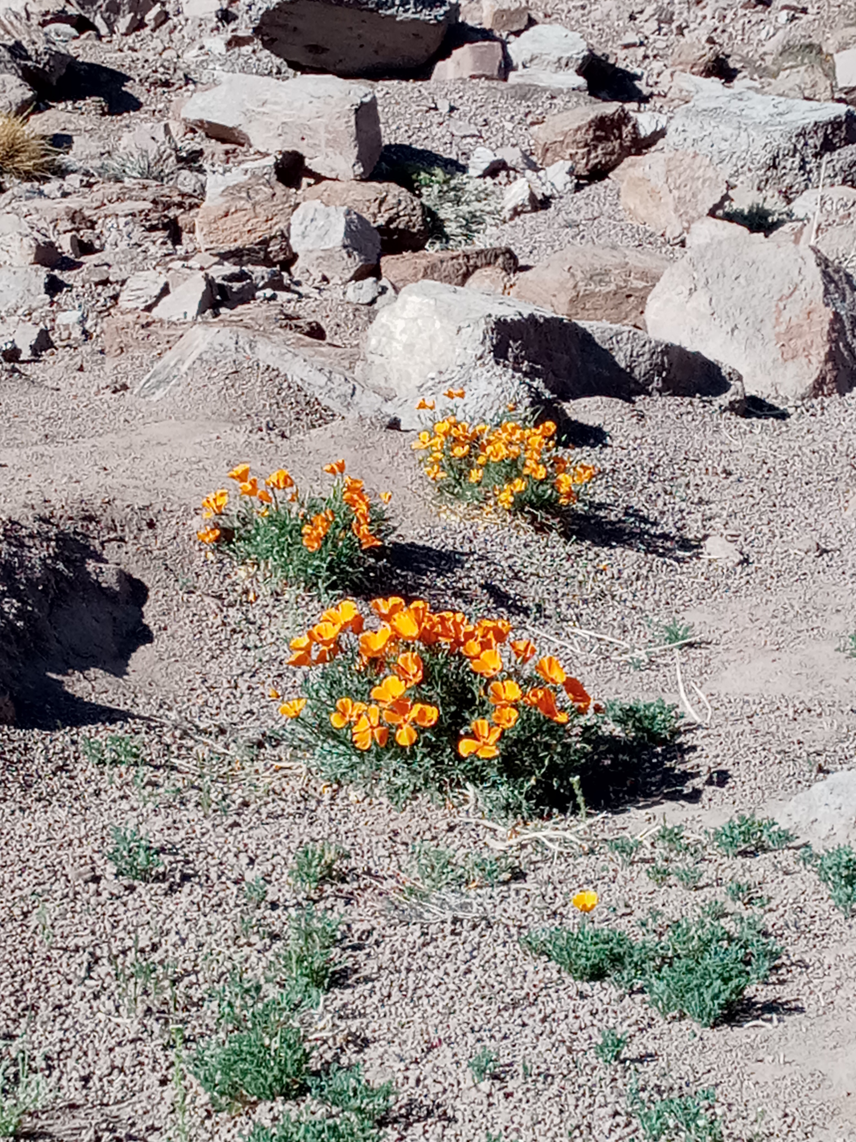

Slide 4

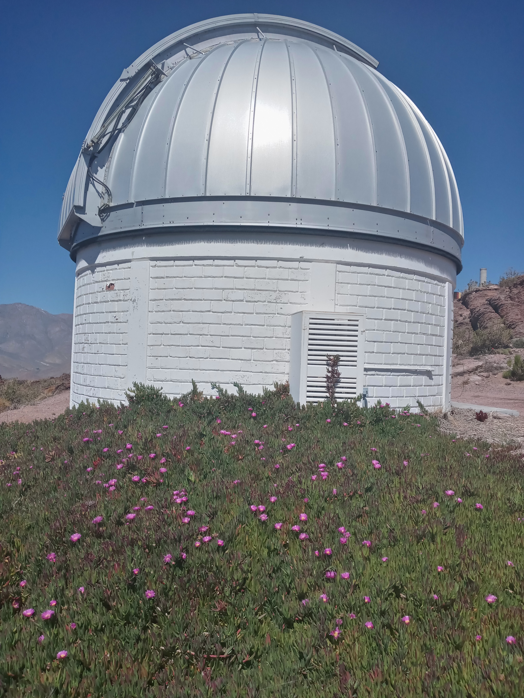

Slide 5
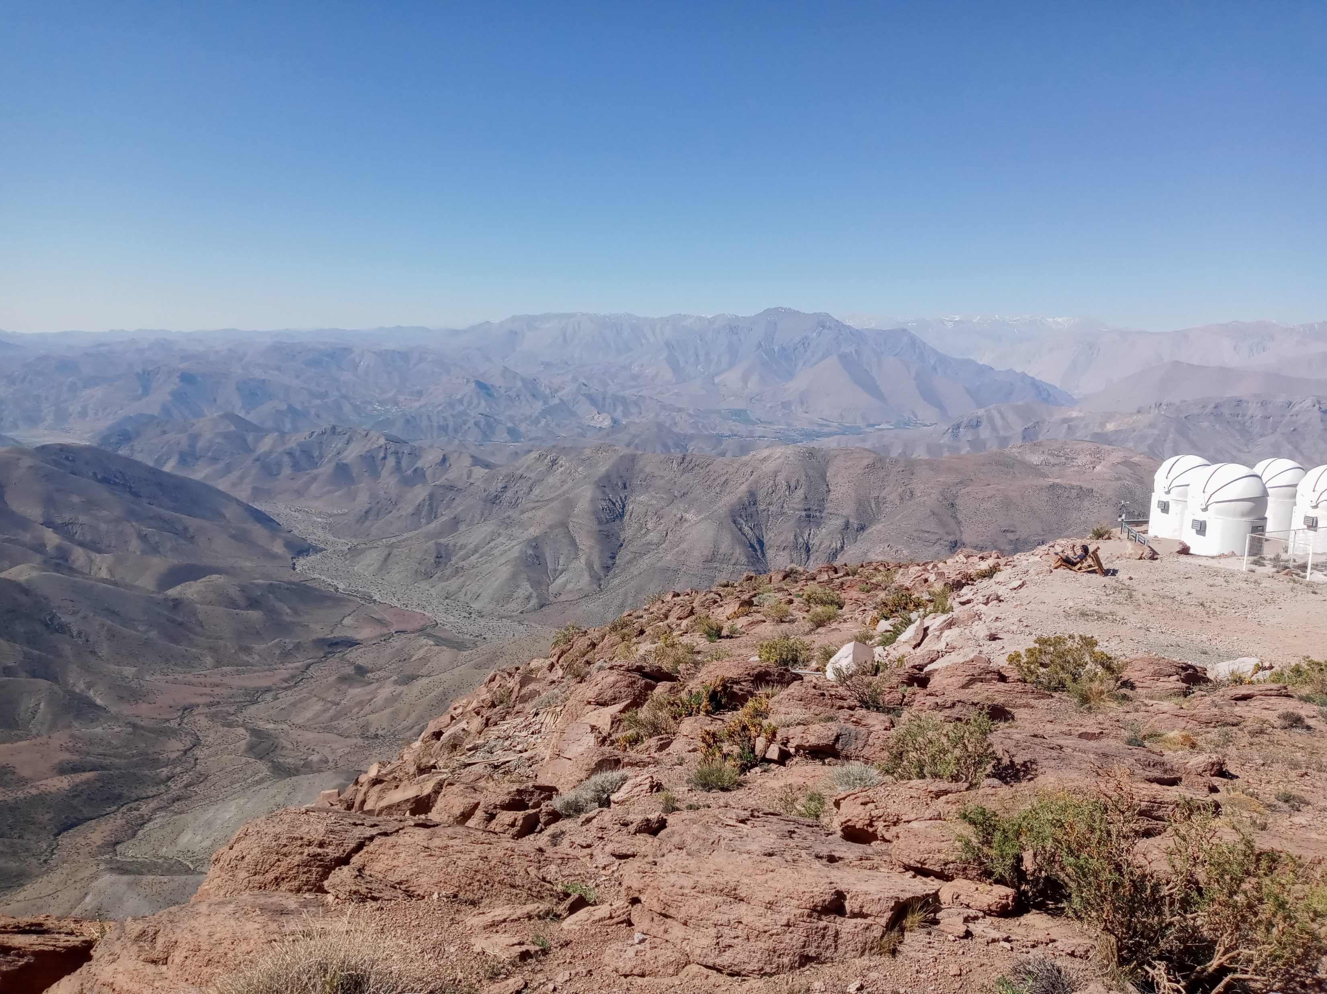


Slide 6
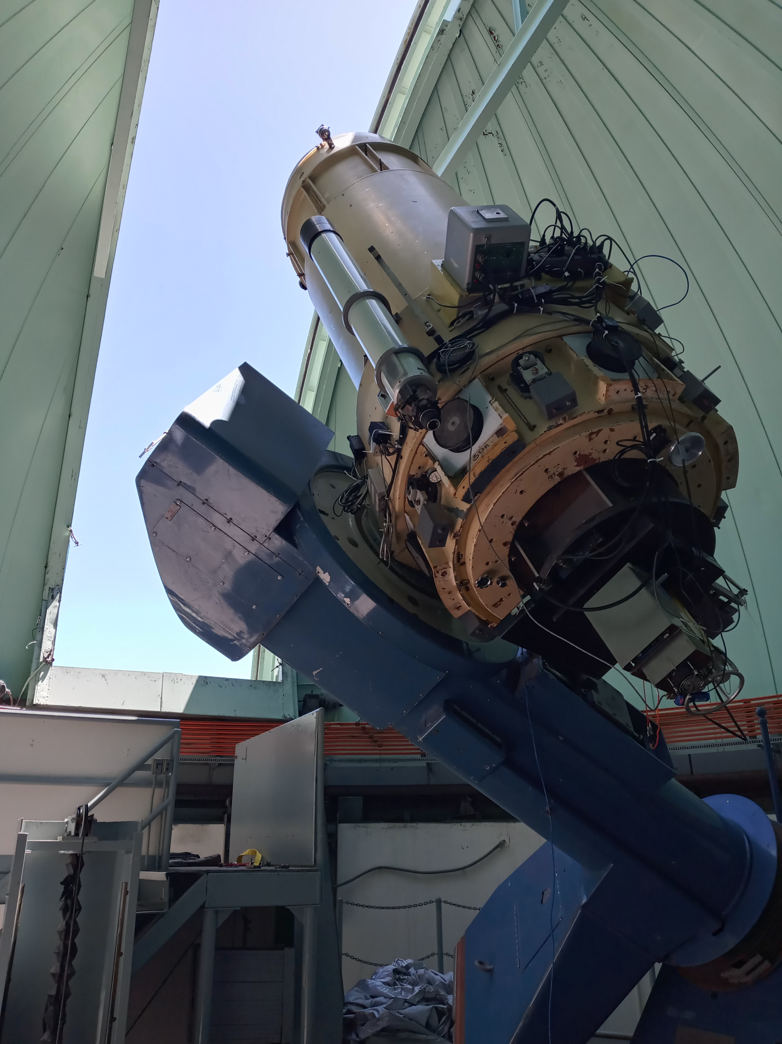
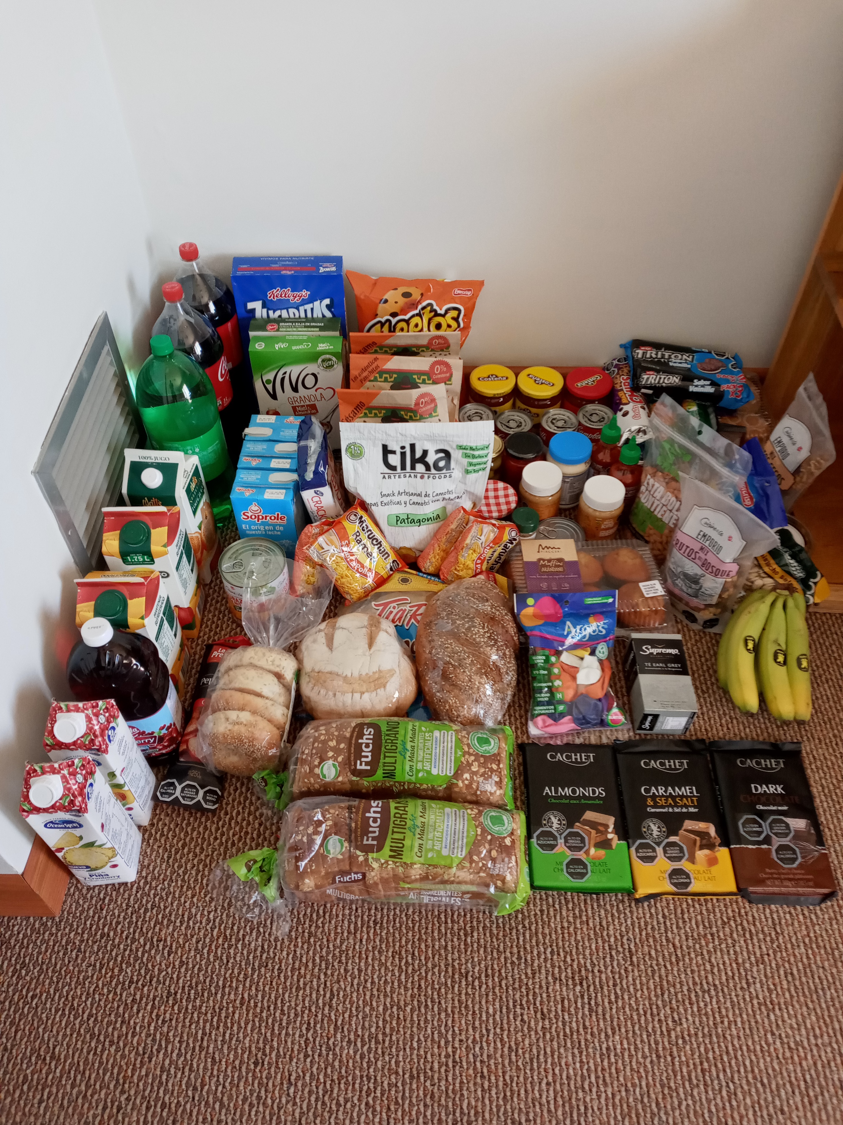

Slide 7
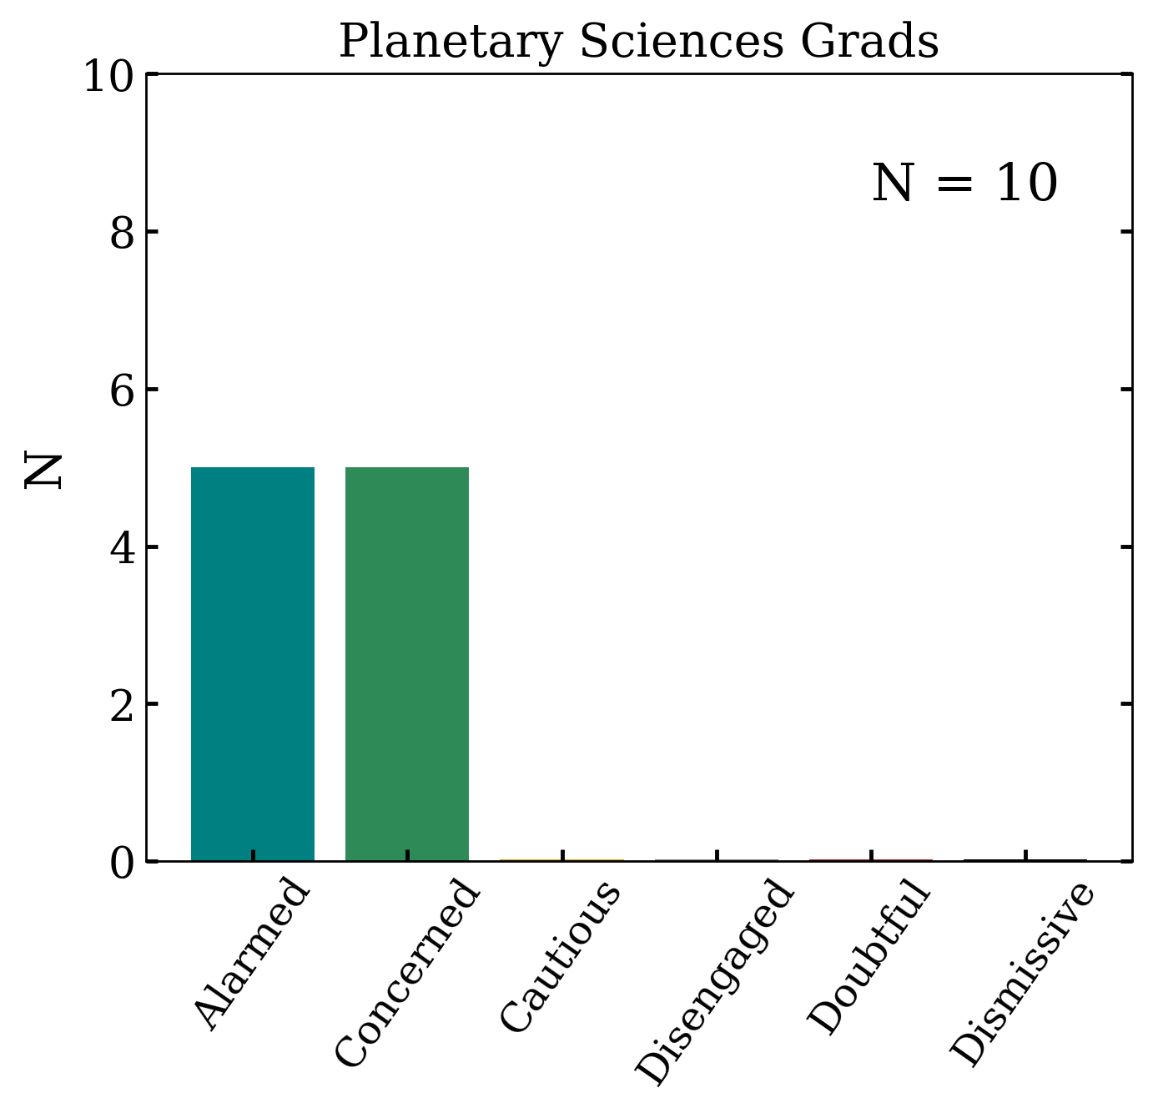
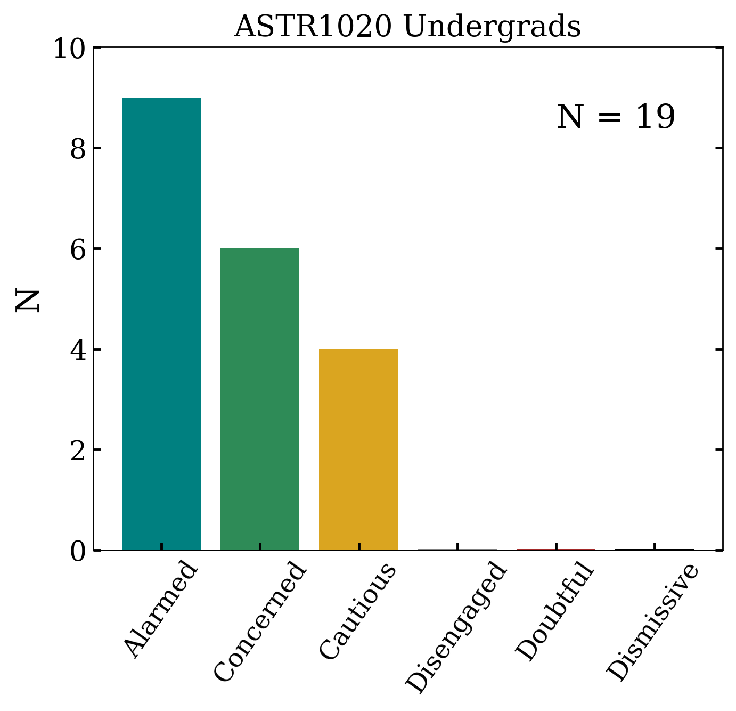
Climate Change Survey

Slide 8
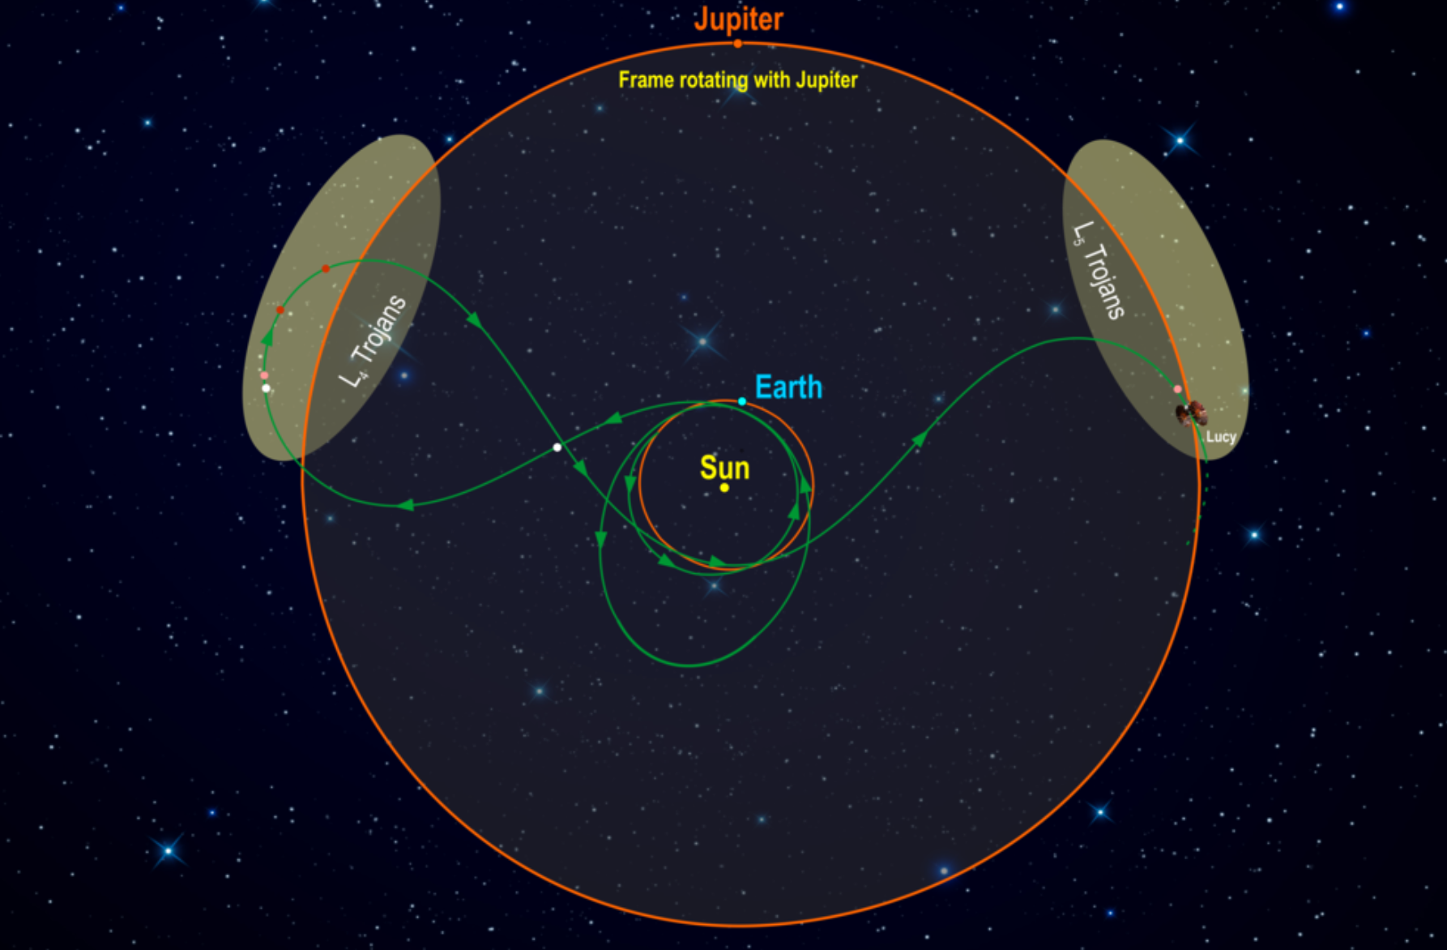
Lucy Mission to Greeks+Trojans
launched 2021 … encounters 2025-2033 … 1 asteroid + 5 Greeks + 2 Trojans

Slide 9
Solar System Explorers: Thu 11/04
Name a minor body (no satellites) with an orbital semimajor axis greater than Mars’ (1.52 AU) and describe three of its physical characteristics, e.g., Hektor is ~400x200x200km in size, has density 1.0-2.4 g/cm³ and albedo 0.02-0.11.
1. …
2. …
3. …
4. …
5. …
6. …
7. …
8. …
9. …
10. …
11. …
12. …
13. …
14. …
15. …
16. …
17. …
18. …
19. …
20. …

Slide 10
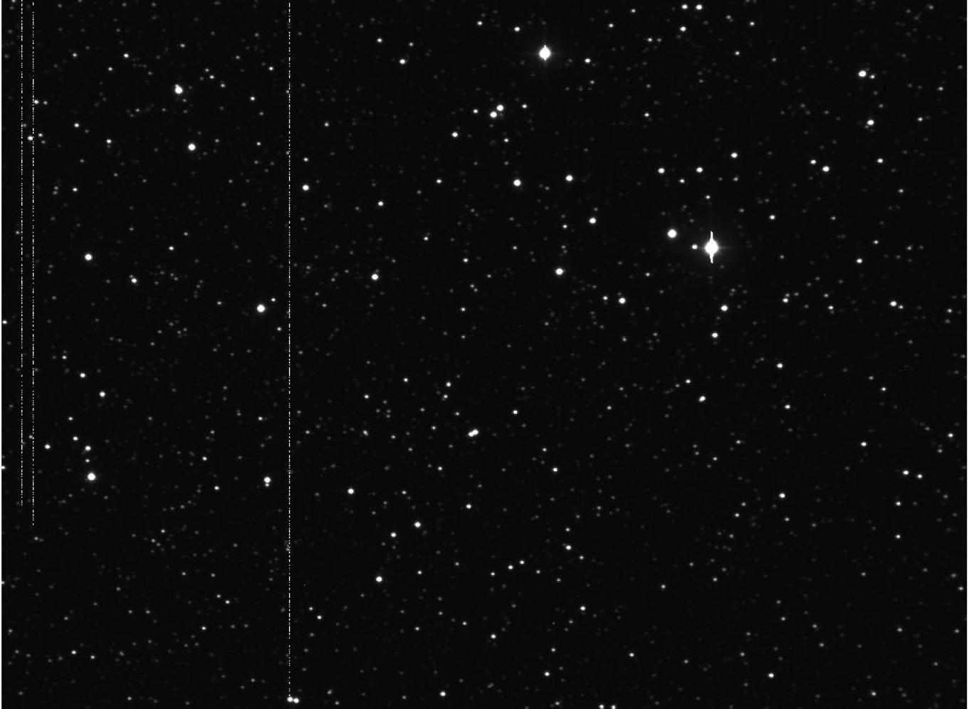
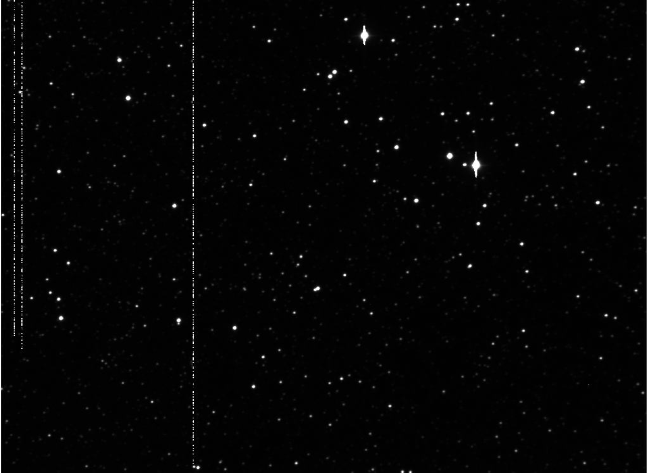
Minor Bodies
beyond Jupiter
contributions
by Nic Scott
Notes:
blink comparator ^ look here, up and left of double blip
I think this is Pluto …

Slide 11
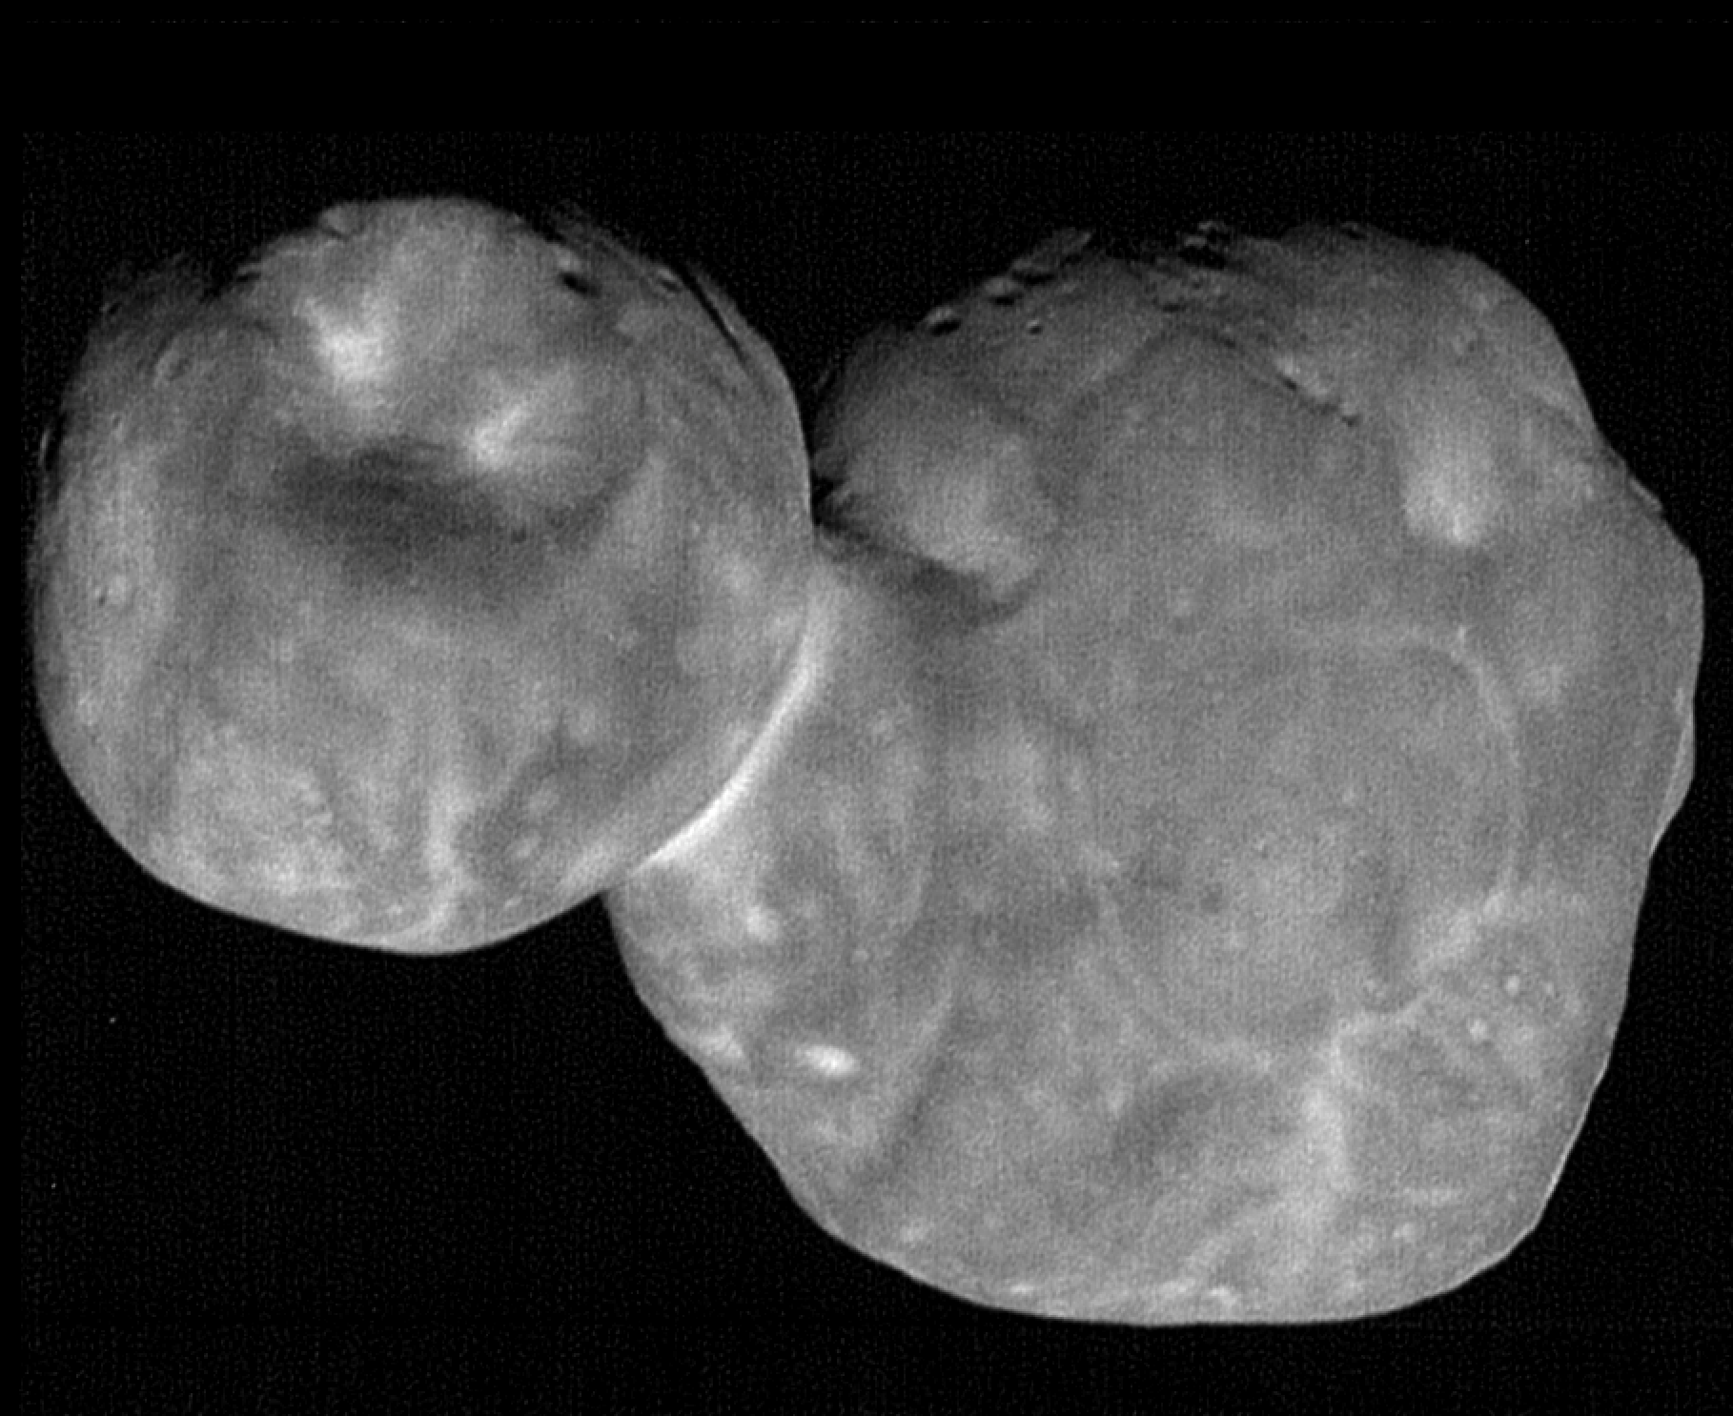
Minor Bodies
beyond Jupiter
486958 Arrokoth (Ultima Thule)

Slide 12
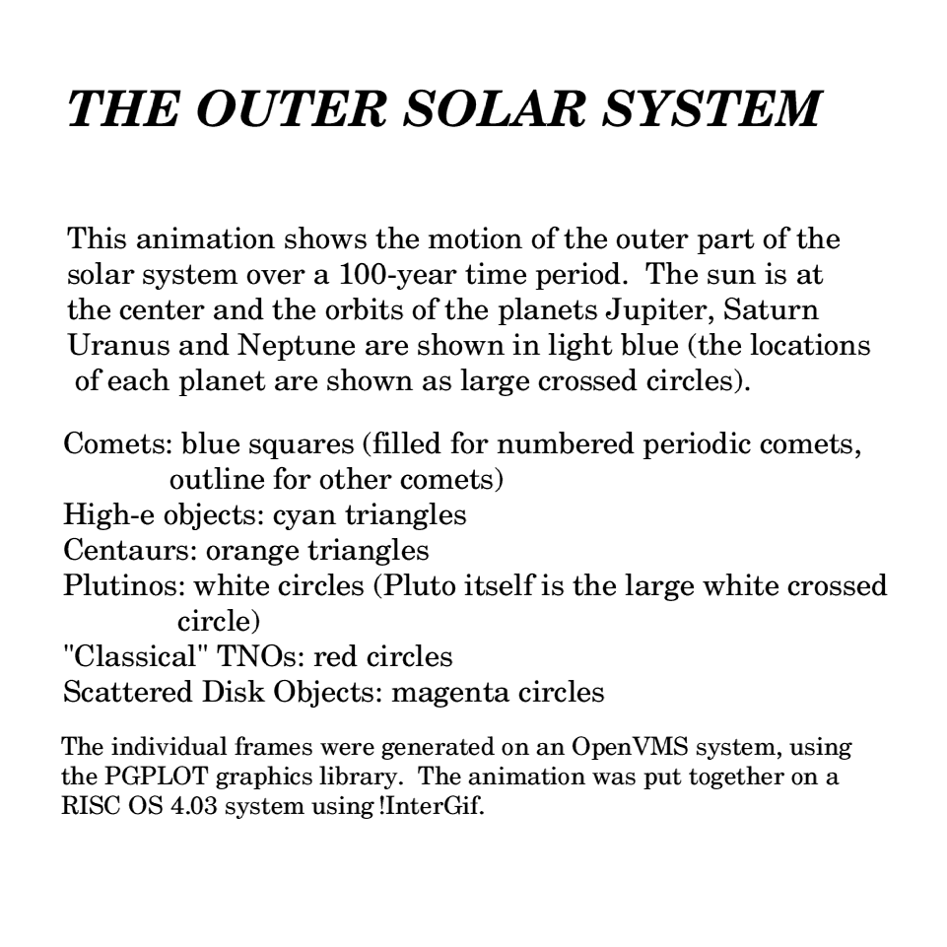
100 Years
Orange: Centaurs
Blue Box: Comets
Filled Box: JupComets
White Circle: Plutinos
Red Circle: TNOs
Magenta Circle: SDOs
Notes:
cyan triangles = Damocloids

Slide 13
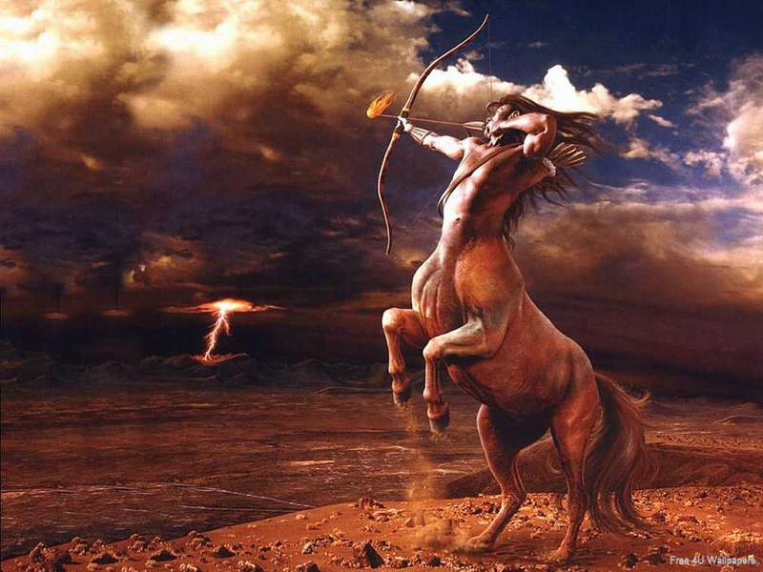
Centaurs

Slide 14
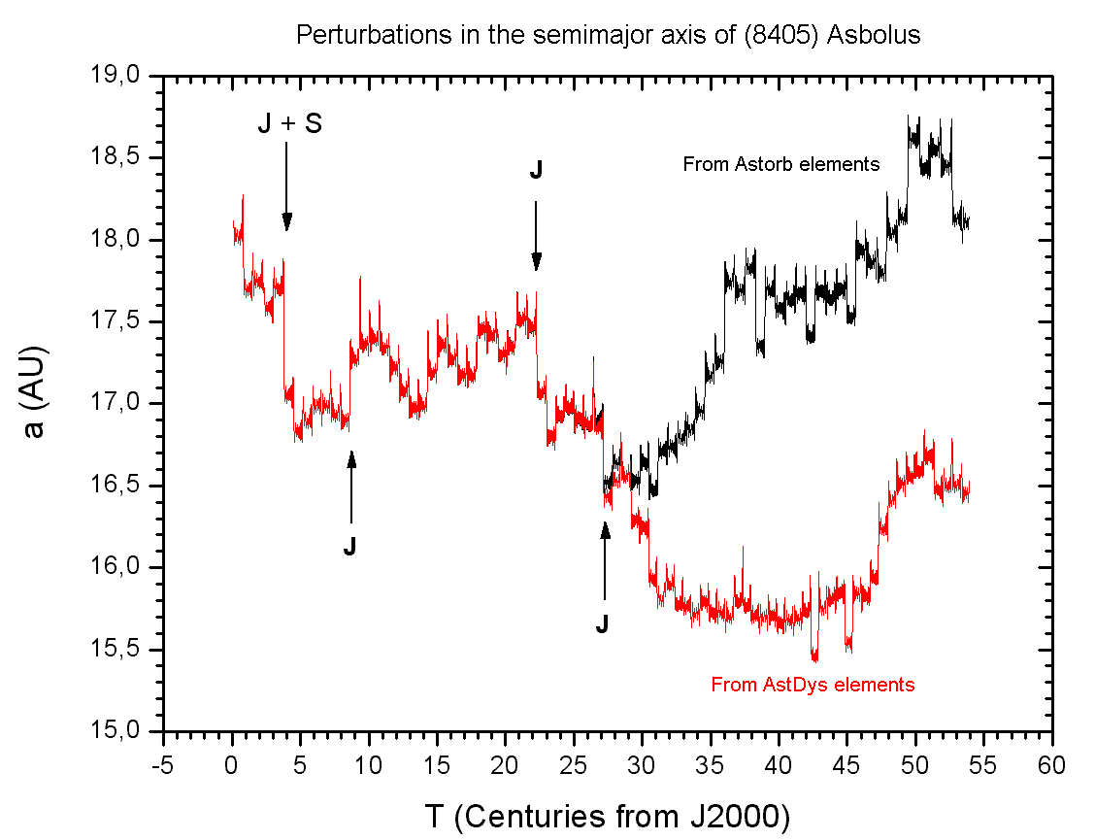
Centaurs
definition a = 5 to 30 AU … not in a 1:1 resonance with any planet
first discovered Hidalgo (1920) … Chiron (1977) --- rings
largest Chariklo (260 km) --- rings
population 677 (JPL 2022 OCT 26)
orbits typically stable
for only
a few million years
Notes:
dynamical classification
Hidalgo discovered first but not identified as part of new population of objects
Chiron and Chariklo both likely to have rings
Stansberry 2007
http://chemistry.unina.it/~alvitagl/solex/AsbolA.GIF

Slide 15
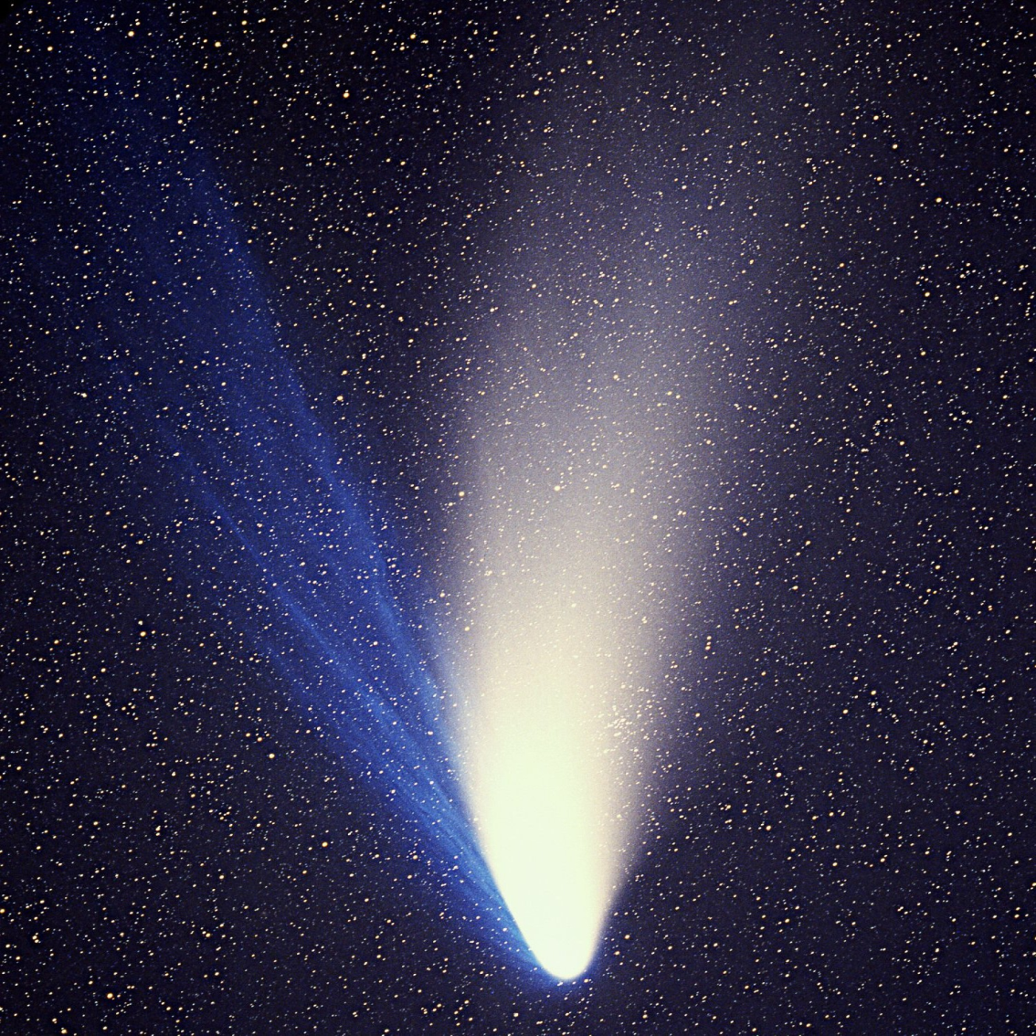
Comets
definition
an object for which a coma or
tail has been observed
careful …
Main Belt Comets
Centaurs
first recorded: Halley’s 239 BCE
largest: Hale-Bopp (60km)
Jupiter family comets: 765
Total population: 3835
(JPL 2022 OCT 26)
Hale-Bopp (1997)
JPL MBDB 3/12/12
Notes:
populations as of 3/8/2017

Slide 16
“TNOs” or “KBOs”
Kuiper’s original prediction: objects were scattered to the Oort cloud by Earth-sized Pluto
did not think the objects presently existed
Edgeworth, Leonard, Whipple, et al. made similarly vague claims
none made accurate, precise predictions
observations do not support a single class of objects

Slide 17
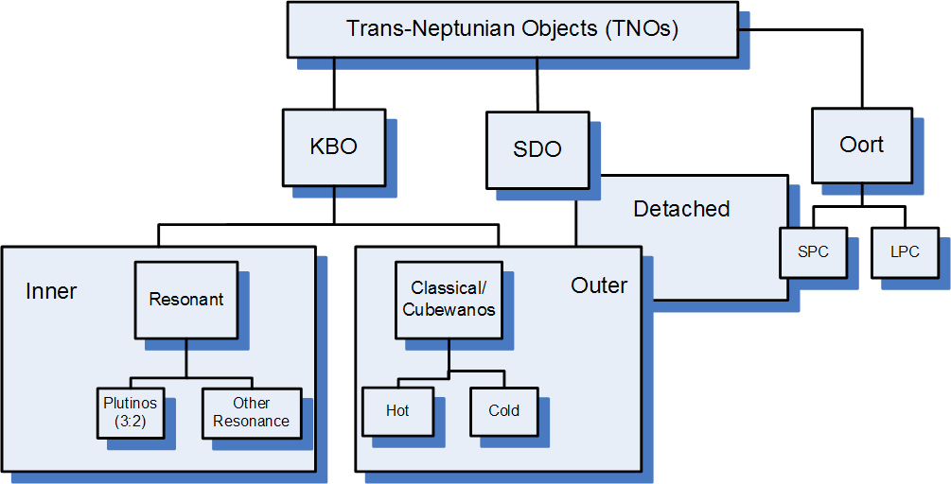
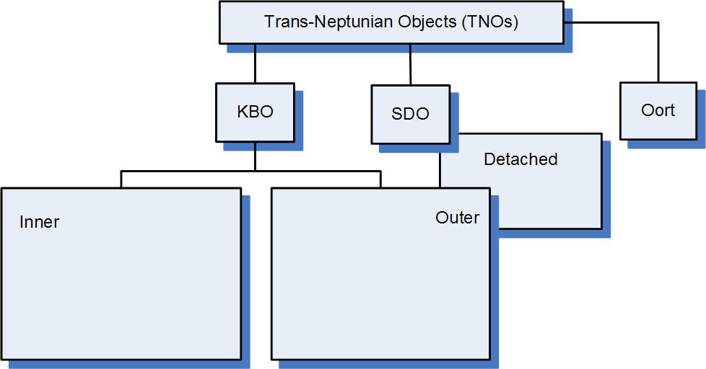
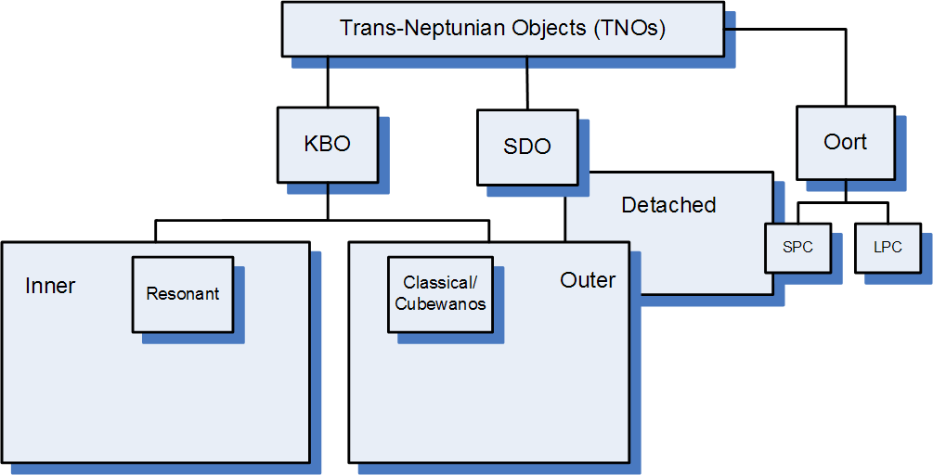
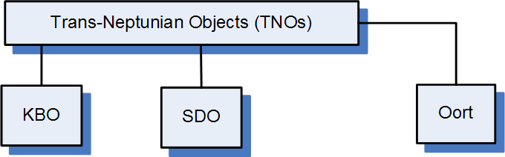
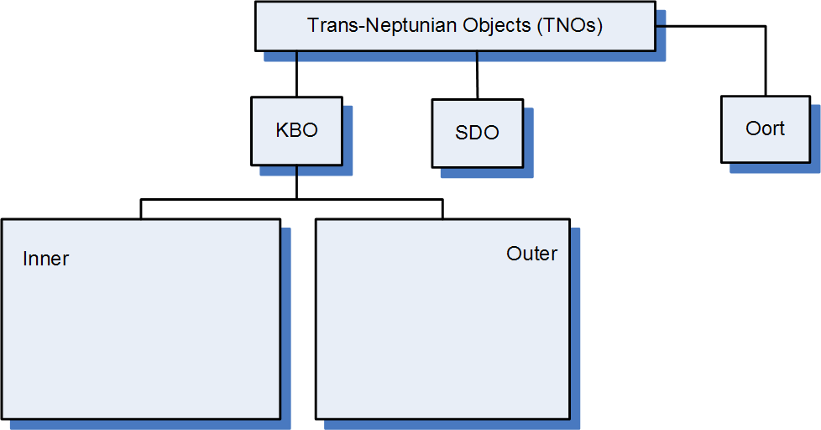
Notes:
Plutoids: dwarf planets beyond Neptune
SPC/LPC = short/long period comets
Cubwanos from 1993 QB1

Slide 18
SSE!
first 5 answers get +1 point
(limit 1 per customer)
Name any TNOs
other than Pluto and Arrokoth (and Triton).

Slide 19
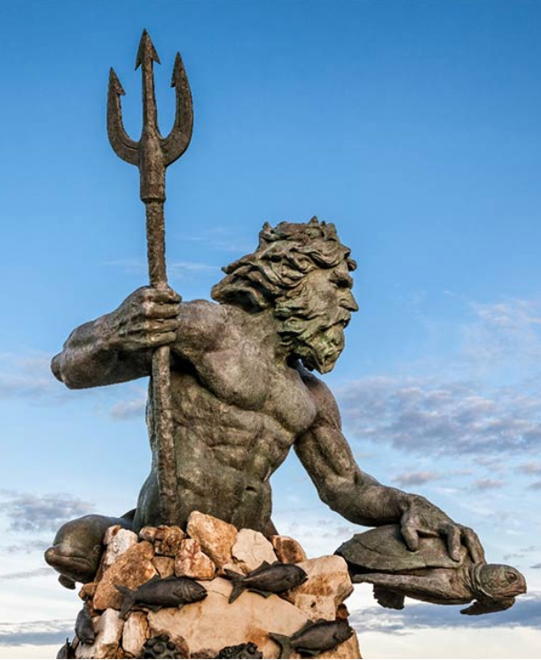
Trans-Neptunian Objects
Pluto disc. 1930 … Charon disc. 1977
QB₁ (Albion) disc. 1992 … Eris disc. 2003
a > 30 AU, most have perihelion > 30 AU
various dynamical classes
torus 10 AU thick at 50 AU (not disk)
source of Centaurs, Jupiter (short period) comets, some outer moons
4210 known (JPL 2022 OCT 26)
70,000+ > 100 km thought to exist (Jewitt)
> 4% multiplicity
volatile ices that survived formation epoch 4.5 Gyr ago … diverse spectra … some atm

Slide 20
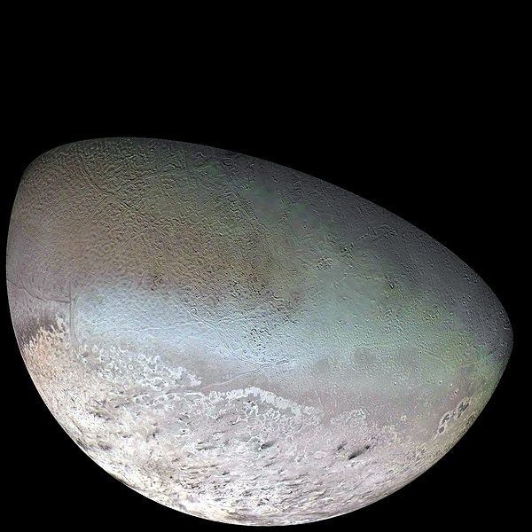
Triton
  retrograde orbit … captured during Neptune’s migration?
  density 2.06 g/cm³
  40% surface imaged … 60% silicates, 40% ices
  T ~ 40K (variable)
  cryovolcanism, “subsurface greenhouse effect”
    clear ice over dark substrate, 4K increase could produce 8 km plumes lasting 1+ yr
    (Soderblom et al. 1990)
  plumes make dark deposits, N₂ winds
  photolysis produced hydrocarbons

Slide 21
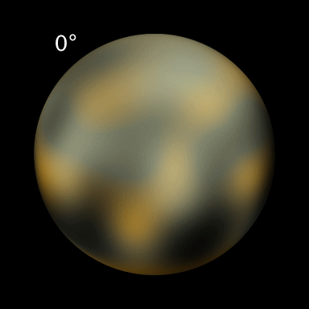
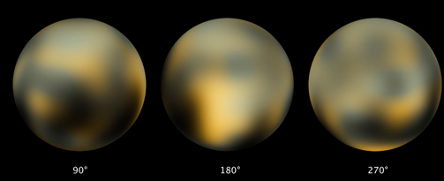
Pluto
Pluto + Charon ~ 20% mass of Moon
Pluto 1.86 g/cm³ … Charon 1.70 g/cm³
5 moons in system … formed by glancing impact?
not isothermal (T ~ 30-60K)
CH₄ + N₂ atmosphere ~1-30 microbar and shifts
low gravity … rapid atmospheric hydrodynamic escape
steep drop in occultation flux near surface … haze
uneven albedo
bright: N₂, CH₄, H₂O, CO ices
cryovolcanism?
dark: tholins?
UV processed N2 + CH₄
seasonal deposits?
Notes:
1ubar at 1250km radius
higher temp (~100K) in upper atmosphere
methane snow?

Slide 22
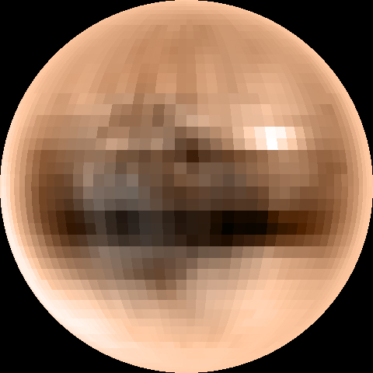
True Color Pluto (Young et al. 2001)

Slide 23
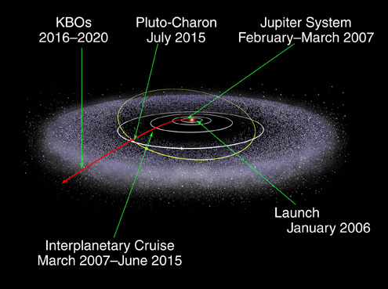
New Horizons

Slide 24
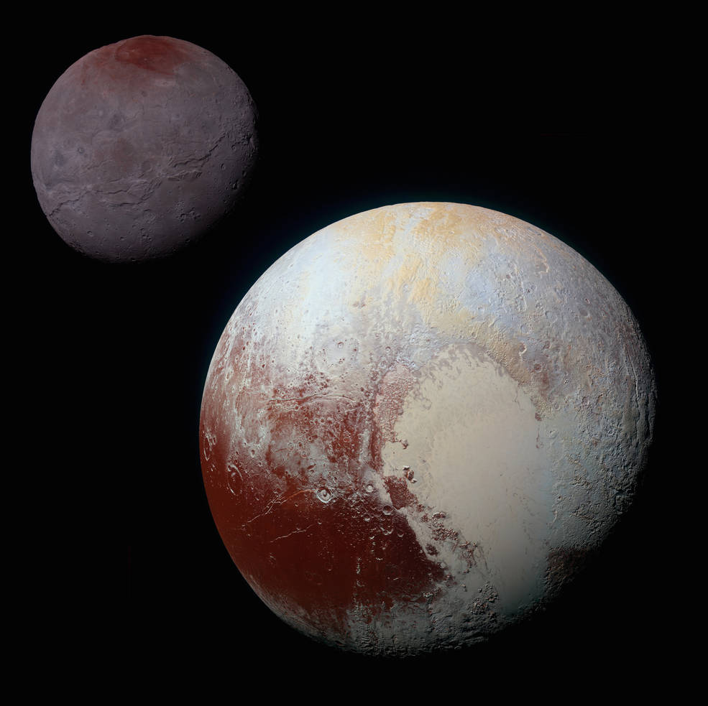
composite image
Pluto movie: https://www.youtube.com/watch?v=6l4kr36TzQ4&vl=en
Notes:
definitely play the movie … great stuff
likely won’t finish slides if you play this

Slide 25
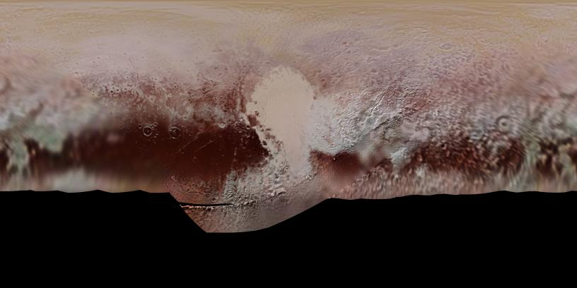
Pluto Map
no data

Slide 26
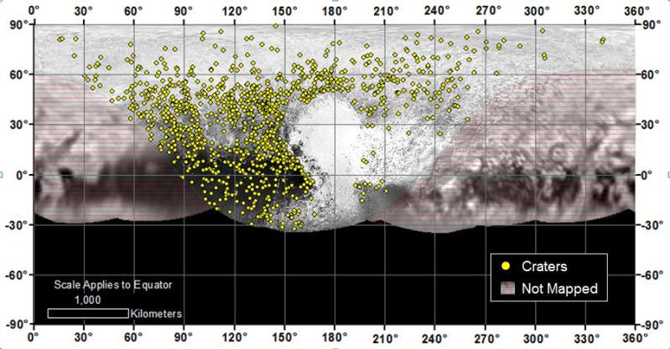
Pluto Map
no data

Slide 27
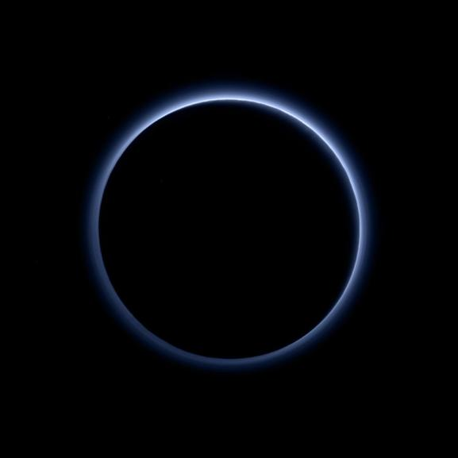
Pluto’s Atmosphere
as human eye
would see it
sunlight acting on N₂ + CH₄ → tholins
Notes:
Pluto's haze layer shows its blue color in this picture taken by the New Horizons Ralph/Multispectral Visible Imaging Camera (MVIC). The high-altitude haze is thought to be similar in nature to that seen at Saturn's moon Titan. The source of both hazes likely involves sunlight-initiated chemical reactions of nitrogen and methane, leading to relatively small, soot-like particles (called tholins) that grow as they settle toward the surface. This image was generated by software that combines information from blue, red and near-infrared images to replicate the color a human eye would perceive as closely as possible.

Slide 28
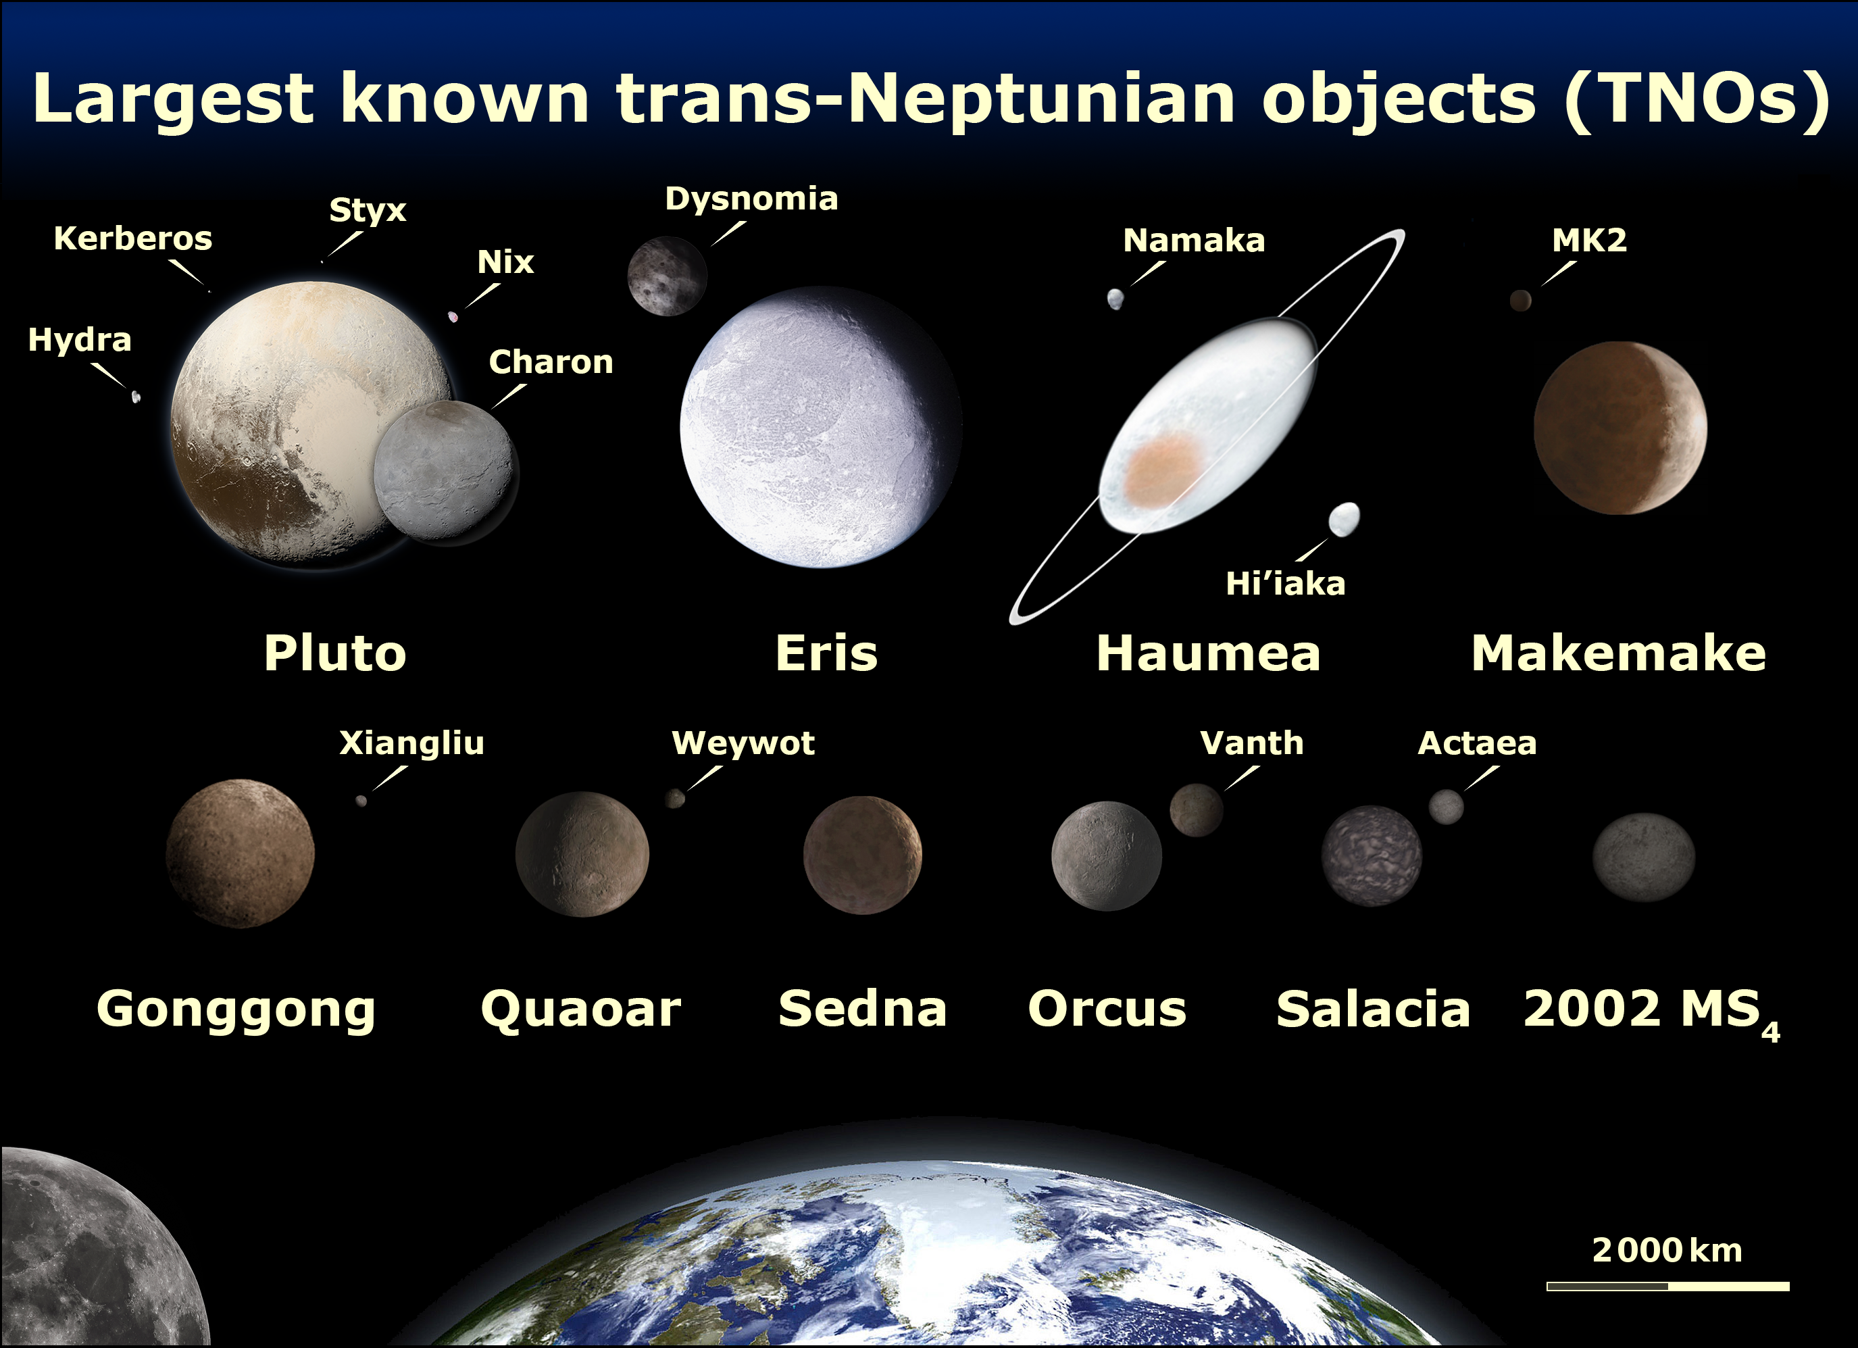
Notes:
Moon is 1.47X the diameter of Pluto

Slide 29


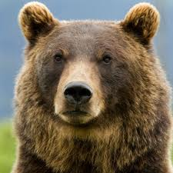

TNO Classes
Resonant Objects linked to Neptune
Classical KBOs orbit roughly where they formed
Scattered Disk Objects flung out by Jovian planets
Detached Objects unaffected by Neptune

Slide 30
Notes:
Plutoids: dwarf planets beyond Neptune
SPC/LPC = short/long period comets
Cubwanos from 1993 QB1

Slide 31
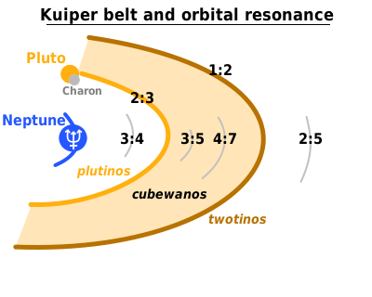
1. Resonant Objects
mean motion resonance with Neptune
“Plutinos” at 2:3
dynamically stable
Notes:
Pluto’s longitude of perihelion is separated from Neptune by 90 deg
what about the Tostinos?

Slide 32
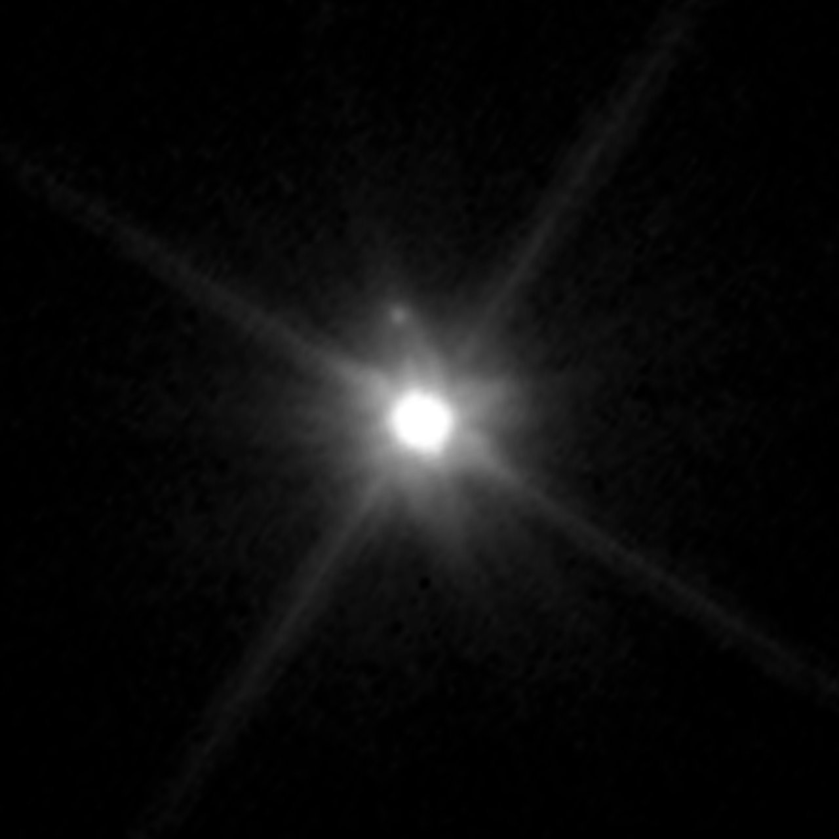
2. Classical KBOs
between 2:3 (39.5 AU) and 1:2 resonances (48 AU)
but not including those
two dynamical classes
“Cold” e < 0.1 and i < 10° … redder
“Hot” e > 0.1 and i up to 40°
Makemake and “MK2” … by HST 2015 APR
Notes:
classical Kuiper Belt has redder objects ... older surface
SDOs/detached objects tend to be pinker … formed in gas giant region and tossed, presumably

Slide 33
3. Scattered Disk Objects
~35 to 40 AU and beyond
source of Jupiter family comets
flung out when Neptune migrated outward
high eccentricity and inclination
first 1996 TL₆₆ … a = 89 AU, e = 0.58, i = 24°
also Eris … a = 68 AU, e = 0.44, i = 44°
scattered and being depleted … OR …
in higher order resonances and ~ stable
Notes:
classical Kuiper Belt has redder objects ... older surface
SDOs/detached objects tend to be pinker … formed in gas giant region and tossed, presumably

Slide 34
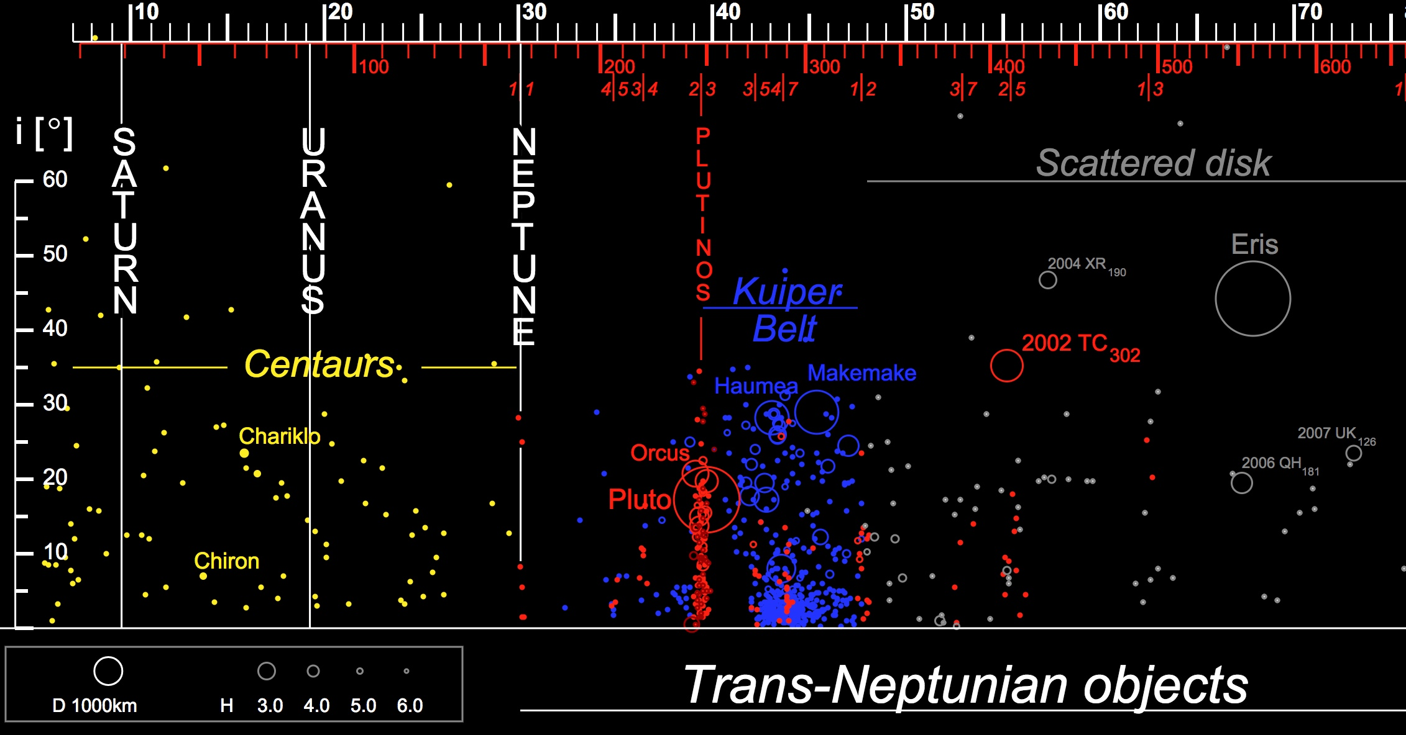
(Centaurs and)
Lions and Tigers and Bears

Slide 35
4. Detached Objects
extended scattered disk/inner Oort Cloud objects
resonances: 1:3, 2:7, 3:11, 5:22 and 4:79 and more
Sedna … a = 524 AU, e = 0.85, i = 12°
2000 CR₁₀₅ … a = 230 AU, e = 0.81, i = 23°
2012 VP₁₁₃ … a = 266 AU, e = 0.69, i = 24°
could not emplaced via Neptune …
passing star … planet 9?
Notes:
2012 VP is the one that reinvigorated the planet 9 discussion

Slide 36
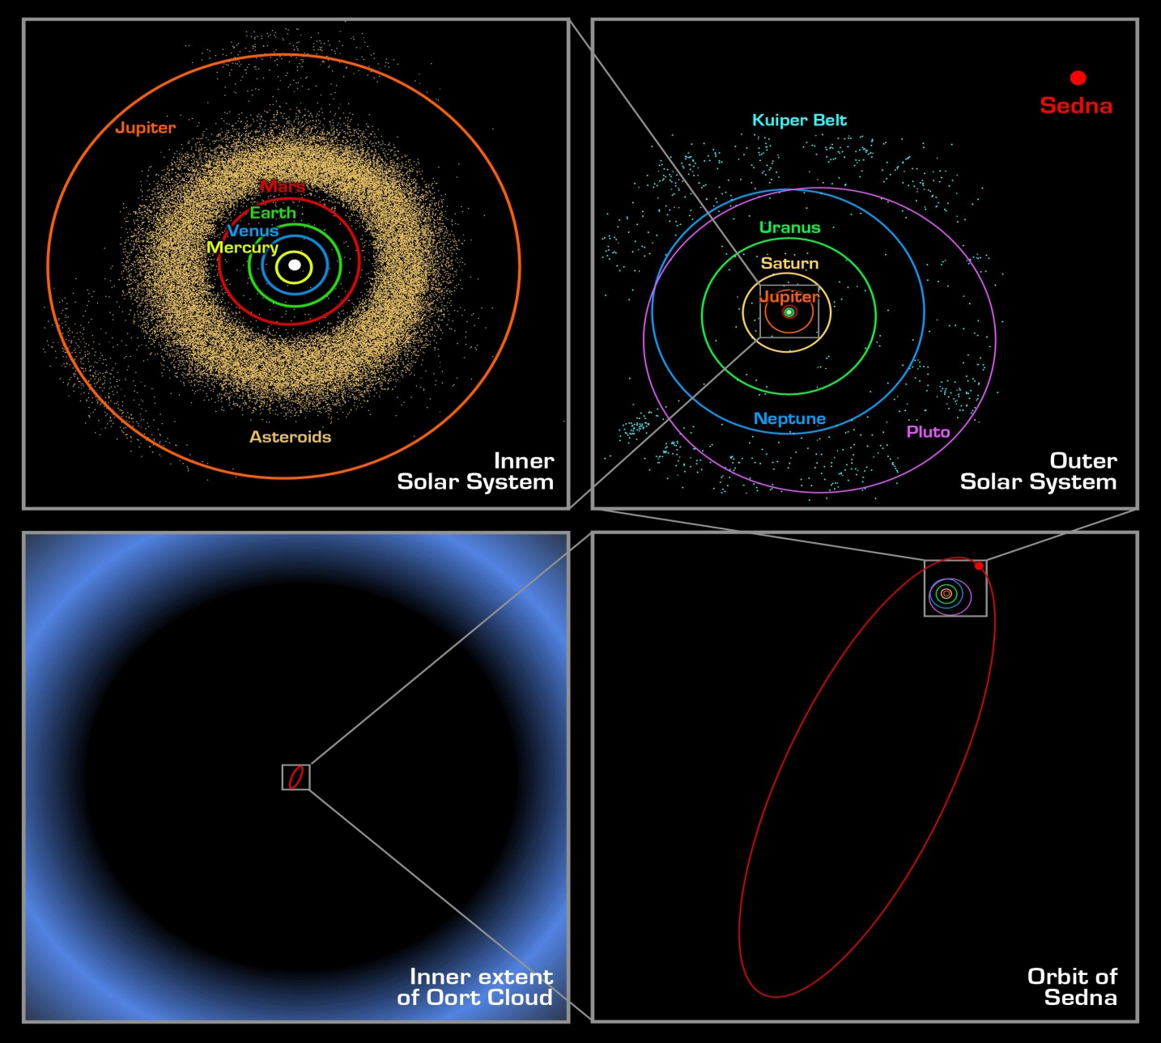
Sedna
P ~ 12,000 yr
e = 0.85
a ~ 524 AU
ap ~ 975 AU
pe ~ 75 AU

Slide 37
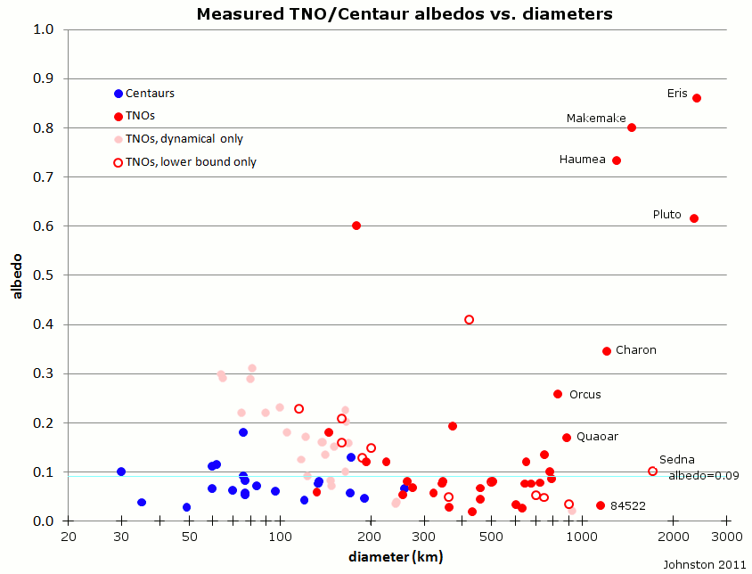
Notes:
Centaurs, 0.076 (21)
TNOs, over 1200 km in diameter, 0.576 (6)
TNOs, under 1200 km in diameter, 0.135 (64)
--better constrained only, 0.133 (53);
--thermal or direct measurement, 0.107 (29) (median 0.079);
--dynamical measurement only, 0.165 (24) (median 0.160).

Slide 38
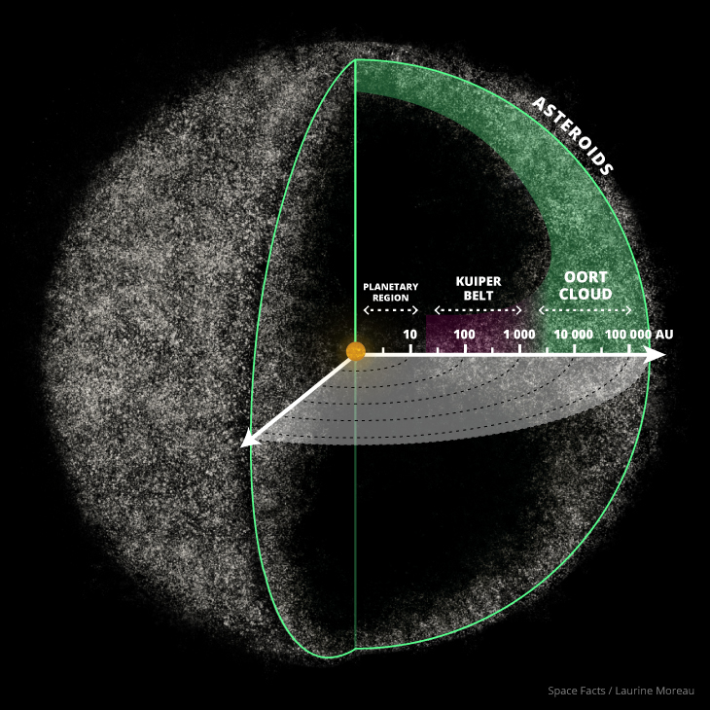
Oort Cloud
TNOs with aphelia > 1000 AU
2017 MB7 8114 ± 500 AU
2014 FE72 3390 ± 1400
2012 DR30 3248.7 ± 7.5
2016 FL59 2454 ± 250000 (33 day obs arc)
2005 VX3 2081 ± 430
2013 BL76 2064.1 ± 5.1
2015 TG387 2037 ± 340
2015 KG163 1612 ± 12
2006 SQ372 1547 ± 2
2013 SY99 1297 ± 41
2002 RN109 1126 ± 49
2013 AZ60 1062.00 ± 0.49
2000 OO67 1000.3 ± 3.8
probably no distinct boundary to Oort cloud
source of Halley family comets
Notes:
list shamelessly pulled from Wikipedia on 2018.1012

Slide 39
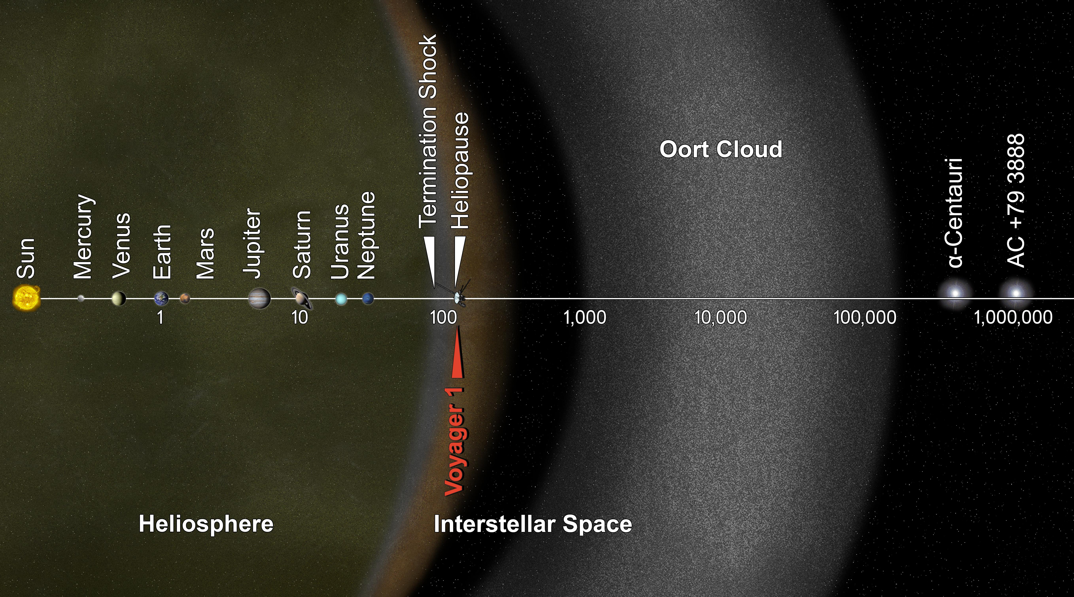
TNOs with aphelia > 1000 AU
https://commons.wikimedia.org/w/index.php?curid=28366203

Slide 40
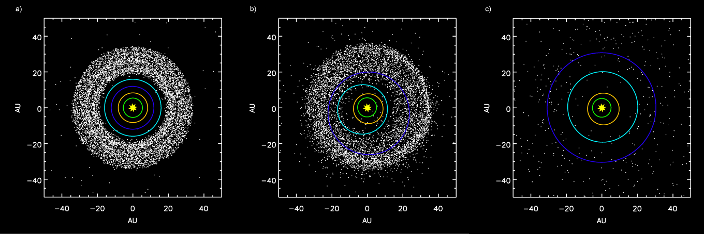
Nice Model Tsiganis et al. (2005) and Gnomes et al. (2005)
(left) before Jupiter/Saturn 2:1 resonance
(mid) scattering of Kuiper belt objects into the Solar System after the orbital shift of Neptune
(right) after ejection of Kuiper Belt bodies by Jupiter
Neptune migration of ∼7 or 8 AU over 10 Myr could account for the resonant populations
scattered disk explained by long term perihelic interactions with Neptune
accounts for late heavy bombardment period at 3.8-3.9 Gyr
explains Hot but not Cold classical KB
alternative is scattering and chaotic capture by an eccentric Neptune (Levison et al. 2008)

Slide 41
…………………………
Notes:
41

Slide 42
Solar System Explorers
Name a Jupiter Trojan, Centaur, or TNO with semimajor axis of at least 5 AU
and describe three of its physical characteristics, e.g., Pluto has density 1.86 g/cm³ and is roughly 60/40% rock/ice by mass, where the ice is primarily N2.
1.
2.
3.
4.
5.
6.
7.
8.
9.
10.
11.
12.
13.
14.
15.
16.
17.
18.
19.
20.

Slide 43
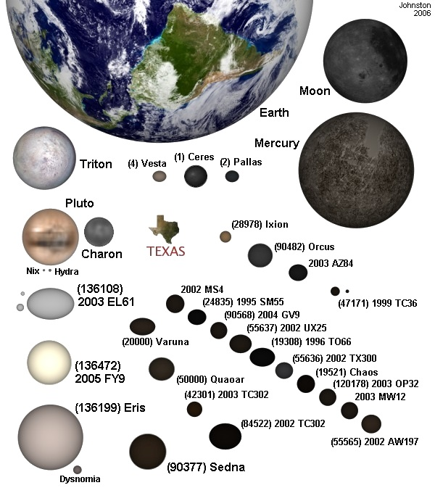
johnstonsarchive.net

Slide 44
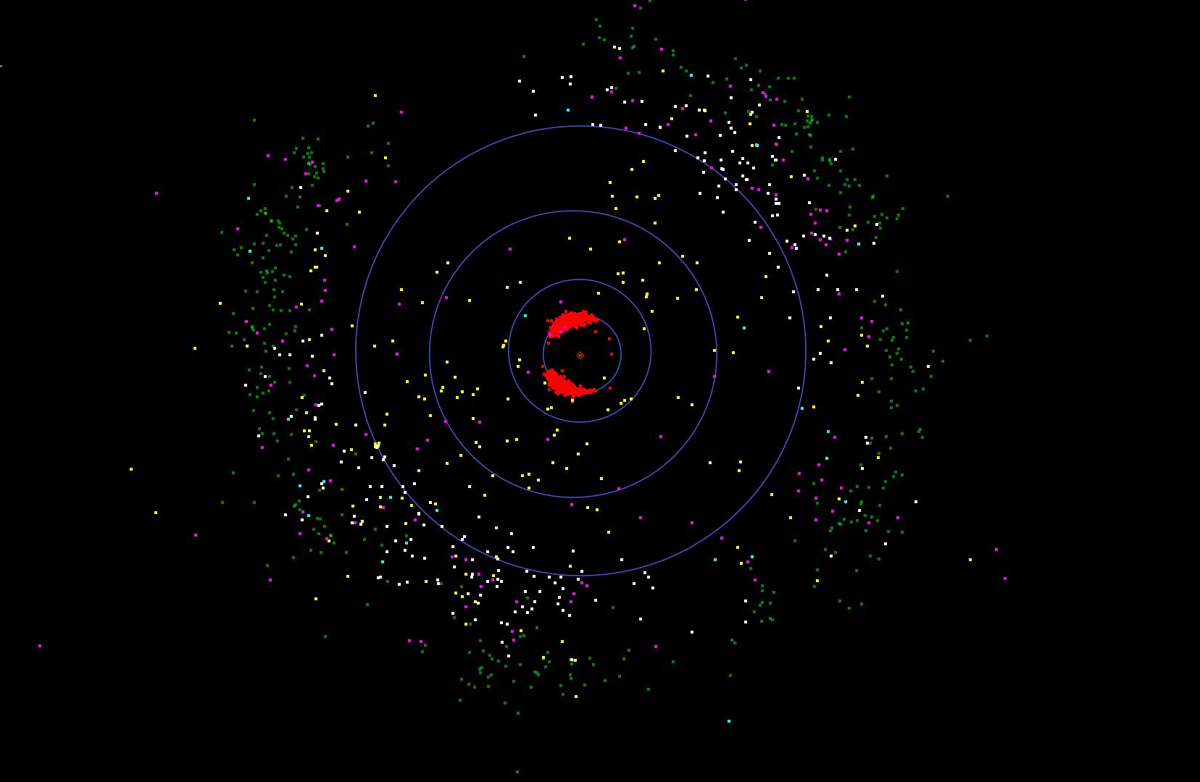
red: trojans 4,079
yellow: centaurs 184
white: plutinos 220
cyan: other resonant TNOs 24
green: cubewano 824
magenta: SDOs 139

Slide 45
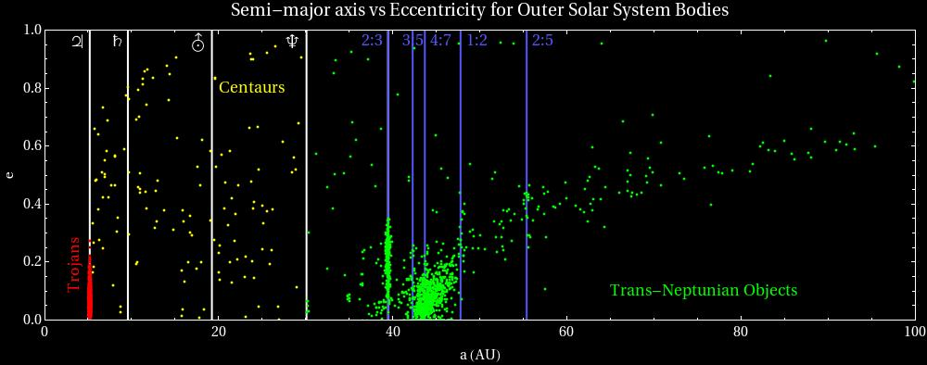
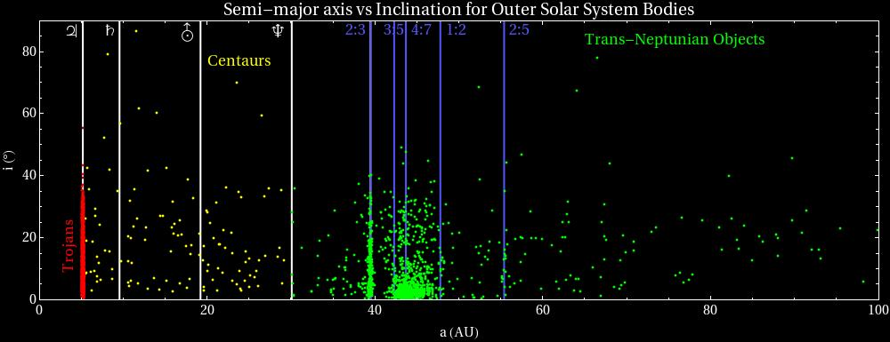

Slide 46
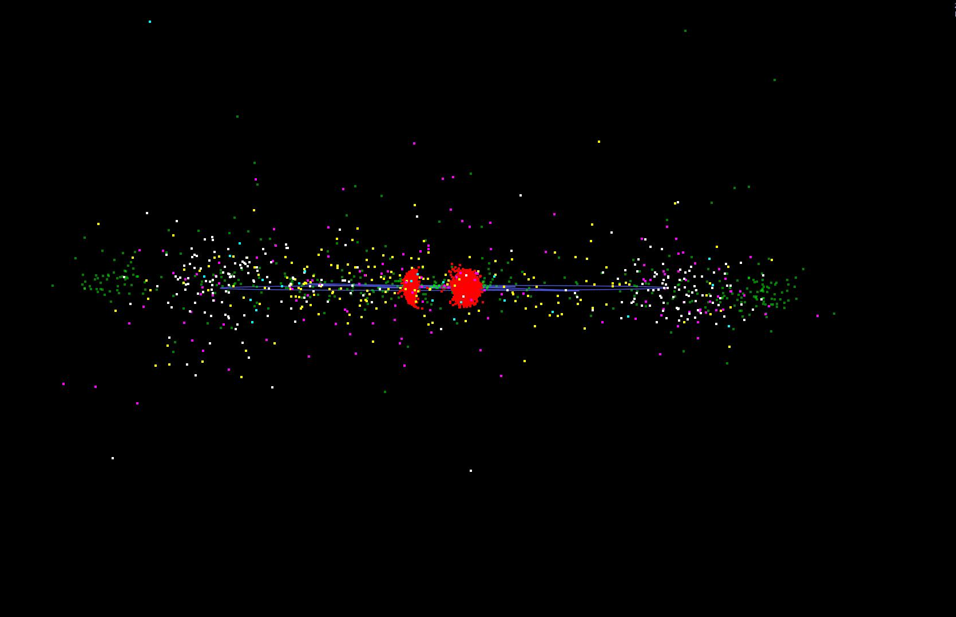
Notes:
green: hildas 2,212
red: trojans 4,079
yellow: centaurs 184
white: plutinos 220
cyan: other resonant TNOs 24
blue: cubewano 824
magenta: SDOs 139

Slide 47
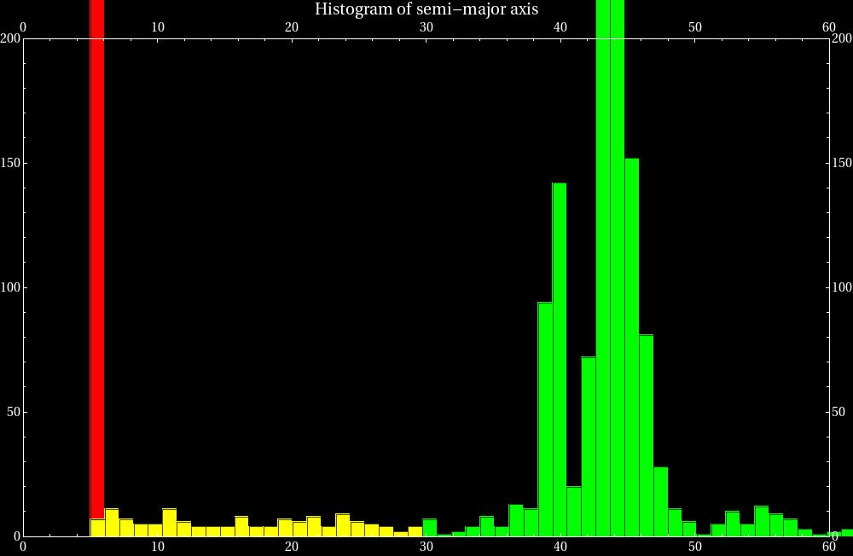
2873
257
2:3
1:2
red: trojans
yellow: centaurs
green: TNOs
Kuiper Cliff
Real edge or gap?
2:5

Slide 48
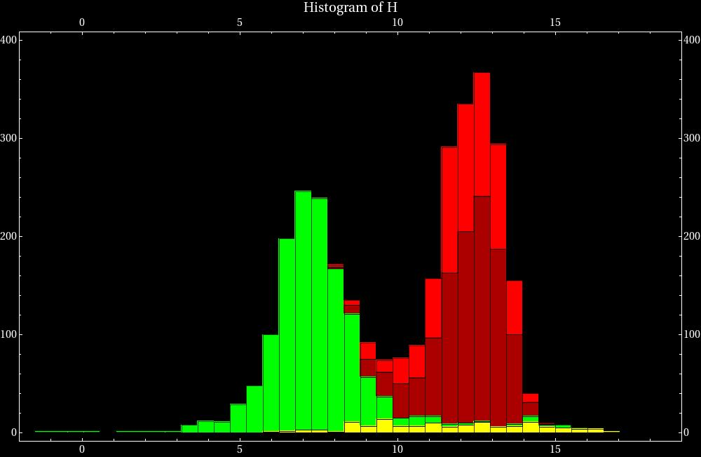
red: trojans
yellow: centaurs
green: TNOs
Haumea
Makemake
Pluto
Eris
Notes:
Add labels for notables-fade in

Slide 49


Slide 50
Compositions
extremely faint … even for 8-10m class telescopes
low temp (< 50K) low density (1-2 g/cm³)
colors (phot for ~few hundred, classification)
… grey to very red
composition (spec for a handful)
… CH₄ (on 3 largest TNOs), NH₃, H₂O, N₂, CO
… similar to comets
outgassing, impacts, radiation processing, cryovolcanism? (resurfacing and methane replenishment)
Notes:
methane requires interior source to replenish
different for TNOs > 1000 km

Slide 51


Colors
Centaurs bimodal
TNOs unimodal
mixed population?
color range from composition?
but low temp range
same initial composition and processed over time?
collisions?
reddening
young surface creates
high albedo

Slide 52

Spectra
Makemake
Licandro et al. 2006

Slide 53

Quaoar
crystalline (not amorphous) ice
heated > 110 K
radioactive decay?
impacts? →
crystalline ice is recent or replenished
(10 Myr)
crystalline ice feature
(1.65 microns)
H₂O ice
H₂O ice
H₂O ice
strong absorption by Earth atm
O-H, C-N, N-H molecular bands apparent, H₂O and CH₄ in largest KBOs
influenced by physical state and grain size, shape, and temperature
from Jewitt and Luu (2004)
Notes:
from Subaru 8m telescope
Crystalline ice has ~ 10 Myr lifespan under cosmic and solar radiation bombardment

Slide 54


Eris (2003 UB₃₁₃)
SDO, 557 yr period
V=18.7, R=18.3
diameter
  Spitzer: 2600-3400 km
  HST (Brown et al.): 2300-2500 km (barely resolved)
  occultation: 2326 +/- 12 km (Pluto is 2360)
  density 2.5 g/cm³ ... mostly rocky
  most massive TNO … 27% > Pluto
96% albedo! (most TNOs 10-20%)
methane dominated surface, like Pluto but less red
~30 K, methane is involatile … pure methane ice
may become volatile and mix as approaches the Sun
similar to Pluto in size and appearance but very different on the inside
Notes:
top is discovery, taken over 3 hrs
middle is occultation
Spitzer diameter inflated because axis pointed toward Sun … overheated

Slide 55


Slide 56
Solar System Explorers 2015
Name a minor body with semimajor axis greater than Mars’ orbit (1.52 AU) and describe three of its physical characteristics, e.g., Pluto has density 2.03 g/cm³ and is roughly 70/30% rock/ice by mass, where the ice is primarily N2.
1. 2687 Steins – in MB has chain of 7 craters, 3x2km, albedo 0.35
2. 243 Ida – density 2.2-2.9 g/cm3, magnetic material, chondrite/meteor-like composition
3. 16 Psyche – 253km, density 6.7 g/cm3, primarily Fe/Ni content
4. 10 Hygiea – 2% mass of MB, many kg, density 2 g/cm3, 500x400x400km
5. Fortuna – density 2.7 g/cm3, tholins on surface, carbonaceous G type
6. Eris – second highest albedo in SS, CH4 ice, diameter comparable to Pluto
7. 55576 Amicus – Centaur, albedo 0.18, 76km, H = 7.4
8. Sedna – one of reddest objects … tholins, 12K, albedo 0.3
9. Kleopatra – shaped like dog bone, Fe/Ni, interior is likely rubble pile
10. Pallas – 7% mass of MB, silicate surface, larger than Vesta but less massive
11. 41 Daphne – overall density 1.95, but surface density is 2.4
12. Temple 1 – density 0.62, comet hit by Deep Impact, hydrocarbons, H2O buried beneath dusty crust
13. Hale-Bopp – sodium tail, smallest dust grains from any comet, 2X deuterium abundance oceans
14. Makemake – code name is Easter Bunny, minimal/no atmosphere
15. Haumea – fastest spinning object in SS at 4 hours
16. …
17. …
18. …
19. …
20. …

Slide 57
Solar System Explorers 2012
Name a minor body with semimajor axis greater than Mars’ orbit (1.52 AU) and describe three of its physical characteristics, e.g. Pluto has density 2.03 g/cm³ and is roughly 70/30% rock/ice by mass, where the ice is primarily N2.
1. Mr. Rogers – 2.34 AU, e 0.34, H 12.6
2. Haumea – 1/3 Pluto mass, ellipsoid ~ E5 … because of rapid rotation
3. Pallas – d 545 km via occulation, a 0.16, Tholen spectral type B (not a C or S)
4. Ixion – 650x822 km, 3e20 kg, 2.0 g/cm3, .434 km/s escape v
5. Vesta – 3.9 g/cm3, 520 km, pyroxenes on surface
6. Sedna – almost as red in Mars (via SMARTS!), d 1600 km, methane and water ices
7. Triton – cryovolcanism, retrograde orbit, cantaloupe terrain due to tidal stress upon orbital entry
8. Psyche – 2.92 AU, nearly pure Fe/Ni, from a parent body but now an orphan
9. Ceres – 41% mass of Main Belt, d 950 km, water/carbonates on surface
10. Ceto – 174 km, 1.37 g/cm3, crystallized ice on surface via companion
11. Enceladus – 100% reflectivity, geysers of water+, creates E ring
12. Eris – most massive KBO KNOWN, a 0.96?, methane ice
13. Asbolus – impact crater less than 10 Myr, 84 km, H 9
14. Hilda – 2:3 resonance with Jup, occulted a star in 2002, H 7.5
15. Quaoar – 43.6 AU, crystalline ice due to recent heating, moon created by Mars hitting
16. …
17. …
18. …
19. …
20. …

Slide 58
Makemake (2005 FY₉)
Classical KBO
a = 46 AU
Peri= 39 AU
i ~ 29 deg
Methane signatures match laboratory pure methane ice, no other ices detected
Spectroscopically red (tholins?)
Similar to Pluto (atmosphere?)
Nitrogen depleted (escape during perihelion?)

Slide 59



Haumea (2003 EL₆₁)
VERY Carbon depleted
Two satellites
System is 28% the mass of Pluto
3.9 hr rotational period
Impact formation (~100 Myr ago)
  from dynamics & 50/50 amorphous/crystalline ice
  part of a collisional family
Crystalline ice presence also suggests prior temp >110K (~50K now)
283 yr period, peri~35 AU, currently near apheli
i=28 deg
~2.6 g/cm³
Water ice covered rock
2,000 x 1,500 x 1,000 km
albedo of 0.71
Variation in all colors (shape)
  Also, dark red spot (organic compounds?)
Cryovolcanism unlikely, surface > 100 Myr, possible source of Jup-Fam comets
possible7:12 resonance
Light curve model
Pole view
Notes:
Blue spot is neptune

Slide 60

Binaries and multiples
1998 WW₃₁, first binary found after Pluto-Charon
CFHT (left), HST (right)
Images from 2001, 0.59”separation, a~20,000km
from Veillet et al. 2002
67 binaries/multiples out of 1,546 objects → relatively high %

Slide 61
Close binaries – impact formation likely (either direct or glancing)
  10 to 20% contact binaries (light curves from Sheppard & Jewitt, 2004)
Wide eccentric binaries –
  “dynamical friction”
    Ancient, dense Kuiper Belt…smaller bodies act collectively to stabilize massive bodies that pass through them
    Fraction of binaries should increase as separation increases (Goldreich et al. 2002)
  3-body interactions → wide binaries
All models require initial density ~100 to 1,000x present population

Slide 62
Missing Mass (the biggest problem?)
Binary models (both impact and accretion) and protoplanetary disk surface density models predict ~100 times more mass
  Dynamic erosion?
    Neptune insufficient, passing star?
  Collisional grinding?
    Remaining dust radiatively dragged into Sun
    only works if initial size distribution was VERY steep ….majority of mass in small bodies (<50km)
maybe KB formed much closer to Sun and migrated?
    Explains dual population

Slide 63

Debris disks
~100 AU
– left over from planetary formation, late heavy bombardment period?
20% of systems are thought to harbor DD
Space missions: IRAS, HST, ISO, Spitzer, Herschel
  Far-IR excess (300 K)
  Sub-mm imaging
  Visible imaging
Structure & asymmetry  exoplanets?
Notes:
Spitzer provided first evidence for warm (300K) dust
LHB from giant planet migration
DD is everything that’s not planets
http://apod.nasa.gov/apod/image/0412/debrisDisk_spitzer_f.jpg

Slide 64


NASA/Goddard/Marc Kuchner and Christopher Stark

Slide 65

New Horizons
  Launched 2006
  July 2015 Pluto
  http://pluto.jhuapl.edu/mission/whereis_nh.php

Slide 66


New Horizons
8.2in telescope
Notes:
http://pluto.jhuapl.edu/

Slide 67
References
Unless otherwise noted: Delsanti & Jewitt The Solar System Beyond the Planets Solar System Update, edited by P. Blondel and J. Mason. ISBN 3-540-26056-0. 329 pp., 2006, p.267 (2006)
Barucci et al. TNO Surface Properties Asteroids, Comets, Meteors, Proceedings of the 229th Symposium of the International Astronomical Union held in Búzios, Rio de Janeiro, Brasil August 7-12, 2005, Edited by Daniela, L.; Sylvio Ferraz, M.; Angel, F. Julio Cambridge: Cambridge University Press, 2006., pp.171-190 (2006)
Gomes et al. Origin of the cataclysmic Late Heavy Bombardment period of the terrestrial planets Nature, Volume 435, Issue 7041, pp. 466-469 (2005)
Tsiganis et al. Origin of the orbital architecture of the giant planets of the Solar System Nature, Volume 435, Issue 7041, pp. 459-461 (2005)
Levison, H. F., Morbidelli, A., Vanlaerhoven, C., Gomes, R., & Tsiganis, K. 2008, Icarus, 196, 258
Fraser & Brown The Hubble Wide Field Camera 3 Test of Surfaces in the Outer Solar System: The Compositional Classes of the Kuiper Belt ApJ (2012)
Stansberry et al. Physical Properties of Kuiper Belt and Centaur Objects: Constraints from the Spitzer Space Telescope, ed. M. A. Barucci, H. Boehnhardt, D. P. Cruikshank, & A. Morbidelli, 161{179} (2008)
  Sagan & Khare, Tholins: organic chemistry of interstellar grains and gas Nature 277, 102-107 (11 January 1979)
Pinilla-Alonso et al. The surface of (136108) Haumea (2003 EL61), the largest carbon-depleted object in the trans-Neptunian belt A&A 496, 547–556 (2009)
Shul’Man The Chemical Composition of Cometary Nuclei The Motion, Evolution of Orbits, and Origin of Comets; Proceedings from IAU Symposium no. 45 (1972)
Delsanti et al. Simultaneous visible-near IR photometric study of Kuiper Belt Object surfaces with the ESO/Very Large Telescopes Astronomy and Astrophysics, v.417, p.1145-1158 (2004)
Licandro et al. The methane ice rich surface of large TNO 2005 FY_9: a Pluto-twin in the trans-neptunian belt? Astronomy and Astrophysics, Volume 445, Issue 3, January III 2006, pp.L35-L38
Jewitt & Luu Crystalline water ice on the Kuiper belt object (50000) Quaoar Nature, Volume 432, Issue 7018, pp. 731-733 (2004)
Elliot et al. The Deep Ecliptic Survey: A Search for Kuiper Belt Objects and Centaurs. II. Dynamical Classification, the Kuiper Belt Plane, and the Core Population The Astronomical Journal, Volume 129, Issue 2, pp. 1117-1162 (2005)
Stansberry et al. Physical Properties of Kuiper Belt and Centaur Objects: Constraints from the Spitzer Space Telescope The Solar System Beyond Neptune, M. A. Barucci, H. Boehnhardt, D. P. Cruikshank, and A. Morbidelli (eds.), University of Arizona Press, Tucson, 592 pp., p.161-179 (2008)
    Soderblom et al. Triton's Geyser-Like Plumes: Discovery and Basic Characterization, Science Vol. 250 no. 4979 pp. 410-415
    (1990)
    Young et al. A Two-Color Map of Pluto's Sub-Charon Hemisphere The Astronomical Journal, Volume 121, Issue 1, pp. 552-561 (2001)
    Brown & Schaller The Mass of Dwarf Planet Eris Science, Volume 316, Issue 5831, pp. 1585- (2007)
    Veillet et al. The binary Kuiper-belt object 1998 WW31 Nature, Volume 416, Issue 6882, pp. 711-713 (2002)
    Scott & Jewitt Extreme Kuiper Belt Object 2001 QG₂₉₈ and the Fraction of Contact Binaries The Astronomical Journal, Volume 127, Issue 5, pp. 3023-3033 (2004)
    Goldreich et al. Formation of Kuiper-belt binaries by dynamical friction and three-body encounters Nature, Volume 420, Issue 6916, pp. 643-646 (2002)
http://www.johnstonsarchive.net/astro/tnos.html
http://www2.ess.ucla.edu/~jewitt/kb.html
http://www.boulder.swri.edu/ekonews/
http://www.minorplanetcenter.net/iau/lists/Unusual.html
http://www.minorplanetcenter.net/iau/lists/TNOs.html
http://planetary.org/explore/topics/trans_neptunian_objects/
http://www.skyandtelescope.com/news/home/106861063.html
http://www.mikebrownsplanets.com/2010/11/shadowy-hand-of-eris.html
http://www.nasa.gov/topics/solarsystem/features/dust-model.html
Exoplanets by Sara Seager. University of Arizona Press, 2011. ISBN: 978-0-8165-2945-2

Slide 68

Pluto has 6.39 day rotation period

Slide 69
Solar System Explorers Quiz 3
1. What percentage of the Main Belt minor bodies’ mass is estimated to be in Ceres? (to within 10%)
2. What is a Damocloid?
3. Why was only Pluto found in the search for planets beyond Neptune?
4. Name four of the five ices seen on TNOs.
5. What particular observational feature of members of the Kuiper Belt leads us to
believe that there were many more objects in the vicinity in the past?
BONUS: Name any three TNOs other than Triton and members of the Pluto system
(IAU names, not first identification numbers/letters).

Slide 70
Solar System Explorers Quiz 3
1. What percentage of the Main Belt minor bodies’ mass is estimated to be in Ceres? (to within 10%)
41%
2. What is a Damocloid?
dead comet
3. Why was only Pluto found in the search for planets beyond Neptune?
other major TNOs off ecliptic
4. Name four of the five ices seen on TNOs.
H₂O, NH₃, CH₄, N₂, CO
5. What particular observational feature of members of the Kuiper Belt leads us to
believe that there were many more objects in the vicinity in the past?
high binary fraction … > 4%
BONUS: Name any three TNOs other than Triton and members of the Pluto system
(IAU names, not first identification numbers/letters).
Eris, Makemake, Haumea, Sedna, Quaoar, Orcus, Varuna, Chaos, Ixion

Slide 71
Next Phase of Project
due Tuesday, April 10
Level 3 (at least) paper

Slide 72
Project Presentations
APRIL 12
1. Sam
2. Ben A.
3. Tiffany
4. Jeremy
APRIL 17
5. Joey
6. Ben O.
7. Emily
8. Charlie
APRIL 19
9. Katie
10. Steven
11. Alexis
12. Ryan
APRIL 23 --- FINAL PAPERS DUE
APRIL 30 --- REVIEWS DUE

Slide 73


Location on the sky

Slide 74
Large TNOs
~ a dozen large TNOs (large ~ 1,000 km)
2003 UB₃₁₃ (Eris)
2005 FY₉ (Makemake)
2003 EL₆₁ (Haumea)
able to retain methane
Trujillo & Brown, 2003 survey

Slide 75


Notes:
green: hildas 2,212
red: trojans 4,079
yellow: centaurs 184
white: plutinos 220
cyan: other resonant TNOs 24
blue: cubewano 824
magenta: SDOs 139

Slide 76


Slide 77

2:3
1:2
2:5
Hot
Cold

Slide 78

H vs perihelion distance, icy (white), non-icy (black), uncertain (dash) from Barucci et al. (2006)

Slide 79

Tholin
Reddish nitrogen-rich organic polymer compounds
“precipitated smog”
Formed from atmospheric nitrogen and methane gases or water ice/methane clathrates
  Titan tholin
    98.4% N2, 1.6% CH4 + trace
  Triton tholin
    99.9% N2, 0.1% CH4
Urey-Miller experiments
  Sagan & Khare, Nature (1979)
Destroyed by free oxygen
Southwest Research Institute

Slide 80

< 40 AU → range of colors (cometary activity?)
> 40 AU → redder (these are low i KBOs, Hot population shows range of colors)
Could be observational bias
from Delsanti et al. (2004)
Notes:
primordial dynamically “cold” population (with
small orbital inclinations) superimposed to a dynamically “hot” population

Slide 81
“The existence of a bifurcation amongst all excited populations argues that the two separate classes of object existed in the primordial disk before the excited Kuiper belt was populated.
The cold classical objects exhibit a different type of surface which has colors that are consistent with being drawn from the red branch of the mixing model, but with much higher albedos.”
from WFC3 tests of KBO surfaces (2012)

Slide 82
Statistics
Early models suggested i~1 deg, due to Neptune
High velocity dispersion (1.6 km/s)
  TNOs shatter upon collision
Velocity dispersion pumping?
  at formation, Vel Disp ~ order of magnitude lower
  Resonance pumping…..explains Pluto’s high i and other resonant objects
  SDO’s….scattering by Neptune migration

Slide 83
Colors & Surface processing
Neutral color Carbon-ices darken with particle radiation over 10⁷⁻⁹ yrs (Shul’Man, 1972)
exact color change depends on various factors
  Composition
  Grain size
High albedo → young surface

Slide 84

Bimodal Classical distribution
Cold formed beyond Neptune and swept out
Hot scattered outwards and captured
Difference in colors due to different formation region?
Unlikely alternative explanation: passing star (~200 AU) stirred and truncated the belt
  perhaps more likely if Sun formed in cluster
from Elliot et al. (2005)

Slide 85



Albedo

Slide 86
Incident flux at obj
Notes:
Phi=phase term, e=emissivity ~ 1 at thermal wavelengths, lambertian surface is diffuse perfect reflector at all wavelengths, flux ratio takes into account 2nd inverse square factor

Slide 87
Masses and albedo
A=0.04→0.1M
  equal to the current total KB mass estimate!
A=0.12→0.02M
Typical assumption: albedo of 0.09
Assuming spherical, p=geometric albedo, D relation from MPC

Slide 88
Distribution, masses, and sizes
Surveys give number and brightness
Need albedo to get diameter
  Assume albedo doesn’t vary with size
Model distribution (diameter >50km) with differential power law, index of 4
Masses originally assumed albedo of 0.04 (Jupiter comets), 3x too low
  Albedo only measurable on large TNOs
Albedo higher on larger TNOs (D>400 km, Stansberry et al. 2008)
Distribution: scattered disk > classical belt > resonant population
Smallest observed ~ 1km diameter

Slide 89

Equilibrium temperatures at different locations on Pluto's surface vs. year, covering one orbital period. Calculations assume emissivity=0.8 and average flux over Pluto's 6.39-day rotation period but otherwise assume no thermal inertia/heat transfer; albedo a is variously taken as 0.3 or 0.6
from Johnstonarchive
Notes:
Axis precesses every Myr

