Slide 1
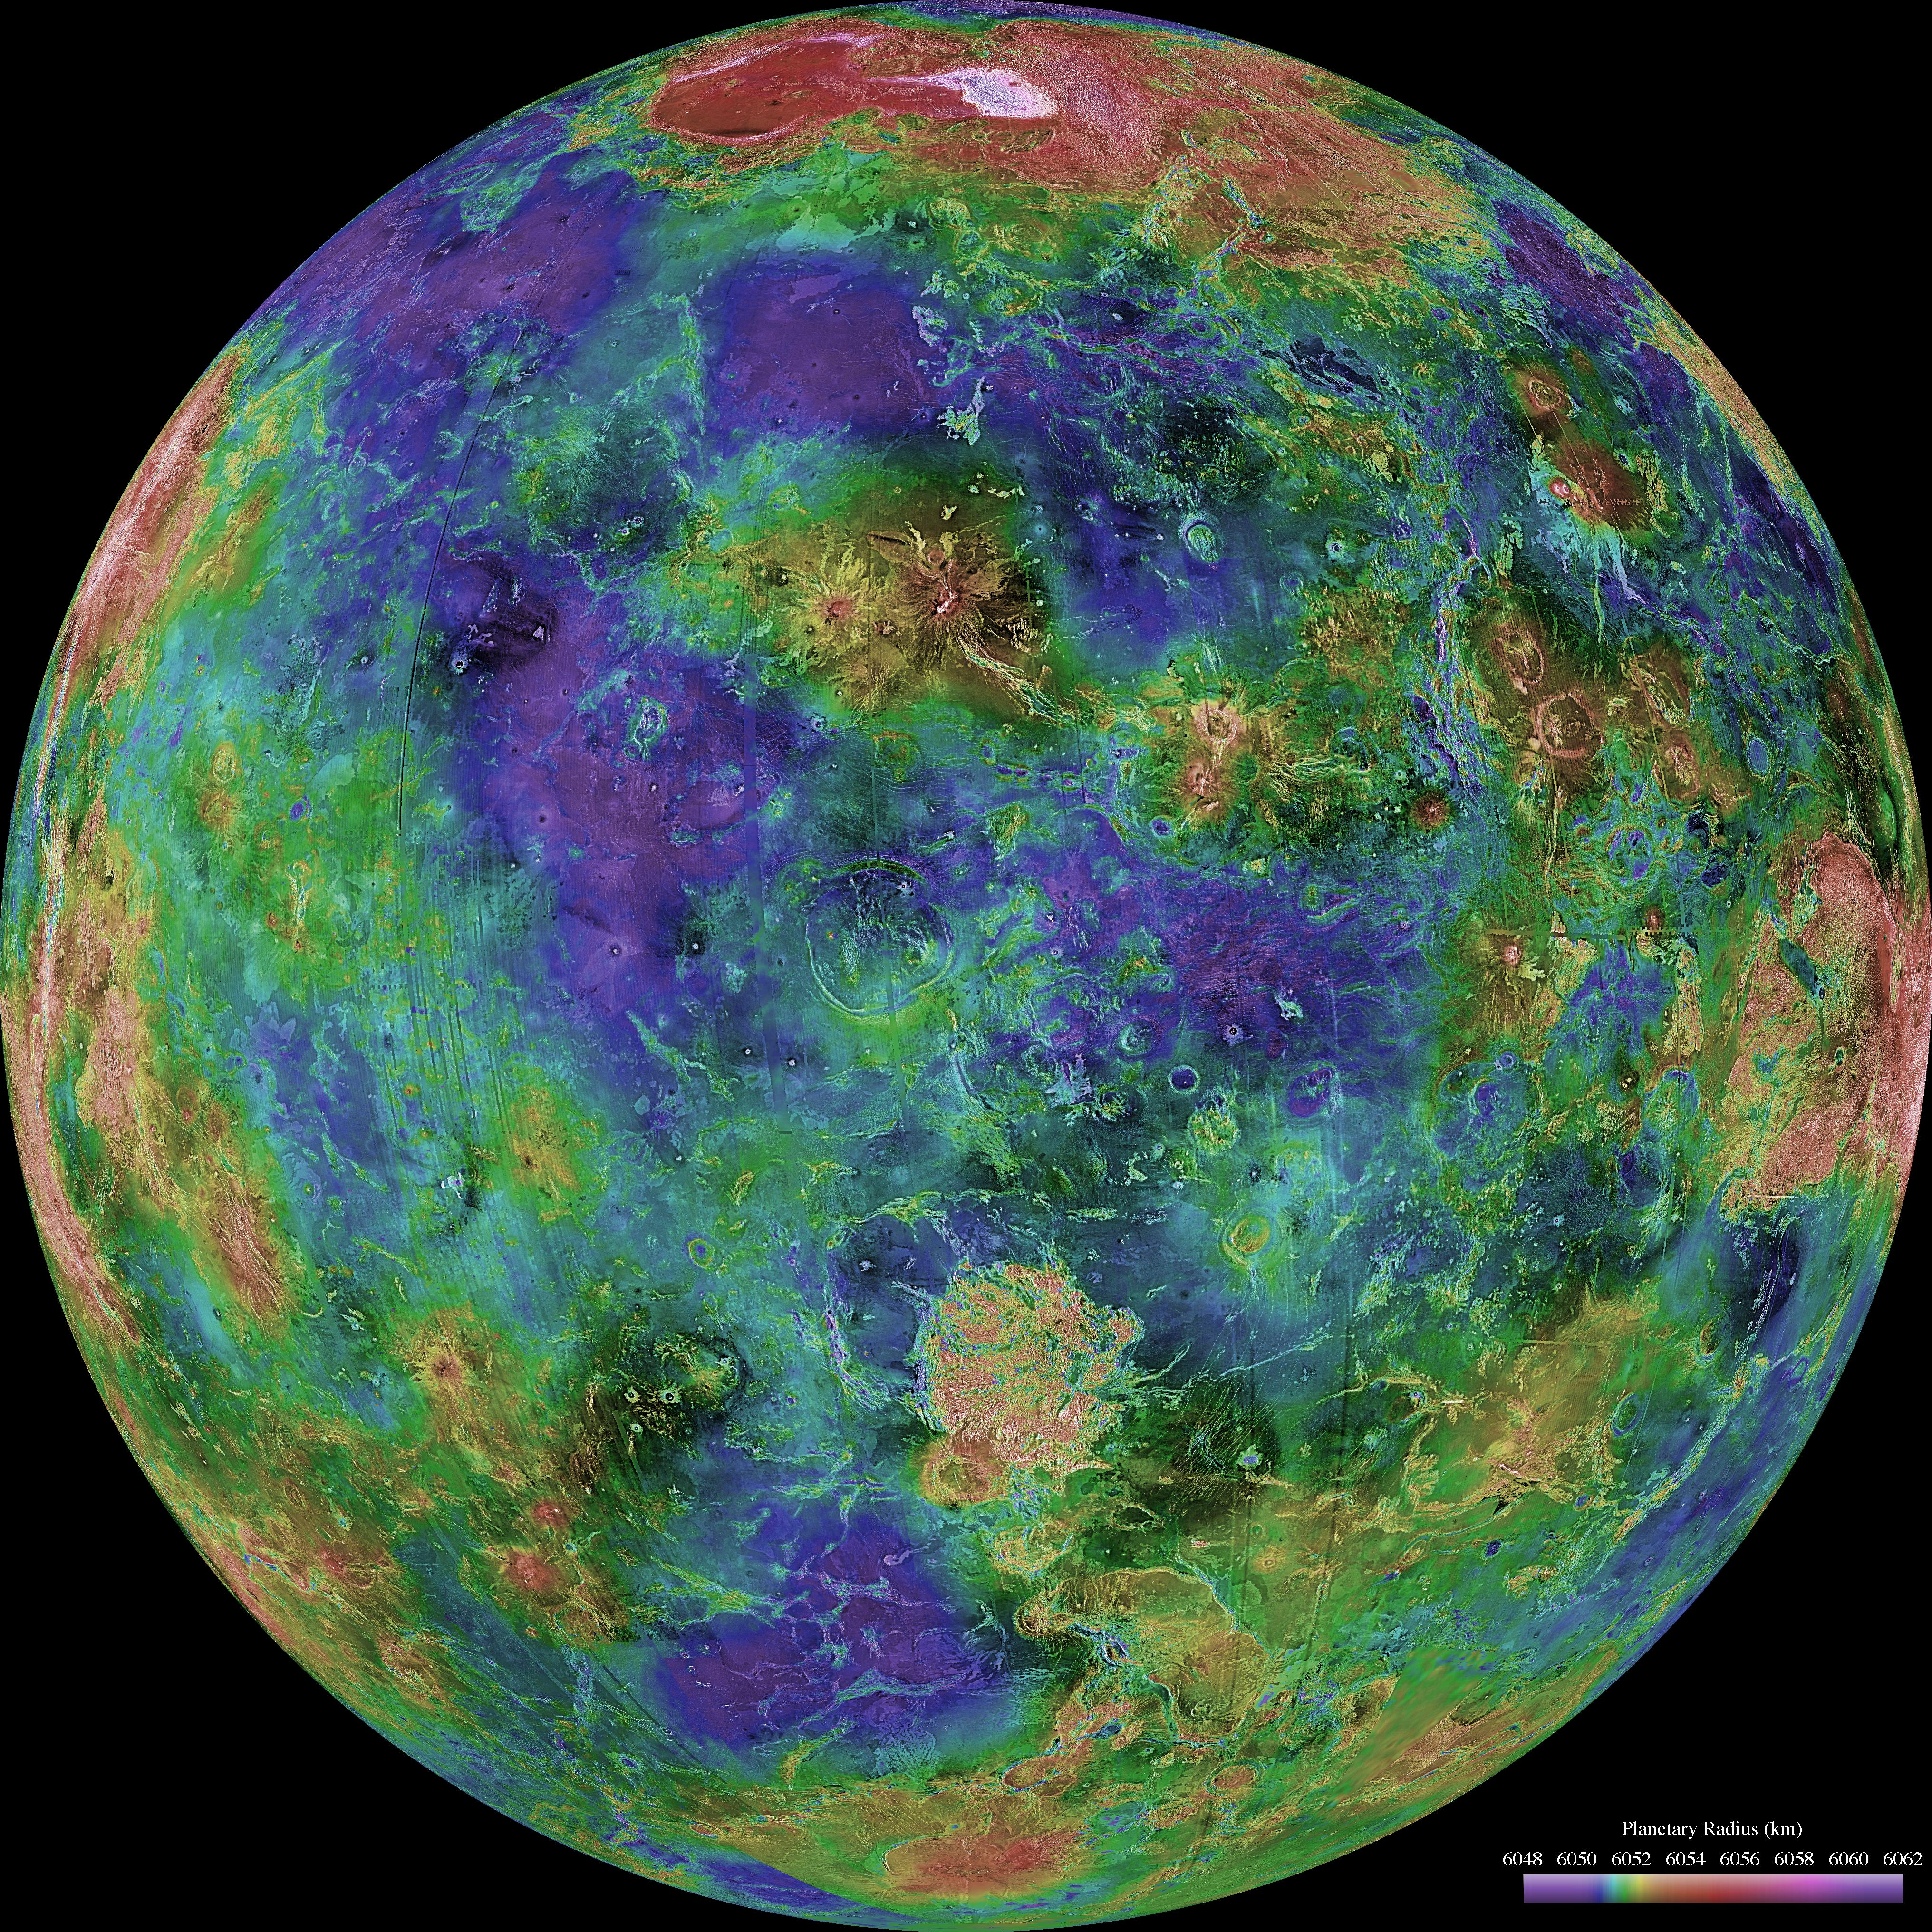
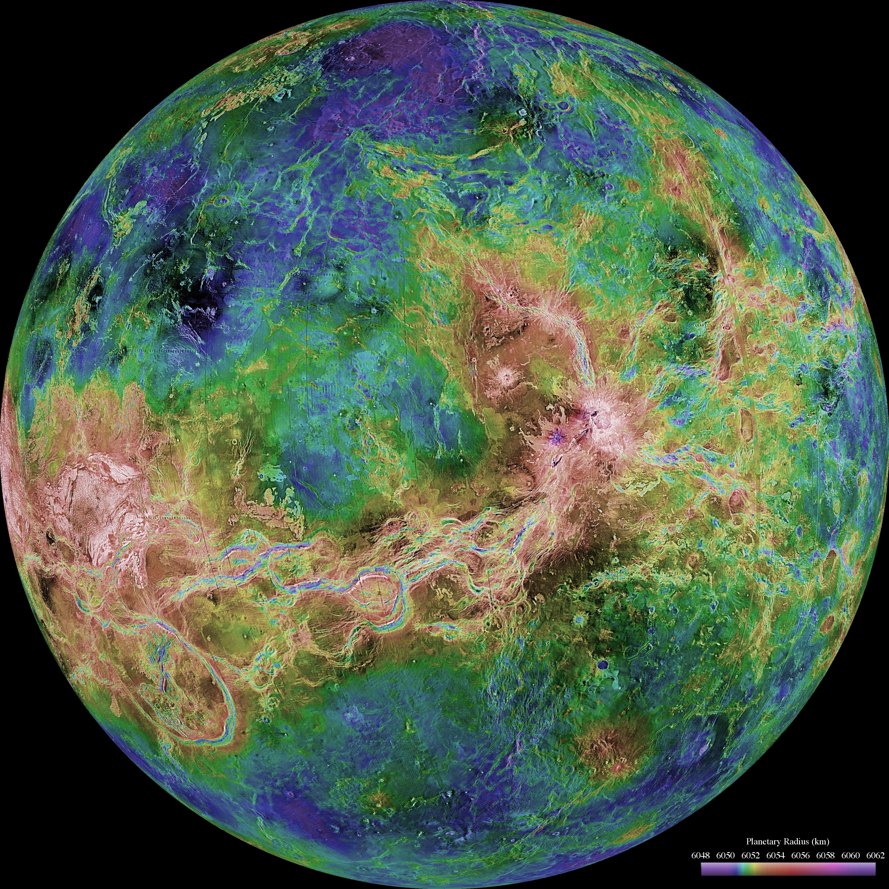
Where is this?
Notes:
Left: high point near pole is Ishtar Terra
Right: high point of spaghetti is Aphrodite Terra
VENUS by Magellan: revealed by more than a decade of radar investigations culminating in the 1990-1994 Magellan mission, is centered at 0 degrees east longitude (left) and 180 degrees (right). The Magellan spacecraft imaged more than 98% of Venus at a resolution of about 100 meters; the effective resolution of this image is about 3 km. A mosaic of the Magellan images (most with illumination from the west) forms the image base. Gaps in the Magellan coverage were filled with images from the Earth-based Arecibo radar in a region centered roughly on 0 degree latitude and longitude, and with a neutral tone elsewhere (primarily near the south pole). The composite image was processed to improve contrast and to emphasize small features, and was color-coded to represent elevation. Gaps in the elevation data from the Magellan radar altimeter were filled with altimetry from the Venera spacecraft and the U.S. Pioneer Venus missions. An orthographic projection was used, simulating a distant view of one hemisphere of the planet.

Slide 2
Solar System Explorers: 10 NOV
A mysterious game of fun …
1. …
2. …
3. …
4. …
5. …
6. …
7. …
8. …
9. …
10. …
11. …
12. …
13. …
14. …
15. …
16. …
17. …
18. …
19. …
20. …

Slide 3
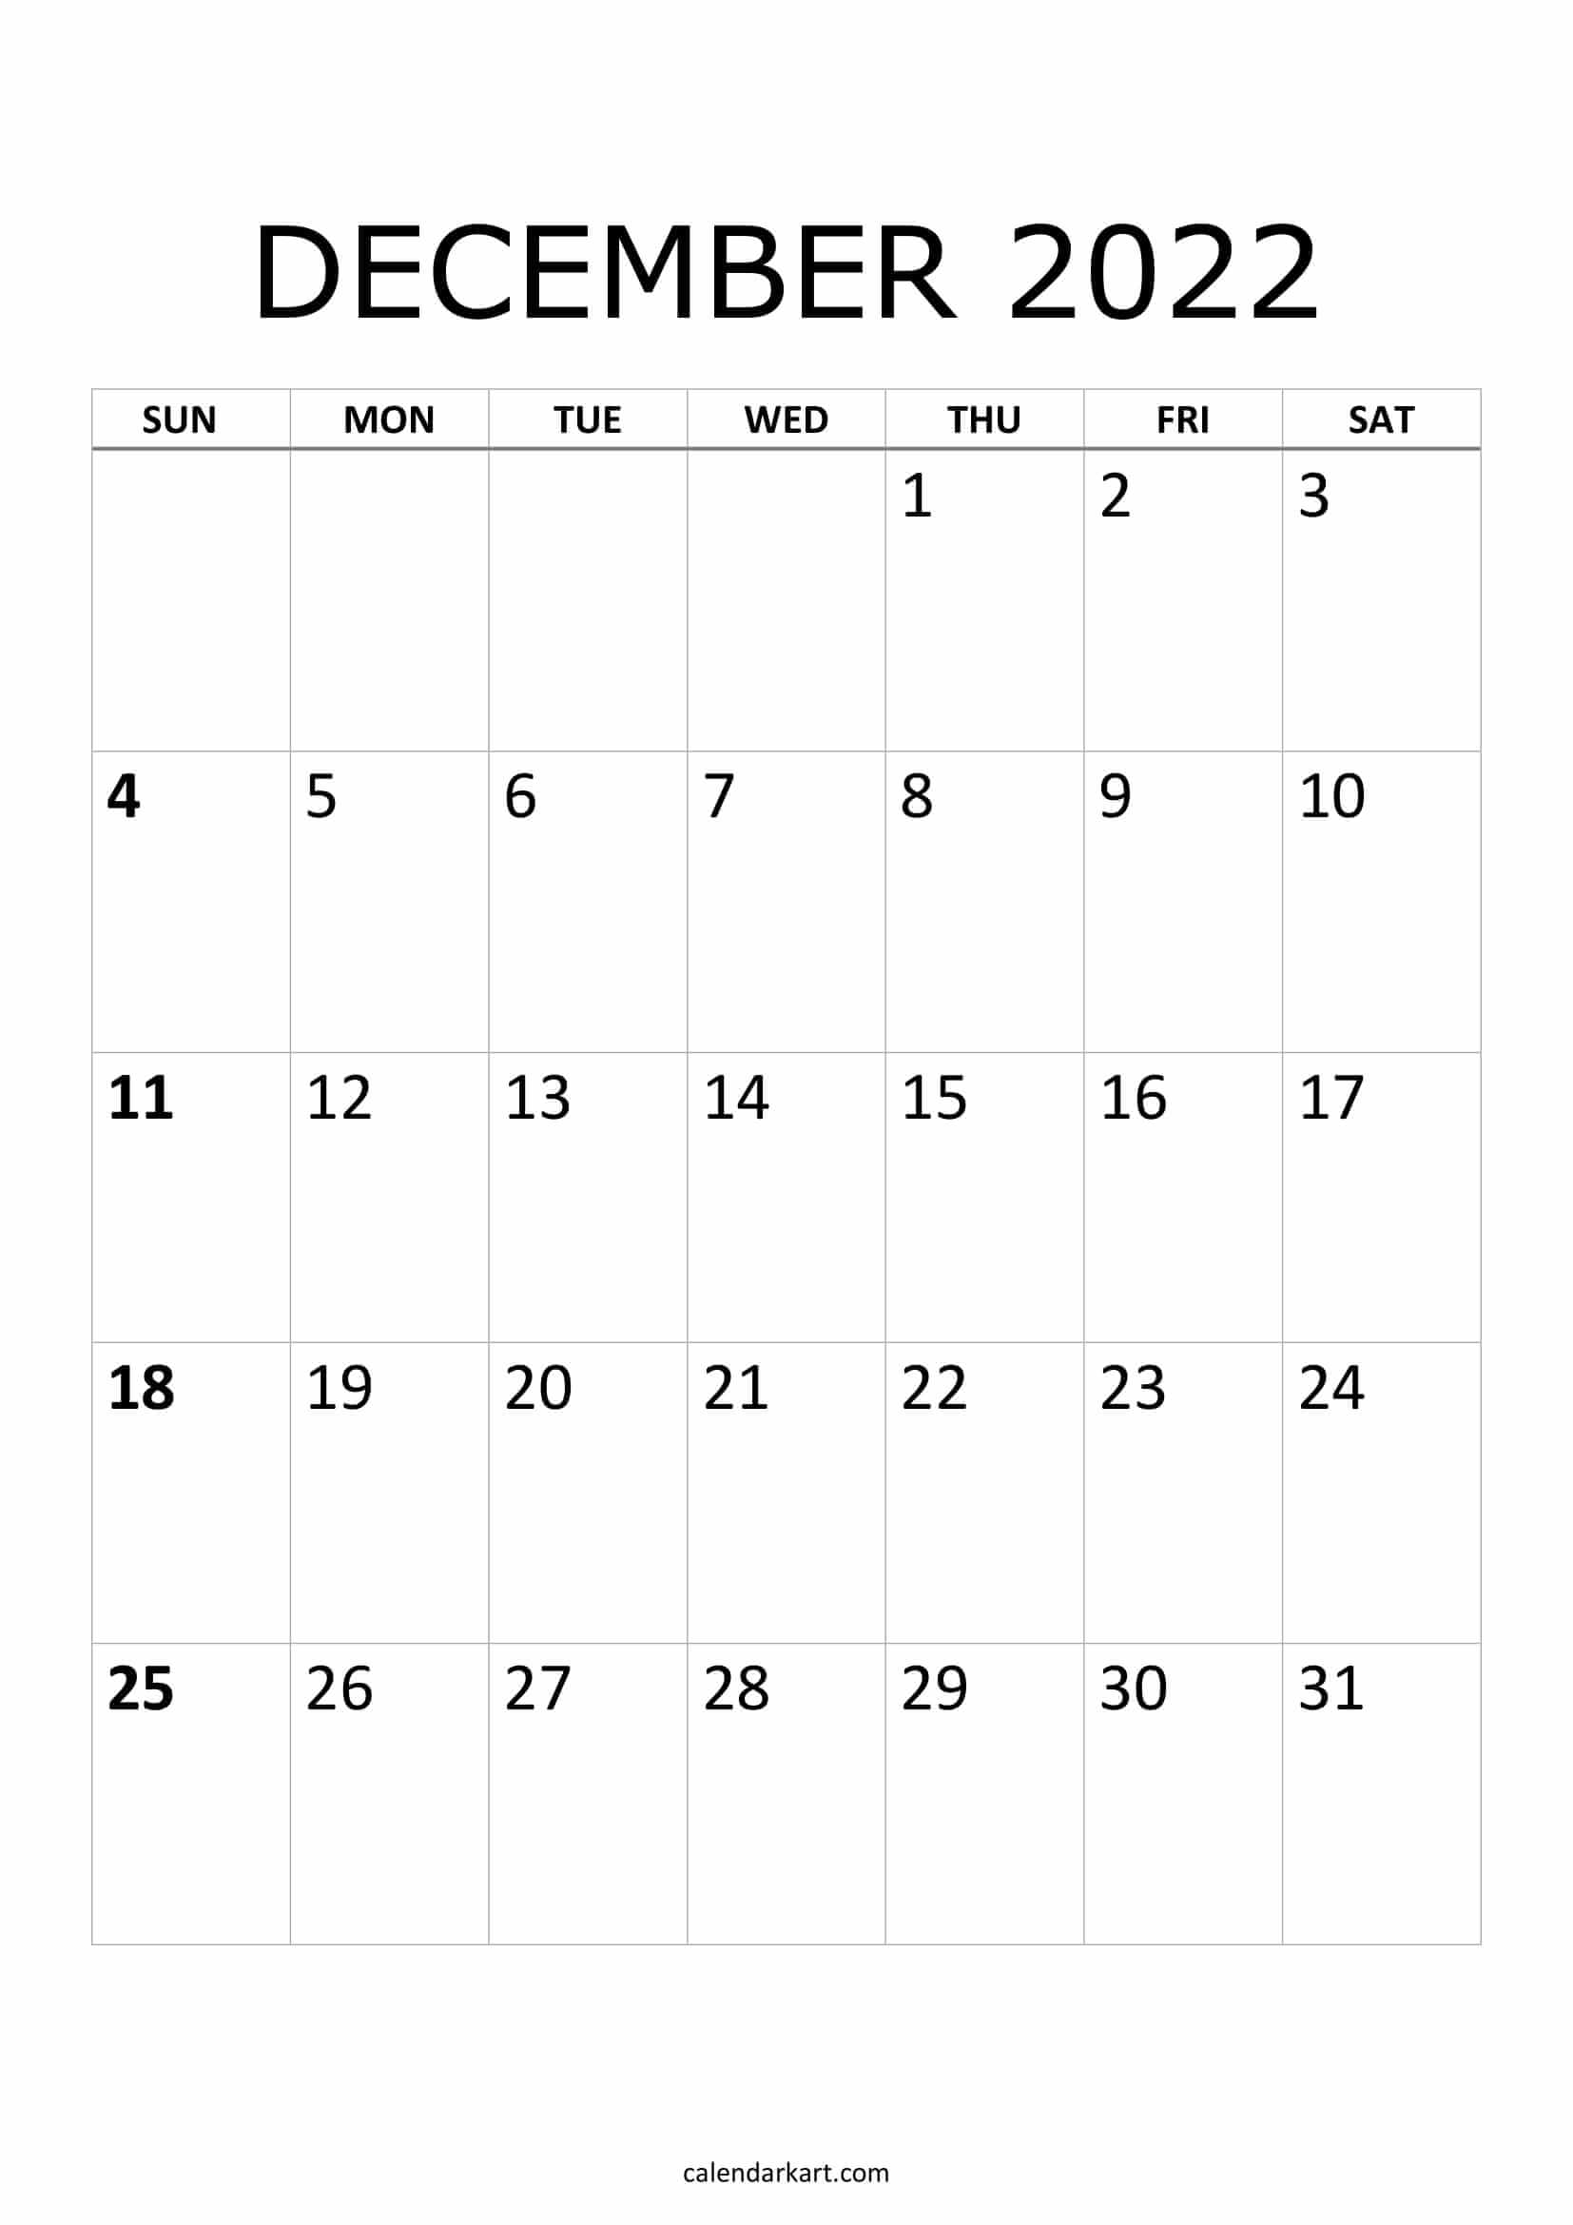
papers
due
5pm
21
22
reviews
due
5pm
23
24
talks
talks
grades
due
T u r k e y T i m e

Slide 4
Talk Schedule
TUESDAY, 15 NOV
1. Maura
2. Garrett
3. Aatiya
4. Tim
5. Sebastian
THURSDAY, 17 NOV
6. Saba
7. Alex
8. Isaac
9. Jessica
Melodie
MONDAY, 21 NOV (online)
Madison
Griffin
Notes:
4

Slide 5
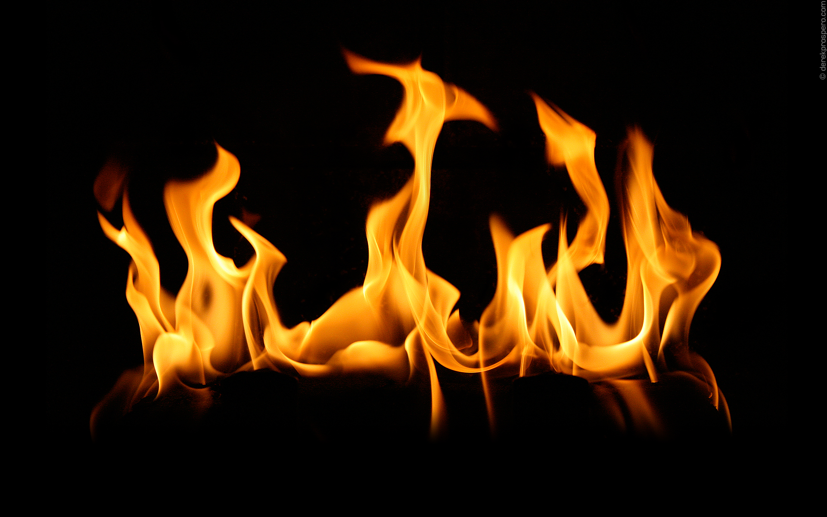
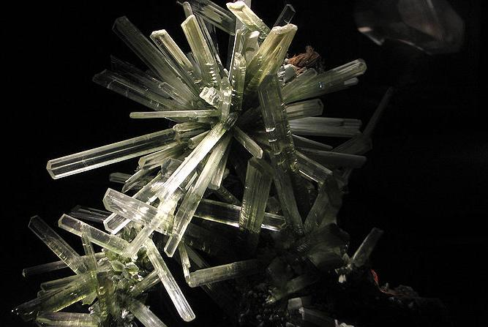
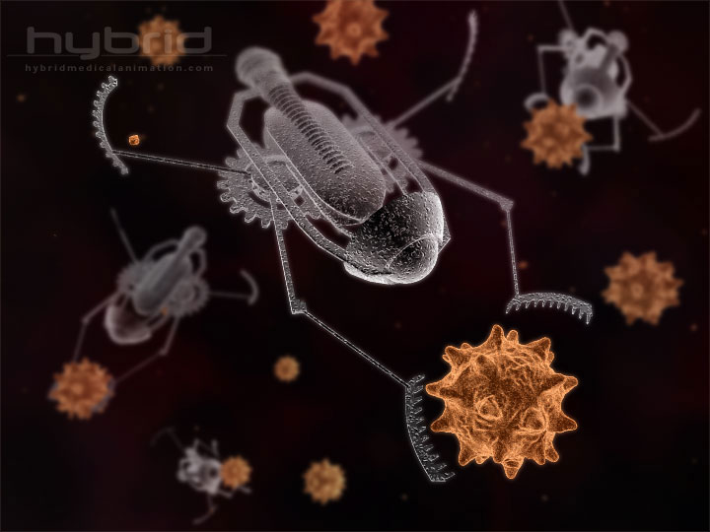
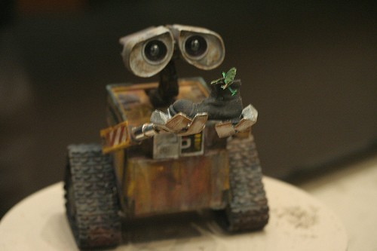
What is
Life?

Slide 6
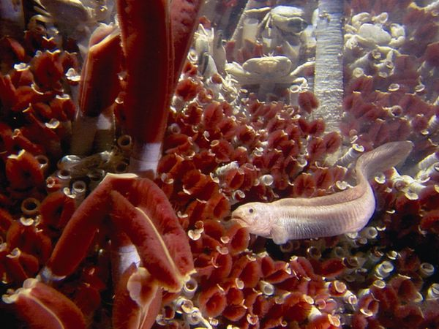
photo: Emory Kristof
Notes:
Mid-Atlantic Ridge with tubeworms, eelpout fish, and crabs

Slide 7
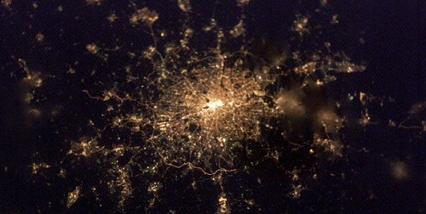
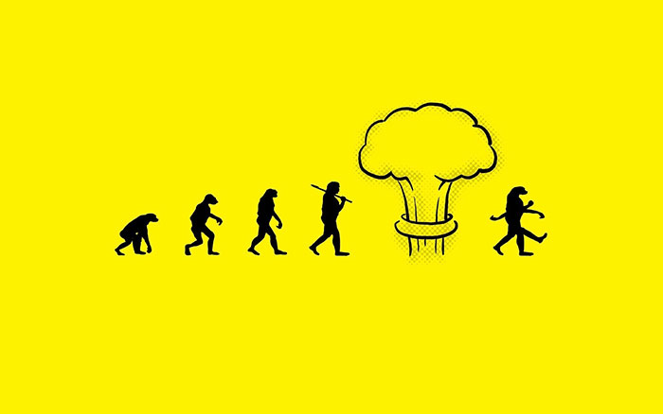
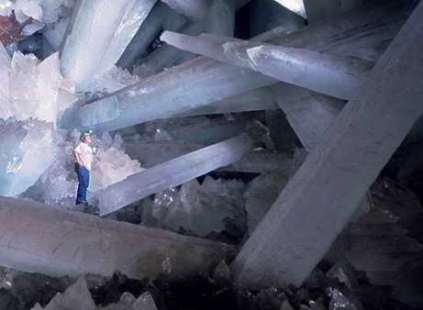
Definition of Life
1. moves
water, sandstorm
2. grows
mountains, crystals
3. reacts
waves, snowmelt
4. defends
fire, avalanche
5. metabolizes
fire
[may have preceded RNA/DNA]
6. reproduces
crystals do, mules don’t
* 7. organized
violates entropy
more organized than surroundings
membrane/wall
* 8. evolves
generational
reacts to environmental changes
Notes:
Cave of Crystals in Mexico

Slide 8
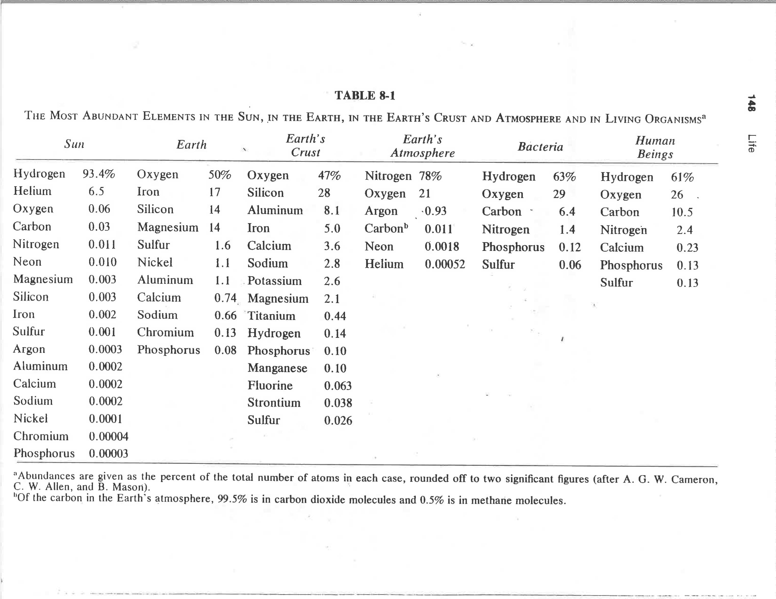
Universal Compositions
Oxygen is everywhere, but
Carbon is RARE
from The Search for Life in the Universe (Goldsmith & Owen, 1980)

Slide 9
Case for Life As We Know It
+ no shortage of locations with varying environments
+ plenty of energy from stars, impacts, weather
+ raw materials, CHON, are ubiquitous
+ evidence of chemical evolution found in meteorites
+ DNA made of a few basic molecules (bases/sugars/phosphates)
+ significant evidence of evolutionary adaptability
+ time
o no evidence that there is no life
– series of unlikely accidents required?
– the Universe can be an unforgiving place
– no experiment has produced a living organism (but, virus made)
– no evidence that there is life!
but, it is early in the game

Slide 10
Energy Sources in Solar System
nuclear fusion
hydrogen → helium
solar radiation
greenhouse effect
differentiation
gravitational settling
radioactive decay
volcanism
tidal heating
friction from direct tides
stressing via orbital resonances
charged particles
from Sun or planet
charged particle imbalance
lightning
ohmic heating
Io deep in Jupiter magnetosphere
… lead to … metabolism
photosynthesis, respiration, eating

Slide 11
Life’s Environmental Requirements
1. solid surface
CHON found in abundance
2. atmosphere and/or ocean
mixing, solubility
protection from photons gamma, x-ray, UV
protection from particles solar wind, cosmic rays
protection from impacts (some)
3. stability
radiation orbital dynamics
temperature greenhouse effect
“escape” Snowball Earth … living planet
4. energy source(s)

Slide 12
Solar System Locations for Life
1 star Sun
4 terrestrial planets Mercury, Venus, Earth, Mars
2 gas giant planets Jupiter, Saturn
2 ice giant planets Uranus, Neptune
7 large moons Moon, Io, Europa, Ganymede,
Callisto, Titan, Triton
small moons, asteroids, Phobos, Ceres, Amalthea,
comets, TNOs, dust Rhea, Enceladus, Titania, Proteus,
Pluto, Charon
WHICH ARE THE BEST OPTIONS?
Notes:
Titania = Uranus’ largest moon, #8 in SS, diam 980 mi
Proteus = Neptune’s second largest moon, diam 260 mi

Slide 13
Solar System Locations for Life
1 star Sun
4 terrestrial planets Mercury, Venus, Earth, Mars
2 gas giant planets Jupiter, Saturn
2 ice giant planets Uranus, Neptune
7 large moons Moon, Io, Europa, Ganymede,
Callisto, Titan, Triton
small moons, asteroids, Phobos, Ceres, Amalthea,
comets, TNOs, dust Rhea, Enceladus, Titania, Proteus,
Pluto, Charon

Slide 14
The Drake Equation
N = R* f_{p} n_{e} f_{l} f_{i} f_{c} L
N # civilizations with detectable electromagnetic emissions
R* rate of star formation (stars/year) suitable for intelligent life
f_{p} fraction of stars with planetary systems
n_{e} # of worlds/system with environment suitable for life
f_{l} fraction of planets on which life appears
f_{i} fraction of life-bearing planets on which intelligent life emerges
f_{c} fraction of civilizations revealing existence
L length of time civilizations release detectable signals (years)

Slide 15
…………………………
Notes:
15

Slide 16
Todd’s Top 10 Tips for Talks
Match the time of your talk to the time allocated.
Watch the “um”s and other useless sounds/words.
Use the fewest words possible per slide.
4. Be sure that all Figure details are legible from the back of the room.
5. Be careful with red and green in deference to our color-challenged friends.
6. If you must have an equation, describe each variable clearly.
7. Use pauses to great effect.
8. Use gestures appropriately, but not frantically.
9. Move, and use lack of movement to great effect.
10. Enjoy your topic … or don’t bother!
Notes:
16

Slide 17
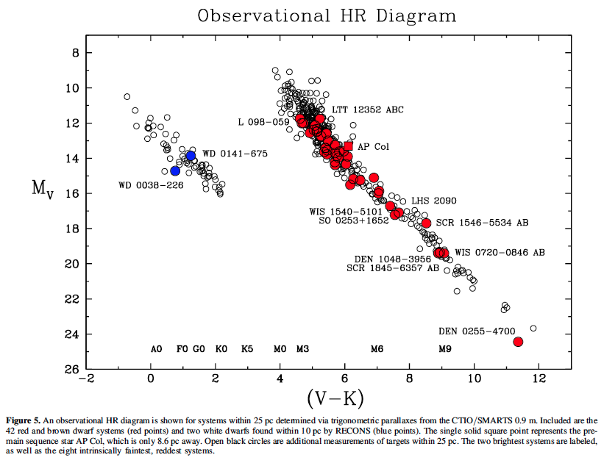
Level 2 Paper Comments

Slide 18
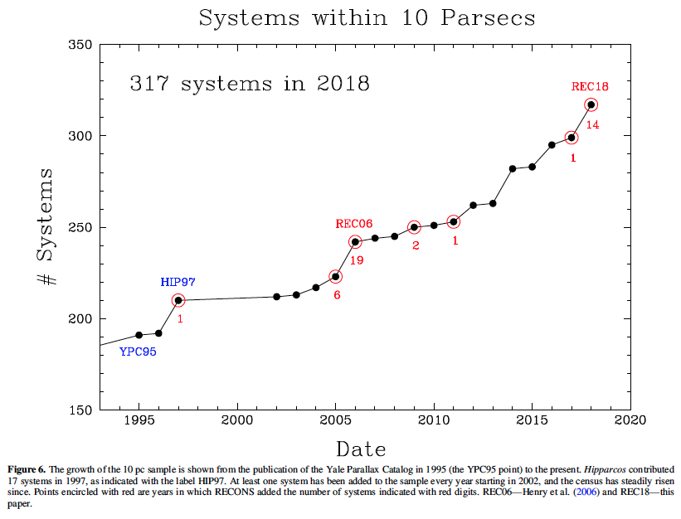
Level 2 Paper Comments

Slide 19
Level 2 Outline Comments
Font Size: \documentclass[arguments]{aastex63} … NOT [preprint] style
8-10 pages of text + 5 pages of Refs/Figures/Tables
Overall RESEARCH paper, not REPORT … sophisticated language, cleaned up
Dates Received = Sep 24; Revised = Oct 20; Accepted = Dec 8
Abstract data rich, NUMBERS, specific RESULTS
Key words: http://astrothesaurus.org/thesaurus … Mars (1007); Astrobiology (74)
Introduction background information … MANY REFERENCES
Tables/Figures at least two of each
must refer to them in text and describe carefully … Why?
Figures must have detailed captions … SCIENTIFIC, LEGIBLE
Discussion may use bullets to call out key things to remember
General Sun, Solar System, Earth, Moon, Galaxy
Galileo, Cassini, New Horizons, Curiosity
that vs. which since vs. because
SPELLCHECK ALWAYS!

Slide 20
SSE!
Which TEEEMate has the highest density?
…
Earth
5.5 g/cm³
Which TEEEMate has the lowest density?
…
Enceladus
1.6 g/cm³
Which TEEEMate is LEAST LIKELY to have geysers?
…
Mars
Which TEEEMate has the oldest surface?
…
Mars
Notes:
Mars is really only SS object with density ~4

