Slide 1
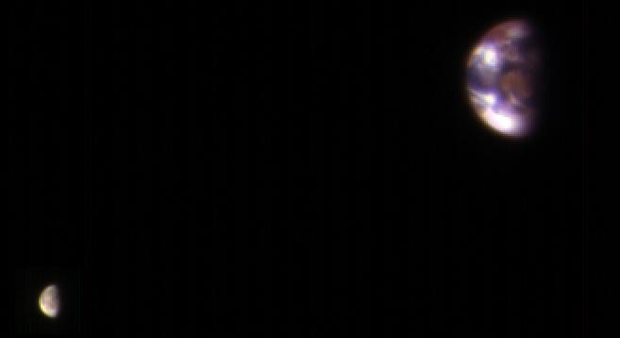
Where is this?
Notes:
EARTH AND MOON FROM MARS: This composite image of Earth and its moon, as seen from Mars, combines the best Earth image with the best moon image from four sets of images acquired on Nov. 20, 2016, by the High Resolution Imaging Science Experiment (HiRISE) camera on NASA's Mars Reconnaissance Orbiter.
Each was separately processed prior to combining them so that the moon is bright enough to see. The moon is much darker than Earth and would barely be visible at the same brightness scale as Earth. The combined view retains the correct sizes and positions of the two bodies relative to each other.
HiRISE takes images in three wavelength bands: infrared, red, and blue-green. These are displayed here as red, green, and blue, respectively. This is similar to Landsat images in which vegetation appears red. The reddish feature in the middle of the Earth image is Australia. Southeast Asia appears as the reddish area (due to vegetation) near the top; Antarctica is the bright blob at bottom-left. Other bright areas are clouds.
These images were acquired for calibration of HiRISE data, since the spectral reflectance of the Moon's near side is very well known. When the component images were taken, Mars was about 127 million miles (205 million kilometers) from Earth. A previous HiRISE image of Earth and the moon is online at PIA10244.

Slide 2
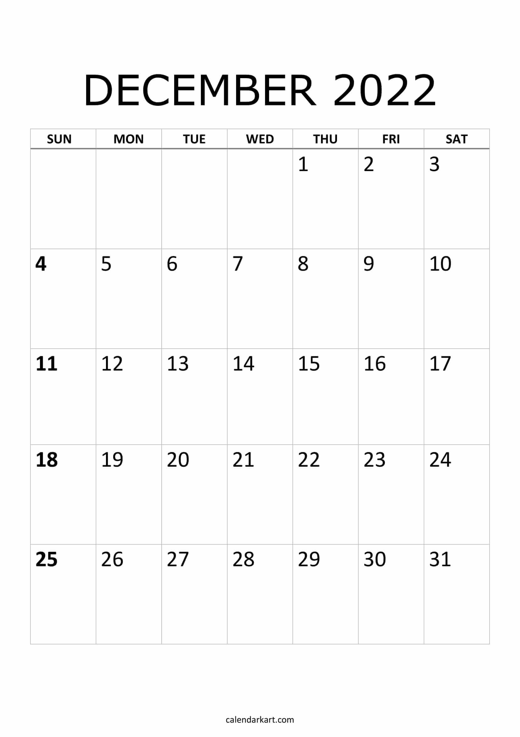
papers
Due
5pm
21
22
reviews
due
5pm
23
24
talks
talks
grades
due
T u r k e y T i m e

Slide 3
Talk Schedule
TUESDAY, 15 NOV
1. Maura
2. Garrett
3. Aatiya
4. Tim
5. Sebastian
THURSDAY, 17 NOV
6. Saba
7. Alex
8. Isaac
9. Jessica
Melodie
TUESDAY, 22 NOV (online)
Madison
Griffin
Notes:
3

Slide 4

Life Beyond Earth

Slide 5
Exoplanet Scorecard (09 NOV 2022)
Indirect Methods (measured/estimated Porb and mass)
1. (pulsar) timing 6 planets
2. radial velocities 1009 planets
3. transits 3888 planets
4. microlensing 9 planets
5. other 50 planets
Direct Methods
6. imaging 13 planets
TOTAL 5197 planets
        exoplanets.nasa.gov
Notes:
counts updated 12 APR 2017 using exoplanet.eu
X. microlensing 81 systems 84 planets

Slide 6
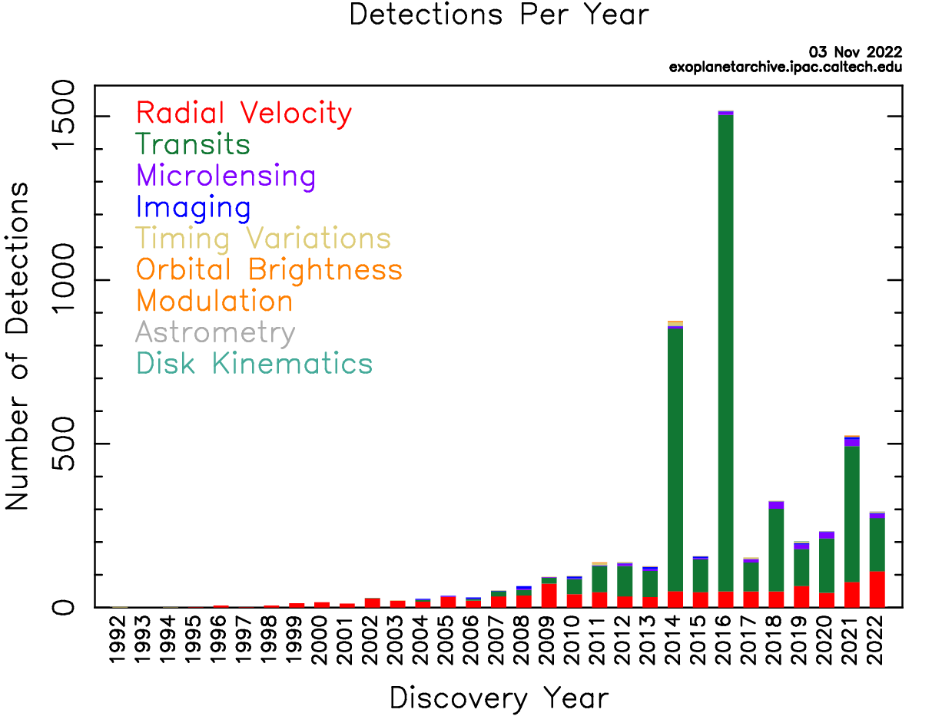
Exoplanets
Gaia will soon blow this up …

Slide 7
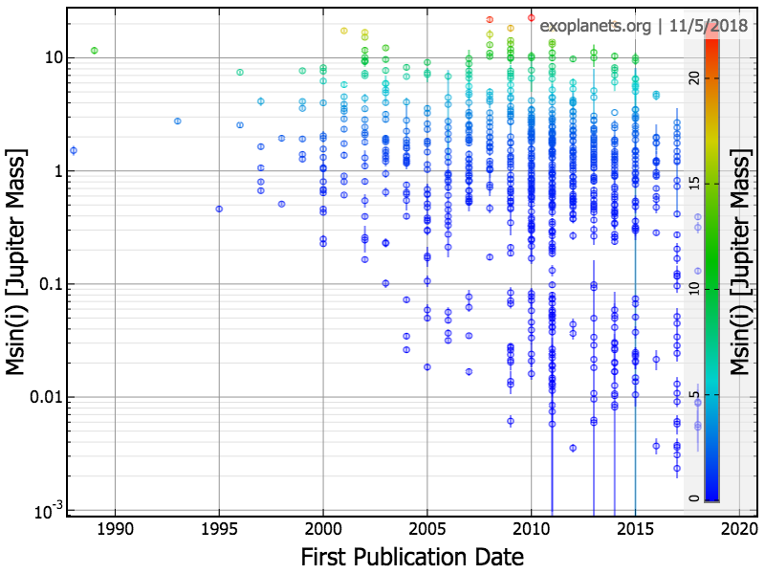
Exoplanets
Jup
Nep
Ear
Notes:
7

Slide 8
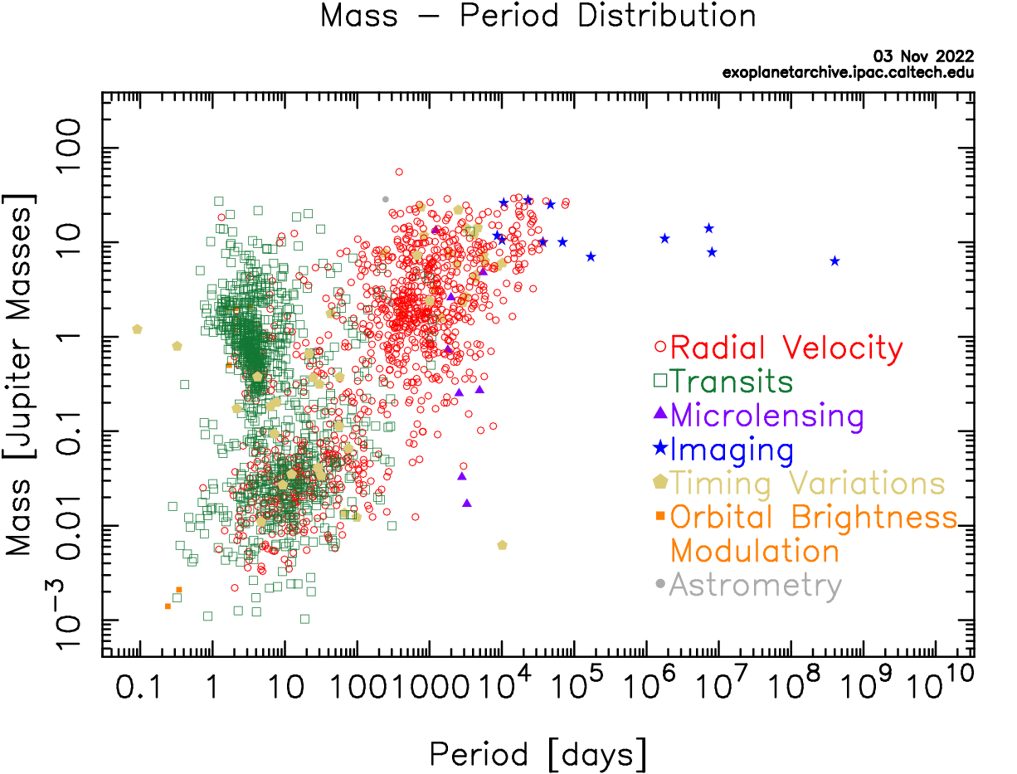
Exoplanets
Jup
Nep
Ear
Notes:
8

Slide 9
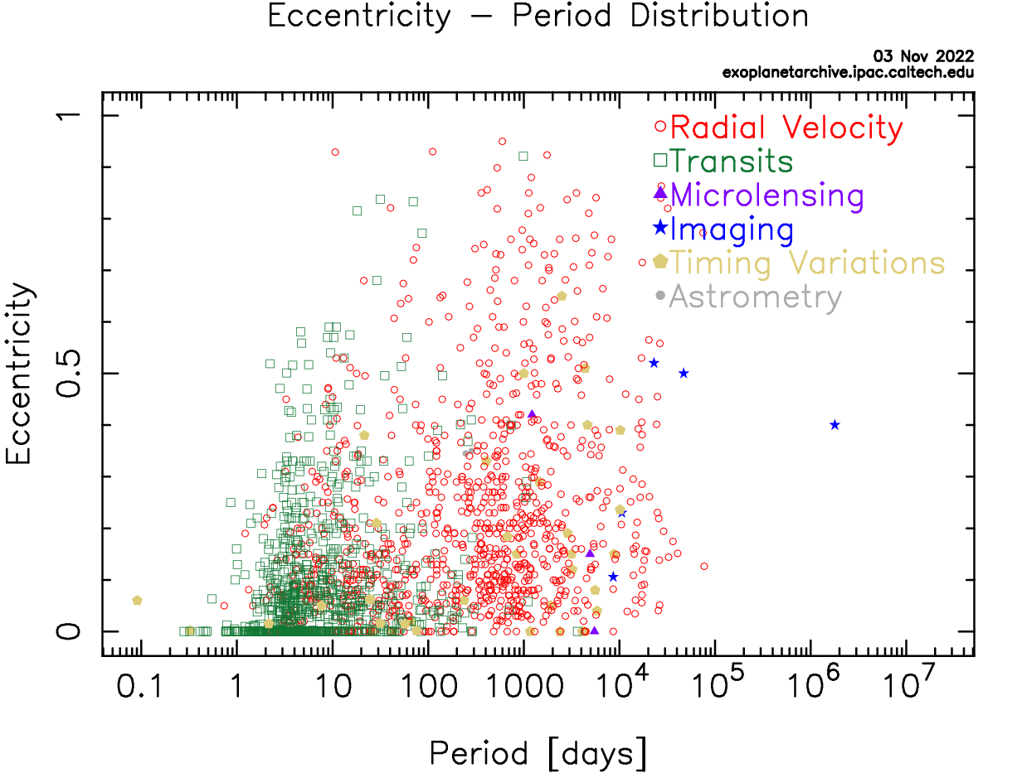
Exoplanets
You think of it, the Universe will make it …

Slide 10
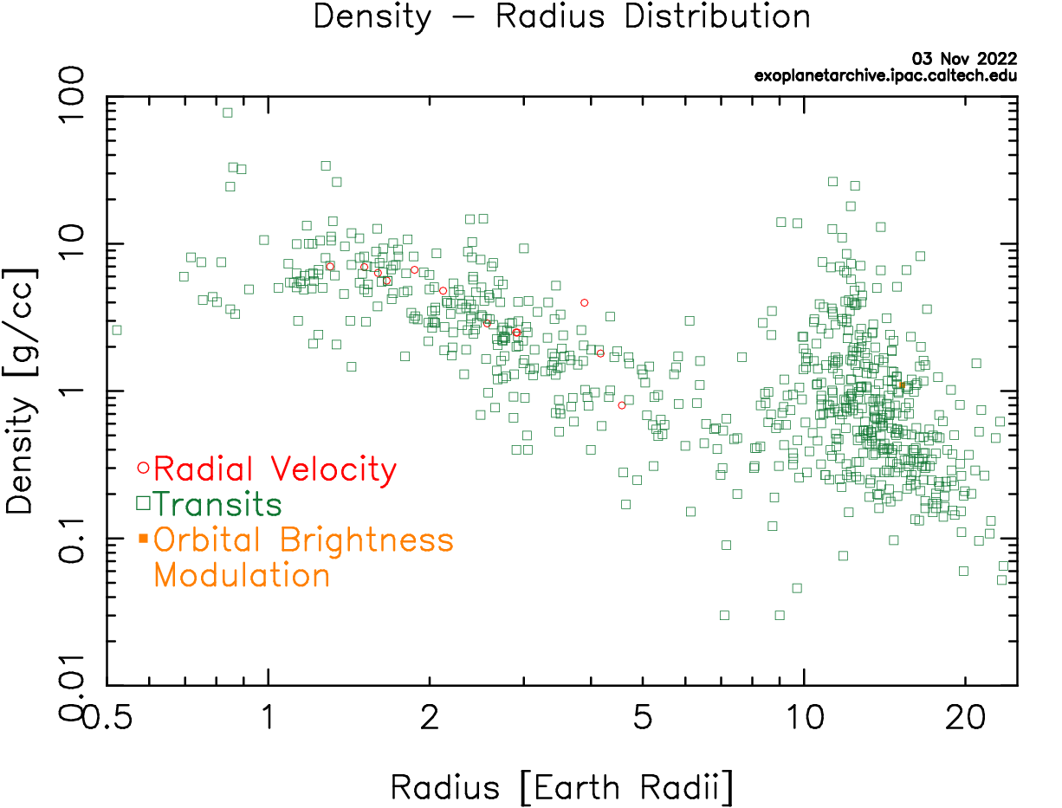
Exoplanets
?
Ear
Jup
?
You think of it, the Universe will make it …

Slide 11
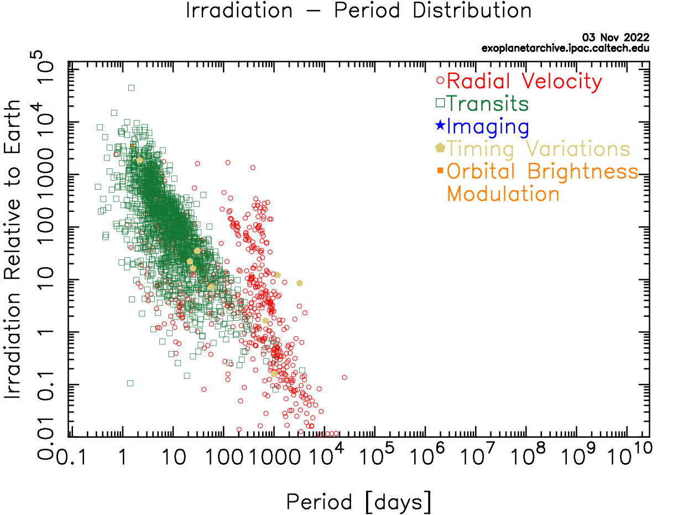
Exoplanets
Ear
You think of it, the Universe will make it …
Notes:
10^10 days is 30 Myr!

Slide 12
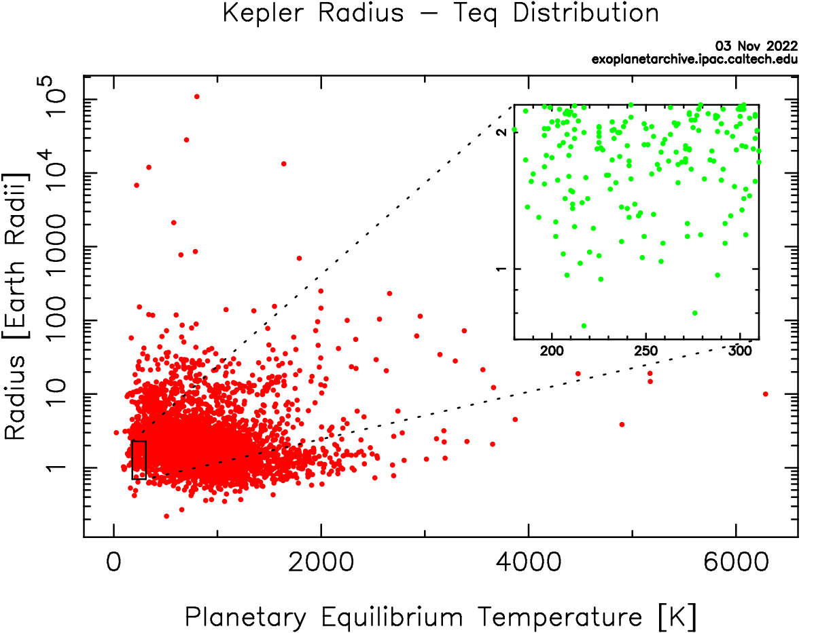
Exoplanets
Ear
You think of it, the Universe will make it …

Slide 13
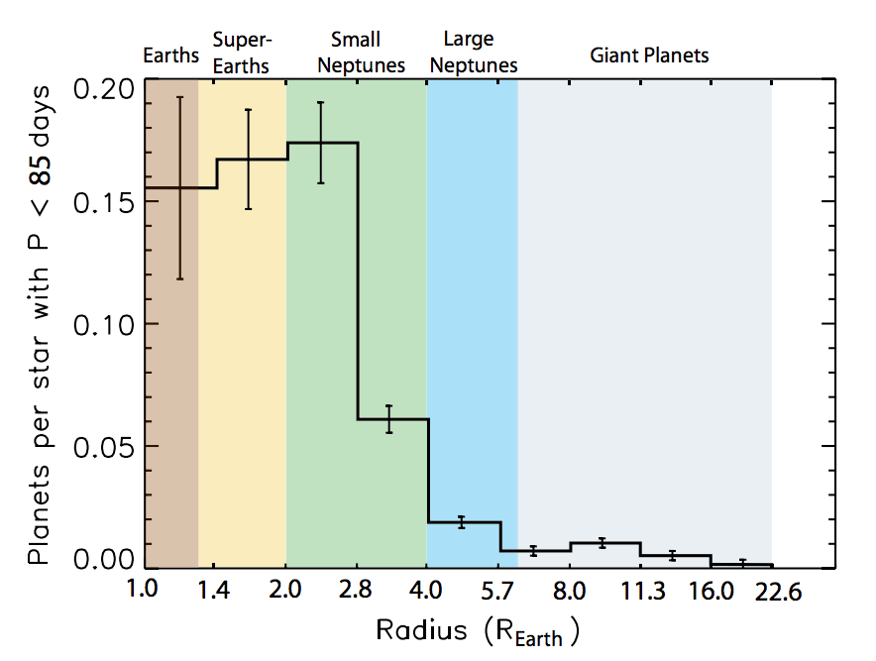
Kepler Results (all stellar types)
what about
longer
orbital P?
Fressin+ 2013
occurrence not strong dependence on host star type
Notes:
Occurrence appears that it might level off for sizes below ~2.8 R_Earth. Is this inherently true for all small planets, or might it be a consequence of the types of orbits Kepler is most sensitive to (<85 day orbits). What about size distributions at longer periods?

Slide 14
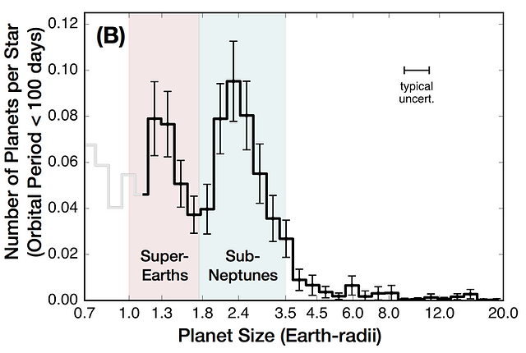
Exoplanet Types
what about
longer
orbital P?
Fulton+ 2017
Notes:
Occurrence appears that it might level off for sizes below ~2.8 R_Earth. Is this inherently true for all small planets, or might it be a consequence of the types of orbits Kepler is most sensitive to (<85 day orbits). What about size distributions at longer periods?

Slide 15
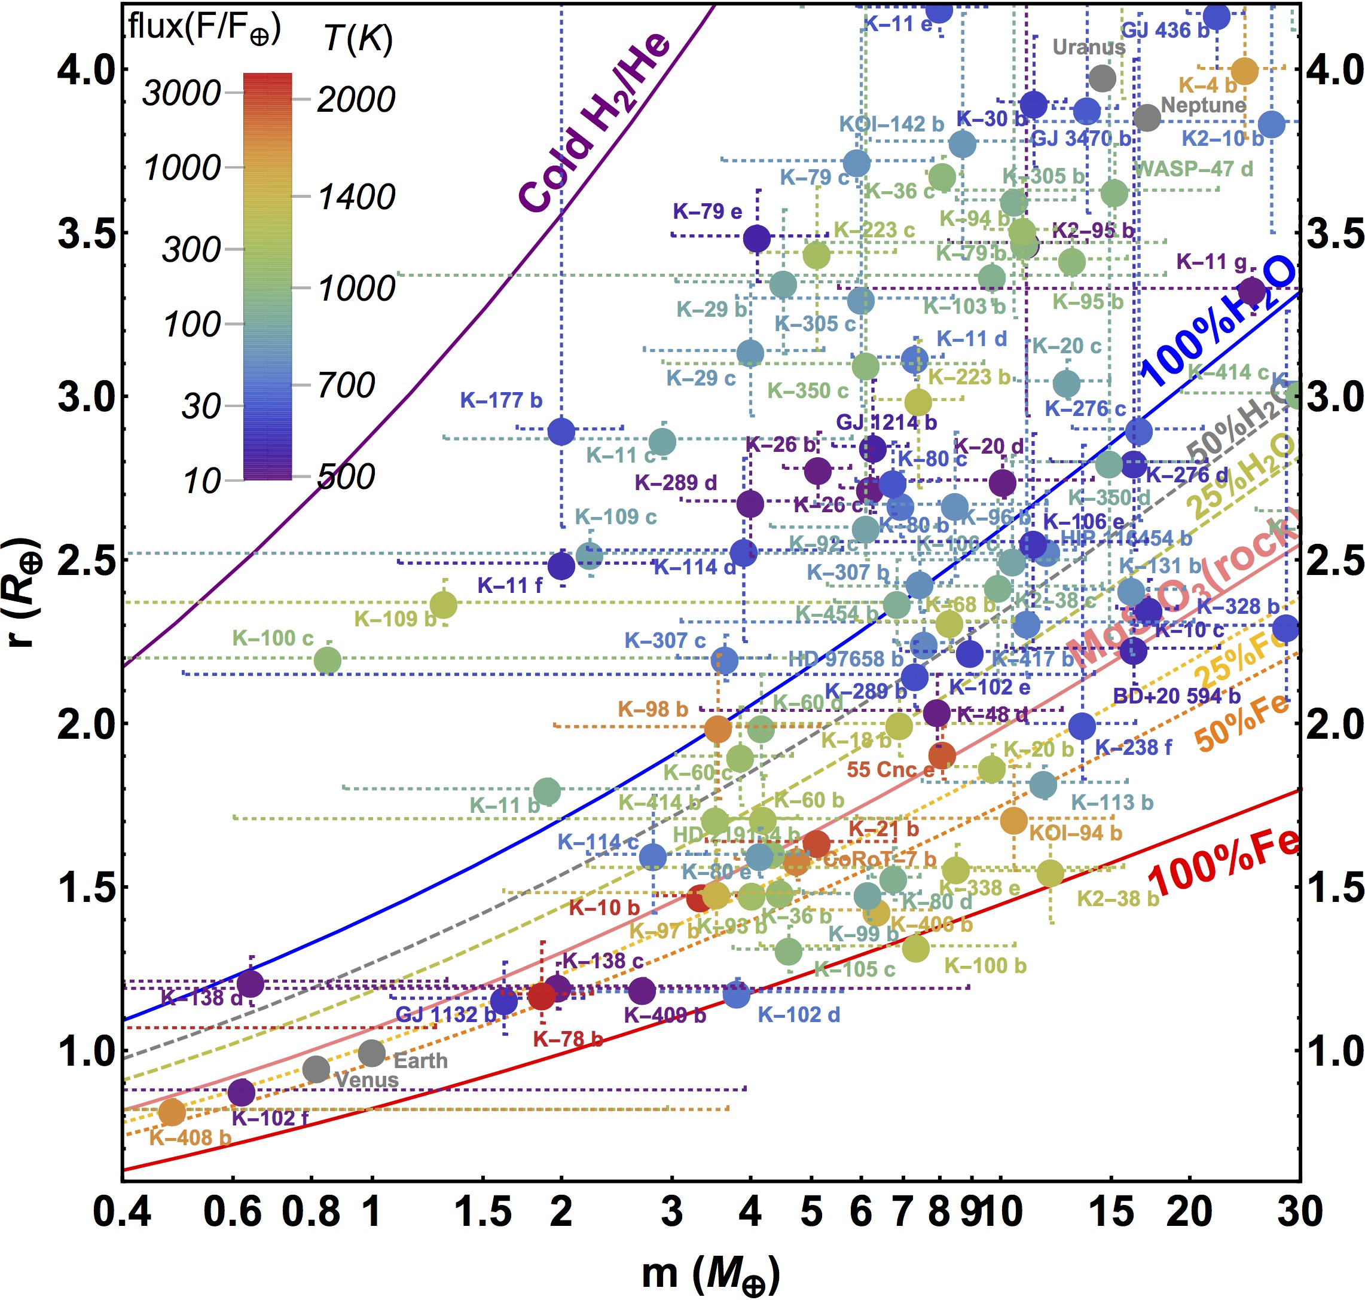
Radius/Mass Diagram … Dirty
planets
orbiting
various
stellar
types
Kaltenegger
2017

Slide 16
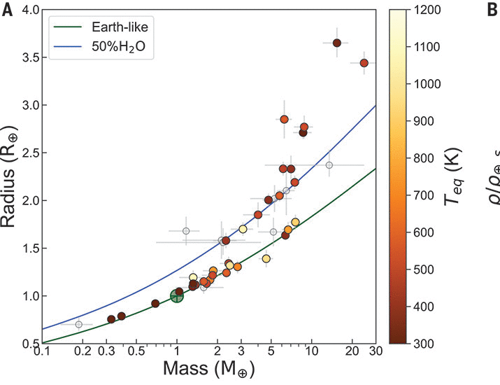
Radius/Mass Diagram … Clean(er)
planets
orbiting
M dwarfs
Luque & Palle
2022

Slide 17
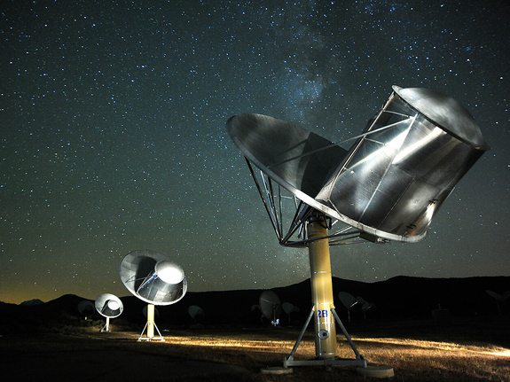
Life Beyond Earth
photo: Emory Kristof
Notes:
Allen Array pic by Seth Shostak

Slide 18
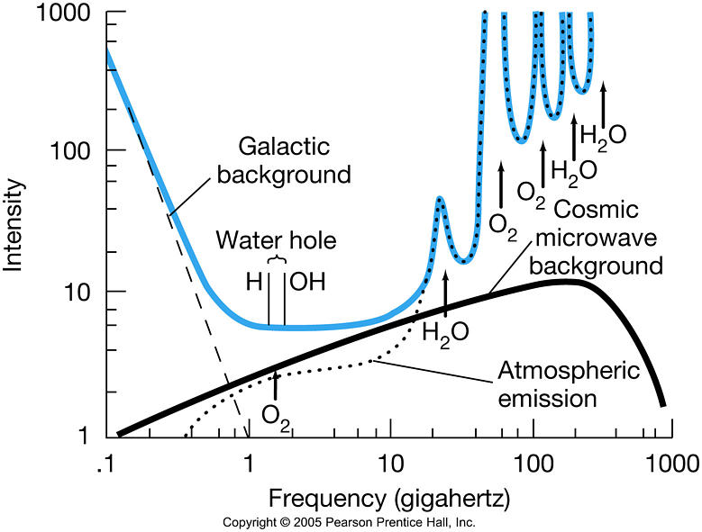
SETI Water Hole

Slide 19
SETI Surveys
 | Ozma | Project Phoenix | Allen Array
Telescope(s) | Greenbank 26m | Arecibo 305m Parkes 64m Greenbank 43m | 350 x 6.1m (= 101m dish)
Frequencies | 1.4198 to 1.4202 GHz | 1.0 to 3.0 GHz | 0.5 to 11.2 GHz
Resolution | 100 kHz | 1 Hz | 0.7 Hz
# channels | 4 | 2 x 10⁶ | 2200
Weeks/year | 4 (once) | 3 (repeating) | 52
Funding | ??? | NASA, then private | SETI Institute
# target stars | 2 | 10³ | 10⁶
# completed | 2 | ~ 50% | first light 2004
# ET signals | 0 | 0 | ???

Slide 20
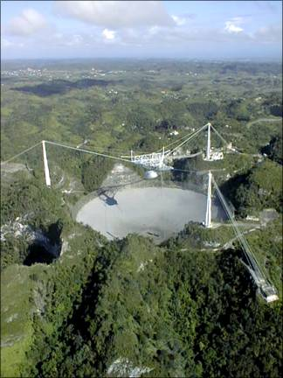
Project Phoenix
began as NASA’s High Resolution Microwave Survey (HRMS)
Targeted Search (Ames) and Sky Survey (JPL)
first observations, October 12, 1992
cancelled by Congress in 1993
renamed Project Phoenix
private funding sources sought
private funding sources found
Arecibo 305m (largest in N)
Jodrell Bank (England)
Greenbank 43m
Parkes 64m (largest in S)

Slide 21
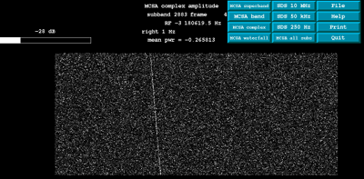
Project Phoenix Detects ET!
time
frequency
test case: Pioneer 10 beyond 70 AU
signal allowed to drift in frequency from Earth motion
separates terrestrial from extraterrestrial signals

Slide 22
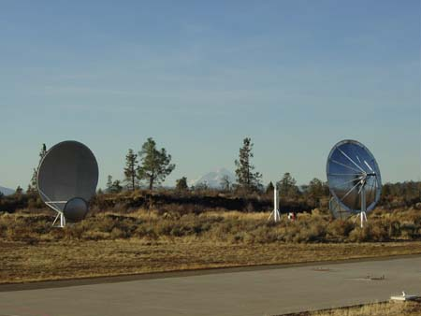
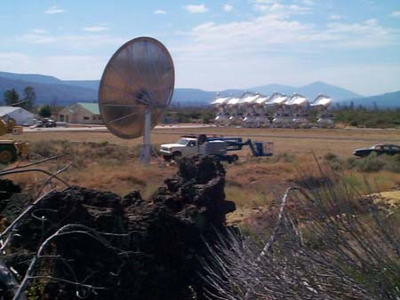
Allen Array
dedicated SETI effort … Paul Allen (co-founder of Microsoft) $30M
SETI Institute and UC Berkeley
Hat Creek Observatory, Mt. Lassen, California
350 antennas 6.1m diameter = 100m radio telescope
42 in operation

Slide 23
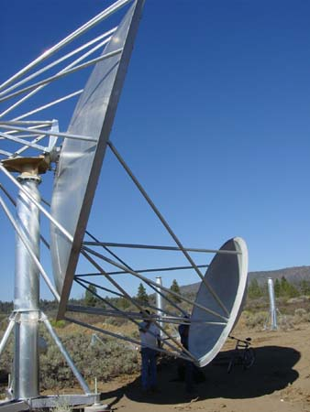
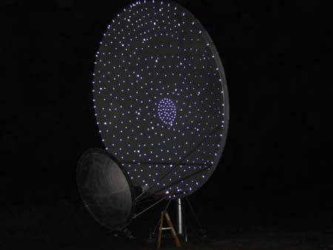
Allen Array
Gregorian design
350 X 6.1m dishes
Notes:
to reduce interference, Gregorian telescopes: A secondary mirror bounces incoming radio signals collected by the large (6.1 meter diameter) primary reflector back to the feed antenna (hidden from view by a fabric shroud) where they are amplified and sent on their way to the control buildings.

Slide 24
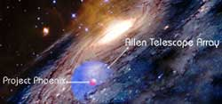
Allen Array
Project Phoenix got 3 weeks/year at Arecibo
Allen Array increases efficiency by > 100X
full time SETI operation
daytime observations ok (Arecibo has Sun problem)
different stars (Arecibo limited to near-ecliptic sources)
multiple dishes … ~20 stars searched simultaneously
expansion easy
… target list grows from 1,000 stars to 1,000,000 stars
Project Phoenix 50 pc
Allen Array 300 pc
Notes:
single pointing of subarrays has ~20 individual stars

Slide 25
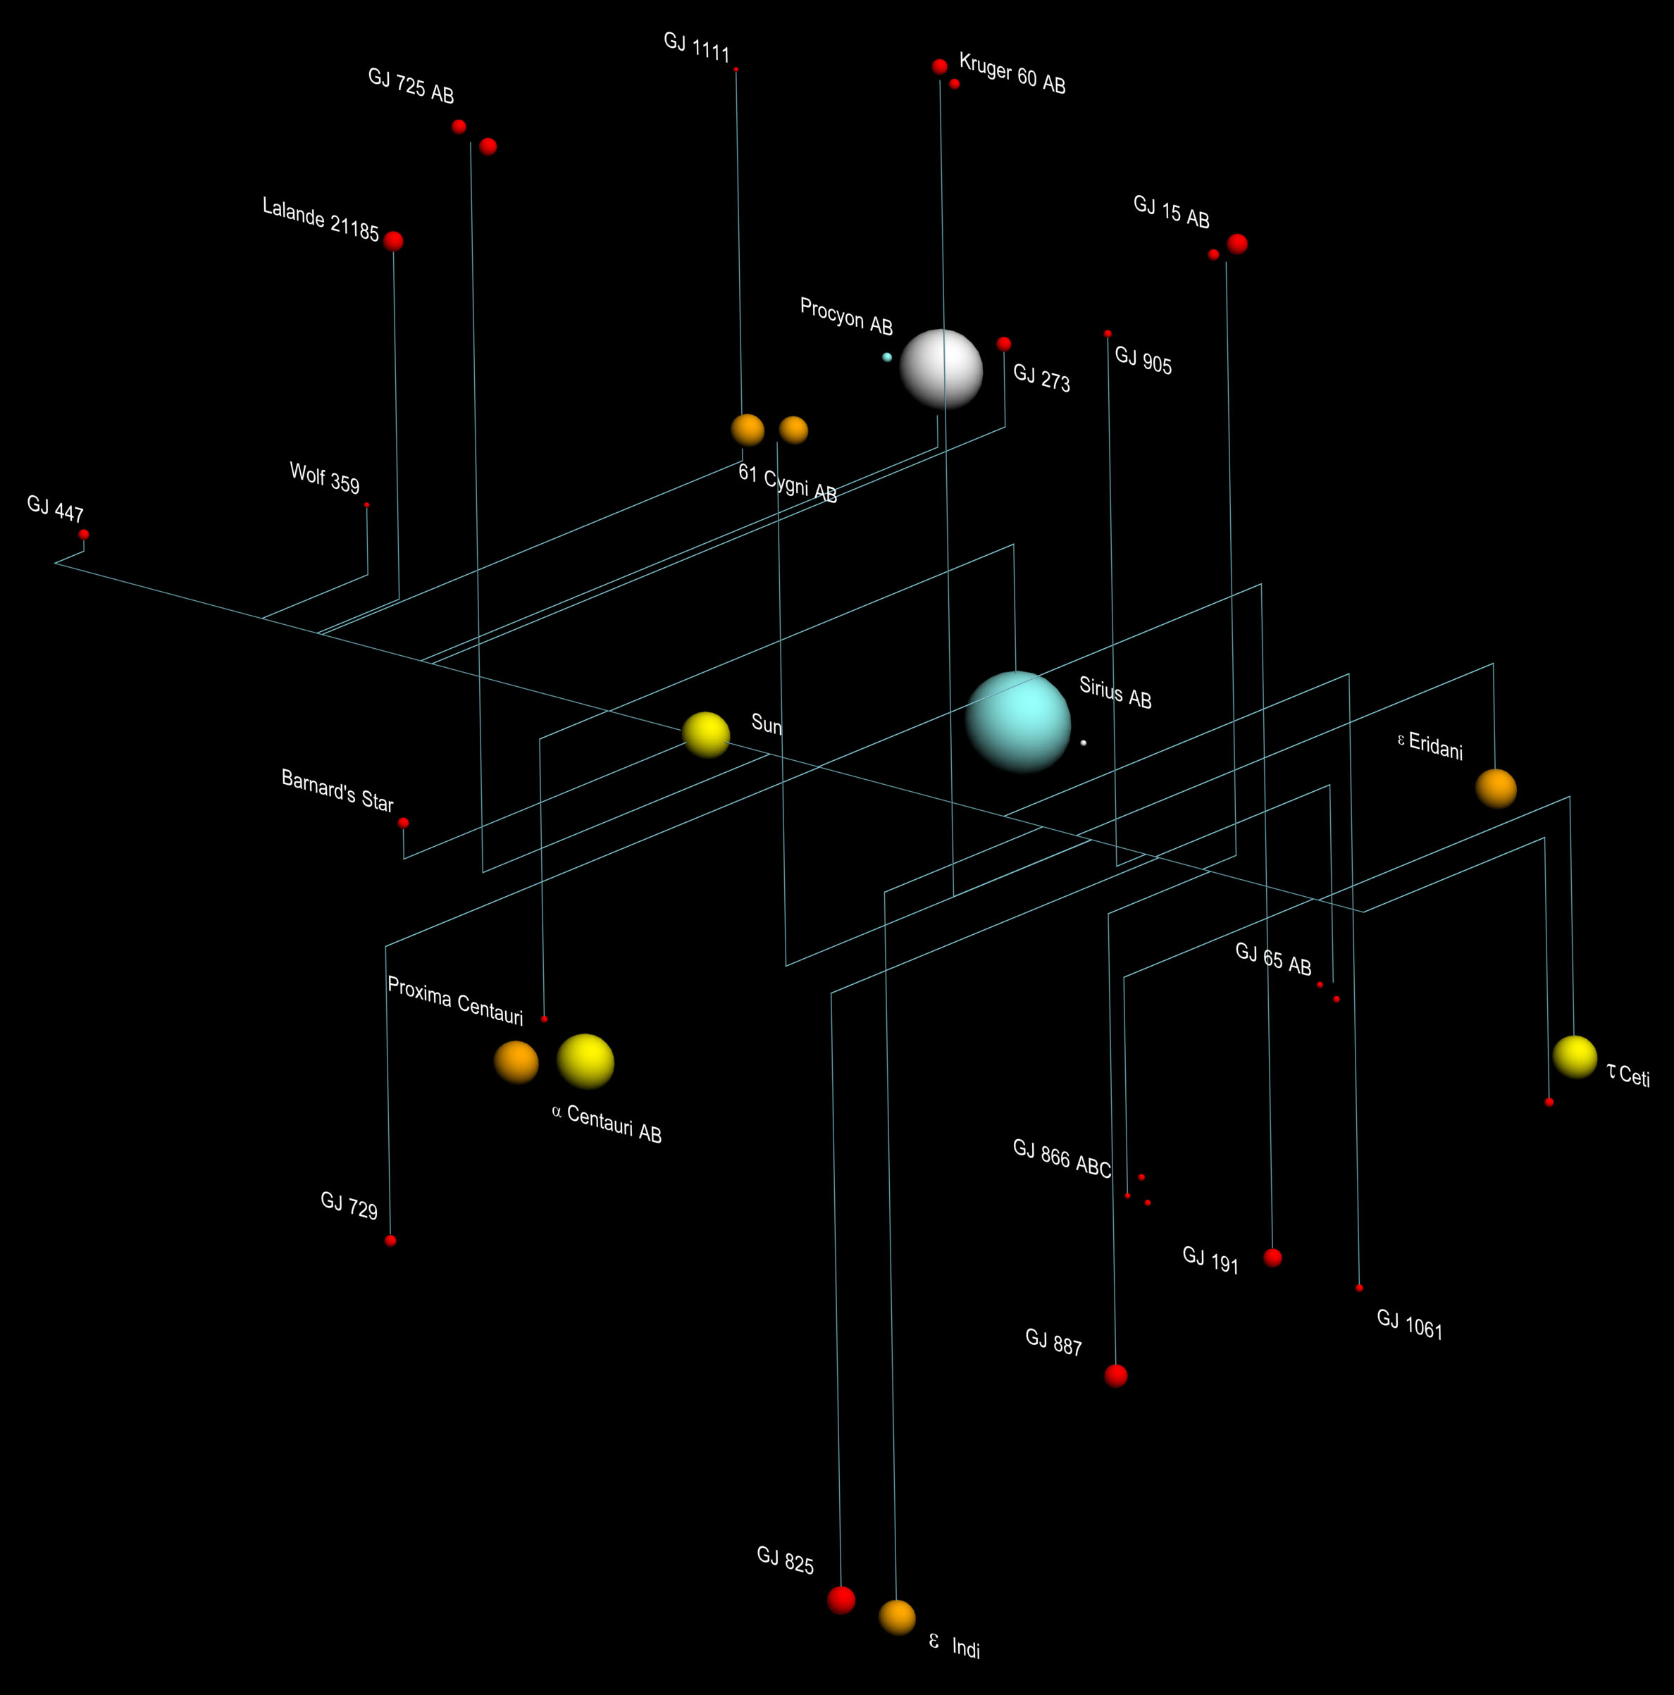
10 Parsec Census 2020.0
wd 21 6 %
O,B 0 0 %
A 4 1 %
F 7 2 %
G 19 5 %
K 43 12 %
M 278 75 %
bd 74
pl 61+8
Notes:
M dwarfs includes WT 460B

Slide 26
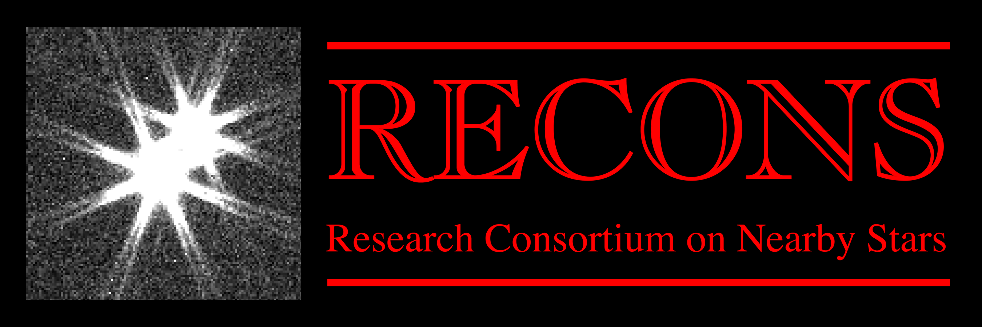
Three Laws of M Dwarfs
M dwarfs dominate the stellar population.
M dwarfs dominate the stellar mass budget.
M dwarfs are more varied than any other spectral type.

Slide 27
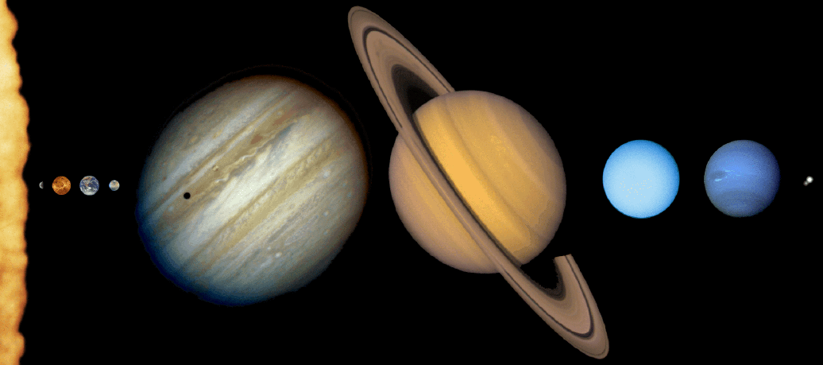
Solar Family
How are they different?

Slide 28
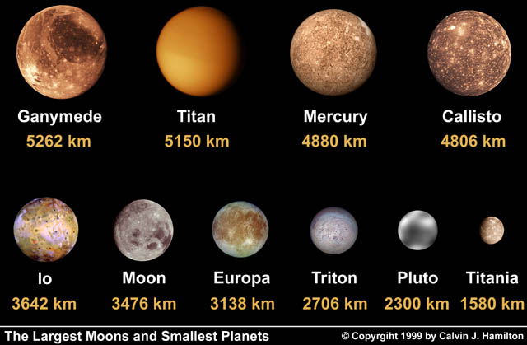
The Seven Dwarfs

Slide 29
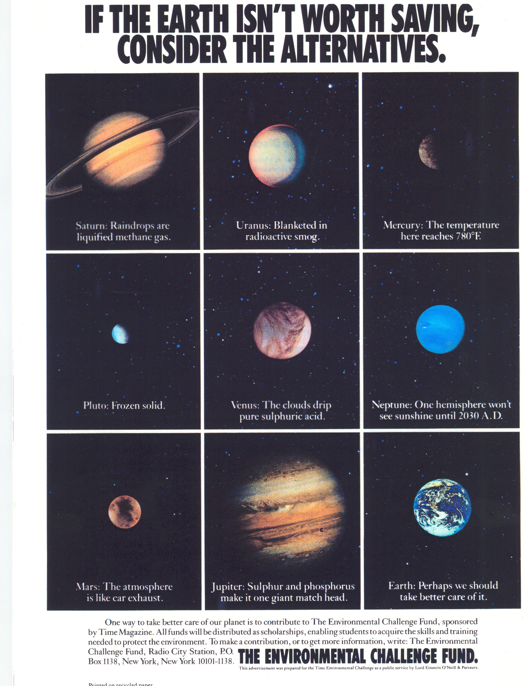
Nice Earth

Slide 30
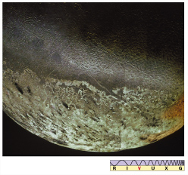
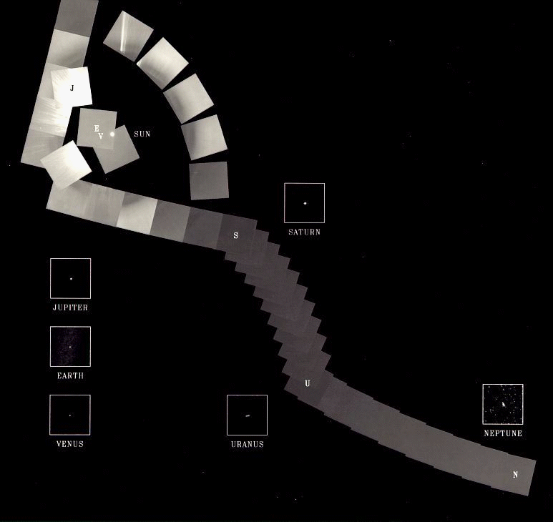
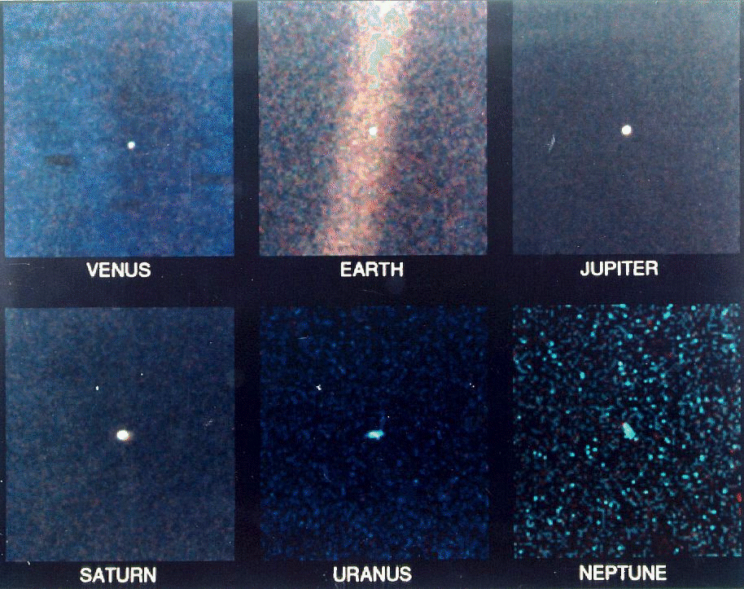
Voyager’s Farewell

Slide 31


The Brothers Henry

Slide 32
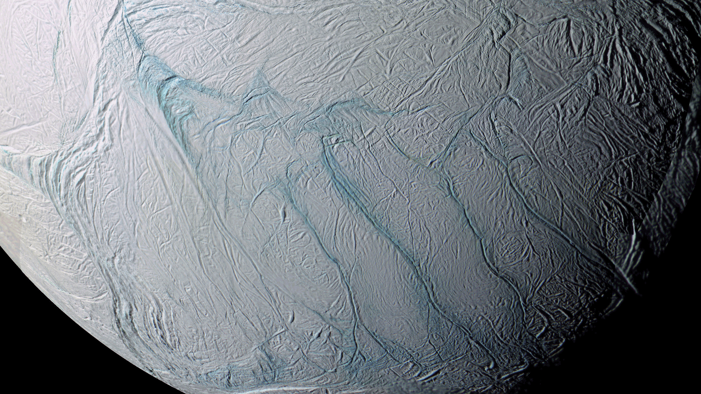
Where is this?
Notes:
ENCELADUS by CASSINI

Slide 33
…………………………
Notes:
33

Slide 34
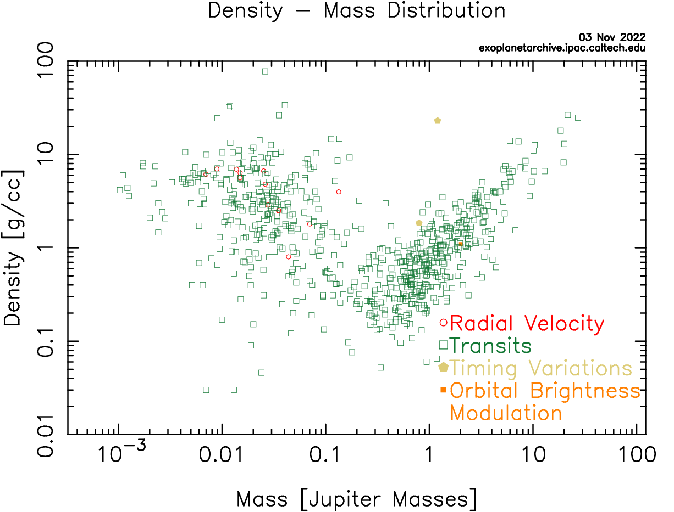
Exoplanets
You think it, the Universe will make it …

Slide 35
How Far for 1 Million Stars?
G 375 parsecs 1222 light years
F-K 244 parsecs 795 light years
A-M 142 parsecs 462 light years
500 Light Year Catalog ... would give 10⁶ stars
The Dream
100 Parsec Catalog … ~350,000 stars

Slide 36
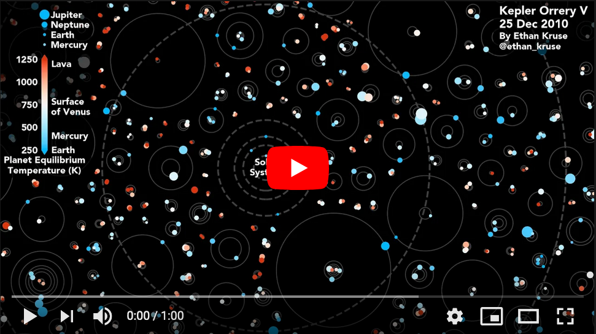
Kepler Orrery V
https://www.youtube.com/watch?v=Td_YeAdygJE

Slide 37
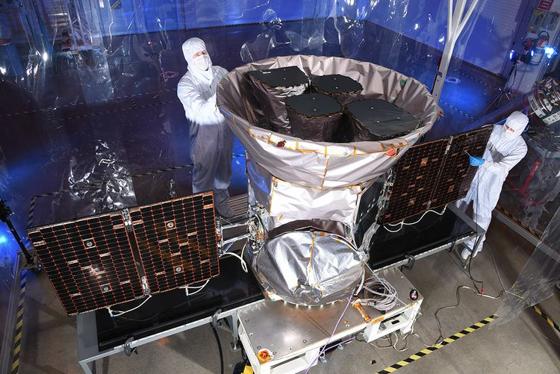
Transiting Exoplanet Survey Satellite TESS

Slide 38
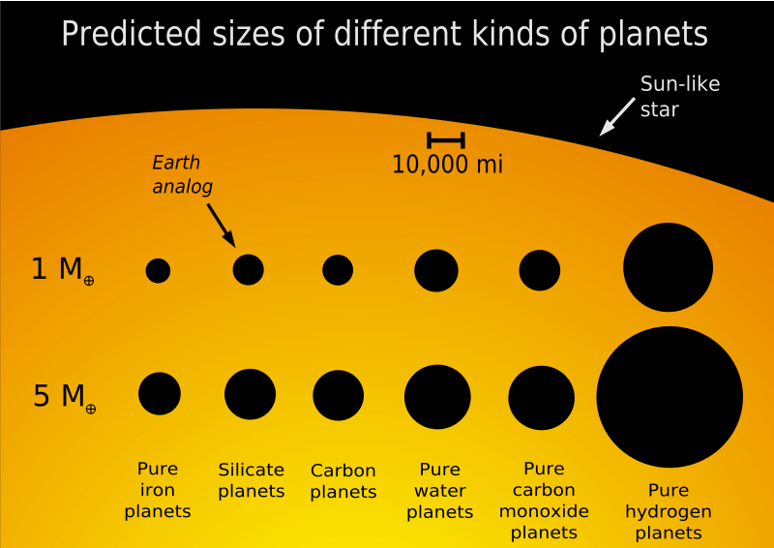

Slide 39
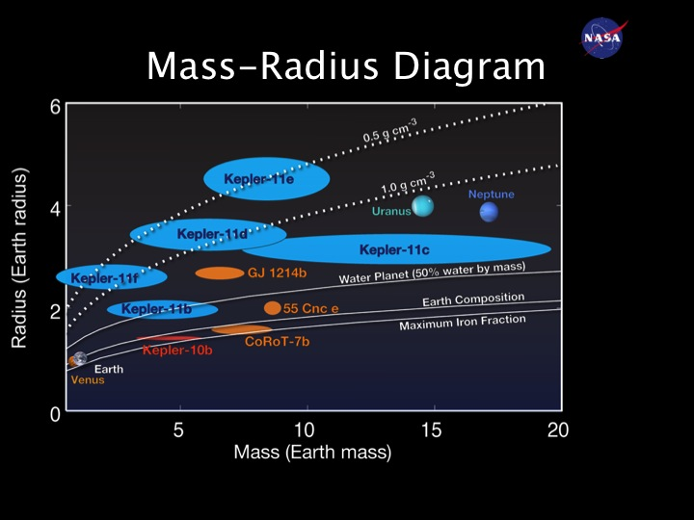

Slide 40
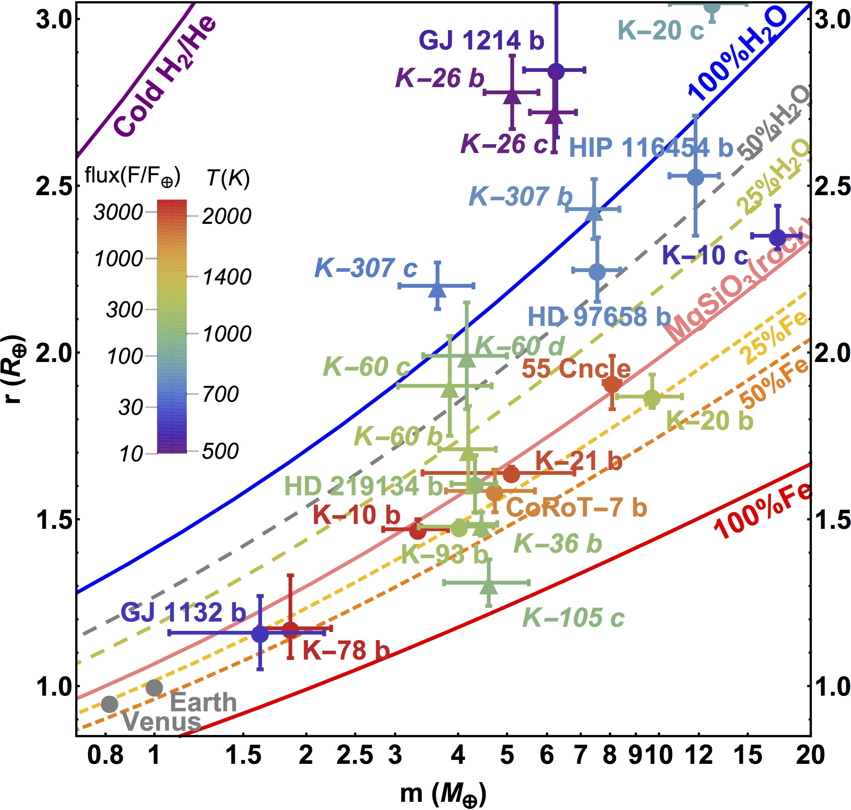
Mass-Radius Plot
of Planets up to
20 Earth Masses
(errors 30% or less)
Zeng
2016

Slide 41
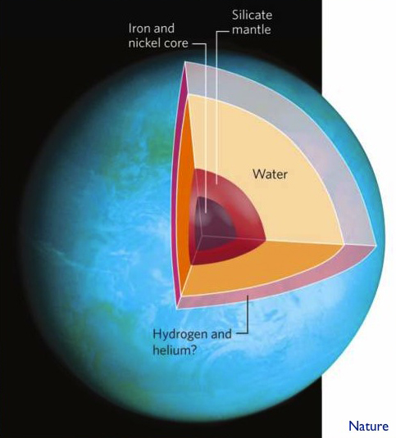
GJ 1214’s Planet
density ~1 g/cm³

Slide 42
M Stars for SETI
the bad news
a. HZ width narrow and close
estimated to be 0.75 AU wide for Sun, only 0.20 for M0V
tidal locking
b. flares, spots
c. planet presence
some models show no terrestrial planets in close
few giants to protect from/encourage comet bombardment
the good news
a. presence of atmosphere can solve tidal locking
for M0V and P = 1.0 Earth, HZ from 0.25 to 0.45 AU
for M0V and P = 0.1 Earth, HZ from 0.14 to 0.30 AU

Slide 43
Planets around M Dwarfs
atmospheric simulations by Joshi et al. 1997
planet placed in orbit to match solar flux levels
compare Earth’s: P ~ 1.0, tau ~ 0.9, room temp 295K
run | pressure | τ | planet | result
1 | 1.0 | 1.00 | Earth, CO₂ | T: 260-330K, CO₂ gas, H₂O ~ solid
2 | 0.1 | 0.25 | Earth, CO₂ | T: 190-360K, CO₂ gas, near collapse
3 | 1.5 | 1.50 | Earth, CO₂ | T: 290-330K, H₂O liquid, nice!
4 | 1.0 | 0.25 | Earth, N₂ | T: 220-330K, N₂ gas, collapse at 77K
5 | 1.0 | 0.50 | Earth, CO₂ | T: 240-320K
6 | 1.0 | 2.00 | Earth, CO₂ | T: 300-360K, hot!
R1 | 1.0 | 1.00 | 2R_{E} , g_{E} | T: 250-340K, further distance
R2 | 1.0 | 1.00 | 2R_{E} , 3g_{E} | T: 230-360K, slow winds
R3 | 1.0 | 1.00 | Mars, CO₂ | T: 270-310K, CO₂ gas

Slide 44
M Stars for SETI
the bad news
a. HZ width narrow and close
estimated to be 0.75 AU wide for Sun, only 0.20 for M0V
tidal locking
b. flares, spots
c. planet presence
some models show no terrestrial planets in close
few giants to protect from/encourage comet bombardment
the good news
a. presence of atmosphere can solve tidal locking
for M0V and P = 1.0 Earth, HZ from 0.25 to 0.45 AU
for M0V and P = 0.1 Earth, HZ from 0.14 to 0.30 AU
b. flares make O3, total UV flux in HZ during flare < Earth-Sun
spots last days/months, not years
c. many of the constraints are purely theoretical
+ time
+ location, location, location

Slide 45
Bottom Line for M Stars
also to be considered…
starspots
flares
orbital eccentricity
atmospheric evolution
less UV flux than for Sun
varying albedo
surface topography affecting wind patterns
what about … global ocean? darkside icecaps? moons?
BOTTOM LINE:
HZ around M dwarfs not determined simply by the M dwarf !
atmospheric composition (τ) matters
atmospheric pressure (P) matters
planet gravity (g) matters
planet size (R) matters

Slide 46
G Stars vs. M Stars
Where are you more likely to find an Earth?
HZ limits area/* # * total area
G stars 0.85-1.60 AU 5.77 AU² 21 121 AU²
M stars 0.25-0.45 AU 0.44 AU² 233 103 AU²
finally, don’t forget search advantages of M dwarfs
detection: interferometry and radial velocities measure reflexes
imaging: dynamic range to bridge identical, but M dwarfs closer

Slide 47
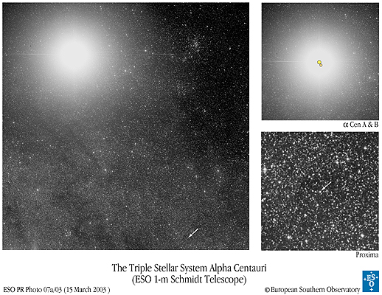
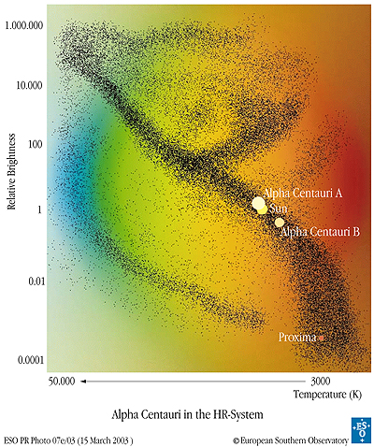
The Nearest Star System
Proxima V = 11.09 M5.5V 0.11 Mo 0.15 Ro 0.00014 Lo
π = 0.77199 0.00225 arcsec
α Cen A V = 0.01 G 2 V 1.10 Mo 1.23 Ro 1.52 Lo
α Cen B V = 1.34 K 0 V 0.91 Mo 0.87 Ro 0.50 Lo
π = 0.74723 0.00117 arcsec
AB orbit P = 80 y a = 24 AU

Slide 48
Target List: Project Phoenix
3-part sample (Henry, Torres, Soderblom, Latham et al. 1995)
Sample I = Nearest 100 Star Systems
  selected by trigonometric parallax
  ~ 150 stars within 7 pc (70% are M dwarfs)
  unbiased sample, maximizes signal strength threshold
  bonus science: luminosity and mass functions, planet targets
Sample II = Best & Brightest
selected by trigonometric parallax and characteristics
very solar type stars:
(B-V) = 0.55 to 0.75
older than 3 Gyr via chromospheric emission
no stellar companions within 10 AU
~ 140 stars within 20 pc, G0V to G8V types (reduced to 70)
push sensitivity limit to extremes
bonus science: context of our Sun in Galaxy

Slide 49
Target List: Project Phoenix
Sample III = G Dwarfs
selected by Stromgren photometry + spectral types
somewhat solar type stars … ~ 5000 stars within 50 pc, F8V to K2V
a. (B-V) = 0.50 to 1.00
b. older than 3 Gyr via chromospheric emission

Slide 50
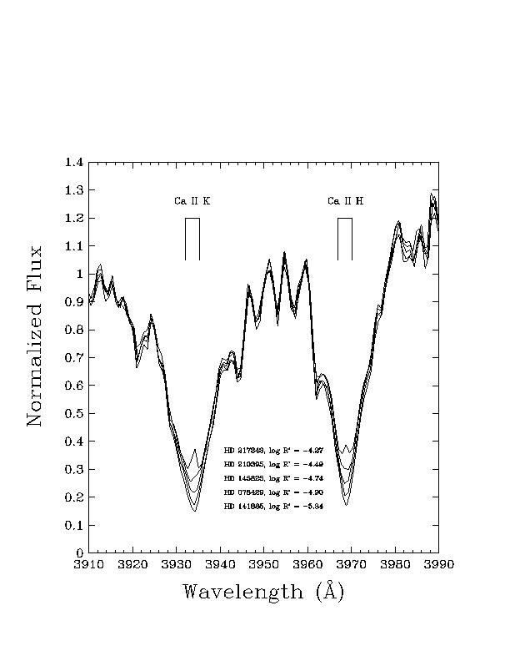
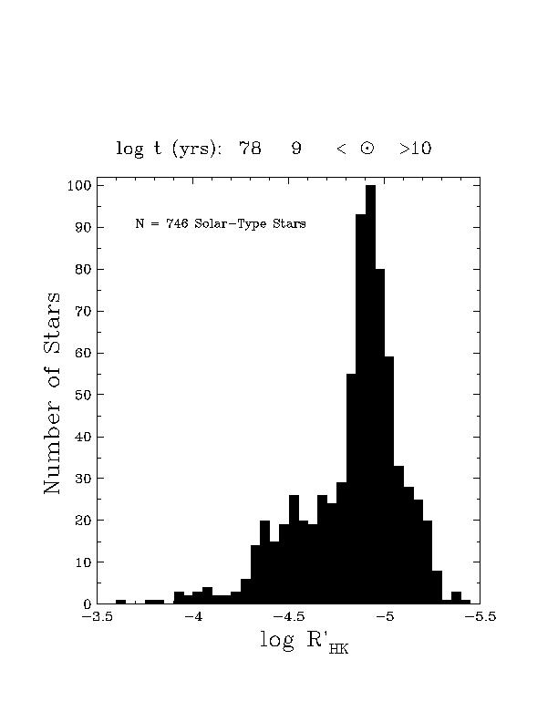
Ca II HK Measurements

Slide 51
Target List: Project Phoenix
Sample III = G Dwarfs
selected by Stromgren photometry + spectral types
somewhat solar type stars … ~ 5000 stars within 50 pc, F8V to K2V
a. (B-V) = 0.50 to 1.00
b. older than 3 Gyr via chromospheric emission
~ 1 star in 3 is removed because of youth
c. no stellar companions within 10 AU
~ 1 star in 4 is removed because of a close companion
… result is ~ 1000 rigorously selected sweet stars
bonus science: stellar birthrate, multiplicity
( these are the targets searched by the radial velocity groups )

Slide 52
Target List: ATA Search
generalized sample (Turnbull and Tarter 2003)
a. direct observations
parallaxes from Hipparcos results
spectral type/Stromgren photometry
multiplicity
Ca II HK emission
variability/X-ray luminosity
b. derived characteristics
kinematics
rotation
metallicity
c. theoretical constraints
habitable zones
evolutionary tracks
three-body stability

Slide 53
Solar System Inventory 2012
stars
planets
moons
ring systems
minor planets
Centaurs
Trans-Neptunian Objects
comets
… and …
1
8
167 (JPL 2012 JAN 16)
4 (+1?)
576,776 (JPL 2012 JAN 16)
204 (JPL 2012 JAN 16)
1,495 (JPL 2012 JAN 16)
255ª (MPC 2012 JAN 16)
dust
ª periodic and numbered
Notes:
JUP = 62 … SAT = 61 … URA = 24 … NEP = 13 … PLU = 4

Slide 54
Solar System Inventory 2009
stars
planets
moons
ring systems
minor planets
Kuiper Belt Objects
comets
… and …
1
8
165 (as of 2009 JAN 11)
4+1
436,000ª (as of 2008 DEC 12)
1,300 (as of 2009 JAN 11)
152,000^{b} (as of 2008 DEC 15)
dust
ª with orbits
^{b} periodic and numbered

Slide 55
Solar System Inventory 2006
stars
planets
moons
ring systems
minor planets
Kuiper Belt Objects
comets
… and …
1
8
152 (as of 2006 JAN 17)
4
305,000ª (as of 2005 DEC 15)
923 (as of 2006 JAN 17)
95,000^{b} (as of 2005 DEC 15)
dust
ª with orbits
^{b} periodic and numbered

