Slide 1
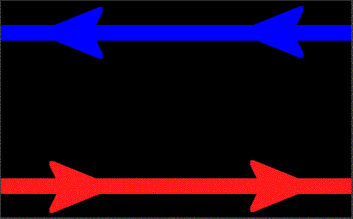
A typical flare releases energy, whose origin is magnetic, of 10²⁶ ergs per second.
magnetic reconnection is considered to release energy in flares at observed rate.
Giovanelli (1946) and Hoyle (1949): flares related to solar magnetic changes.
Cowling-Dungey (1953): formation of current sheets by collapsing magnetic fields
Sweet-Parker (1957-63): steady-state reconnection
Petschek(1964): fast reconnection
Credit: ESA

